Slide 1
Doctrine and Covenants 41
Food
Bishops
of the
Church
Presentation by ©http://fashionsbylynda.com/blog/

Slide 2
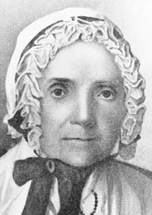
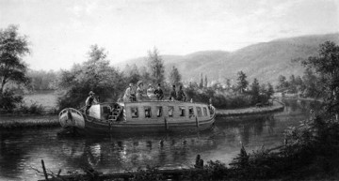
Previously…Lucy Mack Smith
Lucy Mack Smith led a group of 80 Church members from Fayette, New York, to Ohio.
As they traveled by boat on the Cayuga and Seneca Canal to Buffalo, New York, Lucy reminded the Saints that they were traveling by commandment of the Lord, like Lehi of old when he left Jerusalem.
She counseled the Saints that if they would be faithful, they “had the same reasons to expect the blessings of God”
Lucy Mack Smith

Slide 3
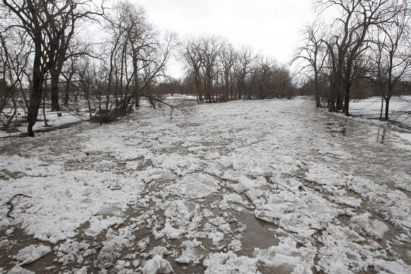
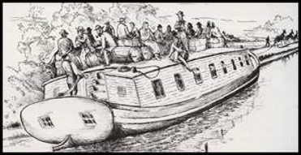
Arrival in Buffalo
When they arrived in Buffalo, they found that the harbor was jammed with ice, preventing boats from coming and going.
“After several anxious days in Buffalo, a number of the children had become sick, and many of the group were hungry and discouraged.
They took deck passage on a boat, put their things on board, and obtained temporary shelter for the women and children until early the next morning.
When they were back on board, Lucy persuaded the still murmuring group to ask the Lord to break the twenty-foot clogs of ice that jammed the harbor”

Slide 4
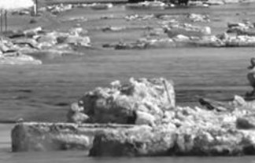
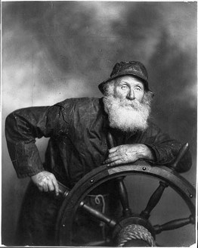
“Have Faith”
Lucy exhorted her group to have faith in God and promised that if they would unite in prayer and ask God to break the ice that jammed the harbor, it would be done.
Lucy described what happened next: “At that instant a noise was heard, like bursting thunder.
The captain cried, ‘Every man to his post.’ The ice parted, leaving barely a passage for the boat, and so narrow that as the boat passed through the buckets of the waterwheel were torn off with a crash. …
We had barely passed through the avenue when the ice closed together again”

Slide 5
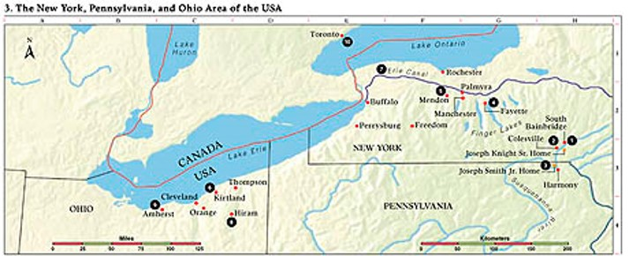
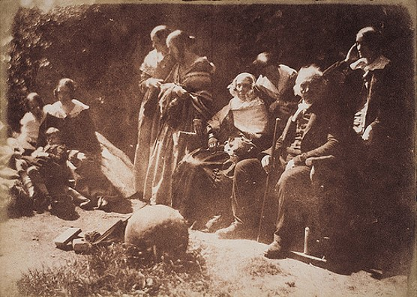
Background
January 1831
The Prophet Joseph Smith and his wife, Emma, as well as Sidney Rigdon and Edward Partridge, left New York for Ohio. Most of the New York Saints followed during the next five months.
They found that the Kirtland Branch had grown to nearly one hundred members. Many of the new converts had belonged to a religious society known as “Disciples.”
The Prophet then received revelation giving some instructions as the Saints from other areas began settling in Kirtland.

Slide 6
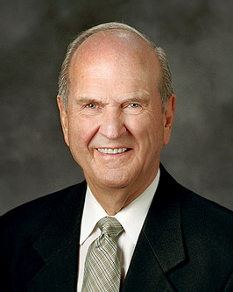
The Greatest Blessings
That Ye Hear Him
It takes conscious and consistent effort to fill our daily lives with His words, His teachings, His truths. …
We can go to the scriptures. They teach us about Jesus Christ and His gospel, the magnitude of His Atonement, and our Father’s great plan of happiness and redemption. …
As we feast on the words of Christ daily, the words of Christ will tell us how to respond to difficulties we never thought we would face.
We can also hear Him in the temple. The house of the Lord is a house of learning. There the Lord teaches in His own way. …
… We hear Him as we heed the words of prophets, seers, and revelators. Ordained Apostles of Jesus Christ always testify of Him. They point the way as we make our way through the heart-wrenching maze of our mortal experiences. Russell M. Nelson
The Lord delights to bless those who hear Him.
D&C 41:1

Slide 7
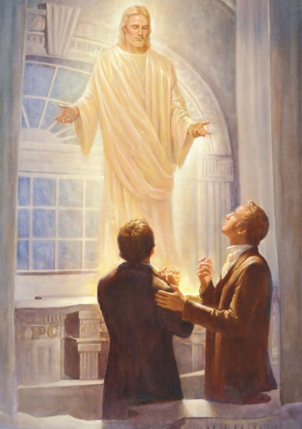
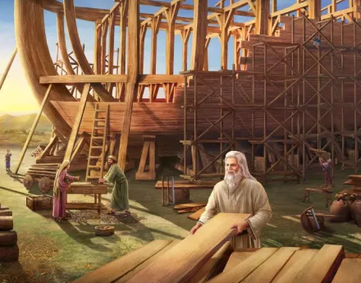
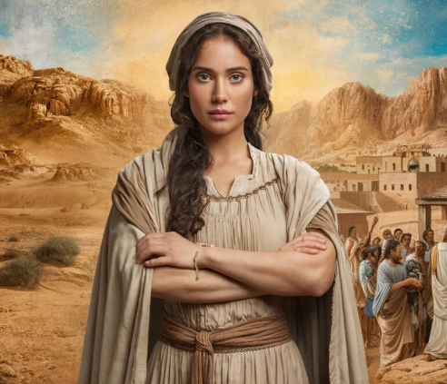
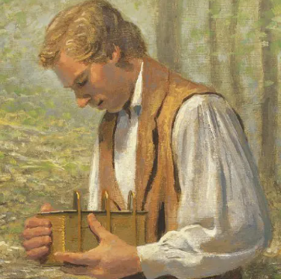
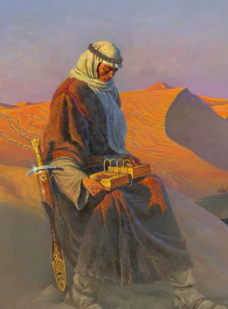
Blessings in the Scriptures
Noah building an ark and being saved from the flood
Genesis 6-8
Joseph Smith being able to protect the plates
Joseph smith History 1:46,60
Mary accepting the role to be the Savior’s mother and feeling the Lord’s blessings
Luke 1:38, 46-49
Joseph Smith and Oliver Cowdery baptizing one another after receiving the Aaronic Priesthood and then receiving a manifestation of the Holy Ghost
Joseph Smith History 1:68-74
Deborah obeying the Lord’s command to free Israel from captivity
Judges 4:1-8, 13-15
Nephi gaining the brass plates
1 Nephi 3-5

Slide 8
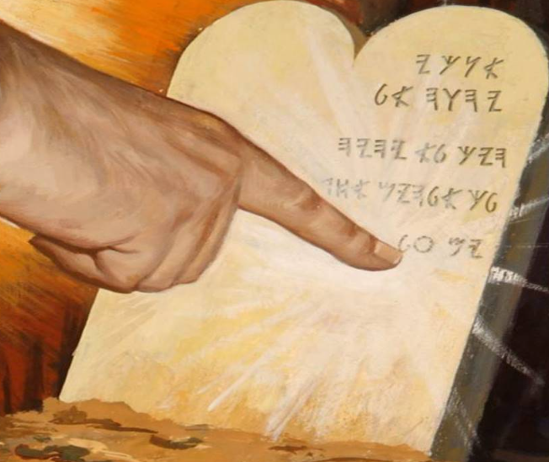
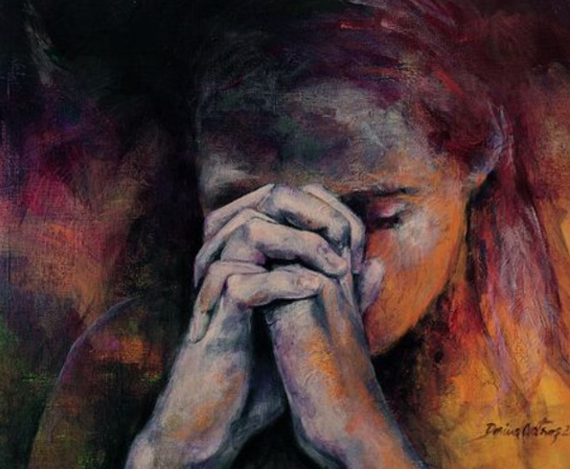
Blessings in the Scriptures
Tithes to the Storehouse and receive windows of heaven
Malachi 3:10
1 John 3:22
Jarom 1:9
Mosiah 2:41
Doctrine and Covenants 19:38; 82:10; 89:1, 18-21; 130:21

Slide 9
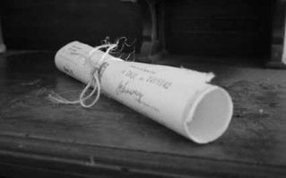
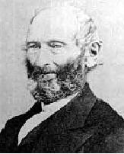
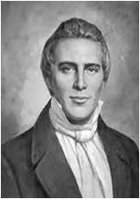
History-Common Stock
Even after joining the Church, these converts continued to practice what was called “common stock,” or the holding of all property in common.
But discord arose among members over the manner in which this system should operate. Some considered that what belonged to one member belonged to anyone in the branch.
“Therefore,” wrote John Whitmer, “they would take each other’s clothes and other property and use it without leave, which brought on confusion and disappointments, for they did not understand the scripture”
Prophet Joseph Smith
D&C 41:1-12

Slide 10
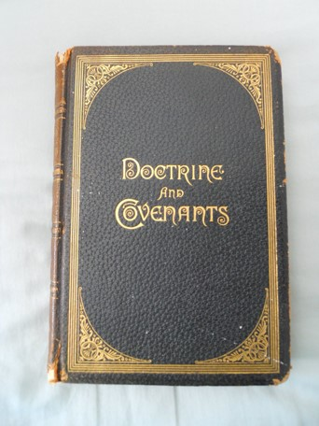
A More Perfect Law
“The branch of the Church in this part of the Lord’s vineyard, which had increased to nearly one hundred members, were striving to do the will of God, so far as they knew it, though some strange notions and false spirits had crept in among them.
With a little caution and some wisdom, I soon assisted the brethren and sisters to overcome them.
The plan of ‘common stock,’ which had existed in what was called ‘the family,’ whose members generally had embraced the everlasting Gospel, was readily abandoned for the more perfect law of the Lord; and the false spirits were easily discerned and rejected by the light of revelation.”
Prophet Joseph Smith
As a result Section 41 was revealed

Slide 11
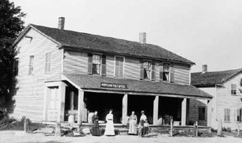
Abandon “Common Stock”
The Prophet Joseph Smith persuaded the members of the Kirtland Branch to abandon the “common stock” plan for the more perfect law of the Lord to be revealed according to the promise given at Fayette, New York.
The Lord directed the elders of the Church to assemble in Kirtland to receive this law. The law was given a few days later and is known as the law of consecration
D&C 41:2-6

Slide 12
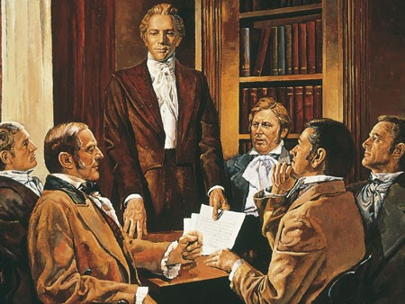
Laws
He commanded the elders of the Church to assemble to agree upon the word, pray with faith, receive His law, and see that His law was kept by the members of the Church.
D&C 41:2-4

Slide 13
Law of Consecration
To establish storehouses to assist with the temporal needs of Church members, especially those who were poor.
D&C 42:31-38

Slide 14
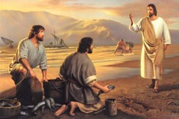
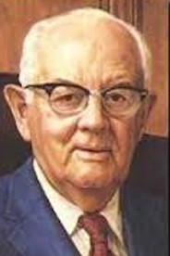
Disciple
Two characteristics of disciples of the Lord: they receive his law, and they do it
“As important as it is to have this vision in mind, defining and describing Zion will not bring it about. That can only be done through consistent and concerted daily effort by every single member of the Church. No matter what the cost in toil or sacrifice, we must ‘do it.’ That is one of my favorite phrases: ‘Do It.’”
Spencer W. Kimball
D&C 41:5

Slide 15
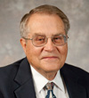
Meet--House
“Earlier definitions of the word meet, which are now listed as archaic in some modern dictionaries, include the idea of being proper, fit, acceptable, permissible, right, necessary, or desirable.
Ludlow
When the Lord’s people relocate there is always a commandment to build a “house” unto Him.
D&C 41:6-8

Slide 16
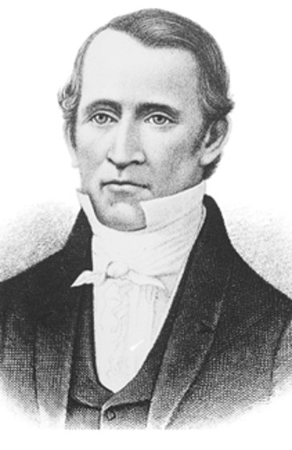
Spiritual Agent
In the law of consecration, the bishop was the spiritual and temporal agent who directed the program, assigned inheritances, received properties, and so on.
The law was to be revealed shortly, so it was appropriate that Edward Partridge should be called as the first bishop in the Church.
D&C 41:9-11

Slide 17
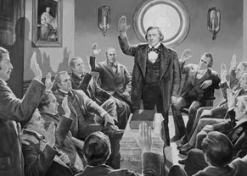
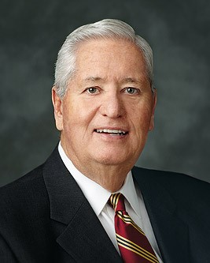
Bishops
Bishops are called of God, sustained by the voice of the members, and ordained by the proper authority
Appointed by the voice of the church-- the members of the Church have pledged their support to, or sustained, the person who has been called of God.
Bishop H. David Burton (1996)
D&C 41:9-11
Presiding Bishop Gérald Caussé
(as of 2015)

Slide 18
Sources:
Video:
“We Walk by Faith,” from time code 7:30 to 12:39.
Price of Discipleship (1:25)
Lucy Mack Smith (History of Joseph Smith by His Mother, ed. Preston Nibley [1958], 195–96; Church History in the Fulness of Times Student Manual, 2nd ed. [Church Educational System manual, 2003], 91).
(Church History in the Fulness of Times Student Manual, 92).
(History of Joseph Smith by His Mother, 197–205).
Presentation by ©http://fashionsbylynda.com/blog/
Russell M. Nelson, “Hear Him,” Ensign or Liahona, May 2020, 89–90
Prophet Joseph Smith (“Church History,” Journal of History, Jan. 1908, p. 50).
(History of the Church, 1:146–47.)
Spencer W. Kimball (In Conference Report, Apr. 1978, p. 122; or Ensign, May 1978, p. 81.)
(Ludlow, Companion, 2:175.)
Presentation by ©http://fashionsbylynda.com/blog/

Slide 19
D&C 41:6
President Joseph Fielding Smith wrote: “The things of the kingdom are not for the unworthy, whether they are in or out of the Church. It is the duty of the members to hold in the most solemn and sacred manner every commandment, every covenant, every principle of truth which the Lord has revealed for their salvation. He has given to the members, if they will humbly receive them, covenants and obligations which are not for the world. Things that are most holy and sacred, which are revealed to those who have made covenant to be ‘just and true,’ and who have ‘overcome by faith,’ things which are imparted to them as a means of bringing to pass their exaltation, should not be lightly treated, ridiculed, or spoken of before the world. ‘For it is not meet that the things which belong to the children of the kingdom should be given to them that are not worthy, or to dogs, or the pearls to be cast before swine.’ Yet how often do we see the foolish, the ignorant and those who fail to comprehend the vastness of these sacred principles and covenants, treating them lightly and unworthily even before the world!” (Church History and Modern Revelation,1:179–80.)
Edward Partridge’s willingness to “leave his merchandise” (D&C 41:9) and spend his time building up the Church is confirmed in the following account:
“Partridge’s daughter later recalled that after this revelation was dictated, her father sold his property and ‘realized but little’ from the transactions. She added, ‘My fathers course in joining the Mormon religion and sacrificing his property caused his friends of the world to think him insane. They could not see what there was in religion to make a man give up all worldly considerations for it’”
(Documents, Volume 1: July 1828–June 1831, vol. 1 of the Documents series of The Joseph Smith Papers [2013], 244).
Edward Partridge and Sidney Rigdon had journeyed to New York to meet the Prophet Joseph Smith. “According to Philo Dibble, Partridge also went in behalf of others. [Philo Dibble] was told by a neighbor, ‘We have sent a man down to York State to find out the truth of this work, and he is a man who will not lie.’
Dibble, “Philo Dibble’s Narrative,” p. 77.]” (Church History in the Fulness of Times Student Manual, 2nd ed. [Church Educational System manual, 2003], 82). Joseph described Edward as “a pattern of piety, and one of the Lord’s great men” (in History of the Church, 1:128).
THE PRESIDING BISHOPRIC is the presidency of the Aaronic Priesthood throughout the Church. The Presiding Bishop and his two counselors also serve under the direction of the First Presidency to administer the temporal affairs of the Church.
Like other General Authorities, members of the Presiding Bishopric travel frequently to meet with and teach members of the Church throughout the world. When they are not traveling, they counsel with other Church leaders regarding the Young Men program and temporal matters such as tithing and fast offerings, welfare programs, humanitarian service, building projects, and much more.
More History—Introduction of Newel K. Whitney:
In late January 1831, Joseph and Emma Smith left New York to travel nearly 300 miles by sleigh to Kirtland, Ohio. When Joseph and Emma arrived in Kirtland, they stopped in front of the Gilbert & Whitney Store:
“[Joseph] springing up the steps walked into the store and to where the junior partner was standing. ‘Newel K. Whitney! Thou art the man!’ he exclaimed, extending his hand cordially, as if to an old and familiar acquaintance. ‘You have the advantage of me,’ replied [Newel K. Whitney], as he mechanically took the proffered hand, ‘I could not call you by name as you have me.’ ‘I am Joseph the Prophet,’ said the stranger smiling. ‘You’ve prayed me here, now what do you want of me?’” (History of the Church, 1:145–46).
Joseph explained that he had previously received a vision in which Newel was praying for him to go to Kirtland. The Whitneys received Joseph and Emma Smith with kindness, and Joseph and Emma lived with them for a time. (See History of the Church, 1:146; see also C hurch History in the Fulness of Times Student Manual, 2nd ed. [Church Educational System manual, 2003], 90–91.)
D&C 41:1 Receiving Blessings:
When you receive any blessing from God, you can conclude that you have complied with an eternal law governing reception of that blessing. But remember that the “irrevocably decreed” law is time insensitive, meaning blessings come on God’s timetable. Even ancient prophets in search of their heavenly home “died in faith, not having received the promises, but having seen them afar off … [and] were persuaded … and embraced them” [Hebrews 11:13]. If a desired blessing from God has not been received—yet—you do not need to go crazy, wondering what more you need to do. Instead, heed Joseph Smith’s counsel to “cheerfully do all things that lie in [your] power; and then … stand still, with the utmost assurance, to see the … arm [of God] … revealed” [Doctrine and Covenants 123:17]. Some blessings are reserved for later, even for the most valiant of God’s children. (Dale G. Renlund, “Abound with Blessings,” Ensign or Liahona, May 2019, 72)

