Slide 1
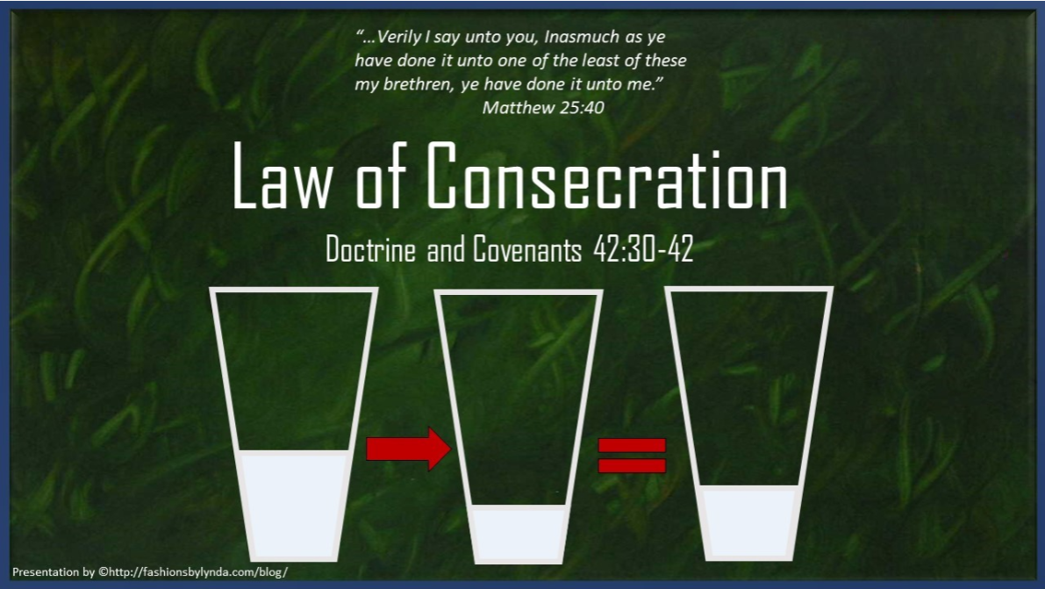

Slide 2
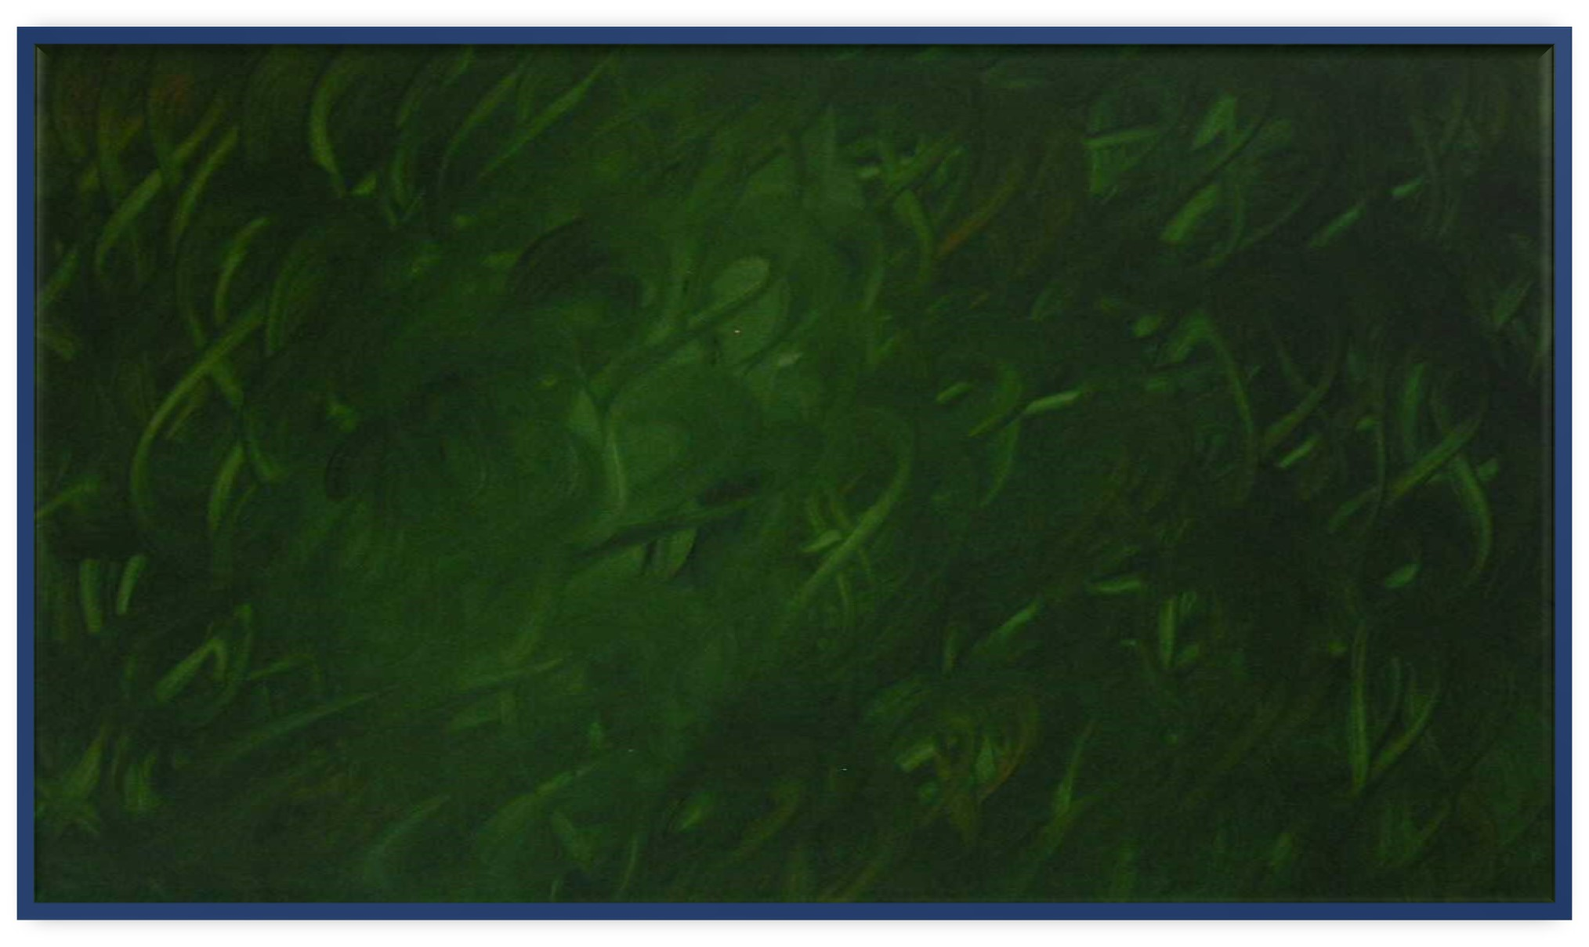
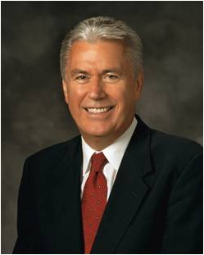
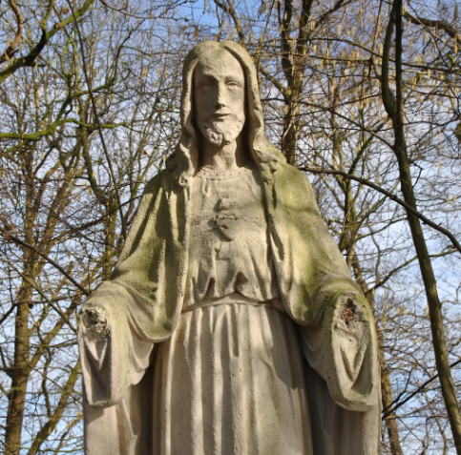
A story is told that during the bombing of a city in World War II, a large statue of Jesus Christ was severely damaged. When the townspeople found the statue among the rubble, they mourned because it had been a beloved symbol of their faith and of God’s presence in their lives.
Experts were able to repair most of the statue, but its hands had been damaged so severely that they could not be restored. Some suggested that they hire a sculptor to make new hands, but others wanted to leave it as it was—a permanent reminder of the tragedy of war.
Ultimately, the statue remained without hands. However, the people of the city added on the base of the statue of Jesus Christ a sign with these words: “You are my hands.”
Dieter F. Uchtdorf
Can we be Jesus Christ’s hands?

Slide 3
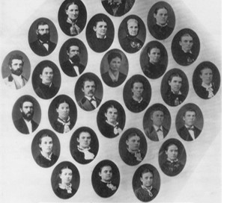
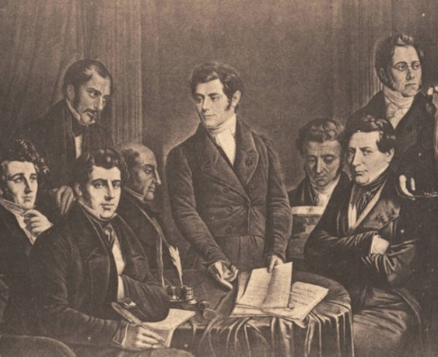
Early Communal Systems
During Joseph Smith’s day, some groups of people attempted to form communal systems in which the group shared ownership of all the wealth and resources.
Prior to the revelation on the law of consecration, some members of the Church in Ohio had established such a group. Some of their practices were problematic:

Slide 4
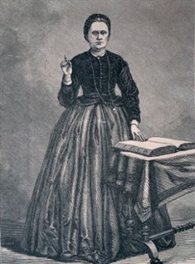
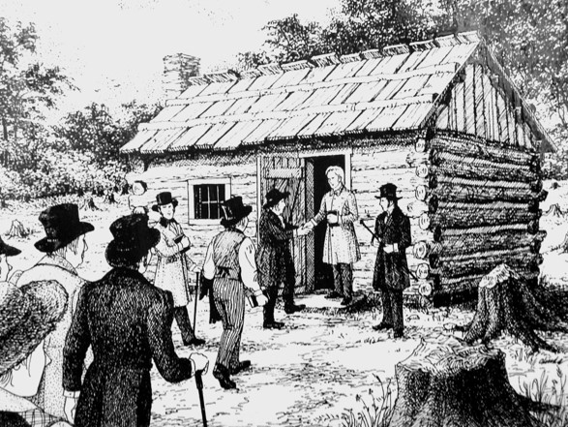
“When [Joseph Smith] arrived in Ohio [he] discovered a group of about fifty people who had established a cooperative venture based on their interpretation of statements in the book of Acts, describing the early Saints as having all things in common.
This group, known as ‘the family,’ … were members of the Church living on Isaac Morley’s farm near the village of Kirtland. When John Whitmer arrived in mid-January, he noted that what they were doing created many problems.

Slide 5
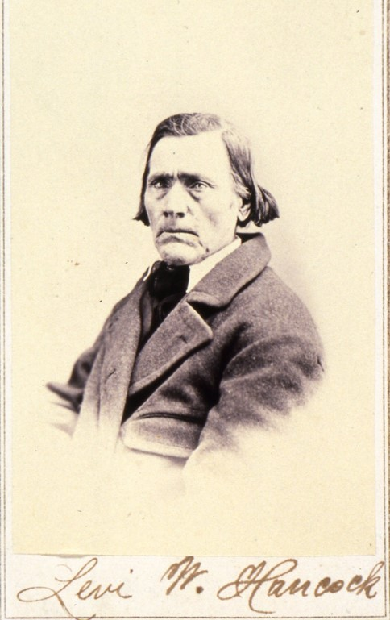

For example, Heman Bassett took a pocket watch belonging to Levi Hancock and sold it. When asked why, Heman replied, ‘Oh, I thought it was all in the family.’ Levi responded that he did not like such ‘family doing’ and would not endure it any longer.

Slide 6
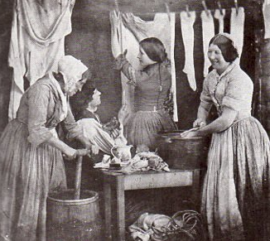
“The Family”
A group of Church members living on Isaac and Lucy Morley’s farm had a great desire to live the gospel of Jesus Christ and take care of each other.
“The Prophet Joseph … realized the need to establish a more perfect system to meet the growing economic needs of the Church.
Revenue was required to finance various Church undertakings, such as publishing revelations and missionary tracts. … Money, goods, and property were needed to help the poor and to assist immigrants who were sacrificing much to gather to Ohio, so Joseph inquired of the Lord”
The revelation recorded in Doctrine and Covenants 42, which revealed the Lord’s law of consecration, was one of several revelations that came in response to Joseph’s inquiry.
Church History

Slide 7
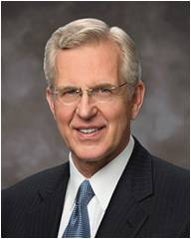
Consecration
February 1831
The Lord commanded the Saints to consecrate their properties to support the poor
“To consecrate is to set apart or dedicate something as sacred, devoted to holy purposes”
Elder D. Todd Christofferson
The Lord asks us to consecrate what we have to Him to care for the poor and build His kingdom.
We serve the Savior by serving the poor

Slide 8
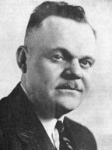
All Things Are Mine
“The basic principle and the justification for the law of consecration ‘is that everything we have belongs to the Lord; therefore, the Lord may call upon us for any and all of the property which we have, because it belongs to Him. … President Marion G. Romney
I, the Lord, stretched out the heavens, and built the earth, my very handiwork; and all things therein are mine.
And it is my purpose to provide for my saints, for all things are mine.
But it must needs be done in mine own way; and behold this is the way that I, the Lord, have decreed to provide for my saints, that the poor shall be exalted, in that the rich are made low.
For the earth is full, and there is enough and to spare; yea, I prepared all things, and have given unto the children of men to be agents unto themselves.”
D&C 104:14-17
D&C 42:30-34

Slide 9
The Needs of a Family
The needs of a family
Families who have their needs met
Families who do not have enough money or goods to support their needs
D&C 42:30-34

Slide 10
Stewardship
Every family worked with the bishop and received what was called a “stewardship” (D&C 42:72). This means that each family was entrusted with property and resources from the Lord.
Each family was entrusted with property and resources from the Lord. Families had private ownership of the property and resources they received, and they were to use their agency to manage their stewardship.
The needs of a family
As stewards of the Lord’s property and resources, they were accountable to Him and fully responsible for what He entrusted to them.
The Church modified this practice of Law of Consecration in 1833
D&C 42:30-34

Slide 11
Allocating Funds
Wherefore, let my servant Edward Partridge, and those whom he has chosen, in whom I am well pleased, appoint unto this people their portions, every man equal according to his family, according to his circumstances and his wants and needs.”
D&C 51:3
The allocation of portions was based on each family’s circumstances, wants, and needs.
D&C 42:30-34

Slide 12

Allocating Funds
What did the Lord require of people who declared their wants and needs to the bishop?
They were to be just, or, in other words, fair and honest
D&C 42:30-34

Slide 13
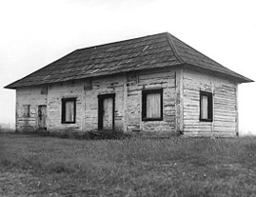
Residue
What did the Lord instruct the Saints to do with the leftover property, or the “residue”?
They were to use it to help the poor, finance Church buildings, and help members who were in need.
What do you think the pitcher represents in these verses?
The storehouse
D&C 42:33-34

Slide 14
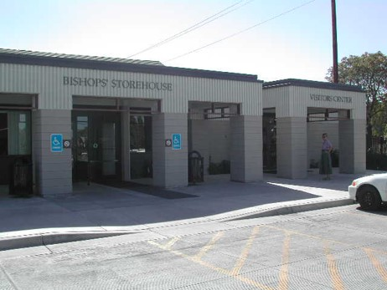

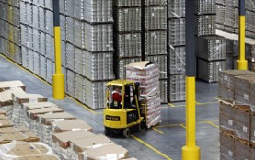
Bishop’s Storehouse
“More than 180 years later, bishops’ storehouses around the world continue to support bishops in the call to ‘be faithful; stand in the office which [the Lord has] appointed unto [them]; succor the weak, lift up the hands which hang down, and strengthen the feeble knees’.
“Whether it is a building containing food and other supplies or a set of resources in the ward a bishop can draw from, bishops’ storehouses are being used to care for those in need.
The Lord’s storehouse is available to every bishop and exists in every ward. Contrary to conventional wisdom, the Lord’s storehouse is not limited to a building or a warehouse filled with commodities awaiting distribution.’
D&C 42:34 Church News

Slide 15
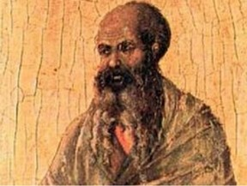
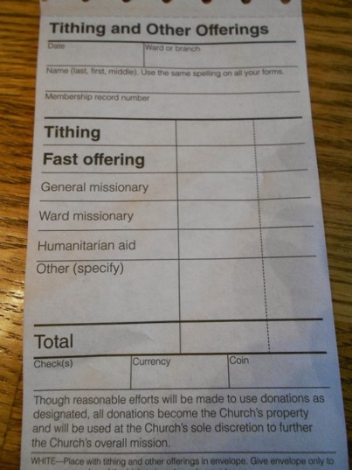
Fast Offerings
“Where a brick and mortar storehouse is not available, bishops can purchase needed commodities from local merchants using fast offerings.”
“Bring ye all the tithes into the storehouse, … and prove me now herewith, saith the Lord of hosts, if I will not open you the windows of heaven, and pour you out a blessing, that there shall not be room enough to receive it.”
Malachi 3:10
D&C 42:34 Church News

Slide 16

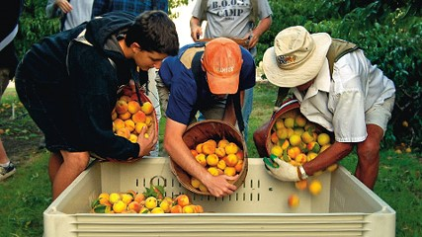
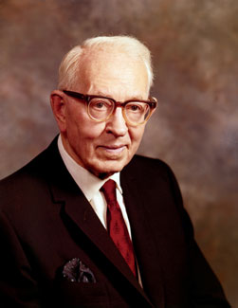
“The United Order, or law of consecration, does not contemplate that the idler shall eat the bread of the laborer.
While all shall share in common and none shall possess above another, yet all must give service and labor for the benefit of all”
President Joseph Fielding Smith

Slide 17
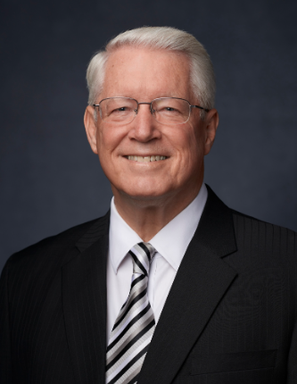
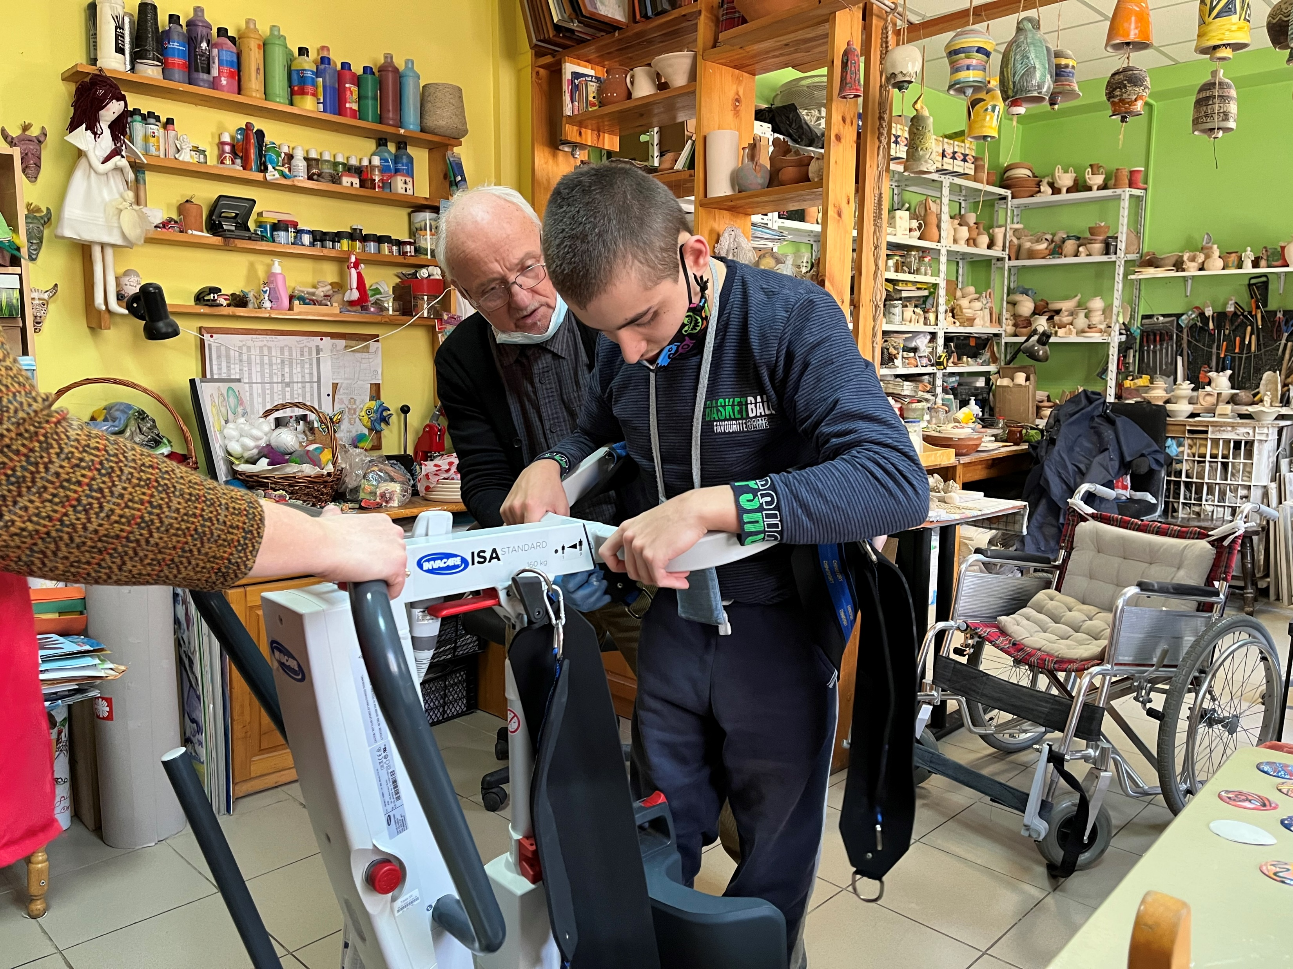
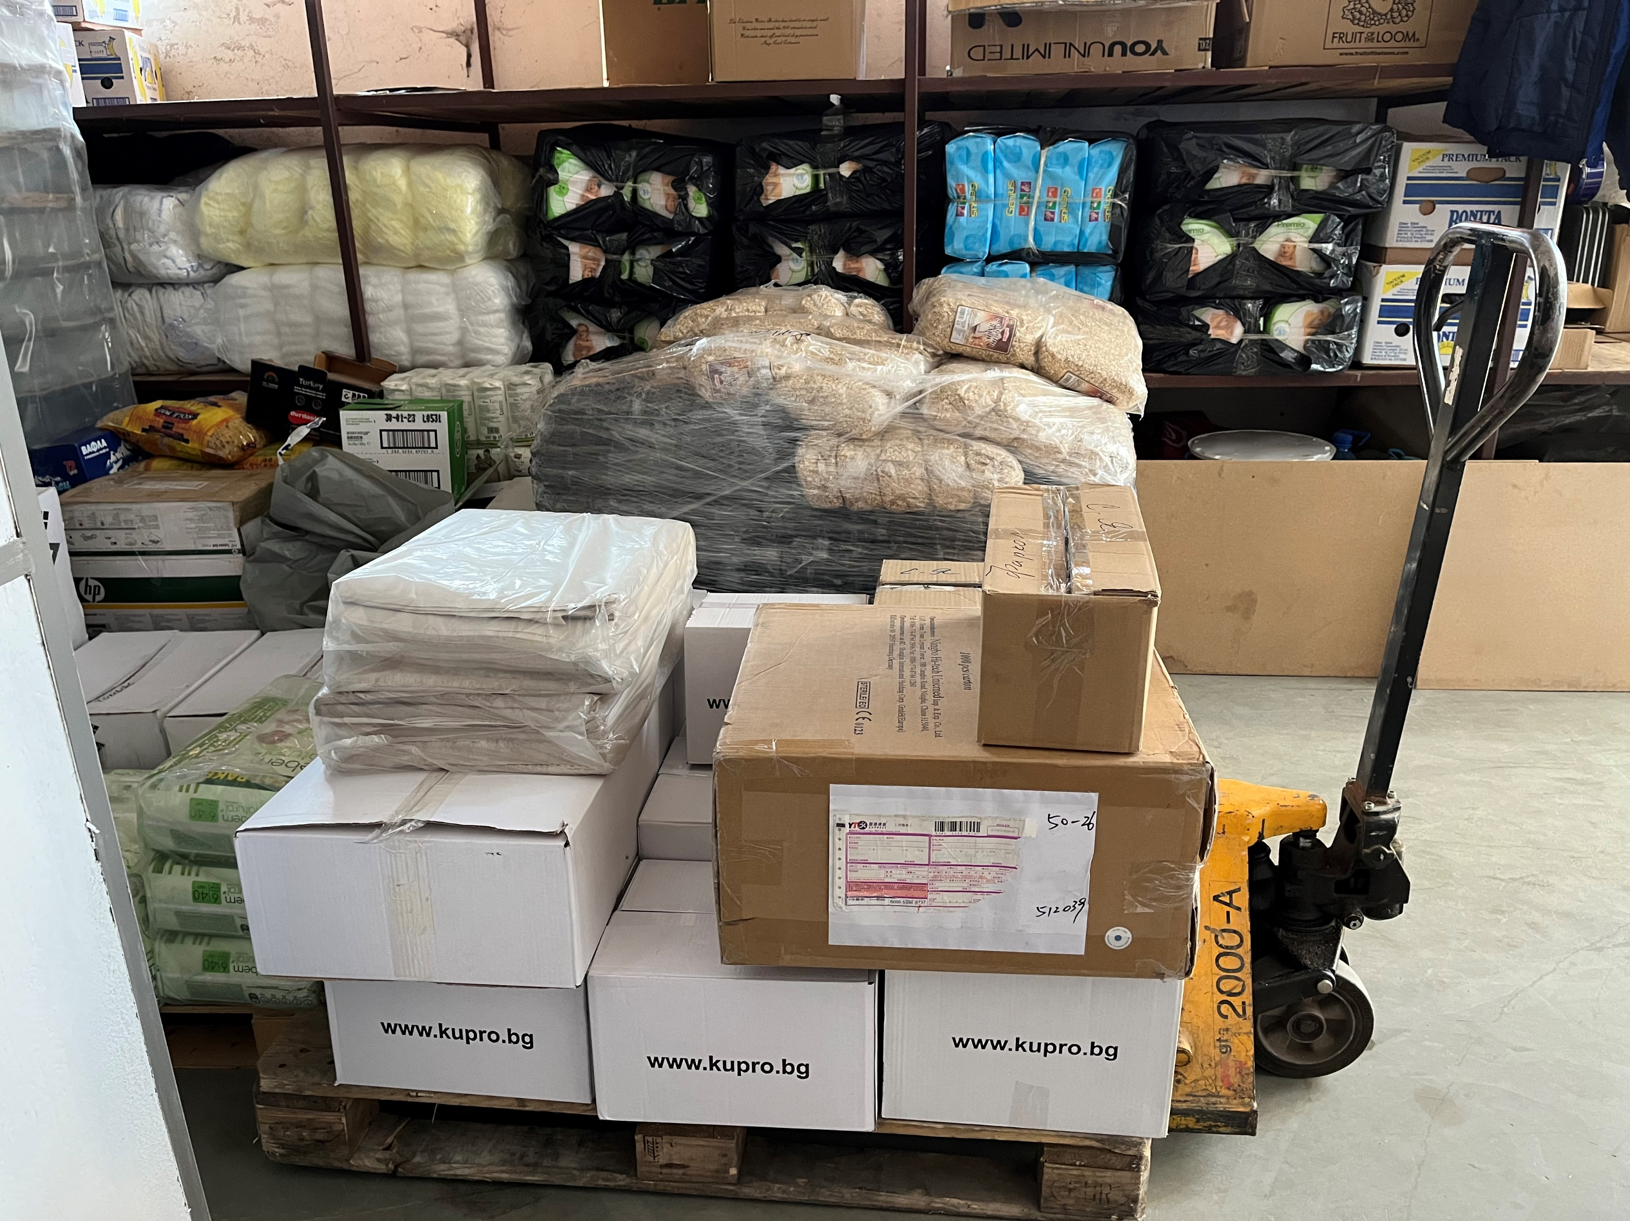
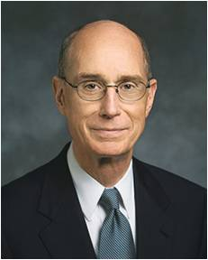
Those in Need
Caring for the poor and needy is inherent in the ministry of the Savior. It is in everything He does. He reaches out to all and lifts us. … I invite each of us to become more like the Savior by caring for the poor and needy.
Dean M. Davies
Because the Lord hears their cries and feels your deep compassion for [those in need], He has from the beginning of time provided ways for His disciples to help. He has invited His children to consecrate their time, their means, and themselves to join with Him in serving others.
Henry B. Eyring

Slide 18
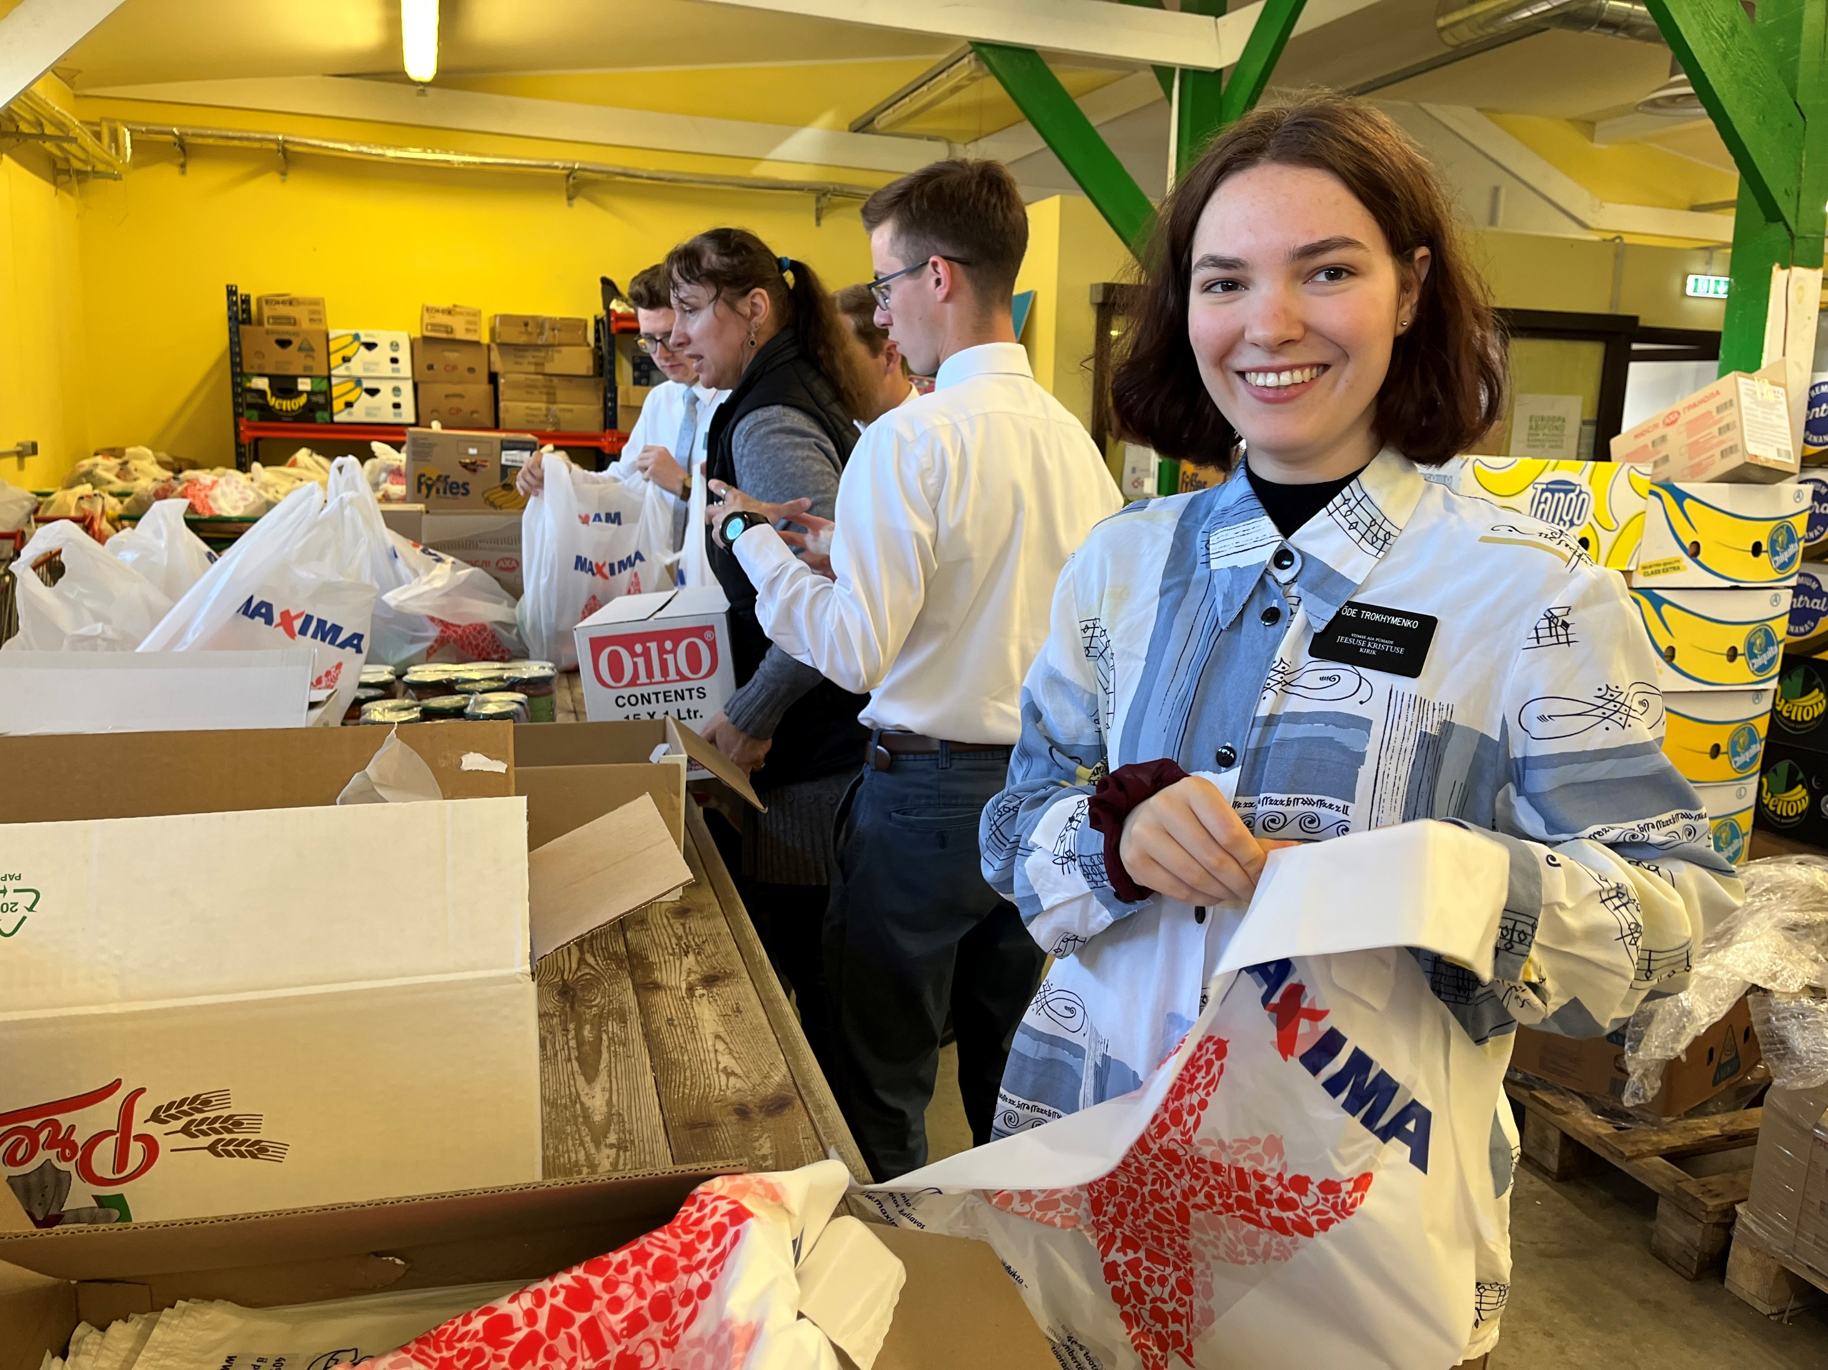
Doing Good To Others
“For inasmuch as ye do it unto the least of these, ye do it unto me.”
As we do good unto others, we do it unto the Lord
Missionaries serve in Estonia Food Bank
D&C 42:38

Slide 19
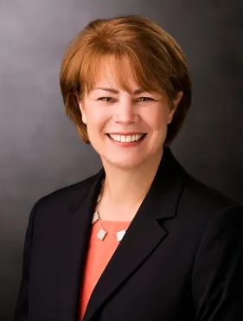
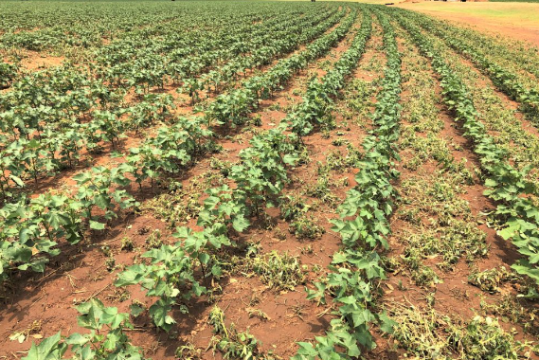

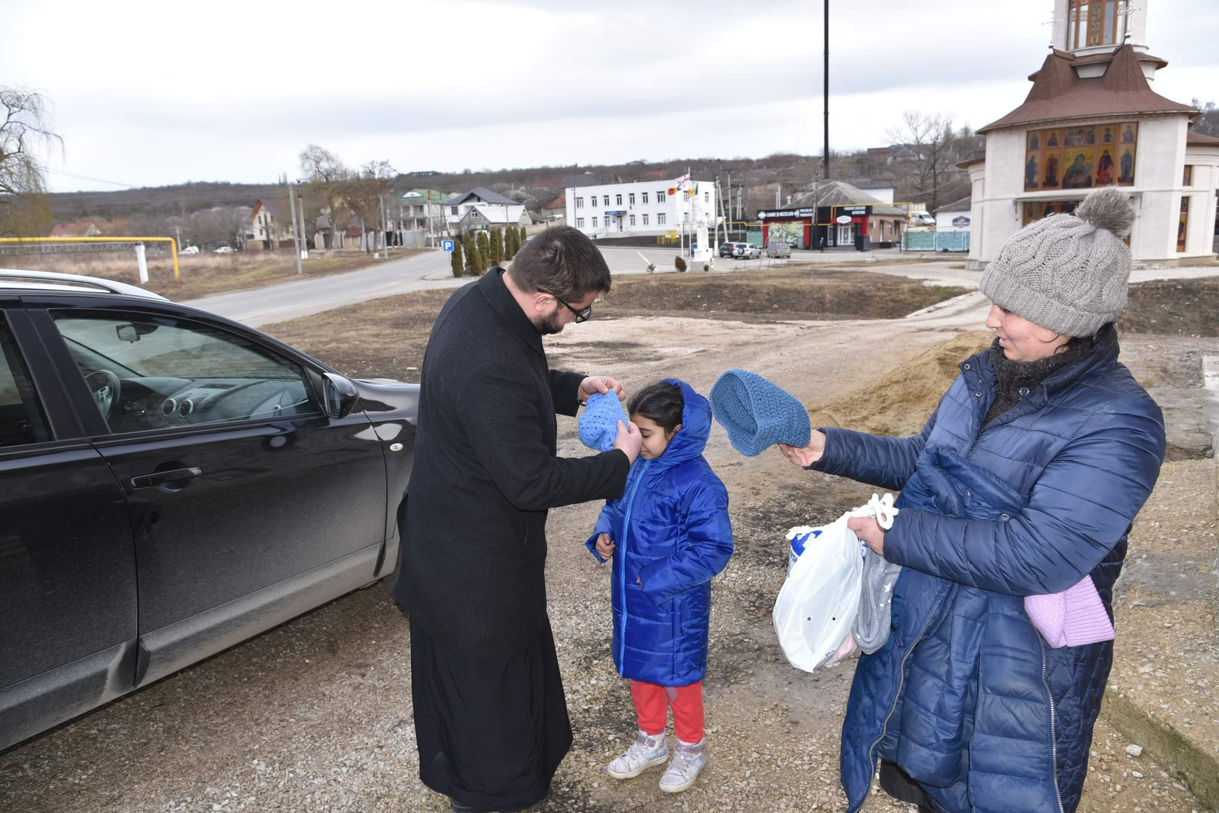
The Church and Service
The ministering we do through Relief Society, priesthood quorums, and classes
Fasting and the use of fast offerings
Welfare farms and canneries
Welcome centers for immigrants
Outreach for those in prison
Church humanitarian effort
The JustServe app, where it’s available, that matches volunteers with service opportunities
Church donation of Hats and coats to Moldova community
These are all ways, organized through the priesthood, where small efforts collectively make a big impact, magnifying the many individual things we do as disciples of Jesus Christ.
Sharon Eubank

Slide 20


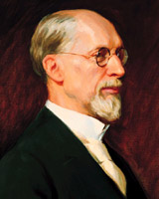
Living Within Our Means
The Lord does not expect us to make our own clothing. However, He does want us to be neat and clean in our appearance.
Let us be more concerned about the adornment of our minds that are eternal, rather than adornment of our persons with things that are of no lasting benefit.”
George Albert Smith
D&C 42:40-41

Slide 21



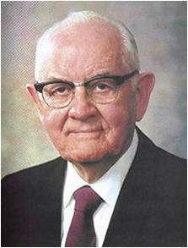
“Consecration is the giving of one’s time, talents, and means to care for those in need—whether spiritually or temporally—and in building the Lord’s kingdom”
President Spencer W. Kimball

Slide 22
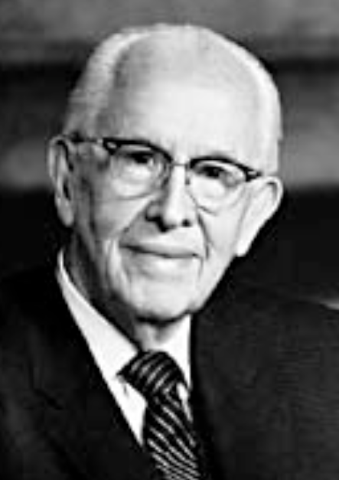

Proud of Heart
Pride can take many forms, all of them ugly. Pride leads us away from God and stops us from becoming the person we should be.
The central feature of pride is enmity—enmity toward God and enmity toward our fellowmen. Enmity means “hatred toward, hostility to, or a state of opposition.” It is the power by which Satan wishes to reign over us.
Pride is essentially competitive in nature.
The proud cannot accept the authority of God giving direction to their lives.
The proud make every man their adversary by pitting their intellects, opinions, works, wealth, talents, or any other worldly measuring device against others.
When pride has a hold on our hearts, we lose our independence of the world and deliver our freedoms to the bondage of men’s judgment.
Ezra Taft Benson
Symbolic Meaning of Pride:
Its most common traits are: majesty, strength, courage, justice, and military might. It can be both solar and lunar. Commonly referred to as "the KING of the beasts," it is a symbol of Kingly power and might, but as the lioness it is commonly related to the Great Mother and protection.
“Behold, the pride of this nation, or the people of the Nephites, hath proven their destruction” (Moroni 8:27).
D&C 42:40

Slide 23

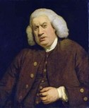
Idleness
Lazy-- a term which generally refers to a lack of motion and/or energy.
“People say nothing is impossible, but I do nothing every day.”
― A.A. Milne, Winnie-the-Pooh
To the Seminary Student
“The happiest part of a man's life is what he passes lying awake in bed in the morning.”
― Samuel Johnson
D&C 42:42

Slide 24
Sources:
Videos:
“Fast Offerings: A Simple Commandment with a Marvelous Promise” (3:01)
“Syrian Refugee—‘The Moment I Was Shot I Knew I Would Never Walk Again’” (2:39)
“A Thousand Days” (4:32).
They Gave Up Their Christmas(4:45)
Caring for the Poor and Needy(5:40)
Sacrifice Whatever the Lord Requires (1:11)
Dieter F. Uchtdorf, “You Are My Hands,” Ensign or Liahona, May 2010, 68
Church History in the Fulness of Times Student Manual, 2nd ed. [Church Educational System manual, 2003], 95).
[Levi W. Hancock, “Levi Hancock Journal,” LDS Historical Department, Salt Lake City, p. 81.]”
Elder D. Todd Christofferson (“Reflections on a Consecrated Life,” Ensign or Liahona, Nov. 2010, 16).
President Marion G. Romney (J. Reuben Clark, Jr., in Conference Report, Oct. 1942, p. 55)” (“Living the Principles of the Law of Consecration,” Ensign, Feb. 1979, 3).
President Joseph Fielding Smith(Church History and Modern Revelation, 2 vols. [1953], 1:205).
George Albert Smith (In Conference Report, Apr. 1915, p. 97.)
Presentation by ©http://fashionsbylynda.com/blog/
Spencer W. Kimball (“Welfare Services: The Gospel in Action,” Ensign, Nov. 1977, 78).
“Bishops’ Storehouse Opens the Windows of Heaven,” Church News and Events, May 20, 2011, LDS.org).
Dean M. Davies “The Law of the Fast: A Personal Responsibility to Care for the Poor and Needy,” Ensign or Liahona, Nov. 2014, 55.
Henry B. Eyring, “Opportunities to Do Good,” Ensign or Liahona, May 2011, 22.
Ezra Taft Benson (excerpts from) “Faces of Pride” April 1989 general conference
Sharon Eubank, “I Pray He’ll Use Us,” Liahona, Nov. 2021, 54)
Presentation by ©http://fashionsbylynda.com/blog/

Slide 25
Laws of Consecration compared to socialistic programs:
The Lord’s law of consecration compared to socialistic programs
Some have suggested that the practice of the law of consecration and the system of the united order are only a religious kind of socialism or communism. Others assert that it was a development either from the economic philosophies of Joseph Smith’s day or from communal experiments within the new religion. Such assumptions are false. In more recent times President Marion G. Romney of the First Presidency outlined the revealed system of the united order:
“(1) The cornerstone of the United Order is belief in God and acceptance of him as Lord of the earth and the author of the United Order. …
“(2) The United Order is implemented by the voluntary free-will actions of men, evidenced by a consecration of all their property to the Church of God. …
“(3) … The United Order is operated upon the principle of private ownership and individual management. …
“(4) The United Order is non-political. …
“(5) A righteous people is a prerequisite to the United Order. …
“The United Order exalts the poor and humbles the rich. In the process both are sanctified. The poor, released from the bondage and humiliating limitations of poverty, are enabled as free men to rise to their full potential, both temporally and spiritually. The rich, by consecration and by imparting of their surplus for the benefit of the poor, not by constraint but willingly as an act of free will, evidence that charity for their fellowmen characterized by Mormon as ‘the pure love of Christ.’ (Moro. 7:47.)” (in Conference Report, Apr. 1966, 97).
President J. Reuben Clark Jr. of the First Presidency said: “The United Order has not been generally understood. … [It] was not a communal system. … The United Order and communism are not synonymous” (in Conference Report, Oct. 1943, 11).
Personal Responsibility:
President Romney explained that we need to take personal responsibility for caring for the poor and needy: “In this modern world plagued with counterfeits for the Lord’s plan, we must not be misled into supposing that we can discharge our obligations to the poor and the needy by shifting the responsibility to some governmental or other public agency. Only by voluntarily giving out of an abundant love for our neighbors can we develop that charity characterized by Mormon as ‘the pure love of Christ.’ (Moro. 7:47)” (“Caring for the Poor and Needy,” Ensign, Jan. 1973, 98).
Idleness: President Clark made the following statements about government gratuities:
“The dispensing of these great quantities of gratuities has produced in the minds of hundreds of thousands—if not millions—of people … a love for idleness, a feeling that the world owes them a living. It has made a breeding ground for some of the most destructive political doctrines that have ever found any hold, … and I think it may lead us into serious political trouble” (quoted in Marion G. Romney, “Church Welfare Services’ Basic Principles,” Ensign, May 1976, 121).
“Society owes to no man a life of idleness, no matter what his age. I have never seen one line in Holy Writ that calls for, or even sanctions this. In the past no free society has been able to support great groups in idleness and live free” (in Conference Report, Apr. 1938, 107).
Our 2021 expenditures for those in need in 188 countries worldwide totaled $906 million—almost a billion dollars. In addition, our members volunteered over 6 million hours of labor in the same cause.
Those figures are, of course, an incomplete report of our giving and helping. They do not include the personal services our members give individually as they minister to one another in called positions and voluntary member-to-member service. And our 2021 report makes no mention of what our members do individually through innumerable charitable organizations not formally connected with our Church. (Dallin H. Oaks, “Helping the Poor and Distressed,” Liahona, Nov. 2022, 6)
Fast Offerings: In addition to paying tithing, we are commanded to give of our substance to assist the poor and needy. One way to do this is by fasting and going without food and drink for two consecutive meals. The Lord restored the principle of fasting through the Prophet Joseph Smith, and the Church designates one Sunday a month as a day of fasting. Fasting, which has always been an indication of the true church, is an opportunity for spiritual renewal and growing closer to our Heavenly Father. As part of the fast, members of the Church contribute a generous fast offering for the care of the poor and the needy. This offering should be at least the value of the two meals the Church member went without while fasting. These funds are used to provide food, shelter, and other necessities to people in need, both locally and worldwide. There is no standard donation amount for fast offerings. As you contribute generously to these funds, you will be blessed both spiritually and temporally for your desire to help others. Tithing and Fast Offerings, (2007), 1–14

