Slide 2
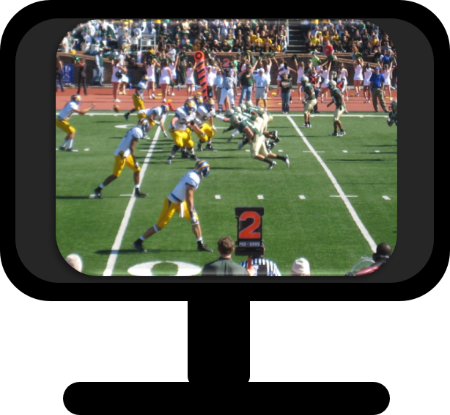
How easy would it to be to follow two games at the same time?
February 1831

Slide 3
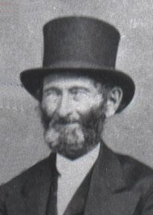
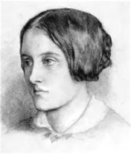
Background
February 1831
John Whitmer recorded the following about Mrs. Hubble:
“She professed to be a prophetess of the Lord, and professed to have many revelations, and knew the Book of Mormon was true, and that she should become a teacher in the church of Christ.
She appeared to be very sanctimonious and deceived some who were not able to detect her in her hypocrisy; others, however, had the spirit of discernment and her follies and abominations were manifest.”
History of the Church
Mrs. Hubble was one of many who falsely claimed revelations to guide the Church or to correct the Prophet.
Many members became confused and bewildered by the different claims. Under these circumstances the Prophet went to the Lord for guidance and received the revelation recorded as Doctrine and Covenants 43.

Slide 4
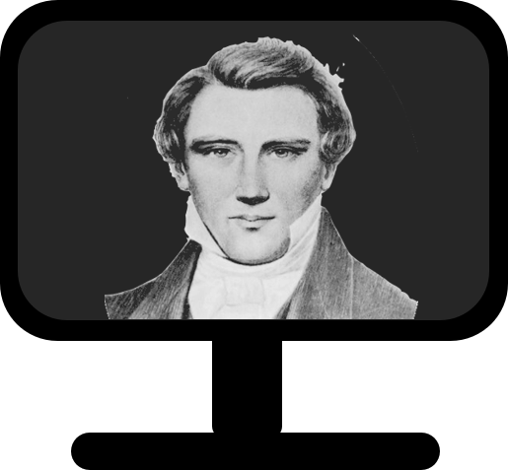
None Else
There is only one appointed at a time to receive divine revelations and commandments for the Church.
Only the President of the Church can receive revelations for the entire Church
However:
A person may receive revelation concerning his or her own personal life
D&C 43:1-7

Slide 5
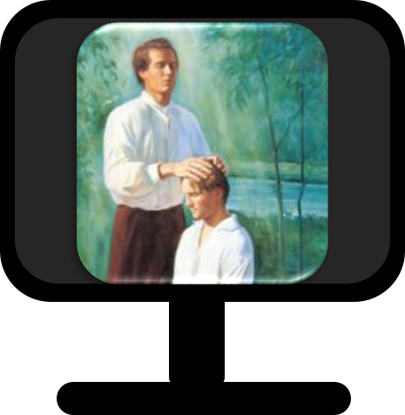
“‘I say unto you, that it shall not be given to any one to go forth to preach my gospel, or to build up my church, except he be ordained by some one who has authority, and it is known to the church that he has authority and has been regularly ordained by the heads of the church.’
“There are some among us now who have not been regularly ordained by the heads of the Church who tell of impending political and economic chaos, the end of the world. …
D&C 43:1-7 President Boyd K. Packer

Slide 6
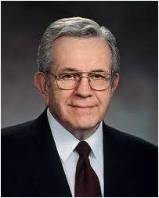
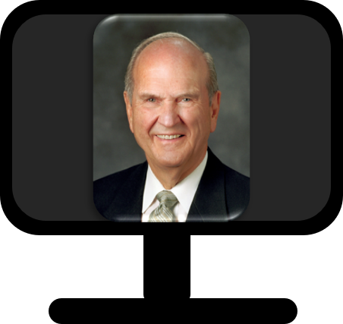
“Those deceivers say that the Brethren do not know what is going on in the world or that the Brethren approve of their teaching but do not wish to speak of it over the pulpit. Neither is true.
The Brethren, by virtue of traveling constantly everywhere on earth, certainly know what is going on, and by virtue of prophetic insight are able to read the signs of the times.
“Do not be deceived by them—those deceivers. If there is to be any gathering, it will be announced by those who have been regularly ordained and who are known to the Church to have authority…
Come away from any others. Follow your leaders who have been duly ordained and have been publicly sustained, and you will not be led astray.”
D&C 43:1-7 President Boyd K. Packer

Slide 7
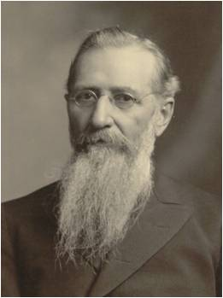
“It is not my business nor that of any other individual to rise up as a revelator, as a prophet, as a seer, as an inspired man, to give revelation for the guidance of the Church, or to assume to dictate to the presiding authorities of the Church. … We can accept nothing as authoritative but that which comes directly through the appointed channel, the constituted organizations of the Priesthood, which is the channel that God has appointed through which to make known His mind and will to the world. …
“… the moment that individuals look to any other source, that moment they throw themselves open to the seductive influences of Satan, and render themselves liable to become servants of the devil; they lose sight of the true order through which the blessings of the Priesthood are to be enjoyed; they step outside of the pale of the kingdom of God, and are on dangerous ground. Whenever you see a man rise up claiming to have received direct revelation from the Lord to the Church, independent of the order and channel of the Priesthood, you may set him down as an impostor.”
D&C 43:7 Joseph F. Smith

Slide 8
Instruct
תורה—Hebrew for Torah meaning instructions
When we assemble together, we are to instruct and edify one another so we can learn how to act and direct the Church
The duty of the Saints are to assemble and instruct, edify, and sanctify by that which has been received, not to endeavor to bring forth new Revelations.
D&C 43:8

Slide 9
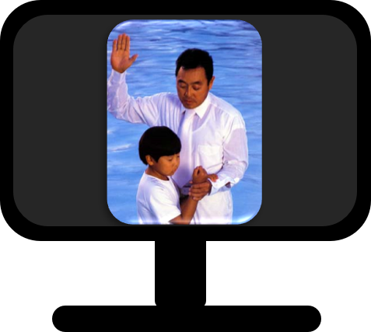
Bind Yourselves
By entering into covenants or making commitments with others, we bind our self by our own integrity to act in a certain way.
Covenants bring a sense of responsibility,
Covenant making can help us break away from routines or habits of the past.
There are always positive consequences for keeping divine covenants and negative consequences for breaking them.
The Lord, seeing our willingness to make commitments, gives us His Spirit, which strengthens us to do what we have committed to do.
D&C 43:9 Student Manual

Slide 10
Knowledge
We are to bind ourselves to act on the knowledge we receive.
We become sanctified as we act on the truths we learn.
Action
The Lord told the Saints that if they wanted to receive the truths of the gospel, they needed to sustain Joseph Smith in his calling.
D&C 43:11-14

Slide 11
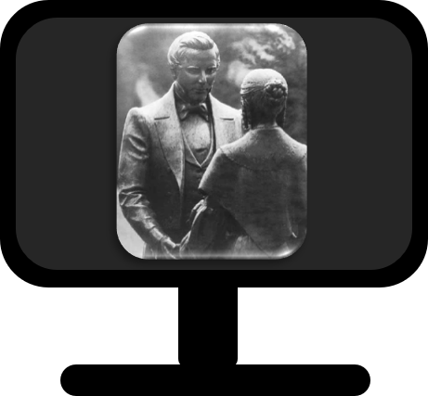
Sustaining Joseph in His Calling
The Saints were counseled that if they desired to receive the mysteries and glories of the kingdom, they should provide the temporal necessities for Joseph Smith so he could spend his time doing what only he could do—fulfilling his prophetic calling.
The Prophet was told that “the greatest blessings which God had to bestow should be given to those who contributed to the support of his family while he was translating the fulness of the Scriptures.”
Though the Saints were somewhat helpful, Joseph did not receive enough to support his family, despite several attempts by Church leaders to get members to contribute.
The process of translation was slowed, and efforts to prepare a manuscript for press were delayed. As a result, he was unable to finish his translation, even though the Lord had instructed that it be published.
D&C 43:12-14 Joseph Smith and Church History

Slide 12
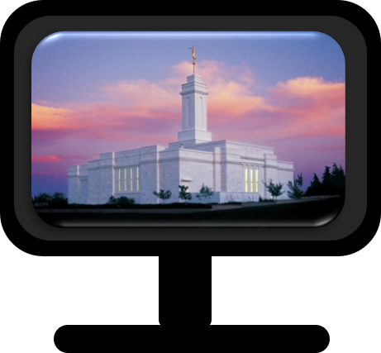
Those Who Are Called To Preach
Teachers in God’s kingdom are not to teach from the doctrines and philosophies of the world but are to base their teachings on the revelations of the Holy Spirit.
The Lord promises an endowment of power to those who sanctify themselves. The Saints had the gift of the Holy Ghost and the priesthood, and they would soon receive the endowment that was to be given in holy temples.
D&C 43:15-16 Student Manual

Slide 13
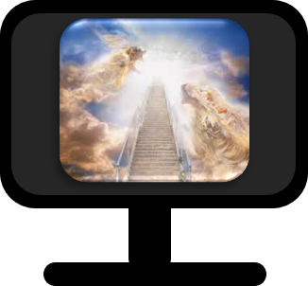
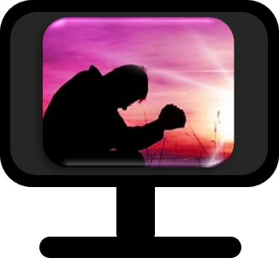
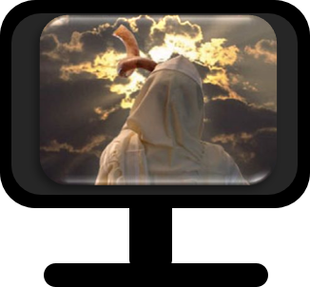
Called To Preach Repentance
In preparation for the
2nd Coming
D&C 43:17-22

Slide 14
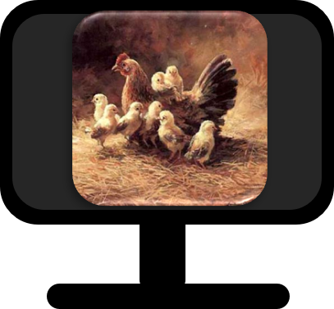
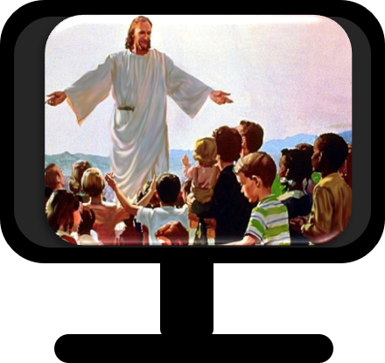
Lord Gathers His People
A hen cares for her chicks and would sacrifice her life to protect them.
When danger threatens, she gathers the chicks under her wings for protection.
The Lord loves His people, the house of Israel. He gave His life for His people and has sought to gather them together so he could protect and nourish them.
D&C 43:24 Book of Mormon Student Manual

Slide 15
Voices of the Lord
Lightnings –Warnings to inhabitants of the earth given by missionaries.
Natural phenomena—efforts of church leaders, missionaries, angels, and even His own voice, to convince the people of the earth to repent and prepare for the future.
D&C 43:24 Student Manual

Slide 16
How Loud Should the Lord Get?
“It is possible to become so hardened that we brush aside the warning voice, and even forget our sufferings. Those who lost their homes and loved ones won’t easily forget, though, even if the general public does.
“Must the Lord speak in louder tones? Must He send greater disasters before we listen to His warning voice?
“How much does it take to waken us to a realization that God is real, that there is an end to His patience, and that the only true security in these troubled times is through obedience to the Most High? Why fly in the face of Providence?”
Church News
D&C 43:25-27 Student Manual

Slide 17
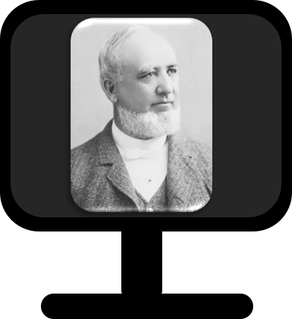
Millennium
During the Millennium, Satan will be bound and Jesus Christ will reign with His people on the earth.
“We talk about Satan being bound. Satan will be bound by the power of God; but he will be bound also by the determination of the people of God not to listen to him, not to be governed by him”
President George Q. Cannon
D&C 43:30-31

Slide 18
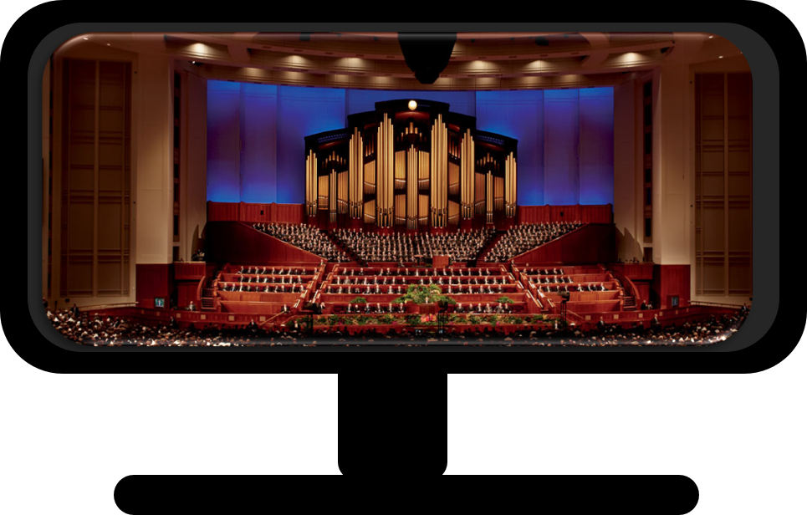
Assemble Together
Every six months in this building and other buildings throughout the world, Church members gather to hear from prophets and apostles and other Church leaders.
D&C 44:1-8

Slide 19
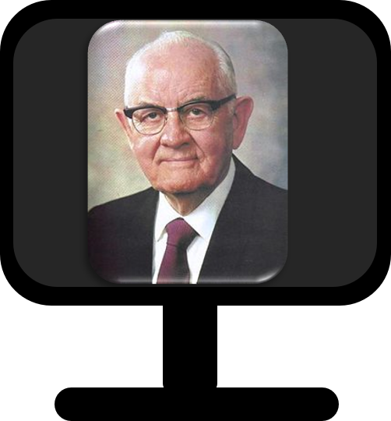
“We hope that the leaders and the members of the Church who have attended and listened to the conference have been inspired and uplifted. We hope you have made copious notes of the thoughts that have come to your mind as the Brethren have addressed you.
Many suggestions have been given that will help you as leaders in the perfection of your work. Many helpful thoughts have been given for the perfection of our own lives, and that, of course, is the basic reason for our coming.
“While sitting here, I have made up my mind that when I go home from this conference this night there are many, many areas in my life that I can perfect. I have made a mental list of them, and I expect to go to work as soon as we get through with conference.”
President Spencer W. Kimball

Slide 20
Sources:
Videos:
Revelation Comes in an Orderly Way (1:00)
We Act (2:06)
Prepare Today for the Second Coming (1:06)
(History of the Church, 1:154n.)
Christina Georgina Rossetti artist of woman portrait
President Boyd K. Packer (“To Be Learned Is Good If … ,” Ensign, Nov. 1992, 73). (See also Doctrine and Covenants Student Manual, 2nd ed. [Church Educational System manual, 2001], 87.)
Joseph F. Smith (In Journal of Discourses, 24:188–90.)
Doctrine and Covenants Religion 324-325 Student Manual Section 43
History of the Church, 4:136–37, 164, 187, 493, 517).
Joseph and Emma Portrait by Julia Roger
Book of Mormon Student Manual Chapter 40: 3 Nephi 8–11 (2009), 295–301
(Church News, 21 June 1980, p. 12.)
” President George Q. Cannon (Gospel Truth: Discourses and Writings of President George Q. Cannon, comp. Jerreld L. Newquist, 2 vols. [1957–74], 1:86).
President Spencer W. Kimball (“Spoken from Their Hearts,” Ensign, Nov. 1975, 111).
Presentation by ©http://fashionsbylynda.com/blog/

Slide 21
During Conferences
D&C 1:14
D&C 20:61–66
D&C 43:8
D&C 58:56
D&C 72:7
D&C 73:2
D&C 124:144
The arm of the Lord shall be revealed
Conferences are to do whatever church business is necessary to be done at the time and elders are to receive their licenses from other elders, by vote of the church to which they belong, or from the conferences.
Assemble together ye shall instruct and edify each other, that ye may know how to act and direct my church, how to act upon the points of my law and commandments
counseled by the elders of the church at the conferences
The duty of the bishop shall be made known by the commandments which have been given, and the voice of the conference
it shall be made known unto them, by the voice of the conference, their several missions
You should fill all these offices and approve of those names which I have mentioned, or else disapprove of them at my general conference;

