Slide 1
Doctrine and Covenants 42:43-93
Death and Healing
But Jesus turned him about, and when he saw her, he said, Daughter, be of good comfort; thy faith hath made thee whole. And the woman was made whole from that hour.
R
X

Slide 2
What Are These Items Used For:
Which of these should we rely on in times of illness?

Slide 3
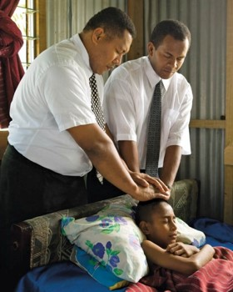
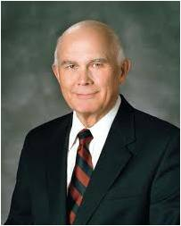
“Latter-day Saints believe in applying the best available scientific knowledge and techniques. We use nutrition, exercise, and other practices to preserve health, and we enlist the help of healing practitioners, such as physicians and surgeons, to restore health.
“The use of medical science is not at odds with our prayers of faith and our reliance on priesthood blessings. …
“Of course we don’t wait until all other methods are exhausted before we pray in faith or give priesthood blessings for healing. In emergencies, prayers and blessings come first. Most often we pursue all efforts simultaneously”
Elder Dallin H. Oaks

Slide 4
Faith to Be Healed
Sometimes members of the Church have the mistaken idea that all sickness should be dealt with only through priesthood administrations.
As stated in a Church News editorial: “Every man, woman and child should care for his or her body as the temple of God which it is.
Attention should be given to proper rest and exercise, and a well-balanced diet. The Lord has given us the Word of Wisdom to assist us further in better caring for our bodies.
Student Manual
R
X
If we have faith in Jesus Christ, we can be healed according to His will.
D&C 42:43

Slide 5
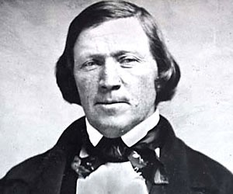
Priesthood Blessings and Herbs
November 1942:
Brigham Young was seriously ill.
“He was suddenly and severely attacked by disease with strong symptions of apoplexy,
We immediately adminstered to him by laying on of hands and prayer, accompanied with the use of herbs.”
History of the Church
D&C 42:43

Slide 6
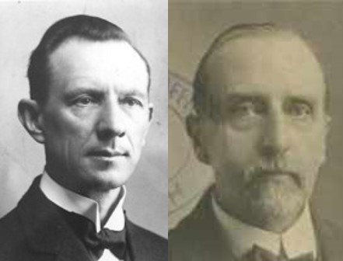
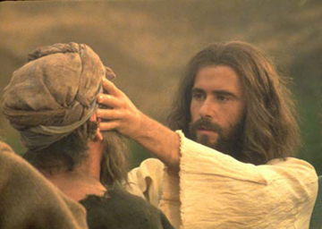
If They Die
All who have any experience in the Church know of instances of miraculous healing, but there is no promise that all afflicted persons for whom the Elders pray shall recover. But the promise to the Church members is that, if they die, “they shall die unto me.”
Smith and Sjodahl
Thou shalt weep:
It is natural to feel sorrow when death parts from our loved ones.
D&C 42:44-45

Slide 7
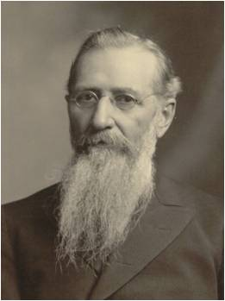
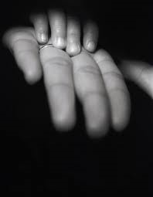
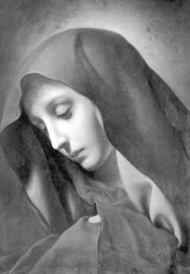
Not Taste Death
“We must not mourn as those who are “without hope” of a reunion. To those who die in the Lord death is not bitter. To them it does not taste like death. It is sweet.
What reason have we to mourn? None, except that we are deprived for a few days of the society of one whom we love.”
D&C 42:46 Joseph F. Smith

Slide 8
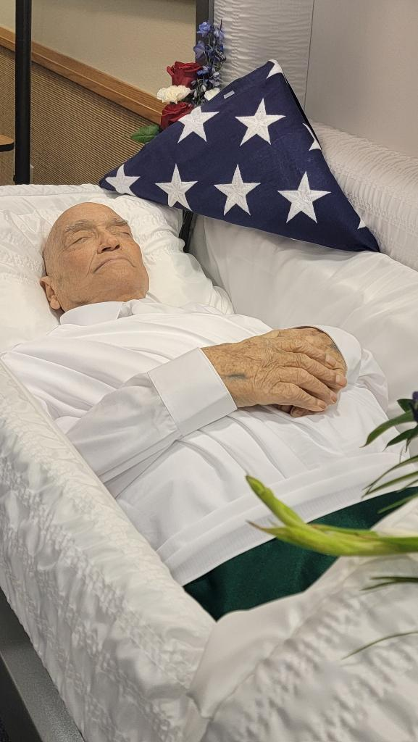
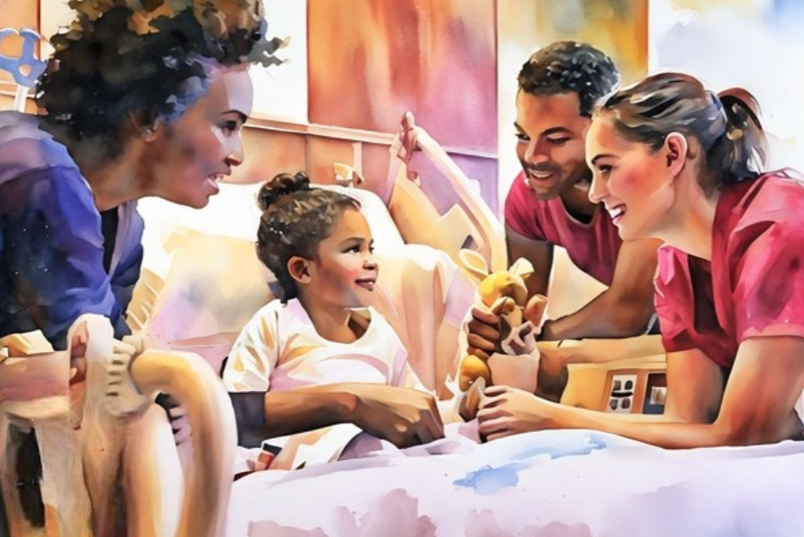
Miracles and Healing
And it came to pass that when he had thus spoken, all the multitude, with one accord, did go forth with their sick and their afflicted, and their lame, and with their blind, and with their dumb, and with all them that were afflicted in any manner; and he did heal them every one as they were brought forth unto him.
3 Nephi 17:9
And when he had called unto him his twelve disciples, he gave them power against unclean spirits, to cast them out, and to heal all manner of sickness and all manner of disease.
Matthew 10:1
Miracles of healing are often included in the scriptures as signs manifest among the followers of Jesus Christ.
More complicated are situations in which faith is manifest and people are not healed.
The Lord specifies that those with faith can be healed, as long as they are not “appointed unto death”.
There are instances in which the worthiness and faith of all involved are sufficient, but it is simply time for the person to move on to the next life.
Casey Paul Griffiths
D&C 42:43-48

Slide 9
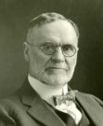
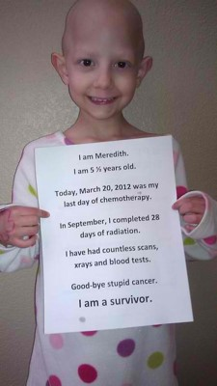
Appointed to Death
“Sometimes God intervenes even when the decree of death has gone forth…but the rule is that he whose time for departure has come must follow the beck and call of the silent messenger…
…but he who “is not appointed to death” shall be healed, in accordance with his faith. And those who have not faith to be healed may yet have faith in the Lord to become His children.
Many believe that He can give them back their body, in resurrection, but deny His power to heal them this side of the grave.”
D&C 42:48-52 Orson F. Whitney

Slide 10
“As children of God, knowing of His great love and His ultimate knowledge of what is best for our eternal welfare, we trust in Him. The first principle of the gospel is faith in the Lord Jesus Christ, and faith means trust.
I felt that trust in a talk my cousin gave at the funeral of a teenage girl who had died of a serious illness. He spoke these words, which first astonished me and then edified me:
‘I know it was the will of the Lord that she die. She had good medical care. She was given priesthood blessings. Her name was on the prayer roll in the temple. She was the subject of hundreds of prayers for her restoration to health. And I know that there is enough faith in this family that she would have been healed unless it was the will of the Lord to take her home at this time.’ I felt that same trust in the words of the father of another choice girl whose life was taken by cancer in her teen years. He declared, ‘Our family’s faith is in Jesus Christ and is not dependent on outcomes.’
Those teachings ring true to me. We do all that we can for the healing of a loved one, and then we trust in the Lord for the outcome.”
D&C 42:48-52 Elder Dallin H. Oaks

Slide 11
Stewardship—the Saints
“54. Thou shalt not take thy brother’s garment--Business must be coupled with humane considerations. Do not exact the ‘pound of flesh.’
“Thou shalt pay-- Avoid debt. On this point modern legislators might study the Mosaic legislation with profit.
“56. My Scriptures shall be given--The Joseph Smith Translation of the Bible. …
“57. Until ye have received them in full--Note the injunction against teaching the new version as long as it was incomplete.
“59–60. The things which thou hast received--Refers to the Revelations given. They are the law by which the Church shall be governed. According to that law men will be saved or condemned.
D&C 42 Smith and Sjodahl

Slide 12
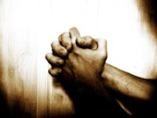
Stewardship—the Saints
“61–64. Here is a promise that, in answer to prayer, the Saints shall receive revelations and knowledge. The Spirit of Revelation is with the Saints whose hearts are opened to let the light in. The promise embraces especially a Revelation concerning the location of the New Jerusalem.
“68–69. In view of such promises it is the duty of the Saints to pray for wisdom and to rejoice before the Lord. …
“70–73. The law of remuneration is that those who administer in spiritual affairs must have their stewardships and labor for their living, ‘even as the members.’ This is wisdom. For in that position they are absolutely independent and can preach the truth without fear. Those who administer in temporal affairs and give their entire time to public business are to have a just remuneration. If they were to earn a living for themselves, they could not give all their time and energy to the community.”
D&C 42 Smith and Sjodahl

Slide 13
If We Ask…
R
R
X
X
If we ask, the Lord will give us knowledge that will bring us peace, joy, and eternal life.
If we ask for wisdom, the Lord will give to us liberally.
D&C 42:61, 69

Slide 14
Direction for the Priesthood
The Lord described some laws governing Church discipline.
He specifically gave direction to priesthood leaders concerning how to minister to those who have committed serious sin, including sexual sins, stealing, lying, or “any manner of iniquity”
D&C 42:74-87

Slide 15
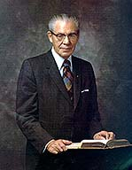
Resolving Personal Offenses
Have you ever felt hurt or offended by someone else’s words or actions?
What are we to do with someone who has offended us?
Reconcile with him or her privately.
The word reconcile means to resolve differences and restore harmony.
D&C 42:88-93

Slide 16
Resolving Appropriately
Offenses given in private should be …
Offenses given in public should be …
… resolved in public.
… resolved in private.
D&C 42:88-93

Slide 17
Sources:
Videos:
Healing the Sick (17:34)
If We Are Well Prepared, Death Brings No Terror (1:10)
Elder Dallin H. Oaks (“Healing the Sick,” Ensign or Liahona, May 2010, 47, 50).
Doctrine and Covenants Religion 324-325 Student Manual Section 42
History of the Church Vol. V.. P. 126
Hyrum M. Smith and Janne M. Sjodahl Doctrine and Covenants Commentary pg. 232-234
Casey Paul Griffiths Doctrine and Covenants Central
Presentation by ©http://fashionsbylynda.com/blog/
Joseph F. Smith Journal of Discourse Vol. XIX pg. 263
Orson F. Whitney Life of Heber C. Kimball pg. 273-4
President N. Eldon Tanner (Conference Report, Apr., 1880, p. 78.
Presentation by ©http://fashionsbylynda.com/blog/

Slide 18
To Be Healed:
“There are times when we should pray for the sick, and through the priesthood lay hands upon the head of the ill and bless them. …
“But our belief in the divine power of healing should in no way preclude seeking competent medical assistance. Dr. James E. Talmage, a member of the Council of the Twelve, in 1921 said in an address:
“‘I say some have charged us with inconsistency, for they say: “If you believe in the gift of healing, what is the need of doctors, what is the need of surgeons, why build hospitals?” Because we know that “there is a law irrevocably decreed in heaven, before the world was, and when we attain any blessing it is by obedience to that law upon which it is predicated;” and the law is, in the instance under consideration, that we shall do all we can of ourselves. …
“‘We must do all we can, and then ask the Lord to do the rest, such as we cannot do. Hence we hold the medical and surgical profession in high regard. … When we have done all we can then the Divine Power will be directly applicable and operative.’
“The fact that faithful Latter-day Saints today are among some of the world’s eminent physicians and surgeons affirms our continuing adherence to the statement of Dr. Talmage made 56 years ago.” (Church News, 19 Feb. 1977, p. 16.)
Doctrine and Covenants 42:46–47. Death is sweet to those who die in the Lord
President Joseph Fielding Smith explained what it means that death is sweet to those who die in the Lord:
“To some members of the Church the saying that those who die in the Lord shall not taste of death has been a hard saying. They have seen good faithful men and women suffer days and at times for months before they were taken. But here the Lord does not say they shall not suffer pain of body, but that they shall be free from the anguish and torment of soul which will be partaken of by the wicked, and although they may suffer in body, yet death to them will be sweet in that they will realize that they are worthy before the Lord” (Church History and Modern Revelation, 2 vols. [1953], 1:186). (See also Doctrine and Covenants Student Manual, 2nd ed. [Church Educational System manual, 2001], 85.)
“Not appointed unto death”
President Joseph Fielding Smith said, “No righteous man is ever taken before his time” (in “Funeral Services for Elder Richard L. Evans,” Ensign, Dec. 1971, 10).
Elder David A. Bednar of the Quorum of the Twelve Apostles explained that just as we need faith to be healed, we need faith to accept the Lord’s will that we not be healed:
“[There is] a principle that applies to every devoted disciple: strong faith in the Savior is submissively accepting of His will and timing in our lives—even if the outcome is not what we hoped for or wanted. …
“Righteousness and faith certainly are instrumental in moving mountains—if moving mountains accomplishes God’s purposes and is in accordance with His will. Righteousness and faith certainly are instrumental in healing the sick, deaf, or lame—if such healing accomplishes God’s purposes and is in accordance with His will. Thus, even with strong faith, many mountains will not be moved. And not all of the sick and infirm will be healed. If all opposition were curtailed, if all maladies were removed, then the primary purposes of the Father’s plan would be frustrated.
“Many of the lessons we are to learn in mortality can only be received through the things we experience and sometimes suffer. And God expects and trusts us to face temporary mortal adversity with His help so we can learn what we need to learn and ultimately become what we are to become in eternity” (“That We Might ‘Not … Shrink’ [D&C 19:18]” [CES devotional for young adults, Mar. 3, 2013],
(See also Doctrine and Covenants Student Manual,2nd ed. [Church Educational System manual, 2001], 85–6.)

Slide 19
President N. Eldon Tanner gave the following counsel on the ways those appointed to judge should deal with transgressors:
“Every mission president, stake president, and bishop is directed and instructed how to investigate and handle all cases of transgression. A person who is guilty of a serious transgression cannot progress, and he is not happy while the guilt is upon him. Until he has confessed and repented he is in bondage. The transgressor who is dealt with as he should be, with love and with proper discipline, will later express his appreciation for your concern, your interest, and your leadership. As he is properly dealt with, he is in a position to repent and come back to full activity. But he must be dealt with. …
“It has been reported to me that some bishops and even stake presidents have said that they never have excommunicated or disciplined anyone and that they do not intend to. This attitude is entirely wrong. Judges in Israel have the responsibility to sit in righteous judgment where it becomes necessary. Let me read from the twentieth section of the Doctrine and Covenants an important reminder to those who have the responsibility of judging: ‘Any member of the Church of Christ transgressing, or being overtaken in a fault, shall be dealt with as the scriptures direct.’ (D&C 20:80.)
“Brethren, study the scriptures and the handbook and do as they direct and discipline the members of the Church when necessary. Remember that it is no kindness to a transgressor for his local authority to ignore or overlook or try to cover up his iniquity.
“Let me read a quotation from President John Taylor wherein he discussed this subject: ‘Furthermore, I have heard of some Bishops who have been seeking to cover up the iniquities of men: I tell them, in the name of God, they will have to bear … that iniquity, and if any of you want to partake of the sins of men, or uphold them, you will have to bear them. Do you hear it, you Bishops and you Presidents? God will require it at your hands. You are not placed in position to tamper with the principles of righteousness, nor to cover up the infamies and corruptions of men.’ (Conference Report,Apr., 1880, p. 78.)
“These are very strong words, brethren, and they were spoken by a president of the Church, a prophet of God. Also, George Q. Cannon makes this significant statement: ‘The Spirit of God would undoubtedly be so grieved that it would forsake not only those who are guilty of these acts, but it would withdraw itself from those who would suffer them to be done in our midst unchecked and unrebuked.’” (In Conference Report, Oct. 1974, p. 110; or Ensign, Nov. 1974, p. 78.)

Slide 20
Some of the “Lost Books” of the Scriptures | Old Testament | A Comprehensive History on the Church Volume 1 pg. 248-294 by B.H. Roberts
Scriptures existing in the days of Abraham | Galatians 3:8 | Older than the five book of Moses, for Abraham was before Moses.
The Book of the Covenant | Exodus 45:7 | Through which Moses instructed Israel
The Book of the Wars of the Lord | Numbers 21:14
The Book of Jasher | John 10:13 and 2 Samuel 1:18
The Book of the Manner of the Kingdom | 1 Samuel 10:25
History book by Solomon | 1 Kings 4:32, 33 | Three thousand proverbs, a thousand and five songs.
The acts of Solomon | 1 Kings 11:41
The Book of Gad the Seer | 1 Chronicles 11:29
The Book of Nathan the Prophet | 1 Chronicles 29:29, 2 Chronicles 9:29
The prophecy of Ahijah, the Shilonite | 2 Chronicles 9:29
The Visions of Iddo the Seer | 2 Chronicles 9:22
The Book of Shemaiah the Prophet | 2 Chronicles12:15
The Story of the Porphet Iddo | 2 Chronicles 23:22
The Book of Jehu | 2 Chronicles 20:34
Prophecy of Enoch | Jude 15, 16 | Enoch has a revelation concerning the glorious coming of the Son of God to judgment.

Slide 21
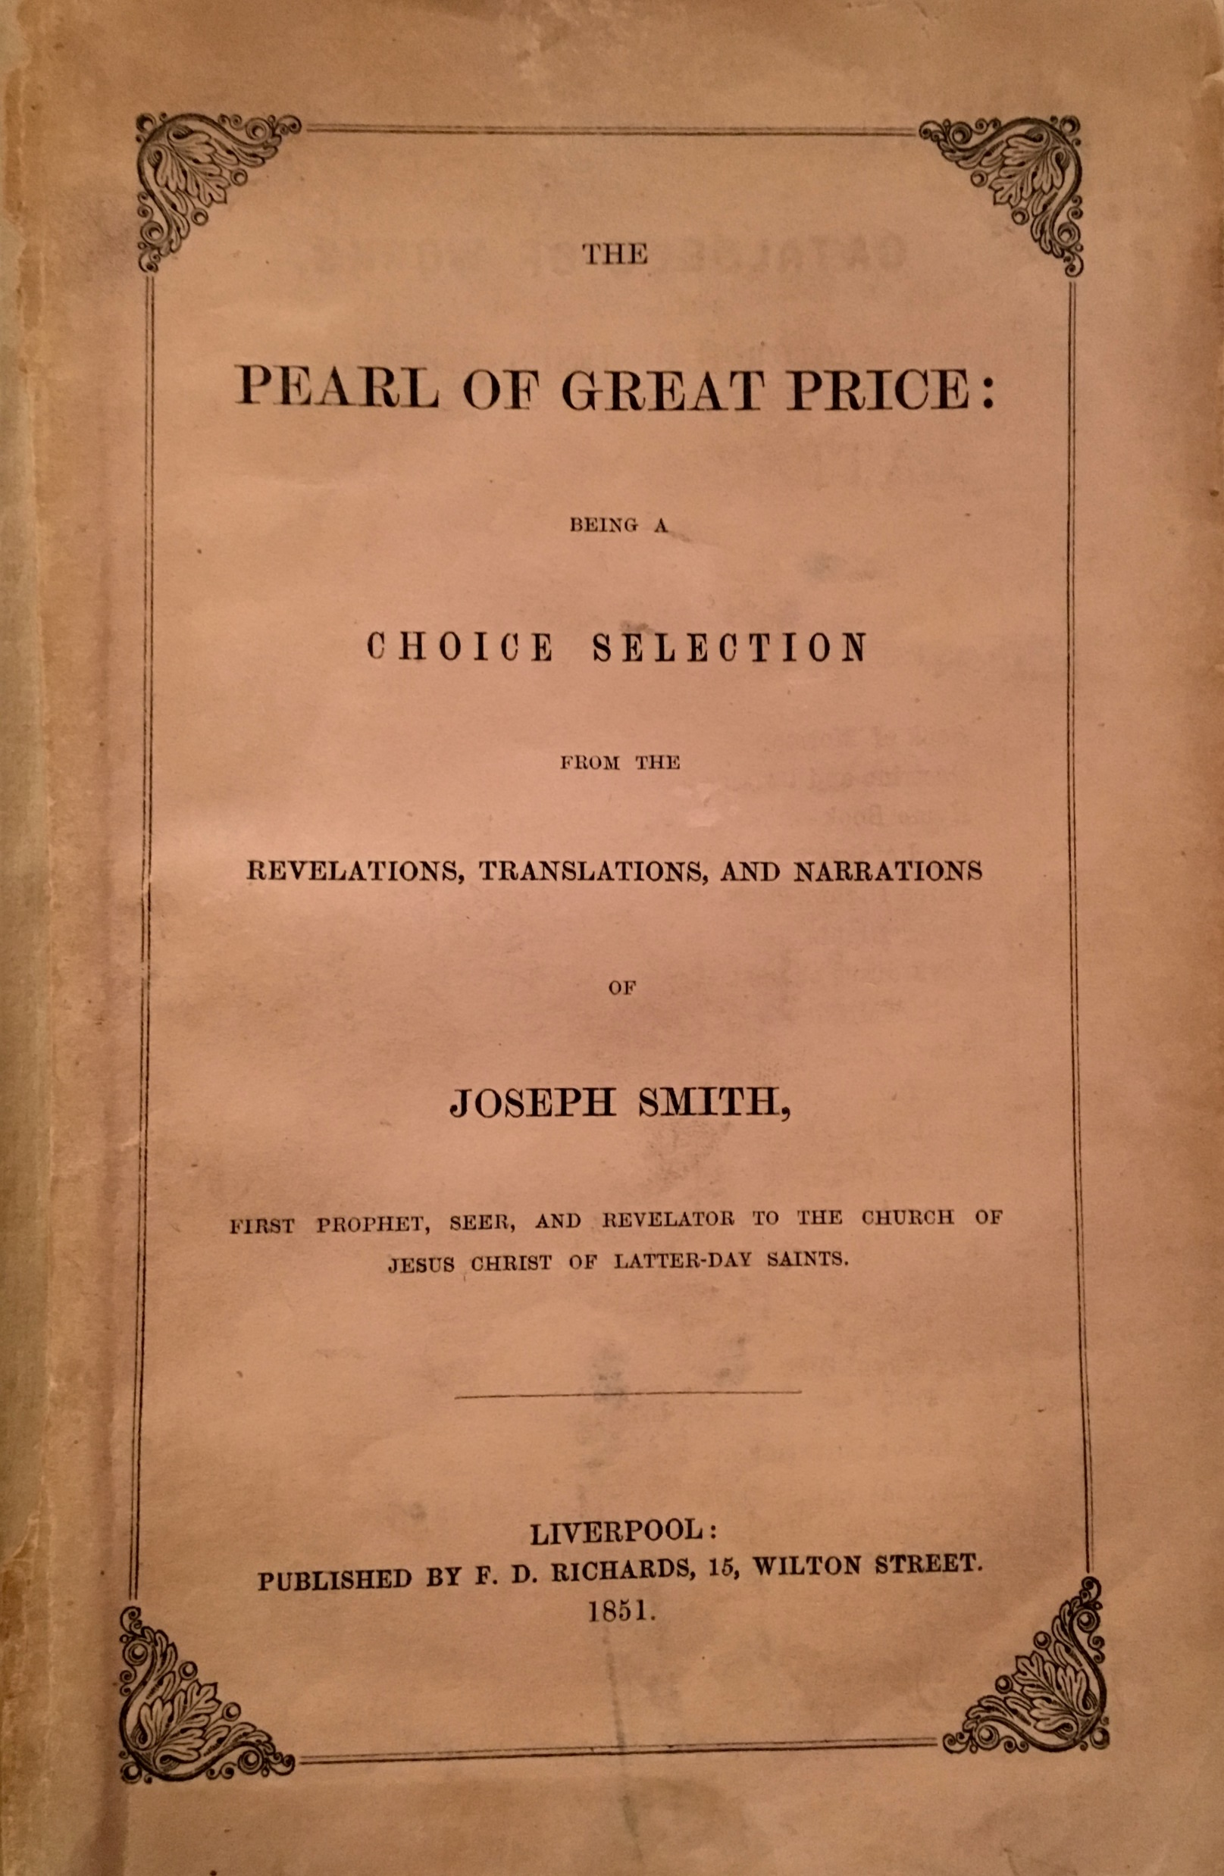
Books That Might Be Missing | New Testament | A Comprehensive History on the Church Volume 1 pg. 248-294 by B.H. Roberts
Another Epistle of Jude | Jude 3 | We have but one epistle of Jude. Would not the epistle on the “common salvation” be as important as the one and the only one we have from Jude’s pen?
Another Epistle tot the Ephesians | Ephesians 3 | Paul alludes to another epistle which he had written to that people, but of which the world has no knowledge except this reference to it, which is made by its author. This epistle contained a revelation from God.
Another Epistle to the Laodiceans | Colossians 4:16 | From this it would appear since Paul in it speaks of a former letter he had written, and which was doubtless as good scripture as the two which have been preserved.
“On the revised version of the Jewish scriptures the church has published several chapters un the title, The Book of Moses, and also the 24th chapter of St. Matthew, including in it the last verse of the 23rd chapter. These extracts are found in a collection of sacred writings called the Pearl of Great Price. A Selection from the Revelations, Translations and Narrations of Joseph Smith, first published by Franklin D Richards in England, 1851.

Slide 22
Faith in a Time of Cholera
By: Amy Tanner Thiriot - February 19, 2014
Ann Prior was born into a prosperous family in East London, but the family was reduced to poverty through a series of misfortunes including the death of her father. When Ann was eleven, she acted against her Scottish mother’s wishes and left school to become a dressmaker so she could help support the family.
She worked as a dressmaker for several years, and then when she was almost seventeen, she married George Jarvis, a sailor who had traveled around the world several times.
Between ocean voyages, George took care of ships in harbor. He and Ann were living on board a ship with their two children when George heard the missionaries of The Church of Jesus Christ of Latter-day Saints preaching on an English street-corner. He hurried back to the ship to tell Ann what he’d heard about Joseph Smith and the restoration of the Gospel. Ann heard his explanation and replied, “George, it’s true!”
They were baptized in the Thames on Christmas Day, 1848. When George sailed on a voyage not long afterward, Ann moved in with her mother, Catherine Prior. She told about her subsequent experiences in her autobiography:
“I will write a few lines about the cholera. I was home with my mother when it was so bad that cards where posted about warning you that if any one was [taken] with it and you did not send word to persons apointed to take them to the pest house, you were under a heavy pena[l]ty. You were not allowed to have a docter at your home.
When cholera swept through London in 1849, the disease killed more than 18,000 people in a single season.³ It was not until the next decade that doctors began to understand the cause of cholera and how the bacteria Vibrio cholerae spread through primitive water and sanitation systems.
A cholera infection starts when a person is exposed to large amounts of cholera bacteria transmitted by fecal matter in water or food. First comes vomiting and diarrhea. As the disease progresses, victims become visibly dehydrated, get weaker and weaker, and turn purple and black in their extremities and face. Treatments in 1849 were primitive: doctors could do little more than give solutions of electrolytes in water, although a few were making some early but unsuccessful attempts at intravenous saline rehydration.”
The cases of cholera got nearer and nearer to Ann and her mother and children.
“A Child that had played with my boy in the evening the following morning was dead.
Close neighbors to us while the woman was puting her things on to follow her husband to the grave was taken with it, and in two hours they buried her with him. My [step]brother went with a man to bury his wife and he declared he heard her scream while going to the grave.”

Slide 23
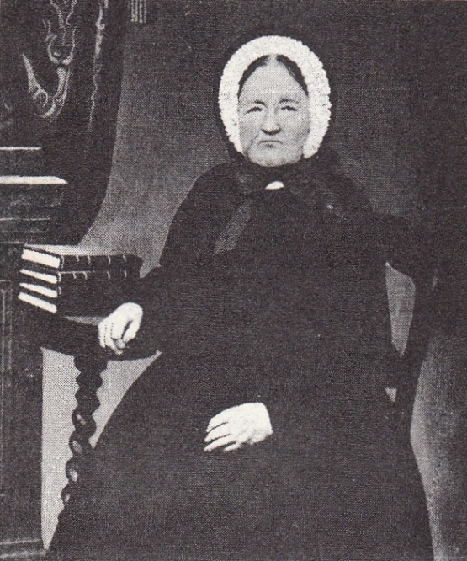
Then Ann came down with the disease.
“… the neighbors heard me [retching]. They expected to hear my Mother or I had passed away before morning. They did not know which one of us it was that had the cholera.
I implored my mother not to send me to the pest house or I should die. We were miles from any Elders. What could I do or what could my mother do with my baby in her arms?
I had, by good fortune, a bottle of consecrated oil and it was [where] I could see it in the window… I could not speak but I pointed to the bottle of oil. My Mother did not know but what it was hair oil. I had not told her about it; I had told her about baptism and she did not believe.… She thought I was delirius but she gave me the oil to pacify me.
I asked the Lord to add to my testimony by staying the continual [retching] and I was healed. My mother said I was quite black in the face. I do not say I should have died if I had not used the oil, but I do know those that did recover … were six week[s] or more before they got well. The stench was so bad Mother had to burn things to sweet[en] the rooms.
I was up and told my brother and others of the goodness of the Lord to me. I was laughed to scorn, but I give God the glory to this day for I know He answers prayers.”
Eight years after Ann survived the cholera, she left her mother in London and traveled with her husband and children to Boston, then later to the Salt Lake Valley, and still later to the Cotton Mission in St. George, Utah. She raised nine of her eleven children to adulthood and left her descendants with many stories of faith healing, hard work, and adventures on both sides of the ocean.
http://www.keepapitchinin.org/2014/02/19/faithcholeraconsecratedoil/

