Slide 1
Doctrine and Covenants 45:1-8
The Advocate
Presentation by ©http://fashionsbylynda.com/blog/

Slide 2
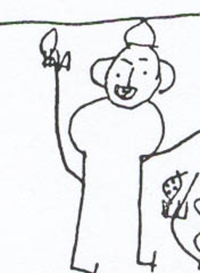
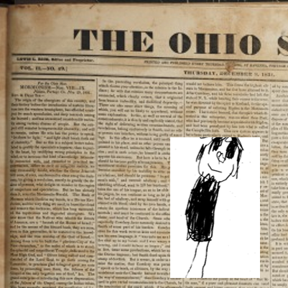
Background
March 1831
Civic leaders, ministers, newspaper editors, and parishioners joined together in an effort to stop the conversion of their neighbors to the new religion.
“Many false reports, lies, and foolish stories, were published in the newspapers, and circulated in every direction, to prevent people from investigating the work, or embracing the faith”
Joseph Smith

Slide 3
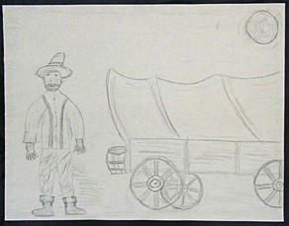
Background
March 1831
During these trying times of slander and abuse, the Lord blessed the Saints with revelations of comfort, peace, and assurance.
One of these revelations was section 45
“To the joy of the Saints who had to struggle against everything that prejudice and wickedness could invent, I received the following in D&C 45” Joseph Smith

Slide 4
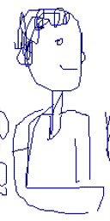
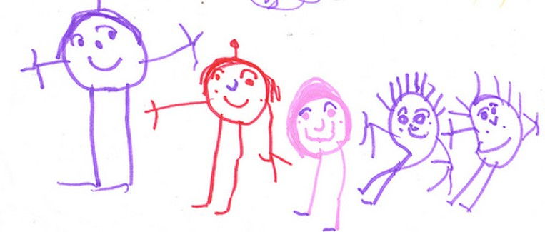
Qualities
What qualities would a person need to have before you would want to listen to his or her counsel?
Would you be more likely to listen to someone who cares about you?
Would you be more likely to listen to someone who knows about the subject in which they are offering?

Slide 5
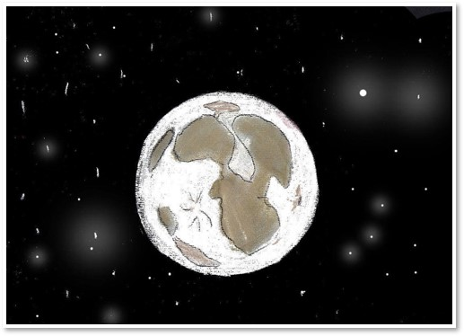
Jesus Created
45:1

Slide 6
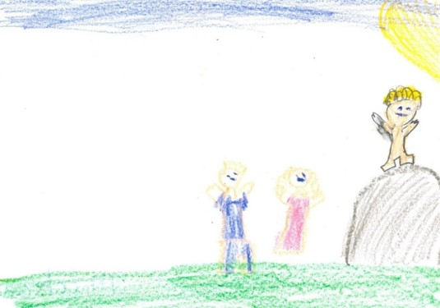
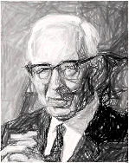
In An Hour When Ye Think Ye Not
“One of the great failings of mankind is to ignore warnings of punishment for sin. In all ages of the world it has been the peculiar belief of men that the sayings of the prophets were to be fulfilled in times still future. That is true of the people today. We have had ample warning of the nearness of the coming of the great and dreadful day of the Lord. The signs are upon us in all their power. …
In this revelation we are given the warning that the summer is passing and if we are heedless of the warning we will find the summer past, the harvest ended and our souls not saved. While no man knows the day or the hour, yet if we are taken unawares, we will be without excuse, for the signs are ample and we now see them being fulfilled.”
President Joseph Fielding Smith
45:2

Slide 7
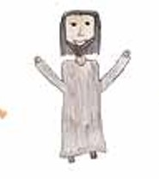
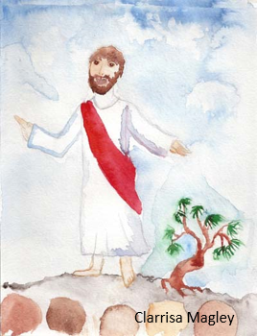
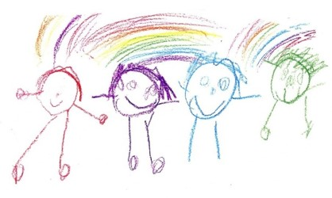
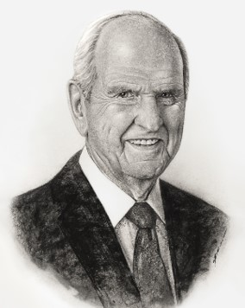
Advocate - Pleading Your Cause
An advocate is someone who pleads the cause of someone else. Sometimes this happens in a court of law, where an advocate presents evidence to a judge on behalf of someone who has been condemned.
Judge
Advocate
Defendant
Us
Heavenly Father
Jesus Christ
Jesus is our Advocate with the Father. The word advocate comes from Latin roots meaning a “voice for,” or “one who pleads for another.” Other related terms are used in scripture, such as intercessor or mediator …
… Comprehending him as our advocate-intercessor-mediator with the Father gives us assurance of his unequaled understanding, justice, and mercy.
Russell M. Nelson
45:3 See Also *

Slide 8
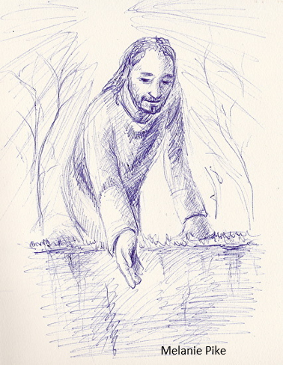
Our Advocate
His perfection and His suffering pay the price to satisfy justice for those of His “brethren that believe on my name.”
Imagine the indescribable sorrow of standing before the judgment bar with no one to step forward, no one to speak for you.
How tragic that some will not come to Him in true faith and repentance so that He can take their guilt upon Him and become their advocate with the Father.
45:4-5

Slide 9
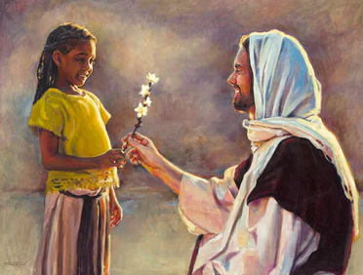
Knowing Thee
One simple way we get to know someone is by learning their name. …
Jesus knew and called people by name. To ancient Israel, the Lord said, “Fear not: for I have redeemed thee, I have called thee by thy name”; thou art mine
Just as Jesus knows each of us by name, one way we can come to better know Jesus is by learning His many names. …
Many of Jesus’s names are titles that help us understand His mission, purpose, character, and attributes.
As we come to know Jesus’s many names, we will come to better understand His divine mission and His selfless character. Knowing His many names also inspires us to become more like Him.
Jonathan S. Schmitt
Isaiah 43:1
Rod Peterson

Slide 10
While It is Called “Today”
Modern revelation states that the earth’s temporal history spans seven thousand years, divided into periods of one thousand years each (see D&C 77:6–7).
Since the earth will have a temporal existence before it is celestialized, and since it is known that the earth is now in the sixth period of a thousand years, or the sixth “day,” in the Lord’s terminology the present period is “today” and Christ will come “tomorrow.”
In a later revelation, the Lord used this same terminology, indicating that “now it is called today until the coming of the Son of Man,” that “after today cometh the burning,” that “tomorrow all the proud and they that do wickedly shall be as stubble”
Student Manual
45:6

Slide 11
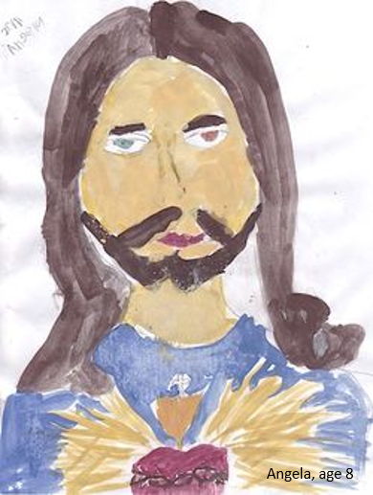
The Life and Light
Jesus Christ is the beginning and the end.
I am Alpha and Omega
Jesus Christ is the light and the life of the world.
Jesus Christ has sent His “everlasting covenant … to be a light to the world, and to be a standard for [His] people.” In another revelation, He said that His everlasting covenant is “the fulness of [His] gospel”
45:7-8

Slide 12
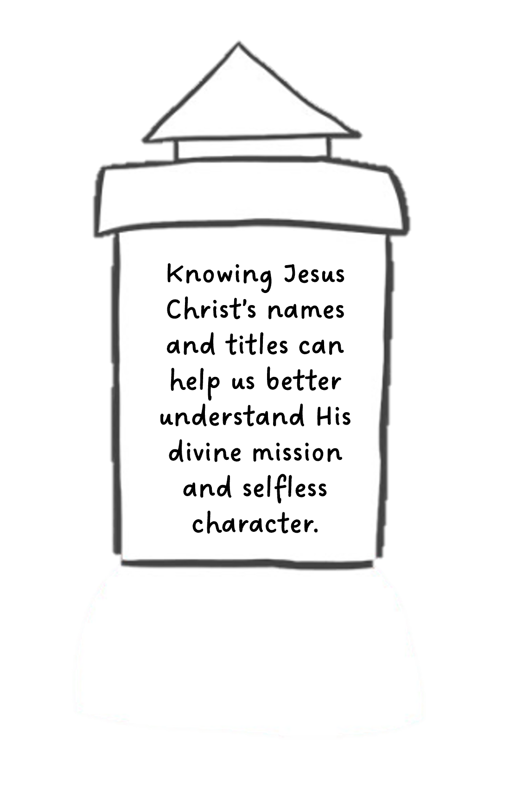
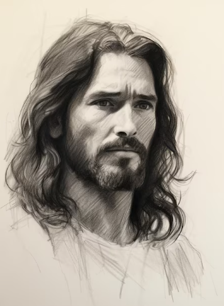
Other Names of Jesus Christ
Immanuel – Matthew 1:23.
Lamb of God – John 1:29.
King of the Jews – Matthew 27:37.
Wonderful Counselor, Mighty God, Everlasting Father, Prince of Peace
– Isaiah 9:6.
The Bread of Life – John 6:35.
The Redeemer – Isaiah 59:20.
The Living Stone – 1 Peter 2:4-8.

Slide 13
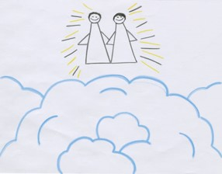
Sources:
Video:
Christlike Attributes (2:53)
Joseph Smith (History of the Church, 1:158).
Jonathan S. Schmitt, “That They Might Know Thee,” Liahona, Nov. 2022, 104–5
President Joseph Fielding Smith (Church History and Modern Revelation, 1:195.)
Doctrine and Covenants Religion 324-325 Student Manual Section 45
Smith and Sjodahl, Commentary, p. 255
Presentation by ©http://fashionsbylynda.com/blog/
Russell M. Nelson, “Jesus the Christ—Our Master and More” [Brigham Young University devotional, Feb. 2, 1992], 4, speeches.byu.edu
Presentation by ©http://fashionsbylynda.com/blog/

Slide 14
*Advocate: 1 John 2:1; D&C 29:5; 32:3; 45:3; 110:4
Intercessor or Mediator: 1 Timothy 2:5; 2 Nephi 2:28; D&C 76:69
Justice and Mercy: Alma 7:12
The Advocate
In Jesus Christ, “we have an advocate with the Father” [1 John 2:1]. After completing His atoning sacrifice, Jesus “ascended into heaven … to claim of the Father his rights of mercy which he hath upon the children of men.” And, having claimed the rights of mercy, “he advocateth the cause of the children of men” [Moroni 7:27, 28].
Christ’s advocacy with the Father in our behalf is not adversarial. Jesus Christ, who allowed His will to be swallowed up in the will of the Father, would not champion anything other than what the Father has wanted all along. Heavenly Father undoubtedly cheers for and applauds our successes.
Christ’s advocacy is, at least in part, to remind us that He has paid for our sins and that no one is excluded from the reach of God’s mercy. (Dale G. Renlund, “Choose You This Day,” Ensign or Liahona, Nov. 2018, 104–5)
D&C 7 Alpha, the first letter of the Greek alphabet, suggests commencement and inception. “… I was in the beginning with the Father, … ” he reveals (D&C 93:21), and, as the Firstborn, he stood at the right hand of the Father in the councils of heaven and in the work of creation. …
… As Omega, a name taken from the last letter of the Greek alphabet, Christ is the terminus, the end cause as well as the end result of mortal experience. …
These letters from the Greek suggest the universal role of Jesus from the beginning of the world to its end. But he ought to be Alpha and Omega in the particular as well—our personal beginning and our individual end—that model by which we shape our journey … and the standard by which we measure it at its conclusion.
In every choice we make, he ought to be our point of reckoning, our charted course, our only harbor ahead. He should be for us individually what he is for all men collectively—the very brackets of existence, the compass of our privilege. We should not stray outside him. We should not want to try. I am Alpha and Omega. (Jeffrey R. Holland, “Whom Say Ye That I Am?,” Ensign, Sept. 1974, 6–7)
D&C 7-8 Light and Life:
In every season of our lives, in all of the circumstances we may encounter, and in each challenge we may face, Jesus Christ is the light that dispels fear, provides assurance and direction, and engenders enduring peace and joy. (David A. Bednar, “The Light and the Life of the World,” [First Presidency Christmas devotional, Dec. 6, 2015], broadcasts.ChurchofJesusChrist.org)

Slide 15
Judgment:
The imagery of a judicial system is often invoked when the Last Judgment is mentioned in scriptures.
Man goes before the “judgment bar”
2 Nephi 33:15), there to be “arraigned” (Alma 11:44) and face God, “the Judge of all” (Hebrews 12:23).
As part of that imagery, Jesus is called the Advocate (paraclaytos). In the King James Version of the New Testament, Jesus is called the “advocate” only once (1 John 2:1).
The same word (paraclaytos) is used for the Holy Ghost, although it is translated “Comforter” (John 14:16).
Thus, Jesus is one Paraclete, or Comforter, and the Holy Ghost is called “another Comforter” (John 14:16).
The Greek word comes from para,to the side of, and kalayo, to summon. “Hence, originally, one who is called to another’s side to aid him, as an advocate in a court of justice” (Vincent, Word Studies, 1:486).
In the terminology of today’s legal system, an advocate is a lawyer who pleads another’s cause in a court of law, or in other words, an attorney for the defense.
Usually, the attorney for the defense pleads the cause on the basis that the client is innocent; or if guilty, that extenuating circumstances should be considered and mercy extended. At the time of eternal judgment, we will stand before the bar of God accused of being imperfect and unworthy to enter God’s presence, “for all have sinned, and come short of the glory of God” (Romans 3:23).
At that time we have an Advocate with the Father.
He will stand beside us to plead our cause before the Great Judge; however, He does not plead our case by pointing to our lack of guilt; rather, it is His own sinlessness to which He calls God’s attention (see D&C 45:4).
His perfection and His suffering pay the price to satisfy justice for those of His “brethren that believe on my name” (v. 5). Imagine the indescribable sorrow of standing before the judgment bar with no one to step forward, no one to speak for you.
How tragic that some will not come to Him in true faith and repentance so that He can take their guilt upon Him and become their advocate with the Father. Student Manual Religion 324-325
Role of the Savior as a mediator…President Boyd K. Packer of the Quorum of the Twelve Apostles explains:
“Each of us lives on a kind of spiritual credit. One day the account will be closed, a settlement demanded. However casually we may view it now, when that day comes and the foreclosure is imminent, we will look around in restless agony for someone, anyone, to help us.
“And, by eternal law, mercy cannot be extended save there be one who is both willing and able to assume our debt and pay the price and arrange the terms for our redemption. “Unless there is a mediator, unless we have a friend, the full weight of justice untempered, unsympathetic, must, positively must fall on us. The full recompense for every transgression, however minor or however deep, will be exacted from us to the uttermost farthing.
“But know this: Truth, glorious truth, proclaims there is such a Mediator.
“‘For there is one God, and one mediator between God and men, the man Christ Jesus.’ (1 Tim. 2:5)” (“The Mediator,” Ensign, May 1977, 55–56).
President Packer emphasized that the Lord is acting as our Advocate with the Father in our everyday lives:
“For some reason, we think the Atonement of Christ applies only at the end of mortal life to redemption from the Fall, from spiritual death. It is much more than that. It is an ever-present power to call upon in everyday life. When we are racked or harrowed up or tormented by guilt or burdened with grief, He can heal us. While we do not fully understand how the Atonement of Christ was made, we can experience ‘the peace of God, which passeth all understanding.’ [Philippians 4:7.]” (“The Touch of the Master’s Hand,” Ensign, May 2001, 23).

