Slide 1
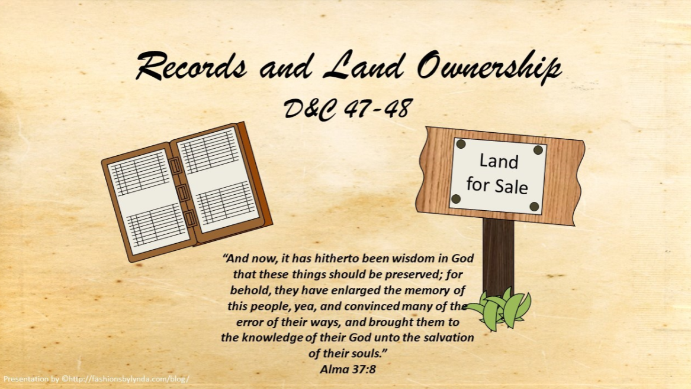

Slide 2
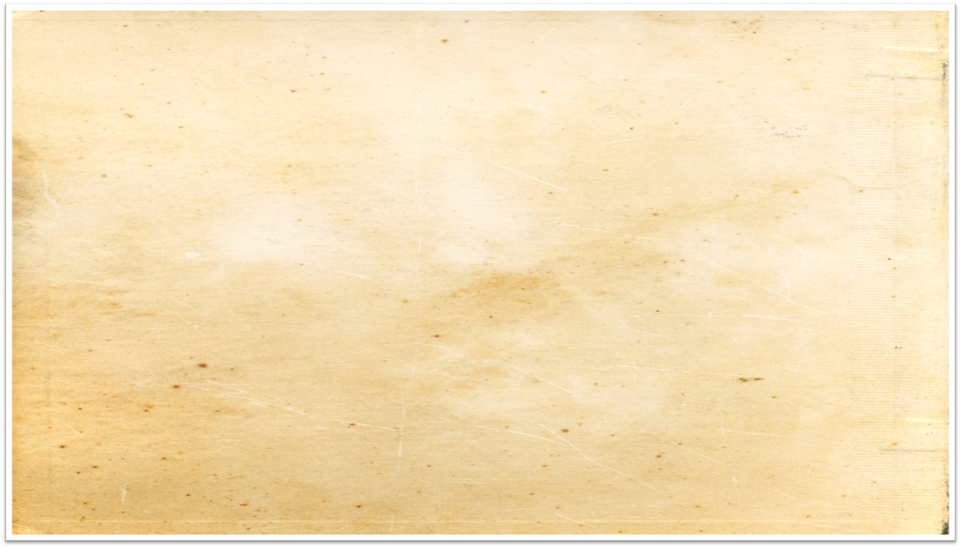
Background
March 1831
Prior to this time, Oliver Cowdery had been acting as a historian and recorder for the Church.
In this role, he kept a record of the revelations the Prophet had received.
However, Oliver Cowdery had been on a mission since October 1830 and was therefore unable to continue as a historian and recorder, so John Whitmer was appointed.
D&C 47:1-4

Slide 3
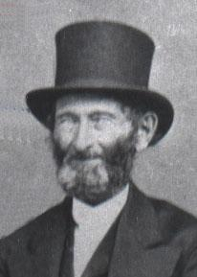
Custodian of Records
March 1831
John Whitmer’s history of the Church is a mere sketch of events that transpired between 1831 and 1838. His work consisted of eighty-five pages, which included many of the revelations given to the Prophet Joseph Smith.
He was excommunicated on March 10, 1838, at Far West and refused to deliver up the documents in his possession.
He took his history with him.
In 1893, many years after his death, the Church obtained a copy of his history.
Student Manual and Smith and Sjodahl
D&C 47:1-4

Slide 4
Starting a Record
March 1831
“Behold, there shall be a record kept among you; …” D&C 21:1
The Prophet Joseph Smith began his history on May 2, 1831:
“To disabuse the public mind, and put all inquirers after the truth into possession of the facts, as they have transpired, in relation to both myself and the Church, so far as I have such facts in my possession.”

Slide 5
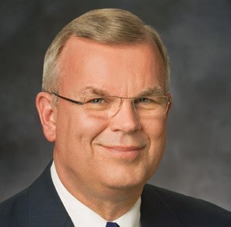
Church Records Today
By a sustaining vote a Church Historian and Recorder is called by the First Presidency and appointed
Elder Steven E. Snow

Slide 6
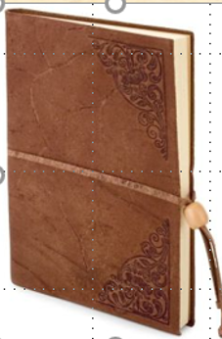
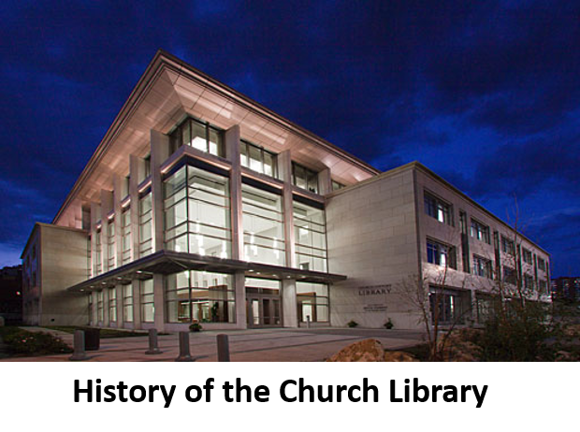
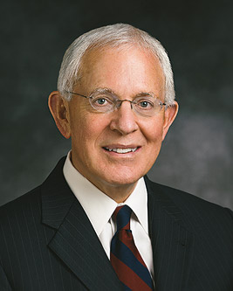
Duties of Historian
“The work of the Church historian and recorder is largely one of record keeping. It includes the gathering and preserving of Church history sources, the recording of ordinances, and the collection of minutes. The scriptures also suggest there is a responsibility to ensure the records are used ‘for the good of the church, and for the rising generations’ (D&C 69:8).
“The roles of historian and recorder are complementary and at times almost indistinguishable. I think that’s why, in the early days of the Church, sometimes a recorder was appointed and sometimes a historian and why over time the roles were joined together in one calling”
Elder Marlin K. Jensen

Slide 7
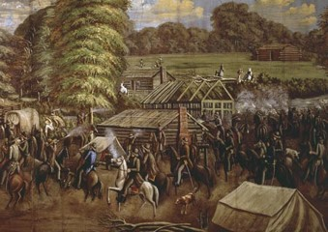

“There are other great stories in our history that deserve to be known and taught at church and at home. The lessons of Kirtland, the trials of Missouri, the triumphs and eventual expulsion of the Saints from Nauvoo, and the westward trek of the pioneers are stories that inspire Latter-day Saints in every land and language.
But there are equally moving stories about the rise and progress of the Church and the impact of the gospel in the lives of ordinary members in every nation touched by the restored gospel. These need recording and preserving as well.
“… Many of the Church’s greatest stories are contained in personal and family histories, and these are a part of our individual and family heritages”
Elder Marlin K. Jensen

Slide 8
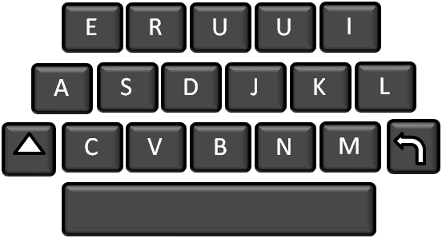
Record Keeping
“Record keeping is not restricted to those who keep the history of the church.
All members of the Church have been counseled to keep personal histories.
Though we may not be appointed Church Historian’s, we are all responsible to be historians in the Church.
Each of us is charged with the responsibility of recording our own history and providing a written record that can serve and benefit others who may read therefrom.”
Otten and Caldwell

Slide 9
Joseph Smith
“It is a fact, if I now had in my possession, every decision which had been had upon important items of doctrine and duties since the commencement of this work, I would not part with them for any sum of money; but we have neglected to take minutes of such things, thinking, perhaps, that they would never benefit us afterwards; which, if we had them now, would decide almost every point of doctrine which might be agitated.
But this has been neglected, and now we cannot bear record to the Church and to the world, of the great and glorious manifestations which have been made to us with that degree of power and authority we otherwise could, if we now had these things to publish abroad.”
My Record

Slide 10
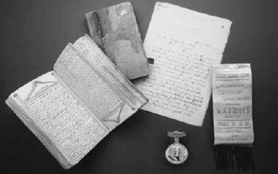
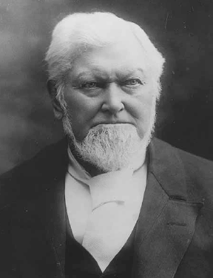
Purpose of Record Keeping
“The devil has sought to take away my life form the day I was born until now, more so even than the lives of other men. I seem to be ma marked victim of the adversary.
I can find but one reason for this: the devil knew if I got into the Church of Jesus Christ of Latter-day Saints, I would write the history of that Church and leave on record the works and teachings of the prophets, of the apostles and elders.
I have recorded nearly all the sermons and teachings that I ever heard for the Prophet Joseph, I have in my journal many of the sermons of President Brigham Young, and such men as Orson Hyde, Parley P. Pratt and others.
Another reason I was moved upon to write in the early days was that nearly all the historians appointed in those time apostatized and took the journals away with them.
Wilford Woodruff

Slide 11
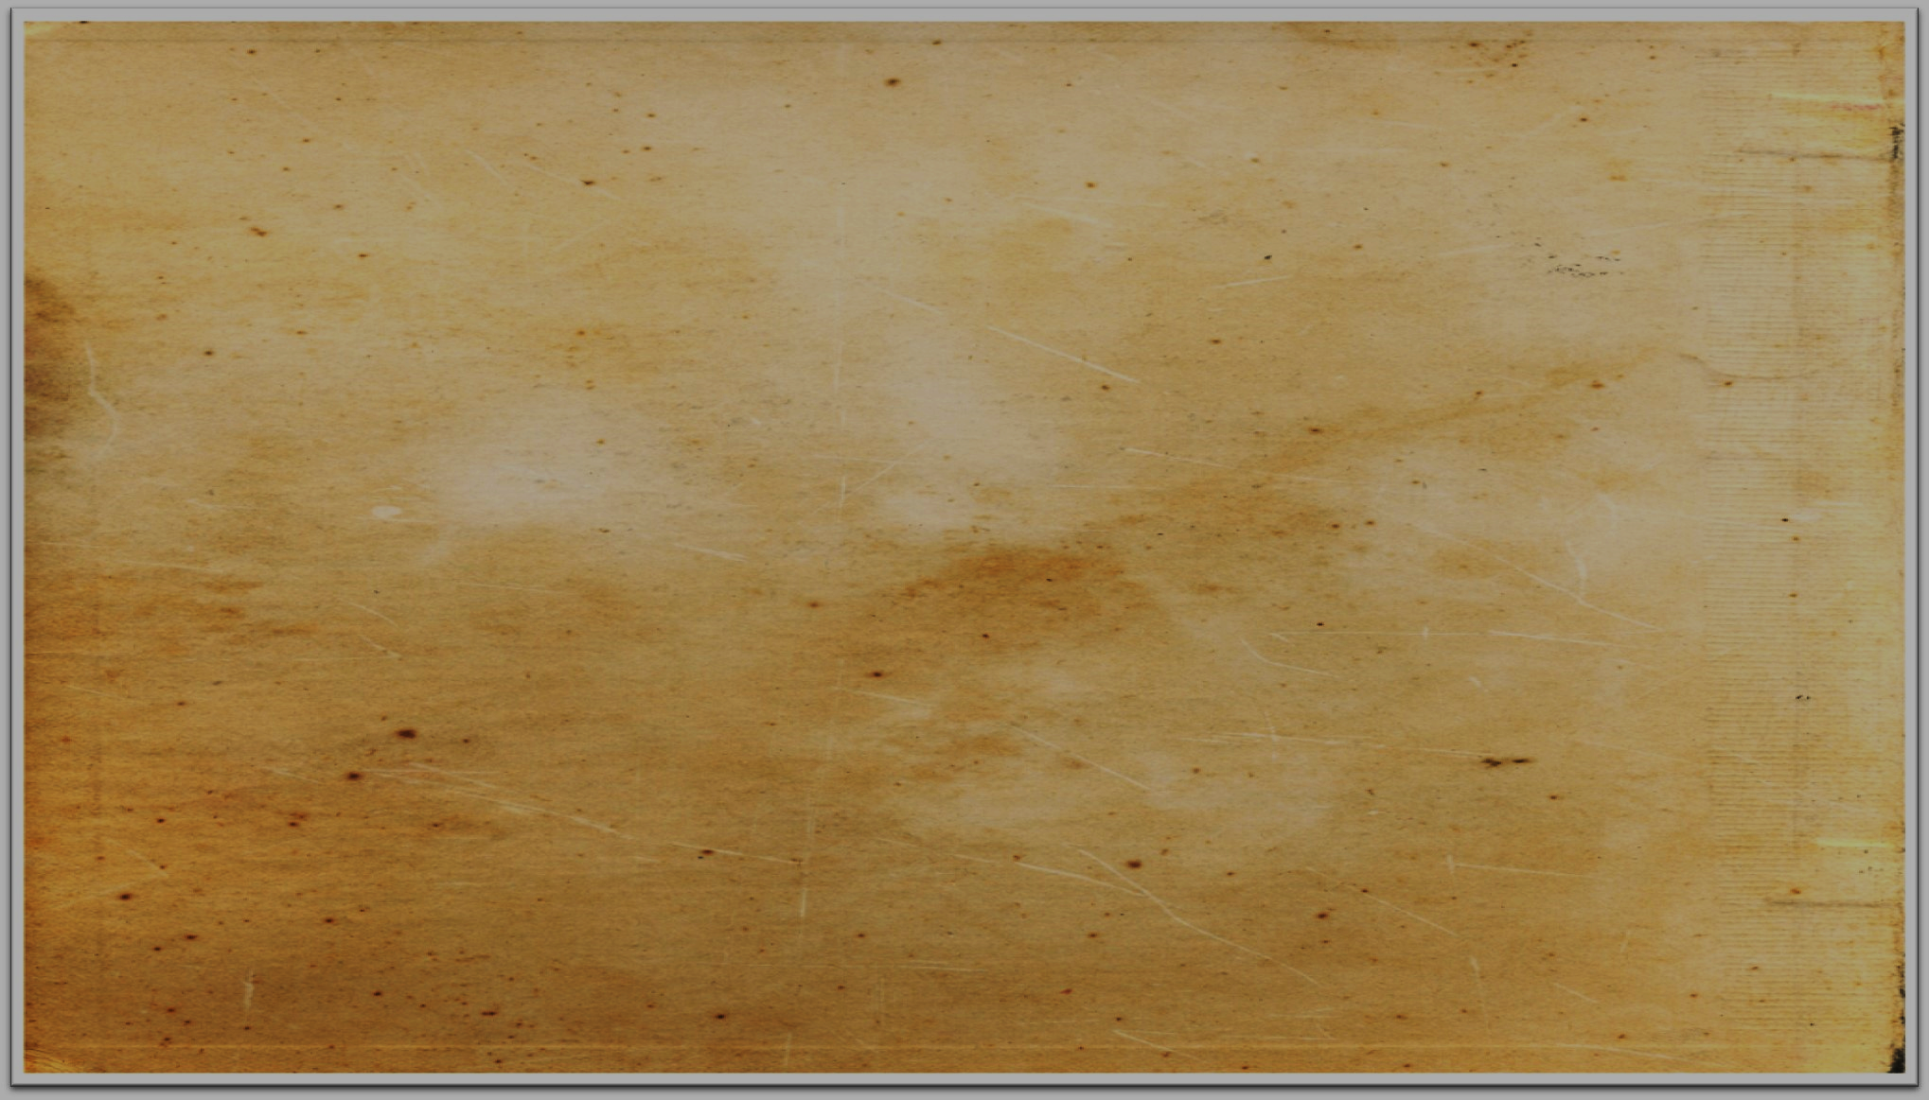
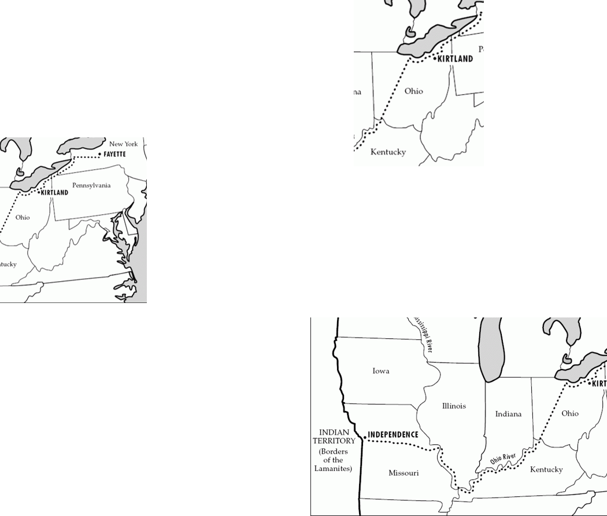
Where Should We Go?
The Saints living in Ohio were anticipating the arrival of the saints from the East and wondered what their obligations were as to how to assist in providing places for them to settle.
The Eastern saints who had been commanded to move to Ohio, were wondering where they could settle their families and how permanent such locations would be.
The Lord in Section 48 told both groups that the settlements in Ohio were temporary.
Ohio was a place of gathering for strength while the Lord prepared the Saints to establish Zion in the land of Missouri.
(D&C 64:21-22)
D&C 48:1-3 Otten and Caldwell

Slide 12
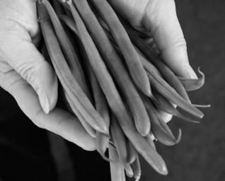
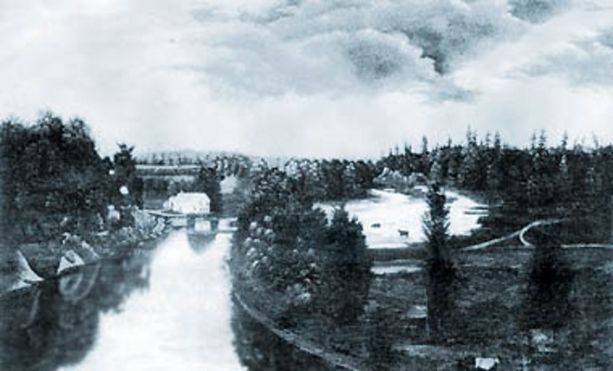
Share
The Lord commands Latter-day Saints to share what they have with those in need.
The Lord wanted the Saints to prepare to purchase land when He would reveal the location of the city of Zion, or New Jerusalem.
The Lord commanded the Saints to save all the money they could in preparation for laying the foundation of that city.
D&C 48:4-6

Slide 13
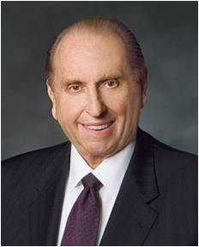




Story
“We undertook a project to save nickels and dimes for what was to be a gigantic Christmas party.
Sister Gertsch kept a careful record of our progress.
As boys with typical appetites we converted in our minds the monetary totals to cakes, cookies, pies, and ice cream. This was to be a glorious event. Never before had any of our teachers even suggested a social event like this was to be.
“The summer months faded into autumn. Autumn turned to winter. Our party goal had been achieved. The class had grown. A good spirit prevailed.
President Thomas S. Monson

Slide 14
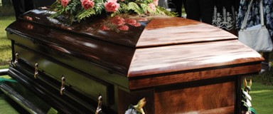
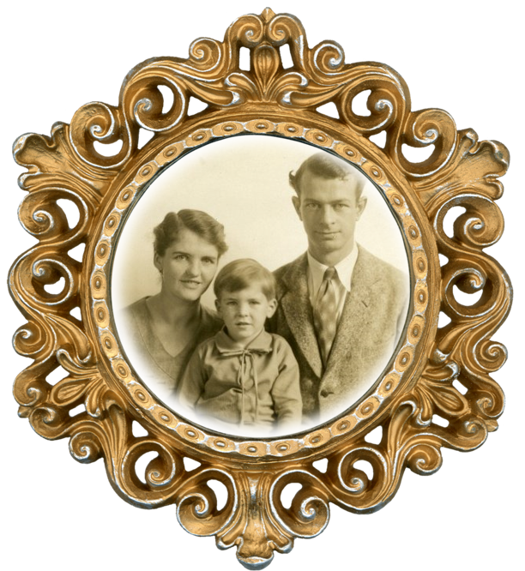
“None of us will forget that gray morning when our beloved teacher announced to us that the mother of one of our classmates had passed away. We thought of our own mothers and how much they meant to us. We felt sincere sorrow for Billy Devenport in his great loss.
“The lesson this Sunday was from the book of Acts, chapter 20, verse 35: ‘Remember the words of the Lord Jesus, how he said, It is more blessed to give than to receive.’ At the conclusion of the presentation of a well-prepared lesson, Lucy Gertsch commented on the economic situation of Billy’s family. These were Depression times, and money was scarce.
President Thomas S. Monson

Slide 15



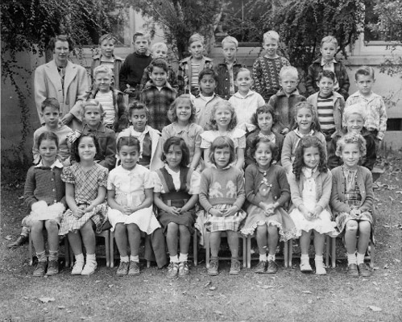
“With a twinkle in her eyes, she asked: ‘How would you like to follow this teaching of our Lord? How would you feel about taking our party fund and, as a class, giving it to the Devenports as an expression of our love?’
The decision was unanimous. We counted so carefully each penny and placed the total sum in a large envelope. A beautiful card was purchased and inscribed with our names.
This simple act of kindness welded us together as one”
President Thomas S. Monson

Slide 16

Sources:
Video:
Turning Hearts (3:05)
Humanitarian Efforts Review—Bishop Burton (2:51)
Joseph Smith History of the Church Vol. 1 p. 1
(in History of the Church, 2:198–99). (See also Doctrine and Covenants Student Manual, 2nd ed. [Church Educational System manual, 2001], 103.)
Elder Marlin K. Jensen of the Seventy, who served as Church Historian from 2005 to 2012: (“There Shall Be a Record Kept among You,” Ensign, Dec. 2007, 31).
Presentation by ©http://fashionsbylynda.com/blog/
Doctrine and Covenant Student Manual Religion 324-325 Section 47
Hyrum M. Smith and Janne M. Sjodahl Doctrine and Covenants Commentary pg. 279
Wilford Woodruff, History of His Life and Labors p. 477
Otten and Caldwell Sacred Truths of the Doctrine & Covenants Vol. 1 pg. 227-233
President Thomas S. Monson (“Your Personal Influence,” Ensign or Liahona, May 2004, 21–22).
Mrs McNutt's second grade class, Livermore Elementary School, 1948-1949
Presentation by ©http://fashionsbylynda.com/blog/

Slide 17
2012 Church Historian and Recorder Called:
The First Presidency of The Church of Jesus Christ of Latter-day Saints recently announced the call of Elder Steven E. Snow of the Presidency of the Seventy as Church Historian and Recorder, a role previously filled by Elder Marlin K. Jensen of the Seventy.
Elder Snow will be released from the Presidency of the Seventy, while Elder Jensen will be released from the First Quorum of the Seventy and given emeritus status at the October 2012 general conference.
Until then, Elder Snow and Elder Jensen will work together for training and transition purposes.
Born on May 18, 1942, in Ogden, Utah, Elder Jensen was named a member of the First Quorum of the Seventy on April 1, 1989. He was sustained as Church Historian and Recorder in April 2005. The letter from the Brethren notes that Elder Jensen “has served with excellence and distinction in [his] assignments.”
Elder Snow was called to serve as a member of the First Quorum of the Seventy in March 2001 and has been a member of the Presidency of the Seventy since August 2007. He currently has supervisory responsibility for the Utah Areas. Church News 11 January 2012
Award:
“Richard E. Turley Jr., the assistant Church historian and recorder of The Church of Jesus Christ of Latter-day Saints, has guided the Church’s significant history operations, including archives, museums, 25 historic sites and a vast records management system. "His actions stand as a beacon to others,” noted Carroll Van West, the 2013 Feis Award committee chair and director of the Center for Historic Preservation at Middle Tennessee State University.
Turley said, “This award recognizes the work of many thousands of employees, missionaries, and volunteers over recent decades to make Church history and family history information available to millions of people around the globe.”
The Herbert Feis Award, established in 1984, is named in memory of Herbert Feis (1893-1972), public servant and historian of recent American foreign policy, with an initial endowment from the Rockefeller Foundation. Initially awarded for books produced by historians working outside of academe, the scope of the award was changed in 2006 to emphasize significant contributions in the field of public history.
The American Historical Association is a nonprofit membership organization founded in 1884 and incorporated by Congress in 1889 for the promotion of historical studies. The AHA provides leadership for the discipline, protects academic freedom, develops professional standards, aids in the pursuit and publication of scholarship, and supplies various services to sustain and enhance the work of its members. As the largest organization of historians in the United States, the AHA is comprised of over 14,000 members and serves historians representing every historical period and geographical area.
Turley was selected by a prize review committee of AHA members including Carroll Van West, chair (Middle Tennessee State University); James R. Akerman (Newberry Library, Chicago, Illinois); Redmond J. Barnett (Washington State Historical Society); James F. Brooks (School for Advanced Research, Santa Fe, New Mexico); and Patricia A. Schechter (Portland State University).
Mormon Newsroom
2008: Today’s announcement follows on the heels of the creation of The Church Historian’s Press just two weeks ago. The new imprint will publish works related to the Church’s origin and growth, such as The Joseph Smith Papers, a documentary series that will eventually comprise 25–30 volumes.
The construction of the 230,000-square-foot Church History Library in downtown Salt Lake City is further evidence of the Church’s desire to make its history available to scholars and the public. The new library, to be completed in the spring of 2009, will include a collection of 270,000 books, pamphlets and magazines, as well as 240,000 original unpublished records.

Slide 18
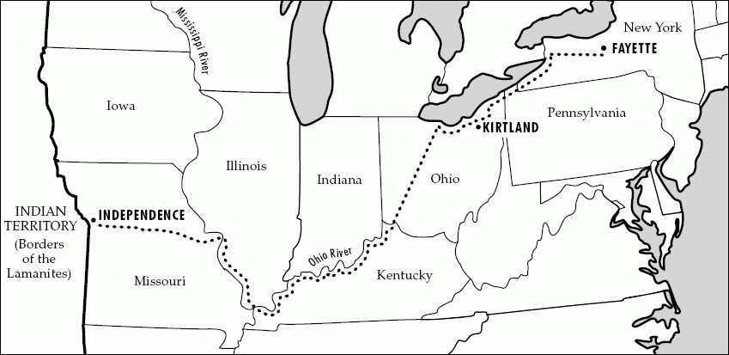
Church History Library:
15 E North Temple St, Salt Lake City, UT 84150
This new building opened to the public on June 22, 2009.
The LDS Church History Library preserves materials related to its history, from the 1820s in upstate New York, to the current day with more than 14 million members around the world. Since 1972, these historical collections have been stored in the LDS Church Office Building in Salt Lake City, but that facility closed in April 2009 to prepare for the move to the Church History Library.
The historical materials of the LDS Church contain rich information about both Mormon history and the development of the western United States. These collections include:
270,000 books, pamphlets, magazines, manuals
500,000 historic photographs, posters, maps
23,000 audio and video recordings
120,000 local histories for LDS Church units
150,000 journals, diaries, papers, and manuscripts
20,000 rolls of microfilm
3.5 million patriarchal blessings for LDS Church members
Wikipedia
Purpose and value of records:
The devil has sought to take away my life form the day I was born until now, more so even than the lives of other men. I seem to be ma marked victim of the adversary. I can find but one reason for this: the devil knew if I got into the Church of Jesus Christ of latter-day Saints, I would write the history of that Church and leave on record the works and teachings of the prophets, of the apostles and elders. I have recorded nearly all the sermons and teachings that I ever heard for the Prophet Joseph, I have in my journal many of the sermons of President Brigham young, and such men as Orson Hyde, Parley P. Pratt and others. Another reason I was moved upon to write in the early days was that nearly all the historians appointed in those time apostatized and took the journals away with them.
Wilford Woodruff, History of His Life and Labors p. 477

