Slide 1

Doctrine and Covenants 49
Marriage Between Man and Woman
Nevertheless neither is the man without the woman, neither the woman without the man, in the Lord.
Corinthians 11:11
Presentation by ©http://fashionsbylynda.com/blog/

Slide 2

The Monkey Trap
Put a ball or fruit in a box with a hole just big enough for its hand
When the monkey grasps the object, it is unable to remove its fist because it is grasping an object too large to fit through the hole.
In their determination to hold on to the object, some monkeys will allow themselves to be caught.
What things are we determined to hold on to?

Slide 3

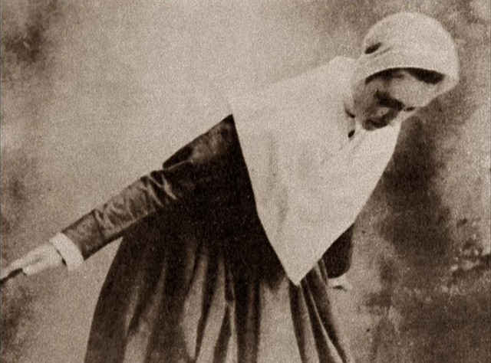
The Truth But Not All
The Holy Bible
The
Book
of
Mormon
Frequently people want to accept a part of the gospel, but not all of it.
ANOTHER TESTAMENT
OF JESUS CHRIST
Some are willing to accept Sabbath day meetings but reject tithing.
Others will obey the Word of Wisdom yet condone unchastity.
When the message of the Restoration was presented to the Shakers, they accepted that which was compatible with their beliefs and rejected that which was not.
D&C 49:2

Slide 4
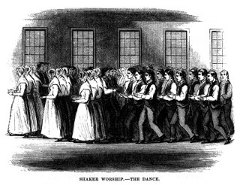
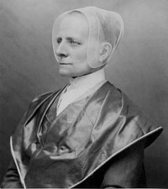
Background-Shaking Quakers
Formerly members of the Society of Friends (Quakers), they were called Shaking Quakers or Shakers
Their dress and manners resembled in certain respects those of Quakers, and their manner of worship included shaking and physical contortions.
Founder: Ann Lee in 1700’s in England and moved to America with followers in 1800

Slide 5
Leman Copley
He was born in 1781 in Connecticut
He was a member of the Shakers (the United Society of Believers in Christ’s Second Coming)
He was converted to the Church in 1831
He went with Sidney Rigdon and parley P. Pratt to preach the Gospel to the Shakers in North Union, Ohio
The Shakers rejected the message
He dishonored his pledge to assist those gathering to Ohio from the East
Leman eventually left the church and took upon another religion (Church of Christ)
He died a wealthy landowner in Madison, Ohio in December 1862
Who’s Who

Slide 6
Shakers VS The Lord’s Doctrine
1. Christ’s Second Coming had already occurred.
D&C 49:5-8
No one except God knows when the Second Coming will occur.
2. Christ had appeared in the form of a woman named Ann Lee.
D&C 49:22–25
If we know the signs of the Second Coming, we will not be deceived by false claims.
3. Baptism by water was not considered essential.
D&C 49:11-14
Jesus Christ has commanded His servants to call upon people to believe in Him, repent, be baptized, and receive the gift of the Holy Ghost.
4. They rejected marriage and believed in living a life of total celibacy (abstaining from marriage and sexual relations)
D&C 49:15-17
Marriage between a man and a woman is ordained of God, and husbands and wives are commanded to be one and to have children
5. Some Shakers forbade the eating of meat.
D&C 49:18-21
The Lord has provided the animals of the earth for our use.

Slide 7

Why was the Earth Created?
Simply summarized, the earth was created that families might be.
Russell M. Nelson

Slide 8
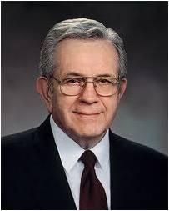




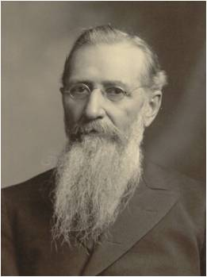
Animals are provided “for the use of man”
“Young people, learn to use moderation and common sense in matters of health and nutrition, and particularly in medication. Avoid being extreme or fanatical or becoming a faddist.
“For example, the Word of Wisdom counsels us to eat meat sparingly (see D&C 89:12). Lest someone become extreme, we are told in another revelation that ‘whoso forbiddeth to [eat meat] is not ordained of God’ (D&C 49:18)”
President Boyd K. Packer
“I do not believe any man should kill animals or birds unless he needs them for food, and then he should not kill innocent little birds that are not intended for food for man. I think it is wicked for men to thirst in their souls to kill almost everything which possesses animal life.
It is wrong, and I have been surprised at prominent men whom I have seen whose very souls seemed to be athirst for the shedding of animal blood.’”
President Joseph F. Smith

Slide 9
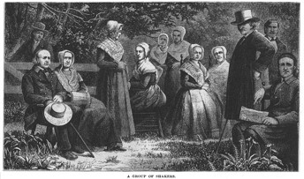
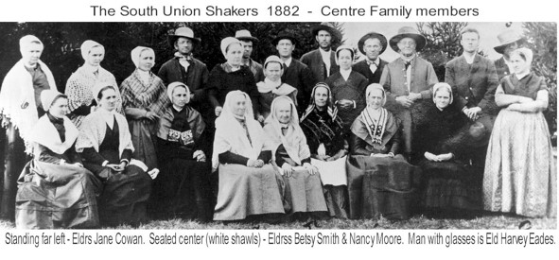
Sidney, Parley, and Leman
The three missionaries arrived at North Union on a Saturday evening and were allowed to give to the group a long discussion of the gospel. They spent the night, and the next morning they spoke in the regular Sunday meeting. Sidney Rigdon read the revelation to them as a part of his comments, and it was instantly rejected by the leader of the group, Ashbel Kitchell. The rest of the group agreed with Kitchell, and the missionaries withdrew.
Student Manual
The Shakers and Leman Copley did not follow the Lord’s counsel.
The Shakers rejected the missionaries’ message, and Leman Copley returned to his former beliefs and left the Church.

Slide 10
Doctrinal Mastery
And again, verily I say unto you, that whoso forbiddeth to marry is not ordained of God, for marriage is ordained of God unto man.
Wherefore, it is lawful that he should have one wife, and they twain shall be one flesh, and all this that the earth might answer the end of its creation;
And that it might be filled with the measure of man, according to his creation before the world was made.
D&C 49:15-17

Slide 11

What are some worldly beliefs that cause people to reject marriage in our day?
What evidence have you seen of Satan trying to alter or destroy the sacredness of marriage and family in Heavenly Father’s plan?

Slide 12
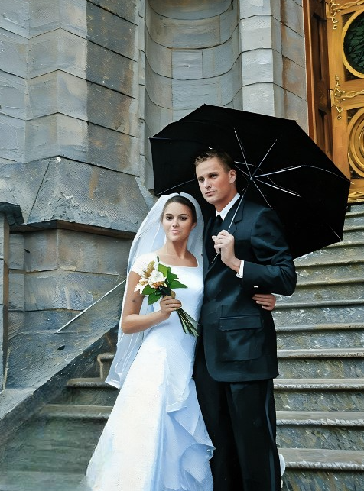
Marriage Between Man and Woman
But from the beginning of the creation God made them male and female.
For this cause shall a man leave his father and mother, and cleave to his wife;
And they twain shall be one flesh: so then they are no more twain, but one flesh.
What therefore God hath joined together, let not man put asunder.
Mark 10:6-9
Nevertheless neither is the man without the woman, neither the woman without the man, in the Lord.
Corinthians 11:11
D&C 49:15-17

Slide 13
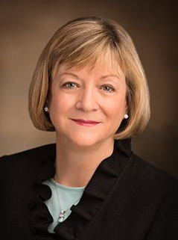
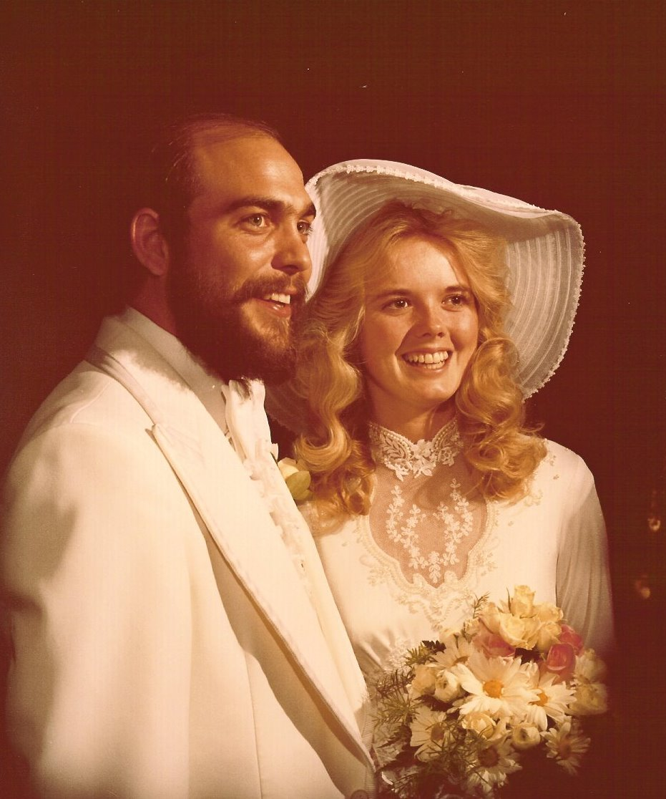
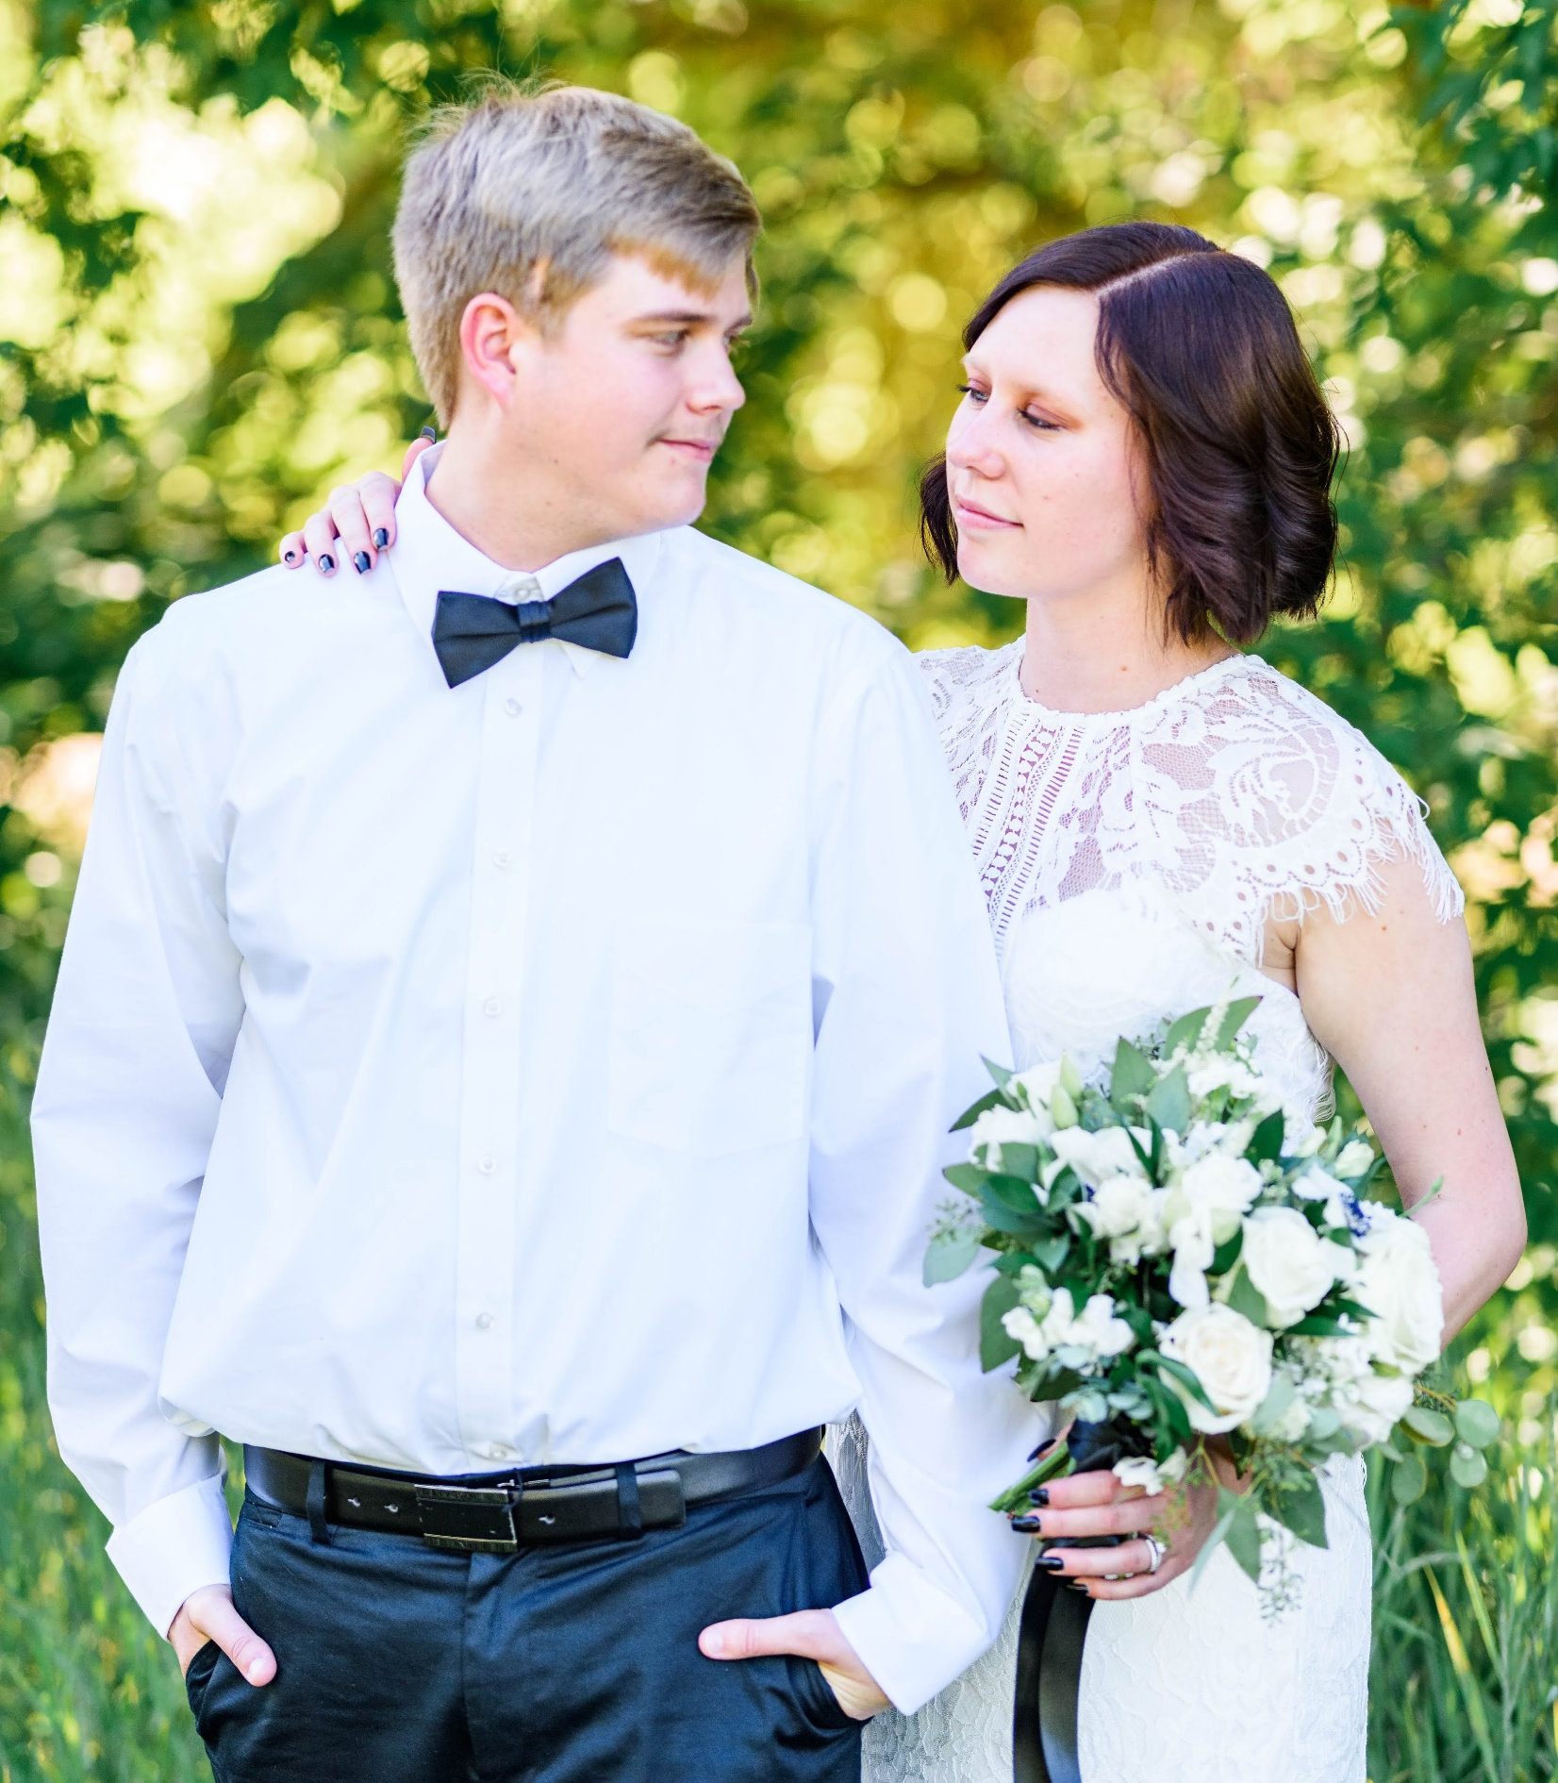
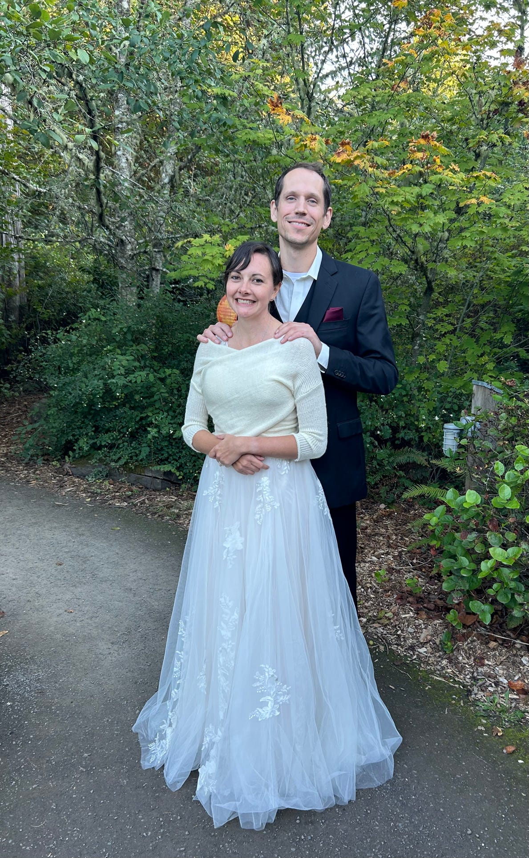
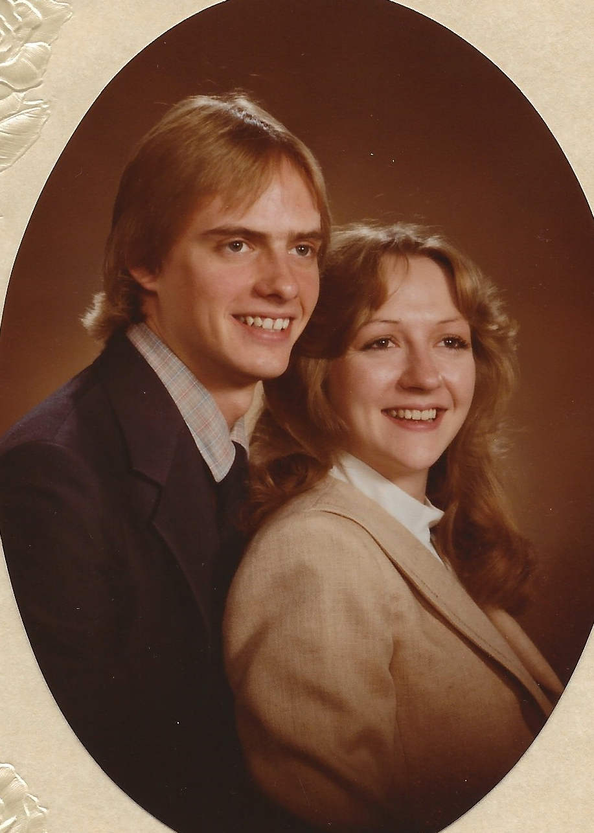
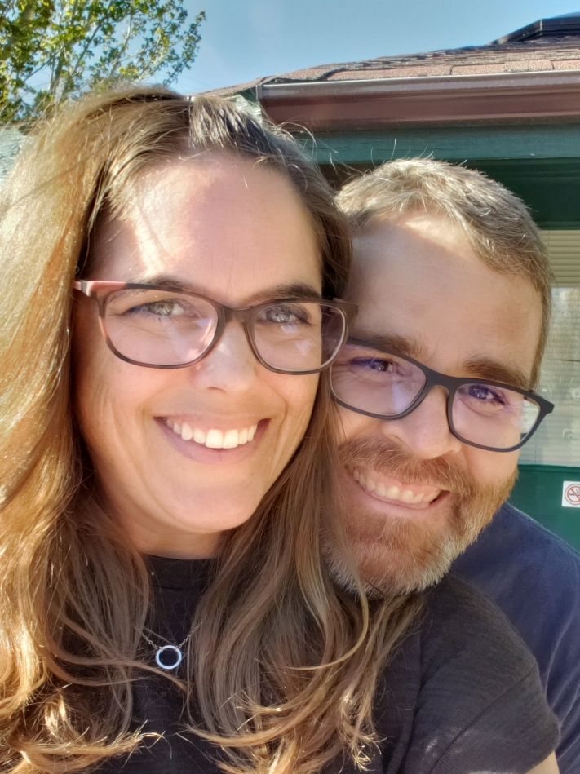
We are taught in the scriptures, “Nevertheless neither is the man without the woman, neither the woman without the man, in the Lord”.
For anyone to attain the fulness of priesthood blessings, there must be a husband and a wife sealed in the house of the Lord, working together in righteousness and remaining faithful to their covenants.
This is the Lord’s plan for His children, and no amount of public discourse or criticism will change what the Lord has declared. …
Let us be defenders of marriage as the Lord has ordained it while continuing to show love and compassion for those with differing views.
Bonnie L. Oscarson
D&C 49:15-17; 1 Corinthians 11:11

Slide 14
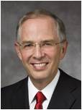
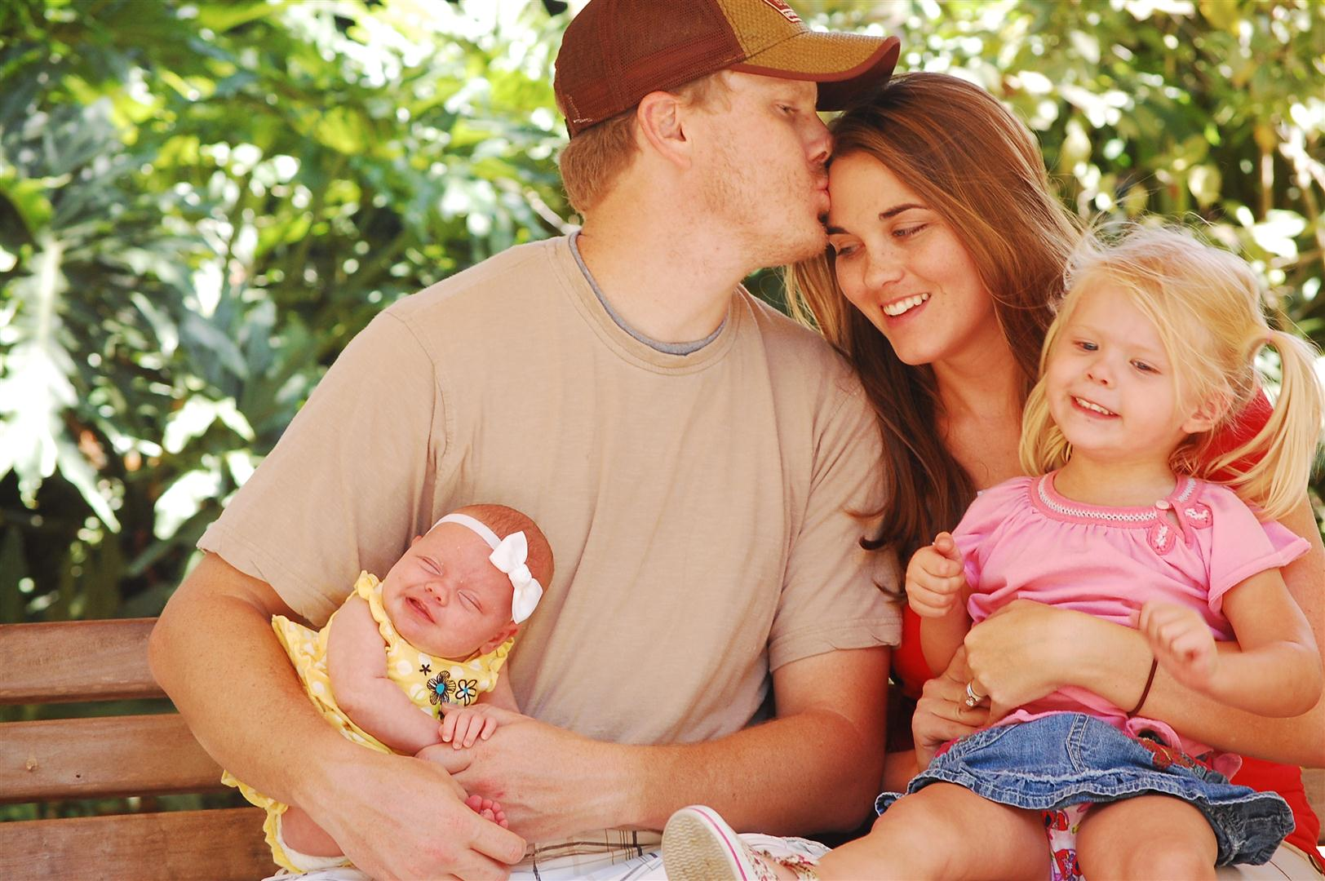

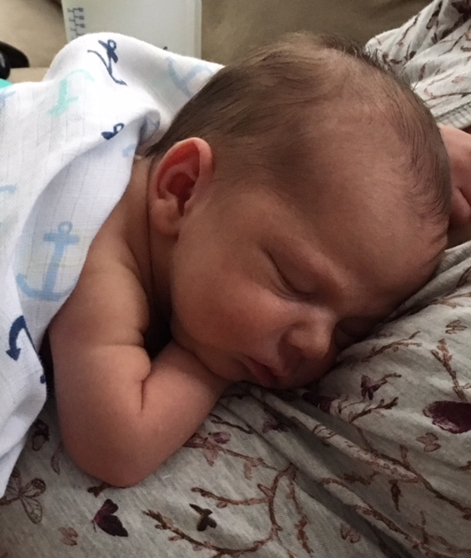
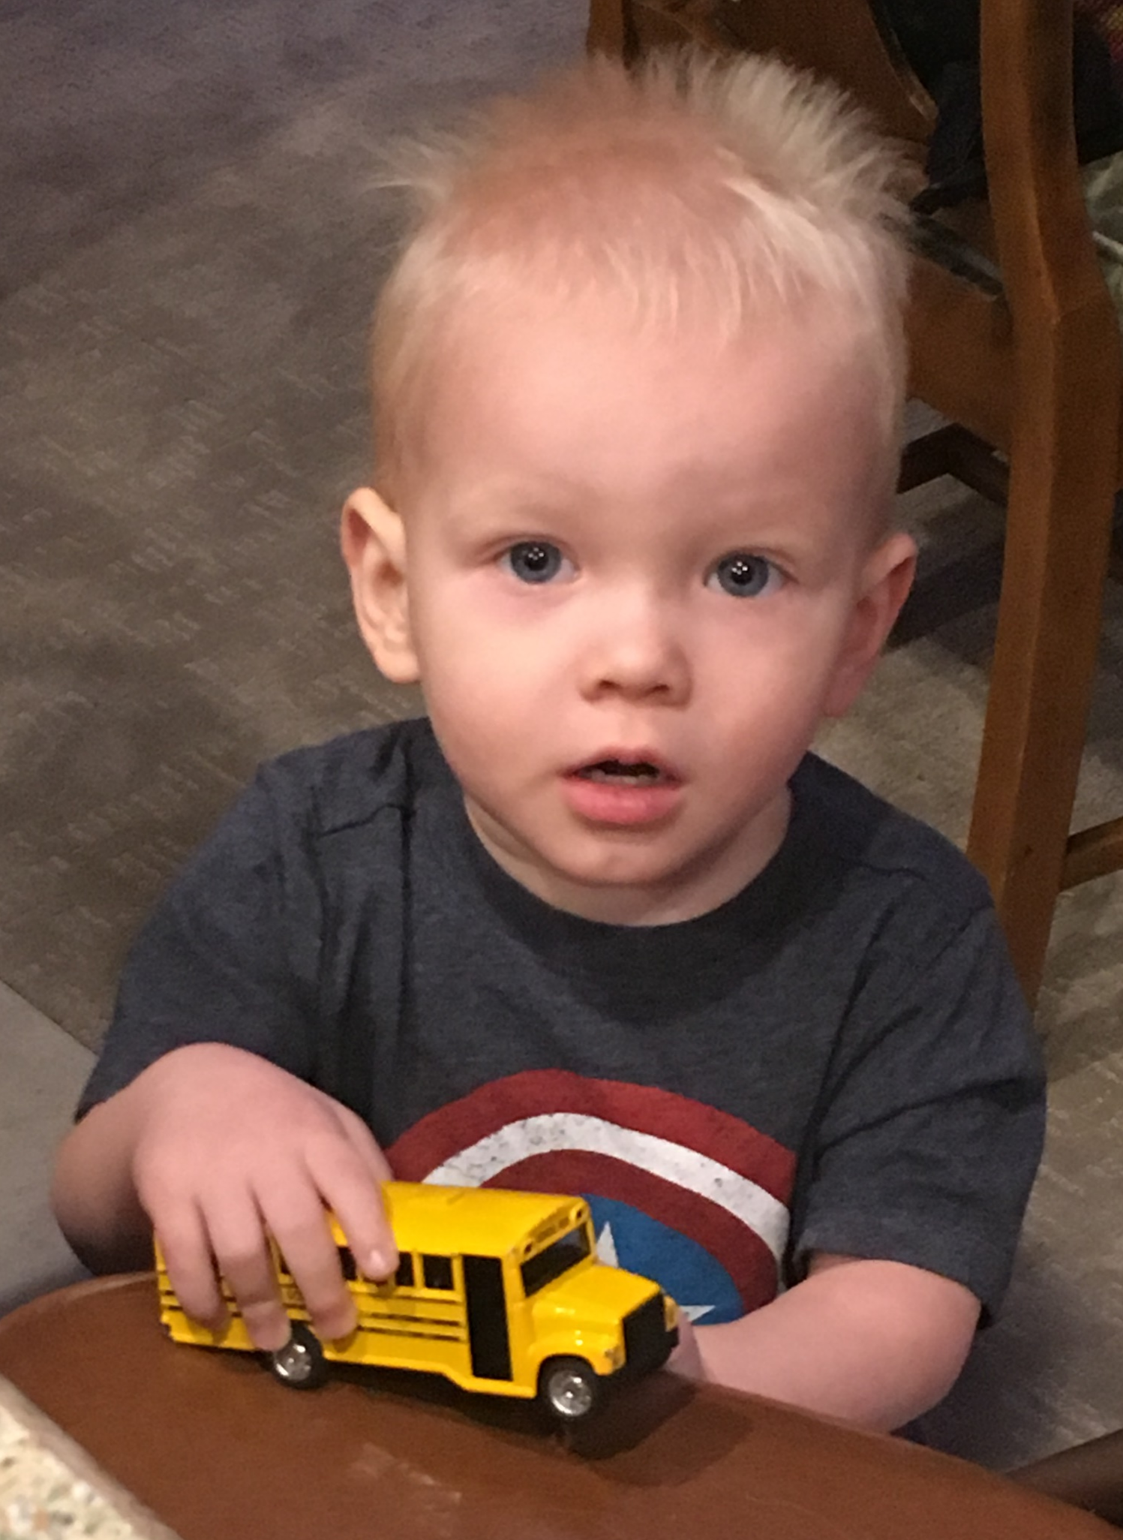
Multiply and Replenish the Earth
So God created man in his own image, in the image of God created he him; male and female created he them.
And God blessed them, and God said unto them, Be fruitful, and multiply, and replenish the earth, and subdue it: and have dominion over the fish of the sea, and over the fowl of the air, and over every living thing that moveth upon the earth.
Genisis 1:27-28
When a child is born to a husband and wife, they are fulfilling part of our Heavenly Father’s plan to bring children to earth.
The Lord said, “This is my work and my glory—to bring to pass the immortality and eternal life of man”.
Before immortality, there must be mortality.
Neil L. Andersen
Lo, children are an heritage of the Lord: and the fruit of the womb is his reward.
Psalm 127:3
D&C 49:15-17; Moses 1:39

Slide 15
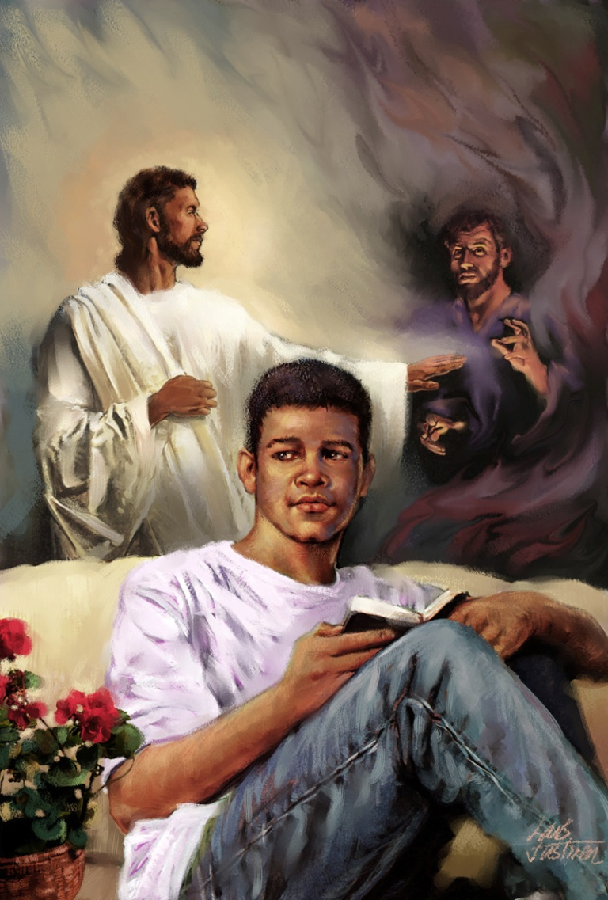
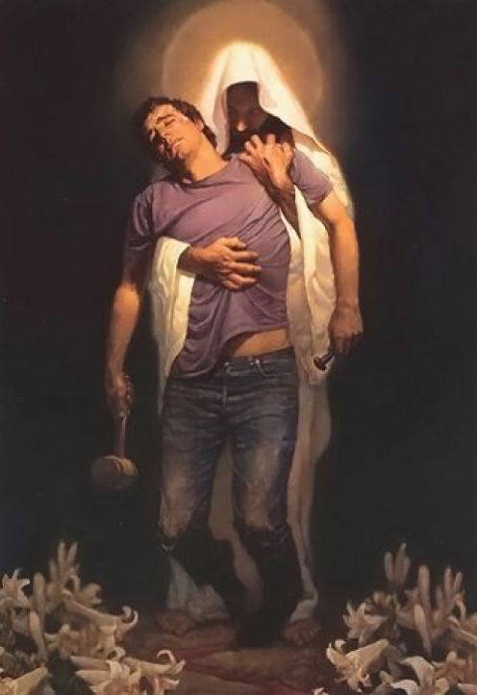
Rearward
Someone who protects someone else from behind
D&C 49:27

Slide 16
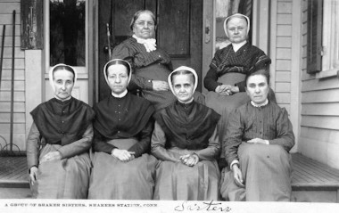
Sources:
Videos:
Man and Woman (0:56)
Deseret Dairy (3:45)
Selective Obedience (1:09)
Satan Seeks to Deceive Us (1:23)
Who’s Who in the Doctrine and Covenants by Ed J. Pinegar and Richard J. Allen pg.16
Doctrine and Covenants Student Manual Religion 324-325 Section 49
President Boyd K. Packer (“The Word of Wisdom: The Principle and the Promises,” Ensign, May 1996, 18).
President Joseph F. Smith said(In Conference Report, Oct. 1978, p. 64; or Ensign, Nov. 1978, p. 45.)
Presentation by ©http://fashionsbylynda.com/blog/
Russell M. Nelson, “The Creation,” Ensign, May 2000, 85
More about the Shakers: https://www.learnreligions.com/the-shakers-4693219
Bonnie L. Oscarson, “Defenders of the Family Proclamation,” Ensign or Liahona, May 2015, 15
Neil L. Andersen, “Children,” Ensign or Liahona, Nov. 2011, 28)
Presentation by ©http://fashionsbylynda.com/blog/

Slide 17
D&C 49:2
Desiring “to know the truth in part”
Elder Glenn L. Pace of the Seventy spoke of the danger of partial obedience to prophetic counsel:
“There are some of our members who practice selective obedience. A prophet is not one who displays a smorgasbord of truth from which we are free to pick and choose. However, some members become critical and suggest the prophet should change the menu. A prophet doesn’t take a poll to see which way the wind of public opinion is blowing. He reveals the will of the Lord to us. The world is full of deteriorating churches who have succumbed to public opinion and have become more dedicated to tickling the ears of their members than obeying the laws of God.
“In 1831, some converts wanted to bring a few of their previous beliefs into the Church with them. Our problem today is with members who seem very vulnerable to the trends in society (and the pointing fingers which attend them) and want the Church to change its position to accommodate them. The doctrinal grass on the other side of the fence looks very green to them.
“The Lord’s counsel in 1831 is relevant today: ‘Behold, I say unto you, that they desire to know the truth in part, but not all, for they are not right before me and must needs repent.’ (D&C 49:2.)
“We need to accept the full truth—even all of it—‘put on the whole armour of God’ (Eph. 6:11), and get to work building up the kingdom. Each of us might ask ourselves, ‘Am I a positive contributor to building up the kingdom in our day of this dispensation of the fulness of times?’” (“Follow the Prophet,” Ensign, May 1989, 26–27).
People’s choices: President Gordon B. Hinckley taught:
“People inquire about our position on those who consider themselves so-called gays and lesbians. My response is that we love them as sons and daughters of God. They may have certain inclinations which are powerful and which may be difficult to control. Most people have inclinations of one kind or another at various times. If they do not act upon these inclinations, then they can go forward as do all other members of the Church. If they violate the law of chastity and the moral standards of the Church, then they are subject to the discipline of the Church, just as others are” (“What Are People Asking about Us?” Ensign, Nov. 1998, 71).
D&C 49:7
Marriage:
President Gordon B. Hinckley extolled marriage between a man and a woman in the following statement:
“How wonderful a thing is marriage under the plan of our Eternal Father, a plan provided in His divine wisdom for the happiness and security of His children and the continuity of the race. …
“President Joseph F. Smith once declared ‘that no man can be saved and exalted in the kingdom of God without the woman, and no woman can reach perfection and exaltation in the kingdom of God, alone. … God instituted marriage in the beginning. He made man in His own image and likeness, male and female, and in their creation it was designed that they should be united together in sacred bonds of marriage, and one is not perfect without the other.’ (In Conference Report, April 1913, p. 118.)
“Surely no one reading the scriptures, both ancient and modern, can doubt the divine concept of marriage. The sweetest feelings of life, the most generous and satisfying impulses of the human heart, find expression in a marriage that stands pure and unsullied above the evil of the world.
“Such a marriage, I believe, is the desire—the hoped-for, the longed-for, the prayed-for desire—of men and women everywhere” (“What God Hath Joined Together,” Ensign, May 1991, 71).
The following statement, The Church of Jesus Christ of Latter-day Saints does not condone same-sex marriage:
“The Church has a single, undeviating standard of sexual morality: intimate relations are proper only between a husband and a wife united in the bonds of matrimony.
“The Church’s opposition to same-sex marriage neither constitutes nor condones any kind of hostility towards homosexual men and women. Protecting marriage between a man and a woman does not affect Church members’ Christian obligations of love, kindness and humanity toward all people. … We can express genuine love and friendship for a homosexual family member or friend without accepting the practice of homosexuality or any re-definition of marriage” (“The Divine Institution of Marriage,” mormonnewsroom.org).
Partnership:
The restored gospel of Jesus Christ proclaims the principle of full partnership between woman and man, both in mortal life and in the eternities. Although each possesses specific attributes and divinely appointed responsibilities, woman and man fill equally relevant and essential roles in God’s plan of happiness for His children. …
… There is no superiority or inferiority in the marriage relationship, and neither walks ahead of or behind the other. They walk side by side, as equals, the divine offspring of God. They become one in thought, desire, and purpose with our Heavenly Father and Jesus Christ, leading and guiding the family unit together. (Ulisses Soares, “In Partnership with the Lord,” Liahona, Nov. 2022, 42)

Slide 18
Ann Lee was born in Manchester, England, and baptized privately at Manchester Cathedral on 1 June 1742,[ aged 6. Her parents were members of a distinct branch of the Society of Friends, and too poor to afford their children even the rudiments of education. Ann Lee's father, John Lees, was a blacksmith during the day and a tailor at night. It is probable that Ann Lee's original surname was Lees, but somewhere through time it changed to Lee. Little is known about her mother other than she was a very religious woman. When Ann was young she worked in a cotton factory, then she worked as a cutter of hatter's fur, and later as a cook in a Manchester infirmary.
In 1758 she joined the Wardley's, an English sect founded by Jane and preacher James Wardley; this was the precursor to the Shaker sect. She believed in and taught her followers that it is possible to attain perfect holiness by giving up sexual relations. Like her predecessors, the Wardleys, she taught that the shaking and trembling were caused by sin being purged from the body by the power of the Holy Spirit, purifying the worshiper.
Beginning during her youth, Ann Lee was uncomfortable with sexuality, especially her own. This repulsion towards sexual activity continued and manifested itself most poignantly in her repeated attempts to avoid marriage and remain single. Eventually her father forced her to marry Abraham Stanley. They were married at Manchester Cathedral on 5 January 1761.[She became pregnant four times, all of her children died during infancy. Her difficult pregnancies and the loss of four children were traumatic experiences that contributed to Ann Lee’s dislike of sexual relations. Lee developed radical religious convictions that advocated celibacy and the abandonment of marriage, as well as the importance of pursuing perfection in every facet of life. She differed from the Quakers, who, though they supported gender equality, did not accept forbidding sexuality within marriage.
Wikipedia More about the Shakers: https://www.learnreligions.com/the-shakers-4693219
In England, Ann Lee rose to prominence by urging other believers to preach more publicly concerning the imminent second coming, and to attack sin more boldly and unconventionally. She spoke of visions and messages from God, claiming that she had received a vision from God the message that celibacy and confession of sin are the only true road to salvation and the only way in which the Kingdom of God could be established on the earth. She was frequently imprisoned for breaking the Sabbath by dancing and shouting, and for blasphemy.
Lee often was characterized as a virago (a woman with masculine, domineering attributes), possibly because most English and Americans could not accept her ideals of gender equality, or possibly because she was extraordinarily outspoken.
She claimed to have had many miraculous escapes from death. She told of being examined by four clergymen of the Established Church, claiming that she spoke to them for four hours in 72 tongues.
While in prison in Manchester for 14 days, she said she had a revelation that "a complete cross against the lusts of generation, added to a full and explicit confession, before witnesses, of all the sins committed under its influence, was the only possible remedy and means of salvation." After this, probably in 1770, she was chosen by the Society as "Mother in spiritual things" and called herself "Ann, the Word" and also "Mother Ann." After being released from prison a second time, witnesses say Mother Ann performed a number of miracles, including healing the sick.
Lee eventually decided to leave England for America in order to escape the persecution (i.e. multiple arrests and stays in prison) she experienced in Great Britain.
Ann Lee in America:
In 1774 a revelation led her to take a select band to America. She was accompanied by her husband, who soon afterwards deserted her. Also following her to America were her brother, William Lee (1740–1784); Nancy Lee, her niece; James Whittaker (1751–1787), who had been brought up by Mother Ann and was probably related to her; John Hocknell (1723–1799), who provided the funds for the trip; his son, Richard; James Shepherd, and Mary Partington. Mother Ann and her converts arrived on 6 August 1774, in New York City, where they stayed for nearly five years. In 1779 Hocknell leased land at Niskayuna, in the township of Watervliet, near Albany, and the Shakers settled there, where a unique community life began to develop and thrive.
During the American Revolution, Lee and her followers maintained a stance of neutrality. Maintaining the position that they were pacifists, Ann Lee and her followers did not side with either the British or the colonists.
Ann Lee opened her testimony to the world's people on the famous Dark Day in May 1780, when the sun disappeared and it was so dark that candles had to be lighted to see indoors at noon. She soon recruited a number of followers who had joined the New Light revival at New Lebanon, New York, in 1779, including Lucy Wright.
Beginning in the spring of 1781 Mother Ann and some of her followers went on an extensive missionary journey to find converts in Massachusetts and Connecticut. They often stayed in the homes of local sympathizers, such as the Benjamin Osborn House near the New York - Massachusetts line. There were also songs attributed to her which were sung without words.
The followers of Mother Ann came to believe that she embodied all the perfections of God in female form, and was revealed as the "second coming" of Christ. The fact that Ann Lee was considered to be Christ’s female counterpart was unique. She preached that sinfulness could be avoided by not only treating men and women equally, but also by keeping them separated so as to prevent any sort of temptation leading to impure acts. Celibacy and confession of sin were essential for salvation.
Ann Lee's mission throughout New England was especially successful in converting groups who were already outside the mainstream of New England Protestantism, including followers of Shadrack Ireland. To the mainstream, however, she was too radical for comfort. Ann Lee herself recognized how revolutionary her ideas were when she said, "We [the Shakers] are the people who turned the world upside down."
Unfortunately, the Shakers were sometimes met by violent mobs, such as in Shirley, Massachusetts, and Ann Lee suffered violence at their hands more than once. Because of these hardships Mother Ann became quite frail; she died on 8 September 1784, at the age of 48.

Slide 19
Beliefs of the Shakers:
“1. The Deity is dual in nature. God is both male and female. The male principle of Christ came to earth as Jesus, the son of a Jewish carpenter. The female principle is represented in ‘Mother Ann’ [Ann Lee, founder of the Shakers], and in her the promise of our Lord’s Second Advent was fulfilled. Incidentally, the Shakers believe that even angels and spirits are both male and female.
“2. Celibacy. This must be qualified by saying that they neither condemn nor oppose marriage, but they assert the possibility of attaining a higher or angelic order of existence to which virginity is a prime requisite.
“3. Open confession of sins.
“4. Community of possessions.
“5. Separation from the world. Ostentation, luxury, and private property are regarded as sinful and unchristian.
“6. Pacifism.
“7. Equality of the sexes.
“8. Consecrated work.
“9. Continuous revelation.
“10. External ordinances, ‘especially baptism and the Lord’s supper, ceased in the apostolic age.’ (Burder, History of All Religions, p. 502.)
“11. Christ’s kingdom upon the earth began with the establishment of the Shaker Church. From the days of the Apostles the Lord had sent no one to preach until the Shakers were raised up to call in the elect in a new dispensation.
“12. The doctrines of the Trinity, vicarious atonement, and resurrection of the body are untrue.
“13. Disease is a sin against God.
“14. Abstinence from meat (in some groups, at least).” (Sperry, Compendium, pp. 204–6.)
The Shakers thrived as a church until about the beginning of the twentieth century. Since then their numbers have steadily declined until today only one active community is left, at Sabbath day Lake, Maine.

