Slide 1
Doctrine and Covenants 50
Avoiding Deception
Presentation by ©http://fashionsbylynda.com/blog/

Slide 2
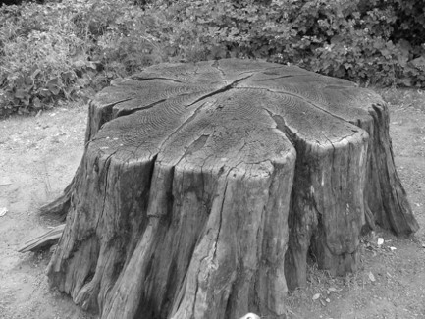
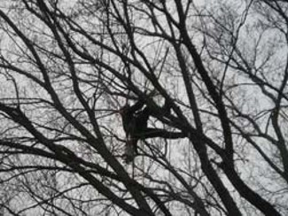
Background Counterfeit Revelations
Soon after the Gospel was established in Kirtland, and during the absence of the authorities of the Church, many false spirits were introduced, many strange visions were seen, and wild, enthusiastic notions were entertained:
Men ran out of doors under the influence of this spirit, and some of them got upon the stumps of trees and shouted, and all kinds of extravagances were entered into by them;
May 1831
One man pursued a ball that he said he saw flying in the air, until he came to a precipice, when he jumped into the top of a tree, which saved his life;
And many ridiculous things were entered into, calculated to bring disgrace upon the Church of God, to cause the Spirit of God to be withdrawn, and to uproot and destroy those glorious principles which had been developed for the salvation of the human family.”
HC

Slide 3
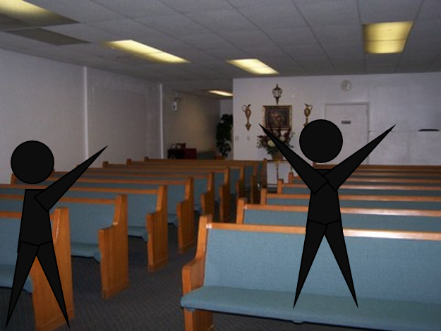
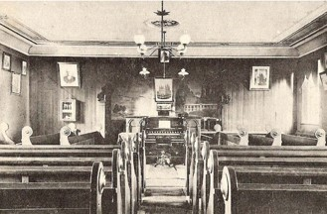
Unusual Sacrament Meetings
Imagine some adult Church members are standing on benches and speaking loudly, while others are rolling around on the floor.
How would you feel?
What do you think would happen to the Spirit under such circumstances?

Slide 4
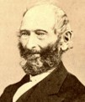
John Whitmer Recorded:
Some had visions and could not tell what they saw, some would fancy to themselves that they had the sword of Laban, and would wield it [like a soldier on horseback], some would act like an Indian in the act of scalping, some would slide or scoot … [on] the floor, with the rapidity of a serpent. …
Thus the devil blinded the eyes of some good and honest disciples.
Concerns about these actions led Joseph Smith to inquire of the Lord and receive Doctrine and Covenants 50.
John Whitmer, History, 1831–circa 1847, 26, josephsmithpapers.org

Slide 5
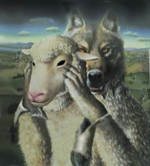
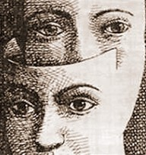
False Spirits
“The devil has great power to deceive; he will so transform things as to make one gape at those who are doing the will of God.”
Joseph Smith
Latter-day Saints must observe the Lord’s counsel in order to escape Satan’s deceptions:
D&C 50:2-9

Slide 6
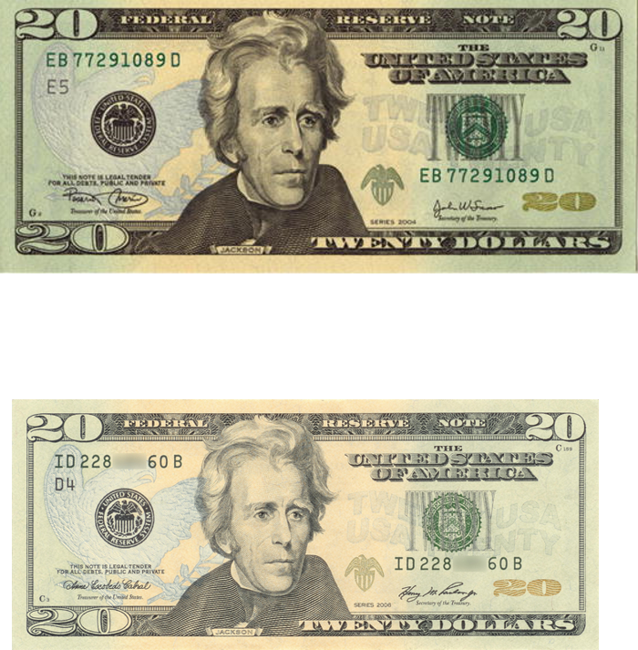
Counterfeit
If you were given the job of picking out such false money, how would you go about it?
By memorizing every kind of counterfeit?
No. Your time would be better spent if you studied real money.
After you knew what real money looked like, you could recognize a counterfeit.
Similarly, when we learn how to identify the truth, we can recognize those that are false.

Slide 7
The Source
What was the source of this influence?
Why would Satan want to deceive the Saints?
What words did the Lord use to describe some members of the Church at this time?
What is a hypocrite?
How can hypocrisy give power to the adversary?
What did the Lord say would happen to hypocrites?
Hello! That’s what he does
Deceivers Hypocrites
A person who pretends to have virtues, morals or religious beliefs possess
D&C 50:2-9

Slide 8
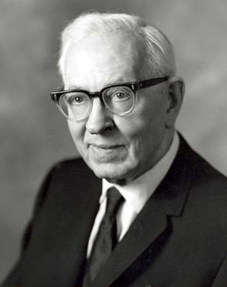
“From the time of the fall of man until now Satan and his followers who were cast out of heaven, have been deceiving men.
Today, as in the beginning, Lucifer is saying, ‘I am also a son of God … believe it or not,’ and men today believe not for the same reason that they refused to believe in the beginning. ‘Some commandments are of men,’ so the Savior informed Joseph Smith…
Some commandments are of devils, and these are also made manifest largely through the activities of men. …
These false spirits make themselves manifest in various ways and in all communities.
Some of the most startling and prevalent forms of false manifestations are in the false gifts of tongues, and in religious meetings particularly among some sects where the worshippers fall in fits, shout, sing and pray in disorderly fashion, sometimes frothing at the mouth and their bodies partaking of unnatural contortions.” President Joseph Fielding Smith
D&C 50:2-9

Slide 9
To Reason
The Lord sometimes reasons with us in the same way we reason with each other.
His purpose in reasoning with us is the same as His reason for speaking to us in our own language: He wants them to “come to understanding.”
Come now, and let us reason together, saith the Lord: though your sins be as scarlet, they shall be as white as snow; though they be red like crimson, they shall be as wool.
Isaiah 1:18
D&C 50:10-12

Slide 10
Teach and Learn By the Spirit
To be an effective Teacher
Preach in “the Spirit”
To be ordained of Him
To preach the word of truth by the Comforter
To be an effective Learner
To receive the spirit which you don’t understand
To receive the truth
Wherefore, he that preacheth and he that receiveth, understand one another, and both are edified and rejoice together.
D&C 50:13-22

Slide 11
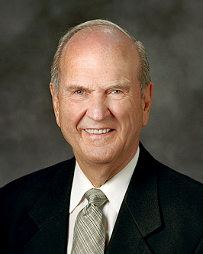
To Better Receive
“How many of you have assumed the ‘bored position’ during sacrament meeting?
You know the position: bent forward at the waist, chin resting on hands, elbows on knees, staring vacantly at the floor. Has it occurred to you that it is your choice whether the meeting is interesting or not? …
“Each member of the Church bears responsibility for the spiritual enrichment that can come from a sacrament meeting. Each should sing with a grateful heart and respond with an audible ‘amen’ at the conclusion of a prayer or a testimony.
We personally ponder the Atonement of Jesus Christ. We reflect upon the significance of His suffering at Gethsemane and His Crucifixion on Calvary.
At this time, each of us is to ‘examine himself’ (1 Cor. 11:28) and reflect upon personal covenants made with the Lord. At this time, we meditate upon the sacred things of God.”
D&C 50:19; 1 Cor. 11:28

Slide 12
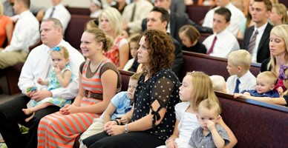
Worship
“Worship is an individual responsibility, and regardless of what is said from the pulpit, if one wishes to worship the Lord in spirit and in truth, he may do so. … If the service is a failure to you, you have failed. No one can worship for you; you must do your own waiting upon the Lord.”
President Spencer W. Kimball

Slide 13
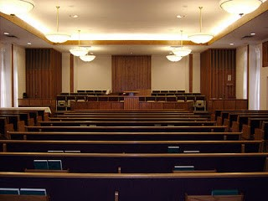
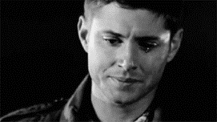
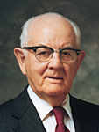
Receiving the Spirit
“One youth described how he first experienced the spirit of worship. He had been marginally active through his Aaronic Priesthood years.
When he attended sacrament meeting, he usually sat in the back with a group of his friends, and he was less than a model of reverence.
One day, however, he came in a little late, and there were no seats by his friends. He sat alone, and for the first time in his life, he closed his eyes during the prayers, he sang the hymns, he listened to the sacrament prayers, and he paid attention to the speakers.
About midway through the first speaker, he found tears welling up in his eyes. With some embarrassment, he carefully glanced around; no one else seemed emotional. He didn’t know for sure what was happening to him, but the experience changed his life. It was during that meeting that he really started his spiritual preparation for his mission. He felt something, and fortunately, he acted and thus sustained those feelings”
President Spencer W. Kimball

Slide 14
When we teach and learn by the Spirit, we understand one another and we are edified and rejoice together
D&C 50:21-22

Slide 15
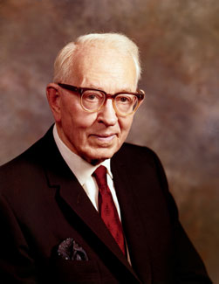
Edify
The things of God edify: they spiritually support and lift us toward a better life. They bring us closer to our Father in Heaven. The things of Satan do the opposite. No spiritual growth occurs, no intelligence is communicated, we are not edified.
That which comes from God enlightens and edifies, but that which is not of God brings confusion and darkness.
“There is no saying of greater truth than ‘that which doth not edify is not of God.’ And that which is not of God is darkness, it matters not whether it comes in the guise of religion, ethics, philosophy or revelation. No revelation from God will fail to edify.”
President Joseph Fielding Smith
D&C 50:24

Slide 16
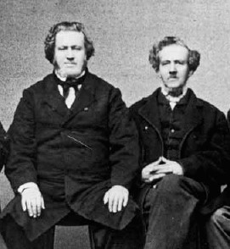
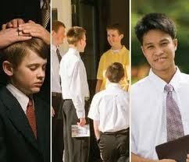
Power and Responsibility
That come with their ordination. He said that priesthood holders are to serve others and keep themselves pure.
As they do so, the Lord will give them power to overcome false spirits like those that were found among some of the Saints at the time this revelation was given.
”Wherefore, it shall come to pass, that if you behold a spirit manifested that you cannot understand, and you receive not that spirit, ye shall ask of the Father in the name of Jesus; and if he give not unto you that spirit, then you may know that it is not of God.”
D&C 50:26-36

Slide 17
Joseph Wakefield
He was born July 7, 1792, in Watertown, New York State
He was baptized around 1831 and moved to Kirtland, Ohio
He accompanied Parley P. Pratt on a mission to the Western Reserve
He was ordained a high priest on June 3, 1831, by Lyman Wight and served another mission to the eastern states (D&C 52:35)
In 1832 he baptized George A. Smith (a future apostle)
He fell into apostasy and was excommunicated in 1834
He turned his bitterness into persecution against the Prophet Joseph Smith
He was quoted that: The prophet would do the work of translation and then take breaks to play with the children. Wakefield did not believe that this was conduct of a man of god and left the church accordingly.
He died January 18, 1835
D&C 50:37
Who’s Who

Slide 18
John Corrill
He was born on September 17, 1794 in Bone, Massachusetts
He heard about the gospel from missionaries while passing through Harpersville, Ohio
He was baptized in January 1831 and became an elder
In May 1831 he was call to go forth among the churches and strengthen them
He was called in June 1831 to join many of the priesthood leaders in journeying to Missouri
He served as second counselor to Bishop Edward partridge, and offered himself to the mobs in Missouri as a ransom for the church
After being expelled from Missouri, he continued to serve faithfully, however…
He fell into apostasy beginning in 1838 and betrayed the Prophet Joseph by testifying falsely against him in a court hearing
On March 17, 1839 he was excommunicated
He died in Adams County, Illinois in 1842 at the age of 48.
D&C 50:38
Who’s Who

Slide 19
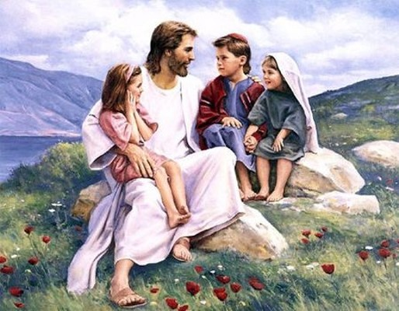
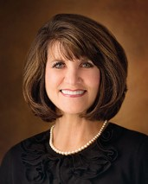
Ye Are Little Children
Humble Hearts and willing to learn
And said, Verily I say unto you, Except ye be converted, and become as little children, ye shall not enter into the kingdom of heaven. Whosoever therefore shall humble himself as this little child, the same is greatest in the kingdom of heaven.
Matthew 18:3-4
If we have a heart to learn and a willingness to follow the example of children, their divine attributes can hold a key to unlocking our own spiritual growth.
Jean A Stevens
D&C 50:40

Slide 20
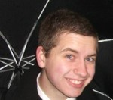
Grow in Grace
But grow in grace, and in the knowledge of our Lord and Saviour Jesus Christ. To him be glory both now and for ever. Amen.
2 Peter 3 :18
It is by grace that we even have the small possibility of being saved. It is because of grace that Christ came to the earth to atone for our sins and make it possible for us to return to our Father in Heaven.
But it is not by grace that we are forced into heaven. We are not automatically saved because of this wonderful doctrine. We still have to do our part. Faith is not merely enough, we must do works. Mitchel
D&C 50:40

Slide 21
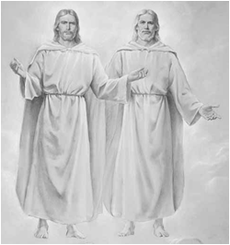
One in Purpose
And the Father and I are one. I am in the Father and the Father in me; and inasmuch as ye have received me, ye are in me and I in you
God the Father and Jesus Christ are two separate beings who work together for one purpose
D&C 50:43

Slide 22
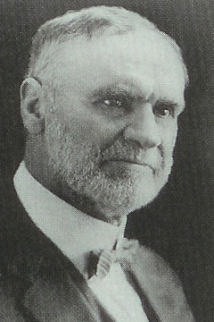
You Shall See Me
“It is not given to every man to look upon the face of God as did Moses [Moses 1:11], as did Joseph Smith.
One must be specially prepared before he can see what Joseph saw. …
I do not expect the Lord to manifest Himself to me in the same way that He did to Joseph the Prophet.
I expect Him to communicate with me through the gifts He has endowed me with, not through those with which He has endowed my brother or sister, unless they have the right to receive for me a message from Him.
When the Lord speaks to me or to you, it will be in a method and manner justified by our preparation, our gifts, our powers; for we have all been endowed in some degree.”
Elder Orson F. Whitney
D&C 50:45

Slide 23
Sources:
Joseph Smith (History of the Church, 4:580.)
Videos:
“Come, Follow Me: Rejoice Together” (1:20)
“A Teacher” (2:52).
A Man without Eloquence (6:06)
Faith Lights the Way (1:55)
Joseph Smith(Teachings, p. 227)
President Joseph Fielding Smith (Church History and Modern Revelation, 1:200.)
President Spencer W. Kimball (Ensign, Jan. 1978, p. 5.) (“Yagottawanna,” Ensign, May 1991, 46).
President Joseph Fielding Smith (Church History and Modern Revelation, 1:201–2.)
Doctrine and Covenants Who’s Who by Ed J. Pinegar and Richard J. Allen pg. 16, 164
Jean A Stevens Become as a Little Child Oct. 2014 Gen. Conf.
The testimony of Mitchel ://www.mormon.org/me/BGF3/Mitchel?rel=author
Presentation by ©http://fashionsbylynda.com/blog/
Elder Orson F. Whitney (In Conference Report, Apr. 1910, p. 60.)
President Nelson’s insight about the sacrament you may have missed By Lindsey Williams
Presentation by ©http://fashionsbylynda.com/blog/

Slide 24
Elder Parley P. Pratt was also a witness to these unusual operations:
“All these things were new and strange to me, and had originated in the Church during the absence, and previous to the arrival of President Joseph Smith from New York.
“Feeling our weakness and inexperience, and lest we should err in judgment concerning the spiritual phenomena, myself, John Murdock, and several other Elders, went to Joseph Smith, and asked him to inquire of the Lord concerning these spirits or manifestations.” (Autobiography of Parley P. Pratt, pp. 61–62.)
D&C 50: 13-21 Some of the early Saints had fallen victim to excessive spiritual displays, “receiving them to be of God” (D&C 50:15). The Lord indicated that these displays are not justified. The Prophet Joseph Smith explained:
“One great evil is, that men are ignorant of the nature of spirits; their power, laws, government, intelligence, etc., and imagine that when there is anything like power, revelation, or vision manifested, that it must be of God. …
“… who can drag into daylight and develop the hidden mysteries of the false spirits that so frequently are made manifest among the Latter-day Saints? We answer that no man can do this without the Priesthood, and having a knowledge of the laws by which spirits are governed; for as ‘no man knows the things of God,’ but by the Spirit of God, so no man knows the spirit of the devil, and his power and influence, but by possessing intelligence which is more than human, and having unfolded through the medium of the Priesthood the mysterious operations of his devices; without knowing the angelic form, the sanctified look and gesture, and the zeal that is frequently manifested by him for the glory of God, together with the prophetic spirit, the gracious influence, the godly appearance, and the holy garb, which are so characteristic of his proceedings and his mysterious windings.
“A man must have the discerning of spirits before he can drag into daylight this hellish influence and unfold it unto the world in all its soul-destroying, diabolical, and horrid colors. …
“… the great difficulty lies in the ignorance of the nature of spirits, of the laws by which they are governed, and the signs by which they may be known; … it requires the Spirit of God to know the things of God; and the spirit of the devil can only be unmasked through that medium.” (History of the Church, 4:572–74;
D&C 50:22-24 That Which is of God:
“Others frequently possess a spirit that will cause them to lie down, and during its operation, animation is frequently entirely suspended; they consider it to be the power of God, and a glorious manifestation from God—a manifestation of what? Is there any intelligence communicated? Are the curtains of heaven withdrawn, or the purposes of God developed? Have they seen and conversed with an angel—or have the glories of futurity burst upon their view? No! but their body has been inanimate, the operation of their spirit suspended, and all the intelligence that can be obtained from them when they arise, is a shout of ‘glory,’ or ‘hallelujah,’ or some incoherent expression; but they have had ‘the power.’
“The Shaker will whirl around on his heel, impelled by a supernatural agency or spirit, and think that he is governed by the Spirit of God; and the Jumper will jump and enter into all kinds of extravagances. A Primitive Methodist will shout under the influence of that spirit, until he will rend the heavens with his cries; while the Quakers (or Friends) moved as they think, by the Spirit of God, will sit still and say nothing. Is God the author of all this? If not of all of it, which does He recognize? Surely, such a heterogeneous mass of confusion never can enter into the kingdom of heaven.” (Teachings, pp. 203–4.)
More on John Corrill: Missouri Mormon War
Corrill was elected by the primarily Mormon residents of Caldwell County to be the county's first representative to the Missouri State Legislature in August 1838. During this same election, distrust between Missourians and Mormons erupted into an armed conflict, known today as the Missouri Mormon War. Corrill witnessed many key events and was involved in surrendering and turning over Joseph Smith to the state militia, which Smith saw as a betrayal. At the Richmond hearings in November, Corrill testified for the state against Smith and the Mormon actions in the conflict.
Disfavor grew between Corrill and the Mormons. Some Mormons had in the past accused him of opposing priesthood authority and "the Judgment of God" in his preference for autonomy and democracy in the church. In his only term in the Missouri House of Representatives. As a state representative after the armed conflict subsided, Corrill presented a petition from the Mormons for relief from their mistreatment. However, he continued to distance himself from the church, culminating in his excommunication in 1839 and publication of his account of the church's history and conflicts.

Slide 25
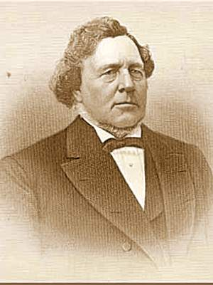
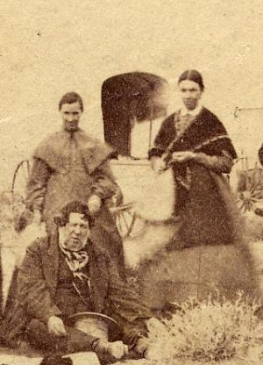
George Albert Smith during the Prophet Joseph Smith’s Time
Born 1817 Potsdam, New York
Baptized 1832
Participated in Zion's Camp 1834
Ordained Seventy and called to First Quorum of Seventy 1835
Ordained Apostle and called to Quorum of Twelve 1839
First Counselor to Brigham Young 1868-75
Died 1875 Salt Lake City, Utah
George Albert Smith is generally called George A. Smith to differentiate him from his grandson and namesake, George Albert Smith who served as President of the Church from 1945 until his death in 1951.
George was born June 26, 1817 in Potsdam, New York, the son of John Smith and Clarissa Lyman. He was raised as a Congregationalist but failed to receive spiritual edification from the sect. When his uncle, Joseph Smith, Sr. and Cousin Don Carlos Smith left a copy of the Book of Mormon at his father's home, George read it and had certain objections. These, however, were answered to his satisfaction by the two missionaries. As he criticized Congregational doctrine more strongly, the Reverend Frederick C. Cannon "sealed him up unto damnation."
George was baptized September 10, 1832 by Joseph Wakefield. In May of 1833, he and his parents joined the Saints in Kirtland, Ohio. A year later, he accompanied his cousin, the Prophet Joseph Smith, Jr. on Zion's Camp, a military expedition intended to relieve the suffering Saints in Missouri. In 1835, George was ordained a Seventy and set apart as a member of the First Quorum of the Seventy. thus becoming a General Authority.
By 1839, Thomas B. Marsh and Orson Hyde had been removed from the Twelve for apostasy. David W. Patten had suffered the martyr's fate in Missouri. George A. Smith was ordained an Apostle April 26, 1839 at Far West, Missouri byHeber C. Kimball to bring the Quorum back up to strength.
Remaining faithful, George and his family made the trek west and joined the Saints in the Great Basin. He was set apart as First Counselor to President Brigham Young on October 7, 1868 after the death of Heber C. Kimball. He served as President Young's emissary many years, more particularly in colonizing southern Utah. St. George, Utah is named for him. He was active in civic and public affairs as well as in the Church. He rose to the rank of Lieutenant General in the territorial militia and was elected territorial senator. During the Utah War he led the saints' southern flank.
George A. Smith died September 1, 1875 in Salt Lake City. His grandson George Albert Smith (1870-1951),, was the eighth President of the Church and ordained an apostle in 1903, at age 33.

