Slide 1
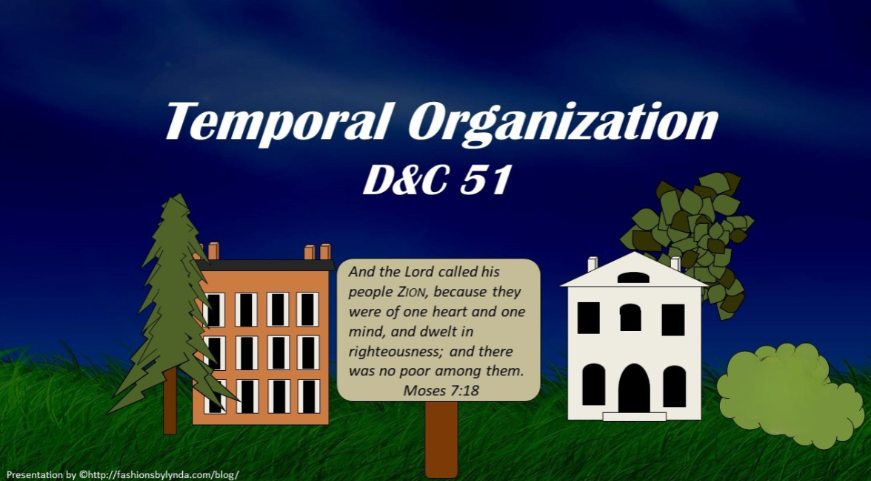

Slide 2

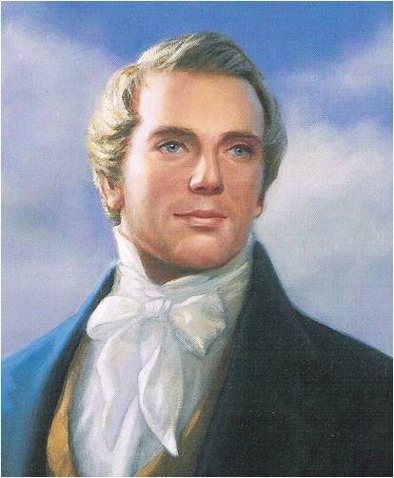
Background
In the spring of 1831, Joseph Smith received a revelation. The Lord instructed the members of the Colesville, New York, branch to settle the Thompson, Ohio, area and to fulfill their stewardships by living the law of consecration.

Slide 3
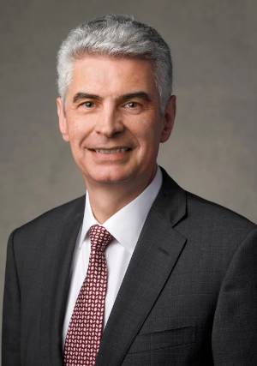
Temporal Responsibility
In gospel terms, the word stewardship designates a sacred spiritual or temporal responsibility to take care of something that belongs to God for which we are accountable.
Gérald Caussé

Slide 4
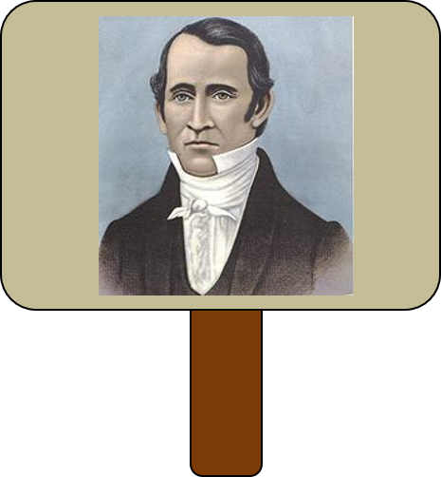
Stewardship
May 1831
Edward Partridge, the newly appointed bishop of the Church, felt the responsibility of caring for them when they arrived in Ohio.
The basic elements of the law of consecration had been given.
Many situations required more detailed answers.
Bishop Partridge sought help from the Prophet Joseph Smith, who inquired of the Lord and received what is now section 51 of the Doctrine and Covenants.

Slide 5
Needs Be
Must be effected in accordance with the Law of God
All things should be spiritual to man
Necessary
D&C 51:1-3

Slide 6
Cut Off
“Unless the organization is in accordance with divine laws, it will not be permanent.
…An individualistic society is not much of a success without God…
D&C 51:2

Slide 7
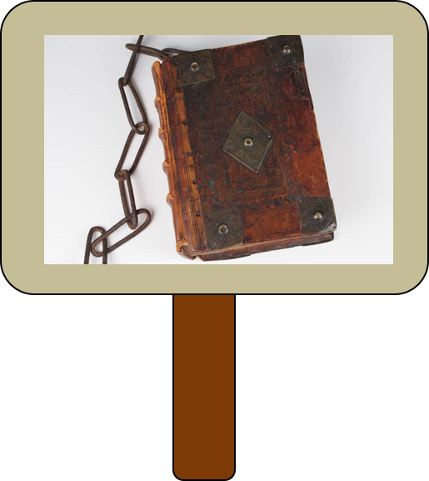
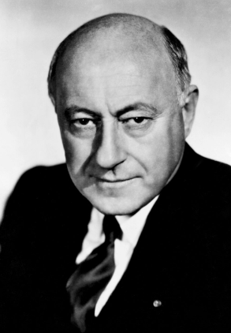
Restrictive ?
“We are too inclined to think of law as something merely restrictive—something hemming us in.
We sometimes think of law as the opposite of liberty. But that is a false conception.
That is not the way that God’s inspired prophets and lawgivers looked upon the law.
Law has a twofold purpose. It is meant to govern. It is also meant to educate.”
Cecil B. De Mille
D&C 51:1-3

Slide 8
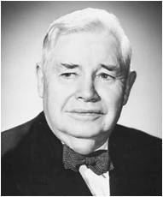
Equality
To the Saints in Thompson, Ohio
“…That revelation affirms that every man is to be ‘equal according to his family, according to his circumstances and his wants and needs.’
Obviously, this is not a case of ‘dead level’ equality.
It is ‘equality’ that will vary as much as the man’s circumstances, his family, his wants and needs, may vary.”
President J. Reuben Clark Jr.
And you are to be equal, or in other words, you are to have equal claims on the properties, for the benefit of managing the concerns of your stewardships, every man according to his wants and his needs, inasmuch as his wants are just—D&C 82:17
The Lord expects His people to deal honestly with others and be unified
D&C 51:3

Slide 9

Individualistic System
Given in writing
The plan was that everyone’s property was transferred to the Bishop…the bishop would deed back according to their needs
In a community there would always be some who would wish to draw out…and perhaps obtain lawsuits
Surplus—retained by Bishop and given for the benefit of the sick or aged, those who were unable to contribute to the community
Legal agreements were made to protect the property
Those who transgressed and found unworthy as a member retained the property deeded to them, but have not claim on portions set aside for the maintenance of the poor or needy
D&C 51:4-6 Smith and Sjodahl

Slide 10
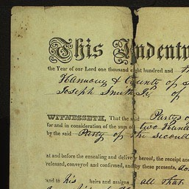
Agent and His Duties
The Bishopric would receive the property
Belongs to him—The stewardship of each individual was to be secured to him by a legal deed
Special Agent to handle money required for food and clothing
The Agent would see to it that property was not unduly accumulated, but that the needs of all were supplied.
D&C 51:7-8 Smith and Sjodahl

Slide 11

Be Alike
To preserve unity and equality
Under the united order everyone was alike in that they were independent and had full opportunity to use their gifts and talents in building the kingdom of God.
They were also alike in that all had equal opportunity to benefit from whatever talents and abilities existed in the community.
The idea that everyone was alike in goods possessed or income received is in error.
The order was united in love, purpose, and commitment, but unity does not mean sameness.
A couple with seven children has needs different from one just beginning married life.
But unless all were honest the society could not function in the way the Lord had intended it to be
The Lord expects His people to deal honestly with others and be unified
D&C 51:9 Smith and Sjodahl

Slide 12
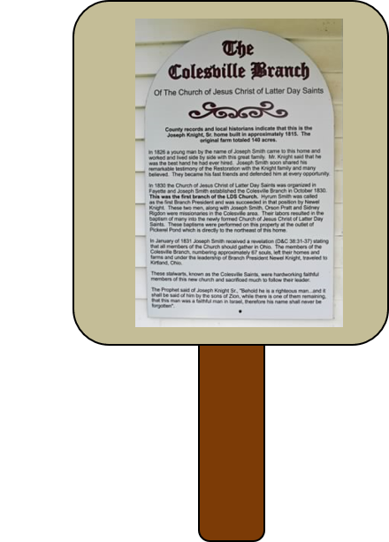
Not Be Given
The meaning conveyed is that the property owned by the Colesville Branch could not be claimed by any other Branch.”
The word ‘church’ in this paragraph stands for ‘Branch,’ and elsewhere.
D&C 51:10 Smith and Sjodahl

Slide 13
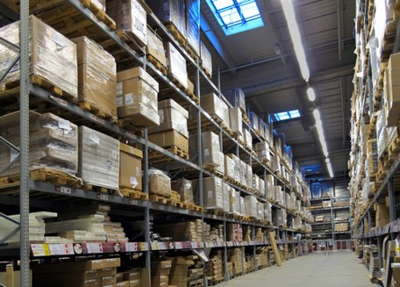
Responsibility of Bishop
A general storehouse-- for products, grain, meats, raw materials of every kind, manufactured articles, works of art, etc, as well as money
The Major responsibility for implementing the United Order rested with the bishop
The Bishop then gives the goods to the people according to their needs of the family while he is employed in the business of the Church
D&C 51:13-14 Smith and Sjodahl

Slide 14
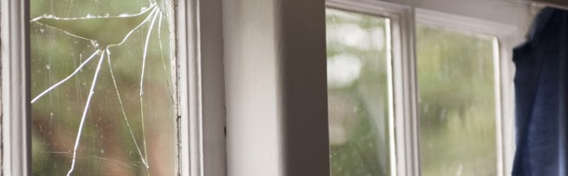
Act Upon This Land
People who locate in a home or apartment knowing that they will move to another in a short time may have a tendency to neglect Church attendance and other responsibilities.
They rationalize, “Well, we won’t be here long.” The Lord wanted the Saints to live the gospel and share it in Ohio as though they were to be there for a long time.
D&C 51:17

Slide 15
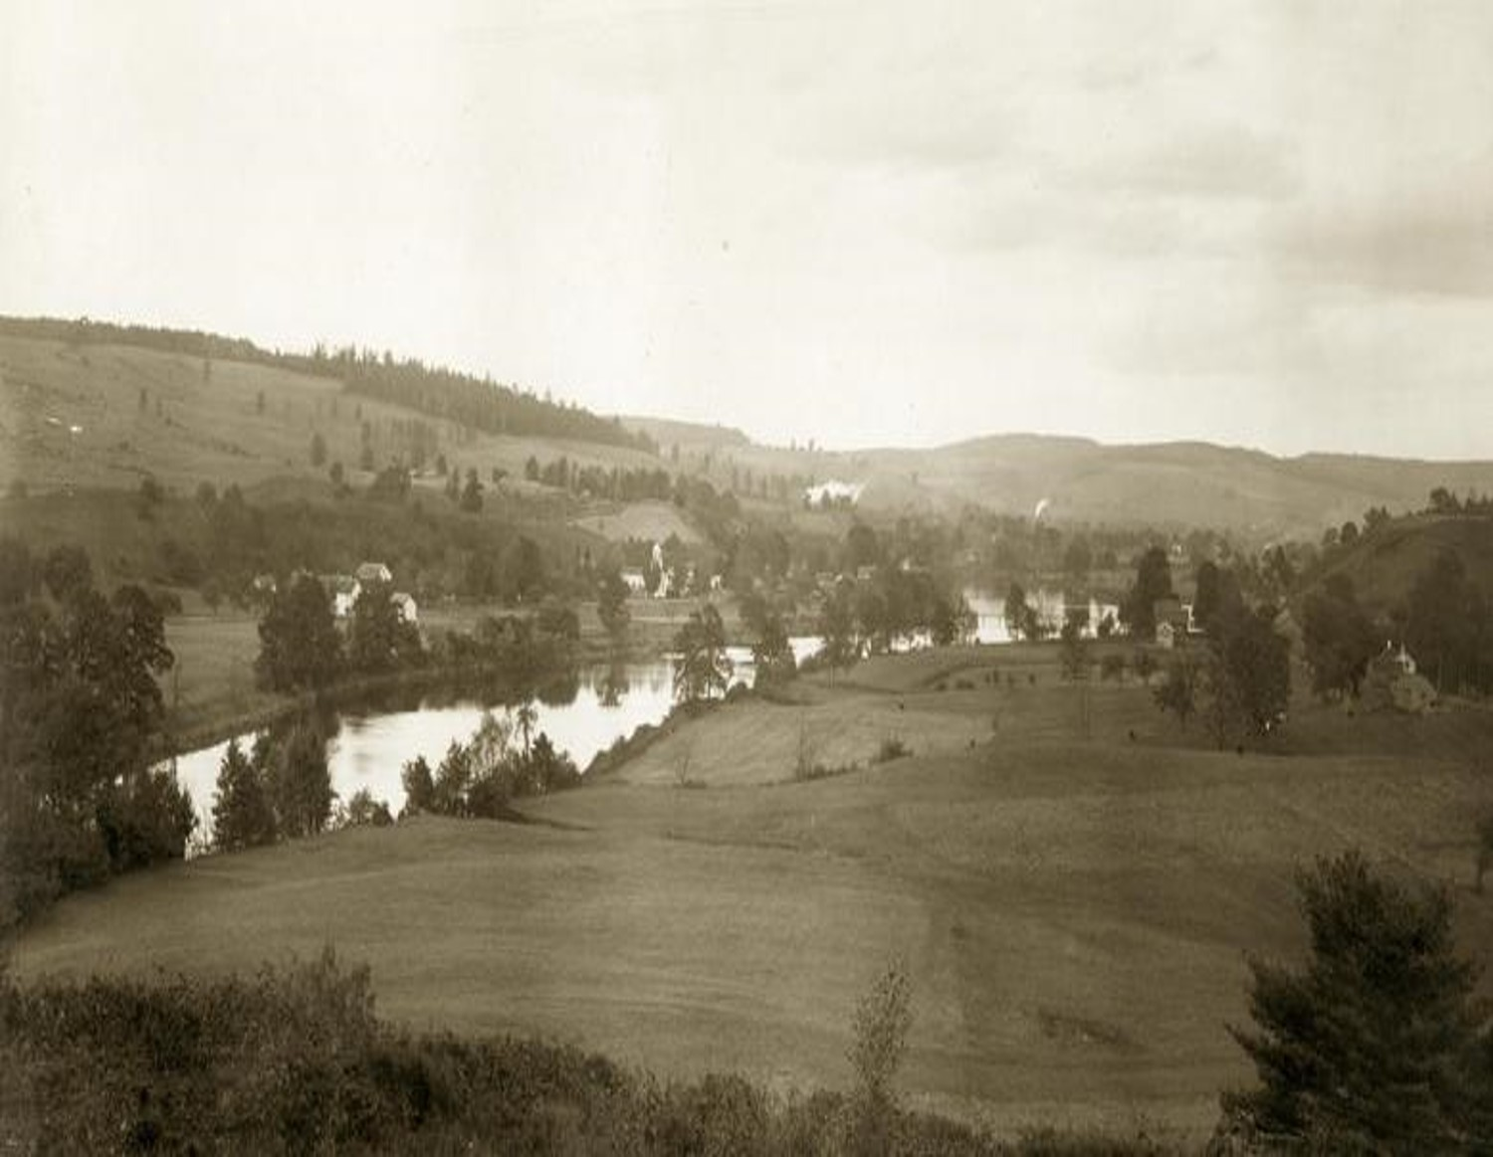
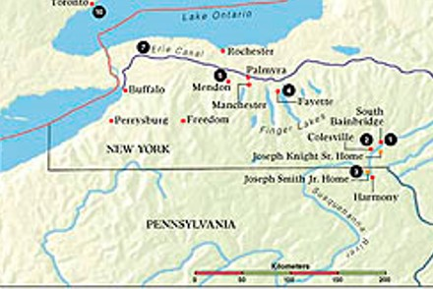
To Be An Example
Those in Colesville, the Saints are to be an an example of how the Law of God should work among the people.
“We must not forget that to take care of whatever material and temporal gifts we may have in just as much the duty of the a Latter-day Saint, as to attend meetings and to pray.
All our talents should be used for the furtherance of the Kingdom of Christ.
D&C 51:18-19 Smith and Sjodahl

Slide 16

The First Converts in Jerusalem
The first converts in Jerusalem, who embraced the gospel at the time of Pentecost, sold their “possessions and goods” and distributed to all according to the needs of each.
It may be supposed that they retained their homes, as provided by the Mosaic law, and also other things necessary for their own maintenance, and that they sold the rest for the benefit of the needy Saints, at the same time extending their hospitality to all
(Acts 2:45).
That which was intended for distribution was laid at the feet of the Apostles. They were the representative of the Lord, and the money was, therefore, in fact, given to Him.
Not one of them said that his possessions were his, but everyone considered himself as the Lord’s steward.
See Ananias Story (Acts 5:4)
D&C 51:18-19 Smith and Sjodahl

Slide 17
Sources:
Gérald Caussé, “Our Earthly Stewardship,” Liahona, Nov. 2022, 57
Presentation by ©http://fashionsbylynda.com/blog/
Cecil B. DeMille, producer of the movie The Ten Commandments, (Commencement Address, Brigham Young University Speeches of the Year [Provo, 31 May 1957], p. 4.)
President J. Reuben Clark Jr. (In Conference Report, Oct. 1942, p. 55.)
Hyrum M. Smith and Janne M. Sjodahl Doctrine and Covenants Commentary pg. 297-302
Presentation by ©http://fashionsbylynda.com/blog/

Slide 18
United Order: D&C 51:4-6
President J. Reuben Clark Jr. explained: “The fundamental principle of this system was the private ownership of property. Each man owned his portion, or inheritance, or stewardship, with an absolute title, which he could alienate, or hypothecate, or otherwise treat as his own. The Church did not own all of the property, and the life under the United Order was not a communal life. … The United Order is an individualistic system, not a communal system.” (In Conference Report, Oct. 1942, p. 57.)
President Clark further showed that a written title or deed was issued that satisfied the requirements of civil law and secured to an individual the rights of private ownership of property. The importance of such written agreements is evident when it is remembered that people had their agency to leave the united order. A written contract between the bishop and the individual secured the terms of the agreement when the person entered the order (see D&C 51:6). So even though a person acknowledged that all property ultimately belongs to God, for legal and practical purposes his deeded portion became his private property. It did not belong to the Church. This arrangement was true of the initial inheritance of land and buildings given to each person in the order. Any surplus earned from one’s stewardship was given to the Church.
“If anyone transgressed and was counted unworthy of membership in the Church, he also lost his standing in the society, but in that case he was to retain the property deeded to him, but have no claim on the portion set apart for the maintenance of the poor and needy” (Smith and Sjodahl, Commentary, p. 298).
People who chose to withdraw from the order often ended up with bitter feelings against the Church. Handling the transactions through legally constituted means provided protection for both the individual and the Church. “In the community there would always be some who would wish to draw out and, perhaps, embarrass the rest by lawsuits, or otherwise. In order to prevent such designs, just and equitable provisions were to be made and secured by legal agreements.” (Smith and Sjodahl, Commentary, p. 298.)

