Slide 1
Doctrine and Covenants 52
Two By Two
Presentation by ©http://fashionsbylynda.com/blog/

Slide 2
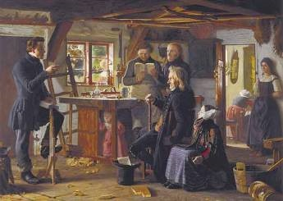
Kirtland, Ohio June 6, 1831
Letters were sent to all missionaries to return and come to the conference
During this conference a significant new office was conferred upon a number of the brethren, that of high priest in the Melchizedek Priesthood.
The Prophet Joseph Smith received the spirit of prophecy and prophesied that John the Revelator was among the ten tribes preparing them to return from their long dispersion. HC
D&C 52:2

Slide 3
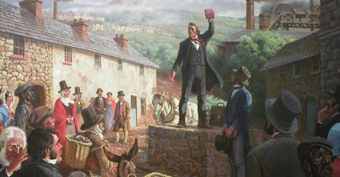
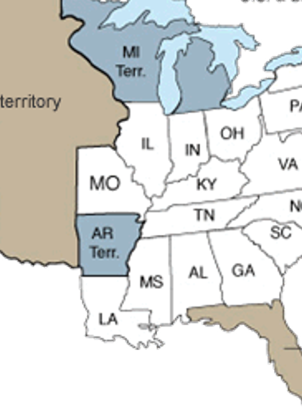
Conferences
Held every 3 months or as often as the Saints assembled in conference decided upon
Usually the leaders of the Church decided in one conference the date and place of the next. The Lord in this revelation designated Missouri as the location of the next conference…
D&C 20:61

Slide 4
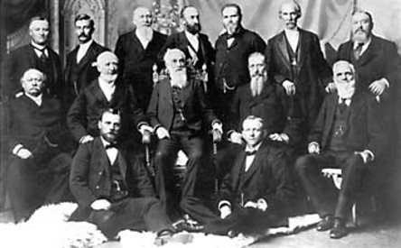
Purpose of Conference
One purpose of this revelation was to call certain brethren to travel as missionaries from Ohio to Missouri.
Twenty-eight missionaries were called in this revelation; however, thirty actually went—one of the original twenty-eight did not go, and three more were called later
D&C 52:3, 7-8, 22-32 Student Manual

Slide 5
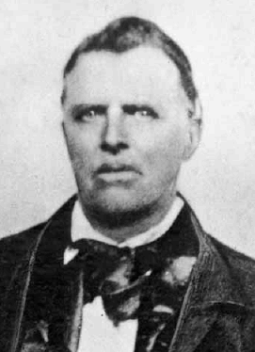
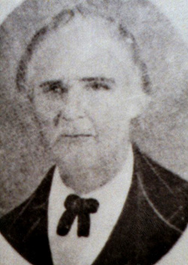
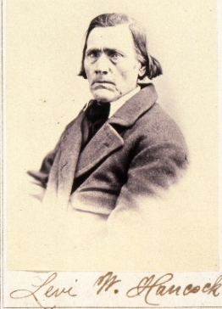
28 Called
D&C 52:7-21
D&C 52:21-24
D&C 52:25-29
D&C 52:30-32
Lyman Wight
John Corrill
John Murdock *
Hyrum Smith *
5. Thomas B. Marsh **
6. Ezra Thayre
7. Isaac Morley *
8. Ezra Booth
9. Edward Partridge *
10. Martin Harris **
11. Sidney Rigdon
12. Joseph Smith Jun. *
13. David Whitmer
14. Harvey Whitlock
15. Parley P. Pratt *
16. Orson Pratt **
17. Solomon Hancock *
18. Simeon Carter *
19. Edson Fuller
20. Jacob Scott
21. Levi W. Hancock *
22. Zebedee Coltrin *
23. Reynolds Cahoon *
24. Samuel H. Smith *
25. Wheeler Baldwin
26. William Carter ?
27. Newel Knight *
28. Selah J. Griffin *
The last two to be ordained then take their journey
* Those who stayed strong and valiant
* * Those who fell away but returned to the church
Who’s Who

Slide 6
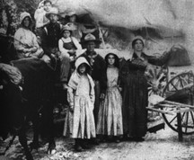
The Others
D&C 52:35
D&C 52:37
D&C 52:38-40
Joseph Wakefield
Solomon Humphrey *
To take their mission to the east to their families
Heman Basset lost his calling and it was given to Simonds Ryder
Ordained:
Jared Carter
George James **
These were to watch over the church and preach in their surrounding areas and labor with their hands and take care of the poor, need and sick
1/3 of the adults mentioned in the Doctrine and Covenants rebelled and separated from the mainstream of the restored Church. Sound familiar?
See D&C 29:36

Slide 7
Finding a Clue
Continual Guidance
Instructions were given to Joseph Smith and other priesthood leaders at a conference of the Church held in Kirtland, Ohio, in June 1831.
The Lord had previously revealed that the Saints would establish a city called Zion. (D&C 28:9)
but He had not yet revealed its location.
As we follow God’s instructions faithfully, He reveals more of His will to us
What do you feel are some benefits of receiving the Lord’s guidance and truth little by little rather than all at once?
D&C 52:4-5

Slide 8
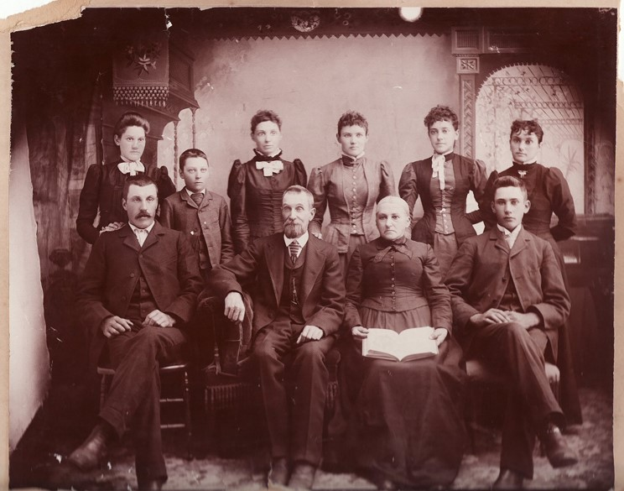
A Missionary Standard
They should teach those things that He has revealed to His prophets and Apostles, that which is taught to them through the influence of the Holy Ghost.
Many problems arise when people begin to offer their personal opinions as doctrines of the Church. In 1837 the Twelve Apostles wrote an epistle in which they warned…
D&C 52:9 Student Manual

Slide 9
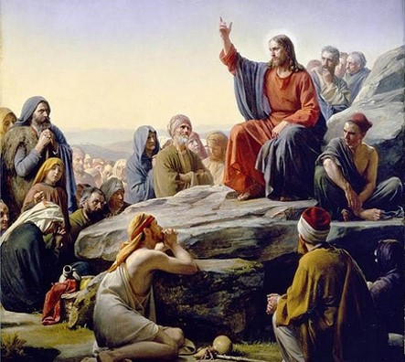
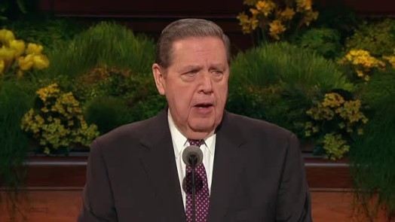
Preaching the Word of God
“Be careful that you teach not for the word of God the commandments of men, nor the doctrines of men, nor the ordinances of men, inasmuch as you are God’s messengers. Study the word of God, and preach it and not your opinions, for no man’s opinion is worth a straw.
Advance no principle but what you can prove, for one scriptural proof is worth ten thousand opinions. We would moreover say, abide by that revelation which says ‘Preach nothing but repentance to this generation,’ and leave the further mysteries of the kingdom till God shall tell you to preach them, which is not now.”
HC
D&C 52:9 Student Manual

Slide 10
The truth of all things is measured by the scriptures.
That which harmonizes with them should be accepted; that which is contrary to their teachings, however plausible it may seem for the moment, will not endure and should be rejected.”
Bruce R. McConkie
D&C 52:9 Student Manual

Slide 11
Pattern—In Which to Follow
A pattern is a representative sample of traits, acts, or other features characterizing an individual. In these verses the Lord indicates that one observable feature of those who are inspired of God is that they obey the ordinances of the gospel.
In order to avoid being deceived by Satan, a person must obey the Lord’s ordinances and live according to the revelations He has given.
D&C 52:14-19 Student Manual

Slide 12
Actions and Attributes
Whose Spirit is contrite
A person who has a repentant attitude
Obey min ordinances
A person who receives the Lord’s ordinances and keeps the associated covenants
Whose language is meek and ediffieth
A person whose speech is humble and lifts or builds others
Trembleth under my power
A person who feels reverence for the power of God
Bring forth fruits
A person who produces something good (such as “praise and wisdom”) by following the revelations God has given
D&C 52:15-17

Slide 13
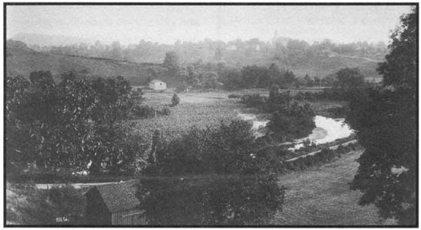
Those Left in Ohio
These men were assigned to stay home and be the priesthood leaders for the Saints in Kirtland.
By laboring with their own hands for their support, rather than being paid for their priesthood service, these brethren would help prevent idolatry and priestcraft from springing up in the Church.
Mortify therefore your members which are upon the earth; fornication, uncleanness, inordinate affection, evil concupiscence, and covetousness, which is idolatry:
Colossians 3:5
D&C 52:39 Student Manual

Slide 14
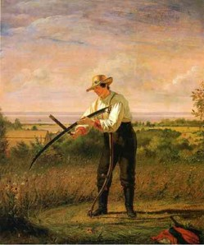
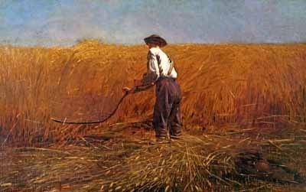
When people set their hearts on natural things, or prestige, or power to the point that God is no longer supreme, then that becomes as god to them.
They worship, or give allegiance to, those things. This verse suggests that if the elders who remained in Ohio did not labor with their own hands, they might be guilty of this kind of covetousness or idolatry.
D&C 52:39 Student Manual

Slide 15
Disciples of Jesus Christ watch over and care for those who are poor, needy, sick, and afflicted
D&C 52:40

Slide 16
Sources:
Videos:
Daily Bread: Experience (3:11)
Michelle's Story (5:48)
History of the Church, 1:175–76).
Doctrine and Covenants Student Manual Religion 324-325 Section 52
(History of the Church, 3:395–96.).
Bruce R. McConkie (Mormon Doctrine, p. 765.
Presentation by ©http://fashionsbylynda.com/blog/
Doctrine and Covenants Who’s Who by Ed J. Pinegar and Richard J. Allen pg. 193-196
Presentation by ©http://fashionsbylynda.com/blog/

