Slide 1
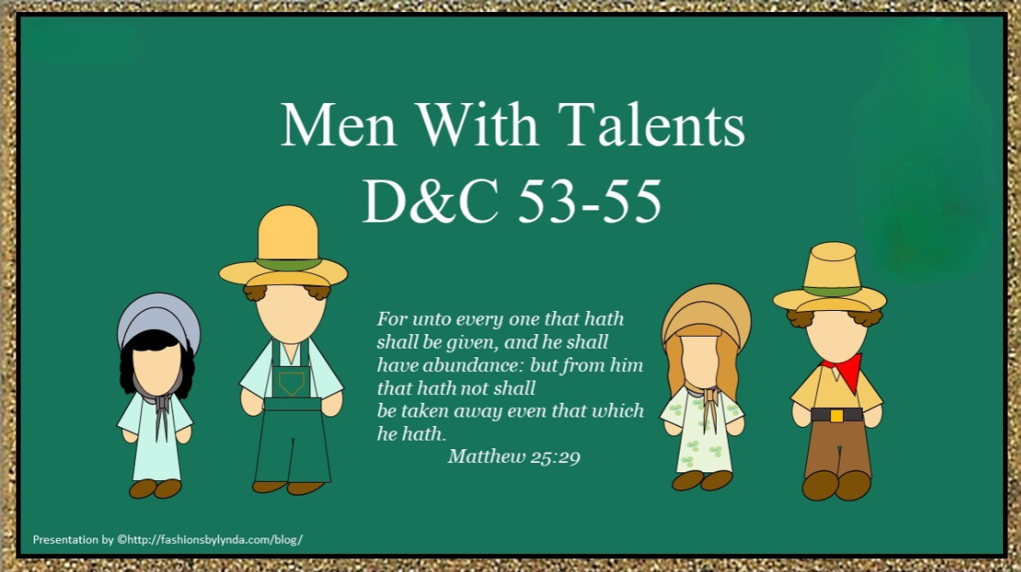
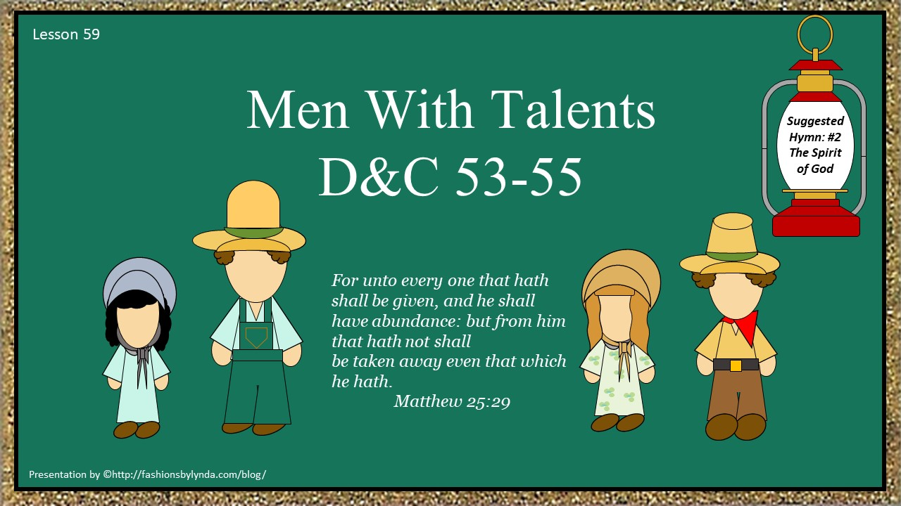

Slide 2

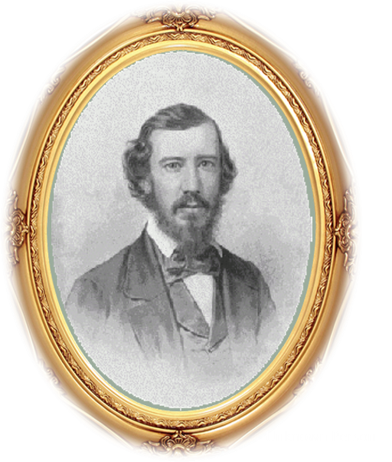
Not on the List
Sidney Gilbert found that he was not listed as one of those missionaries mentioned in D&C 52. He went to the Prophet Joseph Smith and asked what the Lord would have him do. Joseph inquired and received the revelation in Doctrine and Covenants 53.
The Lord calls Sidney Gilbert to be an elder and travel with Joseph Smith to Missouri

Slide 3
Algernon Sidney Gilbert
He was born December 28, 1789, at New Haven, Connecticut
He became a merchant and real property entrepreneur in Ohio
He and partner, Newel K. Whitney, operated a store in Kirtland in which they became members of the Church
The Lord gave him a personal revelation in Section 53
He traveled with Joseph Smith to Independence Missouri where he served as a land agent for the Church and opened a grocery and dry goods store
He felt inadequate as a missionary, but he preserved valuable handwritten copies of many of the early revelations
The Mobs partially destroyed his store in Independence in 1833
He opened his home to members of Zion’s Camp which he was in contact with Cholera and later died on June 29, 1834
Who’s Who

Slide 4
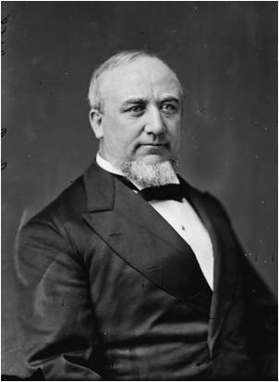

Forsake the World
The Commandment given to those who have entered into a covenant relationship with the Lord.
They…We… are to forsake the standards and habits of the apostate world
“We need to be born again, and have new hearts put in us. There is too much of the old leaven about us. We are not born again as we should be.
…You must have new desires, new hearts, so to speak, in you.
Hundreds of people who are called Latter-day Saints you could not distinguish from the world…
He wants us to be a changed people when we embrace His Gospel, and to be animated by entirely new motives, and have a faith that will lay hold of the promises of God.”
President George Q. Cannon
D&C 53:2

Slide 5
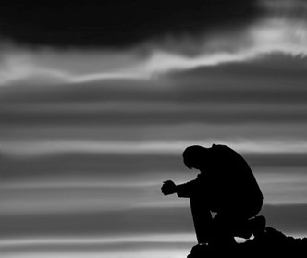
I Have Heard Your Prayers
“… our prayers are heard and answered. We are familiar with the truth found in 2 Nephi in the Book of Mormon: “Men are, that they might have joy.” I testify that much of that joy comes as we recognize that we can communicate with our Heavenly Father through prayer and that those prayers will be heard and answered—perhaps not how and when we expected they would be answered, but they will be answered and by a Heavenly Father who knows and loves us perfectly and who desires our happiness.
Hasn’t He promised us…
“Be thou humble; and the Lord thy God shall lead thee by the hand, and give thee answer to thy prayers”?
D&C 112:10
D&C 53:1 President Thomas S. Monson

Slide 6
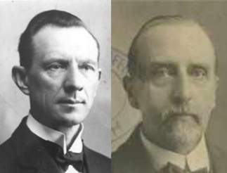
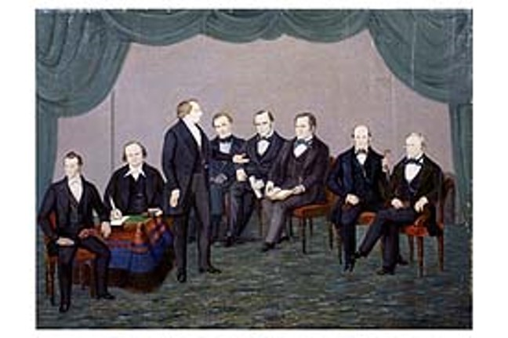
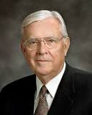
Take Upon You Mine Ordination
“An Appeal from Him who was crucified for the sins of the world to His servant, to take up the calling as a preacher of the first principles of the gospel.”
Smith and Sjodahl
“We just don’t know what trouble is compared to the problems of the early leaders of this Church. I submit to you that those who remained true and faithful and went forward to establish this great work on the face of the earth were those men and women who had an unwavering testimony, a witness in their own hearts by the power of revelation earned by their own study, pondering, and prayers.”
M. Russell Ballard
D&C 53:3

Slide 7
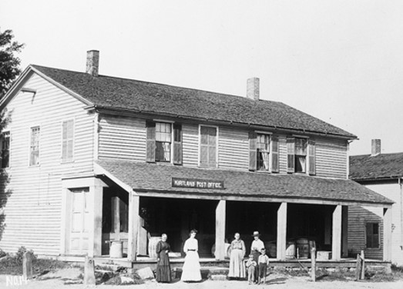
To Be An Agent
The Saints were about to gather in a new locality, even in Missouri, and they needed men like Sidney Gilbert to transact business for them
As we follow God’s instructions faithfully, He reveals more of His will to us.
Sidney Gilbert will take up his journey to Missouri with Joseph Smith and Sidney Rigdon…
First Ordinances---there will be other things required to “labor in the vineyard”
D&C 53:4-6

Slide 8
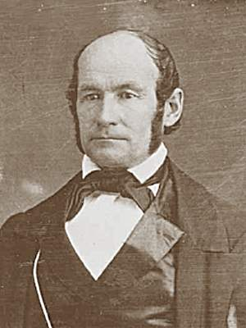
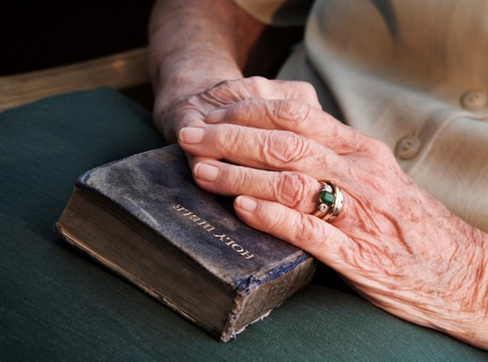
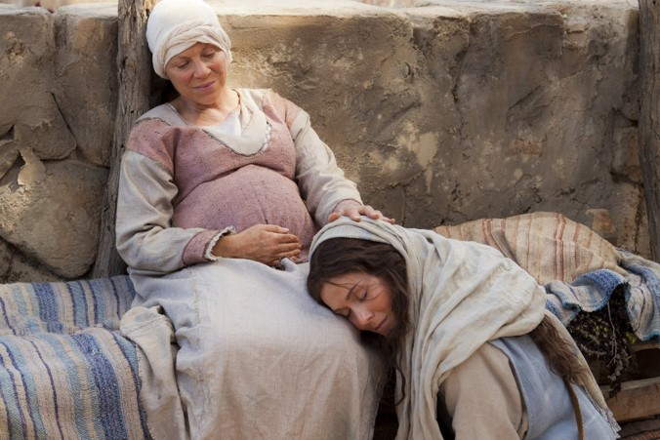
Endure to the End
“If you all live your religion and are faithful to the end of your days, that proves that you were chosen as were Jesus and John, who were prophesied of many hundred years before they came, as were many others.
Mary, the mother of Jesus, was raised up to bear the Savior.
Elizabeth was ordained and set apart to come along near the meridian of time,
and we were ordained to come along near the end of time.”
Heber C. Kimball
D&C 53:7

Slide 9
Newel Knight
He was born on September 13, 1800 in Vermont
He was the son of Joseph Knight Sr. and brother of Joseph Knight Jr.
He became acquainted with Joseph Smith when Joseph boarded with the Knight’s in 1826
He was baptized in May of 1830
He suffered persecutions in Missouri and Nauvoo and his wife Sally died because of the suffering in Missouri
He is connected with leading the Thompson, Ohio Saints to Missouri and he was in the high council in Nauvoo
While en route westward with the Saints fleeing from the mobs, he contacted a lung disorder and died in Iowa Territory on January 11, 1847 leaving second wife Lydia and 7 young children
Who’s Who

Slide 10
Leaving Thompson,Ohio to Missouri
April 1831
Newel Knight
Led group of Saints from Colesville, New York to Ohio
May 1831
Bishop Edward Partridge
Saints settle on land in Thompson, Ohio given to them by Leman Copley
Saints in Thompson
They planted crops and made improvements of property, but started to become greedy and selfish
Leman Copley
Returns from mission to Shakers and doubts his faith.
He rejects the faith and orders Saints to leave the land. He charges them 60 dollars and broke his covenant of letting the saints live on the land
The Saints have nowhere to go…they ask Joseph Smith what they should do

Slide 11
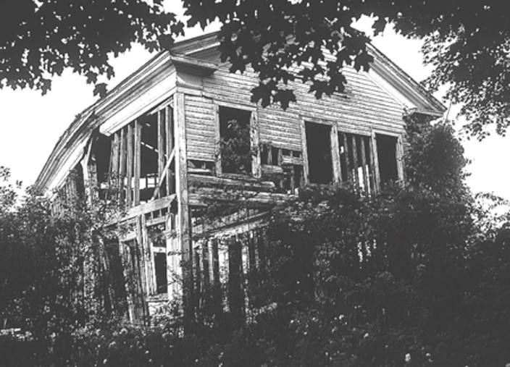
Repent and Be Humble
Old Building on Copley Farm
After their failure to obtain land in Kirtland, the Colesville Saints were directed to leave Ohio and go to Missouri; but since they would arrive in Missouri before the Lord’s commandments concerning the law of consecration would be fully implemented, the Lord told them how to act until they could be properly included in the united order.
D&C 54

Slide 12
William Wines Phelps
He was born on February 17, 1792, in Hanover, New Jersey
He purchased a copy of the Book of Mormon from Parley P. Pratt in April 1830
He moved to Kirtland in 1831 and received a revelation through the Prophet Joseph Smith in Section 55
He was baptized on June 10, 1831
He was directed to set up a shop as a printer (D&C 57:11-13)
He was also given a revelation through the Prophet concerning repentance
He was urged to complete the Book of Commandments containing the revelations given to that point in time.
In 1833 a mob destroyed the printing press and he returned to Kirtland where he assisted in the preparation of the 1835 edition of the Doctrine and Covenants and also the first Church hymnbook
He donated funds to support the building of the Kirtland Temple and composed the song “The Spirit of God Like a Fire is Burning”. He wrote many Hymns for the Church
He died March 6, 1872, in Salt Lake City, Utah
Who’s Who

Slide 13
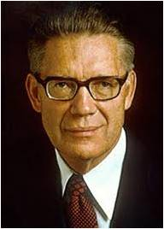
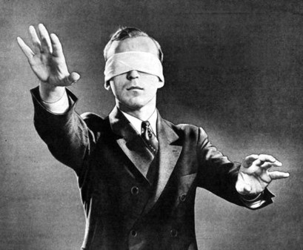
Single Eye Glory to God
“Through the natural eyes men see the light which guides them in their physical existence, through their spiritual eyes, the spiritual light which leads to eternal life.
As long as the natural eyes are unimpaired, men can see and be guided by the light of day; and as long as the spiritual eyes are single to the glory of God—
that is, as long as they are undimmed by sin and are focused solely on righteousness—
men can view and understand the things of the Spirit.
But if apostasy enters and the spiritual light turns to darkness, ‘how great is that darkness!’”
Bruce R. McConkie
D&C 55:1

Slide 14
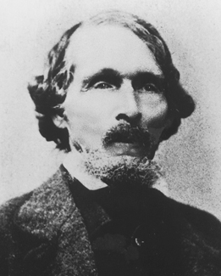
William Chosen and Called
William W. Phelps set up the first printing press for the Church in Missouri. He published the first Church newspaper, the Evening and the Morning Star.
He helped compile, prepare, and publish the revelations in the Book of Commandments in 1833 and later in the 1835 edition of the Doctrine and Covenants.
He helped prepare the first Church hymnbook and wrote the words to a number of hymns, including “The Spirit of God,” which was sung at the Kirtland Temple dedication. He gave 500 dollars to help complete that temple.
God can use our talents, skills, and abilities to bless His children.
D&C 55

Slide 15
Joseph Coe
He was an early convert to the Church in New York, arrived in Kirtland in 1831
He traveled to Missouri with Joseph Smith and Sidney Rigdon, leaving Kirtland on June 19, 1831
Later, again in Kirtland, he was appointed general agent of the Church
He supervised land purchases in 1833, including 103 acres of the Peter French farm, on which the Kirtland Temple would be built
He was called to the Kirtland high council in February 1834
In July 1835, he helped with the purchase of Egyptian mummies and papyri, which led to Joseph Smith bringing forth the book of Abraham
Manual

Slide 16
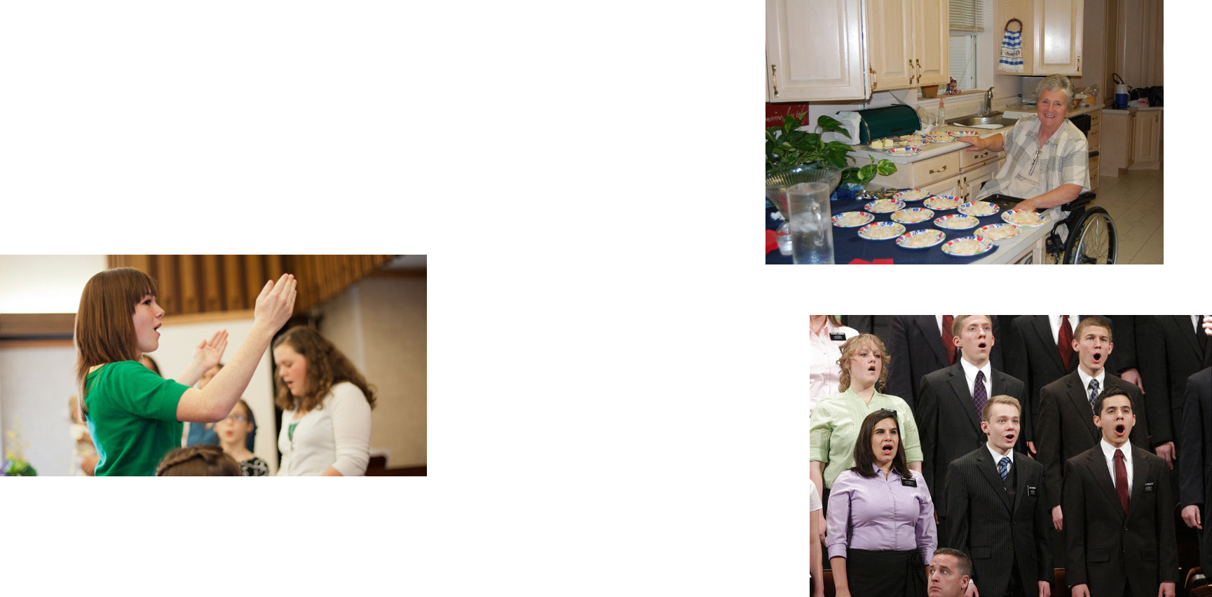
Our Talents, Skills, and Abilities
Each of us has a talent…gift…knowhow of certain things and the Lord uses us to help others in our callings and to be of service to others in building his kingdom
God can use our talents, skills, and abilities to bless His children
D&C 55

Slide 17
Sources:
Video:
God Will Lift Us Up (4:58)
Doctrine and Covenants Who’s Who by Ed J. Pinegar and Richard J. Allen pgs. 36, 116
Presentation by ©http://fashionsbylynda.com/blog/
President Thomas S. Monson Consider the Blessings October 2012 General Conference
Hyrum M. Smith and Janne M. Sjodahl Doctrine and Covenants Commentary pg. 313
M. Russell Ballard Choose to Serve BYU Speeches January 5, 1986
President George Q. Cannon (In Conference Report, Oct. 1899, p. 50.)
Heber C. Kimball, Jour of Dis., Vol V., p. 34
Bruce R. McConkie Doctrinal New Testament Commentary, 1:240.
Presentation by ©http://fashionsbylynda.com/blog/

Slide 18
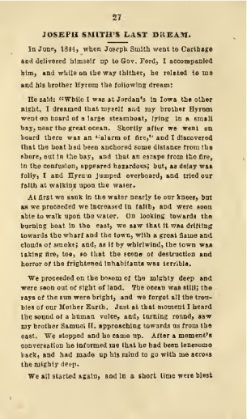
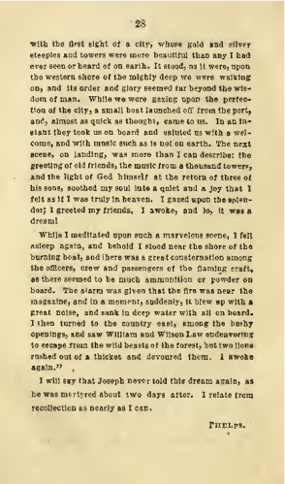
W. W. Phelps about Joseph Smith

Slide 19
William Wines Phelps, or "W.W." as he was commonly known, was born on 17 Feb 1792 in Hanover, Morris Co., New Jersey. Mr. Phelps had a common school education, but was self-taught in many subjects. When quite young he removed to Ohio, soon returning to Homer, N. Y., where he started a paper called the Western Courier.
From there he removed to Trurnansburgh, Tompkins Co. New York, and started the publication of a paper called the Lake Light. From there he removed to Canandaigua, Ontario Co., New York, where in 1820 he published a paper in the interest of the Anti-Masons, called the Ontario Phoenix.
His wife Sally (Stella) Waterman was born on 24 Jul 1797 in Franklin, Delaware, NY. William and Sally were married on 28 Apr 1815 by Samuel Kelsey Esq. in Smyrna, Chenago, NY.
Phelps was an aspirant for the office of lieutenant governor of New York at the time he first learned of Mormonism through reading the Book of Mormon and talking with Sidney Rigdon. He bought a copy of the book from Parley P. Pratt. On April 30, 1830, "I was thrown into prison at Lyons, N.Y. by a couple of Presbyterian traders, for a small debt, for the purpose, as I was informed, of 'keeping me from joining the Mormons.' “
Nonetheless, on December 24, 1830, William met Joseph Smith and was convinced he was a prophet.⁽William wrote of his experience meeting the prophet, "Now, notwithstanding my body was not baptized into this church till Thursday the 10th of June, 1831, yet my heart was there from the time I became acquainted with the book of Mormon; and my hope steadfast like an anchor, and my faith increased like the grass after a refreshing shower, when I for the first time, held a conversation with our beloved brother Joseph."
In June 1831 William moved to Kirtland, Ohio, where Joseph Smith, by revelation, called him to be baptized, ordained, and assist Oliver Cowdery in the printing office, and accompany the company to Missouri. In that same month, the Prophet of the Church of Jesus Christ of Latter-day Saints Joseph Smith gave a revelation to William Phelps.
One of the Prophet's scribes, William Phelps assisted Emma Smith in preparing the first hymnal. William wrote the "Hosanna Anthem", later named "The Spirit of God Like a Fire Is Burning," specifically for the Kirtland Temple dedication, although it was sung in Church meetings before that time. William authored twenty-nine of the ninety songs in the first 1835 edition. Hymns by William W. Phelps include:
Gently Raise the Sacred Strain
Now Let Us Rejoice
Hosanna Anthem (The Spirit of God)
Praise to the Man
Vade Mecum
William "undertook a mission to Jackson County, Missouri, where he located as a printer, and published a monthly paper, The Evening and Morning Star, the first number of which appeared in June, 1832." After fourteen issues are published, a mob of Jackson county citizens demand that the Mormons must immediately leave the county. They present their demands to W. W. Phelps and two other local Church leaders, who ask for time to consult with their leaders in Missouri and Ohio.
The mob attacked his house, which contained the printing equipment, and pulled it partly down, seized the printing materials, destroyed many papers, and threw his family and furniture out of doors. Three days later, on July 23, the mob renewed their depredations, and William W. Phelps and others offered themselves as a ransom for the Saints, being willing to be scourged, or to die, if that would appease the anger of the mob. The mob would not accept this sacrifice, however, but continued to utter threats of violence against the whole Church.
"This persecution culminated in the Saints being driven from their homes in Jackson County, in November, 1833. Mob leaders warned Brother Phelps and others to flee for their lives, or they would be killed. Despite repeated appeals, which Elder Phelps helped to frame, to the governor of Missouri, and to the president of the United States, no protection or redress was ever given them.
"When the exiled Saints in Clay County were organized into a stake, David Whitmer was chosen president, with William W. Phelps and John Whitmer as counselors. He took a prominent part in all matters pertaining to the welfare of the Saints in Missouri.
"In the early part of 1835, he and his son Waterman were called to Kirtland, where they made their home with the family of the Prophet Joseph Smith and assisted a committee appointed to compile the Book of Doctrine and Covenants. About this time, Elder Phelps subscribed $500 [about $8,000 in 2001 dollars] toward the erection of the Kirtland Temple. When the Church purchased the Egyptian mummies and papyrus from Michael H. Chandler in 1835, William W. Phelps served as one of the scribes in the translation by Joseph Smith of the Book of Abraham."
He was implicated in the difficulty surrounding the destruction of the non-Mormon newspaper Nauvoo Expositor and was summoned with Joseph Smith to be tried for treason at Carthage, Illinois. He accompanied the pioneers to Utah, where he became one of the first regents of the University of Deseret and a representative in the Utah legislature.
On March 10, 1838, he was accused by the High Council of profiting from a Far West, Missouri, land deal and reneging on a $2,000 subscription to the building of a temple. William and John Whitmer were excommunicated by the high council and congregation. Excommunicated on December 9, 1839, he is rebaptized two days later on December 11 and returned to full fellowship in 1841. He later fulfilled a mission to the eastern states. On February 2, 1846, William follows the teachings of the Prophet and becomes a polygamist, marrying Laura Stowell and Elizabeth Dunn.
He was in the Utah legislature in 1850-57, Speaker of the House for several terms, and a justice of the peace. He became "Astronomer, astrologist, and almanac-maker" for his sect, and was the author of the forty signs of the "Deseret Alphabet."
William died on 7 Mar 1872 in Salt Lake City and was buried in Salt Lake City, UT. Sally died on 2 Jan 1874 in Salt Lake City, Salt Lake, UT.
William Wines Phelps and Mary Ann Phelps Rich, a woman prominent in LDS history, are 5th cousins 2 times removed. http://www.phelpsfamilyhistory.com/bios/william_wines_phelps.asp

Slide 20
The Saints in Thompson, Ohio:
“It is difficult to determine with exactness in what the transgressions of the Saints at Thompson consisted; but it is evident that selfishness and rebellion were at the bottom of their trouble, and that Leman Copley and Ezra Thayre were immediately concerned in it. The Saints comprising the Colesville branch, when they arrived at the gathering place, in Ohio, were advised to remain together and were settled at Thompson, a place in the vicinity of Kirtland. …
It is evident that some of the brethren already living at Thompson, had agreed to enter into the law of consecration and stewardship with the Saints from Colesville; and that afterwards they broke this covenant. Among these were Leman Copley and Ezra Thayre. ‘A man by the name of Copley,’ says Newel Knight in his journal, ‘had a considerable tract of land there [in Thompson] which he offered to let the Saints occupy. Consequently a contract was agreed upon, and we commenced work in good faith. But in a short time Copley broke the engagement, and I went to Kirtland to see Brother Joseph,’ etc. (Scraps of Biography, in which is published Newel Knight’s journal, ch. vi.) Of this matter, John Whitmer, then the Church Historian, writes: ‘At this time [the early part of June] the Church at Thompson, Ohio, was involved in difficulty because of the rebellion of Leman Copley, who would not do as he had previously agreed, which thing confused the whole Church, and finally the Lord spake through Joseph the Prophet, saying:’ He then quotes the revelation to Newel Knight. … —(John Whitmer’s History of the Church, chap. viii.)” (In History of the Church, 1:180n.)
W. W. Phelps commented on the assignment he received from the Lord:
“As a people we are fast approaching a desired end, which may literally be called a beginning. Thus far, we cannot be reproached with being backward in instruction. By revelation, in 1831, I was appointed to ‘do the work of printing, and of selecting and writing books for schools in this church, that little children might receive instruction;’ and since then I have received a further sanction. We are preparing to go out from among the people, where we can serve God in righteousness; and the first thing is, to teach our children; for they are as the Israel of old. It is our children who will take the kingdom and bear it off to all the world. The first commandment with promise to Israel was, ‘Honor thy father and thy mother, that thy days may be long in the land, which the Lord thy God giveth thee.’ We will instruct our children in the paths of righteousness; and we want that instruction compiled in a book.” (Times and Seasons,1 Nov. 1845, p. 1015.)

