Slide 1
Doctrine and Covenants 56
The Rebellious, the Rich, and the Poor
Presentation by ©http://fashionsbylynda.com/blog/

Slide 2
Background
June 1831
In Section 52 the brethren were called to go in pairs and preach the gospel---
But when Ezra Thayre lost the spirit of his assignment because of problems at Thompson, Ohio, and was slow in making preparations to go on his mission.
Thomas B. Marsh, his assigned companion, went to Joseph Smith seeking an answer to the dilemma. The Prophet inquired of the Lord and received what is now known as section 56.
HC

Slide 3
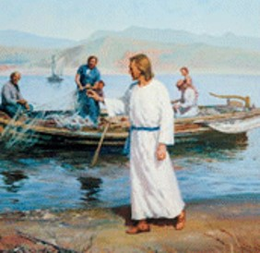
Taking up the Cross
“A voluntary act of submitting our will in the Lord.”
To be saved, we must take up our cross, follow the Savior, and keep His commandments..
“When a Latter-day Saint is obedient to the Lord, whether it be a new commandment or the revocation of a former one, he is demonstrating his desire to follow the Savior by taking up his own cross of obedience.”
D&C 56:2 Otten and Caldwell

Slide 4
Accepting Changes
“One of the great evidences of a Latter-day Saint’s faith in Jesus Christ is his willingness to accept and render obedience to policies, directions, practices, and commandments that have been given and will yet be given by the Lord as announced by His authorized servants.”
Otten and Caldwell
D&C 56:3-4

Slide 5
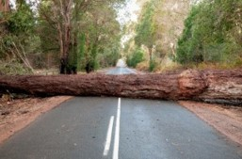
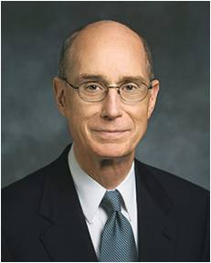
Are You Ready To Go?
“The preparation is to be ready to go and do whatever the Lord wants done as the world is preparing for His coming.
None of us knows exactly what those errands will be. But we know what it will take to be ready, so each of us can prepare.
What you will need in the dramatic moment will be built in the steady performance of obedient service. I will tell you two of the things you will need and the preparation it takes to be ready.”
Henry B. Erying
What Keeps us from being prepared?

Slide 6
Then said Jesus unto his disciples, If any man will come after me, let him deny himself, and take up his cross, and follow me. Matthew 16:24
A young man is approaching the age when he will be able to serve a mission. He worries about everything he will leave behind when he serves.
If we choose not to take up our cross, we may lose opportunities to bless others and receive blessings ourselves
A young woman knows that the youth in her ward will be visiting the temple in a few months, but she doesn’t have a temple recommend. There is something in her life right now that will prevent her from receiving one.

Slide 7
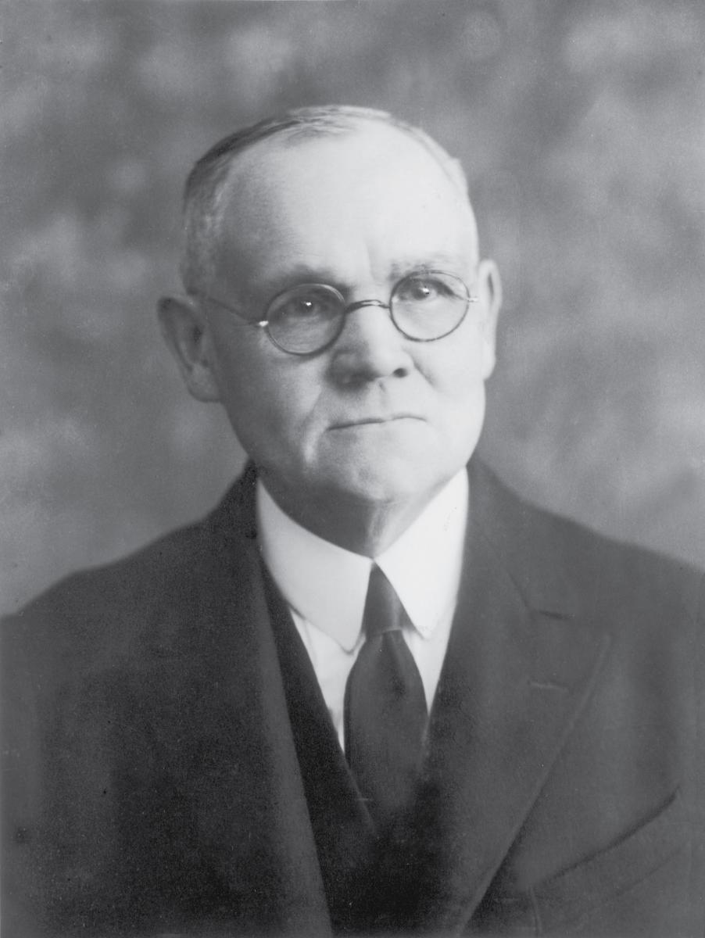
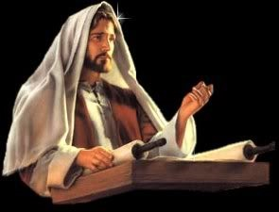
Revoking a Commandment
“Only the rebellious, those who will not obey the commandments of God are to be thus dealt with, are to have their blessings revoked;
Only these will forfeit the blessings to which they were entitled.”
Elder James E. Talmage
Any commandment, or revocation thereof, will be channeled through the Lord’s mouthpiece, the living prophet (D&C 21, 28 ,and 43)
Rebellion is a reason for the Lord to revoke the commandment
The Lord can give a commandment or revoke a commandment as He sees fit
D&C 56:3-4

Slide 8
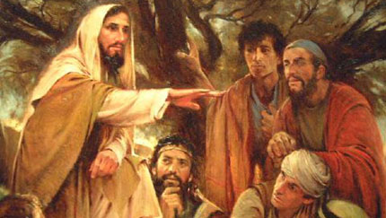
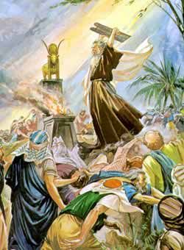
History
After the Lord offered a higher law to Moses and his people, the children of Israel rebelled and began worshiping a golden calf. The Lord then gave them a lesser law.
During the Savior’s mortal ministry, He sent the Apostles only to members of the house of Israel. Shortly after the Savior’s Resurrection, He told the Apostles to preach the gospel to people of all nations.
Exodus 32–34; JST Exodus 34:1–2; D&C 84:23–27; Matthew 10:5; 28:19

Slide 9
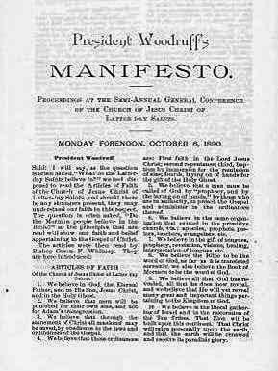
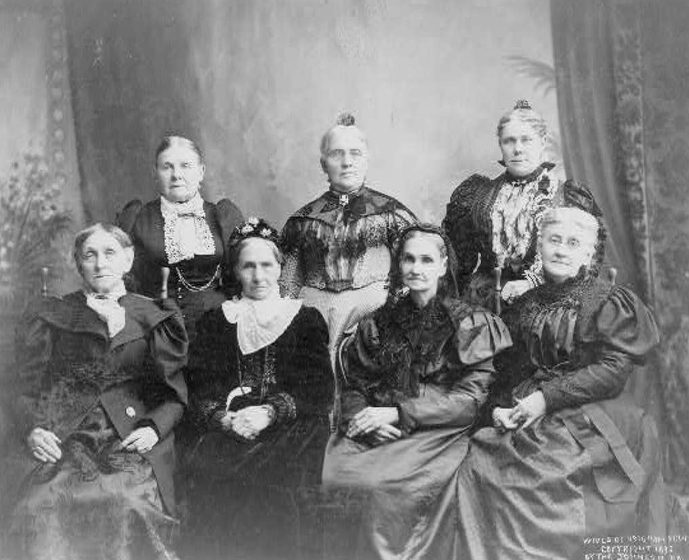
History
In this dispensation the Lord commanded some of the early Saints to practice plural marriage. The Prophet Joseph Smith and many other Church leaders found this commandment difficult, but they obeyed it.
After receiving revelation, President Wilford Woodruff issued the Manifesto, which was accepted by the Church as authoritative and binding on October 6, 1890. This led to the end of the practice of plural marriage in the Church.
Official Declaration 1

Slide 10
Selah J. Griffin
He was born on March 17, 1799, at Redding, Connecticut
He was a blacksmith by trade in Kirtland and became a member of the Church
He was ordained an elder on June 6, 1831, by Joseph Smith
He was called the next day to be Thomas B. Marsh’s companion to Missouri where he and his family settled
His family suffered in Missouri by intense persecution from the mobs which drove them from their home in 1833
He lost everything and concluded that Church service was “too high” and separated himself from the mainstream Saints before their exodus to the West
Who’s Who

Slide 11
Change of Assignments
Selah J. Griffin, formerly assigned to Newel Knight, was assigned to Thomas B. Marsh.
Newel Knight was called to go with the Colesville Saints to Missouri, and Ezra Thayre was released from his missionary calling.
Newel was to remain with Colesville Saints for a short while in Thompson, Ohio
To go to Missouri
D&C 56:5-7

Slide 12
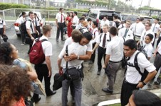
Transfer Day in Mission Field
They get transferred regularly regardless. But that is a consideration. Its to help them stay focused on the work and not get too attached to specific investigators or ward members. Which can make people get lazy and casual.
Sometimes when a missionary is in an area for a long time, (too long), the investigators they work with become more attached to the missionary than the message he is there to teach. We don't need converts *to missionaries* who will someday go home, but to the *gospel* which is eternal.
So, it just makes sense. Transfers happen in the mission areas every 6 weeks, but that doesn't mean they move that often. I’d say a normal length of time in any given area is 3-6 months.
Penny Lane a returned missionary

Slide 13
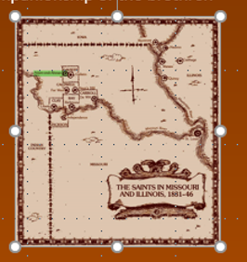
Pride and Selfishness
While living in Thompson, Ohio the Lord gave Ezra another chance to repent and come back into the fold
If he obeyed the Lord with regard to the land on which he lived, he would still have a chance of going to Missouri
He would not lose any money, but he would lose the companionship of the brethren
Ezra chose to repent, and seven months later he was again called to serve as a missionary with Thomas B. Marsh
He also was a member of Zion’s Camp in 1834 in assisting in moving the persecuted saints out of Jackson County, Missouri… he was a member of the stake high council in Adam-ondi-Ahman…later he joined the Reorganized Church
D&C 56:8-13

Slide 14
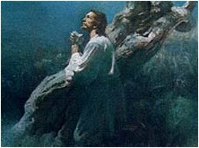
Overcoming and Repenting
Overcoming Selfishness
“Selfishness consists in caring unduly or supremely for oneself; it is one of the lusts of the flesh which must be overcome by those who gain salvation. A selfish person clings to his own comfort, advantage, or position at the expense of others. Men are commanded to repent of their pride and selfishness.
In practice the way to do this is to serve in the Church and make generous financial contributions to sustain its programs.”
Bruce R. McConkie
Seek not to receive council in your own way
Repent through the Lord, because your sins will not just “go away” because you wish it
D&C 56:14-15

Slide 15
Repentance includes obeying the Lord’s counsel and turning away from unrighteous desires
D&C 56:14-15

Slide 16
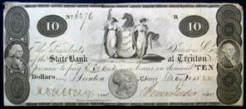
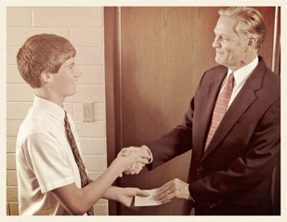
Responsibility of the Rich
The remainder of this revelation was directed to Ezra Thayre. Because of his selfishness, which was a cause of the Colesville Saints’ having to leave Thompson, Ohio, the Lord gave him, and all Saints, counsel on the proper use of temporal things.
The responsibility of the rich:
The Lord has instructed his prophets about how the poor are to be taken care of: such principles as tithing and fast offerings assist Latter-day Saints to take care of their responsibility to the poor.
Student Manual
D&C 56:16

Slide 17
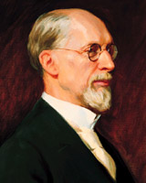
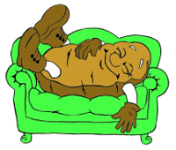
Rich VS Poor
“That is the situation of many of our own brothers and sisters in America with all the blessings that we enjoy—better wages, better homes, better opportunities for education than have ever been known before.
Yet we have today men who not only will not work themselves, but they also will not permit somebody else to be employed.
They are not willing to earn their living by work, but they propose to take it from the rich man. …
D&C 56:17 George A. Smith

Slide 18
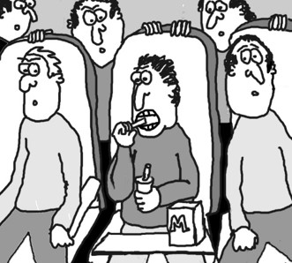
Covet
“We must not fall into the bad habits of other people.
We must not get into the frame of mind that we will take what the other man has.
Refer back to the ten commandments, and you will find one short paragraph, ‘Thou shalt not covet.’
That is what is the matter with a good many people today.
They are coveting what somebody else has, when as a matter of fact, many of them have been cared for and provided with means to live by those very ones from whom they would take away property.”
D&C 56:17 George A. Smith

Slide 19
Those with humble hearts will inherit the earth.
D&C 56:18-20

Slide 20
Sources:
Videos:
Come What May, and Love It (3:31)
Your Day For a Mission (3:31)
History of the Church, 1:186.
Elder James E. Talmage (In Conference Report, Apr. 1921, p. 113
Otten and Caldwell Sacred Truths of the Doctrine and Covenants Vol. 1 page 271
Henry B. Eyring Be Ready October 2009 General Conference
Presentation by ©http://fashionsbylynda.com/blog/
Doctrine and Covenants Who’s Who by Ed J. Pinegar and Richard J. Allen pg 38
Bruce R. McConkie (McConkie, Mormon Doctrine, p. 701.
Doctrine and Covenants Student Manual Religion 324-325 Section 56
George Albert Smith (In Conference Report, Oct. 1949, pp. 170, 172.)
Cartoon by Jeff Burkhart
Presentation by ©http://fashionsbylynda.com/blog/

Slide 21
D&C 56:2
President Ezra Taft Benson spoke of the expectation for young men to sacrifice whatever is necessary to serve a mission:
“Concerning serving a mission, President [Spencer W.] Kimball has said, ‘How selfish and thoughtless would it be for a young man to grow to maturity, spend his time preparing for his life’s work and his occupation and be unwilling to serve his Creator in this, the most important service in the world’ (Regional Representatives’ seminar, 30 Sept. 1977). …
“Young men, this statement by President Kimball should be your personal motto: “Every LDS male who is worthy and able should fill a mission” (Ensign, May 1974, p. 87). We ask you to make the sacrifice. We call it that because of want for a better name for it. It’s an investment. Enlist in this, the greatest service in the world. Do not evade the responsibility. Do not conscientiously object. We invite you to join the army … that is swelling in numbers each day. Your job will be to proclaim the message of the Restoration to the world. Know that you have our confidence and love. We expect you to perform that mission” (“This Is a Day of Sacrifice,” Ensign, May 1979, 33).
Being Prepared to Go:
The first is to have faith. The priesthood is the authority to act in the name of God. It is the right to call down the powers of heaven. So you must have faith that God lives and that you have won His confidence to allow you to use His power for His purposes.
Now, the second thing they will need is confidence that they can live up to the blessings and the trust which God has offered them. Most of the influences around them drag them down to doubt the existence of God, of His love for them, and of the reality of the sometimes quiet messages they receive through the Holy Ghost and the Spirit of Christ. Their peers may urge them to choose sin.
We can help them choose to prepare by loving them, warning them, and by showing confidence in them. But we can help them even more by our example of a faithful and inspired servant. In our families, in quorums, in classes, and as we associate with them in any setting, we can act as true priesthood holders who use its power as God has taught us.
Excerpts from Henry B. Eyring Speaking about the Young men Be Ready
Oct 2009 GEN cONF
Changing Direction: D&C 56:5-7 President Boyd K. Packer of the Quorum of the Twelve Apostles gave insights into how the Lord sometimes changes the direction given to the Church. President Packer encouraged members to trust in the revelation process given to the Apostles and to accept changes in practices and procedures as they are revealed:
“Changes in organization or procedures are a testimony that revelation is ongoing. While doctrines remain fixed, the methods or procedures do not. …
“The gospel plan was revealed line upon line, precept upon precept, here a little, and there a little. And it goes on: ‘We believe that He will yet reveal many great and important things pertaining to the Kingdom of God.’ (A of F 1:9.)
“There will be changes made in the future as in the past. Whether the Brethren make changes or resist them depends entirely upon the instructions they receive through the channels of revelation which were established in the beginning.
“The doctrines will remain fixed, eternal; the organization, programs, and procedures will be altered as directed by Him whose church this is. …
“And in the end, what is given comes because the Lord has spoken it, ‘whether by [His] own voice or by the voice of [His] servants, it is the same.’ (D&C 1:38.) We know His voice when He speaks” (“Revelation in a Changing World,” Ensign, Nov. 1989, 15, 16).

