Slide 2
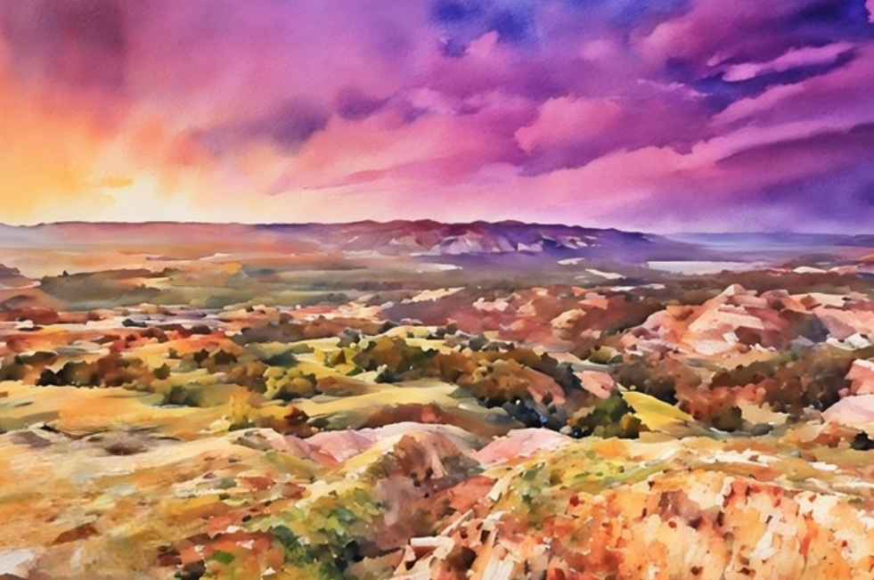
ZION
In June 1831, the Lord commanded Joseph Smith and a group of elders to travel about 800 miles (1,287 km) from Ohio to Missouri, where they would hold a conference and learn about the land of their inheritance.
The revelation recorded in Doctrine and Covenants 57 was received when Joseph Smith and the elders arrived in Missouri in July 1831.
D&C 52: 1,2,5; D&C 57

Slide 3
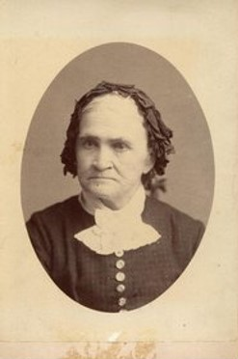
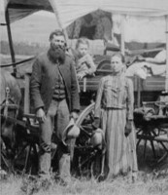
Anxiously Waiting
“Sister Knight, mother of Newel and a member of the Colesville branch, risked her life making the trip to Zion.
Polly’s health was failing, but her anxiety to see the promised land was so great that she refused to be left behind in Ohio. …
Her son wrote, ‘Her only, or her greatest desire, was to set her feet upon the land of Zion, and to have her body interred in that land.’ …
He later reported that ‘the Lord gave her the desire of her heart, and she lived to stand upon that land’
Polly died within two weeks of her arrival in the land of Zion and was the first Latter-day Saint to be buried in Missouri”
Polly Knight Bio
Polly Peck Knight
Unknown photo

Slide 4
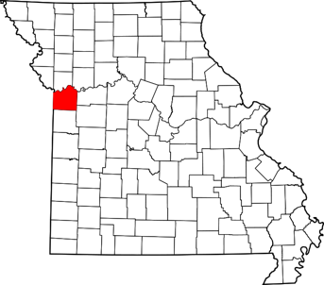
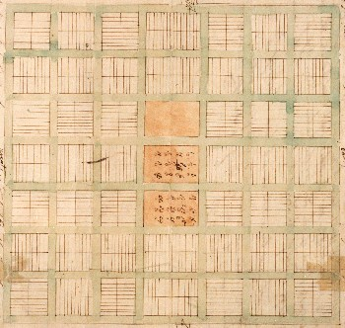
Location, Location, Location
The Lord revealed the location for the city of Zion in Section 57 fulfilling a promise given in Section 52
The Temple is the center place of Zion
D&C 57:1-3

Slide 5
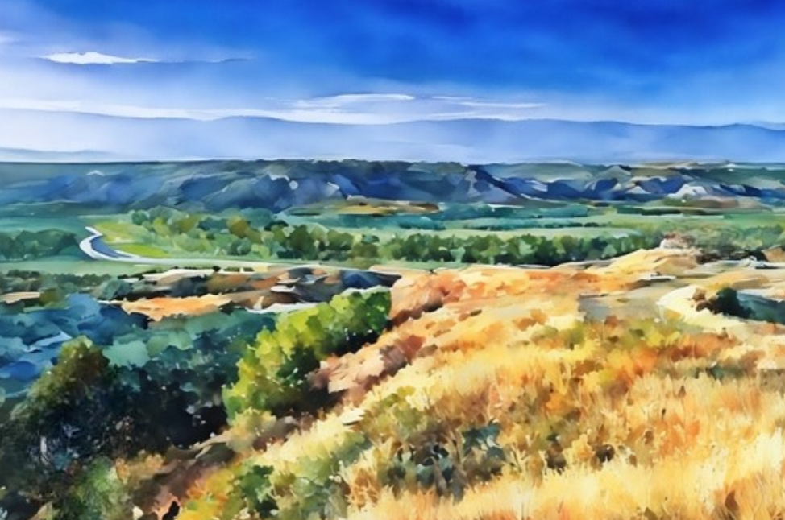
The Saints in the 1830s to establish a city of Zion in Independence, Missouri, were unsuccessful due to persecution. By 1838, the Saints were driven out of Missouri by their enemies.
Although the Lord has promised that there will be a future city of Zion built upon the American continent.
Today we are counseled to build up Zion wherever we live by striving to live righteously and establishing the Church throughout the world.
Articles of Faith 1:10

Slide 6
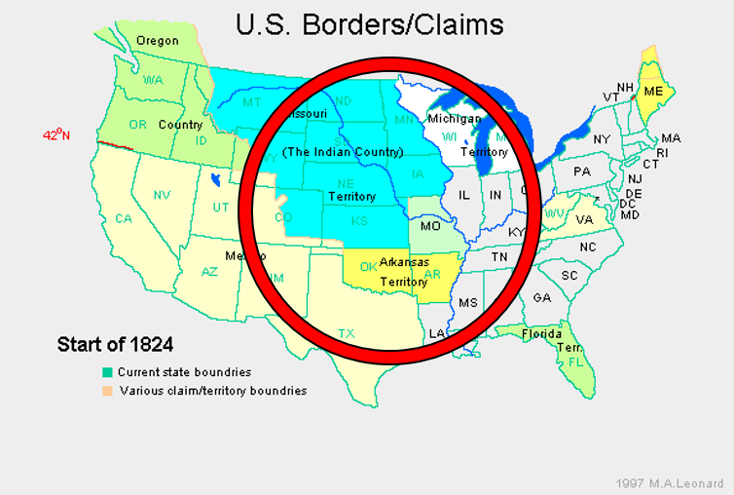
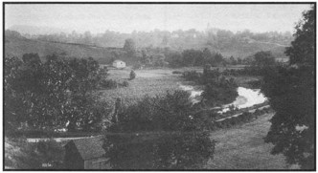
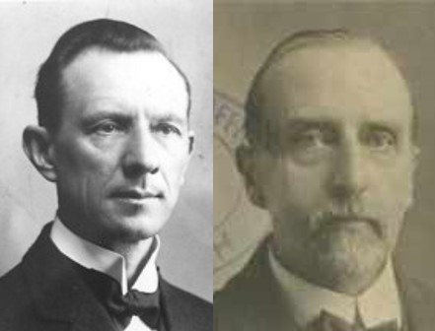
Jews and Gentiles
The Lamanites—Jewish Ancestry /The Saints
The Saints were to be strictly honest in all their dealings with their fellowmen. Jackson county at this time was sparsely settled. There was a great deal of unoccupied land, an this could be secured at the price of $1.25 an acre
Smith and Sjodahl
D&C 57:4

Slide 7
President Joseph Fielding Smith explained that this expression “has reference to the line separating the Lamanites from the settlers in Jackson County.
At this time the United States Government had given to the Indians the lands west of the Missouri, only later to take them away again.
The Lamanites, who are Israelites, were referred to as Jews, and the Gentiles were the people, many of whom were of the lawless element, living east of the river.”
Mosiah 25:1-2
Omni 1:12-17
3 Nephi 2:14-16
4 Nephi 1:17
Helaman 6:21

Slide 8
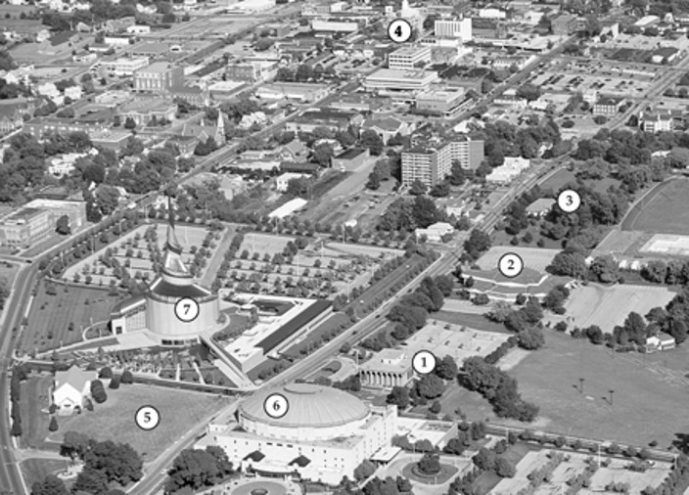
Site of 1833 Church printing office
Community of Christ Temple, a house of public worship
Missouri Independence Mission office
Independence Missouri Stake Center
Auditorium of the Community of Christ, formerly known as the Reorganized Church
Latter-day Visitor’s Center
Spot where the Prophet stood to dedicate the temple lot, no owned by the Church of Christ (Temple Lot)
The temple lot in Independence, Missouri, which was dedicated by the Prophet Joseph Smith on 3 August 1831, and surrounding area. Portions of the temple lot are now owned by the Church and by two other faiths.
Student Manual

Slide 9
Assignments
Sidney Gilbert—an agent for the Church-- to receive money, buy land in surrounding area
He was to establish a store of goods and send goods out to the people
He was also to preach the gospel
Edward Partridge—to divide the land and provisions to the people
He also was instructed to make preparations for the arriving saints
William W. Phelps—to be established as a printer and to write
Oliver Cowdery—to assist William W. Phelps—to copy, correct, and select through the Spirit of the Holy Ghost
The Savior builds up Zion by using our individual abilities.
They were all to come and establish their families in Missouri
D&C 57:6-15

Slide 10
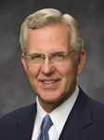
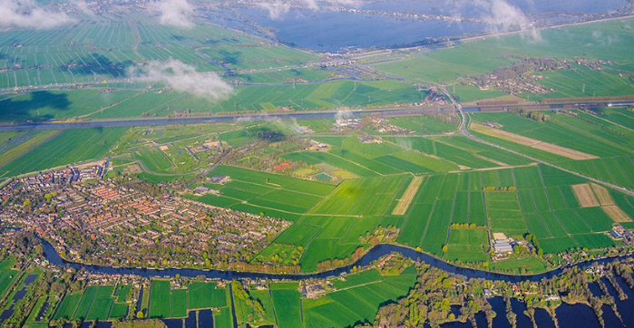
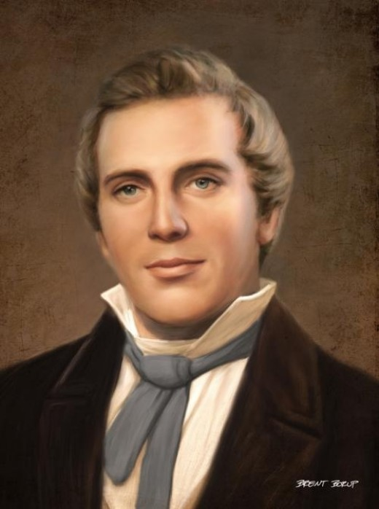
Build Up Zion Today
Through His prophets, He has encouraged us to build Zion wherever we live.
D. Todd Christofferson
We ought to have the building up of Zion as our greatest object.
What are some ways you can establish Zion around you today?
Teachings of Presidents of the Church: Joseph Smith [2007], 186).

Slide 11
Sources:
Video:
“Eyes to See” from time code 4:54 to 6:54
“The Needs before Us” from time code 6:03 to 8:10.
Practice, Celebration, Dedication: Temple Blessing in El Salvador (5:50)
Polly Knight Biography [Scraps of Biography: Tenth Book of the Faith-Promoting Series (1883), 70; see also History of the Church,1:199]. (Church History in the Fulness of Times, 2nd ed. [Church Educational System manual, 2003], 105).
Presentation by ©http://fashionsbylynda.com/blog/
Hyrum M. Smith and Janne M. Sjodahl Doctrine and Covenants Commentary pg. 328-329
Doctrine and Covenants Student Manual Religion 324-325 Section 57
President Joseph Fielding Smith (Church History and Modern Revelation, 1:206; see also the map in Notes and Commentary on D&C 28:9.)
D. Todd Christofferson, “Come to Zion,” Ensign or Liahona, Nov. 2008, 38).
Presentation by ©http://fashionsbylynda.com/blog/

Slide 12
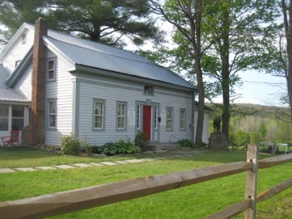
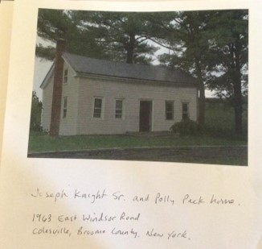
Polly Knight:
Polly Peck Knight (Joseph Knight Sr.'s wife). It said that Joseph Smith spoke at her funeral. The lesson manual said "The Saints from Colesville, New York, were among the first Church members to settle in Missouri. they had made the arduous journey from New York to Kirtland, Ohio, but had lived in Ohio only a short time before being commanded to travel to Missouri. Polly Knight, a member of the Colesville branch, traveled to the land of Zion, only to die there a week later. Although she had been failing in health she was determined to hold on. Her son wrote: "She quietly fell asleep in death, rejoicing in the new and everlasting covenant of the gospel and praising God that she had lived to see the land of Zion. . . Brother Joseph Smith attended the funeral of my mother and addressed us in a very able and consoling manner." (page 184) -Teachings of the Presidents of the Church, Prophet Joseph Smith, page 184
All the way west, Polly Knight, wife of Joseph Knight, Sr., who had mothered young Joseph Smith in the old days at Colesville, had been steadily failing. It was her one great wish to live to see the "land of Zion." Now less than a month after she had arrived with all her family, she passed away. Joseph Smith delayed his departure until after her funeral. Hers was the first death in the church in the land of Zion. Tradition is silent upon the place of her burial.
Polly Peck Knight died on on August 7, 1831, shortly after the "Colesville Branch" arrived in Jackson County, Missouri. The Colesville Saints numbered 62 when they arrived in Independence on July 25, 1831. They stopped a short time at Joshua Lewis's house in what became the Whitmer Settlement, where they participated in the dedication of Zion. There they buried Newel's mother, Polly, the wife of Joseph Knight Sr.
Find a Grave

