Slide 1

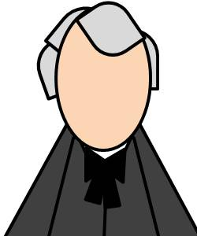
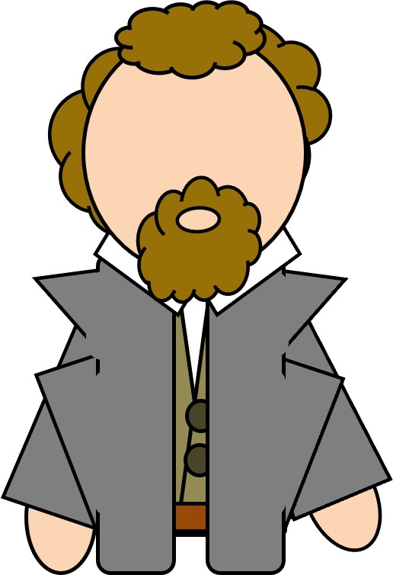
Doctrine and Covenants 58:34-65
Forgiveness For Those Who Repent
Likewise, I say unto you, there is joy in the presence of the angels of God over one sinner that repenteth.
Luke 15:10
Presentation by ©http://fashionsbylynda.com/blog/

Slide 2
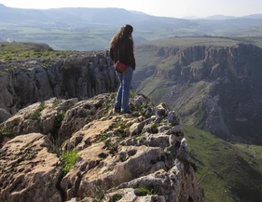


Wounded
Imagine your friend told you he fell from a ledge last night. He feels a lot of pain when he breathes and thinks his arm is broken.
He has decided not to see a doctor because he is worried that the doctor and others will be disappointed if they find out he chose to go near that dangerous ledge.
So, he plans to keep his pain a secret, hoping everything will heal properly in time.

Slide 3
Hiding
A similar situation…
…but this time your friend tells you that he has committed a serious sin.
Rather than follow the Savior’s teachings about repentance, he has decided to hide his sin and hope things will get better over time.

Slide 4
Those Who Need…
Even the most faithful disciples of Jesus Christ need repentance and forgiveness.
Doctrine and Covenants 58 is to invite several leaders of His church to repent and a promise to forgive.

Slide 5
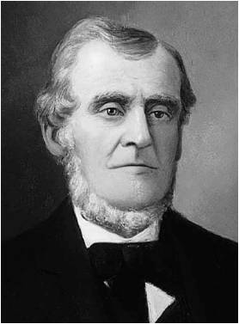
Counsel to Martin Harris
Martin Harris was called to be the first to obey the Law of Consecration
He was instructed to be an example in giving money to the bishop.
He donated a large sum of money to help Bishop Edward Partridge purchase land for the Church.
And Zion cannot be built up unless it is by the principles of the law of the celestial kingdom; otherwise I cannot receive her unto myself.
D&C 105:5
Martin Harris was to repent--of his pride
D&C 58:34-39

Slide 6
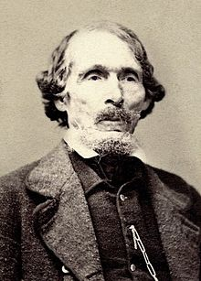
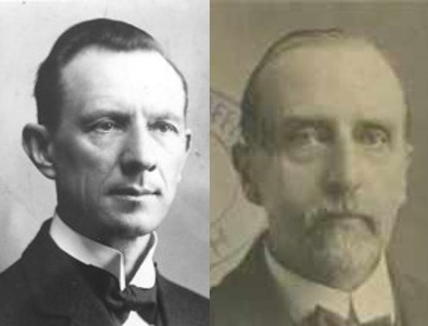
Counsel to William W. Phelps
William W. Phelps’s office was publisher and to receive an inheritance in the land
Excel--He needed to repent because he also sought worldly praise
“Lacking humility and needing to excel—a disposition born of selfishness and pride, unless overcome, it will disqualify one for the celestial kingdom. To excel and to be unconscious of it is the disposition of a humble disciple of Christ”
Smith and Sjodahl
So likewise ye, when ye shall have done all those things which are commanded you, say, We are unprofitable servants: we have done that which was our duty to do.
Luke 17:10
D&C 58:40-41

Slide 7
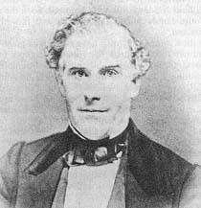
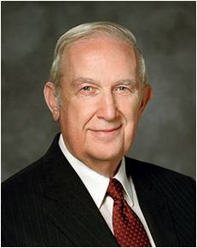
Counsel to Ziba Peterson
Ziba Peterson was released from his present calling and told to repent of his sins which he was hiding.
He was to still work among the brethren
“Satan strives to convince one that sins can be hidden from others, yet it is he that causes them to be revealed in the most compromising circumstances. His objective is the enslavement of God’s children. All of his enticing, alluring temptations have as their root the destruction of the individual.”
Elder Richard G. Scott
Chasten:
Correction or discipline given to individuals or groups in order to help them improve or become.
Guide to the Scriptures
Side Note: Ziba Peterson (died 1849) was an early American Latter-Day Saint best known as one of the four initial missionaries sent by Joseph Smith in 1830 to preach to Native Americans in Indian Territory. This mission brought in several influential converts and introduced the church to Kirtland, Ohio and Jackson County, Missouri, which would become religiously significant to Mormonism.
D&C 58:60

Slide 8
Repent to Receive
But if the wicked will turn from all his sins that he hath committed, and keep all my statutes, and do that which is lawful and right, he shall surely live, he shall not die.
All his transgressions that he hath committed, they shall not be mentioned unto him: in his righteousness that he hath done he shall live.
Ezekiel 18:21-22
If we repent of our sins, the Lord will forgive us.
D&C 58:42-43

Slide 9
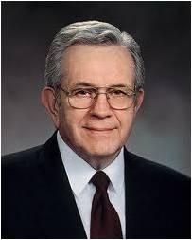
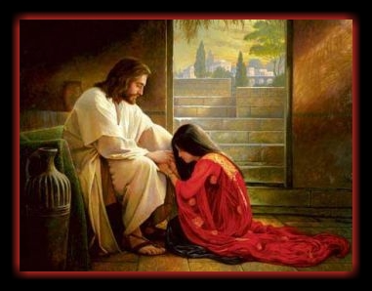
Remember No More
“No matter what our transgressions have been, no matter how much our actions may have hurt others, that guilt can all be wiped out. To me, perhaps the most beautiful phrase in all scripture is when the Lord said, ‘Behold, he who has repented of his sins, the same is forgiven, and I, the Lord, remember them no more’. “That is the promise of the gospel of Jesus Christ and the Atonement”
Elder Boyd K. Packer
D&C 58:42

Slide 10
Doctrinal Mastery
Behold, he who
has repented of his sins, the same is forgiven, and I, the Lord, remember them no more.
By this ye may know if a man repenteth of his sins—behold, he will confess them and forsake them.
D&C 58:42-43

Slide 11
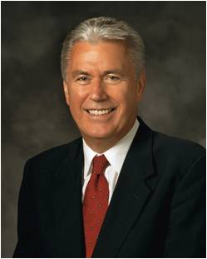
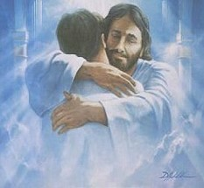
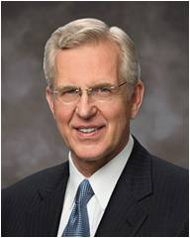
Confess and Forsake
“Once we have truly repented, Christ will take away the burden of guilt for our sins.
We can know for ourselves that we have been forgiven and made clean.
The Holy Ghost will verify this to us; He is the Sanctifier.
No other testimony of forgiveness can be greater.”
President Dieter F. Uchtdorf
“Confessing and forsaking are powerful concepts. They are much more than a casual ‘I admit it; I’m sorry.’ Confession is a deep, sometimes agonizing acknowledgment of error and offense to God and man”
Elder D. Todd Christofferson
D&C 58:43

Slide 12

Repentance—A Change of Heart
“Repentance is more than simply acknowledging wrongdoings. It is a change of mind and heart. It includes turning away from sin and turning to God for forgiveness. It is motivated by love for God and the sincere desire to obey His commandments”
For the Strength of Youth
To repent, the Lord requires us to confess and forsake our sins.

Slide 13

Am I Really Forgiven?
Some people mistakenly think that if they can still remember their sins then they haven’t fully repented.
“Satan will try to make us believe that our sins are not forgiven because we can remember them. Satan is a liar; he tries to blur our vision and lead us away from the path of repentance and forgiveness.
God did not promise that we would not remember our sins. Remembering will help us avoid making the same mistakes again.
But if we stay true and faithful,
the memory of our sins will
be softened over time. This
will be part of the needed
healing and sanctification
process”
President Dieter F. Uchtdorf
D&C 58:43

Slide 14

Not Yet
Why Were the Saints Commanded Not to All Gather Immediately to the Land of Zion?
The time had not yet come and would not for “many years” for all the Saints to receive their inheritances in Zion.
A great deal of work, preparation, and patience is required before Zion can be fully established.
The Church had neither the strength nor the means to purchase lands sufficient for all the Saints in Zion.
So, before Zion could be established, a great deal of missionary work needed to be done to strengthen the Church.
Student Manual
D&C 58:44-48, 56

Slide 15

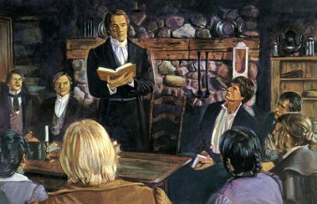
The Gospel is For Everyone
The Saints were told to “push the people together from the ends of the earth”, that is, through missionary work they must gather together the dispersed members of the house of Israel preparatory to the establishment of Zion. The Church is still in that process.
Elders were to build up Zion
Elders were and are to preach the gospel to all the world
The gospel must be preached to every person.
D&C 58:44-62

Slide 16
Sources:
Video:
“The Savior Wants to Forgive” (5:50),
Reclaimed (3:26)
Hyrum M. Smith and Janne M. Sjodahl Doctrine and Covenants Commentary pg. 343
Elder Richard G. Scott To Be Free of Heavy Burdens October 2002 General Conference
Boyd K. Packer (“The Atonement,” Ensign or Liahona, Nov. 2012, 77).
President Dieter F. Uchtdorf (“Point of Safe Return,” Ensign or Liahona, May 2007, 101).
For the Strength of Youth [booklet, 2011], 28)
Presentation by ©http://fashionsbylynda.com/blog/
Elder D. Todd Christofferson (“The Divine Gift of Repentance,” Ensign or Liahona, Nov. 2011, 40).
Doctrine and Covenants Student Manual Religion 324-325 Section 58
Presentation by ©http://fashionsbylynda.com/blog/

Slide 17
Repentance, however, requires that we forsake and turn completely from our sins and confess them. Elder Spencer W. Kimball taught: “No one can ever be forgiven of any transgression until there is repentance, and one has not repented until he has bared his soul and admitted his intentions and weaknesses without excuses or rationalizations. He must admit to himself that he has grievously sinned. When he has confessed to himself without the slightest minimizing of the offense, or rationalizing its seriousness, or soft-pedaling its gravity, and admits it is as big as it really is, then he is ready to begin his repentance; and any other elements of repentance are of reduced value, until the conviction is established totally, and then repentance may mature and forgiveness may eventually come.” (Love Versus Lust, Brigham Young University Speeches of the Year [Provo, 5 Jan. 1965], p. 10.)
The Lord’s forgiveness comes to those who truly repent. Elder Kimball also said that “those who heed the call, whether members or nonmembers of the Church, can be partakers of the miracle of forgiveness. God will wipe away from their eyes the tears of anguish, and remorse, and consternation, and fear, and guilt. Dry eyes will replace the wet ones, and smiles of satisfaction will replace the worried, anxious look.
“What relief! What comfort! What joy! Those laden with transgressions and sorrows and sin may be forgiven and cleansed and purified if they will return to their Lord, learn of him, and keep his commandments. And all of us needing to repent of day-to-day follies and weaknesses can likewise share in this miracle.” President Spencer W. Kimball (Miracle of Forgiveness, pp. 367–68.)
Elder Russell M. Nelson of the Quorum of the Twelve Apostles explained what it means to repent:
“The doctrine of repentance is much broader than a dictionary’s definition. When Jesus said ‘repent,’ His disciples recorded that command in the Greek language with the verb metanoeo. This powerful word has great significance. In this word, the prefix meta means ‘change.’ The suffix relates to four important Greek terms: nous, meaning ‘the mind’; gnosis, meaning ‘knowledge’; pneuma ,meaning ‘spirit’; and pnoe, meaning ‘breath.’
“Thus, when Jesus said ‘repent,’ He asked us to change—to change our mind, knowledge, and spirit—even our breath. A prophet explained that such a change in one’s breath is to breathe with grateful acknowledgment of Him who grants each breath. King Benjamin said, ‘If ye should serve him who has created you … and is preserving you from day to day, by lending you breath … from one moment to another—I say, if ye should serve him with all your whole souls yet ye would be unprofitable servants.’ [Mosiah 2:21.]
“Yes, the Lord has commanded us to repent, to change our ways, to come unto Him, and be more like Him. [See 3 Nephi 27:21, 27.] This requires a total change” (“Repentance and Conversion,” Ensign or Liahona, May 2007, 103).
D&C 58:50–51. A Commandment to Write a Description of Zion
The Lord commanded Sidney Rigdon to write a description of the land in Missouri and to listen to the Spirit in order to write the will of the Lord concerning the land. Then he was to write a letter to the Saints in general and include a subscription to raise money for the purchase of the land. Since photographs were unobtainable, Sidney Rigdon’s description could encourage the Saints in sending contributions for the purchase. (Later the Lord indicated that what Sidney Rigdon had written was unacceptable, probably in reference to this assignment; see D&C 63:55–56.)
The following description of Zion was included in the History of the Church, although whether it is a version of Sidney Rigdon’s description or whether it was written by someone else is not clear: “The country is unlike the timbered states of the East. As far as the eye can reach the beautiful rolling prairies lie spread out like a sea of meadows; and are decorated with a growth of flowers so gorgeous and grand as to exceed description; and nothing is more fruitful, or a richer stockholder in the blooming prairie than the honey bee. Only on the water courses is timber to be found. There in strips from one to three miles in width, and following faithfully the meanderings of the streams, it grows in luxuriant forests. The forests are a mixture of oak, hickory, black walnut, elm, ash, cherry, honey locust, mulberry, coffee bean, hackberry, boxelder, and bass wood; with the addition of cottonwood, butterwood, pecan, and soft and hard maple upon the bottoms. The shrubbery is beautiful, and consists in part of plums, grapes, crab apple, and persimmons.
“The soil is rich and fertile; from three to ten feet deep, and generally composed of a rich black mould, intermingled with clay and sand. It yields in abundance, wheat, corn, sweet potatoes, cotton and many other common agricultural products. Horses, cattle and hogs, though of an inferior breed, are tolerably plentiful and seem nearly to raise themselves by grazing in the vast prairie range in summer, and feeding upon the bottoms in winter. The wild game is less plentiful of course where man has commenced the cultivation of the soil, than in the wild prairies. Buffalo, elk, deer, bear, wolves, beaver and many smaller animals here roam at pleasure. Turkeys, geese, swans, ducks, yea a variety of the feathered tribe, are among the rich abundance that grace the delightful regions of this goodly land—the heritage of the children of God.
“The season is mild and delightful nearly three quarters of the year, and as the land of Zion, situated at about equal distances from the Atlantic and Pacific oceans, as well as from the Alleghany and Rocky mountains, in the thirty-ninth degree of north latitude, and between the sixteenth and seventeenth degrees of west longitude, it bids fair—when the curse is taken from the land—to become one of the most blessed places on the globe. The winters are milder than the Atlantic states of the same parallel of latitude, and the weather is more agreeable; so that were the virtues of the inhabitants only equal to the blessings of the Lord which He permits to crown the industry of those inhabitants, there would be a measure of the good things of life for the benefit of the Saints, full, pressed down, and running over, even an hundredfold.” (History of the Church, 1:197–98.)
Doctrine and Covenants 58:39. “Repent”
Elder D. Todd Christofferson of the Quorum of the Twelve Apostles taught that repentance is more than just a checklist of things to do:
“Attempts to create a list of specific steps of repentance may be helpful to some, but it may also lead to a mechanical, check-off-the-boxes approach with no real feeling or change. True repentance is not superficial. The Lord gives two overarching requirements: ‘By this ye may know if a man repenteth of his sins—behold, he will confess them and forsake them’ (D&C 58:43)” (“The Divine Gift of Repentance,” Ensign or Liahona, Nov. 2011, 40).

Slide 18
Requirements of Confession:
“You always need to confess your sins to the Lord. If they are serious transgressions, such as [sexual] immorality, they need to be confessed to a bishop or stake president. Please understand that confession is not repentance. It is an essential step but is not of itself adequate. Partial confession by mentioning lesser mistakes will not help you resolve a more serious, undisclosed transgression. Essential to forgiveness is a willingness to fully disclose to the Lord and, where necessary, His priesthood judge all that you have done” Elder Richard G. Scott (“Finding Forgiveness,” Ensign, May 1995, 76).
Honesty in Confession:
“No one can ever be forgiven of any transgression until there is repentance, and one has not repented until he has bared his soul and admitted his intentions and weaknesses without excuses or rationalizations” President Spencer W. Kimball (Love versus Lust, Brigham Young University Speeches of the Year [Jan. 5, 1965], 10).
Serious Transgression:
“Serious transgression such as immorality requires the help of one who holds keys of authority, such as a bishop or stake president, to quietly work out the repentance process to make sure that it is complete and appropriately done” Elder Richard G. Scott (“The Power of Righteousness,” Ensign, Nov. 1998, 69–70).
Confess and Forsake:
“The forsaking of sins implies never returning. Forsaking requires time. To help us, the Lord at times allows the residue of our mistakes to rest in our memory. It is a vital part of our mortal learning.
“As we honestly confess our sins, restore what we can to the offended, and forsake our sins by keeping the commandments, we are in the process of receiving forgiveness. With time, we will feel the anguish of our sorrow subside, taking ‘away the guilt from our hearts’ [Alma 24:10] and bringing ‘peace of conscience.’ [Mosiah 4:3.]
“For those who are truly repentant but seem unable to feel relief: continue keeping the commandments. I promise you, relief will come in the timetable of the Lord. Healing also requires time” Elder Neil L. Anderson (“Repent … That I May Heal You,” Ensign or Liahona, Nov. 2009, 42).

