Slide 1

Doctrine and Covenants 59
The Lord’s Day
And upon the first day of the week, when the disciples came together to break bread, Paul preached unto them, ready to depart on the morrow; and continued his speech until midnight.
Acts 20:7
Sunday | Monday | Tuesday | Wednesday | Thursday | Friday | Saturday
Presentation by ©http://fashionsbylynda.com/blog/

Slide 2
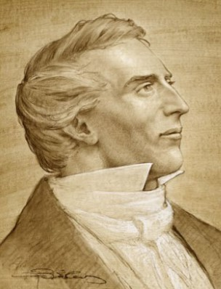
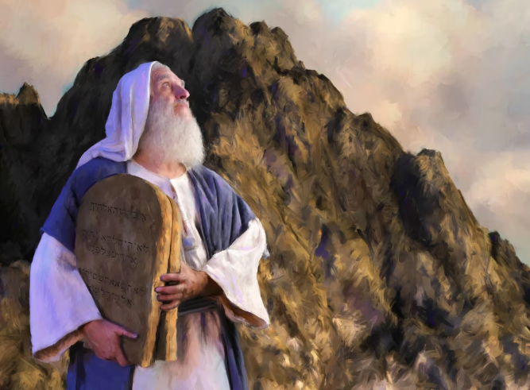
Background
In 1831 the Lord called some Saints to move to Jackson County, Missouri, to establish Zion.
While the Prophet Joseph Smith was with these Saints, he received instructions from the Lord about keeping the Sabbath day holy.
And I, God, blessed the seventh day, and sanctified it; because that in it I had rested from all my work which I, God, had created and made.
Moses 3:3

Slide 3
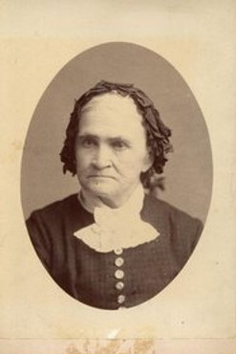
Polly Knight—First Church Member to Die in Zion
Jackson County, Missouri—Aug. 7, 1831
Although her health was failing at age 55, Polly Knight left her home in Colesville, New York, determined to obey the Lord and come to Zion.
Polly made it to Zion (Jackson County, Missouri) and died a few days later.
On the day of her funeral, a Sunday, the Prophet Joseph Smith received the revelation recorded in Doctrine and Covenants 59.
In this revelation, the Lord taught truths that could comfort Polly’s family (see verses 1–2).
He also spoke of His commandments, with an emphasis on the Sabbath. The Lord promised great blessings to those who keep the Sabbath day holy.
D&C 59:1-2

Slide 4

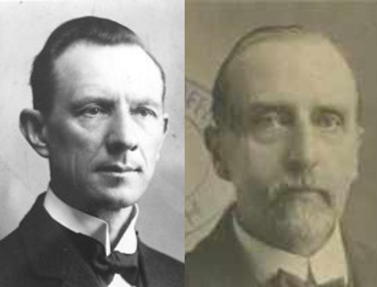
Blessed Means Happiness
Conditions for happiness:
Those who come “with an eye single to my glory, according to my commandments.”
“Those who go there to get wealth, and honor have something else in view than the glory of God, and they have no promise of happiness”
Smith and Sjodahl
D&C 59:1

Slide 5
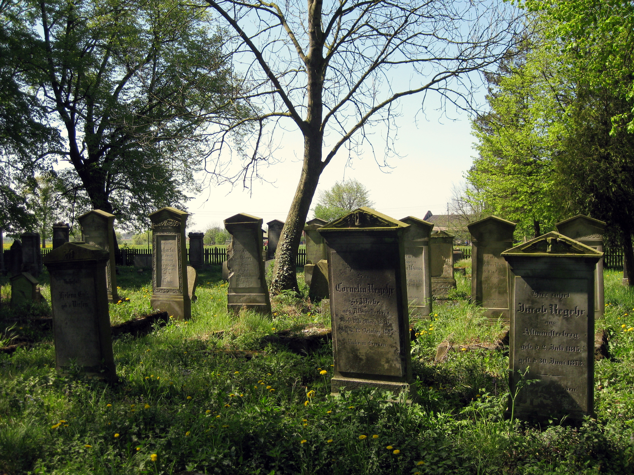


They That Live —They That Die
Those in Zion
This is the Lord’s earth and He will share it with them
The architect will rest but his house remains standing—his legacy
“Those who die shall rest from their labors. Death to them is but a sweet repose, a rest from toil, a refreshing sleep, from which they shall awake in the morning of the resurrection.”
Smith and Sjodahl
D&C 59:2

Slide 6

Happy Are They Who…
Keep the commandments
Keep the Law of Consecration
Keep all other laws and ordinances of the gospel
“Those who love God, love His commandments, as blessings bestowed upon them.
Love prompts them to render obedience”
Smith and Sjodahl
D&C 59:3-4

Slide 7
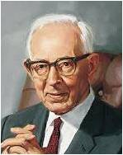
“Today, with the earth subject to Satan’s rule, it is quite generally the selfish, self-centered, proud and haughty people of the earth who apparently inherit it.
This is in harmony with the spirit of unrighteousness which has prevailed on the earth since the fall of man. When Christ comes to take possession of the earth and rule in his right as King of kings, he will keep his promise and the meek shall come into their own [see Matthew 5:5].
If they die, even then their inheritance shall stand, for the earth is to be the eternal abode of those who inherit the celestial kingdom. …
This earth eventually … will be prepared for the righteous, or the meek, and it is their everlasting inheritance.”
President Joseph Fielding Smith
If we keep the commandments with an eye single to the glory of God, then we will be blessed both temporally and spiritually.
D&C 59:4

Slide 8

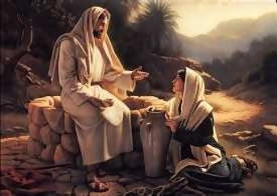
With All
What do you think it means to love the Lord with all of your ________?
What are some actions or attitudes you might see in people who love the Lord
with all of their ________________ versus those who do not?
D&C 59:5

Slide 9



The Great Commandment
“Thou shalt love the Lord thy God with all thy hear, with all thy might, mind, and strength; and in the name of Jesus Christ thou shalt serve him.”
We must love God with all of our heart, might, mind, and strength
Heart---emotions or sentiments
Might---the soul—spiritual faculties. See Matthew 22:37
Mind---intellect
Strength—physical attributes
As a oneness
“This commandment enjoins on us to lover our Heavenly Father so that our entire beings—our emotions, our spiritual faculties, our mental and physical activities are all devoted to Him and His service.”
Smith and Sjodahl
D&C 59:5-6

Slide 10

The 2nd Great Commandment
Thou shalt love thy neighbor as thyself. Thou shalt not steal; neither commit adultery, nor kill, nor do anything like unto it.
This law is eternal. It is given to Israel…it is given to us
Thou shalt not avenge, nor bear any grudge against the children of thy people, but thou shalt love thy neighbour as thyself: I am the Lord.
Leviticus 19:18
“God does not give a command that cannot be obeyed.”
Smith and Sjodahl
D&C 59:6

Slide 11
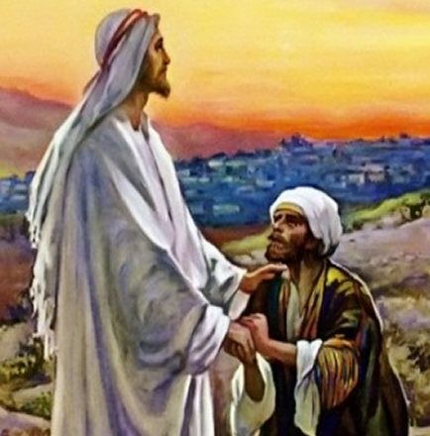

Other Commandments
Thou shalt thank the Lord thy God in all things.
“Gratitude is a natural manifestation of love. We are commanded to thank God “in all things;”
in adversity as well as prosperity;
in sorrow as well as joy;
in death as well as life;.
If we love God, we shall never pray for benefits without thanking Him for blessings already bestowed.”
Smith and Sjodahl
D&C 59:7

Slide 12
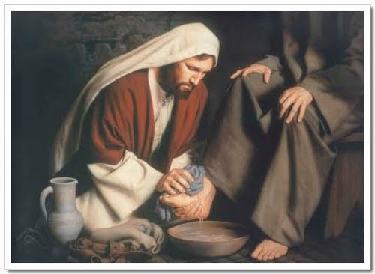
A Sacrifice
Thou shalt offer a sacrifice unto the Lord thy God in righteousness, even that of a broken heart and a contrite spirit.
“Sacrifice is a natural manifestation of love. But the sacrifice God delights in is a “broken heart, and a contrite spirit… D&C 52:15...
Humility is the beginning of exaltation.”
Smith and Sjodahl
D&C 59:8

Slide 13
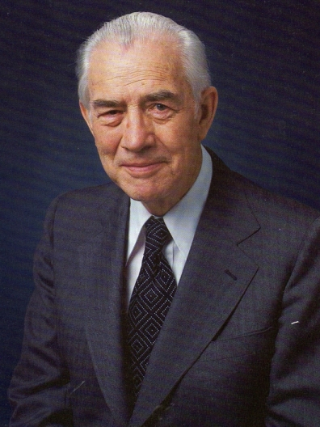
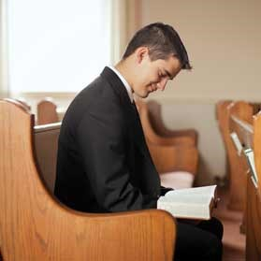
Sabbath Day—His Holy Day
And that thou mayest more fully keep thyself unspotted from the world, thou shalt go to the house of prayer and offer up thy sacraments upon my holy day.
For verily this is a day appointed unto you to rest from your labors, and to pay thy devotions unto the Most High;
“Our observance or nonobservance of the Sabbath Day is an unerring measure of our attitude toward the Lord personally and toward his suffering in Gethsemane, his death on the cross, and his resurrection from the dead” Elder Mark E. Petersen
D&C 59:9-10

Slide 14
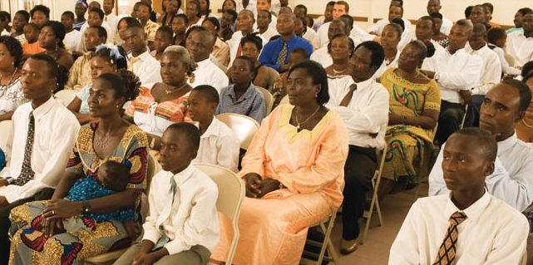
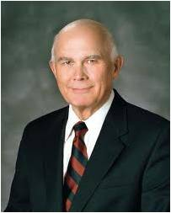
The Sabbath is a day for us to show our devotion to God.
“This is a commandment with a promise. By participating weekly and appropriately in the ordinance of the sacrament we qualify for the promise that we will ‘always have his Spirit to be with us.”
Elder Dallin H. Oaks
D&C 59:9-10

Slide 15
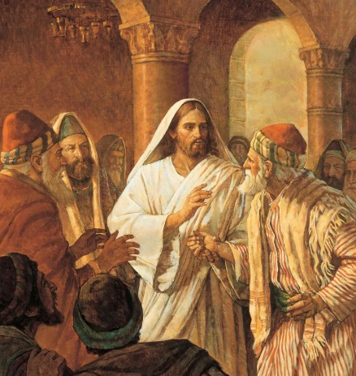
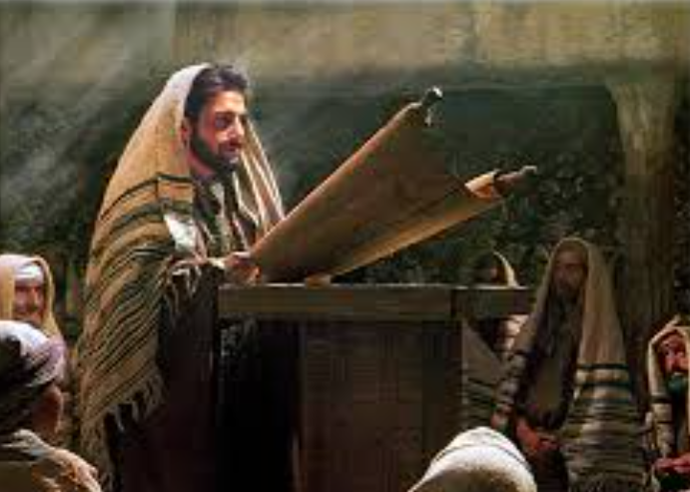
What did Jesus do on the Sabbath Day?
Matthew 12:9-13
Luke 4:16

Slide 16


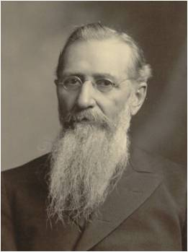
All Days—At All Times
“We do not believe in worshiping God, or being religious on the Sabbath day only;
but we believe it is as necessary to be religious on Monday, Tuesday and every day of the week, as it is on the Sabbath day…
…Believing and acting thus, we become strengthened in our faith, the Spirit of God increases with us, we advance in knowledge, and we are better able to defend the cause we are engaged in.”
Joseph F. Smith
D&C 59:11

Slide 17
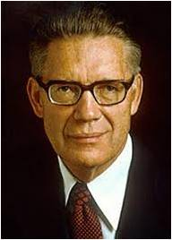
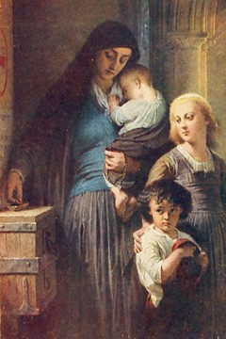
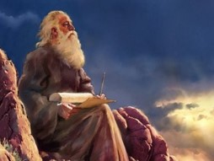
Oblation
Oblation is defined as:
“Giving full devotion to the Lord, of offering him a broken heart and a contrite spirit.
In a lesser and more temporal sense, an oblation is the offering of sacrifices, or of fast offering, or of any charitable contribution to the Church.
Isaiah spoke of vain oblations meaning the ritualistic offering of sacrifices when the spirit and meaning of the ordinance and offering had been lost. (Isa. 1:13)
Ezekiel foretold that oblations would again be offered by Israel in the day of gathering (Ezek. 20:33-44).”
Elder Bruce R. McConkie
D&C 59:12

Slide 18
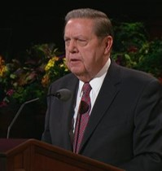
Fasting—May Be Perfect
Is not this the fast that I have chosen? to loose the bands of wickedness, to undo the heavy burdens, and to let the oppressed go free, and that ye break every yoke?
Is it not to deal thy bread to the hungry, and that thou bring the poor that are cast out to thy house? when thou seest the naked, that thou cover him; and that thou hide not thyself from thine own flesh?
Isaiah 58:6-7
I bear witness of the miracles, both spiritual and temporal, that come to those who live the law of the fast. I bear witness of the miracles that have come to me. Truly, as Isaiah recorded, I have cried out in the fast more than once, and truly God has responded, “Here I am.”
Cherish that sacred privilege at least monthly, and be as generous as circumstances permit in your fast offering and other humanitarian, educational, and missionary contributions. I promise that God will be generous to you, and those who find relief at your hand will call your name blessed forever.
More than three-quarters of a million members of the Church were helped last year through fast offerings administered by devoted bishops and Relief Society presidents. That is a lot of grateful Latter-day Saints.”
Elder Jeffrey R. Holland
D&C 59:13-14

Slide 19
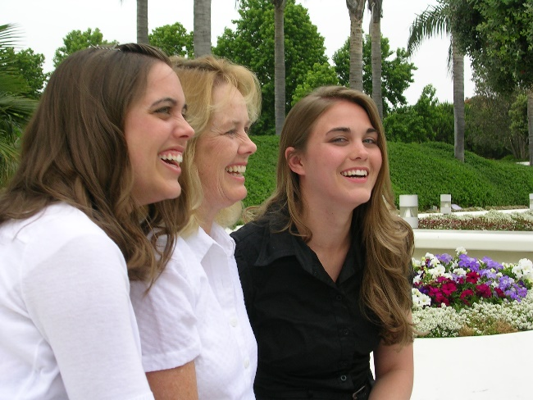
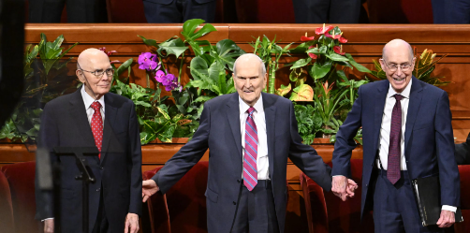
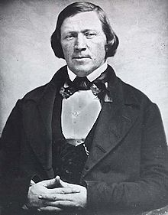
A Time to Laugh
Though laughter at the appropriate time is not sin, it must be governed.
“Joyful laughter meets with divine approval, and when properly engaged in, it is wholesome and edifying. Incident to the normal experiences of mortality, there is ‘A time to weep, and a time to laugh.’ (Eccles. 3:4.) …
“I like to be pleased myself; I like to be filled with joy, but if I cannot be filled with joy and gladness that is full of meat and marrow, or, in other words, full of meaning and sense, I would rather retain my gravity.
“There is but one step between life and death, between faithfulness and apostasy, between the sublime and the ridiculous. …
“Never give way to vain laughter.”
President Brigham Young
D&C 59:15

Slide 20
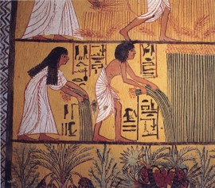

Ye Shall Prosper
Blessings of Obedience
One of the prominent themes of the Book of Mormon is that “as ye shall keep my commandments, ye shall prosper.”
“Prosper” implies more than an accumulation of physical wealth, but temporal prosperity is included in that blessing.
The Lord promises to bless the land as well as the people.
And inasmuch as ye shall keep my commandments, ye shall prosper, and shall be led to a land of promise; yea, even a land which I have prepared for you; yea, a land which is choice above all other lands.
1 Nephi 2:20
D&C 59:16-20

Slide 21
Blessings
How Do we respond to the blessings given to us by God?
We offend God when we do not express our gratitude to Him and keep His commandments
D&C 59:20-24

Slide 22

Earthly and Eternal Blessings
“This gift of eternal life in the world to come may not, of course, be fully realized during earth life. An assurance that it will be obtained in the world to come may, however, be had in this world. As a matter of fact, the blessings of the celestial kingdom are promised only to those who have such an assurance. According to the vision, a successful candidate for these blessings must qualify on three counts:
1st
One must have ‘… received the testimony of Jesus, and believed on his name’ and been ‘… baptized after the manner of his burial’;
2nd
One must have received ‘the Holy Spirit by the laying on of the hands of him who is ordained and sealed unto this power
3rd
One must be ‘sealed by the Holy Spirit of promise.’ (D. & C. 76:51–53.)
D&C 59:20-24 Elder Marion G. Romney

Slide 23
Sources:
Videos:
“Only upon the Principles of Righteousness” from time code 5:24 to 6:26,
“Upon My Holy Day” (9:52)
Elder Hales Talks about Gratitude (3:35)
Hyrum M. Smith and Janne M. Sjodahl Doctrine and Covenants Commentary pg. 348
President Joseph Fielding Smith (Church History and Modern Revelation, 1:215–16.)
Elder Mark E. Peterson “The Sabbath Day,” Ensign, May 1975, 49
Elder Dallin H. Oaks (“Sacrament Meeting and the Sacrament,” Ensign or Liahona, Nov. 2008, 17, 20).
Joseph F. Smith Journal of Discourse Vol. VI p, 277
Presentation by ©http://fashionsbylynda.com/blog/
Elder Bruce R. McConkie (Mormon Doctrine, pp. 541–42.)
Elder Jeffrey R. Holland Are We Not All Beggars? Oct. 2014 Gen. Conf.
President Brigham Young (In Journal of Discourses, 9:290.)
Elder Marion G. Romney (In Conference Report, Oct. 1949, pp. 39–45.)
Presentation by ©http://fashionsbylynda.com/blog/

Slide 24
“Sister Knight, mother of Newel and a member of the Colesville branch, risked her life making the trip to Zion.
Polly’s health was failing, but her anxiety to see the promised land was so great that she refused to be left behind in Ohio. …
Her son wrote, ‘Her only, or her greatest desire, was to set her feet upon the land of Zion, and to have her body interred in that land.’ …
He later reported that ‘the Lord gave her the desire of her heart, and she lived to stand upon that land’
Polly died within two weeks of her arrival in the land of Zion and was the first Latter-day Saint to be buried in Missouri”
Polly Knight Bio
Doctrine and Covenants 59:9. “My holy day”
The revelation recorded in Doctrine and Covenants 59 was the first revelation recorded in this dispensation in which the Lord gave specific instructions on Sabbath day observance. The Lord directed the revelation toward the Saints who would be building up the city of Zion. These Saints lived near other residents of Jackson County, many of whom followed a worldly trend and did not keep the Sabbath day holy, choosing instead to pursue various forms of entertainment.
Resting on the Sabbath Day:
I first found delight in the Sabbath many years ago when, as a busy surgeon, I knew that the Sabbath became a day for personal healing. By the end of each week, my hands were sore from repeatedly scrubbing them with soap, water, and a bristle brush. I also needed a breather from the burden of a demanding profession. Sunday provided much-needed relief. …
In Hebrew, the word Sabbath means “rest.” The purpose of the Sabbath dates back to the Creation of the world, when after six days of labor the Lord rested from the work of creation. (Russell M. Nelson, “The Sabbath Is a Delight,” Ensign or Liahona, May 2015, 129)
I believe [Jesus Christ wants] us to understand that the Sabbath was His gift to us, granting real respite from the rigors of daily life and an opportunity for spiritual and physical renewal. God gave us this special day, not for amusement or daily labor but for a rest from duty, with physical and spiritual relief. (Russell M. Nelson, “The Sabbath Is a Delight,” Ensign or Liahona, May 2015, 129)
Doctrine and Covenants 59:9. “Keep thyself unspotted from the world”
Elder Dallin H. Oaks of the Quorum of the Twelve Apostles explained how partaking of the sacrament can help us remain unspotted from the world:
“We live in the perilous times prophesied by the Apostle Paul (see 2 Timothy 3:1). Those who try to walk the straight and narrow path see inviting detours on every hand. We can be distracted, degraded, downhearted, or depressed. How can we have the Spirit of the Lord to guide our choices and keep us on the path?
“In modern revelation the Lord gave the answer in this commandment:
“‘And that thou mayest more fully keep thyself unspotted from the world, thou shalt go to the house of prayer and offer up thy sacraments upon my holy day;
“‘For verily this is a day appointed unto you to rest from your labors, and to pay thy devotions unto the Most High’ (D&C 59:9–10).
“This is a commandment with a promise. By participating weekly and appropriately in the ordinance of the sacrament we qualify for the promise that we will ‘always have his Spirit to be with [us]’ (D&C 20:77). That Spirit is the foundation of our testimony. It testifies of the Father and the Son, brings all things to our remembrance, and leads us into truth. It is the compass to guide us on our path. This gift of the Holy Ghost, President Wilford Woodruff taught, ‘is the greatest gift that can be bestowed upon man’ (Deseret Weekly, Apr. 6, 1889, 451). …
“How can we have the Spirit of the Lord to guide our choices so that we will remain ‘unspotted from the world’ (D&C 59:9) and on the safe path through mortality? We need to qualify for the cleansing power of the Atonement of Jesus Christ. We do this by keeping His commandment to come to Him with a broken heart and a contrite spirit and in that wonderful weekly meeting partake of the emblems of the sacrament and make the covenants that qualify us for the precious promise that we will always have His Spirit to be with us (see D&C 20:77)” (“Sacrament Meeting and the Sacrament,” Ensign or Liahona, Nov. 2008, 17, 20).
Pay Thy Devotion unto the Most High
President John Taylor said: “To serve the Lord, is one of the great objects of our existence; and I appreciate as a great privilege the opportunity we enjoy of worshiping God on the Sabbath day. And when we do meet to worship God, I like to see us worship him with all our hearts. I think it altogether out of place on such occasions to hear people talk about secular things; these are times, above all others perhaps, when our feelings and affections should be drawn out towards God. If we sing praises to God, let us do it in the proper spirit; if we pray, let every soul be engaged in prayer, doing it with all our hearts, that through our union our spirits may be blended in one, that our prayers and our worship may be available with God, whose Spirit permeates all things, and is always present in the assemblies of good and faithful Saints.” (In Journal of Discourses, 22:226.)
The next 3 slides: A comparison of the commandments Exodus, D&C 42, and D&C 59

Slide 25
Exodus 20 | D&C 49 | D&C 59
“Thou shalt have no other gods before me” (v. 3) |  | “Thou shalt love the Lord thy God with all thy heart, with all thy might, mind, and strength” (v. 5).
 |  | “Thou shalt offer a sacrifice unto the Lord thy God in righteousness, even that of a broken heart and a contrite spirit” (v. 8).
 |  | “In the name of Jesus Christ thou shalt serve him” (v. 5).
“Thou shalt not make unto thee any graven image” (v. 4).
“Thou shalt not take the name of the Lord thy God in vain” (v. 7). | If thou lovest me thou shalt serve me and keep all my commandments” (v. 29).*
“Remember the sabbath day, to keep it holy” (v. 8). |  | “And that thou mayest more fully keep thyself unspotted from the world, thou shalt go to the house of prayer and offer up thy sacraments upon my holy day” (v. 9).
 |  | “On this the Lord’s day, thou shalt offer thine oblations and thy sacraments unto the Most High, confessing thy sins unto the brethren, and before the Lord” (v. 12).
 |  | “On this day, thou shalt do none other thing, only let thy food be prepared with singleness of heart” (v. 13).
“Honour thy father and thy mother” (v. 12).
“Thou shalt not kill” (v. 13). | “Thou shalt not kill” (v. 18).* | “Thou shalt not … kill, nor do anything like unto it” (v. 6).

Slide 26
Exodus 20 | D&C 49 | D&C 59
“Thou shalt not commit adultery” (v. 14). | “Thou shalt not commit adultery” (v. 24).* | “Thou shalt not … commit adultery, … nor do anything like unto it” (v. 6).
 | “Thou shalt love thy wife with all thy heart, and shalt cleave unto her and none else” (v. 22).*
 | “He that looketh upon a woman to lust after her shall deny the faith, and shall not have the Spirit” (v. 23).*
“Thou shalt not steal” (v. 15). | “Thou shalt not steal” (v. 20).* | “Thou shalt not steal, … nor do anything like unto it” (v. 6).
 | “Thou shalt not take thy brother’s garment; thou shalt pay for that which thou receivest of thy brother” (v. 54).
“Thou shalt not bear false witness against thy neighbour” (v. 16). | “Thou shalt not lie” (v. 21).* | “Thou shalt love thy neighbor as thyself” (v. 6).
 | “Thou shalt not speak evil of thy neighbor, nor do him any harm” (v. 27).
 | “Thou shalt live together in love” (v. 45).
“Thou shalt not covet” (v. 17). | “He that looketh upon a woman to lust after her shall deny the faith, and shall not have the Spirit” (v. 23).*
 | “Thou shalt not be proud in thy heart” (v. 40). | “Thou shalt thank the Lord thy God in all things” (v. 7).
 | “Thou shalt not be idle” (v. 42).* | “God … hath given all these things unto man; for unto this end were they made to be used, with judgment, not to excess, neither by extortion” (v. 20).

Slide 27
Exodus 20 | D&C 49 | D&C 59
 | “Thou shalt stand in the place of thy stewardship” (v. 53).*
 | “If thou obtainest more than that which would be for thy support, thou shalt give it into my storehouse” (v. 55).**
 | “Thou shalt take the things which thou hast received … to be my law” (v. 59).
 | “Thou shalt observe all these things, and great shall be thy reward” (v. 65).
 | “Ye shall observe the laws which ye have received and be faithful” (v. 66).
After each of these commandments, an instruction is given to the Church for dealing with violations of these laws.
** These were specific commands, or laws, applying to the law of consecration
Student Manual D&C Religion 324-325

Slide 28
Fasting: President Joseph F. Smith said:
“Now, while the law requires the Saints in all the world to fast from ‘even to even’ and to abstain both from food and drink, it can easily be seen from the Scriptures, and especially from the words of Jesus, that it is more important to obtain the true spirit of love for God and man, ‘purity of heart and simplicity of intention,’ than it is to carry out the cold letter of the law. The Lord has instituted the fast on a reasonable and intelligent basis, and none of his works are vain or unwise. His law is perfect in this as in other things. Hence, those who can are required to comply thereto; it is a duty from which they cannot escape; but let it be remembered that the observance of the fast day by abstaining twenty-four hours from food and drink is not an absolute rule, it is no iron-clad law to us, but it is left with the people as a matter of conscience, to exercise wisdom and discretion. Many are subject to weakness, others are delicate in health, and others have nursing babies; of such it should not be required to fast. Neither should parents compel their little children to fast. I have known children to cry for something to eat on fast day. In such cases, going without food will do them no good. Instead, they dread the day to come, and in place of hailing it, dislike it; while the compulsion engenders a spirit of rebellion in them, rather than a love for the Lord and their fellows. Better teach them the principle, and let them observe it when they are old enough to choose intelligently, than to so compel them.
“But those should fast who can, and all classes among us should be taught to save the meals which they would eat, or their equivalent, for the poor. None are exempt from this; it is required of the Saints, old and young, in every part of the Church. It is no excuse that in some places there are no poor. In such cases the fast donation should be forwarded to the proper authorities for transmission to such stakes of Zion as may stand in need.” (Gospel Doctrine, pp. 243–44.)
Laughter:
President Joseph F. Smith taught: “The Lord has called upon us to be a sober-minded people, not given to much laughter, frivolity and light-mindedness, but to consider thoughtfully and thoroughly the things of his kingdom that we may be prepared in all things to understand the glorious truths of the gospel, and be prepared for blessings to come. …
“… I believe that it is necessary for the Saints to have amusement, but it must be of the proper kind. I do not believe the Lord intends and desires that we should pull a long face and look sanctimonious and hypocritical. I think he expects us to be happy and of a cheerful countenance, but he does not expect of us the indulgence in boisterous and unseemly conduct and the seeking after the vain and foolish things which amuse and entertain the world. He has commanded us to the contrary for our own good and eternal welfare.” (In Conference Report, Oct. 1916, p. 70.)
The Prophet Joseph Smith said: “The things of God are of deep import; and time, and experience, and careful and ponderous and solemn thoughts can only find them out. Thy mind, O man! if thou wilt lead a soul unto salvation, must stretch as high as the utmost heavens, and search unto and contemplate the darkest abyss, and the broad expanse of eternity—thou must commune with God. How much more dignified and noble are the thoughts of God, than the vain imaginations of the human heart! None but fools will trifle with the souls of men.
“How vain and trifling have been our spirits, our conferences, our councils, our meetings, our private as well as public conversations—too low, too mean, too vulgar, too condescending for the dignified characters of the called and chosen of God, according to the purposes of his will, from before the foundation of the world!” (Teachings, p. 137.)
The Prophet instructed the elders to “walk before the Lord in soberness and righteousness,” and “do away with lightmindedness” (Teachings,p. 326).
Be cautious with humor. Loud, inappropriate laughter will offend the Spirit. A good sense of humor helps revelation; loud laughter does not. A sense of humor is an escape valve for the pressures of life. (Richard G. Scott, “How to Obtain Revelation and Inspiration for Your Personal Life,” Ensign or Liahona, May 2012, 46)

