Slide 1
Doctrine and Covenants 63:1-23
The Lord’s Law of Chastity
Presentation by ©http://fashionsbylynda.com/blog/

Slide 2
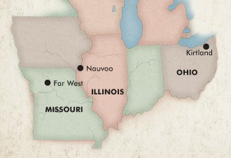
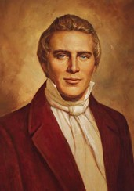
Background
Summer 1831 Independence Missouri
During the Prophet’s absence, some Church members in Ohio turned away from the Lord’s commandments and committed serious sins including the violation of the law of chastity.
The Prophet Joseph Smith returned to Kirtland on August 27, and on August 30, he received the revelation recorded in Doctrine and Covenants 63.

Slide 3
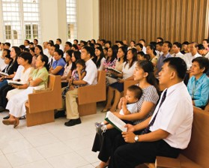
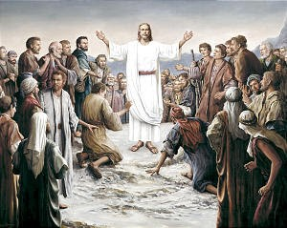
Hearken
Hearken—to hear
Open one’s heart—to listen with love and affection and desire to do His will
Give ear—devotion for hearing the truth
Listen—to give attention
God expects His people to exert themselves to learn His will and do it
He does not reveal His will to us without an earnest effort on our part to lean it.
D&C 63:1 Smith and Sjodahl

Slide 4
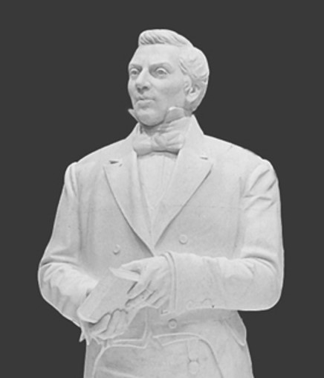
People of the Lord
His commandments are not to be taken lightly and that those who ignore them or rebel against them will be punished.
“We know not what we shall be called to pass through before Zion is delivered and established; therefore, we have great need to live near to God, and always be in strict obedience to all His commandments, that we may have a conscience void of offense toward God and man” (Teachings, p. 32).
D&C 63:1 Student Manual

Slide 5
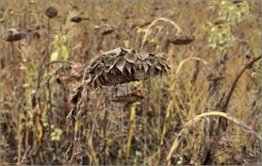
Anger--Kindled
God is love but also a “consuming fire” in the presence of rebellion and apostasy.
“The same sun that gives life to the humblest living plant parches the grass that is dead.”
D&C 63:2 Smith and Sjodahl

Slide 6
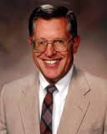
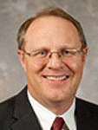
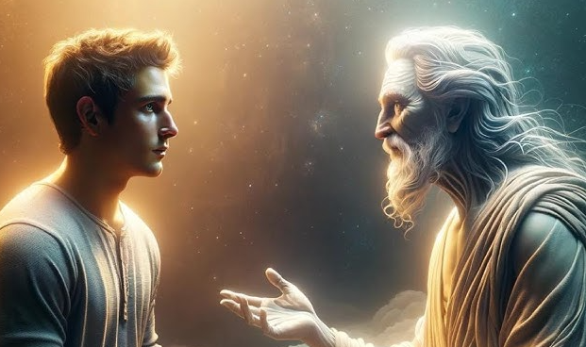
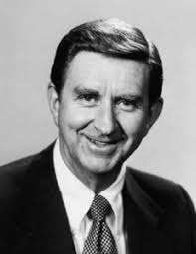
The Lord is Over Life and Death
“The Lord knows that which is necessary for the salvation of each of his children.
Some will die and work out their salvation in the world of spirits.
Others will remain in mortality seeking to overcome the natural man while still in the flesh.”
McConkie and Ostler
“Repeatedly He has protected our eternal agency, thus helping us to qualify through opposition and in the face of alternatives for the sweet blessing of eternal creative service. But we must choose—and be held accountable.”
Marion D. Hanks
D&C 63:3

Slide 7
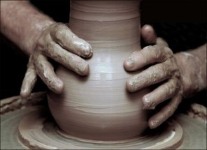
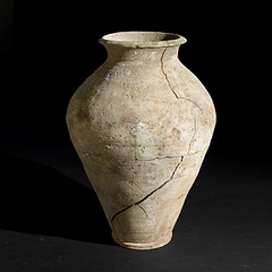
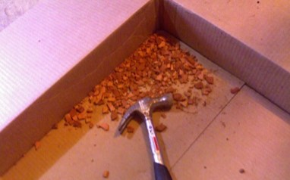
Who Buildeth Up…And Destroyeth
A potter once molded soft clay into a beautiful statue. Unfortunately, the clay cracked when it dried, leaving many weaknesses and flaws in the statue.
The potter tried unsuccessfully to fill the cracks with new clay and to correct the flaws in the hardened clay. Despite his best efforts, he could not restore the beauty and grace of the original statue.
He did the only thing that can be done to hardened, cracked, and imperfect clay. He broke the statue with a hammer, pounded the hardened clay into dust, added fresh water, and began shaping a new statue.
Aaronic Priesthood Manual
D&C 63:4

Slide 8
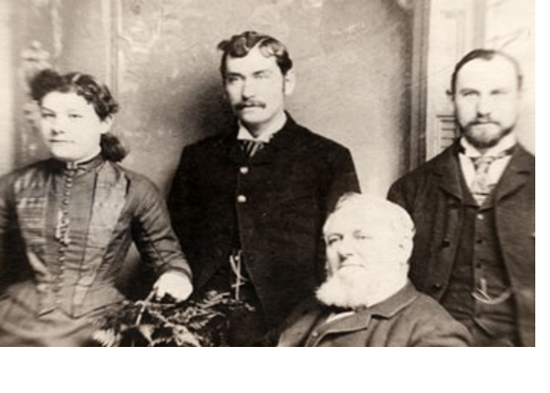
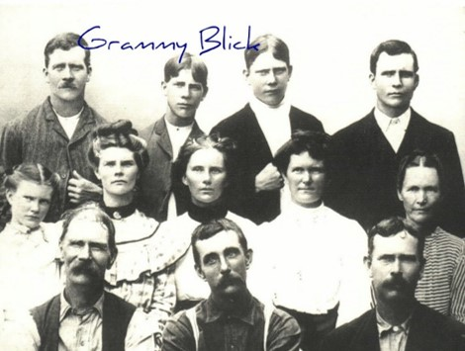
Warning
For those who did not have sufficient faith and the unbelievers
Those that profess to be Church members are reminded of the reward they will lose—”for that day”—the second coming of the Lord.
D&C 63:6

Slide 9
Sign Seekers
“The Saints sought signs because the faith had been rooted out of their heart by the spirit of adultery.”
McConkie and Ostler
“He who seeketh a sign is an adulterous person…and that principle is eternal, undeviating, and firm as the pillars of heaven; for whenever you see a man seeking after a sign, you may set it down that he is an adulterous man.”
Prophet Joseph Smith
Adultery—1812 dictionary, "soft, silly, weak-minded;" by 1836 as "foolishly sentimental,“---Corrupt—today it has a different meaning
D&C 63:8

Slide 10
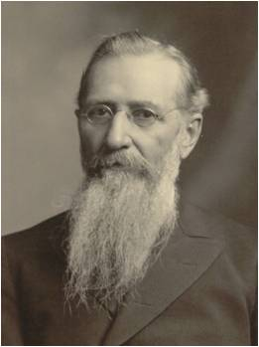
Faith Cometh Not By Signs
Signs can not be the substitute for faith.
Excising faith brings spiritual strength, but sign seeking does not.
“Show me Latter-day Saints who have to feed upon miracles, signs and visions in order to keep them steadfast in the church, and I will show you members of the church who are not in good standing before God, and who are walking in slippery paths.”
Joseph F. Smith
D&C 63:8

Slide 11
Process of Faith
The process by which faith, or power, is developed is one of testing. The Lord gives certain principles, and by obedience to them, blessings and power follow.
But one has no proof of that promise until one acts on the basis of trust or belief. Then comes the confirmation of the reality of the principle, but only after one acts in faith and trust.
“Faith, if it hath not works, is dead, being alone.”
James 2:17
Faith is things which are hoped for and not seen: wherefore,…ye receive no witness until after the trial of your faith.”
Ether 12:6
D&C 63:8

Slide 12
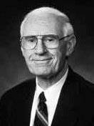
Roots of Faith
Tree #1 Russian Olive Tree.
It was watered every time the lawn was watered, and in that kind of protected environment it grew to be a beautiful tree. Yet one night a tremendous wind came up. Trees all over town were blown down, and with them went our Russian olive.
We had watered it so well that the roots did not have to reach down into the soil; and because they were so close to the surface, the tree toppled over.
Tree #2 Cottonwood Tree
This tree always stood by itself, completely exposed to the elements, with nothing but a ditch running by, which most of the time is dry. It is gnarled and tough, and its roots have had to sink deep in order to drink of the water of life; but because its roots were forced downward, it lives.
D&C 63:8-11 Loren C. Dunn

Slide 13
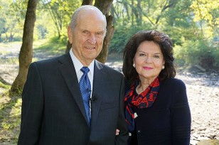
Deep Roots
I see in many people this same kind of beauty. Adversity and trial have driven the roots of faith and testimony deep in order to tap the reservoir of spiritual strength that comes from such experiences.
By nature they know how to stand and fight and hang on.
One person who has sunken deep the roots of faith and testimony because of the trials and affliction of years is the man whom we will sustain tomorrow as prophet, seer, and revelator. His branches can offer shade because his roots are deep.
D&C 63:8-11 Loren C. Dunn

Slide 14
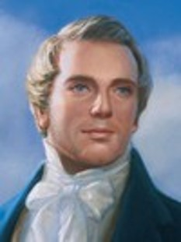
Signs
Faith in Jesus Christ does not come by signs, but signs follow those who have faith in Him.
“When he actually learned that faith, humility, patience, and tribulation go before blessing, and that God brings low before He exalts; that instead of the ‘Savior’s granting him power to smite men and make them believe’ … then he was disappointed.”
(History of the Church, 1:216).
D&C 63:10

Slide 15
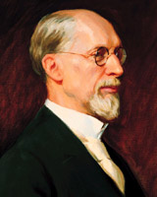
Book of Mormon Sign Seekers
Sherem—fell to the earth and died a few days later
Jacob 7:13-20
Korihor—was struck dumb, then was cast out and had to beg for food and was trampled to death by the Zoramites
Alma 30:48-50
When the Church of Jesus Christ of Latter-day Saints was first founded, you could see persons rise up and ask…”What sign will you show us that we may be made to believe?”
George Albert Smith
D&C 63:11

Slide 16
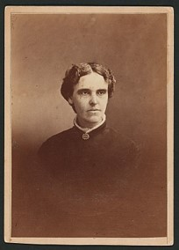
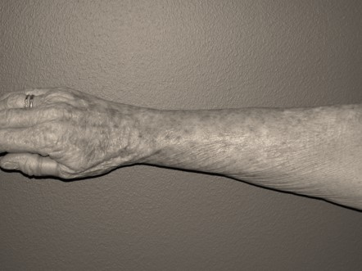
Church History Sign Seeker
Ezra Booth was a Methodist preacher in Ohio. He became interested in the Restoration in early 1831 after reading from the Book of Mormon. He traveled to Kirtland with John and Alice Johnson to meet the Prophet. Mrs. Johnson suffered from rheumatism, which had caused pain, swelling, and stiffness in her arm. When she first met Joseph Smith, she had not been able to raise her hand to her head for about two years.
“During the interview the conversation turned on the subject of supernatural gifts, such as were conferred in the days of the apostles. Some one said, ‘Here is Mrs. Johnson with a lame arm; has God given any power to man now on the earth to cure her?’
A few moments later, when the conversation had turned in another direction, [Joseph] Smith rose, and walking across the room, taking Mrs. Johnson by the hand, said in the most solemn and impressive manner: ‘Woman, in the name of the Lord Jesus Christ I command thee to be whole,’ and immediately left the room. … Mrs. Johnson at once lifted [her arm] up with ease, and on her return home the next day she was able to do her washing without difficulty or pain”.
HC

Slide 17
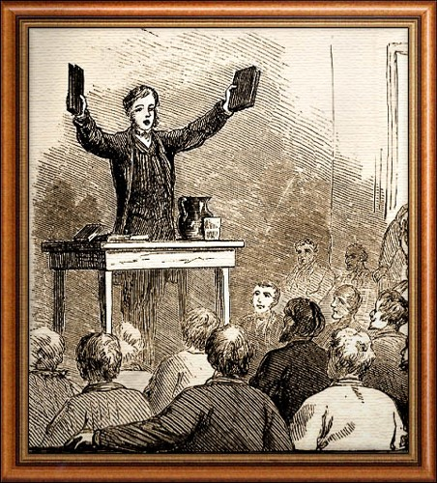
Soon after Ezra Booth witnessed this miracle, he was baptized.
Ezra Booth is an example of someone relying on signs rather than faith. After he was baptized, he received the priesthood and was sent on a mission to Missouri. Booth apparently began this mission with great expectations, assuming he would be able to convert many by displaying signs and performing miracles.
However, after preaching for a short time and not seeing the results he anticipated, Booth “turned away” and apostatized.
The Prophet Joseph Smith made the following observation about Ezra Booth:
“When he actually learned that faith, humility, patience, and tribulation go before blessing, and that God brings low before He exalts; that instead of the ‘Savior’s granting him power to smite men and make them believe’ … then he was disappointed”
HC

Slide 18
The Importance of Virtue
The Savior’s commandment to be sexually pure is often referred to as the law of chastity.
To be virtuous includes having moral integrity, being sexually pure, and having spiritual power and strength.
He that hath clean hands, and a pure heart; who hath not lifted up his soul unto vanity, nor sworn deceitfully.
Psalm 24:4
Sexual feelings are an important part of God’s plan to create happy marriages and eternal families. These feelings are not sinful—they are sacred.
Because sexual feelings are so sacred and so powerful, God has given you His law of chastity to prepare you to use these feelings as He intends.
The law of chastity states that God approves of sexual activity only between a man and a woman who are married.
(For the Strength of Youth)
D&C 63:13-16; (Guide to scriptures)

Slide 19
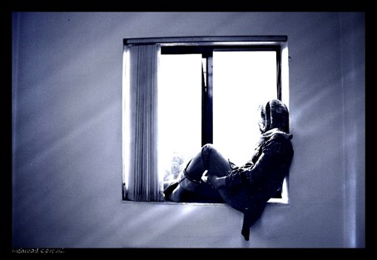
Secret Sins--Folly
“Often at the most inopportune time unrepented immorality is made known. …all wicked acts kept in darkness are eventually drawn out into the light of day. Even if our unrepented sins are not revealed in this life, certainly at the judgment all will be made manifest.”
McConkie and Ostler
D&C 63:15

Slide 20
Look With Lust
The world view: “Only the act is, as a rule, regarded as sin
If we look upon others with lust, we will not have the Spirit and we deny the faith
The Lord’s view: Transgression begins in the thoughts and desires of the heart, and that the outcome of cherishing such things is apostasy. The Spirit leaves the impure heart; then the door is open for doubt, denial, and fear.
D&C 63:16-17 –McConkie and Ostler

Slide 21
“Above all, start by separating yourself from people, materials, and circumstances that will harm you. …
“… If a TV show is indecent, turn it off. If a movie is crude, walk out. If an improper relationship is developing, sever it. Many of these influences, at least initially, may not technically be evil, but they can blunt our judgment, dull our spirituality, and lead to something that could be evil. …
“… Replace lewd thoughts with hopeful images and joyful memories; picture the faces of those who love you and would be shattered if you let them down. … Whatever thoughts you have, make sure they are welcome in your heart by invitation only. …
“Cultivate and be where the Spirit of the Lord is. Make sure that includes your own home or apartment, dictating the kind of art, music, and literature you keep there”
Elder Jeffrey R. Holland

Slide 22
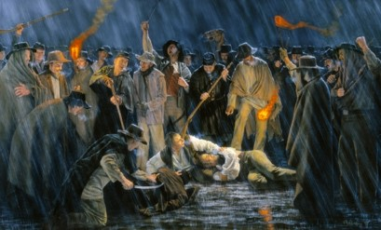
Fault Finders
“Those who are guilty and do not repent in a short time become fault-finders, criticizing their brethren, then the principles of the Gospel, and finally become bitter in their souls against the work and those who are engaged in it.”
“The most bitter opponents of the church and the gospel many times have been proved to be immoral and leading unclean lives.”
D&C 63:16-17–McConkie and Ostler

Slide 23
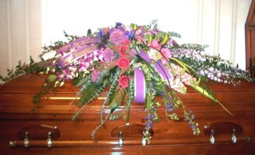
The Second Death
“The death of the body is not the end of the existence of the individual that passes through that experience…
…There is a life hereafter, and there is a death more terrible than the first. There is a death by which the sinner is separated from God forever.”
D&C 63:17 Smith and Sjodahl

Slide 24
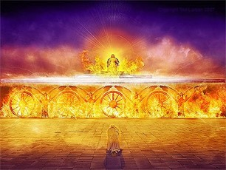
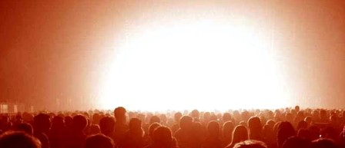
The First Resurrection
And I saw thrones, and they sat upon them, and judgment was given unto them: and I saw the souls of them that were beheaded for the witness of Jesus, and for the word of God, and which had not worshipped the beast, neither his image, neither had received his mark upon their foreheads, or in their hands; and they lived and reigned with Christ a thousand years.
But the rest of the dead lived not again until the thousand years were finished. This is the first resurrection.
Blessed and holy is he that hath part in the first resurrection: on such the second death hath no power, but they shall be priests of God and of Christ, and shall reign with him a thousand years.
D&C 63:18 Revelation 20:4-6

Slide 25
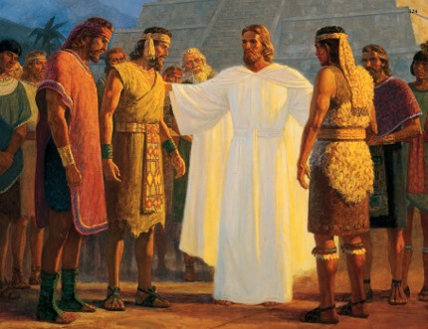
Transfiguration
The change that will come upon those who live on the earth during the Millennium, and be like those in the days experienced by the Three Nephites
Transformation is not the same as resurrection but came upon the three disciples “that they might not taste of death…that they might not suffer pain nor sorrow.”
3 Nephi 28:38
D&C 63:20–McConkie and Ostler

Slide 26
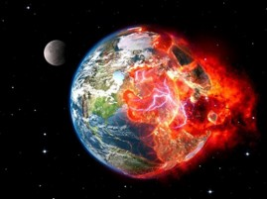
Earth Pass Through Fire
The Earth will pass through fire and become “sanctified and immortal”
For, behold, I create new heavens and a new earth: and the former shall not be remembered, nor come into mind.
Isaiah 65:17
All forms of life—be plant or animal—that exist on the earth during the Millennium must abide that glory.
This earth, in its sanctified and immortal state, will be made like unto crystal and will be a Urim and Thummim to the inhabitants who dwell thereon, whereby all things pertaining to an inferior kingdom, or all kingdoms of a lower order, will be manifest to those who dwell on it; and this earth will be Christ’s.
D&C 130:9
D&C 63:20-21

Slide 27
The Earth will be renewed and receive it s paradisiacal glory
D&C 63:20-21; Article of Faith 10

Slide 28
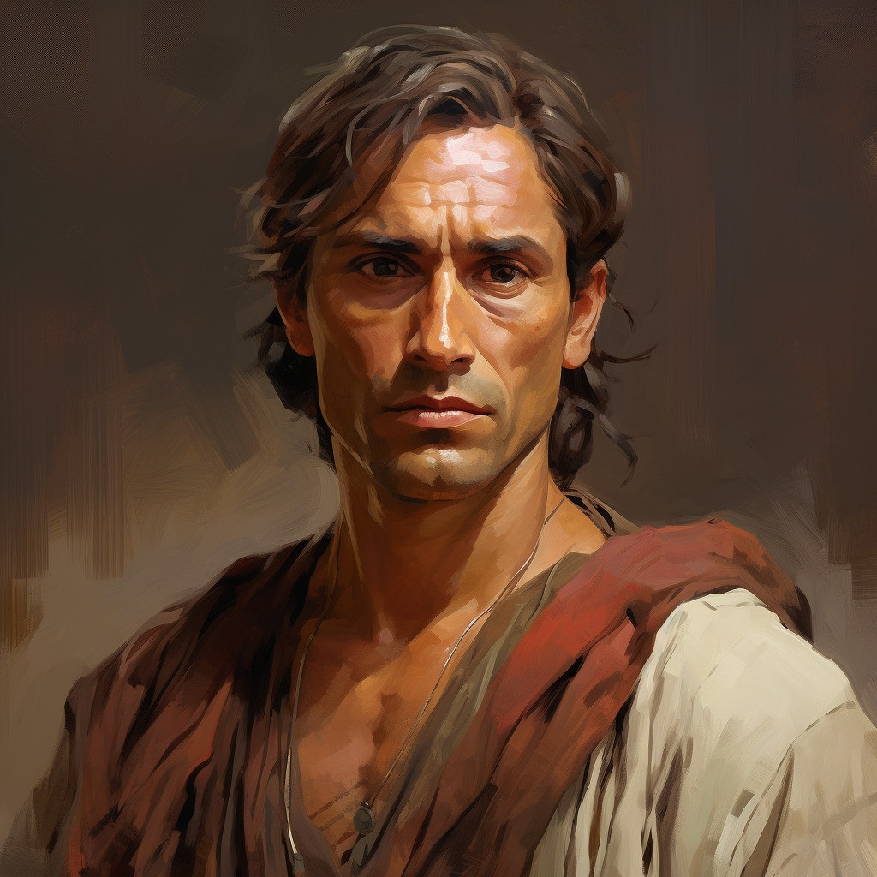
Mysteries of His Kingdom
The prophet Alma taught, “It is given unto many to know the mysteries of God; nevertheless they are laid under a strict command that they shall not impart only according to the portion of his word which he doth grant unto the children of men, according to the heed and diligence which they give unto him” (Alma 12:9)
D&C 63:23

Slide 29
Sources:
Video:
“What Should I Do When I See Pornography?” (5:45)
“Stay within the Lines” (5:10)
“Atonement—Not a One-Time Thing” (3:00)
“I Choose to Be Pure” (4:19)
“Inspiring Short: The Miracle of the Ordinary” (3:00).
Faith Precedes the Miracle (0:56)
Watch Your Step (2:38)
Hyrum M. Smith and Janne M. Sjodahl Doctrine and Covenants Commentary pg. 373
Doctrine and Covenants Student Manual Religion 324-325 Section 63
Marion D. Hanks Agency and Love Oct. 1983 Gen. Conf.
Joseph Fielding McConkie and Craig J. Ostler Revelations of the Restoration pg. 448-450
HC--History of the Church, 1:215-216
Presentation by ©http://fashionsbylynda.com/blog/
Aaronic Priesthood Manual 2, (1993), 69–71
Teachings of the Prophet Joseph Smith pg. 157
Joseph F. Smith Gospel Doctrine pg. 7
Loren C. Dunn Hanging On April 1974 Gen. Conf.
George Albert Smith Journal of Discourses 2-326-27
Elder Jeffrey R. Holland (“Place No More for the Enemy of My Soul,” Ensign or Liahona, May 2010, 45, 46)
For the Strength of Youth: A guide for Making Choices (2022)
Presentation by ©http://fashionsbylynda.com/blog/

Slide 30
The Potter and the Clay –Heber C. Kimball (1801-1868) Found in January Ensign 2011
“I ask you, brethren and sisters, if you expect to go into heaven, if you do not do His will on earth as it is done in heaven? Can those persons who pursue a course of carelessness, neglect of duty, and disobedience, when they depart from this life, expect that their spirits will associate with the spirits of the righteous in the spirit world? I do not expect it, and when you depart from this state of existence, you will find it out for yourselves. …
That man or woman who will not learn the principle of subjection, and become like clay in the hands of the potter, will be led astray. …
The Saints are receiving their endowment, and preparing for that which is in the future; to dwell in the heavens, and sit upon thrones, and reign over kingdoms and dominions, principalities and powers; and as this work progresses, the works of Satan will increase, and he will continue to present one thing after another, following up the work of God, and increasing means of deception, to lead astray such men and women, and take them captive. As the work of God increases in power and extent upon the earth, so will the works of Satan increase. I expect that tribulation will be upon the wicked, and continue from this time until they are swept off from the earth. I just as much expect these things as I do to see the sun rise and set tomorrow.
I would like to see all this people do right, and keep the commandments of God. I would like to see them fulfil their covenants, and live up to their vows and promises, and fulfil their obligations, for they have obligated themselves before God, and before angels, and before earthly witnesses, that they would do this. …
Comparing us to clay that is in the hands of the potter, if that clay is passive, I have power as a potter to mold it and make it into a vessel unto honor. Who is to mold these vessels? Is it God Himself in person, or is it His servants, His potters, or journeymen, in company with those He has placed to oversee the work? The Great Master Potter dictates His servants, and it is for them to carry out His purposes, and make vessels according to His designs; and when they have done the work, they deliver it up to the Master for His acceptance; and if their works are not good, He does not accept them; the only works He accepts, are those that are prepared according to the design He gave. God will not be trifled with; neither will His servants; their words have got to be fulfilled, and they are the men that are to mold you, and tell you what shape to move in. …
Now suppose I subject myself enough, in the hands of the potter, to be shaped according as he was dictated by the Great Master potter, that rules over all things in heaven and on earth, He would make me into a vessel of honor.
There are many vessels that are destroyed after they have been molded and shaped. Why? Because they are not contented with the shape the potter has given them, but straightway put themselves into a shape to please themselves; therefore they are beyond understanding what God designs, and they destroy themselves by the power of their own agency, for this is given to every man and woman, to do just as they please. …
If we are united, and the Priesthood is united, and the families of this Church, with their husbands at their head, are united, we stand, and all hell, with the devil at their head, have nothing to do with us; they cannot move us. But if we are divided we fall.
What do you say to our being one, and clinging together? … Would we not be a happy company? It is that alone that will make you truly happy; and to be perfectly limber in the hands of the potter like clay. What makes the clay snap? Because it wants its own way; and you cannot be happy unless you submit to the law of God, and to the principles of His government.
When a person is miserable, wretched, and unhappy in himself, put him in what circumstances you please, and he is wretched still. If a person is poor, and composes his mind, and calmly submits to the providences of God, he will feel cheerful and happy in all circumstances, if he continues to keep the commandments of God.”

Slide 31
Roots of Faith--
It reminds me of two trees that were close to my home when I was growing up. The one was a Russian olive and grew right in our yard. It was watered every time the lawn was watered, and in that kind of protected environment it grew to be a beautiful tree. Yet one night a tremendous wind came up. Trees all over town were blown down, and with them went our Russian olive. We had watered it so well that the roots did not have to reach down into the soil; and because they were so close to the surface, the tree toppled over.
The second tree withstood the gale. It was a tremendous cottonwood, which still stands in the lane just half a block from where I was born. This tree was in the fullness of its growth when I was a child. It has always stood by itself, completely exposed to the elements, with nothing but a ditch running by, which most of the time is dry. It is gnarled and tough, and its roots have had to sink deep in order to drink of the water of life; but because its roots were forced downward, it lives. I was out home the other day and noticed that most of the trees around this cottonwood are gone. But in all of its power and majesty, it still hangs on.
I see in many people this same kind of beauty. Adversity and trial have driven the roots of faith and testimony deep in order to tap the reservoir of spiritual strength that comes from such experiences. By nature they know how to stand and fight and hang on.
One person who has sunken deep the roots of faith and testimony because of the trials and affliction of years is the man whom we will sustain tomorrow as prophet, seer, and revelator. His branches can offer shade because his roots are deep.
Loren C. Dunn Hanging On April 1974 Gen. Conf.
Those Seeking a Sign:
When we understand this process, we can see why sign seeking is condemned. Someone who demands outward evidence of the power of God as a condition for believing is seeking to circumvent the process by which faith is developed. He wants proof without price. As with the adulterer, he seeks the results without accepting the responsibility. Thus it is a wicked and adulterous generation that seeks signs.
The Prophet Joseph Smith said: “I will give you one of the Keys of the mysteries of the Kingdom. It is an eternal principle, that has existed with God from all eternity: That man who rises up to condemn others, finding fault with the Church, saying that they are out of the way, while he himself is righteous, then know assuredly, that that man is in the high road to apostasy; and if he does not repent, will apostatize, as God lives. The principle is as correct as the one that Jesus put forth in saying that he who seeketh a sign is an adulterous person; and that principle is eternal, undeviating, and firm as the pillars of heaven; for whenever you see a man seeking after a sign, you may set it down that he is an adulterous man.” (Teachings, pp. 156–57.)
Lust Causes The Spirit to be Withdrawn: D&C 63:16
I share a warning. Satan is extremely good at blocking spiritual communication by inducing individuals, through temptation, to violate the laws upon which spiritual communication is founded. With some, he is able to convince them that they are not able to receive such guidance from the Lord.
“Satan has become a master at using the addictive power of pornography to limit individual capacity to be led by the Spirit. The onslaught of pornography in all of its vicious, corroding, destructive forms has caused great grief, suffering, heartache, and destroyed marriages. It is one of the most damning influences on earth. Whether it be through the printed page, movies, television, obscene lyrics, vulgarities on the telephone, or flickering personal computer screen, pornography is overpoweringly addictive and severely damaging. This potent tool of Lucifer degrades the mind and the heart and the soul of any who use it. All who are caught in its seductive, tantalizing web and remain so will become addicted to its immoral, destructive influence. For many, that addiction cannot be overcome without help. The tragic pattern is so familiar. It begins with curiosity that is fueled by its stimulation and is justified by the false premise that when done privately, it does no harm to anyone else. For those lulled by this lie, the experimentation goes deeper, with more powerful stimulations, until the trap closes and a terribly immoral, addictive habit exercises its vicious control. …
“If you are ensnarled in pornography, make a total commitment to overcome it now. Find a quiet place; pray urgently for help and support. Be patient and obedient. Don’t give up” Elder Richard G. Scott (“To Acquire Spiritual Guidance,” Ensign or Liahona, Nov. 2009, 8–9).
D&C 13-16: Chastity is sexual purity. Those who are chaste are morally clean in their thoughts, words, and actions. Chastity means not having any sexual relations before marriage. It also means complete fidelity to husband or wife during marriage. (Topics and Questions, “Chastity,” topics.ChurchofJesusChrist.org)

