Slide 1
Doctrine and Covenants 71
Criticizing the Church
Presentation by ©http://fashionsbylynda.com/blog/

Slide 2
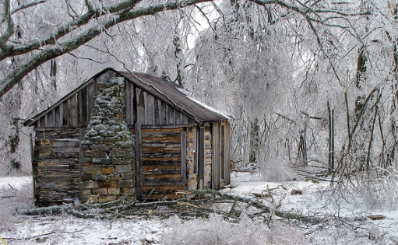
Background
In the winter of 1831, letters containing false information about Joseph Smith and the Church were being distributed in the Kirtland area.
In Doctrine and Covenants 71, the Savior instructed Joseph Smith and Sidney Rigdon to travel throughout the region, correcting the falsehoods
Persecution increased dramatically for Joseph Smith and the Saints in Kirtland in the winter of 1831.
Some Saints began leaving the Church, including Ezra Booth and Symonds Ryder.
Booth began publishing letters attacking Joseph and trying to overthrow the work of the Lord

Slide 3
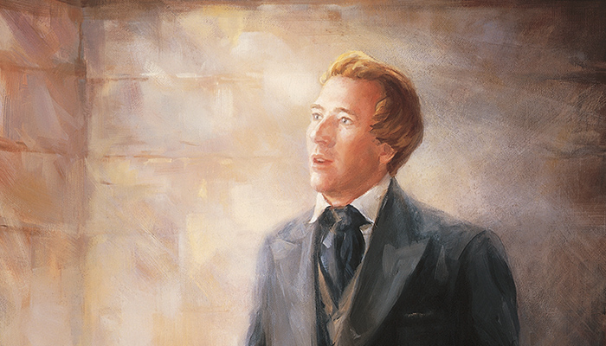
Expounding Mysteries
December 1831—Hiram, Ohio
“A mystery is a truth that cannot be known except through divine revelation—a sacred secret. … In our day such great truths as those pertaining to the restoration of the priesthood, the work for the dead, and the re-establishment of the Church are ‘mysteries,’ because they could not have been discovered except by revelation.”
(Smith and Sjodahl, Commentary, p. 141.)
D&C 71:1

Slide 4
Mission for a Season
Joseph and Sidney were called on this mission largely to refute the falsehoods being spread by Ezra Booth and Symonds Rider.
While Booth’s apostasy is thoroughly explained in the letters he wrote to the Ohio Star, the reasons why Symonds Rider became antagonistic toward the Church are less clear.
One possible reason for his leaving may be that, according to a popular rumor, Rider’s name was misspelled in his mission call, and this mistake led to his apostasy.
Casey Paul Griffiths
D&C 71:2-3

Slide 5
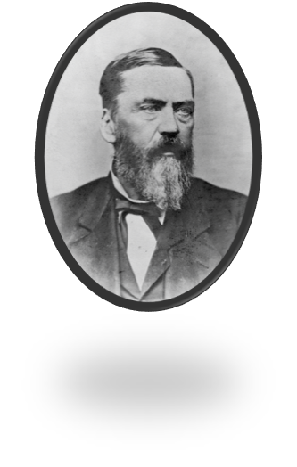
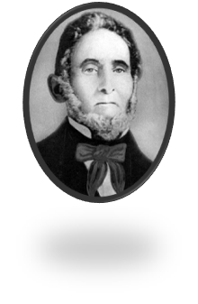
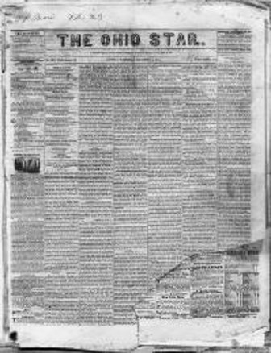
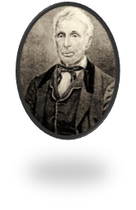
The Ohio Star
Sidney Rigdon obeyed the Lord’s counsel and invited Ezra Booth to join him in the town of Ravenna, where they would publicly discuss the letters Ezra had sent to the newspaper.
Sidney also challenged Symonds Ryder to a public debate on the Book of Mormon.
Both men declined the invitations.
Sidney still testified of the truth in Ravenna and other locations.
Ezra Booth published some anti Mormon literature
Symonds Ryder also sent other articles to other magazines criticizing the Church and Joseph Smith

Slide 6
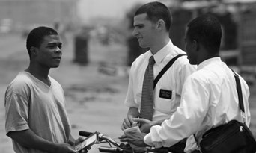
Critics of the Church
December 1831—Hiram, Ohio
“The most effective way to defend the Gospel is to declare it.”
“Falsehood cannot hold its own against the truth in open display, the ministers of darkness of necessity must first shade or distort the light of heaven.”
D&C 71:7 McConkie and Ostler

Slide 7
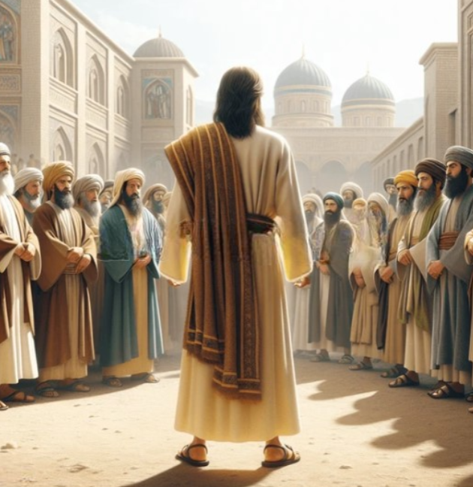
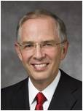
Reaction to Criticism
How can we know the best way to handle situations when others criticize our beliefs or share false information about the Savior’s Church?
When do you think it is better to ignore the criticism?
By the shield of our faith in Jesus Christ, we become peacemakers, quenching … all the fiery darts of the adversary …
How does a peacemaker calm and cool the fiery darts? Certainly not by shrinking before those who disparage us. Rather, we remain confident in our faith, sharing our beliefs with conviction but always void of anger or malice. …
Peacemakers are not passive; they are persuasive in the Savior’s way.
What gives us the inner strength to cool, calm, and quench the fiery darts aimed toward the truths we love? The strength comes from
our faith in Jesus Christ and our faith in His words.
Neil L. Andersen
D&C 71:7; Ephesians 6:16; D&C 3:8

Slide 8
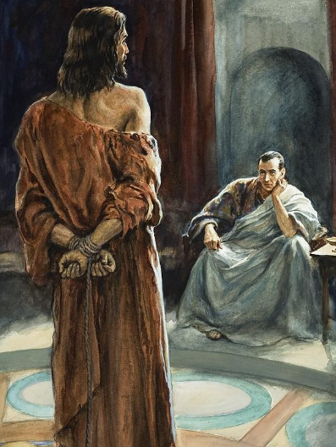
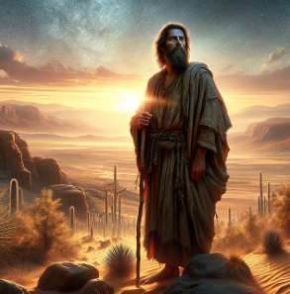
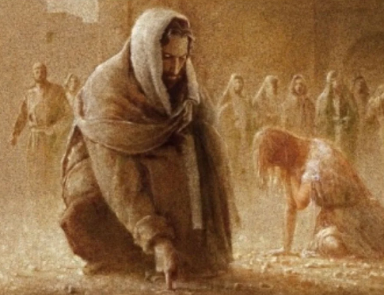
The Savior’s Response
Matthew 4:3-11
John 8:2-11
Luke 23:8-10
D&C 71:7

Slide 9
Respond in the Savior’s Way
The Lord promises He will give us the words to say if we speak in His name.
The Lord offers counsel on how to give correction.
D&C 71:7; 100:5-7; 121:41-45

Slide 10
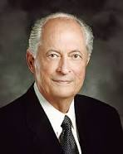
However:
“As we respond to others, each circumstance will be different. Fortunately, the Lord knows the hearts of our accusers and how we can most effectively respond to them.
As true disciples seek guidance from the Spirit, they receive inspiration tailored to each encounter. And in every encounter, true disciples respond in ways that invite the Spirit of the Lord”
Elder Robert D. Hales
When people criticize the church, we can respond by sharing truths from the scriptures and following the guidance of the Spirit
D&C 71:7-10

Slide 11
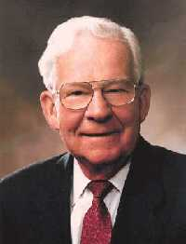
“As true disciples, our primary concern must be others’ welfare, not personal vindication.
Questions and criticisms give us an opportunity to reach out to others and demonstrate that they matter to our Heavenly Father and to us. Our aim should be to help them understand the truth, not defend our egos or score points in a theological debate.
Our heartfelt testimonies are the most powerful answer we can give our accusers. And such testimonies can only be borne in love and meekness”
Elder Robert D. Hales
“Probably we will never be free of those who are openly anti-Mormon. Therefore, we encourage all our members to refuse to become anti-anti-Mormon”
Elder Marvin J. Ashton

Slide 12
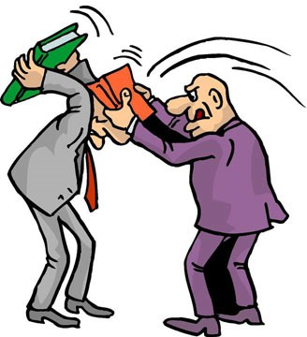
Bible Bashing
Bible bashing always drives the Spirit away
When we do not retaliate—when we turn the other cheek and resist feelings of anger—we too stand with the Savior. We show forth His love, which is the only power that can subdue the adversary and answer our accusers without accusing them in return. That is not weakness. That is Christian courage.
Elder Robert D. Hales

Slide 13
Negative Publicity
Experience shows that seasons of negative publicity about the Church can help accomplish the Lord’s purposes.
In 1983 the First Presidency wrote to Church leaders, “Opposition may be in itself an opportunity. Among the continuing challenges faced by our missionaries is a lack of interest in religious matters and in our message.
These criticisms create … interest in the Church. … This provides an opportunity [for members] to present the truth to those whose attention is thus directed toward us.”
We can take advantage of such opportunities in many ways: a kind letter to the editor, a conversation with a friend, a comment on a blog, or a reassuring word to one who has made a disparaging comment. We can answer with love those who have been influenced by misinformation and prejudice—who are “kept from the truth because they know not where to find it” (D&C 123:12). I assure you that to answer our accusers in this way is never weakness. It is Christian courage in action.
Elder Robert D. Hales

Slide 14
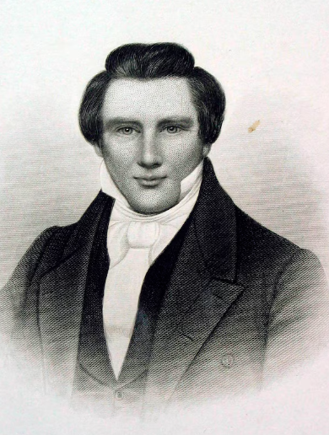
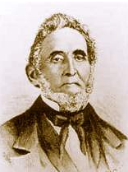
The Rest of the Story
Joseph Smith and Sidney Rigdon were obedient to the revelation they received. They traveled throughout the area, preaching the Savior’s gospel and correcting the falsehoods that had been spread.

Slide 15
Sources:
Videos:
“Everyday Example: When Beliefs Are Questioned” (12:48)
(see History, 1838–1856 [Manuscript History of the Church], volume A-1, 153–54, josephsmithpapers.org).
President Joseph Fielding Smith (Church History and Modern Revelation, 1:268–69.)
Casey Paul Griffiths Doctrine and Covenants Central (71:1-4)
Joseph Fielding McConkie and Craig J. Ostler Revelations of the Restoration pg 497
Neil L. Andersen, “Following Jesus: Being a Peacemaker,” Liahona, May 2022, 17–18)
Presentation by ©http://fashionsbylynda.com/blog/
Elder Robert D. Hales (“Christian Courage: The Price of Discipleship,” Ensign or Liahona, Nov. 2008, 73).
Elder Marvin J. Ashton “Pure Religion,” Ensign, Nov. 1982, 63.
Presentation by ©http://fashionsbylynda.com/blog/

Slide 16
When we contend with each other in anger, Satan laughs and the God of heaven weeps.
Satan laughs and God weeps for at least two reasons. First, contention weakens our collective witness to the world of Jesus Christ and the redemption that comes through His “merits, … mercy, and grace” [2 Nephi 2:8]. … His latter-day work is compromised when contention or enmity exists among His disciples [see John 17:21, 23]. Second, contention is spiritually unhealthy for us as individuals. We are robbed of peace, joy, and rest, and our ability to feel the Spirit is compromised.
Jesus Christ explained that His doctrine was not “to stir up the hearts of men with anger, one against another; but [that His] doctrine [is] that such things should be done away” [3 Nephi 11:30]. If I am quick to take offense or respond to differences of opinion by becoming angry or judgmental, I “fail” the spiritual stress test. This failed test does not mean that I am hopeless. Rather, it points out that I need to change. And that is good to know. (Dale G. Renlund, “The Peace of Christ Abolishes Enmity,” Liahona, Nov. 2021, 83–84)
Examples of Civility:
On the subject of public discourse, we should all follow the gospel teachings to love our neighbor and avoid contention. Followers of Christ should be examples of civility. We should love all people, be good listeners, and show concern for their sincere beliefs. Though we may disagree, we should not be disagreeable. Our stands and communications on controversial topics should not be contentious. We should be wise in explaining and pursuing our positions and in exercising our influence. (Dallin H. Oaks, “Loving Others and Living with Differences,” Ensign or Liahona, Nov. 2014, 27)
Defending Your Faith:
I say to all and especially the youth of the Church that if you haven’t already, you will one day find yourself called upon to defend your faith or perhaps even endure some personal abuse simply because you are a member of The Church of Jesus Christ of Latter-day Saints. Such moments will require both courage and courtesy on your part. (Jeffrey R. Holland, “The Cost—and Blessings—of Discipleship,” Ensign or Liahona, May 2014, 6)

