Slide 1
Doctrine and Covenants 72-74
Little Children
“…wherefore, little children are whole, for they are not capable of committing sin; wherefore the curse of Adam is taken from them in me…
Moroni 8:8
Presentation by ©http://fashionsbylynda.com/blog/

Slide 2
Background
December 1831—Kirtland, Ohio
The Last Revelation given in 1831
Because the Church membership was growing Newel K. Whitney was called to be the bishop for the Saints in Ohio
He was to report to Edward Partridge in Independence, Missouri
3 Revelations are given in D&C 72:
The Calling of Newel K. Whitney
The duties of a bishop
The gathering to Zion
D&C 72:1-7

Slide 3
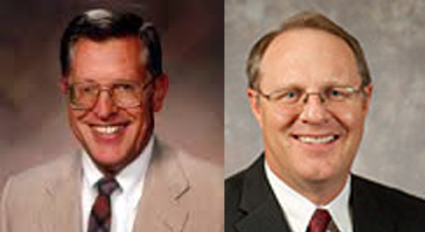
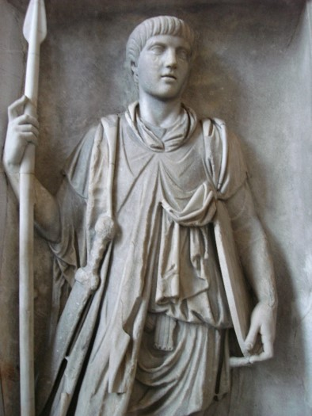
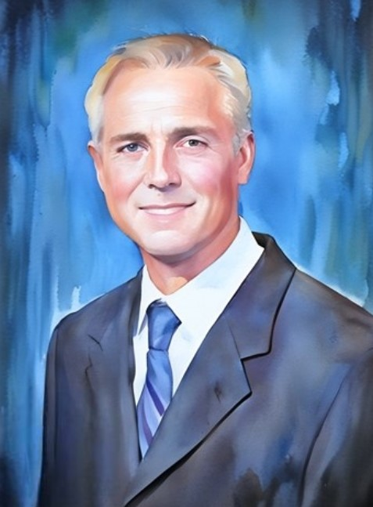
Stewards
Stewards—guardian or keeper of that which belongs to another
Anciently—steward’s tasks could range from tending pigs to supervising the king’s stores or leading his armies to battle. A steward was accountable to his master.
We are all stewards of our divine Master and will in a future day be called upon to give an accounting for what we did with the opportunities that were ours.
D&C 72:3 McConkie and Ostler

Slide 4
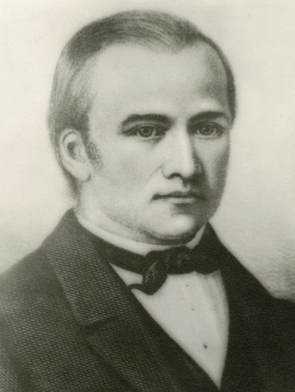
Difficulty in a Calling
“The thought of assuming this important responsibility (the office of bishop) was almost more than [Newel K. Whitney] could bear. … He … distrusted his ability, and [felt] incapable of discharging the high and holy trust. In his perplexity he appealed to the Prophet:
“‘I cannot see a Bishop in myself, Brother Joseph; but if you say it’s the Lord’s will, I’ll try.’
“‘You need not take my word alone;’ answered the Prophet, kindly, ‘Go and ask Father for yourself.’
“Newel … determined to do as [the Prophet] advised. … His humble, heartfelt prayer was answered. In the silence of night and the solitude of his chamber, he heard a voice from heaven: ‘Thy strength is in me.’
The words were few and simple, but they had a world of meaning. His doubts were dispelled like dew before the dawn. He straightway sought the Prophet, told him he was satisfied, and was willing to accept the office to which he had been called”
Orson F. Whiney (grandson of Newel K. Whitney)
D&C 72:8

Slide 5
Duties of a Bishop
Under the Law of Consecration
The Saints were not at this time divided geographically until the Nauvoo period
These men were traveling Bishops
Bishops and branch presidents manage the temporal and spiritual affairs of the Church in their wards and branches
Keeping the storehouse (first storehouse was N.K. Whitney & Co.)
Receiving contributions
To look after the needy
Responsible for temporal affairs of the Church
D&C 72:9-10 McConkie and Ostler

Slide 6
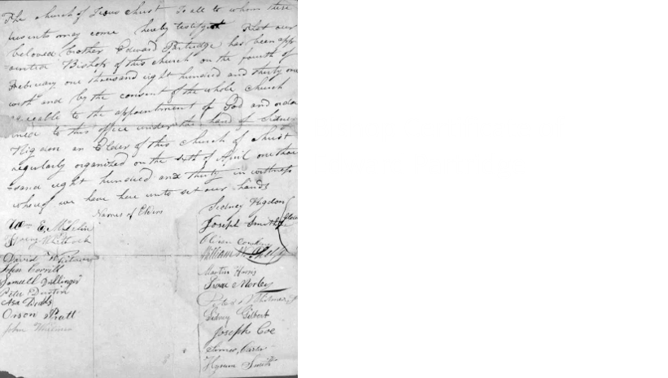
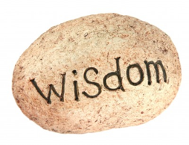
Certificate
A paper claiming that you were a member of the Church
Members of the Church going to Zion were to carry a Bishops certificate or recommend, to show their standing in the church
“Otherwise he…shall not be accounted as a wise steward” vs 26
Wisdom was required in those who went to Zion. They would show their wisdom in the management of their temporal affairs.
D&C 72:17 McConkie and Ostler

Slide 7
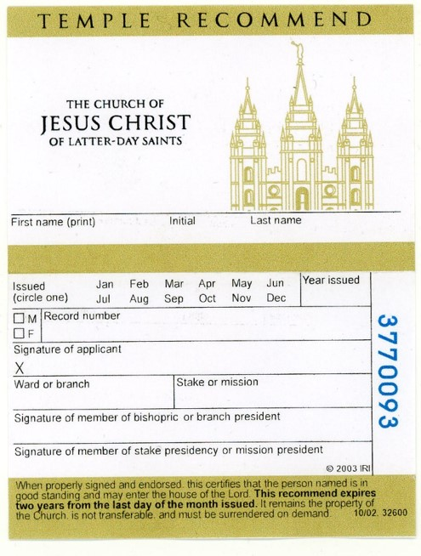
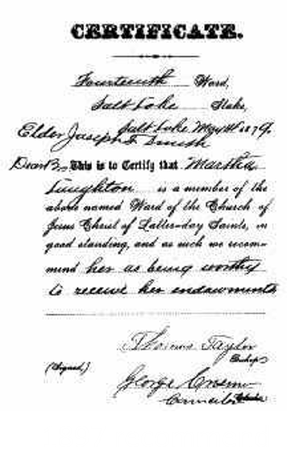
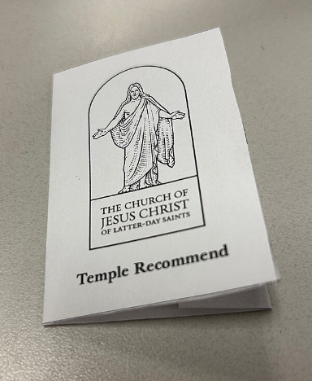
Our Certificate to Enter the Temple
A temple recommend signifies that we have been found worthy through an interview with a member of our bishopric or our branch president and also an interview with a member of our stake presidency or mission presidency. Temple recommend interviews are opportunities for us to examine our worthiness. In each of the interviews, our priesthood leaders will ask us about our personal conduct and faith. Our priesthood leaders keep these interviews private and confidential.
We sign our recommend to confirm our worthiness to enter the temple. Our priesthood leaders also sign our recommend as additional witnesses of our worthiness. This recommend allows us to enter the temple for the next two years, provided we remain worthy.
As of 2021
Ensign Article

Slide 8
Temple Recommend Holders
The following are some of the topics your priesthood leaders will ask you about:
1. Your testimony of Heavenly Father, Jesus Christ, and the Holy Ghost.
2. Whether you sustain the President of the Church.
3. Whether you live the law of chastity, pay tithing, are honest with others, and keep the Word of Wisdom.
4. Whether you strive to attend church, keep the covenants you have made, and keep your life in harmony with the commandments of the gospel.
Limited-use Recommends--Youth
Recommends for youth are called limited-use recommends, and there are two kinds: group and individual. Your name can be added to a group recommend if you visit the temple with your ward or branch.
This recommend is valid for only one visit. If you live near a temple and can regularly participate in baptisms for the dead, you can ask your bishop or branch president for an individual recommend, which is good for one year, provided you remain worthy.
Ensign Article

Slide 9
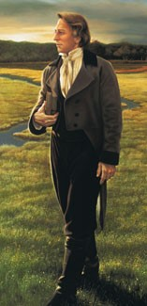
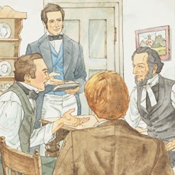
The Literary Firm
Following the November 1831 conference in Hiram, Ohio, six men were called to consecrate their time and efforts in managing the publishing, printing, and distribution of Church publications, including the scriptures.
This group of men—Joseph Smith, Martin Harris, Oliver Cowdery, John Whitmer, Sidney Rigdon, and William W. Phelps—became known as the Literary Firm.
The Lord authorized these men to request assistance for sustenance from the bishop with the intent that this publishing business would eventually produce enough income to become self-sustaining.
Members of the Literary Firm were to be supported by the proceeds of the business, while any surplus profits would be consecrated back to the Lord’s storehouse,
Although the Literary Firm did not last more than a handful of years, it made a significant contribution
to the world by publishing the Book of
Commandments and its successor the
Doctrine and Covenants, as well as
Church newspapers, such as the Evening
and the Morning Star.
D&C 72:20-22 Joseph Smith Papers

Slide 10
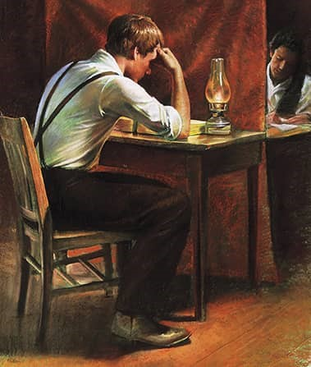
Continue to Translate
January 1832—Hiram, Ohio
The Lord instructed that the elders who had been preaching were to continue doing so until the next conference, which would be held in two weeks.
The Prophet Joseph Smith and Sidney Rigdon had been preaching to help combat misinformation about the Church resulting from the publication of Ezra Booth’s letters.
The Lord asks that Joseph Smith and Sidney Rigdon commence in the revision of the Bible
Joseph Smith went through all of the Bible, dictating to a scribe changes, deletions, or additions, but he did not complete a revision of the entire Bible.
He never considered what he had accomplished as ready for publication, and he probably would have made many more corrections had he lived longer. Student Manual
D&C 73:1-5

Slide 11
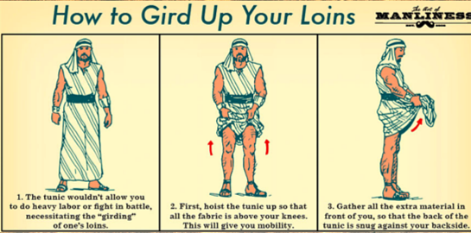
Gird Up Your Loins
This phrase comes from the Bible, where girding up your loins meant to tie up long, loose clothes so that they were more practical when you were working or traveling or getting ready for battle
To Prepare yourself mentally to do something difficult
Be Ready for the journey
Be ready to be the Lord’s servant
Prepare your minds and hearts
Be free from the cares, lusts, and aspirations that make you less proficient in the Master’s service
Smith and Sjodahl
Wherefore gird up the loins of your mind, be sober, and hope to the end for the grace that is to be brought unto you at the revelation of Jesus Christ;
1 Peter 1:13
D&C 73:6

Slide 12
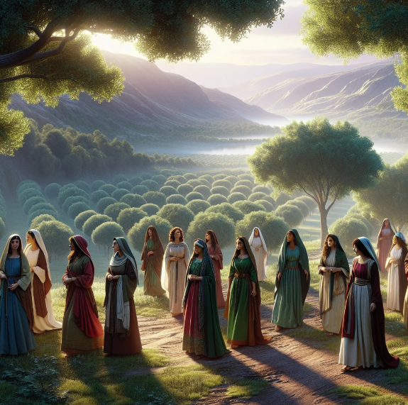
Background
Paul’s Counsel:
Paul is commenting on the issue of whether a woman who is married to a nonbeliever should continue in the marriage. Paul felt that the believing partner should not initiate a divorce, but if the unbelieving partner desired to end the marriage, the believer should not feel bound to remain in the union. Paul’s reasoning for this was summarized as “For how do you know, wife, that you will not save your husband? Or how do you know, husband, that you will not save your wife? Casey Paul Griffiths
The Revelation in Section 74 was received in 1830 before the restoration, but recorded in January 1832
For the unbelieving husband is sanctified by the wife, and the unbelieving wife is sanctified by the husband: else were your children unclean; but now are they holy.
1 Corinthian 7:14
D&C 74:1

Slide 13
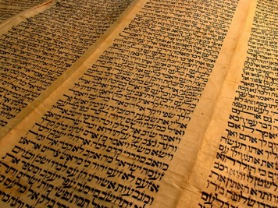
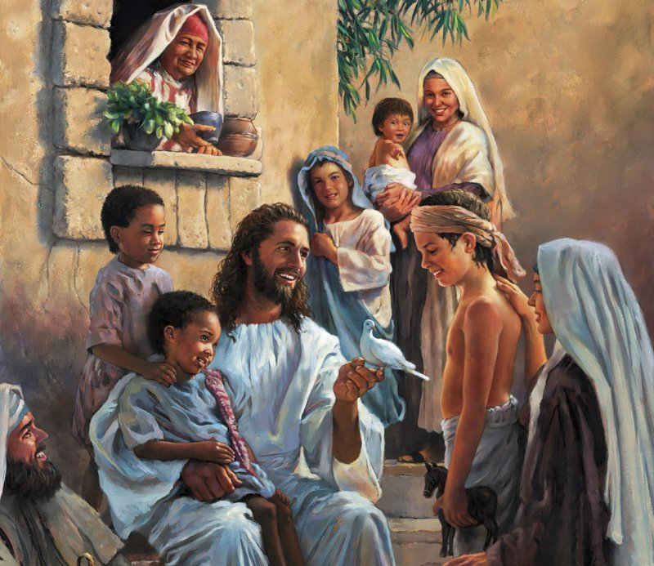
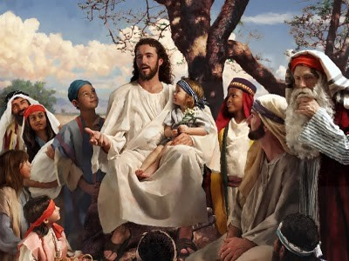
Little Children
Unbelieving, as used here, refers to those Jews who had not joined the Church of Jesus Christ.
They were still living by the rituals of the Mosaic law, which included circumcision of their male children.
Paul taught that little children were sanctified through the Atonement of Christ and that circumcision was no longer necessary as taught by the adherents of the Mosaic law.
Georgy
D&C 74:1

Slide 14
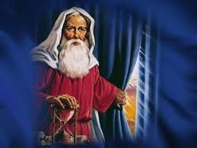
Law of Circumcision
And I will establish my covenant between me and thee and thy seed after thee in their generations for an everlasting covenant, to be a God unto thee, and to thy seed after thee.
And ye shall circumcise the flesh of your foreskin; and it shall be a token of the covenant betwixt me and you.
Genesis 17:7,11
Circumcision was given to Abraham and his posterity as a token of their covenant with God.
Other scriptures make it clear that it was not circumcision itself but rather what it stood for that gave it its greatest significance.
Circumcise therefore the foreskin of your heart, and be no more stiffnecked.
Deuteronomy 10:16
Circumcise yourselves to the Lord, and take away the foreskins of your heart, ye men of Judah and inhabitants of Jerusalem: lest my fury come forth like fire, and burn that none can quench it, because of the evil of your doings. Jeremiah 4:4
D&C 74:2-3

Slide 15
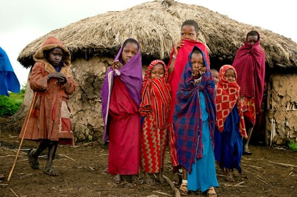
Little Children Are Sanctified
Little Children do not need circumcision to become sanctified, as taught by the adherents of the Mosaic faith
Little Children are holy being sanctified through the atonement of Jesus Christ
D&C 74:4-7 Smith and Sjodahl

Slide 16
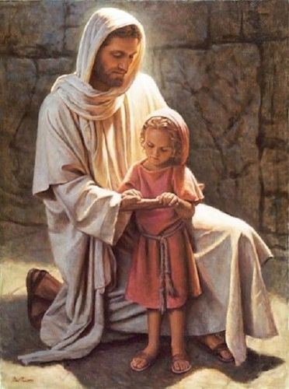
Consecration of Believing Parents
The consecration of the believing parent includes the children.
They are sanctified through the atonement of our Lord. They need no ordinance, until they arrive at the age of accountability, when they should be baptized, after proper instruction.
Del Parson
D&C 74:4-7 Smith and Sjodahl

Slide 17
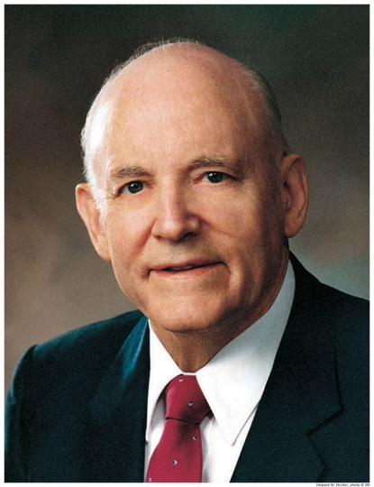
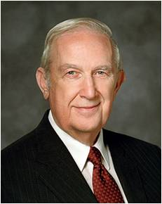
False Traditions
“Appreciation for ethnic, cultural, or national heritage can be very wholesome and beneficial, but it can also perpetuate patterns of life that should be set aside by a devoted Latter-day Saint. …
“[President Howard W. Hunter said]: ‘I suggest that you place the highest priority on your membership in the Church of Jesus Christ. Measure whatever anyone else asks you to do, whether it be from your family, loved ones, your cultural heritage, or traditions you have inherited—measure everything against the teachings of the Savior.
Where you find a variance from those teachings, set that matter aside and do not pursue it. It will not bring you happiness.’”
Elder Richard G. Scott
D&C 74:4-6

Slide 18
Sources:
Videos:
The Divine Call of a Missionary (11:47)
The Office of Bishop (1:22)
Orson F. Whiney (grandson of Newel K. Whitney) (“The Aaronic Priesthood,” Contributor, Jan. 1885, 126).
Joseph Fielding McConkie and Craig J. Ostler Revelations of the Restoration pg. 502
Presentation by ©http://fashionsbylynda.com/blog/
Ensign Article August 2010 Being Worthy to Enter the Temple (What We Believe)
Literary Firm (See Documents, Volume 2: July 1831–January 1833, vol. 2 of the Documents series of The Joseph Smith Papers [2013], xxv–xxvi).
Hyrum Mack Smith and Janne M. Sjodahl Doctrine and Covenants Commentary pg. 431-432
Doctrine and Covenants Student Manual Religion 324-325 Section 73
Elder Richard G. Scott (“Counsel to Students and Faculty,” Church College of New Zealand, 12 Nov. 1990)” (“Removing Barriers to Happiness,” Ensign, May 1998, 85).
Casey Paul Griffiths doctrine and covenants central https://doctrineandcovenantscentral.org/sections/commentary-on-dc-74/?Verses-1-5
Presentation by ©http://fashionsbylynda.com/blog/

Slide 19
Bishop Edward Partridge was called as the first bishop of the Church. Bishop Newel K. Whitney acted under the leadership of Bishop Partridge. President Joseph Fielding Smith explained:
“The bishop in Kirtland [Newel K. Whitney] was to ‘hand over’ to the bishop in Zion [Edward Partridge], the record of the stewardships, where the permanent records should be kept. For this responsibility Newel K. Whitney was called to act as bishop. He was to keep the Lord’s storehouse in Kirtland, and to receive funds in that part of the vineyard, and to take an account of the elders as he was commanded; to administer to their wants, all those who should pay for that which they received, inasmuch as they have wherewith to pay. These funds received were to be consecrated to the good of the Church, ‘to the poor and needy.’ If there were any who were unable to pay, an account was to be made ‘and handed over to the bishop in Zion, who shall pay the debt out of that which the Lord shall put into his hands’” (Church History and Modern Revelation,2 vols. [1953], 1:270). (See also Doctrine and Covenants Student Manual, 2nd ed. [Church Educational System manual, 2001], 152–53.)
When the angel Moroni appeared to Joseph Smith on 21 September 1823, he quoted passages from the Bible, but he quoted them with significant differences from the King James Version (see JS—H 1:36–41.) Later, while translating the Book of Mormon, Joseph learned that many “plain and precious things” had been lost from the Bible (1 Nephi 13:25–29). After he and Oliver Cowdery were baptized, Joseph found his mind enlightened, and the “true meaning and intention” of the scriptures was revealed to him (JS—H 1:74). So when the Prophet had finished translating the Book of Mormon, he turned his attention to the Bible.
Although the word translation brings to mind the use of original texts and ancient languages, Joseph’s work was to restore the correctness of the scripture by the power of the Spirit, not by scholarly interpretation. In June 1830 he wrote that “line upon line of knowledge” was revealed as he received the book of Moses (History of the Church, p. 98), which gave an account of what Moses had received from the Lord that had not survived the ages intact. As he and Sidney Rigdon were working on the New Testament, the Prophet Joseph Smith recorded: “For while we were doing the work of translation, which the Lord had appointed unto us, we came to the twenty-ninth verse of the fifth chapter of John, which was given unto us. … Now this caused us to marvel, for it was given unto us of the Spirit.” (D&C 76:15, 18.) Joseph’s work of translating the Bible was a spiritual task. Later he studied Hebrew and German, but it was not his knowledge of languages that provided a basis to correct the scriptures.
The law of consecration was never fully practiced in Ohio in its complete, community-wide form. It was attempted with the Colesville Saints in Thompson, Ohio, but they were unsuccessful due to various factors, including Leman Copley’s withdrawal of his offer to allow the Colesville Saints to live on his property (see D&C 54). However, principles and practices of the law of consecration were still lived. Some members held stewardships, and a storehouse was in place to help care for the poor and needy as well as the temporal needs of the Church. Bishop Newel K. Whitney was to oversee and manage these elements of the law of consecration along with other temporal affairs of the Church in Ohio. This included the responsibility to manage the Church’s properties in the area.
One of Bishop Whitney’s primary responsibilities was to help care for the poor and needy. One way he did this was by distributing food given by members who held “fast meetings” for the purpose of providing food for those in need. In his calling, Bishop Whitney contributed his skills as a businessman and sacrificed many of his temporal resources for the Church and for the care of others. He served faithfully in his office as bishop to the end of his life—a period of nearly 19 years—during which time he also served as Presiding Bishop to the Church, filling the position originally held by Edward Partridge.
Why Was the Circumcision of Children a Problem in the Early Church?
“When the unbelieving husband had his way, which in that day would be usual, it would too often have the effect of causing the children to give heed to the Jewish tradition which their father followed (vs. 4), the result being that they, too, would not believe the Gospel of Christ. Hence the children became ‘unholy’—that is to say, they became unholy according to the false Jewish tradition which prevailed at the time, for the tradition of the Jews was that little children were unholy (vs. 6). It was for this cause, the Lord continues (vs. 5), that Paul wrote to the Corinthians giving them his own opinion, not the Lord’s, that a member of the Church (‘believer’) should not be united in marriage to an unbeliever, unless the Law of Moses was renounced or done away by them. Then the children of a given couple would not have to be circumcised as the Law of Moses required, and the false tradition of the Jews that little children are unholy could be gradually eliminated.” (Sperry, Compendium, p. 328.)

