Slide 1
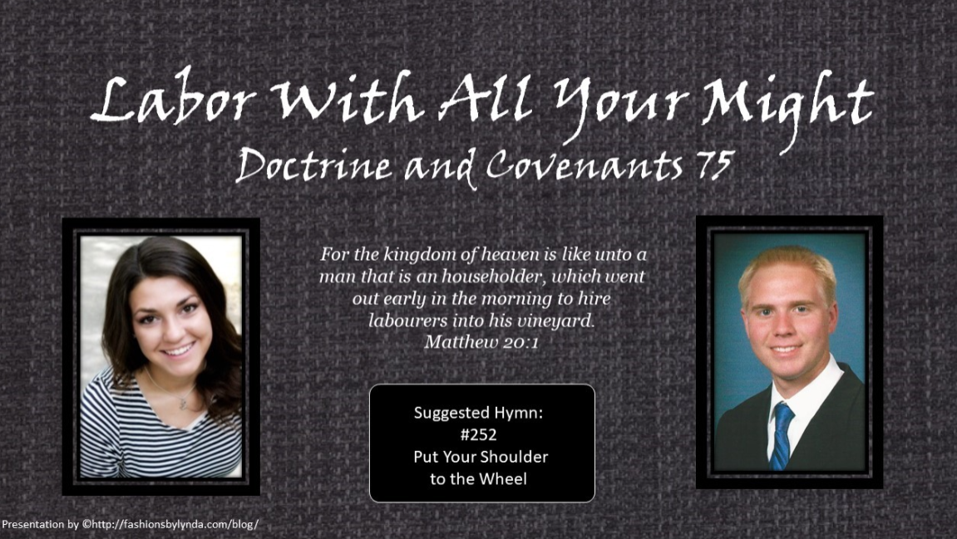

Slide 2

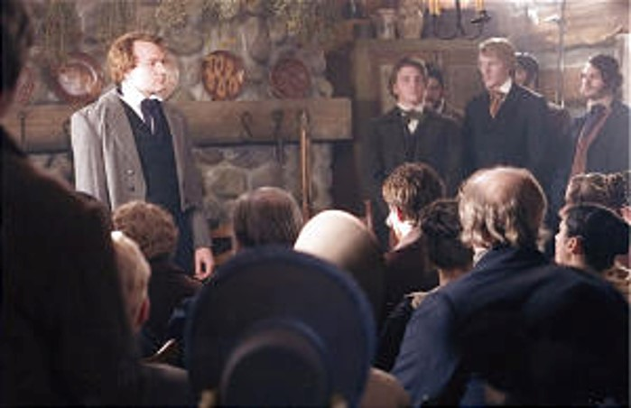
Background
January 1832-- Amherst, Lorain County, Ohio.
On January 25th Joseph was sustained and ordained the President of the High Priesthood
A few days before:
“…The Elders seemed anxious for me to inquire of the Lord that they might know His will, or learn what would be most pleasing to Him for them to do, in order to bring men to a sense of their condition; for, as it was written, all men have gone out of the way, so that none doeth good, no, not one. I inquired and received the following: [D&C 75].” HC

Slide 3
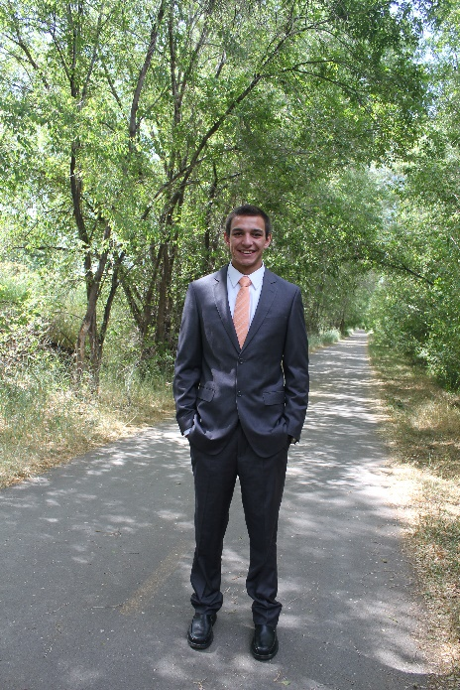

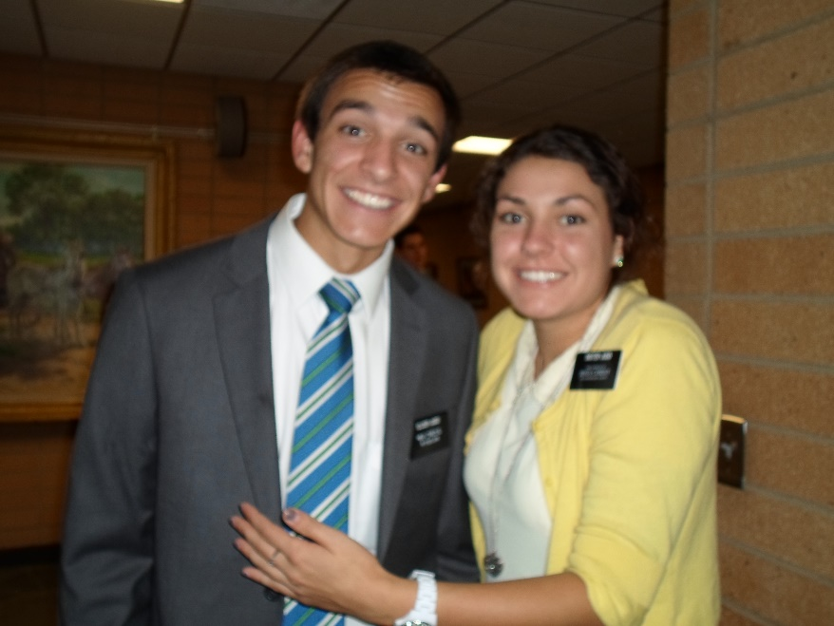
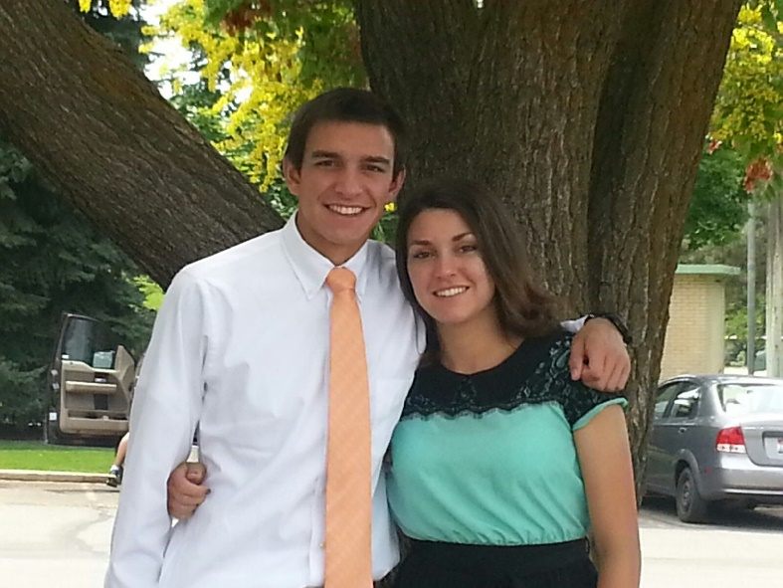
Before a Mission
To Prepare Before Your Mission
spiritual, physical, financial, and emotional preparation
But sanctify the Lord God in your hearts: and be ready always to give an answer to every man that asketh you a reason of the hope that is in you with meekness and fear:
1 Peter 3:15

Slide 4
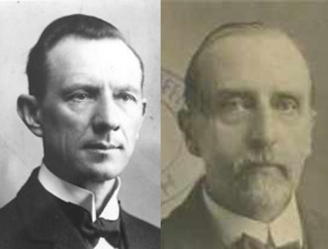
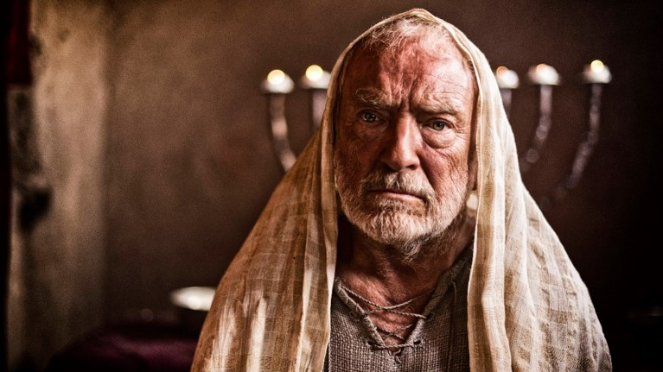
Names of the Elders
And the Lord came, and stood, and called as at other times, Samuel, Samuel. Then Samuel answered, Speak; for thy servant heareth.
1 Samuel 3:10
When the Elders of the Church can say, in all sincerity that they can hear the Lord, (through the Holy Spirit), then the Lord can use them in His ministry.
Smith and Sjodahl
D&C 75:1-2

Slide 5
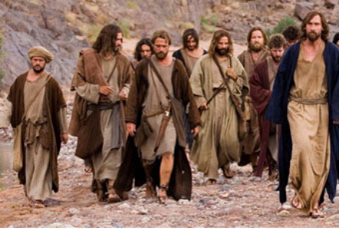
The Work to Be Done
He has work that must be done and he calls his laborers to do it.
He needs their services, but they need the wages which He pays.
He expects them to labor faithfully.
There must be no idlers in His service.
D&C 75:3-4 Smith and Sjodahl

Slide 6
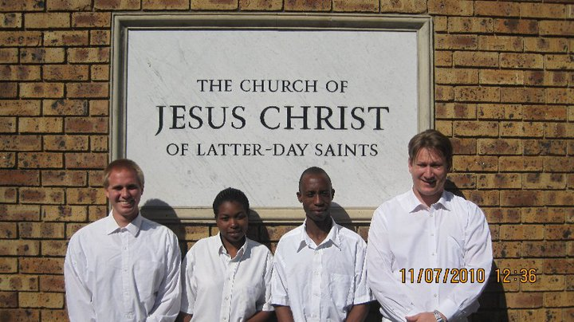
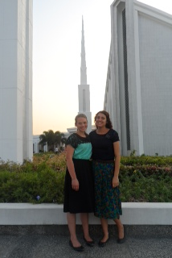
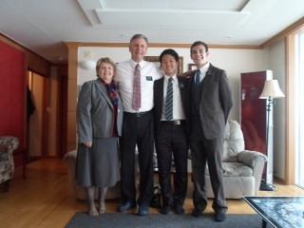
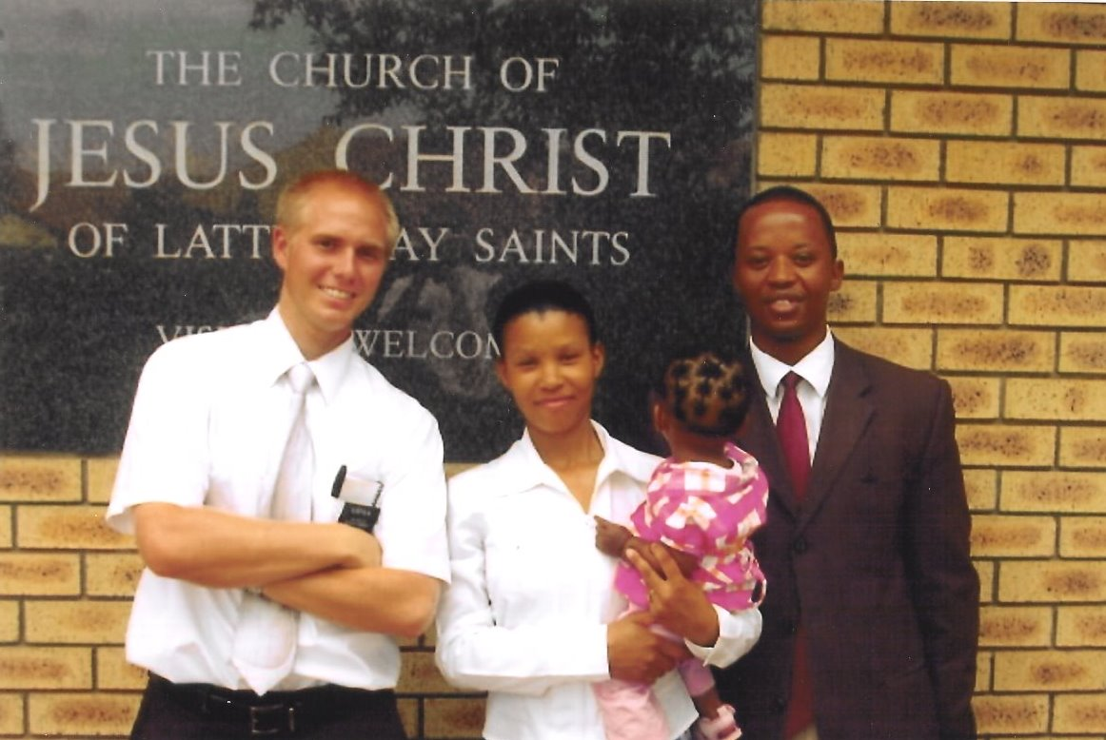
During a Mission
To Serve During Your Mission
As an authorized representative of Jesus Christ, you can teach people with power and authority through the Holy Spirit.
The purpose is to bring others to the gospel of Jesus Christ
Wherefore, how great the importance to make these things known unto the inhabitants of the earth,…
2 Nephi 2:8

Slide 7
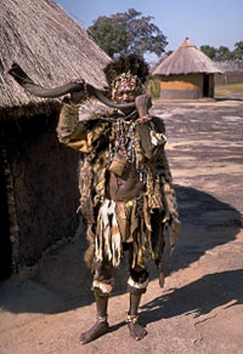
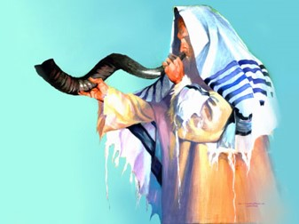
The Sound of a Trump
A trumpet can be heard far and wide
South African World Cup Sound—Vuvuzela or
lepatata
Sofar
The year of jubilee was announced in ancient Israel, from hill top to hill top, by blasts of trumpets. That is the way to proclaim the gospel. The sound of harps and lutes…cannot compare to the vigor and earnestness with which the truth must be proclaimed
D&C 75:3-4 Smith and Sjodahl

Slide 8
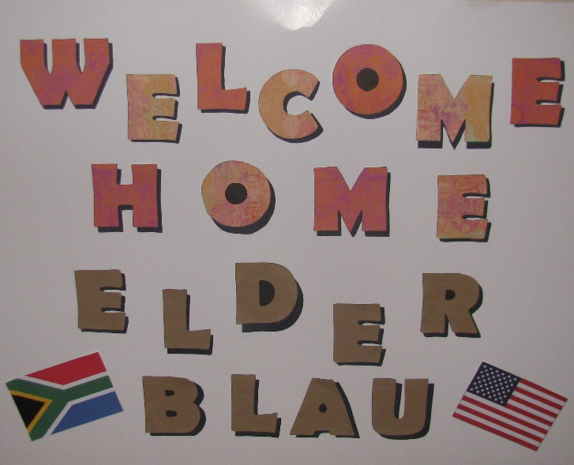
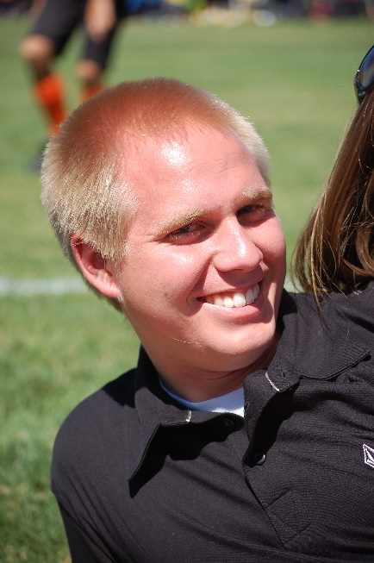
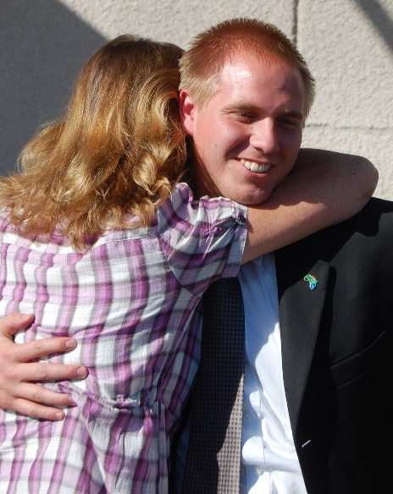
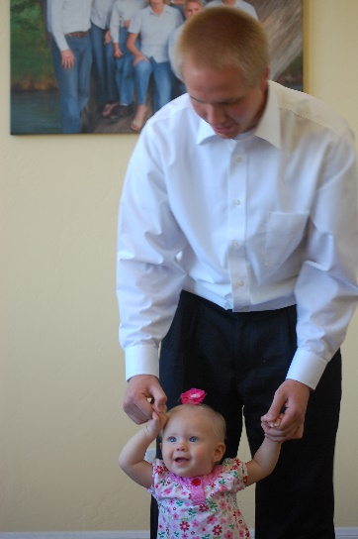
After a Mission
To Remain Faithful and Endure After Your Mission
“Returned missionaries can’t afford to lose any of their good missionary habits. If they don’t hold on to them, they’ll be throwing away two years of precious training!”
Elder Carlos E. Asay
And now I am no more in the world, but these are in the world, and I come to thee. Holy Father, keep through thine own name those whom thou hast given me, that they may be one, as we are.
John 17:11

Slide 9
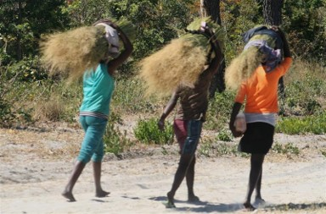
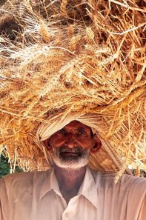
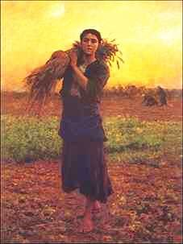
Sheaves and Crowns
Anciently, grain was cut by hand and tied into large bundles or sheaves which were then carried to the place of threshing.
To see a person or an animal “laden with many sheaves” was proof that the person had reaped an abundant harvest and would now enjoy the fruits of his labors.
D&C 75:5 Smith and Sjodahl

Slide 10
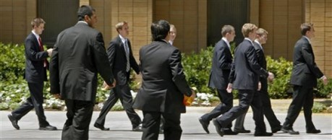

Uncertainty
“Elders who go out to preach the gospel sometimes return and report that they know not whether they have been the means of converting anybody or not.
But if they have been faithful, the harvest is sure.
The seed they have sown may sprout and come to maturity years after they have been released.”
Smith and Sjodahl
D&C 75:5

Slide 11
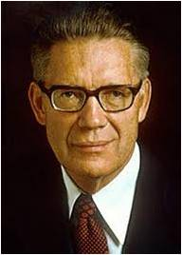

Crowns
“Those who gain exaltation in the highest heaven of the celestial world shall wear crowns. Perhaps literal crowns may be worn on occasion—emblematic of their victory over the world and signifying that they rule and reign as kings and queens in the eternal house of Israel.
But at all times they will be ‘crowned with honor, and glory, and immortality, and eternal life.’
Elder Bruce R. McConkie
If we are faithful in proclaiming the gospel, the Lord will bless us with honor, glory, and eternal life.
D&C 75:5

Slide 12
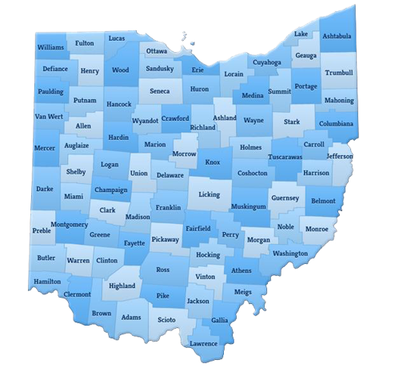
The Will of the Lord
Orson Hyde and Samuel H. Smith to serve in the eastern counties
Asa Dodds and Calves Wilson to serve in the western counties
Lyman Johnson and Orson Pratt to also serve in the eastern counties
William E. McLellin and Luke Johnson to serve in the southern counties
Major N. Ashley and Burr Riggs to serve in the southern counties
D&C 75:6-17

Slide 13
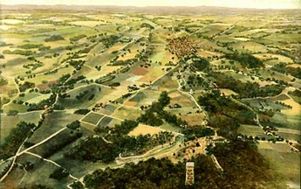
Required of the Missionaries
He who is faithful
To go from House to House—City to city—village to village
Will overcome all things and be lifted up
Those who are invited in the missionaries are to bless the house and the household
If we are faithful in proclaiming the gospel, the Lord will be with us
It is the duty of the Church to assist in supporting the families of those who are called to serve a mission
D&C 75:15-24

Slide 14
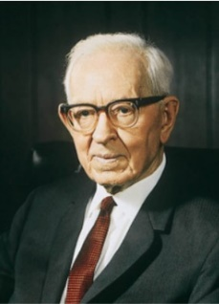
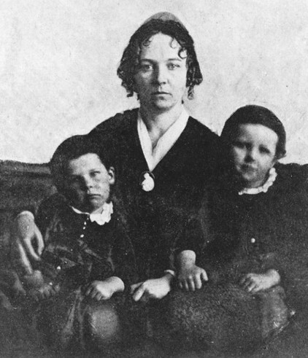
The Families of Missionaries
The support of the Church made it possible for the missionaries to serve the Lord.
“The brethren who were called to take these missionary journeys were quite generally poor men in temporal things. It was difficult for them to go out on the Lord’s work and leave their families without support. Yet the call was essential, for the souls of men were at stake and there were those waiting to hear the message who would be a strength to the Church after they received the Gospel.
The Lord took into account the needs of the families of these brethren, and he said, ‘It is the duty of the Church to assist in supporting the families of those who are called and must needs be sent unto the world. …’
The commandment therefore was given that suitable places should be provided in which these families could be housed and cared for, and the members of the Church were admonished to ‘open their hearts,’ and assist in this undertaking.
If there were brethren, however, who could support themselves and their families, this was required of them.”
President Joseph Fielding Smith
D&C 75:25-29

Slide 15
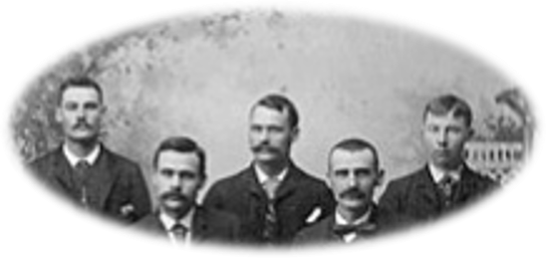
Other Missionaries Called
*Simon Carter
*Emer Harris
Ezra Thayne
**Thomas B. Marsh
*Hyrum Smith
*Reynolds Cahoon
*Daniel Stanton
*Seymour Brunson
Sylvester Smith
*Gideon Carter
Ruggles Esmes
*Stephen Burnett
*Micah B. Welton
**Eden Smith
11 out of 14 missionaries were valiant in the end---pretty good odds
* These men stayed valiant
** These men fell away but returned to the Church
D&C 75:25-29

Slide 16
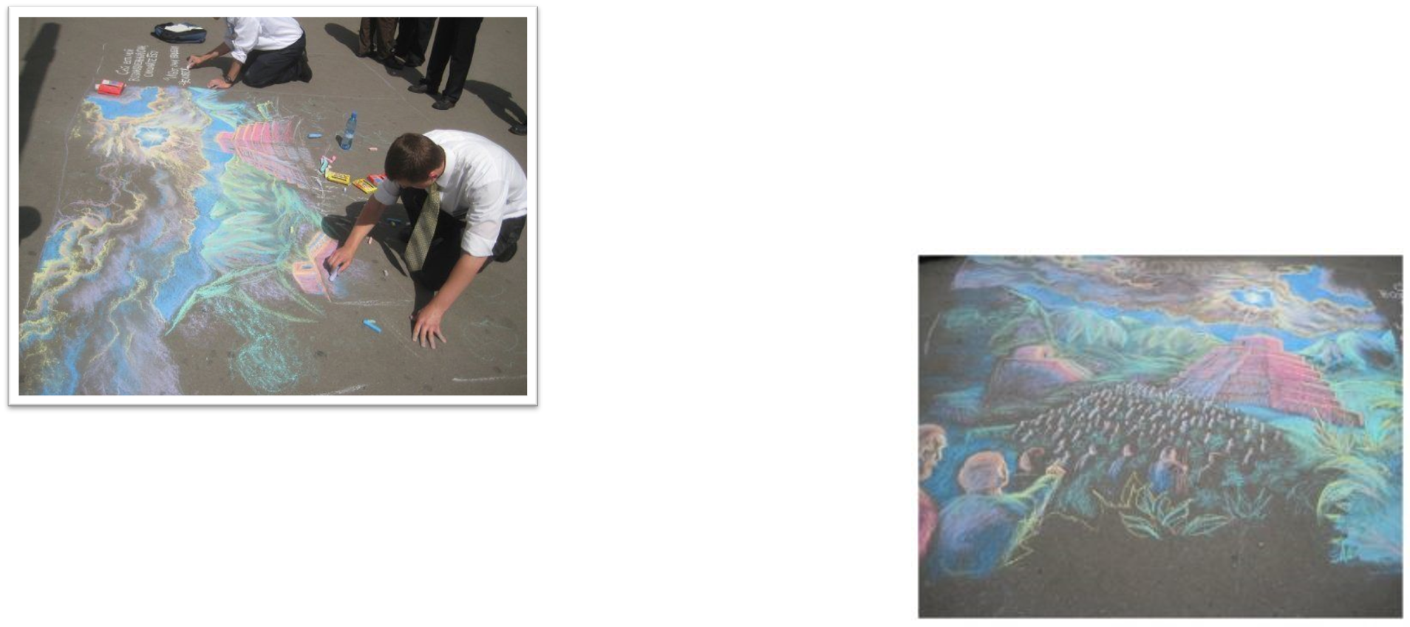
Diligent in All Things
The Lord commands us to be diligent in all things
D&C 75:29

Slide 17
Sources:
Videos:
The Lord Helps Us Share the Gospel (1:00)
Priesthood Duty: Preaching the Gospel (4:48)
History of the Church, 1:242–43.
Hyrum M. Smith and Janne M. Sjodahl Doctrine and Covenants Commentary pgs. 433
Presentation by ©http://fashionsbylynda.com/blog/
Elder Carlos E. Asay excerpt When “The Best Two Years” Are Over” by Janet Brigham Dec. 1978 Ensign
Elder Bruce R. McConkie Mormon Doctrine , p. 173
President Joseph Fielding Smith (Church History and Modern Revelation, 1:276–77.)
Missionary Photos…
Elder Brendon Blau (South Africa Johannesburg Mission 2008-2010)
Sister Haley Judd (Philippines Queen City Mission…2013-Dec. 2014)
Elder Trevor Judd (Korea Busan Mission…2013-July 2015)
Presentation by ©http://fashionsbylynda.com/blog/

Slide 18
The vuvuzela /vuːvuːˈzɛlə/, also known as lepatata Mambu (its Tswana name), is a plastic horn,
which produces a loud monotone note, typically around B♭ 3 (the B♭ below middle C)
Traditionally made and inspired from a kudu horn, the vuvuzela was used to summon distant villagers to attend community gatherings
Wikipedia
They shall wear crowns
Elder Bruce R. McConkie commented on the symbolism of being crowned: “Those who gain exaltation in the highest heaven of the celestial world shall wear crowns. Perhaps literal crowns may be worn on occasion—emblematic of their victory over the world and signifying that they rule and reign as kings and queens in the eternal house of Israel. But at all times they will be ‘crowned with honor, and glory, and immortality, and eternal life.’ (D. & C. 75:5.)” (Mormon Doctrine, p. 173.)
Shake The Dust off Your Feet D&C 75:20-22:
“When our Lord sent forth his disciples to proclaim the Gospel message he instructed them to shake off the dust of their feet as a testimony against those who opposed them. Likewise … the Lord instructed the elders that they had the same privilege. … The cleansing of their feet, either by washing or wiping off the dust, would be recorded in heaven as a testimony against the wicked. This act, however, was not to be performed in the presence of the offenders, ‘lest thou provoke them, but in secret, and wash thy feet, as a testimony against them in the day of judgment’ [D&C 60:15]. The missionaries of the Church who faithfully perform their duty are under the obligation of leaving their testimony with all with whom they come in contact in their work. This testimony will stand as a witness against those who reject the message, at the judgment” (Church History and Modern Revelation, 2 vols. [1953], 1:223; see also Commentary and Background Information for D&C 24:15 in lesson 31).
The dusting of one’s feet serves as a testimony against those who completely reject the Lord’s authorized servants. It is performed only in rare circumstances when the Lord expressly commands it. This act also serves as a witness of their rejection and that those who preached the gospel to them are no longer responsible for them before the Lord.
What Happened to William E. McLellin? D&C 75:6-13:
the Lord rebuked William E. McLellin for his murmurings, revoked the call to serve in the eastern states, and called Orson Hyde to replace him as Samuel Smith’s companion. However, the Lord mercifully extended another call for Brother McLellin to proclaim the gospel in the southern United States with Luke Johnson as his companion. Brother McLellin accepted the call to serve, but he did not continue faithfully. He soon claimed to be too sick to continue his mission. After leaving his mission, he traveled to Hiram, Ohio, and married Emiline Miller.
After serving additional missions and serving for a time as a member of the Quorum of the Twelve Apostles, William E. McLellin was excommunicated on May 11, 1838, after confessing that he had stopped praying and keeping the commandments.

