Slide 1
Doctrine and Covenants 76:1-19
Our Eyes Were Opened
And shall come forth; they that have done good, unto the resurrection of life; and they that have done evil, unto the resurrection of damnation.
John 5:29
Presentation by ©http://fashionsbylynda.com/blog/

Slide 2
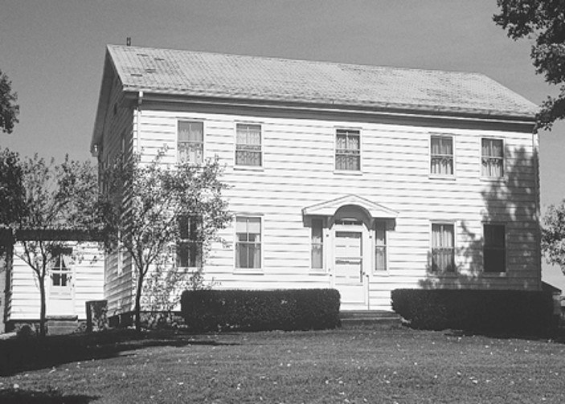
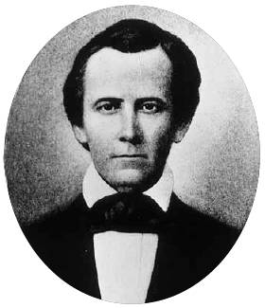
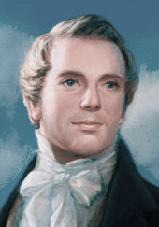
Background
February 16, 1832—Hiram, Ohio at Johnson’s farm
Joseph Smith, Sidney Rigdon, and about 12 other men were in the upstairs room of the John and Elsa Johnson home in Hiram, Ohio.
While Joseph and Sidney worked on the inspired translation of the Bible, they were studying John 5:29, a scripture which described heaven, and they wanted to know more.
As they pondered, they saw a vision, which is recorded in Doctrine and Covenants 76.
The Savior showed Joseph Smith and Sidney Rigdon a series of distinct visions that affirmed the reality and divinity of Jesus Christ, taught about the fall of Satan and the sons of perdition, and revealed the nature of the three kingdoms of glory and those who will inherit them.

Slide 3
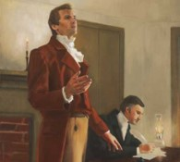
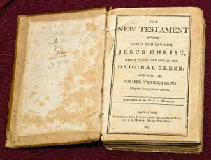
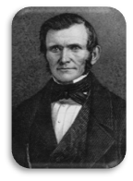
More Light, More Truth
“Upon my return from Amherst [Ohio] conference, I resumed the translation of the Scriptures. From sundry revelations which had been received, it was apparent that many important points touching the salvation of man, had been taken from the Bible, or lost before it was compiled.
It appeared self-evident from what truths were left, that if God rewarded every one according to the deeds done in the body the term ‘Heaven,’ as intended for the Saints’ eternal home must include more kingdoms than one.
Accordingly, on the 16th of February 1832, while translating St. John’s Gospel, myself and Elder Rigdon saw the following vision: [D&C 76].”
Joseph Smith
“I will refer to the ‘Vision’ [in section 76] alone, as a revelation which gives more light, more truth and more principle than any revelation contained in any other book we ever read. It makes plain to our understanding our present condition, where we came from, why we are here, and where we are going to. Any man may know through that revelation what his part and condition will be”
Wilford Woodruff
Sundry--“separate, single; various, distinct; special, private, peculiar, exceptional, particular ...

Slide 4
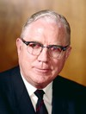
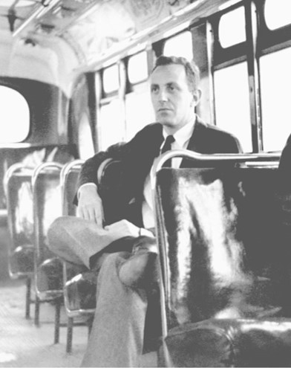
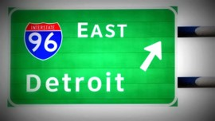
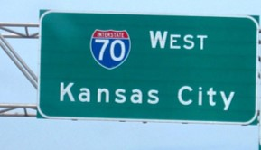
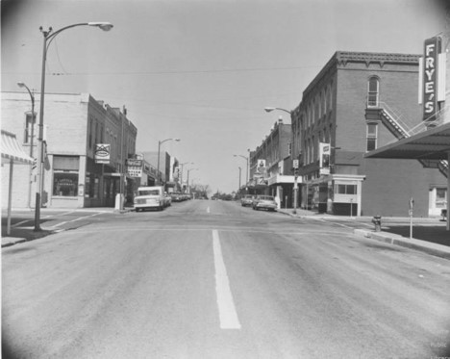
The Wrong Bus
A man got on a bus with the intention and desire to go to Detroit
But when he arrived at the end of a long trip, he found himself in Kansas City.
At first he could not believe it.
When he asked for directions to Woodward Avenue, he was told there was no Woodward Avenue.
He was annoyed and for some time before he could face the fact that in spite of his good intentions and earnest desire, he was not in Detroit at all but in Kansas City
Everything, he thought, was fine except for one little detail; he had caught the wrong bus.
Dr. Harry Emerson Fosdick

Slide 5
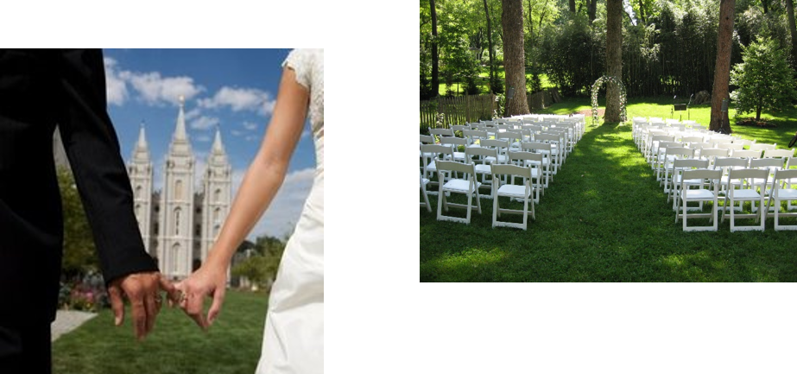
Never Intended To Go There
“Isn’t it interesting that so many human beings arrive at some place in life where they never intended to go.
We pick out goals of honor and success and happiness, and then we sometimes get on the buses that take us to destinations loaded with dishonor, failure, and unpleasantness.

Slide 6
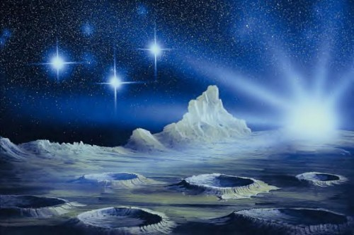
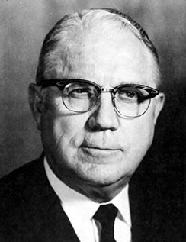
Prepare For What Lies Beyond
“A primary purpose of our mortal existence is to prepare for the life that lies beyond. And our possible destination has been separated into three great subdivisions, which Paul compares in desirability to the light of the sun, the moon, and the stars. …
“And so we come back again to this great idea which is one of the most important in the world: first, that we know where we want to go; and second, that we get on the bus that will take us there”
Elder Sterling W. Sill

Slide 7
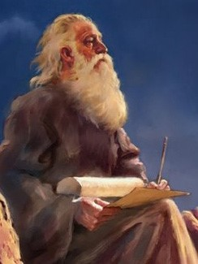
Marvelous Are His Ways
Therefore, behold, I will proceed to do a marvellous work among this people, even a marvellous work and a wonder: for the wisdom of their wise men shall perish, and the understanding of their prudent men shall be hid.
Isaiah 29:14
“Where the Prophet [Isaiah] predicts the destruction of the wisdom of the wise men, and the concealment of their understanding, and gives the assurance that the Lord will “do a marvelous work” among the people.”
This is fulfilled when the Prophet Joseph was called to lay the foundations of the church in this dispensation.
D&C 76:2 Smith and Sjodahl

Slide 8
Power and Glory
“A revelation for those in heaven as well as on the earth
“Spirits beyond the veil—us—must receive their information through the prophets of the Lord”
Unto whom it was revealed, that not unto themselves, but unto us they did minister the things, which are now reported unto you by them that have preached the gospel unto you with the Holy Ghost sent down from heaven; which things the angels desire to look into.
1 Peter 1:12
“The World has almost forgotten that Jehovah, our Lord and Savior, Jesus Christ, is God
When they think God, they endeavor to perceive either an imperceptible Being without body and without direct influence on the events of history; or a Thor hurling his flashing, murderous hammer in every direction.”
D&C 76:1-5 Smith and Sjodahl

Slide 9
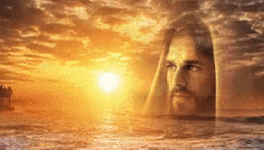
Only in Him
Worship, Love, Hold Him in Awe
“The only true idea we have of God is the one we can obtain by seeing Him as revealed in His son.
The Lord Jesus Christ, is God.”
…is there power to save
For behold, this is my work and my glory—to bring to pass the immortality and eternal life of man.
Moses 1:39
D&C 76:5 Smith and Sjodahl

Slide 10
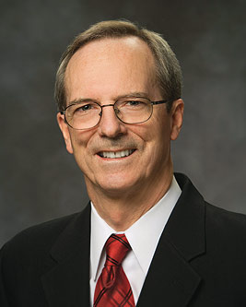
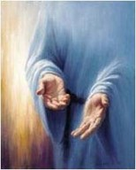
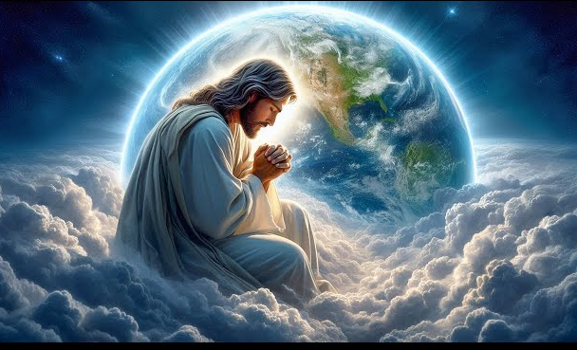
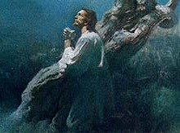
Eternity to Eternity
Infinite in Divineness---He who brought the Atonement
Infinite in Power---The Savior went from grace to grace until he “received all power, both in heaven and on earth” (D&C 93:17)
Infinite in time---retroactively and prospectively through time immemorial
Infinite in coverage—Coverage for all men, earth itself, and all forms of life
Infinite in depth—not only in who it covers, but in what it covers
Infinite is suffering—the degree of suffering endured by the Redeemer (D&C 19:18) “to bleed at every pore”
Infinite in Love---His boundless love, mercy, and grace
Infinite in Blessings—the blessings of the Atonement extend far beyond its well-known triumph over physical and spiritual death.
D&C 76:6 Tad R. Callister

Slide 11
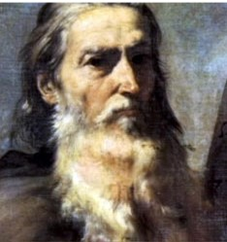
Reveal All Mysteries
Spiritual Truths
One of the rewards promised to God’s faithful servants is revelations of the mysteries of the kingdom of God
The Lord will teach them all that pertains to that kingdom, in order that they may be qualified as citizens, and take part in His government.
If we reverence the Lord and serve Him to the end, He will honor us by revealing truth to us.
The Lord only gives an account of this Earth life to Moses:
But only an account of this earth, and the inhabitants thereof, give I unto you. For behold, there are many
worlds that have passed away by the word of my power. And there are many that now stand, and innumerable
are they unto man; but all things are numbered unto
me, for they are mine and I know them.
Moses 1:35
D&C 76:7

Slide 12
Enlighten Them
For by my Spirit will I enlighten them, and by my power will I make known unto them the secrets of my will—yea, even those things which eye has not seen, nor ear heard, nor yet entered into the heart of man.
To provide knowledge or spiritual insight that increases our understanding or helps us see truth.
D&C 76:10

Slide 13
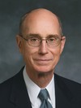
The Power of the Spirit
Touched our eyes of our understanding
As we prayerfully study and ponder the scriptures, we prepare ourselves to receive understanding from the Lord through the Holy Ghost
“Reading, studying, and pondering are not the same. We read words and we may get ideas. We study and we may discover patterns and connections in scripture. But when we ponder, we invite revelation by the Spirit. Pondering, to me, is the thinking and the praying I do after reading and studying in the scriptures carefully”
President Henry B. Eyring
D&C 76:11-19

Slide 14
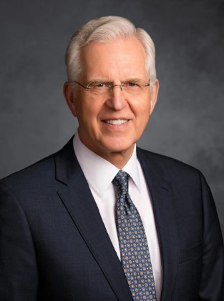
The Power of the Spirit
When I say “study,” I mean something more than reading.
… I see you sometimes reading a few verses, stopping to ponder them, carefully reading the verses again, and as you think about what they mean, praying for understanding, asking questions in your mind, waiting for spiritual impressions, and writing down the impressions and insights that come so you can remember and learn more.
Studying in this way, you may not read a lot of chapters or verses in a half hour, but you will be giving place in your heart for the word of God, and He will be speaking to you. D. Todd Christofferson

Slide 15
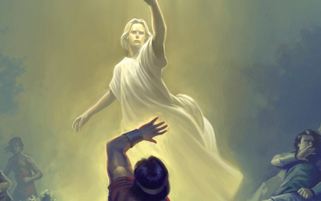
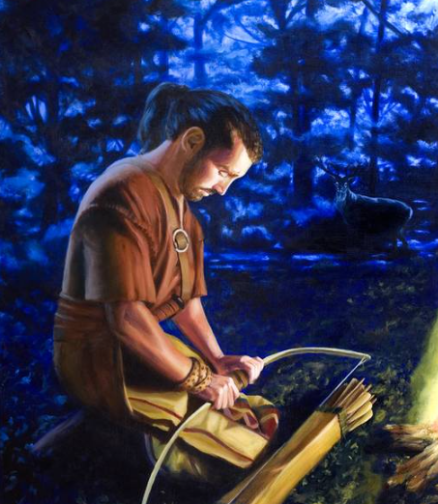
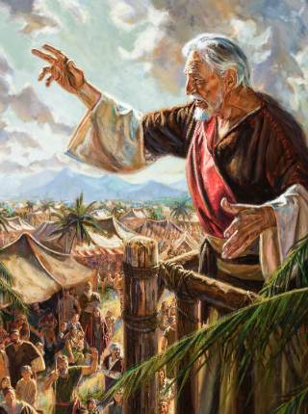
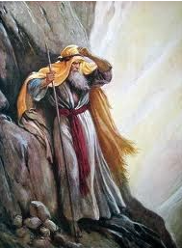
Pray, Ponder, Pay Attention
Enos 1:1-17
Mosiah 3:1-20
Moses 1:1-36
Alma 36:1-30

Slide 16
Preparation in Receiving Revelation
Joseph Smith and Sidney Rigdon said that while they were translating John 5:29 they were “in the Spirit and “by the power of the Spirit” their eyes were opened.
In this context, these phrases refer to a temporary physical and spiritual condition called transfiguration.
Transfiguration occurs when “persons … are temporarily changed in appearance and nature—that is, lifted to a higher spiritual level—so that they can endure the presence and glory of heavenly beings.”
Guide to Scriptures
“Our Eyes Were Opened”
D&C 76:19

Slide 17
Sources:
Videos:
Patterns of Light: The Light of Christ (2:33)
Spiritually Prepared (2:18)
Wilford Woodruff (Teachings of Presidents of the Church: Wilford Woodruff [2004], 120–21).
Joseph Smith (History of the Church, 1:245.)
Presentation by ©http://fashionsbylynda.com/blog/
Elder Sterling W. Sill (“On the Wrong Bus,” New Era, July 1983, 4, 6.) Dr. Harry Emerson Fosdick (modified by Lynda Blau)
Hyrum M. Smith and Janne M. Sjodahl Doctrine and Covenants Commentary pgs. 444-445
Tad R. Callister The Infinite Atonement pgs. 59-60
(Guide to the Scriptures, “Transfiguration,” scriptures.lds.org).
President Henry B. Eyring (“Serve with the Spirit,” Ensign or Liahona, Nov. 2010, 60).
D. Todd Christofferson, “When Thou Art Converted,” Ensign or Liahona, May 2004, 11
Presentation by ©http://fashionsbylynda.com/blog/

Slide 18
Philo Dibble was an eyewitness to the reception of this revelation. He wrote that “the vision which is recorded in the Book of Doctrine and Covenants was given at the house of ‘Father Johnson,’ in Hiram, Ohio, and during the time that Joseph and Sidney were in the spirit and saw the heavens open, there were other men in the room, perhaps twelve, among whom I was one during a part of the time—probably two-thirds of the time,—I saw the glory and felt the power, but did not see the vision.
“The events and conversation, while they were seeing what is written (and many things were seen and related that are not written,) I will relate as minutely as is necessary.
“Joseph would, at intervals, say: ‘What do I see?’ as one might say while looking out the window and beholding what all in the room could not see. Then he would relate what he had seen or what he was looking at. Then Sidney replied, ‘I see the same.’ Presently Sidney would say ‘what do I see?’ and would repeat what he had seen or was seeing, and Joseph would reply, ‘I see the same.’
“This manner of conversation was reported at short intervals to the end of the vision, and during the whole time not a word was spoken by any other person. Not a sound nor motion made by anyone but Joseph and Sidney, and it seemed to me that they never moved a joint or limb during the time I was there, which I think was over an hour, and to the end of the vision.
“Joseph sat firmly and calmly all the time in the midst of a magnificent glory, but Sidney sat limp and pale, apparently as limber as a rag, observing which, Joseph remarked, smilingly, ‘Sidney is not used to it as I am.’” (Juvenile Instructor, May 1892, pp. 303–4.)
The Prophet Joseph Smith wrote: “Nothing could be more pleasing to the Saints upon the order of the kingdom of the Lord, than the light which burst upon the world through the foregoing vision. Every law, every commandment, every promise, every truth, and every point touching the destiny of man, from Genesis to Revelation, where the purity of the scriptures remains unsullied by the folly of men, go to show the perfection of the theory [of different degrees of glory in the future life] and witnesses the fact that that document is a transcript from the records of the eternal world. The sublimity of the ideas; the purity of the language; the scope for action; the continued duration for completion, in order that the heirs of salvation may confess the Lord and bow the knee; the rewards for faithfulness, and the punishments for sins, are so much beyond the narrow-mindedness of men, that every honest man is constrained to exclaim: ‘It came from God.’” (History of the Church,1:252–53.)
if a person fears Him (that is, respects, reverences, and obeys Him) and serves Him to the end, He will be delighted to honor that person. The honors include:
1. A great reward (see D&C 76:6)
.
2. Eternal glory (see v. 6).
3. Revelation of all mysteries of God’s kingdom, both past and present (see v. 7; D&C 6:7, 11 for the definition of mystery).
4. Knowledge of His will concerning all things in the kingdom (see v. 7)
5. Knowledge of the wonders of eternity (see v. 8)
6. Knowledge of many generations (see v. 8)
7. Great wisdom (see v. 9.)
8. Understanding that reaches to heaven and which the world cannot equal (see v. 9.)
9. Enlightenment by the Spirit and power of God (see v. 10.)
The mention of these promises at the beginning of this revelation is significant, for Joseph Smith and Sidney Rigdon indicated that they were not allowed to write all that they were shown (see vv. 113–15).
Not only is it unlawful for man to reveal these things, but it is impossible for him to do so because they are so glorious that man is incapable of making them known (see vv. 115–16). The Savior states, however, that those who will “purify themselves before him” through the power of the Holy Spirit shall have the “privilege of seeing and knowing [these things] for themselves” (vv. 116–17). Student Manual Section 76

Slide 19
President Marion G. Romney said:
“As I have read the scriptures, I have been challenged by the word ponder, so frequently used in the Book of Mormon. The dictionary says that ponder means ‘to weigh mentally, think deeply about, deliberate, meditate.’ …
“Pondering is, in my feeling, a form of prayer. It has, at least, been an approach to the Spirit of the Lord on many occasions.” (In Conference Report, Apr. 1973, p. 117; or Ensign, July 1973, p. 90.)
Direct result of Pondering:
At least two other great visions came as a direct result of pondering. Nephi says that he was “pondering in mine heart” the things of his father’s dream when he was “caught away in the Spirit of the Lord, yea into an exceeding high mountain” (1 Nephi 11:1). And President Joseph F. Smith said that he received his vision of the spirit world as he sat in his room “pondering over the scriptures; and reflecting” (D&C 138:1–2).
President David O. McKay taught the value of meditation:
“I think we pay too little attention to the value of meditation, a principle of devotion. …
“Meditation is one of the most secret, most sacred doors through which we pass into the presence of the Lord. Jesus set the example for us. As soon as he was baptized and received the Father’s approval—‘This is my beloved Son, in whom I am well pleased’ (Matt. 3:17)—Jesus repaired to what is now known as the Mount of Temptation where, during forty days of fasting, he communed with himself and his Father and contemplated the responsibility of his own great mission.
One result of this spiritual communion was such strength as enabled him to say to the tempter: ‘Get thee hence, Satan: for it is written, Thou shalt worship the Lord thy God, and him only shalt thou serve.’ (Matt. 4:10.)” (In Conference Report, Apr. 1967, p. 85.)
“When I say ‘study,’ I mean something more than reading. … I see you sometimes reading a few verses, stopping to ponder them, carefully reading the verses again, and as you think about what they mean, praying for understanding, asking questions in your mind, waiting for spiritual impressions, and writing down the impressions and insights that come so you can remember and learn more. Studying in this way, you may not read a lot of chapters or verses in a half hour, but you will be giving place in your heart for the word of God, and He will be speaking to you” D. Todd Christofferson (“When Thou Art Converted,” Ensign or Liahona, May 2004, 11).
If you would rather use this light for slide 12

Slide 20
Under Joseph Smith’s direction, a poetic version of Doctrine and Covenants 76, commonly called “The Vision,” was written. The poem was printed February 1, 1843, in the Times and Seasons, a Church newspaper published at Nauvoo, Illinois, from November 1839 to February 1846 (see Times and Seasons, Feb. 1, 1843, 82–85). The table below shows portions of Doctrine and Covenants 76, corresponding stanzas from the poem, and insights we can gain from both.
Doctrine and Covenants 76 | Poetic Rendition | Insight
Verse 24 “That by him, and through him, and of him, the worlds are and were created, and the inhabitants thereof are begotten sons and daughters unto God.” | Stanzas 19–20 “19. And I heard a great voice, bearing record from heav’n, He’s the Saviour, and only begotten of God— By him, of him, and through him, the worlds were all made, Even all that career in the heavens so broad, “20. Whose inhabitants, too, from the first to the last, Are sav’d by the very same Saviour of ours; And, of course, are begotten God’s daughters and sons, By the very same truths, and the very same pow’rs.” | Jesus Christ is the Savior for not only the inhabitants of our world but also for the inhabitants of all the worlds made by Him.
Verses 72–73 “Behold, these are they who died without law; “And also they who are the spirits of men kept in prison, whom the Son visited, and preached the gospel unto them, that they might be judged according to men in the flesh.” | Stanzas 54–55 “54. Behold, these are they that have died without law; The heathen of ages that never had hope, And those of the region and shadow of death, The spirits in prison, that light has brought up. “55. To spirits in prison the Savior once preach’d, And taught them the gospel, with powers afresh; And then were the living baptiz’d for their dead, That they might be judg’d as if men in the flesh.” | Unlike Alvin Smith, who would have accepted the gospel had he had the chance to receive it before he died (see D&C 137), there are many who would have rejected the gospel had they received it during mortality. But because of the great mercies of God, these people will have the opportunity to hear and accept the gospel in spirit prison and be judged as though they were in the flesh.
Verses 74–77 “Who received not the testimony of Jesus in the flesh, but afterwards received it. “These are they who are honorable men of the earth, who were blinded by the craftiness of men. “These are they who receive of his glory, but not of his fulness. “These are they who receive of the presence of the Son, but not of the fulness of the Father.” | Stanzas 56–57 “56. These are they that are hon’rable men of the earth; Who were blinded and dup’d by the cunning of men: They receiv’d not the truth of the Savior at first; But did, when they heard it in prison, again. “57. Not valiant for truth, they obtain’d not the crown, But are of that glory that’s typ’d by the moon: They are they, that come into the presence of Christ, But not to the fulness of God, on his throne.” | There are many honorable people who reject the gospel in this life but later repent and accept the gospel when it is taught to them in the spirit world. They will receive terrestrial glory, which is likened to the light of the moon. They will be able to associate with Jesus Christ, but they will not receive of the fulness of God the Father.

