Slide 1
Doctrine and Covenants 76:19-24
Jesus Christ As Himself
And to make all men see what is the fellowship of the mystery, which from the beginning of the world hath been hid in God, who created all things by Jesus Christ:
Ephesians 3:9
Presentation by ©http://fashionsbylynda.com/blog/

Slide 2
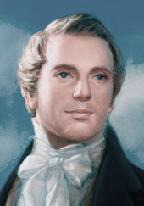
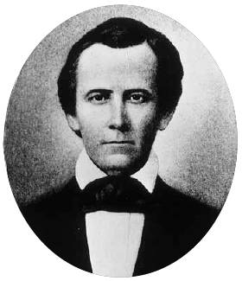
Previously…
And while we meditated upon these things, the Lord touched the eyes of our understandings and they were opened, and the glory of the Lord shone round about.
“Our Eyes Were Opened”
D&C 76:19

Slide 3
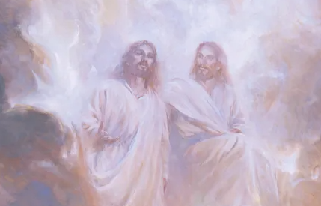
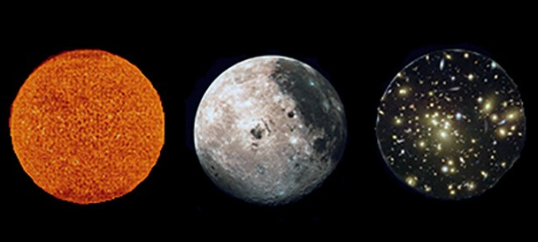
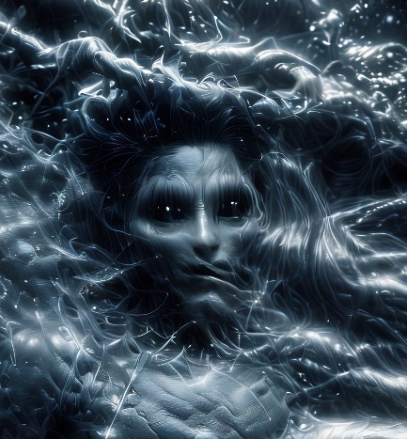
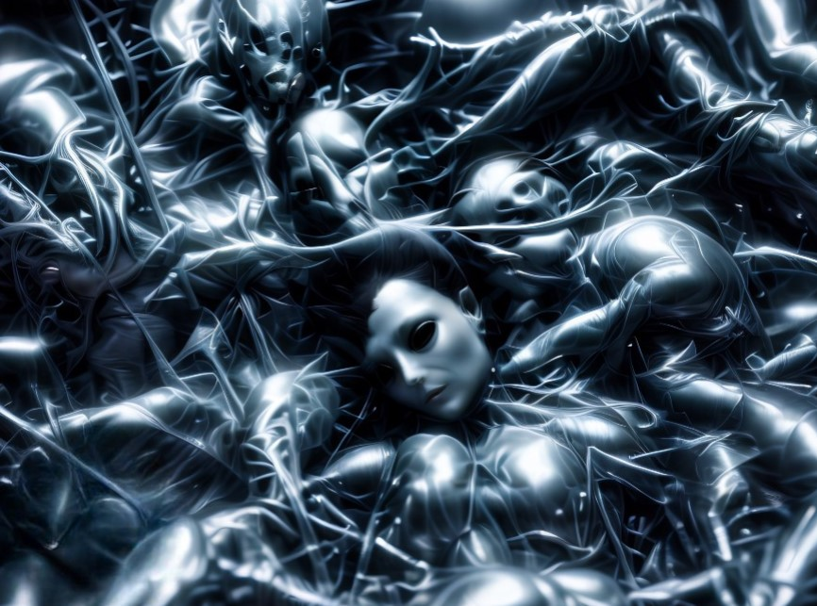
Can You Explain Your Religious Beliefs?
Celestial Glory D&C 76:50-70,92-96
To Others?
D&C 76:19-24
Terestial Glory
D&C 76: 71-80,87,91,97
Sons of Perdition
D&C 76:30-49
Telestial Glory D&C 76:81-86,88-90,98-112
Fall of Satan
D&C 76:25-27

Slide 4
First Part of Vision—Midst Of Their Glory
What They Saw
What They Learned
The Son, Jesus Christ, on the right hand of Heavenly Father—two distinct personages
Holy angels and others, worshipping God and the Lamb
Jesus Christ is the Only Begotten of the Father
Jesus Christ is the Creator of this world and other worlds
We are begotten sons and daughters unto God
D&C 76:20-24

Slide 5
Doctrinal Mastery
And now, after the many testimonies which have been given of him, this is the testimony, last of all, which we give of him: That he lives!
For we saw him, even on the right hand of God; and we heard the voice bearing record that he is the Only Begotten of the Father—
That by him, and through him, and of him, the worlds are and were created, and the inhabitants thereof are begotten sons and daughters unto God.
D&C 76:22-24

Slide 6
Doctrines
Jesus Christ is a living glorified being
We are begotten sons and daughters unto God
Heavenly Father and Jesus Christ are distinct personages
Jesus Christ is the Creator of this world and other worlds
Jesus Christ is the Only Begotten of the Father
D&C 76:20-24

Slide 7
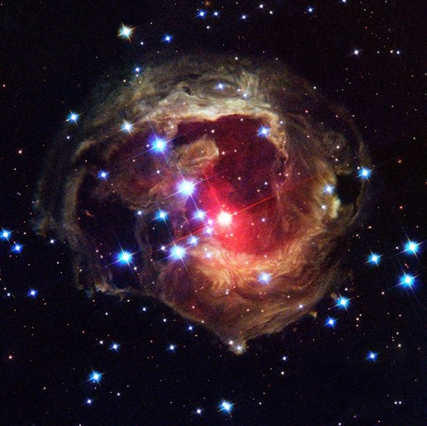
His Fullness
To receive of His fullness is to receive of that divine Spirit which fills Him and makes us one with those who belong to Him—His Church
For by him were all things created, that are in heaven, and that are in earth, visible and invisible, whether they be thrones, or dominions, or principalities, or powers: all things were created by him, and for him:
And he is before all things, and by him all things consist.
And he is the head of the body, the church: who is the beginning, the firstborn from the dead; that in all things he might have the preeminence.
For it pleased the Father that in him should all fulness dwell;
And, having made peace through the blood of his cross, by him to reconcile all things unto himself; by him, I say, whether they be things in earth, or things in heaven.
1 Colossians 16-20
D&C 76:20 Smith and Sjodahl

Slide 8
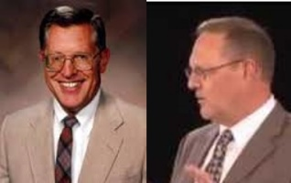
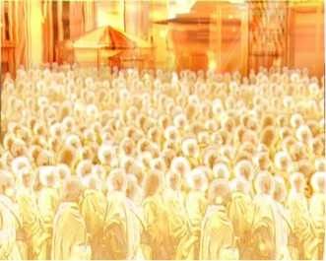
They Who Are Sanctified
Holy angels and the faithful of other worlds in their resurrected state, worshipping God and the Lamb
(McConkie and Ostler)
I beheld round the throne, holy angels and hosts,
And sanctified being from worlds that have been,
In holiness worshipping God and the Lamb,
Forever and ever, amen and amen!
Times and Seasons 4:82
D&C 76:21

Slide 9
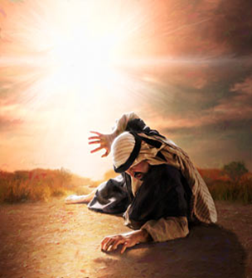
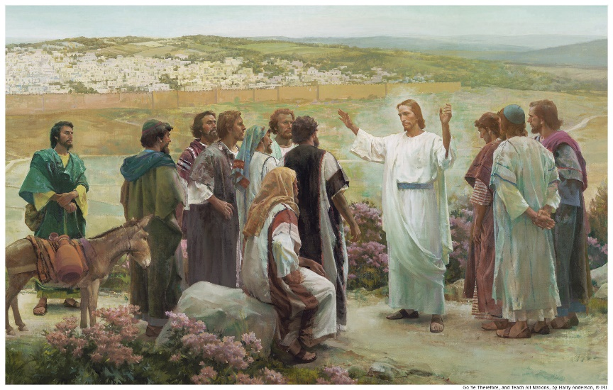
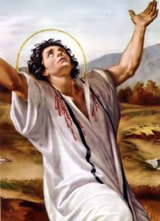
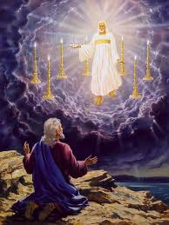
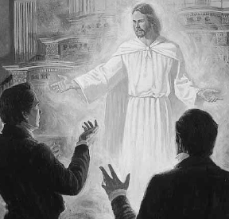
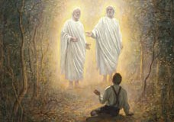
Last of All
The Lord was seen after His resurrection by:
Saul, called Paul after conversion
John, (the Revelator) on Patmos
Stephen, the martyr
Peter and the Twelve and more that 500 men and some women
This was the last testimony to the fact that He lives, a resurrected and glorified Being
However:
This is not the final testimony, but the last up to the time of the vision
Joseph Smith
Joseph Smith and Sidney Rigdon
D&C 76:22 Smith and Sjodahl

Slide 10
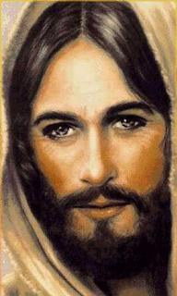
Because Jesus Lives…
He lives, he lives, who once was dead.
He lives, my ever-living Head.
He lives to bless me with his love.
He lives to plead for me above.
He lives my hungry soul to feed.
He lives to bless in time of need.
He lives, my kind, wise heav’nly Friend.
He lives and loves me to the end.
He lives, and while he lives, I’ll sing.
He lives, my Prophet, Priest, and King.
He lives and grants me daily breath.
He lives, and I shall conquer death.
He lives my mansion to prepare.
He lives to bring me safely there.
He lives to grant me rich supply.
He lives to guide me with his eye.
He lives to comfort me when faint.
He lives to hear my soul’s complaint.
He lives to silence all my fears.
He lives to wipe away my tears.
He lives to calm my troubled heart.
He lives all blessings to impart.
He lives! All glory to his name!
He lives, my Savior, still the same.
Oh, sweet the joy this sentence gives:
“I know that my Redeemer lives!”
He lives! All glory to his name!
He lives, my Savior, still the same.
Oh, sweet the joy this sentence gives:
“I know that my Redeemer lives!”
D&C 76:22; “I Know That My Reedemer Lives” Hymn 136

Slide 11
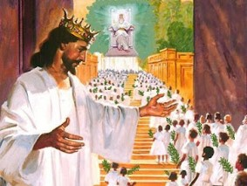
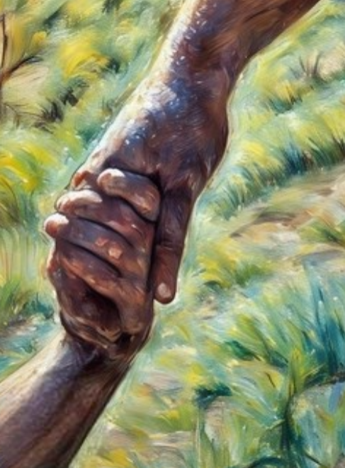
The Only Begotten of the Father
“God the Eternal Father, whom we designate by the exalted name-title Elohim, is the literal Parent of our Lord and Savior Jesus Christ, and of the spirits of the human race.
“Jesus Christ is the Son of Elohim, both as spiritual and bodily offspring, that is to say,
Elohim is literally the Father of the spirit of Jesus Christ, and also the body in which Jesus Christ performed His mission in the flesh, and which body died on the cross, and was afterwards taken up by the process of resurrection, and is now the immortalized tabernacle of the eternal spirit of our Lord and Savior”
Millennial Star
D&C 76:23

Slide 12
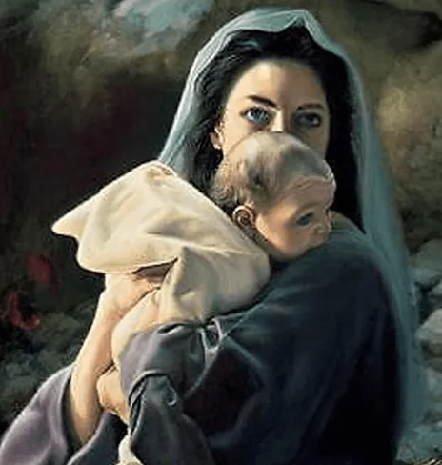
Our Savior, Jesus Christ, is called the Only Begotten Son because He is the only person on earth to be born of a mortal mother and an immortal Father.
He inherited divine powers from God, His Father.
From His mother, Mary, He inherited mortality and was subject to hunger, thirst, fatigue, pain, and death
Ensign
Liz Lemon Swindle
D&C 76:23; John 10:17-18

Slide 13
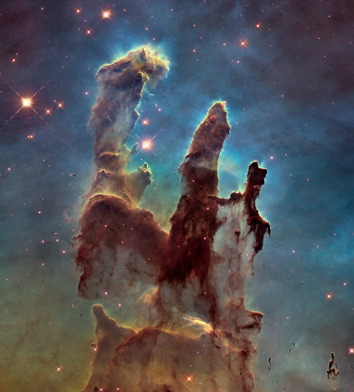
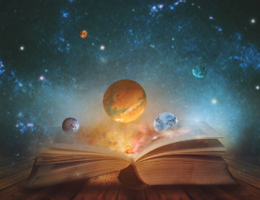
By Him
By him, of him, and through him, the worlds were all made,
Even all that career in the heavens so broad,
Whose inhabitants, too, from the first to the last,
Are sav’d by the very same Saviour of ours;
And, of course, are begotten God’s daughters and sons,
By the very same truths, and the very same pow’rs.
William W. Phelps
…not only is the Savior the same on the other worlds but the “very same truths, and the very same pow’rs”—meaning the priesthood, the ordinances, and the covenants—are the same on the other worlds. Undoubtedly, the other worlds have their own witnesses of Jesus Christ, but the gospel, the good news of Christ, is universal throughout all the worlds.
Casey Paul Griffiths
D&C 76:24

Slide 14
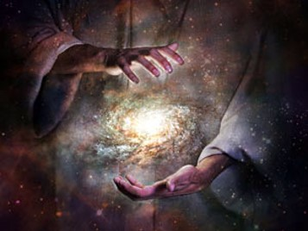
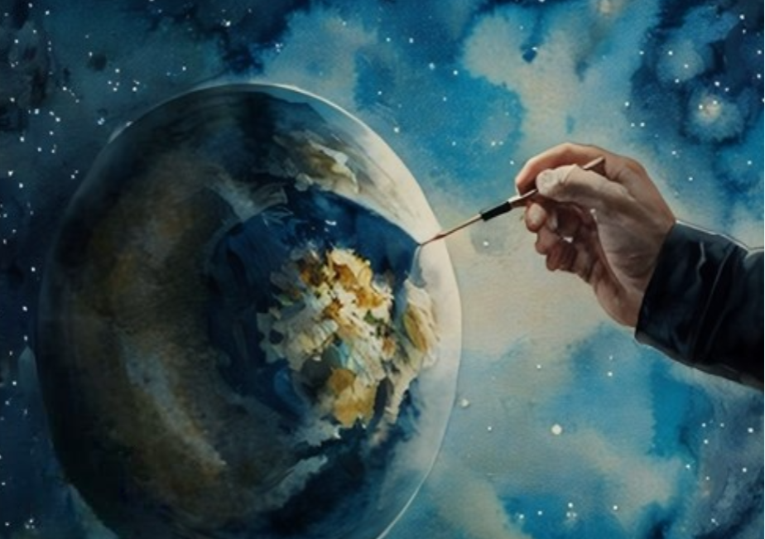
The Worlds Created
The worlds were created through the Son
Created—Formed, organized
These were not made out of nothing
There was no beginning and no end
The world as we know it has a beginning and it will have an end.
Matter itself has neither beginning nor end, as far as mortals can know
D&C 76:24 Smith and Sjodahl

Slide 15
Sources:
Videos:
“We Lived with God” (4:00)
“God’s Greatest Creation” (2:51)
“Principles of Peace: Faith” (3:12)
“The Savior Heals All Wounds” (11:48)
Joseph Fielding McConkie and Craig J. Ostler Revelations of the Restoration pg. 520
Hyrum M. Smith and Janne M. Sjodahl Doctrine and Covenants Commentary pgs. 448-449, 455
Millennial Star—Vol. LXXVIII pp 482, 500 The Father and the Son , a Doctrinal exposition by the First Presidency and the Twelve -- also found in Commentary pg. 449
Presentation by ©http://fashionsbylynda.com/blog/
“The Divine Mission of Jesus Christ: The Only Begotten Son,” Ensign, Dec. 2013, 7
Casey Paul Griffiths Doctrine and Covenants Central Section 76
Presentation by http://fashionsbylynda.com/blog/

Slide 16
We Are Not Alone: D&C 76:23-24
Under the direction of the Father, Christ was the Lord of the universe, who created worlds without number—of which ours is only one (see Ephesians 3:9; Hebrews 1:2).
How many planets are there in the universe with people on them? We don’t know, but we are not alone in the universe! God is not the God of only one planet! (Neal A. Maxwell, “Special Witnesses of Christ,” Ensign, Apr. 2001, 6)
Creator: D&C 76:24
I love to speak about the Savior. It was He, under the direction of the Father, who created this world for us. He separated the light from the darkness, the water from the land.
It was He who brought order and beauty, the plants and the animals.
It was this Creator who answered the call of our Father with words full of love and humility: “Here am I, send me” [Abraham 3:27]. “Father, thy will be done, and the glory be thine forever” [Moses 4:2].
What gratitude we must have felt in realizing that He, who was the Only Begotten of the Father, who was the beloved and chosen from the beginning, was willing to fulfill our Heavenly Father’s eternal plan of salvation for us. (Neil L. Andersen, “Time for the Savior at Christmas” [Brigham Young University devotional, Dec. 7, 2021], 6, speeches.byu.edu)

