Slide 1
Doctrine and Covenants 76:25-49
The Fall of Satan
Wherefore, because that Satan rebelled against me, and sought to destroy the agency of man, which I, the Lord God, had given him, and also, that I should give unto him mine own power; by the power of mine Only Begotten, I caused that he should be cast down;
Moses 4:3
Presentation by http://fashionsbylynda.com/blog/

Slide 2
The Fall of Satan
True or False?
T
__1. Satan was known as Lucifer. (vs. 26)
__2. Satan was a spirit in authority in the presence of God. (vs. 25)
__3. Satan did not mean to disobey Heavenly Father and Jesus Christ. (vs.28)
__4. There was rejoicing in heaven when Satan was cast out. (vs. 26)
__5. Satan makes war with the Saints of God. (vs. 29)
Son of Perdition--Lucifer—light bringer or shining one…He is also known as the “son of the morning”, old serpent, and devil
T
F
Rebellion--Satan sought to dethrone Heavenly Father and take His power, kingdom, and glory.
F
The Heavens Wept Over Him:
Perdition, the title given to Lucifer, means destruction or damnation.
T
The war began in the preexistence—encompass = surround
D&C 76:25-29 dictionary guide

Slide 3
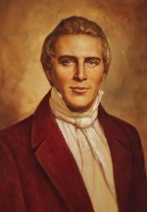
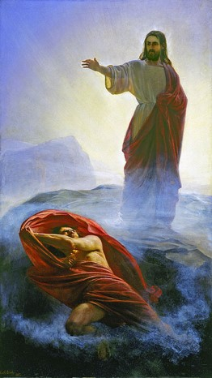
To Make War With the Saints
Lucifer fell from his position as a glorious being to a position of utter loss and destruction.
Knowing that one
of Satan’s names
is Perdition helps
us understand
the title
“son of perdition.”
Although Satan has great power, it is limited.
“There are three independent principles; the Spirit of God, the spirit of man, and the spirit of the devil. All men have power to resist the devil. They who have tabernacles, have power over those who have not.”
Prophet Joseph Smith
Satan makes war with the Saints of God
Student Manual

Slide 4
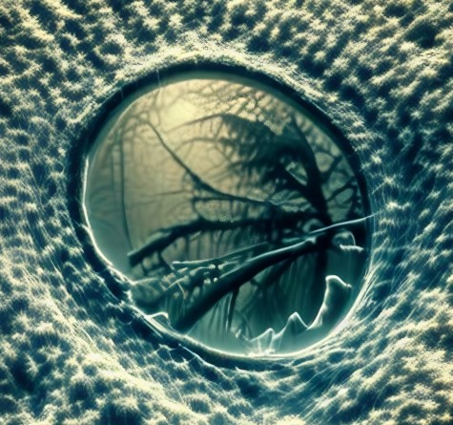
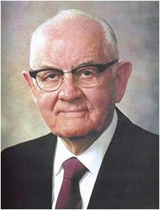
Traitors of the Lord
Denying the Holy Spirit after having received it and denying the Savior
Denying the Holy Spirit
“What must a man do to commit the unpardonable sin? He must receive the Holy Ghost, have the heavens opened unto him, and know God, and then sin against him. After a man has sinned against the Holy Ghost, there is no repentance for him. He has got to say that the sun does not shine while he sees it; he has got to deny Jesus Christ when the heavens have been opened unto him, and to deny the plan of salvation with his eyes open to the truth of it”
Prophet Joseph Smith
“They have sunk so low as to have lost the inclinations and ability to repent”
President Spencer W. Kimball
D&C 76:32-35

Slide 5
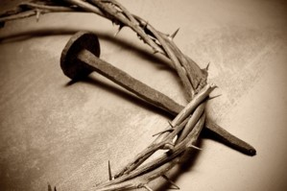
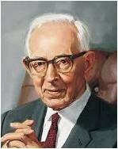
Having Crucified Him
“Commission of the unpardonable sin consists in crucifying unto oneself the Son of God afresh and putting him to open shame…
He thereby commits murder by assenting unto the Lord’s death, that is, having a perfect knowledge of the truth he comes out in open rebellion and places himself in a position wherein he would have crucified Christ knowing perfectly the while that he was the Son of God. Christ is thus crucified afresh and put to open shame.”
Elder Bruce R. McConkie
The scriptures sometimes use the phrase “shedding innocent blood” in reference to the actions of those in this condition.
“The shedding of innocent blood is not confined to taking lives of the innocent, but is also included in seeking to destroy the word of God and putting Christ to open shame.
Those who have known the truth and then fight against the authorized servants of Jesus Christ also fight against Him, and thus are guilty of His blood. “Shedding innocent blood is spoken of in the scriptures as consenting to the death of Jesus Christ and putting him to open shame.”
Joseph Fielding Smith
D&C 76:35

Slide 6
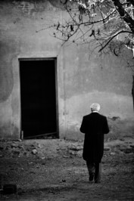
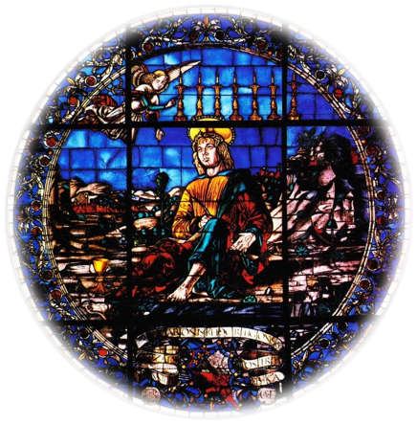
Second Death
The term second death-- the spiritual death that will come upon those sons of perdition who have been resurrected.
“Spiritual death is to be cast out of the presence of the Lord, to die as to the things of righteousness, to die as to the things of the Spirit. Spirit beings as such never die in the sense of annihilation or in the sense that their spirit bodies are disorganized; rather, they continue to live to all eternity either as spirits or as resurrected personages. …
“Eventually, all are redeemed from spiritual death except those who have ‘sinned unto death’, that is, those who are destined to be sons of perdition.
John teaches this by saying that after death and hell have delivered up the dead which are in them, then death and hell shall be ‘cast into the lake of fire. This is the second death.’ And thus the Lord said in our day that the sons of perdition are ‘the only ones on whom the second death shall have any power’ meaning any power after the resurrection.” Elder Bruce R. McConkie
D&C 76:37

Slide 7
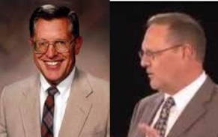
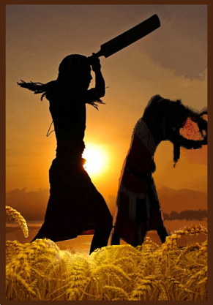
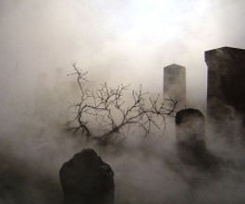
Sons of Perdition
The sons of perdition will not be redeemed from the second spiritual death and will not inherit a kingdom of glory after they are resurrected. Instead, they will suffer for eternity.
“What must a man do to commit the unpardonable sin?
He must receive the Holy Ghost, have the heavens opened unto him, and know God, and then sin against him.”
HC
Whenever [Church members who have truly understood and felt the Holy Spirit} are tempted to rebel against authorized priesthood authority chosen by the Lord to direct His church, they are, in reality, playing to the Lucifer game.
McConkie and Ostler
D&C 76:37

Slide 8
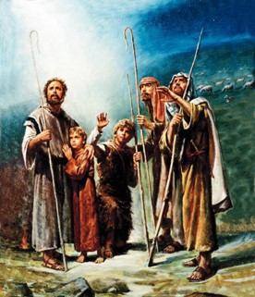
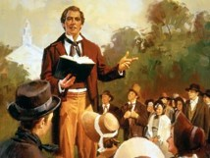
Gospel—Good Tidings
Greek word for gospel—Evangelion—Good tidings or glad tidings
Translated Anglo-Saxon for “Good Story”
Evangelidzo—New Testament verb meaning of Gospel—”to preach or bear witness of the gospel”
Doctrine and Covenants 76 gives a summary of what the gospel, or glad tidings, consists of:
Namely, that all who will may be saved by the atoning power of Jesus Christ.
D&C 76:40-43 Student Manual

Slide 9
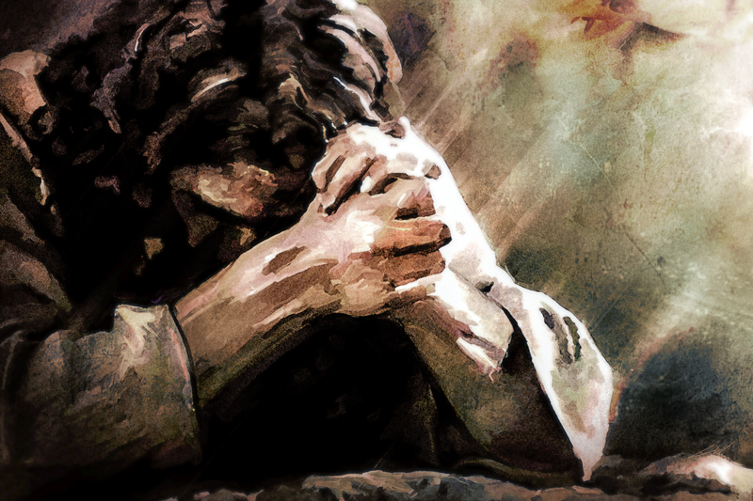
Through the Atonement of Jesus Christ, all of God’s children except the sons of perdition will inherit a place in a kingdom of glory

Slide 10
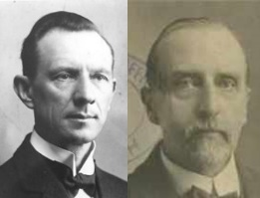
Sons of Perdition are Not Foreordained
“Not foreordained, in the sense of pre-elected by God, to condemnation.
God has ordained that rebellion against Him shall result, if persisted in to the end, in misery, but He has not foreordained anyone to that fate.
A legislature may ordain that thieves must be imprisoned and murderers killed, but that does not mean that it has foreordained any individual, or any number of individuals, to do that which ends in imprisonment, or death.
The sons of Perdition pursue their course according to their own choice, and not as victims of inexorable destiny.”
Smith and Sjodahl
D&C 76:48

Slide 11
It is Not Necessary to Discuss Fate of the Sons of Perdition
It appears that in the early days of the Restoration some attempted to teach the destiny of the sons of perdition. The Prophet Joseph Smith responded by writing:
“Say to the brothers Hulet and to all others, that the Lord never authorized them to say that the devil, his angels, or the sons of perdition, should ever be restored; for their state of destiny was not revealed to man, is not revealed, nor ever shall be revealed, save to those who are made partakers thereof: consequently those who teach this doctrine have not received it of the Spirit of the Lord.
Truly Brother Oliver declared it to be the doctrine of devils. We, therefore, command that this doctrine be taught no more in Zion. We sanction the decision of the Bishop and his council, in relation to this doctrine being a bar to communion.” (Teachings, p. 24.)
D&C 76:44-49

Slide 12
Sources:
Prophet Joseph Smith (Teachings, pp. 189–90.)
(Teachings, p. 24.)
Prophet Joseph Smith (in History of the Church, 6:314-315).
Doctrine and Covenants Student Manual Religion 324-325 Section 76
President Spencer W. Kimball (The Miracle of Forgiveness [1969] 125
Elder Bruce R. McConkie (Mormon Doctrine, 2nd ed. [1966], 816–17).
(Mormon Doctrine, pp. 757–58; see also Notes and Commentary on D&C 63:17; 64:7.)
Joseph Fielding Smith Answers to Gospel Questions, 1:68.
Presentation by ©http://fashionsbylynda.com/blog/
Doctrine and Covenants Student Manual Religion 324-325 Section 76
Presentation by ©http://fashionsbylynda.com/blog/

Slide 13
President George Q. Cannon, commenting on Satan’s title as a son of the morning, said: “Some have called him the son of the morning, but here it is a son of the morning—one among many, doubtless. This angel was a mighty personage, without doubt. The record that is given to us concerning him clearly shows that he occupied a very high position; that he was thought a great deal of, and that he was mighty in his sphere, so much so that when the matter was debated concerning the earth and the plan of salvation, he was of sufficient importance to have a plan, which he proposed as the plan by which this earth should be peopled and the inhabitants thereof redeemed. His plan, however, was not accepted; but it was so plausible and so attractive that out of the whole hosts of heaven one-third accepted his plan and were willing to cast their lot with him. [Moses 4:1–4; D&C 29:36–37.] Now, the difference between Jesus and Lucifer was this: Jesus was willing to submit to the Father.” (In Millennial Star, 5 Sept. 1895, pp. 563–64.)
To become a son of perdition one must sin against the Holy Ghost, but before that is possible, one must receive the gift of the Holy Ghost.
Elder Melvin J. Ballard explained that “unto the Holy Ghost has been given the right and the privilege of manifesting the truth unto men as no other power will. So that when he makes a man see and know a thing he knows it better than he shall ever know anything else; and to sin against that knowledge is to sin against the greatest light there is, and consequently commit the greatest sin there is.” (Millennial Star, 11 Aug. 1932, pp. 499–500.)
Man has power to resist Satan:
President George Q. Cannon testified that every man has power enough to resist Satan. “The Lord our God has sent us here to get experience in these things so that we may know the good from the evil and be able to close our hearts against the evil. … It is true that some have greater power of resistance than others, but everyone has the power to close his heart against doubt, against darkness, against unbelief, against depression, against anger, against hatred, against jealousy, against malice, against envy. God has given this power unto all of us, and we can gain still greater power by calling upon Him for that which we lack. If it were not so, how could we be condemned for giving way to wrong influences?
“There could be no condemnation for our doing what we could not help; but we can help yielding to wrong influences and being quarrelsome and selfish. We can help giving way to the spirit of theft, and we can resist the spirit of lust. God has given us power to resist these things, that our hearts may be kept free from them and also from doubt; and when Satan comes and assails us, it is our privilege to say, ‘Get thee behind me, Satan, for I have no lot nor portion in you, and you have no part in me. I am in the service of God, and I am going to serve Him, and you can do what you please. It is no use you presenting yourself with your blandishments to me. You come and try to insinuate into my heart evil thoughts about the servants of God or about the work of God, and I will not listen to you; I will close my heart against you. …’
“Whenever darkness fills our minds, we may know that we are not possessed of the Spirit of God, and we must get rid of it. When we are filled with the Spirit of God, we are filled with joy, with peace and with happiness no matter what our circumstances may be; for it is a spirit of cheerfulness and of happiness.” (Gospel Truth, 1:19–20.)
State of Hate:
People do not come to such a state in a moment. Elder Joseph Fielding Smith described the path that some follow, which would cause them to hate God and his servants: “The change of heart does not come all at once, but is due to transgression in some form, which continues to lurk in the soul without repentance, until the Holy Ghost withdraws, and then that man is left to spiritual darkness. Sin begets sin, the darkness grows until the love of truth turns to hatred and the love of God is overcome by the wicked desire to destroy all that is just and true. In this way Christ is put to open shame, and blasphemy exalted.” (Instructor, Oct. 1935, p. 432.)
Such people have placed themselves outside the redemptive powers of Christ (see Hebrews 6:4–9; 10:26–29; Matthew 12:31–32). They cannot partake of His mercy because they cannot incline themselves to repent, having totally lost the Spirit of God. Their sin “is an offense so heinous that the sinner is unable to repent; and this is what makes his case hopeless. If he could repent, he could be forgiven; but being incapable of repentance, he cannot be reached by the pardoning power.” (Orson F. Whitney, Improvement Era, Mar. 1920, p. 413.)

