Slide 1
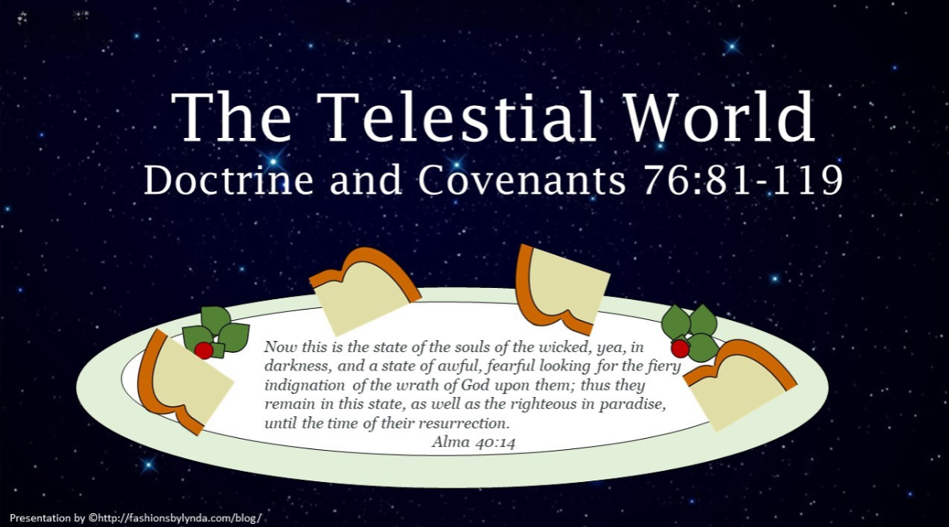

Slide 2
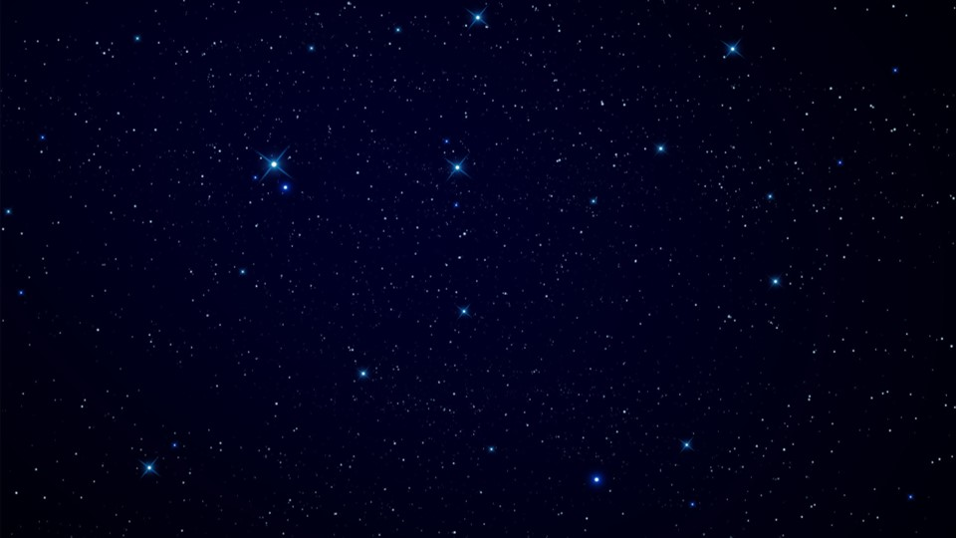
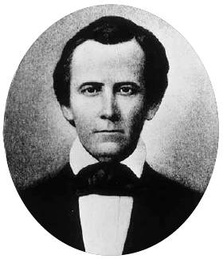
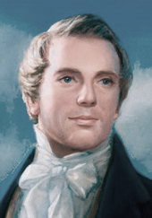
Background
After seeing multiple visions, including visions of the Father and Son’s glory, the fall of Lucifer, and the celestial kingdom, Joseph Smith and Sidney Rigdon saw those who would inherit the terrestrial and telestial kingdoms.
A distinguishing characteristic of those in the terrestrial kingdom was that they were not valiant in their testimony of Jesus.

Slide 3

Telestial World
Previously…
Those who do not accept the gospel of Christ
Those who deny the Holy Spirit
Those who are thrust down to hell
Those who are redeemed from the devil
“These are they who receive not of his fulness in the eternal world, but of the Holy Spirit through the ministration of the terrestrial;”
D&C 76:86
Those who inherit the telestial kingdom must suffer in hell before they are redeemed by the Savior
D&C 76:82-87

Slide 4
Scenario
“My minister told us that after we die, we are going to either heaven or hell. I do not feel like I am good enough to go to heaven right now, but I also do not feel like I am so bad that I should go to hell.
What does your religion teach about heaven and hell?”
Some people will inherit the telestial kingdom because they have refused to receive great blessings offered to them.
What are the blessings they have refused?
They willfully reject the testimony of Jesus and the gospel. Because they reject the Savior and His gospel, they refuse the opportunity to repent of their sins and be cleansed through the Atonement.
The glory we inherit will depend on the way we receive this testimony
D&C 76:82, 101

Slide 5
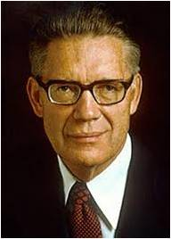
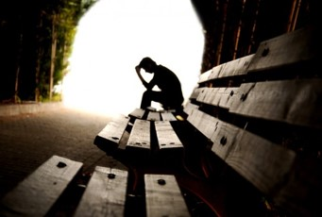
Telestial VS Sons of Perdition
Those who do not commit the “unpardonable sin” of denying the Holy Spirit
Those who commit the “unpardonable sin” of denying the Holy Spirit
“That part of the spirit world inhabited by wicked spirits who are awaiting the eventual day of their resurrection is called hell.
Between their death and resurrection, these souls of the wicked are cast out into outer darkness, into the gloomy depression of sheol, into the hades of waiting wicked spirits, into hell.
There they suffer the torments of the damned; there they welter in the vengeance of eternal fire; there is found weeping and wailing and gnashing of teeth; there the fiery indignation of the wrath of God is poured out upon the wicked.
Elder Bruce R. McConkie
Those who will pass through hell
D&C 76:81-85

Slide 6
The Telestial Glory
They will be heirs of salvation, but their glory is that of the stars, contrasted with that of the moon and sun
They will not receive of His fullness in the eternal world
They will receive administering angels that are appointed to them
They will have the Holy Spirit manifested only through appointed angels
They shall not be redeemed from the devil until the last resurrection, until the Lord finishes His work
They will be thrust down to hell
D&C 76:81-88

Slide 7
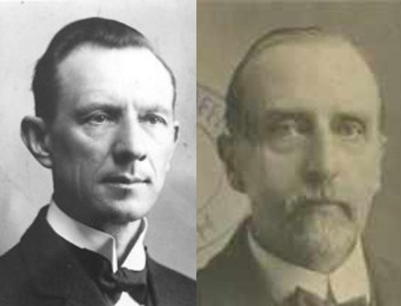
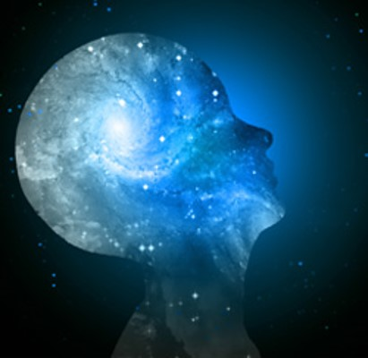
Surpass All Understanding
All who receive the telestial kingdom will have paid a price for this glory. The fact that after they pay this price they inherit a telestial glory is evidence of the Father’s love and mercy.
Understanding “ cannot be conceived of by human mind, except as revealed.
We receive impressions through our senses.
We analyze these impression, classify them, and form deductions from them, and thus we obtain some knowledge of things both seen and unseen;
but we cannot gain any knowledge of the glories beyond any such process. It must be revealed. Revelation is also a source of knowledge.”
Smith and Sjodahl
D&C 76:89

Slide 8
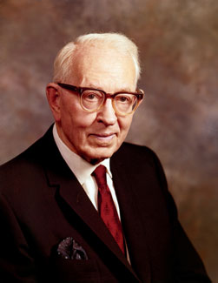
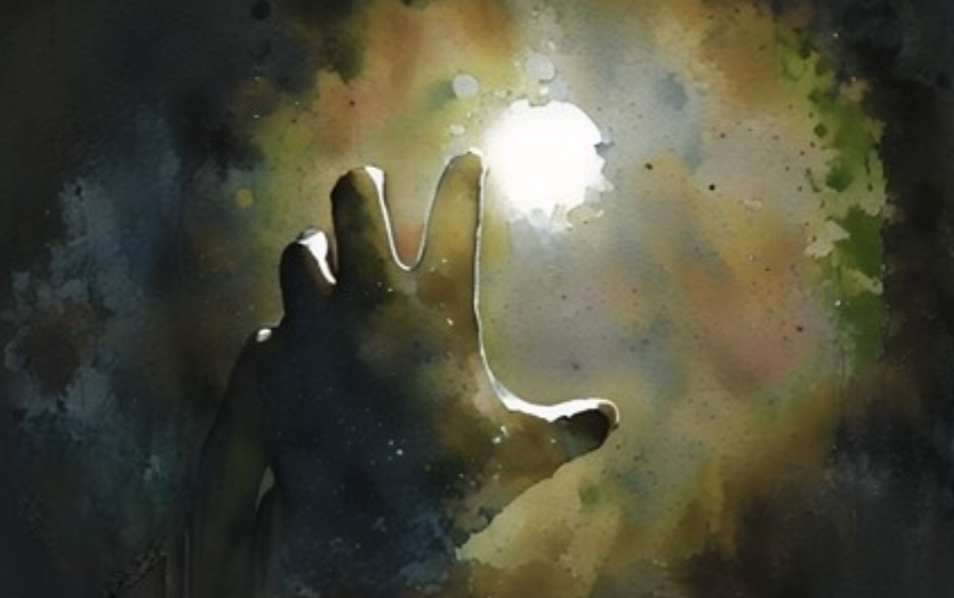
Suffering
This suffering will be a means of cleansing, or purifying, and through it the wicked shall be brought to a condition whereby they may, through the redemption of Jesus Christ, obtain immortality.
Their spirits and bodies shall be again united, and they shall dwell in the telestial kingdom. But this resurrection will not come until the end of the world”
The wicked will suffer for their sins until Jesus Christ completes His work and delivers up the kingdom of God on earth to His Father. Christ will then be crowned with glory
D&C 76:85, 106

Slide 9
No Man Knows Except God
Those who are redeemed from the devil
D&C 76:90

Slide 10
The Glory of the Kingdoms
And thus we saw the glory of the celestial, which excels in all things—where God, even the Father, reigns upon his throne forever and ever;
Those who are redeemed from the devil
And thus we saw the glory of the terrestrial which excels in all things the glory of the telestial, even in glory, and in power, and in might, and in dominion.
The kingdom of glory we inherit will be determined by our actions in this life and the desires of our hearts
Last of all, these all are they who will not be gathered with the saints, to be caught up unto the church of the Firstborn, and received into the cloud.
D&C 76:91-102

Slide 11
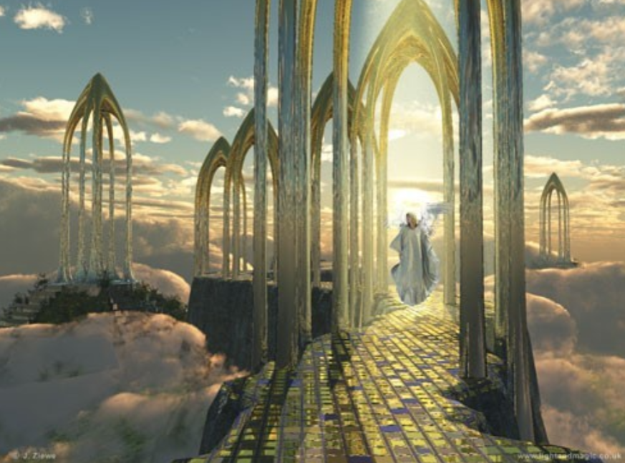
Judgment of the Telestial Beings
Judged according to their works
There are, various degrees of glory in the telestial sphere, and each individual will, in the judgment, receive the “dominion” in the “mansions” of God for which he has, by his works proved himself fit.
The glory of the celestial kingdom surpasses the glory of the terrestrial and telestial kingdoms.
D&C 76:111-112

Slide 12
Can I Hop From World to World?
Telestial Beings can only be administered by Celestial Beings and Terrestrial Beings and the Holy Ghost
Terrestrial Beings can be administered by Celestial Beings and Jesus Christ
Celestial Beings are in the Presence of Heavenly Father and Jesus Christ
They can, only by assignment, visit the Telestial World
They can administer to the Terrestrial and Telestial World as appointed to do so
They cannot visit any other worlds

Slide 13
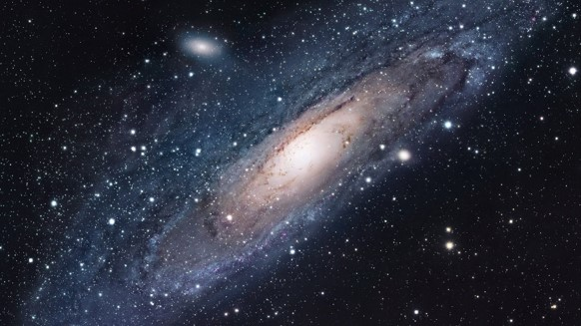
How Can We Receive the Mysteries
The mysteries and knowledge can only been seen, heard, or felt through the power of the
Holy Spirit
Heavenly Father grants us the privilege of knowledge and understanding
It is up to us as to what to do with this knowledge
D&C 76:116-118

Slide 14
Sources:
Video:
Three Degrees of Glory (2:29)
video “Salvation and Exaltation” from time code 2:55 to 6:05
Bruce R. McConkie (Mormon Doctrine, pp. 349–50.)
Presentation by ©http://fashionsbylynda.com/blog/
Hyrum M. Smith and Janne M. Sjodahl Doctrine and Covenants Commentary pg. 468
Presentation by ©http://fashionsbylynda.com/blog/

Slide 15
Those Who Inherit the Telestial Glory Will Pass through Hell
Elder Bruce R. McConkie continues:
“Hell will have an end. Viewing future events, John saw that ‘death and hell delivered up the dead which were in them: and they were judged every man according to their works.’ (Rev. 20:13.) Jacob taught that this escape from death and hell meant the bringing of the body out of the grave and the spirit out of hell. ‘And this death of which I have spoken, which is the spiritual death,’ he said, ‘shall deliver up its dead; which spiritual death is hell; wherefore, death and hell must deliver up their dead, and hell must deliver up its captive spirits, and the grave must deliver up its captive bodies, and the bodies and the spirits of men will be restored one to the other.’ (2 Ne. 9:10–12.) It was in keeping with this principle for David to receive the promise: ‘Thou wilt not leave my soul in hell.’ (Psalms 16:10; Acts 2:27.)
“After their resurrection, the great majority of those who have suffered in hell will pass into the telestial kingdom; the balance, cursed as sons of perdition, will be consigned to partake of endless wo with the devil and his angels. …
“Who will go to hell? This query is abundantly answered in the scriptures. Since those going to a telestial kingdom travel to their destination through the depths of hell and as a result of obedience to telestial law, it follows that all those who live a telestial law will go to hell.” (Mormon Doctrine, pp. 349–50.)
The difference between being saved in the celestial kingdom and inheriting other kingdoms of glory:
“There is quite a difference between being saved in some kingdom, where there is some glory, some happiness, and being saved in the kingdom where our Father resides. …
“Our Father who dwells in yonder heavens, and his Son Jesus Christ, inhabit the highest degree of glory in eternity. They are possessed of all the fulness of glory. They have a fulness of happiness, a fulness of power, a fulness of intelligence, light and truth, and they bear rule over all other kingdoms of inferior glory, of inferior happiness, and of inferior power. … The gospel is intended to exalt the children of men to that same degree of glory, where our Father and where his Son resides” Elder Orson Pratt (Deseret News, Nov. 10, 1880, 642).
President Brigham Young explained how some people in his day responded to the truth that most of the wicked would eventually be redeemed and not suffer in hell forever:
“When God revealed to Joseph Smith and Sidney Rigdon that there was a place prepared for all, according to the light they had received and their rejection of evil and practice of good, it was a great trial to many, and some apostatized because God was not going to send to everlasting punishment heathens and infants, but had a place of salvation, in due time, for all, and would bless the honest and virtuous and truthful, whether they ever belonged to any church or not. It was a new doctrine to this generation, and many stumbled at it” (Teachings of Presidents of the Church: Brigham Young[1997], 292).
Elder Orson Pratt of the Quorum of the Twelve Apostles taught of the difference between being saved in the celestial kingdom and inheriting other kingdoms of glory:
“There is quite a difference between being saved in some kingdom, where there is some glory, some happiness, and being saved in the kingdom where our Father resides. …
“Our Father who dwells in yonder heavens, and his Son Jesus Christ, inhabit the highest degree of glory in eternity. They are possessed of all the fulness of glory. They have a fulness of happiness, a fulness of power, a fulness of intelligence, light and truth, and they bear rule over all other kingdoms of inferior glory, of inferior happiness, and of inferior power. … The gospel is intended to exalt the children of men to that same degree of glory, where our Father and where his Son resides” (Deseret News, Nov. 10, 1880, 642).

