Slide 2
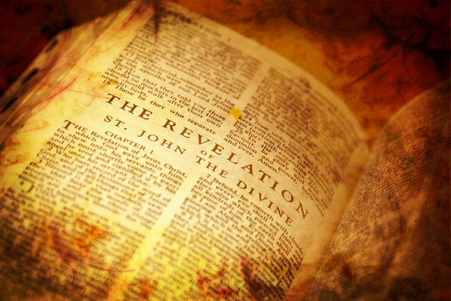
Background
February-March 1832
After Joseph returned from Amherst, Ohio he resumed translating from the New Testament and desired to know the meaning in the book of Revelation
Some question arose in regard to the meaning of some of the figurative and symbolical writings of John in the Book of Revelation
In the form of questions and answers, the Prophet unlocked the book of Revelation by the spirit of revelation.
“In connection with the translation of the Scriptures, I received the following explanation of the Revelation of St. John.”
Joseph Smith

Slide 3
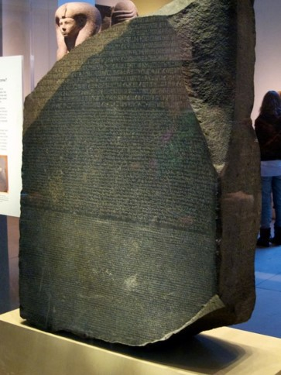
The Key to Revelation
“The Book of Revelation is one of the grandest books in sacred literature, and the Lord clearly designs that the Saints should become familiar with it.
Else, why this Revelation in
the Doctrine and Covenants?
“But [section 77] is not a complete interpretation of the book. It is a key. A key is a very small part of the house. It unlocks the door through which an entrance may be gained, but after the key has been turned, the searcher for treasure must find it for himself. …
“The Lord has, in this Section, given His people a key to the book. … As Champollion, by the key furnished in the brief test on the Rosetta stone, was able to open the secrets of Egyptian hieroglyphics, so the Bible student should be able to read the Apocalypse with a better understanding of it, by the aid of this key.”
Smith and Sjodahl

Slide 4
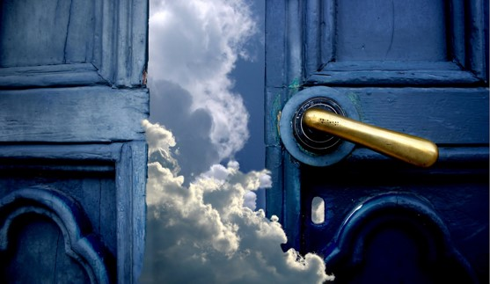
John the Beloved the ancient author of Revelation.
Revelation is a book of holy scripture. It came by revelation from the Lord.
Revelation deals with those things that interest people who have received the gift of the Holy Ghost, and those who have hope of eternal life.
Before John was born Nephi saw John in a vision and angels identified him as “One of
the 12 apostles of the Lamb.” That
John was appointed and foreordained
to write the very visions now found in
the book.
Revelation

Slide 5
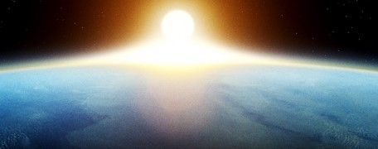
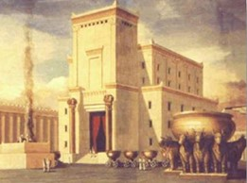
The Sea of Glass
John describes heaven in earthly terms
“Angels do not reside on a planet like this earth; but they reside in the presence of God, on a globe like a sea of glass and fire, where all things for their glory are manifest past, present, and future, and are continually before the Lord.”
Joseph Smith
“In the Temple of Solomon there was an immense basin called “a molten sea” –[cleansing basin]
(1 Kings 7:23)
Smith and Sjodahl
Glassy=Calm
The earth in its sanctified, immortal, and eternal state
D&C 77:1

Slide 6
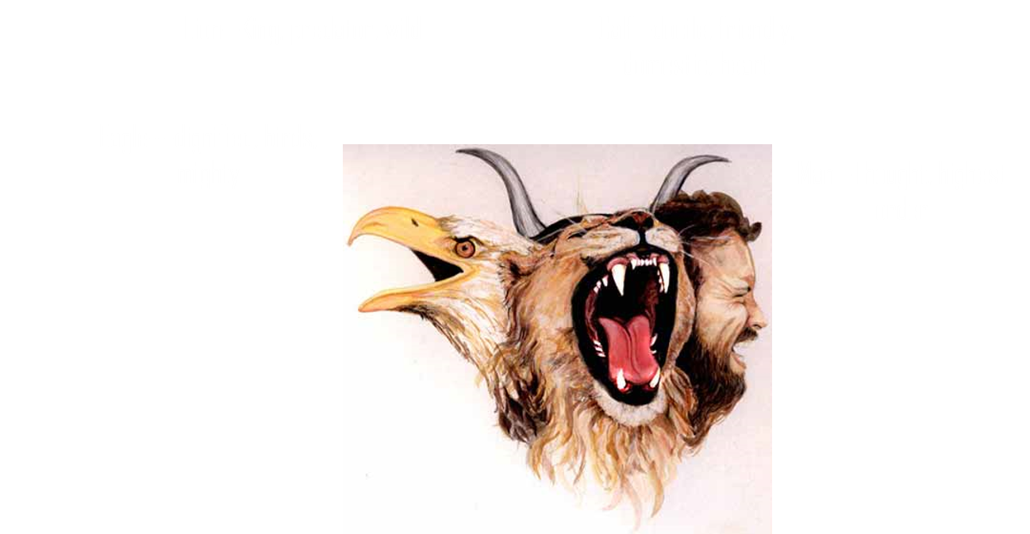
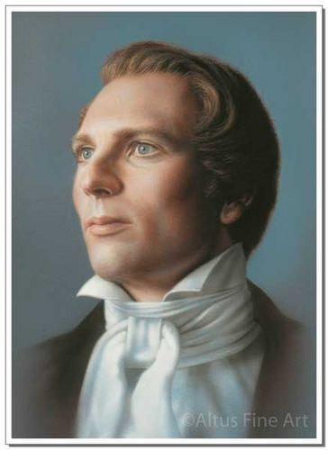
The Four Beasts
Ancient Idea:
Mark=lion
Matthew=man
Luke=ox
John=eagle
Smith and Sjodahl
The most noble of beasts with energy emulating from God
“John saw the actual beasts in heaven, showing to John that beasts did actually exit and were giving glory to God.”
Joseph Smith
D&C 77:2

Slide 7
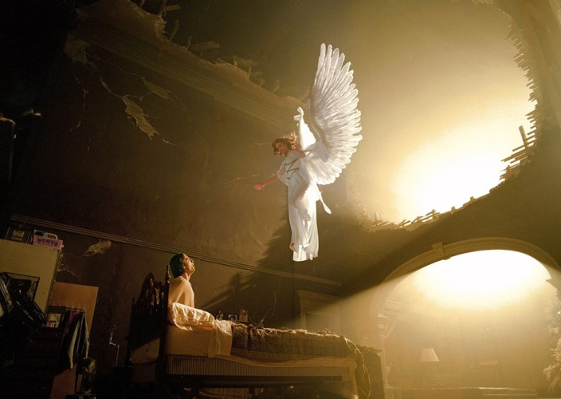
Eyes and Wings
Eyes—light and knowledge
Power to Move and Act
The Prophet Jeremiah uses wings as an image of power swooping down upon Moab and Bozrah (Jeremiah 48:40)
“More often than not, ancient and modern iconography depicts heavenly beings as possessing wings. This image is purely symbolic, however, for “an angel of God never has wings.”
Joseph Smith
D&C 77:4

Slide 8
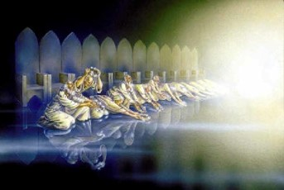
24 Elders—in the future
“had on their heads crowns of gold”
Who might these representatives be?
Not as they were… but as they will be
Can Prophets see into the Future?
Joseph saw his mother and father in heaven, even though they were still alive, in a revelation (D&C 137)
D&C 77:5

Slide 9
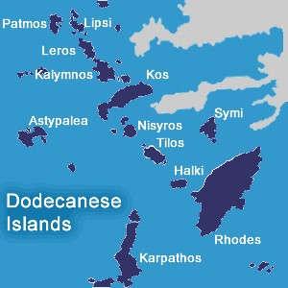
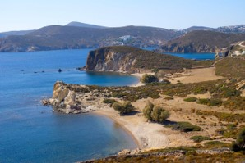
7 Churches
These were the 7 churches—the last strongholds of the Church that existed during the time that John was at Patmos, where he received the account of Revelation
Patmos was a penal colony in Greek isles where John was sent by emperor Domitian because he was a Christian leader and would not deny his faith.
Becky Davies
D&C 77:5

Slide 10
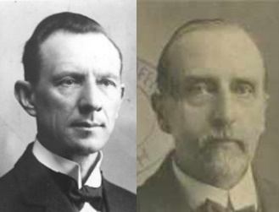
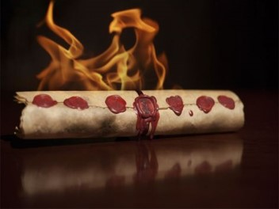
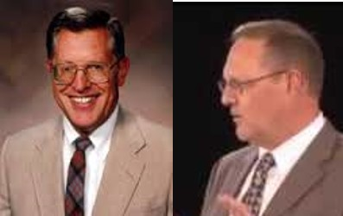
7 Seals
“The book contains the history of the seven thousand years of the temporal existence of the earth”
Smith and Sjodahl
“John had the curtains of heaven withdrawn and by vision looked through the dark vista of future ages, and contemplated events that should transpire throughout every subsequent period of time, until the final winding up scene.”
Joseph Smith
“The time from Adam through the end of the Millennium.
Each thousand year period is represented by it respective seal.”
McConkie and Ostler
D&C 77:6

Slide 11
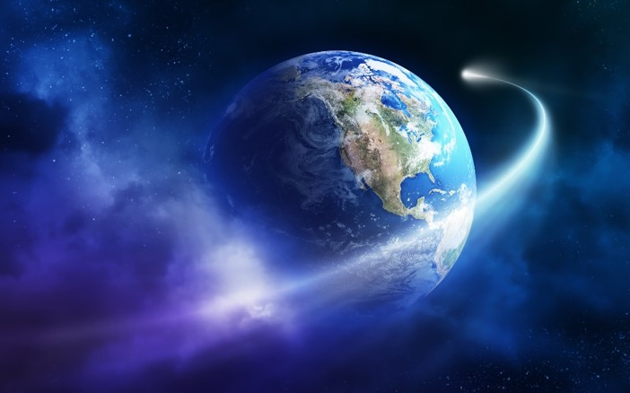
4 Angels
Those who warn and save
Example: The Wheat and the Tares Parable Matthew 13:24-30
Those who judge and destroy=divine executioners
Those who restore keys and knowledge in opening the dispensation of the fullness of times
Example: Elias—title of someone who is a forerunner-- to restore all things
Those who have the everlasting gospel to commit to every nation, kindred, tongue, and people
D&C 77:8

Slide 12
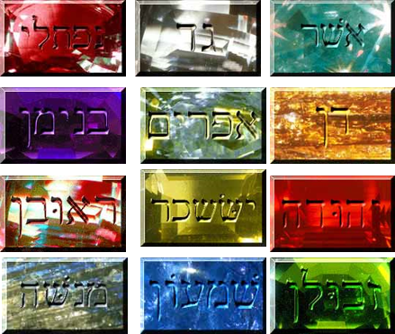
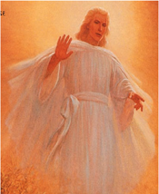
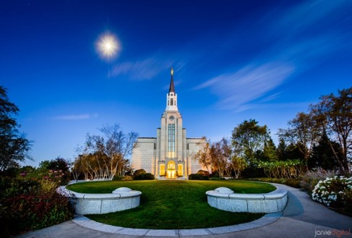
An Elias
A title of someone who is a forerunner-- to restore all things
John the Baptist (JST John 1:21-28)
Noah (D&C 27:6-7, Luke 1:5-25
John the Revelator (D&C 77:9, 14)
Seal of God over the 12 Tribes of Israel
“Four destroying angels holding power over the four quarters of the earth until the servants of God are sealed in their foreheads, which signifies sealing the blessing upon their heads, meaning the everlasting covenant, thereby making their calling and election sure. When a seal is put upon the father and mother it secures their posterity, so that they cannot be lost, but will be saved by virtue of the covenant of their father and mother.”
Joseph Smith
Angels ready to destroy and Elias ‘holds back the wind’ ready to save—by covenants—seal in their foreheads
D&C 77:9

Slide 13
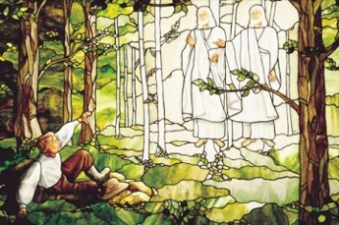
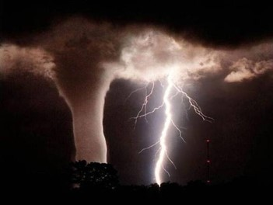
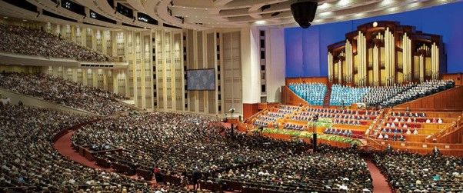
The 6th Seal
The time we live in now
Joseph Smith’s ministry
Restoration
World-wide Church
Zion Established
World-wide calamities
D&C 77:10

Slide 14
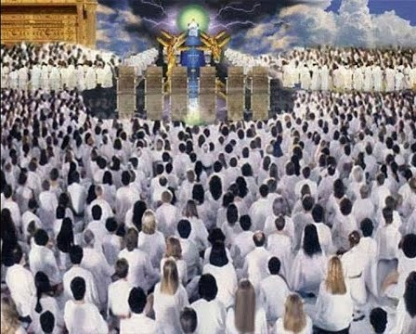
144,000
Those ordained to the Holy Order of God
Tribes of Israel:
12,000 of each tribe.
“Opinions are divided as to whether this refers to Israel, literally, or to believers generally.”
Smith and Sjodahl
“It is not only necessary that you should be baptized for your dead, but you will have to go through all the ordinances for them, the same as you have gone through to save yourselves. There will be 144,000 saviors on Mount Zion, and with them an innumerable host that no man can number. Oh! I beseech you to go forward, go forward and make your calling and your election sure.”
Joseph Smith
D&C 77:11

Slide 15
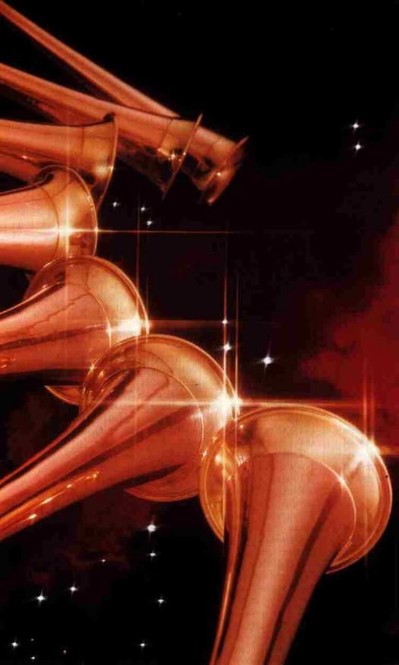
Opening of the 7th Seal
Sounding of the Trump: CALL ATTENTION TO
“The Angels announce the desolation and wars at the sounding of their trumps. The destruction attendant to the return of the Lord both finishes his work in mortality among the wicked and prepares the world for the Millennium”
McConkie and Ostler
John recorded that when he [Christ] had opened the seventh seal, there was silence in heaven about the space of half an hour.(Rev. 8:1-2)
Perhaps a moment of reverence
“The completion of man’s salvation in the seventh millennium”
Smith and Sjodahl
D&C 77:12-13

Slide 16
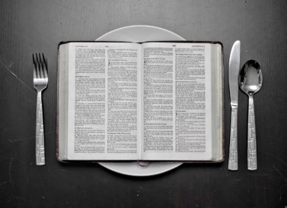
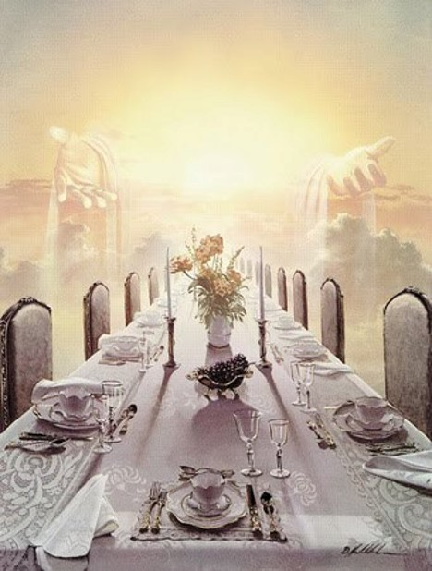
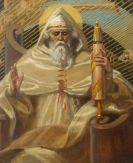
Little Book—Feasting on the Words of Christ
“John’s act of eating a book containing the word of God to him was in keeping with the custom and tradition of ancient Israel. The act signified that he was eating the bread of life, that he was partaking of the good word of God, that he was feasting upon the word of Christ—which was in his mouth sweet as honey.
But it made his belly bitter; that is, the judgments and plagues promised those to whom the Lord’s word was sent caused him to despair and have sorrow of soul. ‘How sweet are thy words unto my taste! yea, sweeter than honey to my mouth!’
Such is the exulting cry of the Psalmist. And conversely, how bitter is the penalty for rebellion and disobedience.
Ezekiel had a similar experience. He was commanded to eat a roll (a book), which was in his mouth as honey for sweetness, but in the writing itself there was ‘lamentations, and mourning, and woe.’ “
Elder Bruce R. McConkie
D&C 77:14

Slide 17
Two Witnesses
Those of sack cloth—
two persons who are not in political power, or stardom
Two—as witnesses—We go out in two’s to preach the gospel
“These prophets will also of necessity have been called and commissioned by him who stands at the head of the earthly church and kingdom of God.”
McConkie and Ostler
D&C 77:15

Slide 18
Through the Prophets
“Prophets gave the scripture, and prophets must interpret it. Holy men of old received revelation from the Holy Ghost, which they recorded as scripture; now men must have the same Holy Spirit to reveal what is meant by the scripture—
Otherwise, there will be a host of private interpretations and consequently many different and disagreeing churches, which is precisely the condition in the religious world today”
Bruce R. McConkie
The Lord reveals the correct interpretation of scripture through His prophets
If we inquire of the Lord, He can help us understand the scriptures

Slide 19
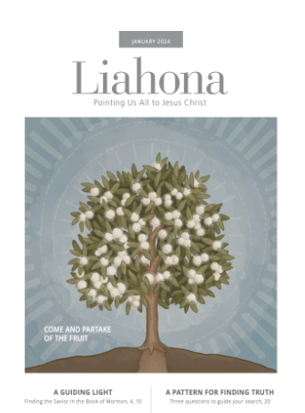
Where Can I Find What the Scriptures Mean?

Slide 20
Sources:
Hyrum M. Smith and Janne M. Sjodahl Doctrine and Covenants Commentary pgs. 473-474, 478
Joseph Smith History of the Church 1:253
Presentation by ©http://fashionsbylynda.com/blog/
Joseph Fielding McConkie and Craig J. Ostler Revelations of the Restoration pg. 555, 558
Teachings of the Prophet Joseph Smith pg. 247,321,366
Elder Bruce R. McConkie (in Conference Report, Oct. 1964, 38).
(Doctrinal New Testament Commentary, 3:507.)
Becky Davies and Lesley Meachum Poway Institute (Chart)
Presentation by http://fashionsbylynda.com/blog/

Slide 21
The Four Beasts “I suppose John saw beings there of a thousand forms, that had been saved from ten thousand times ten thousand earths like this,--strange beasts of which we have no conception: all might be seen in heaven. The grand secret was to show John what there was in heaven. John learned that God glorified Himself by saving all that His hands had made, whether beasts, fouls, fishes or men; and He will glorify Himself with them.
Says one, ‘I cannot believe in the salvation of beasts.’ any man who would tell you that this could not be, would tell you that the revelations are not true. John heard the words of the beasts giving glory to God, and understood them. God who made the beasts could understand every language spoken by them. The four beasts were four of the most noble animals that had filled the measure of their creation, and had been saved from other world, because they were perfect: they were like angels in their sphere. We are not told where they came from, and I do not know; but they were seen and heard by John praising the glorifying God.” Teachings of the Prophet Joseph Smith, 291-92
God Giving Visions:
The Prophet Joseph Smith said: “I make this broad declaration, that whenever God gives a vision of an image, or beast, or figure of any kind, He always holds Himself responsible to give a revelation or interpretation of the meaning thereof, otherwise we are not responsible or accountable for our belief in it. Don’t be afraid of being damned for not knowing the meaning of a vision or figure, if God has not given a revelation or interpretation of the subject.” (Teachings, p. 291.)
“‘The book which John saw’ represented the real history of the world—what the eye of God has seen, what the recording angel has written; and the seven thousand years, corresponding to the seven seals of the Apocalyptic volume, are as seven great days during which Mother Earth will fulfill her mortal mission, laboring six days and resting upon the seventh, her period of sanctification. These seven days do not include the period of our planet’s creation and preparation as a dwelling place for man. They are limited to Earth’s ‘temporal existence,’ that is, to Time, considered as distinct from Eternity.” (Whitney, Saturday Night Thoughts ,p. 11.)
A seal, as the term was used by John (see Revelation 5:1–2), was a bit of wax that secured a folded letter or document and bore the impression of a signet. Once sealed, the document could not be opened without the seal’s being broken. In the case of the earth’s history and destiny, there is only one who is worthy to open the seal and reveal the contents: Jesus Christ (see Revelation 5:2–9). Only through the Atonement of Christ is the temporal existence of the earth of any value. He alone holds the key to the fulfilling of the purpose for which the earth was created. Because of Him the plan of salvation will succeed; without Him all would fail and come to naught, or remain sealed.
Elias:
“By revelation we are also informed that the Elias who was to restore all things is the angel Gabriel who was known in mortality as Noah. Teachings of Joseph Smith, 157
Angels President Joseph Fielding Smith explained that “these angels seem to fit the description of the angels spoken of in the parable of the wheat and the tares, (Matt. 13:24–43 and D. & C. 86:17), who plead with the Lord that they might go forth to reap down the field. They were told to let the wheat and the tares grow together to the time of the end of the harvest, which is the end of the world (Matt. 13:38–39). …
“These angels have been given power over the four parts [quarters] of the earth and they have the power of committing the everlasting Gospel to the peoples of the earth. The fulness of the Gospel was not restored by any one messenger sent from the presence of the Lord. All the ancient prophets who held keys and came and restored them, had a hand in this great work of restoration. There are, we learn from this revelation, four angels unto whom the power has been given, to shut up the heavens, to open them and with power unto life and also unto death and destruction. These are now at work in the earth on their sacred mission.” (Church History and Modern Revelation, 1:300–301.)
Susa Young Gates reported an address by President Wilford Woodruff in which he declared: “Those angels have left the portals of heaven, and they stand over this people and this nation now, and are hovering over the earth waiting to pour out the judgments. And from this very day they shall be poured out.” (Young Women’s Journal, Aug. 1894, p. 512; see also Notes and Commentary for D&C 86:5.)

Slide 22
The 6 Time Periods – Revelation 6
Seal 1 Enoch and Zion | Seal 2 Wickedness/flood/Noah | Seal 3 Famine/ Abraham/ Israel | Seal 4 Age of Empires | Seal 5 Age of martyrs | Seal 6 Latter Days
4000-3000 BC Adam and Enoch White horse-Victory Enoch Conqueror Moses 7:13-17 | 3000-2000 BC Enoch translated Red horse-bloodshed Tower of Babel-Jaredites Flood-2348 BC | 2000-1000 BC Abraham to Moses Black horse- famine/death Jacob/Joseph- famine/ bondage Law of Moses | 1000-0 BC Saul David Israel Judah scattered Pale horse-war, pestilence Divided Kingdom Lost 10 tribes Apostasy | 0-1000 John the Baptist Christ’s birth Kingdom set up Atonement Resurrection Gospel to Gentiles Great Apostasy Dark Ages | 1000-2000 Renaissance Reformation Joseph Smith’s ministry Restoration World-wide Church Zion Established World-wide calamities

Slide 23
Who Are the 144,000?
“Before the Lord shall come … there is to be a great work among the nations. … The ten tribes will have to come forth and come to this land, to be crowned with glory in the midst of Zion by the hands of the servants of God, even the Children of Ephraim; and twelve thousand High Priests will be elected from each of these ten tribes, as well as from the scattered tribes, and sealed in their foreheads, and will be ordained and receive power to gather out of all nations, kindreds, tongues and people as many as will come unto the general assemblage of the Church of the first-born.” (Orson Pratt, in Journal of Discourses, 16:325.)
Trumpets were used anciently to herald or announce something or to draw attention to something. The seven angels who sound trumpets in Revelation 8–10 will signal events that will take place in the beginning of the seventh thousand years (after the seventh seal is opened; see Revelation 8:1), before the Lord comes in His glory.
Two Witnesses:
Elder Parley P. Pratt wrote: “John, in the eleventh chapter of Revelation, gives us many more particulars concerning [the great war in Israel after the Jews are gathered there]. He informs us that after the city and temple are rebuilt by the Jews, the Gentiles will tread it under foot forty and two months, during which time there will be two prophets continually prophesying and working mighty miracles. And it seems that the Gentile army shall be hindered from utterly destroying and overthrowing the city, while these two prophets continue. But, after a struggle of three years and a half, they will at length succeed in destroying these two prophets and then overrunning much of the city; they will send gifts to each other because of the death of the two prophets, and in the meantime will not allow their dead bodies to be put in graves, but suffer them to lie in the streets of Jerusalem three days and a half, during which time the armies of the Gentiles, consisting of many kindreds, tongues and nations, passing through the city, plundering the Jews, will see their dead bodies lying in the street. But after three days and a half, on a sudden, the spirit of life from God will enter them; they will arise and stand upon their feet, and great fear will fall upon them that see them. And then they shall hear a voice from heaven saying, ‘Come up hither,’ and they will ascend up to heaven in a cloud, with enemies beholding them.” (Voice of Warning,p. 33.)
Elder Bruce R. McConkie identified the two prophets as “followers of that humble man Joseph Smith, through whom the Lord of Heaven restored the fulness of his everlasting gospel in this final dispensation of grace. No doubt they will be members of the Council of the Twelve or of the First Presidency of the Church.” (Doctrinal New Testament Commentary,3:509.)
The two witnesses are raised up “to the Jewish nation” and are not necessarily from the Jewish nation (see D&C 77:15–16; italics added.)
Bible Dictionary explains the book of Revelation:
“Also known as the Apocalypse, a Greek word meaning revealed or uncovered. The message of Revelation is the same as that of all scripture: there will be an eventual triumph on this earth of God over the devil; a permanent victory of good over evil, of the Saints over their persecutors, of the kingdom of God over the kingdoms of men and of Satan. This is the subject on which Amos, Isaiah, Jeremiah, Ezekiel, Daniel, Paul, Peter, and all the prophets have written. They spoke of a day of victory that would come, and that the end would be better (more glorious) than the beginning. The victory would be achieved through Jesus Christ.
“Such is the theme of the Revelation. The details about the beasts, the wars, the angels, the men, etc., contribute to the development of this theme. By a little study, the theme can be perceived even if the details are not completely identified. It may be in this sense that the Prophet Joseph Smith said that Revelation was ‘one of the plainest books God ever caused to be written’ (HC 5:342). However, the more fully the details are understood, the greater will be the appreciation of the theme. If we fail to catch a glimpse of the theme, we fail in our comprehension, no matter how many details we are able to understand” (Bible Dictionary, “Revelation of John”).

Slide 24
Becky Davies

