Slide 2
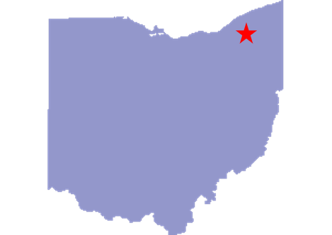
Background
“Besides the work of translating, previous to the 20th of March, I received the four following revelations: [D&C 78–81]”
Joseph Smith
March 1, 1832
Hiram, Ohio
The Lord instructed Joseph Smith, Sidney Rigdon, Newel K. Whitney, and other high priests to organize themselves into a group called the United Firm—based on the law of consecration.
The United Firm
The Firm managed the Church’s property, storehouses, and publishing efforts and provided resources to help meet the temporal needs of the Saints.
The Lord also described the blessings the Saints would receive if they obeyed the commandment to organize this firm

Slide 3
The Firm
“This revelation originally instructed the Prophet, Sidney Rigdon, and Newel K. Whitney to travel to Missouri and organize the Church’s mercantile and publishing endeavors by creating a ‘firm’ that would oversee these efforts, generating funds for the establishment of Zion and for the benefit of the poor.
The phrase ‘the affairs of the storehouse for the poor’ replaced ‘mercantile and publishing establishments’ in the revelation, and the word ‘order’ replaced the word ‘firm.’”

Slide 4
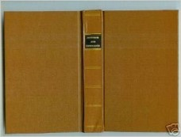
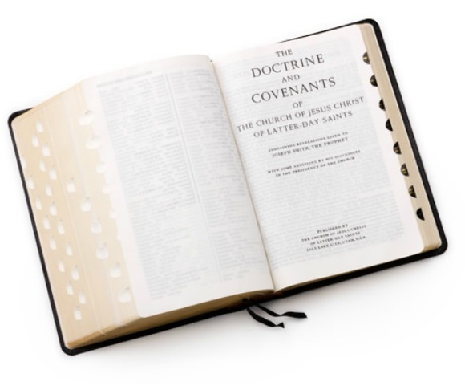
United Order
Formed in April 1832 and disbanded in 1834
In an effort to protect this Church-operated entity from enemies of the Church, some of the language of this revelation was changed when it was first published in the 1835 edition of the Doctrine and Covenants.
For example, the United Firm was referred to as the “order” or “united order.” Around the same time that the Lord commanded Joseph Smith to organize the United Firm.
Order refers to the United Firm
In the 1981 edition of the Doctrine and Covenants, the substitute names were eliminated, since the need for them no longer existed.

Slide 5
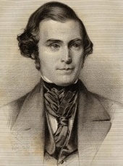
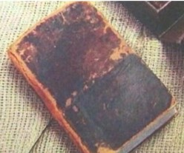
Name Changed to Protect—The Code
“The law of Enoch is so named in the Book of Doctrine and Covenants, but in other words, it is the law given by Joseph Smith, Jr. The word Enoch did not exist in the original copy; neither did some other names. The names that were incorporated when it was printed, did not exist there when the manuscript revelations were given, for I saw them myself.
Some of them I copied. And when the Lord was about to have the Book of Covenants given to the world it was through wisdom, in consequence of the persecutions of our enemies in Kirtland and some of the regions around, that some of the names should be changed,…
…and Joseph was called Baurak Ale, which was a Hebrew word; meaning God bless you. He was also called Gazelam, being a person to whom the Lord had given the Urim and Thummim.
He was also called Enoch.
Sidney Rigdon was called Baneemy.
And the revelation where it read so many dollars into the treasury was changed to talents.
And the City of New York was changed to Cainhannoch.”
Elder Orson Pratt

Slide 6
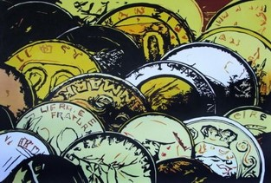
Money
How can money be used for evil?
How can money be used for good?
Caution to setting our minds on
earthly things:
“We might ask ourselves, living as many of us do in societies that worship possessions and pleasures, whether we are remaining aloof from covetousness and the lust to acquire more and more of this world’s goods. Materialism is just one more manifestation of the idolatry and pride that characterize Babylon. Perhaps we can learn to be content with what is sufficient for our needs.”
Elder D. Todd Christofferson

Slide 7
The Storehouses
One was operated by Newel K. Whitney in Kirtland, Ohio. In this responsibility, Brother Gilbert and Brother Whitney acted as agents for the Church.
One was run by Sidney Gilbert in Independence, Missouri.
These storehouses were to supply the Saints with necessary goods, while also generating funds to buy land and to finance the publication of the revelations Joseph Smith had received. These storehouses were also to help those who were in need.

Slide 8
Church’s Temporal Resources
Church Finances—Commercial Businesses (ChurchofJesusChrist.org)
Church Finances and a Growing Global Faith (ChurchofJesusChrist.org)
The Church and Its Financial Independence (ChurchofJesusChrist.org)
Russell M. Nelson, “The Second Great Commandment,” Ensign or Liahona, Nov. 2019, 96–100
Dallin H. Oaks, “Helping the Poor and Distressed,” Liahona, Nov. 2022, 6–8
newsroom.ChurchofJesusChrist.org
D&C 78:3-4

Slide 9
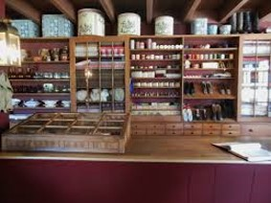
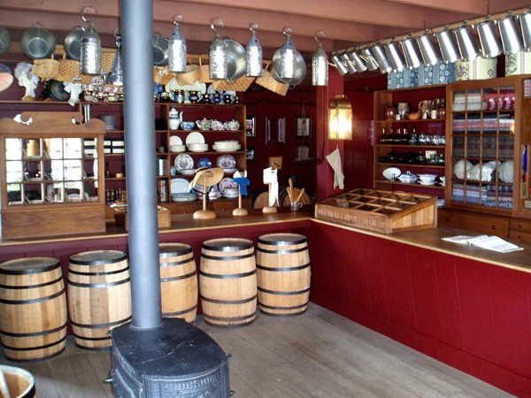
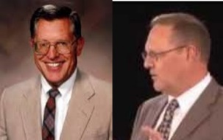
For the Salvation of Man
“God instituted the principles of the law of consecration for the blessing and welfare of the poor.
These principles deal with temporal salvation.
The attitude and spirit in which these principles are applied, however, is inseparable connected with the spiritual welfare of the Lord’s people. Only when the Saints are of one heart and one mind can they dwell in righteousness having no poor among them.”
McConkie and Ostler
D&C 78:4

Slide 10
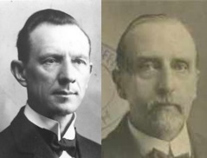
Equal in Earthly Things
“The principle is here taught that the Latter-day Saints must be equal in things pertaining to this Earth. In celestial glory there is perfect equality (Sec. 76:95). But if they have not practiced equality here, they are not prepared to live under that law there.”
Smith and Sjodahl
It should be noted, however, that the Lord has a special definition of equality in the united order.
Student Manual
“The term “equal”…should not be understood to mean “dead-level equality.” or in other words, the Lord does not expect that all people will have the same quantity of the same things of the earth.
The Lord explained equality as meaning that each person under the law should have equal claims or opportunities to obtain the necessary and desirable things of the earth. (See D&C 82:17)
Otten and Caldwell
D&C 78:5-7

Slide 11
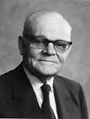
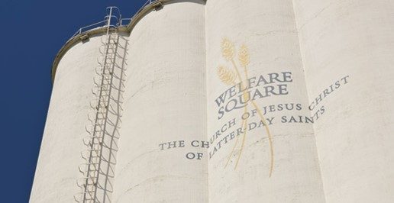
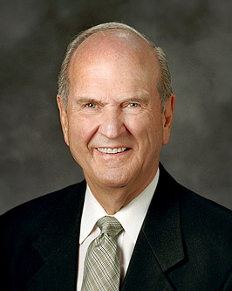
Church Welfare System
“Church welfare is more than just a plan to provide for the physical needs of the Saints. I am convinced that in addition to being a way of economic, salvation in the days of necessity, it has deep spiritual significances; and that should other means always be available with which to supply the physical needs of the people.”
Marion G. Romney quote
“To help relieve hunger, the Church operates 124 bishops’ storehouses throughout the world. Through them, approximately 400,000 food orders are given each year to individuals in need. In locations where no storehouse exists, bishops and branch presidents draw from fast-offering funds of the Church to provide food and supplies for their needy members.
Russell M. Nelson
D&C 78:5-7 McConkie and Ostler

Slide 12
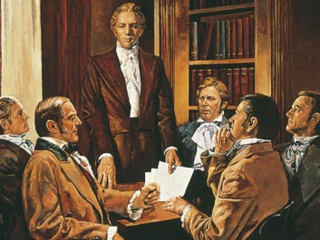
To Honor God
The sole object in the United Order was to honor the Lord
Caring for the poor and needy helps us prepare for a place in the celestial kingdom.
“There can be no successful United Order until the selfishness of man is swallowed up by his desire to glorify his Father in heaven.”
Smith and Sjodahl
Sit in council:
The men, in code names, were to sit on a council that was needed at this time.
Shortly after this council The Prophet Joseph Smith went to Missouri on his second visit to the land of Zion
D&C 78:8-9

Slide 13
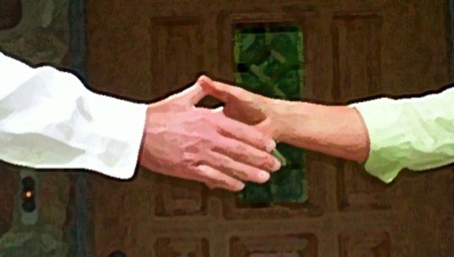
Bond-Everlasting Covenant
The property was conveyed to the Bishop, as trustee-in-trust of the church
“The donor agreed to pay the taxes and to turn over to the Bishop all the accumulations over and above what he needed for the support of himself and family.
“The Bishop bound himself to support the donor out of the church funds, in case of sickness and inability to work, while he was a Church member.”
Whitney’s History of Utah, Vol. I., p. 90-1
Those who broke the covenant would lose their position and membership in the Church
D&C 78:11-12

Slide 14
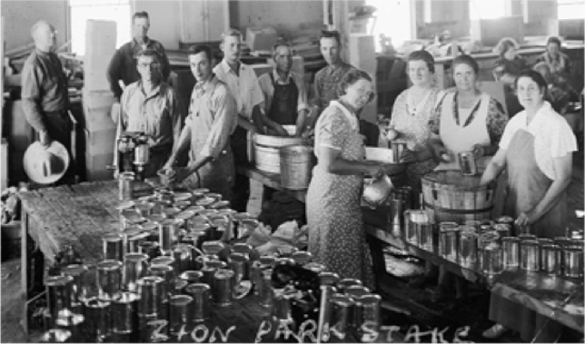
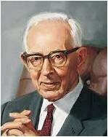
Standing Independent
The law of consecration was withdrawn by the Lord because the Saints showed that they would not abide by its laws.
In 1936, under direction of the First Presidency, the welfare program was instituted, based on the same principles that governed the Saints in the united order, such as love, service, self-reliance, and consecration.
The promise that the Church would stand independent above all other creatures (organizations, people, and so forth) will be partially fulfilled through the implementation of the welfare plan.
Student Manual
“By the keeping of the covenant of consecration the Lord promised that the Church would stand independent above all other creatures beneath the celestial world. It is the will of the Lord, that eventually, the Church may take its rightful place above all other creatures upon the earth, or other spheres that are not celestial. This is the destiny of the church, but the destiny of each of us individually depends on whether or not we will accept in faithfulness the covenants and obligations which are given us.
Joseph Fielding Smith
D&C 78:11-12

Slide 15
The Holy One of Zion
And the nations of the earth shall honor her, and shall say: Surely Zion is the city of our God, and surely Zion cannot fall, neither be moved out of her place, for God is there, and the hand of the Lord is there;
And he hath sworn by the power of his might to be her salvation and her high tower.
Therefore, verily, thus saith the Lord, let Zion rejoice, for this is Zion—the pure in heart; therefore, let Zion rejoice, while all the wicked shall mourn.
D&C 97:19-21
And the Lord called his people Zion, because they were of one heart and one mind, and dwelt in righteousness; and there was no poor among them.
And the Lord said: Blessed is he through whose seed Messiah shall come; for he saith—I am Messiah, the King of Zion, the Rock of Heaven, which is broad as eternity; whoso cometh in at the gate and climbeth up by me shall never fall; wherefore, blessed are they of whom I have spoken, for they shall come forth with songs of everlasting joy.
Moses 7:18, 53
D&C 78:15

Slide 16
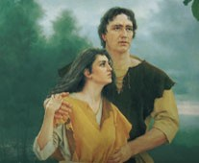
Adam-ondi-Ahman
Spring Hill is named by the Lord Adam-ondi-Ahman, because, said he, it is the place where Adam shall come to visit his people, or the Ancient of Days shall sit, as spoken of by Daniel the prophet.
D&C 116:1
Michael
“Adam was among the intelligences spoken of by the Lord to Abraham who were appointed to be rulers on this earth.
He was Michael, a prince, and son of God chosen to come to this earth and stand at the head of his posterity, holding the ‘keys of salvation under the counsel and direction of the Holy One, who is without beginning of days or end of life.’ This Holy One is Jesus Christ.
On the earth Michael was known as Adam. In the pre-existent state he was a spirit like the others of our Father’s children.”
Joseph Fielding Smith
D&C 78:15-16

Slide 17
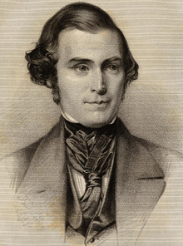
Son of Ahman
This is the name of Jesus Christ in the pure language given to Adam.
“There is one revelation that this people are not generally acquainted with. I think it has never been published, but probably it will be in the Church History. It is given in questions and answers. The first question is, ‘What is the name of God in the pure language?’ The answer says, ‘Ahman.’ ‘What is the name of the Son of God?’ Answer, ‘Son Ahman—the greatest of all the parts of God excepting Ahman.’”
Elder Orson Pratt
“We also learn from the closing verses of this revelation that Jesus Christ is also called Son Ahman. Therefore his name is connected with the name of the place where Adam dwelt. For that reason Elder Orson Pratt gives it the interpretation of ‘The Valley of God.’”
President Joseph Fielding Smith
D&C 78:20

Slide 18
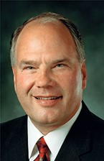
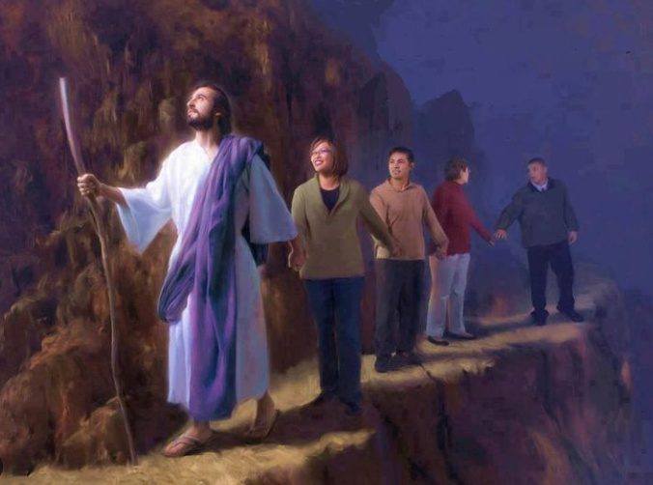
Lead You Along
May we take seriously the Lord’s call to “be of good cheer, for I will lead you along.
He leads us by the Holy Ghost.
May we live close to the Spirit, acting quickly upon our first promptings, knowing they come from God.
I bear witness of the power of the Holy Ghost to guide us, guard us, and ever be with us.
Ronald A. Rasband
D&C 78:18

Slide 19
Blessings In Store For Us
Why is it sometimes difficult for us to understand the blessings the Lord has in store for us?
Even though we may not be able to understand or bear all things, what invitation does the Lord give to us?
How can knowing that the Lord “will lead [us] along” through the things we cannot understand or bear help us be of good cheer?
If we receive all things with thankfulness, the Lord will multiply our blessings
D&C 78:19

Slide 20
Sources:
Videos:
“Caring for the Poor and Needy” (5:40).
“Humanitarian Center Film” (3:13)
“Welfare Square Tour” (6:02)
Becoming What Heavenly Father Desires (0:44)
In the Spirit of Thanksgiving(4:48)
Joseph Smith (History of the Church, 1:255)
Elder Orson Pratt (In Journal of Discourses, 16:156.)
Elder D. Todd Christofferson (“Come to Zion,” Ensign or Liahona, Nov. 2008, 39).
Hyrum M. Smith and Janne M. Sjodahl Doctrine and Covenants Commentary pg. 480-481
Doctrine and Covenants Student Manual Religion 324-325 Section 76
Presentation by ©http://fashionsbylynda.com/blog/
L.G. Otten and C.M. Caldwell Sacred Truths of the Doctrine and Covenants Vol. 2 pg.45
Joseph Fielding McConkie and Craig J. Ostler Revelations of the Restoration pg. 562-563
Russell M. Nelson, “The Second Great Commandment,” Ensign or Liahona, Nov. 2019, 98
Joseph Fielding Smith Church History and Modern Revelation 1:308
Answers to Gospel Questions, 1:5–6
Church History and Modern Revelation, 1:310
Elder Orson Pratt (In Journal of Discourses, 2:342
Bruce R. McConkie, Mormon Doctrine, p. 139
Doctrine and Covenants Who’s Who by Edgar J. Pinegar and Richard J. Allen pg 11, 83
Ronald A. Rasband, “Let the Holy Spirit Guide,” Ensign or Liahona, May 2017, 96
Presentation by ©http://fashionsbylynda.com/blog/

Slide 21
As you are aware, the Lord has established some type of welfare program in every dispensation. In the early days of this, the last dispensation, the Saints were given opportunities to live the law of consecration and were organized into what was called the united order. They were unable to live this higher law, which caused the Lord to suspend it until his people prepared themselves properly. It was not repealed. As we make our presentation today, I hope each of us will see the relationship between the law of consecration and the Welfare Services program.
In the October 1936 semiannual conference of the Church, the First Presidency announced the Church security plan. The name was later changed to the Church welfare plan. Since that time, the Church Welfare Department has developed and assigned to the stakes of the Church an annual commodity budget, supervised the production and distribution of commodities, encouraged the establishment of local production projects and bishops storehouses, supervised Church employment centers, and established Deseret Industries. In the course of these activities, members of the General Church Welfare Committee traveled to stakes and regions teaching the basic principles of Church welfare. President Romney did this for many years.
During this period and even earlier, the Church continued to develop a variety of other services. In 1919, foster care and adoption were introduced under President Joseph F. Smith through the Relief Society. Indian student placement was introduced through President David O. McKay and Elder Spencer W. Kimball. It began in 1953. Services for those who had emotional and mental problems have been provided for many years and were formally organized in 1960. In 1969 these various programs were brought together under the direction of Elders Marion G. Romney and Marvin J. Ashton. In 1970, the Health Services Corporation was organized to administer a system of hospitals the Church had developed over many years. The Health Services Corporation was also given responsibility for the worldwide health needs of Church members. During these few years of consolidation, the Welfare Department continued basically unchanged.
In 1973 these three areas—Welfare Department, Social Services, and Health Services—were brought together in one organization. The First Presidency appointed the Presiding Bishopric to serve as chairmen of the General Welfare Services Committee. To more clearly describe the functions assigned to each of these departments, departmental names were modified. What was known as the Welfare Department is now called the Welfare Production-Distribution Department, headed by Brother R. Quinn Gardner. This department continues to be responsible for many of the economic aspects of Welfare Services.
Social Services is now part of Personal Welfare Services, with Brother Victor Brown, Jr., as director. This department is responsible essentially for the social-emotional aspects and for employment centers. Legally licensed agencies related to Personal Welfare Services continue to carry the name LDS Social Services.
Health Services is now absorbed by Developing Welfare Services. This department is directed by Brother James O. Mason. Now that the Church no longer owns or operates hospitals, this department focuses attention on health needs worldwide; however, its major responsibility is to help priesthood and Relief Society leaders in developing areas of the world understand and prepare for the full Welfare Services program of the Church.
These, then, are the three departments that comprise Welfare Services: Production-Distribution, Personal Welfare, and Developing Welfare. The Presiding Bishopric, these three department heads, and the General Presidency of the Relief Society constitute the General Welfare Services Committee of the Church. We serve under the direction of the First Presidency.
I would like to add a word about the Relief Society. The Relief Society has been associated with the welfare program since its beginning and has continued to play a vital role as Welfare Services has expanded to embrace these other areas we have discussed. We are grateful to the Relief Society for their unfailing support of Welfare Services. We recognize that the program would be seriously limited without their full involvement.
The mission of Welfare Services has been stated in these terms: “To assist priesthood and Relief Society leaders to ensure that individual members and families provide appropriately for their own needs; they are, therefore, self-sustaining and able to share with others, preparatory to living the full law of consecration.”
The Lord has said, “And Zion cannot be built up unless it is by the principles of the law of the celestial kingdom; otherwise I cannot receive her unto myself.” (D&C 105:5.)
We recognize that we are building upon the work of the brethren who have gone before us. We are also very much aware of the scriptural admonition which the Lord has given his people: “Behold, this is the preparation wherewith I prepare you, and the foundation, and the ensample which I give unto you, whereby you may accomplish the commandments which are given you;
“That through my providence, notwithstanding the tribulation which shall descend upon you, that the church may stand independent above all other creatures beneath the celestial world.” (D&C 78:13–14.)
All levels of the Church organization must be prepared—individuals, families, wards, stakes, regions, and areas—to respond to the demands of life, so that we as a united people “may stand independent … beneath the celestial world.”
Victor L. Brown An Overview of Church Welfare Services Oct. 1975 General Conference
A great article of the Church Welfare System by Victor L. Brown Oct. 1975 Gen. Conf.

Slide 22
78:9 Faith and Diligence
The three brethren, Newel K. Whiney, Joseph Smith, and Sidney Rigdon, were the original members of the United Firm. They left to organize the firm in Missouri on 1 April 1832 accompanied by Peter Whitmer Jr. and Jesse Gause. The Prophet Joseph Smith suffered great persecution in the Hiram, Ohio, area previous to leaving in accordance with the Lord’s counsel. A week earlier, on the evening of 24 March 1832, a mob came to the John Johnson home and dragged the Prophet from his bedroom. The mob had previously taken Sidney Rigdon from his home. After tarring and feathering the two men, the mob left them for dead. That evening Emma and Joseph had been taking turns caring for twin babies who were seriously ill with measles. Emma had nursed the children, and Joseph slept in the trundle bed with a baby boy lying on his chest. The mob took the Prophet, but left little Joseph behind to the ravages of the cold that swept into the room. On 29 March, due to the effects of the cold and the measles, the baby boy died. At the time the men departed for Missouri, others in Joseph’s and Sidney’s family were ill wit the measles. The Prophet Joseph Smith wrote concerning the labor undertaken when “leaving our families in affliction amidst the death upon the mercy of mobs and of brethren who you know sometimes are found to be unstable, unbelieving, unmerciful and unkind and in this trying situation to keep the commandment of God we took our lives in our hands and traveled through every combination of wickedness to your country for your salvation” (Jessee, Personal Writings of Joseph Smith, 245).
The efforts of these men to fulfill the Lord’s command to travel to Zion demonstrated their faith and diligence.
Taken from Joseph Smith History of the Church Pg. 262-266
Ahman
D&C 78:20:
Elder Orson Pratt pointed out that “there is one revelation that this people are not generally acquainted with. I think it has never been published, but probably it will be in the church history. It is given in questions and answers. The first question is, ‘What is the name of God in the pure language?’ The answer says, ‘Ahman.’ ‘What is the name of the Son of God?’ Answer, ‘Son Ahman—the greatest of all the parts of God excepting Ahman’” (“Discourse,” Deseret News, May 23, 1855, 82 [part one of this discourse published in Deseret News, May 16, 1855, 76]; see also Documents, Volume 2: July 1831–January 1833, vol. 2 of the Documents series of The Joseph Smith Papers [2013], 215).
D&C 78:20:
President Joseph Fielding Smith taught: “Jesus Christ is also called Son Ahman. (See D. & C. 95:17.) Therefore his name is connected with the name of the place where Adam dwelt. For that reason Elder Orson Pratt gives it the interpretation of ‘The Valley of God’” (Church History and Modern Revelation, 2 vols. [1953], 1:310). (See also Doctrine and Covenants Student Manual, 2nd ed. [Church Educational System manual, 2001], 173.)
Adam-ondi-Ahman is the place where Adam blessed his righteous posterity three years before he died (see D&C 107:53–56) and where he will come to meet with the Saints before the time of the Second Coming (see D&C 116).

