Slide 1
Doctrine and covenants 81
Faithful in Callings
…Who then can be saved? But Jesus beheld them, and said unto them, With men this is impossible; but with God all things are possible
Matthew 19:26-27
Presentation by ©http://fashionsbylynda.com/blog/

Slide 2
Previously…
In spring 1832, the Prophet Joseph Smith and others traveled to Independence, Missouri, obeying the Lord’s command to establish an organization to build Zion and care for the poor.
There, the Prophet received a revelation describing the Lord’s expectations of His people and invited members of the United Firm to bind themselves by covenant to govern the affairs of His Church.

Slide 3
Callings
Why does the Lord give us callings in His Church?
Although a Church leader may receive inspiration to call a member of the Church to a certain position, it is up to the individual who receives the call to faithfully respond to it.

Slide 4
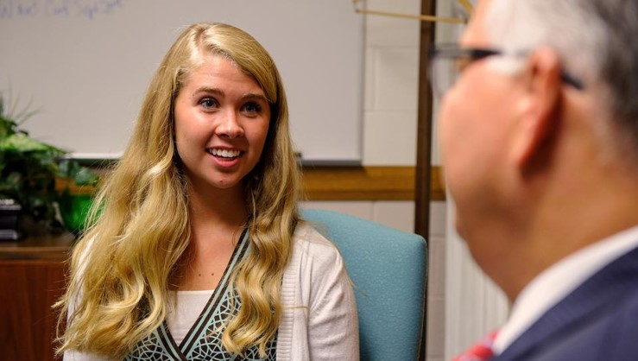
Blessings
What are the blessings of faithfully fulfilling a calling?
Receiving the everlasting gospel
Receiving the gifts of the Holy Ghost and be sanctified by the Spirit
Standing in the stead of Jesus Christ and administer salvation
To have power to become sons (and daughters) of God
To have our marriages and families be an eternal unit
To have the power to govern our own lives, both in temporal and spiritual kingdoms of the world
To have eternal life and see the face of God—calling an election made sure
Elder Bruce R. McConkie

Slide 5
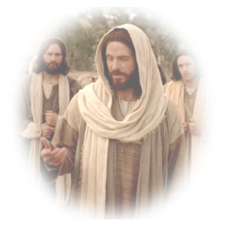
Choosing Not
What if someone chooses not to faithfully fulfill his or her calling?
The choices you make today will directly influence the number and kinds of opportunities you will have in the future. Each daily decision will either limit or broaden your opportunities. As you make righteous decisions during this preparatory period, you will be ready to make righteous decisions in the future.
Elder Robert D. Hales
Read Matthew 19:16-26

Slide 6
Background
8 March 1832
On March 8, 1832, the Lord called Jesse Gause and Sidney Rigdon to serve as counselors to Joseph Smith.
15 March 1832
One week later, on March 15, 1832, the Lord gave the revelation recorded in Doctrine and Covenants 81.
At the time of this revelation, the President of the Church and his counselors were called the Presidency of the High Priesthood. Beginning in 1834, revelations referred to the President and his counselors as the First Presidency

Slide 7
See notes on his calling as a Counselor*
Jesse Gause
He was born in East Marlborough, Pennsylvania in 1785, the son of William Gause and Mary Beverly
He followed the faith, the Society of Friends, (Quaker) of his parents at age 21
In 1814 he joined the Delaware militia during the War of 1812 and left the military in 1815 moving to Wilmington, Delaware where he married Martha Johnson
He became a teacher in Chester County in a Quaker school, and his wife died after the birth of their 4th child in 1828
He remarried again to Minerva and settled in Hancock, Massachusetts, then resigned from the Quakers in 1829 and joined the Shakers and his new wife followed him to North Union, Ohio and left Martha’s 4 other children in the care of his sister
During his move he was introduced to the Church and baptized some time after October 1831
He was called to serve as a counselor in the Presidency of the High Priesthood in March 1832
On August 1, 1832, he embarked on a mission with Zebedee Coltrin. While on this mission, he visited with his wife and tried to convince her of the truth, but she refused to join the Church
A short time later, he became very ill and returned to Kirtland. Unfortunately, He did not complete his mission and did not stay faithful in the Church. Little is known about his death, but he did die in Montgomery, Pennsylvania

Slide 8
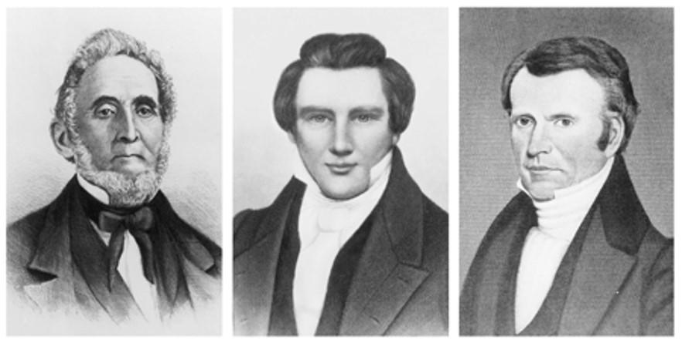
Formal Organization
The President of the Church and his counselors (the Presidency of the High Priesthood) would not be referred to as “the First Presidency” until 1834 (see D&C 102:26–28).
The Lord did not reveal the complete organization of His Church to the Prophet all at once. He revealed different parts of the organization as the need arose and as the Saints were ready to receive them.
The First Presidency of the Church (1833): Sidney Rigdon, Joseph Smith, and Frederick G. Williams
D&C 81:1-2

Slide 9
Frederick G. Williams
Recap
He was born on October 28, 1787, at Suffield, Connecticut
He was a self trained medical practitioner
He and his wife found their way to Kirtland, Ohio and were converted by the missionaries and baptized in October 1830
He was ordained an elder and then a high priest in 1832
He owned some land in Ohio and the Prophet in D&C 64 told him to hold that land for 5 years and in 1834 he deeded his farm to the Prophet Joseph Smith
He was paymaster in Zion’s Camp
He lost his counsellorship and his membership in 1837
He repented and was rebaptized and joined the saints in Missouri (D&C 90:6)
He passed away in Quincy, Ohio in October 1842 of poor health

Slide 10
The Keys of the Priesthood
The Presidency of the High Priesthood holds the keys of God’s kingdom on the earth
D&C 81:1-2

Slide 11
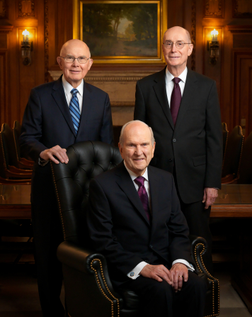
Conferred Upon
“Jesus Christ holds all the keys of the priesthood pertaining to His Church. He has conferred upon each of His Apostles all the keys that pertain to the kingdom of God on earth. The senior living Apostle, the President of the Church, is the only person on earth authorized to exercise all priesthood keys”
Handbook 2

Slide 12
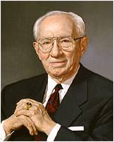
Faithful in counsel
“[A counselor] is an assistant to his president. …
“As an assistant, the counselor is not the president. He does not assume responsibility and move out ahead of his president.
“In presidency meetings, each counselor is free to speak his mind on all issues that come before the presidency. However, it is the prerogative of the president to make the decision, and it is the duty of the counselors to back him in that decision. His decision then becomes their decision, regardless of their previous ideas”
Gordon B. Hinckley
D&C 81:3

Slide 13
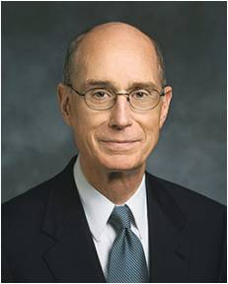
Faithful in Callings
Your call has eternal consequences for others and for you. In the world to come, thousands may call your name blessed, even more than the people you serve here.
They will be the ancestors and the descendants of those who chose eternal life because of something you said or did, or even what you were.
You see, there are no small callings to represent the Lord. Your call carries grave responsibility. But you need not fear, because with your call come great promises.
If someone rejects the Savior’s invitation because you did not do all you could have done, their sorrow will be yours.
D&C 81:4 President Henry B. Eyring

Slide 14
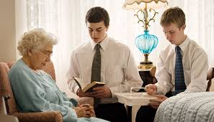
How might serving faithfully in our Church callings help us do a great good for other people?
How might serving faithfully in our Church callings help promote the glory of God?
If we are faithful in our callings, we can do a great good for others and promote the glory of God

Slide 15
Sources:
Video:
Priesthood Keys: The Restoration of Priesthood Keys(2:08)
Counselors (0:45)
Our Work Is to Go About Doing Good (1:35)
“Strengthen the Feeble Knees”(0:31)
Christ and the Rich Young Ruler (2:26)
Elder Bruce R. McConkie The Ten Blessings of the Priesthood October 1977 Gen. Conf.
Elder Robert D. Hales Fulfilling Our Duty to God October 2001 Gen. Conf.
Presentation by ©http://fashionsbylynda.com/blog/
(Handbook 2: Administering the Church [2010], 2.1.1).
Gordon B. Hinckley (“In … Counsellors There Is Safety,” Ensign, Nov. 1990, 49).
President Henry B. Eyring Rise to Your Call October 2002 Gen. Conf.
A Good Read: http://frankstaheli.blogspot.com/2014/02/its-calling-from-lord-so-i-should.html#more
Presentation by ©http://fashionsbylynda.com/blog/

Slide 16
The ten blessings of the priesthood, the Holy Priesthood, after the order of the Son of God
We have received the fulness of the everlasting gospel
We have received the gift of the Holy Ghost, and we are entitled to receive the gifts of the Spirit—
We can be sanctified by the Spirit
We can stand in the place and stead of the Lord Jesus Christ in administering salvation to the children of men
We have power to become the sons of God, to be adopted into the family of the Lord Jesus Christ, to have him as our Father, to be one with him as he is one with his Father.
We can enter into the patriarchal order, the order of eternal marriage, the order which enables the family unit to continue everlastingly in celestial glory.
We have power to govern all things, both temporal and spiritual kingdoms of the world, and the elements and storms and powers of the earth
We have power, through the priesthood, to gain eternal life, the greatest of all the gifts of God.
We have power to make our calling and election sure, so that while we yet dwell in mortality, having overcome the world and been true and faithful in all things, we shall be sealed up unto eternal life and have the unconditional promise of eternal life in the presence of Him whose we are
We have the power—and it is our privilege—so to live, that becoming pure in heart, we shall see the face of God while we yet dwell as mortals in a world of sin and sorrow.
Bruce R. McConkie The Ten Blessings of the Priesthood October 1977 Gen. Conf.
Handbook 2 19.1 Determining Whom to Call General Guidelines
A person must be called of God to serve in the Church (see Articles of Faith 1:5). Leaders seek the guidance of the Spirit in determining whom to call. They consider the worthiness that may be required for the calling. They also consider the member’s personal or family circumstances. Each calling should benefit the people who are served, the member, and the member’s family.
Although service in Church callings requires sacrifice, it should not compromise a member’s ability to fulfill family and employment responsibilities. Before calling a married person to an assignment that requires a significant time commitment, Church leaders consider the effect of the calling on the marriage and family.
When a young man or young woman will be called to a Church position, a member of the bishopric obtains approval from the parents or guardians before issuing the calling.
New converts should be given an appropriate calling or another responsibility to serve as soon as possible. Some new members may be ready for callings as soon as they are baptized and confirmed. Others may need to receive simple assignments that would help them prepare to receive callings. A member of the bishopric interviews new converts before calling them to teach children or youth.
People who are not members of the Church may be called to some positions, such as organist, music director, and assistant Scout leader. However, they should not be called to teaching or administrative positions or as Primary music leaders. The allowance to call nonmembers to some positions does not apply to excommunicated members, who may not have any callings.

Slide 17
Between Jesse Gause and Fredrick G. Williams:
On 15 March 1832 the Prophet Joseph Smith received a revelation calling Frederick G. Williams to be a Counselor in the First Presidency of the Church. Originally, however, this revelation was directed to Jesse Gause.
“Our earliest reference to Jesse Gause is as a member of the Shaker communities in Hancock near Pittsfield, and possibly in North Union, Ohio as well. His conversion and baptism are not found in any of the records of the Church, but one writer has suggested that he was converted by Reynolds Cahoon in late 1830. It was not until 8 March 1832, when Jesse Gause was called to be a counselor to Joseph Smith in the presidency of the high priesthood, that his name is even mentioned in surviving Church records. The notation in the Kirtland Revelation Book is as follows:
“‘March 8, 1832. Chose this day and ordained Brother Jesse Gause and Brother Sidney to be my counselors of the ministry of the presidency of the high priesthood …’ [spelling standardized].
“One week later, a revelation concerning Jesse Gause was received by Joseph Smith, confirming Jesse in his work and giving further direction in his office and calling. There are two manuscript copies of this revelation extant. … In both of these Jesse Gause’s name has been crossed out and Frederick G. Williams’ name written above it. Since that time, all published copies of this revelation (Section 81 of the Doctrine and Covenants) list Frederick G. Williams as the one to whom it is directed. Since this revelation contains instructions, duties, and promised blessings to the one called as counselor to the Prophet, the revelation was just as appropriate for Frederick G. Williams as it was to Jesse Gause.
“After Jesse Gause was ordained, he appeared in a leading role in the Church for only a short time. In April 1832, he accompanied Joseph Smith, Newel K. Whitney, and Peter Whitmer, Jr. on a trip to Missouri. They arrived 24 April and began holding conferences with the Saints in Zion on the 26th. In the minutes of a meeting of the Literary Firm held on Monday, 30 April, Jesse Gause was listed as a counselor to Joseph Smith. …
“Upon his return to Kirtland, Jesse was called to serve a mission with Zebedee Coltrin. They began their journey on 1 August 1832, and traveled until the 19th, at which time Coltrin decided to return to Kirtland because of severe pains in his head. After praying with and for each other, they parted. Jesse Gause continued east and walked right out of the history of the Church, never again to return. There appears to be no other record of the man either in or out of the Church.
“Some months after the departure of Jesse Gause, the presidency of the high priesthood was reorganized with Frederick G. Williams replacing him as counselor. This reorganization was commanded in Section 90 of the Doctrine and Covenants, and actually took place on 18 March 1833.” (Robert J. Woodford, “Jesse Gause, Counselor to the Prophet,” BYU Studies,Spring 1975, pp. 362–64.)
Student Manual Religion 324-325 Section 81
Counselors in the First Presidency
President Harold B. Lee explained the important role of counselors in the First Presidency:
“As I thought of the role of President Tanner and myself as [President Joseph Fielding Smith’s] counselors, I thought of a circumstance in the life of Moses, when the enemies of the church in that day were just as they are in this day. They were threatening to overcome and tear down and to stop the work of the church. As Moses sat upon a hill and raised the rod of his authority, or the keys of his priesthood, Israel prevailed over their enemies; but as the day wore on, his hands became heavy and began to droop at his side.
“And so [Aaron and Hur] held up his hands so they would not be weakened and the rod would not be lowered. He would be sustained so that the enemies of the church would not prevail over the saints of the Most High God. (See Exod. 17:8–12.)
“I think that is the role that President Tanner and I have to fulfill. The hands of President Smith may grow weary. They may tend to droop at times because of his heavy responsibilities; but as we uphold his hands, and as we lead under his direction, by his side, the gates of hell will not prevail against you and against Israel” (in Conference Report, Oct. 1970, 153).
In the April 1994 general conference of the Church, President Gordon B. Hinckley, who was then serving as First Counselor in the First Presidency, acknowledged that President Ezra Taft Benson, the President of the Church at the time, was “suffer[ing] seriously from the effects of age and illness and [had] been unable to fulfill important duties of his sacred office.” Then President Hinckley explained:
“When the President is ill or not able to function fully in all of the duties of his office, his two Counselors together comprise a Quorum of the First Presidency. They carry on with the day-to-day work of the Presidency. In exceptional circumstances, when only one may be able to function, he may act in the authority of the office of the Presidency as set forth in the Doctrine and Covenants, section 102, verses 10–11” (“God Is at the Helm,” Ensign, May 1994, 54).

