Slide 1
Doctrine and Covenants 79-80
Proclaiming
Presentation by ©http://fashionsbylynda.com/blog/

Slide 2
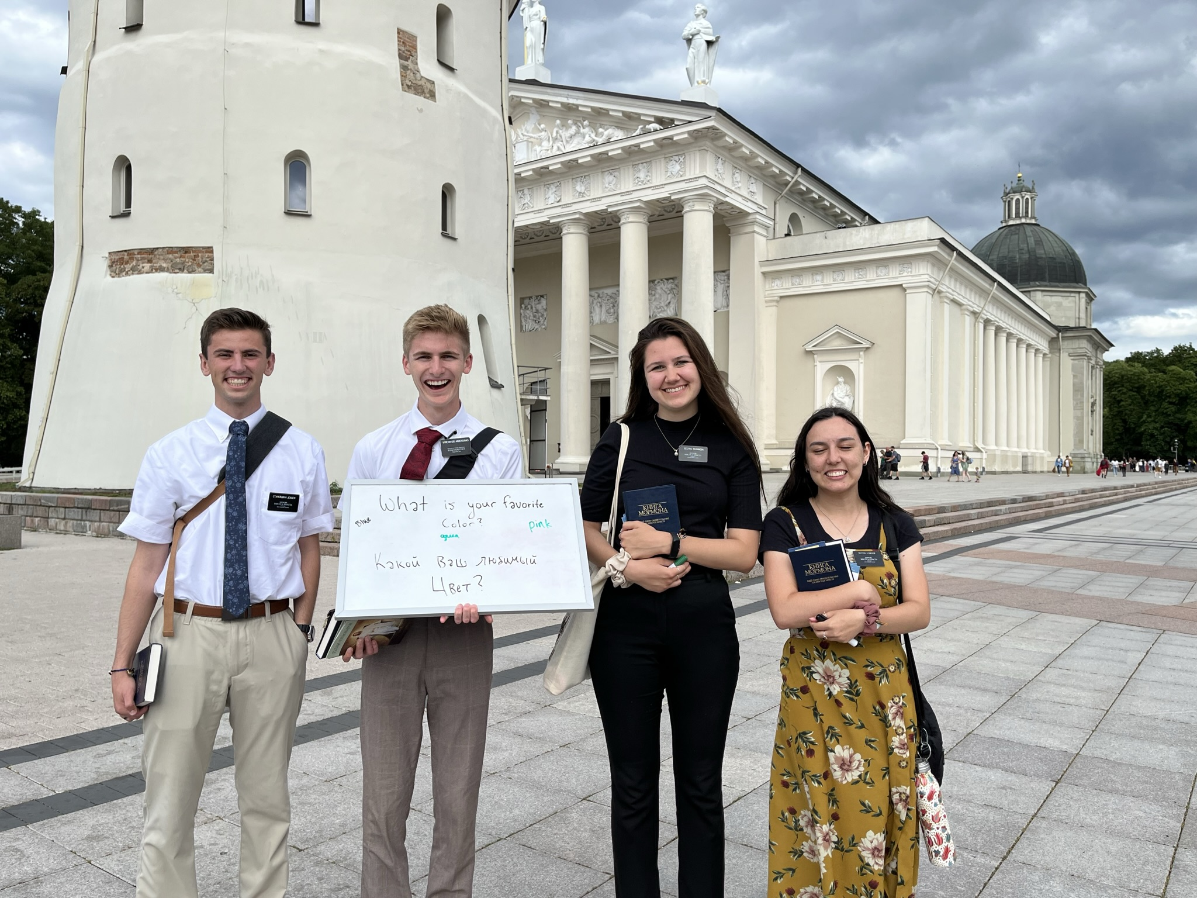
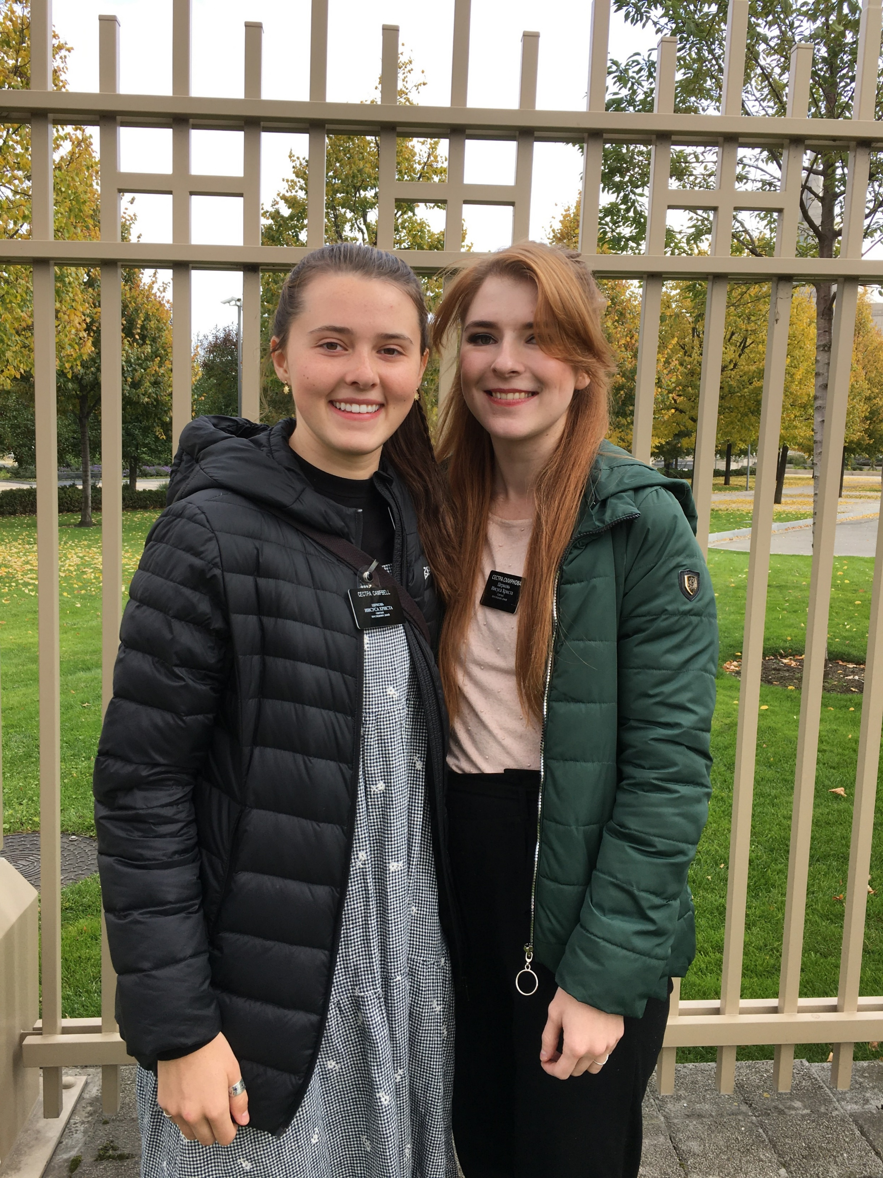
Opportunities to Share the Good News
Wherever you are on this earth, there are plenty of opportunities to share the good news of the gospel of Jesus Christ with people you meet, study with, and live with or work and socialize with.
Dieter F. Uchtdorf
Jesus Christ invites us to share the joy of His gospel with everyone
D&C 79:1

Slide 3
Jared Carter
He was born on June 14, 1801, in Benson, Vermont
He was introduced to the Book of Mormon in January 1831 and immediately believed it was true
He was baptized by Hyrum Smith the following month
Jared and his family moved with the Saints to Colesville, Ohio
He was ordained a priest in accordance with revelation dated June 7, 1831 and went on to become a successful missionary for a period of time and baptized 79 people
Unfortunately, though he was called a member of the building committee and high council in Kirtland, he became disaffected from the church and was disfellowshipped in September 1844 for conspiracy against the Prophet Joseph
He died in July 1855 in Dekalb County, Illinois
D&C 79:1
Who’s Who

Slide 4
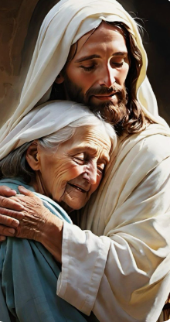
D&C 79:3
Crown with sheaves
D&C 79:4
Heart be glad
D&C 79:2
Comforter

Slide 5
Stephen Burnett
He was born in 1814
He and his family learned of the gospel from John Murdock in Ohio and joined the church and was baptized by Parley P. Pratt in Kirtland Ohio in late November 1830
He was ordained a High Priest at age 17
He was called by revelation on January 25, 1832, to serve as a missionary with Ruggles Eames (D&C 75:35)
Apparently, this calling was not filled, because a second calling was issued by revelation in March 1832 with Eden Smith as his companion (D&C 80)
He also received mission to New Hampshire and other eastern states from 1832 to 1834
Unfortunately, upon his return to Kirtland from this assignment, Stephen apostatized and denounced the Prophet and the Church
Nothing is known about the rest of his life
D&C 80:1
Who’s Who and Teacher Manual

Slide 6
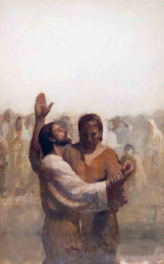
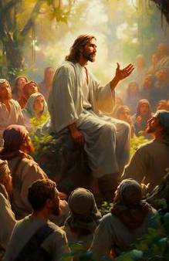
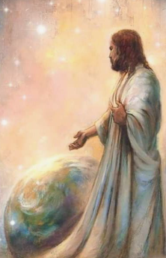
Go Into the World and Preach
Go ye into all the world, preach the gospel to every creature, acting in the authority which I have given you, baptizing in the name of the Father, and of the Son, and of the Holy Ghost.
D&C 68:8
And he said unto them, Go ye into all the world, and preach the gospel to every creature.
Mark 16:15
Go ye therefore, and teach all nations, baptizing them in the name of the Father, and of the Son, and of the Holy Ghost:
Matthew 28:19
D&C 80:1

Slide 7
Eden Smith
He was born in 1806 in Indiana
After joining the church, he was called by revelation in January 1832 as a missionary
His second missionary call was received in March of 1832
In light of Eden’s somewhat contentious nature, he was disfellowshipped on July 2, 1833
He repented and came back into fellowship in the Church.
He joined the Saints in Missouri and later moved to Nauvoo, where he served in the Nauvoo Legion
He died in Iowa on December 7, 1851
D&C 80:3
Who’s Who

Slide 8
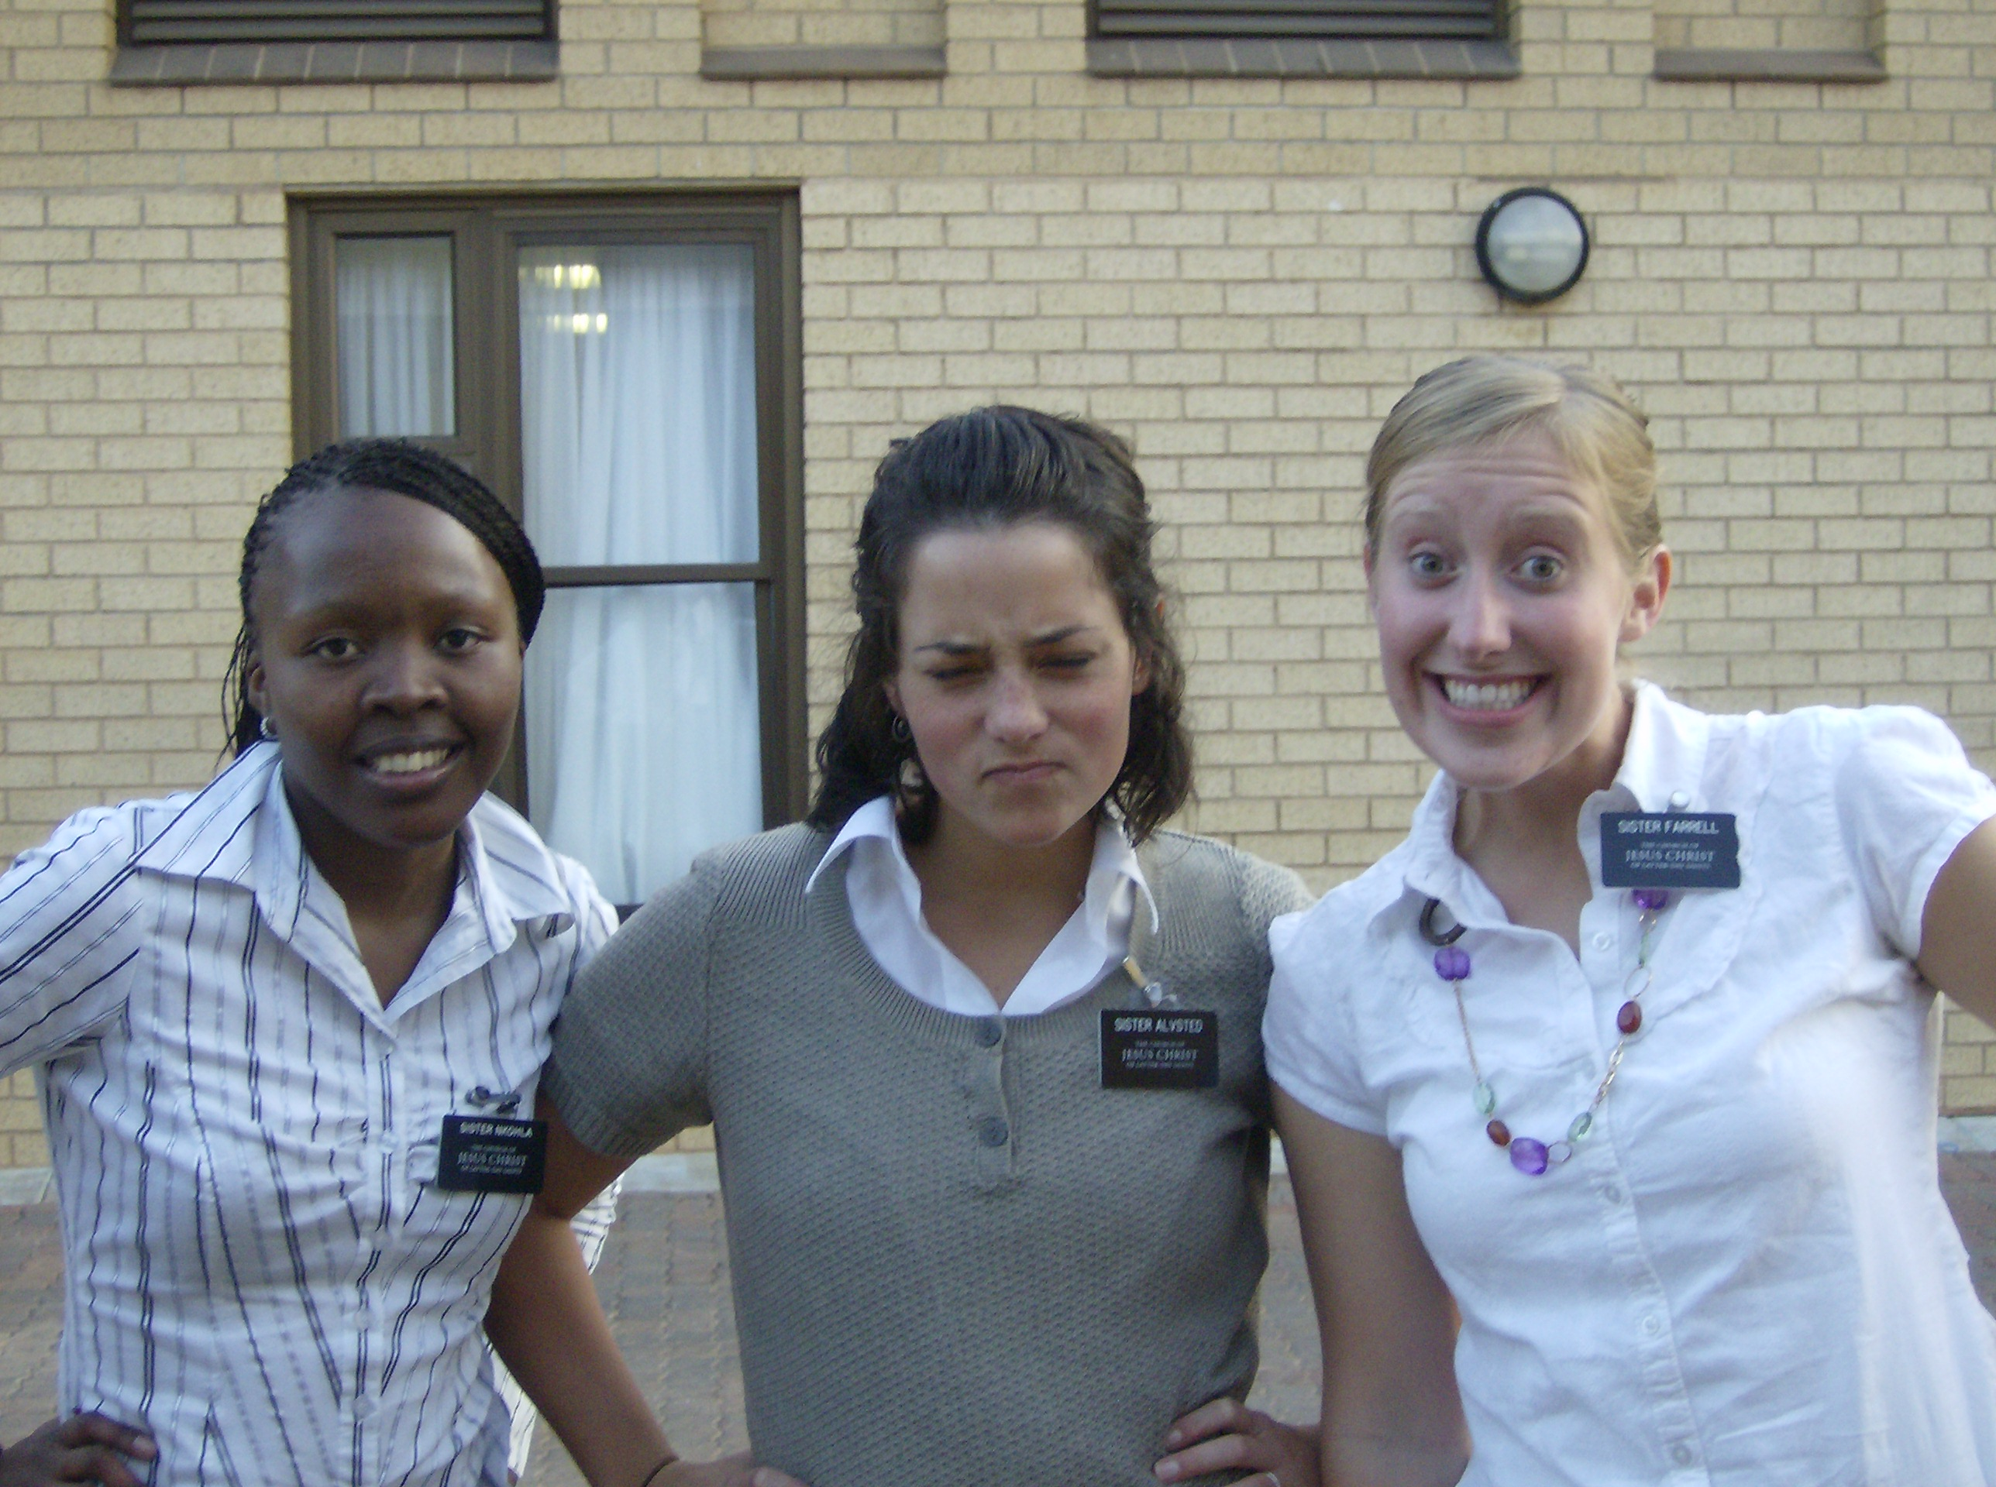
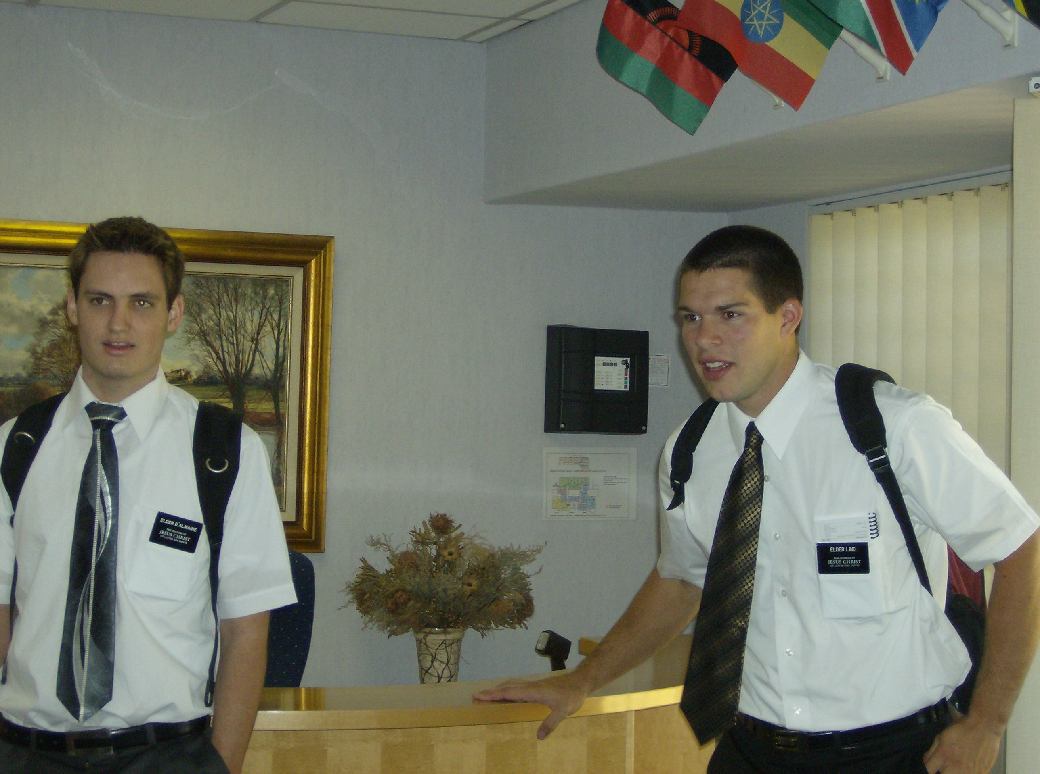
Companions
Missionaries in The Church of Jesus Christ of Latter-day Saints work in pairs, or companionships, for a number of reasons, including:
Safety: Companions help keep missionaries safe, especially when they are far from home.
Focus: Companionships help missionaries stay focused on helping others.
Following Jesus' example: Jesus sent his messengers out in pairs, as described in Mark 6:7.
Cultural navigation: Companions can help missionaries navigate new cultures and learn the area.
Support: Companions can be a source of relief, especially when starting a mission.
And he called unto him the twelve, and began to send them forth by two and two; and gave them power over unclean spirits;
Mark 6:7
D&C 80:3

Slide 9
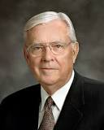
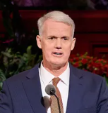
Know to Be True - Truth is Eternal
Rejoice in Truth 1 Corinthians 13:6
T
R
U
T
H
When we are truly converted, we cannot be restrained from testifying. And as it was with Apostles and faithful members of old, so is it also our privilege, our duty, and our solemn obligation to “declare the things which [we] know to be true.”
M. Russell Ballard
Truth is critical for us to establish and strengthen our relationship with God, find peace and joy, and reach our divine potential.
Today, let us consider the following questions:
What is truth, and why is it important?
How do we find truth?
When we find truth, how can we share it?
Elder John C. Pingree Jr.
D&C 80:4

Slide 10
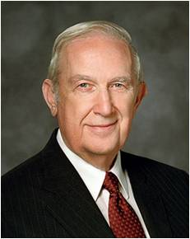
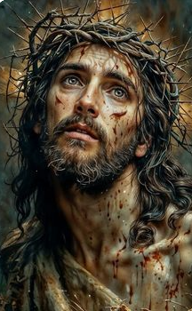
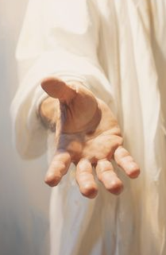
Your Redeemer
The Redeemer loves you and will help you do the essential things that bring happiness now and forever.
Richard G. Scott
D&C 80:5

Slide 11
Sources:
Video:
“Good Things to Share” (2:21)
Doctrine and Covenants Who’s Who by Edgar J. Pinegar and Richard J. Allen pg 11, 83
Dieter F. Uchtdorf, “Missionary Work: Sharing What Is in Your Heart,” Ensign or Liahona, May 2019, 15
Presentation by ©http://fashionsbylynda.com/blog/
M. Russell Ballard, “Pure Testimony,” Ensign or Liahona, Nov. 2004, 41
Elder John C. Pingree Jr. General Conf. Oct 2023 “Eternal Truth”
Richard G. Scott “Jesus Christ, Our Redeemer” April 1997 Gen. Conf.
Presentation by http://fashionsbylynda.com/blog/

