Slide 1

Doctrine and Covenants 82-83
“Unto Whom Much Is Given Much Is Required”
Holy Bible
The
Book
of
Mormon
Doctrine
And
Covenants
ANOTHER TESTAMENT
OF JESUS CHRIST
Presentation by ©http://fashionsbylynda.com/blog/

Slide 2
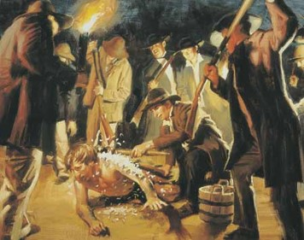
Background
April 26, 1832
The previous month Joseph Smith and Sidney Rigdon were attacked by mobbers.
The Prophet received Section 82 during the council of high priests and elders of the Church in Independence:
In this revelation the Lord forgave the brethren their trespasses and warned them to refrain from further sin.
The Lord also instructed these brethren on how to manage the temporal affairs of Zion.
Four days later, Joseph Smith received the revelation recorded in Doctrine and Covenants 83, in which the Lord instructed Church leaders on how to care for widows and orphans.

Slide 3
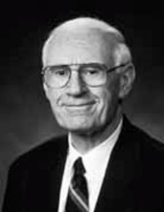
Disagreements--Resolutions
Even those who stand highest among the Church leaders have their human weaknesses.
For several months unkind feelings had developed between Sidney Rigdon in Ohio and Bishop Edward Partridge in Missouri.
Between the morning and afternoon sessions of the conference, Sidney Rigdon and Edward Partridge resolved their differences.
“Today we live in times of conflict, dissent, differences of opinion, charges, countercharges, disagreements. There is a need for us, perhaps more than ever before, to reach within ourselves and allow the qualities of mutual respect, mingled with charity and forgiveness; to influence our actions with one another; to be able to disagree without becoming disagreeable; to lower our voices and build on common ground with the realization that once the storm has passed, we will still have to live with one another.”
Loren C. Dunn
D&C 82:1

Slide 4
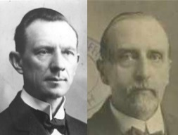

All Of You Have Sinned
Sidney Rigdon and Edward Partridge were not the only ones who had erred
“Although the settlements in Zion increased rapidly, and were exceedingly prosperous, man of the Saints failed to obey the counsel of the authorities. Some refuse to submit to the law of consecration, preferring to obtain property for themselves, and jealousy, covetousness, and general neglect of duty.
“Some of the High Priests and Elders ignored the seven Presidents appointed to have charge of the Branches in Zion….and took the leadership into their own hands.”
Smith and Sjodahl
The Lord requires much of those to whom He has given much
D&C 82:2

Slide 5

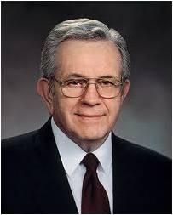
Much is Given—Much is Required
“To join the Church you must forsake every kind of immorality. Husbands are placed under covenant to be faithful to their wives, and wives to their husbands. Young people are persuaded to reserve those sacred life-giving powers for marriage.
Temperance is required. Members of the Church abstain from alcoholic beverages—all of them, all of the time. The same is true with tobacco. And if that were not enough, habit-forming stimulants—tea and coffee—are not used.
And there are other improvements—in humility, in honesty, and reverence, keeping the Sabbath—all aimed at making each of us a decent person.”
Why do you think those who have received more from the Lord would also have more required of them?
“If it is an easy church you are looking for, if that is important to you, this is not it.”
D&C 82:3-4 Elder Boyd K. Packer

Slide 6

Darkness Here
The Condition of the World outside divine revelation
“Spiritual and moral error.
Revelation from God gives light, but when divine revelation is rejected, the adversary spreads his dominion among the children of men.”
Smith and Sjodahl
And the light shineth in darkness; and the darkness comprehended it not.
John 1:5
D&C 82:5

Slide 7

Sins Return
When we knowingly turn from righteousness to sin, our “former sins return.
¶But when the righteous turneth away from his righteousness, and committeth iniquity, and doeth according to all the abominations that the wicked man doeth, shall he live? All his righteousness that he hath done shall not be mentioned: in his trespass that he hath trespassed, and in his sin that he hath sinned, in them shall he die.
Ezekiel 18:24
D&C 82:7

Slide 8
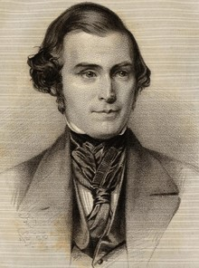

A New Law
When the Saints had not comply with the laws given in 1831(the celestial law) the Lord gave them new laws, less acting laws, called the Order of Enoch.
The law of Ancient Enoch--required for all the people to consecrate all they had—
The Order of Enoch—required only a certain part--certain men should consecrate of all that a man had
Orson Pratt
D&C 82:9

Slide 9
And again, I say unto you, I give unto you a new commandment, that you may understand my will concerning you;
Or, in other words, I give unto you directions how you may act before me, that it may turn to you for your salvation.
D&C 82:8-9
If we will obey the Lord, He will always keep His promises to bless us
D&C 82:10

Slide 10
Doctrinal Mastery
I, the Lord, am bound when ye do what I say; but when ye do not what I say, ye have no promise
D&C 82:10

Slide 11
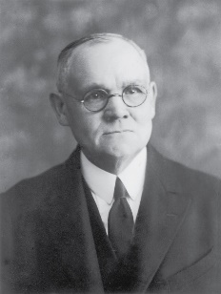
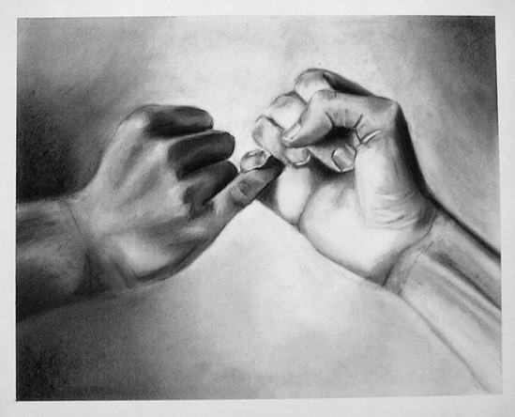
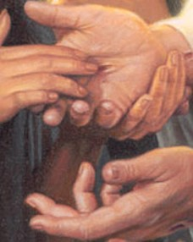
I Am Bound
“‘Mormonism’ has taught me that God holds himself accountable to law even as he expects us to do.
He has set us the example in obedience to law. I know that to say this would have been heresy a few decades ago.
But we have the divine word for it: ‘I, the Lord, am bound when ye do what I say; but when ye do not what I say, ye have no promise.’
He operates by law and not by arbitrariness or caprice.”
Elder James E. Talmage
When we obey the Lord’s commandments, He promises to bless us.
D&C 82:10

Slide 12
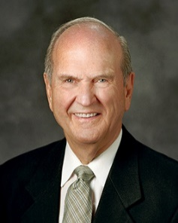

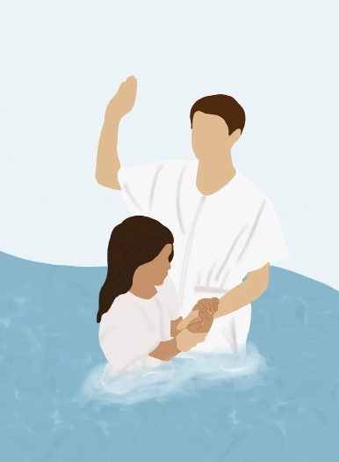
Covenant
Once we make a covenant with God, we leave neutral ground forever. God will not abandon His relationship with those who have forged such a bond with Him. In fact, all those who have made a covenant with God have access to a special kind of love and mercy. …
Once you and I have made a covenant with God, our relationship with Him becomes much closer than before our covenant. Now we are bound together. Because of our covenant with God, He will never tire in His efforts to help us, and we will never exhaust His merciful patience with us. Each of us has a special place in God’s heart. He has high hopes for us.
Russell M. Nelson
D&C 82:11

Slide 13
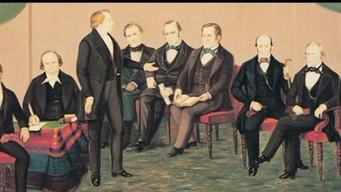
Those To Be An Example
The men named were of the order of Enoch or the united order. As leaders in the Church, they were to be examples to all others, showing how the law of consecration was to be lived .
The “bond and covenant” to which they were binding themselves was that of the law of consecration.
They were to make a solemn covenant with the Lord to keep the laws and rules of that order. The penalty for breaking that oath and covenant was severe
D&C 82:11

Slide 14
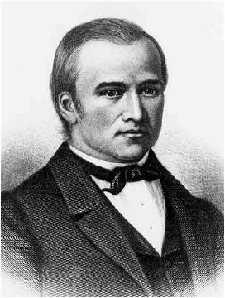
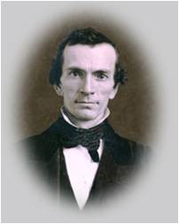
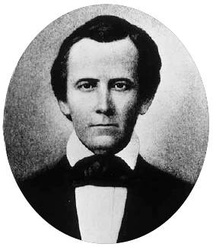
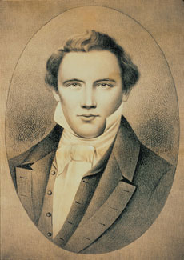
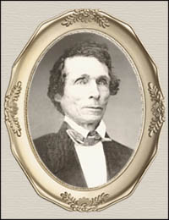
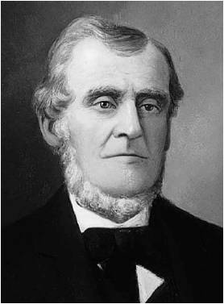
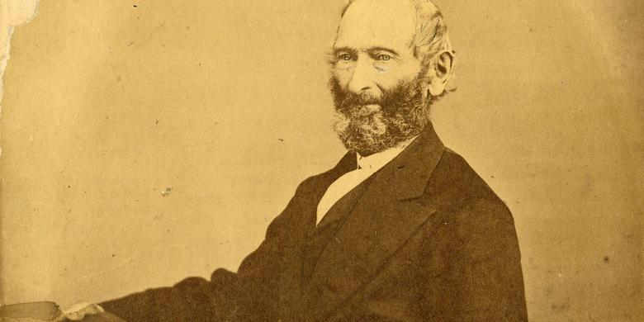
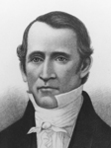
Pseudonyms, or False Names
Code Names to Protect The Church
Olihah
Oliver Cowdery
Ahashdah
Newel K. Whitney
Pelgoram
Sidney Rigdon
Gazelam
Joseph Smith
Shalemanasseh
William W. Phelps
Mahemson
Martin Harris
Horah
John Whitmer
Alam
Edward Partridge
Mahalaleel
Sidney Gilbert
D&C 82:11

Slide 15
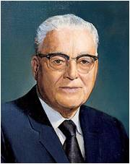
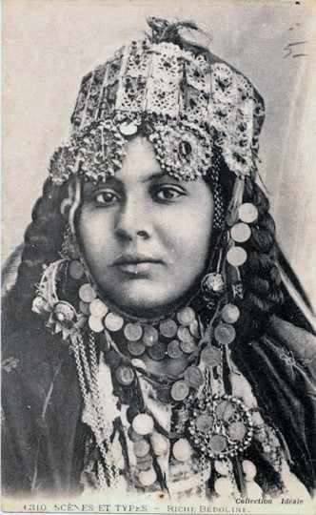
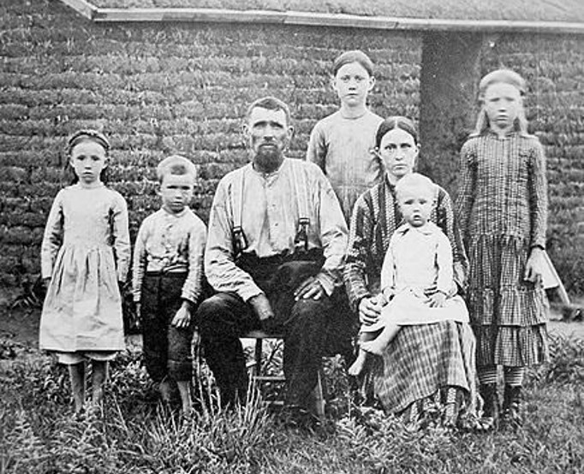
To Be Worthy
“Zion, as used here, undoubtedly had reference to the Church. At that time there was but a small body of Church members just beginning to emerge as an organization, after having experienced harsh treatment from enemies outside the Church. …
To be worthy of such a sacred designation as Zion, the Church must think of itself as a bride adorned for her husband.
And I John saw the holy city, new Jerusalem, coming down from God out of heaven, prepared as a bride adorned for her husband.
Revelation 21:2
It is the relationship the Lord desires in his people in order to be acceptable to our Lord and Master even as a wife would adorn herself in beautiful garments for her husband.”
D&C 82:13-14 Harold B. Lee

Slide 16


Inward Loveliness
“…This people must increase in beauty before the world; have an inward loveliness which may be observed by mankind as a reflection in holiness and in those inherent qualities of sanctity.
The borders of Zion, where the righteous and pure in heart may dwell, must now begin to be enlarged.
The stakes of Zion must be strengthened. All this so that Zion may arise and shine by becoming increasingly diligent in carrying out the plan of salvation throughout the world.”
D&C 82:13-14 Harold B. Lee

Slide 17
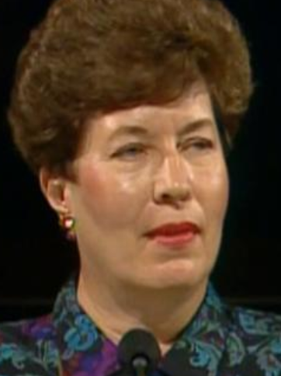
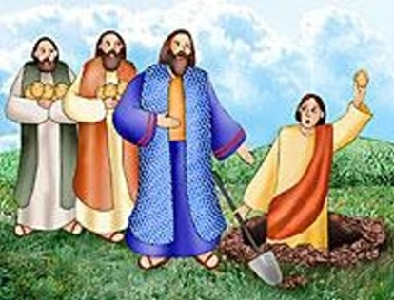
Improve on Your Talents
These are the gifts we bring. The talents we have come from our Heavenly Father, an to honor Him, we can develop and expand them and then return them to Him. All of us possess some talent which we can practice, increase, and offer. Are you regularly practicing your talents? Perhaps your talent is kindness or gratitude. How about being cheerful, helpful, and unselfish? How about practicing that winning smile? The Wise Men brought their gifts of gold, frankincense, and myrrh. We can bring our talents.
Betty Jo N. Jepsen
D&C 82:18

Slide 18


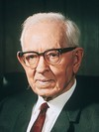
Seek Interest of His Neighbor
“It is verily true that before we can enter into the celestial kingdom we will have to learn how to live in unity with the love of our fellows at heart, desiring their good as well as our own, and not preferring ourselves before them.
Here the Lord gave to the Church the plan and the opportunity to prepare themselves by obedience to celestial law.
They failed, and the privilege to practice this law of consecration had to be postponed because we were not able to esteem our neighbor as ourselves.”
Joseph Fielding Smith
D&C 82:19

Slide 19
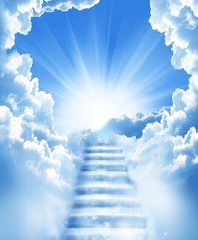

The Everlasting Order
The Order would have been permanent if the Saints had lived up to it, and it would have made them capable of practicing the higher, or celestial Order.
However
It was not accepted or practiced with an eye single to the glory of God
D&C 82:20

Slide 20

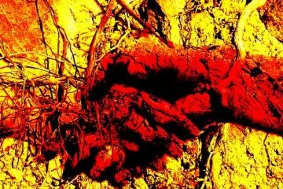

“Mammon of Unrighteousness”
“The commandment of the Lord that the saints should make themselves ‘friends with the mammon of unrighteousness,’ seems to be a hard saying when not properly understood.
It is not intended that in making friends of the ‘mammon of unrighteousness’ that the brethren were to partake with them in their sins; to receive them to their bosoms, intermarry with them and otherwise come down to their level.
They were to so live that peace with their enemies might be assured. They were to treat them kindly, be friendly with them as far as correct and virtuous principles would permit, but never to swear with them or drink and carouse with them.
If they could allay prejudice and show a willingness to trade with and show a kindly spirit, it might help to turn them away from their bitterness. Judgment was to be left with the Lord”
Joseph Fielding Smith
D&C 82:20

Slide 21
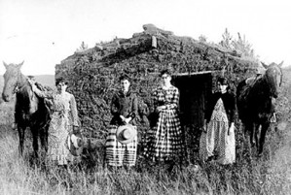
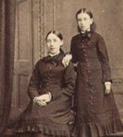
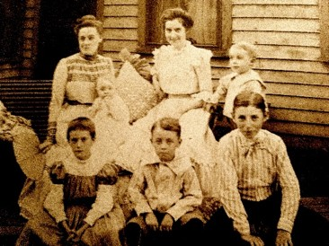
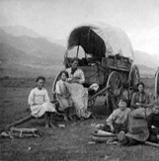
The Widows and the Children
But if any provide not for his own, and specially for those of his own house, he hath denied the faith, and is worse than an infidel.
Let not a widow be taken into the number under threescore years old, having been the wife of one man,
Well reported of for good works; if she have brought up children, if she have lodged strangers, if she have washed the saints’ feet, if she have relieved the afflicted, if she have diligently followed every good work.
But the younger widows refuse: for when they have begun to wax wanton against Christ, they will marry;
1 Timothy 5:8-11
D&C 83

Slide 22
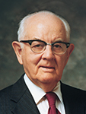
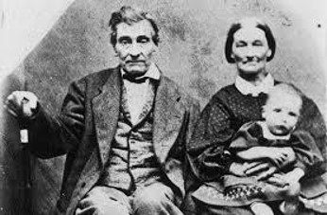
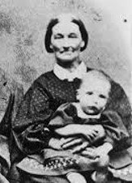
Inheritance
“The Church and its members are commanded by the Lord to be self-reliant and independent.
“The responsibility for each person’s social, emotional, spiritual, physical, or economic well-being rests first upon himself, second upon his family, and third upon the Church if he is a faithful member thereof.
“No true Latter-day Saint, while physically or emotionally able will voluntarily shift the burden of his own or his family’s well-being to someone else.
So long as he can, under the inspiration of the Lord and with his own labors, he will supply himself and his family with the spiritual and temporal necessities of life.
Spencer W. Kimball
The declaration that a widow could remain upon her inheritance and that children who came of age could lay claim upon the Lord’s storehouse referred to the law of consecration
D&C 83

Slide 23
Sources:
Videos:
Much is Required (1:45)
“Treasures in Heaven: The John Tanner Story” from time code 8:21 to 12:24.
Exceeding Great and Precious Promises (1:23)
“An Eye Single to the Glory of God” (1:36)
Loren C. Dunn Before I Build a Wall April 1991 Gen. Conf.
Hyrum M. Smith and Janne M. Sjodahl Doctrine and Covenants Commentary pg. 489
Presentation by ©http://fashionsbylynda.com/blog/
Elder Boyd K. Packer Where Much Is Given, Much Is Required October 1974 Gen. Conf.
Orson Pratt Journal of Discourse Vol XVI p. 156
Elder James E. Talmage (In Conference Report, Apr. 1930, p. 96.)
Harold B. Lee (In Conference Report, Apr. 1973, pp. 4–5; or Ensign, July 1973, p. 3.)
Betty Jo N. Jepsen “By Way of Invitation” (Alma 5:62) October 2014 Gen. Conf.
Joseph Fielding Smith (Church History and Modern Revelation, 1:322.) and (Church History and Modern Revelation,2 vols. [1953], 1:323; see also Doctrine and Covenants Student Manual, 2nd ed. [Church Educational System manual, 2001], 179.)
Spencer W. Kimball (In Conference Report, Oct. 1977, p. 124; or Ensign, Nov. 1977, pp. 77–78.)
Russell M. Nelson, “The Everlasting Covenant,” Liahona, Oct. 2022, 5, 6
Presentation by ©http://fashionsbylynda.com/blog/

Slide 24
Background:
“In the Revelation recorded in Section 78, our Savior commanded His servants of the High Priesthood to effect an organization for the temporal benefit of the people, and directed the Prophet Joseph, Newel K. Whitney, and Sidney Rigdon to go from Hiram, Ohio, to Missouri, and ‘sit in council with the Saints which are in Zion,’ on that matter. The Prophet commenced the journey on April 1st, 1832, accompanied by Newel K. Whitney, Peter Whitmer, and Jesse Gause, and they were joined by Sidney Rigdon at Warren, the same day. The excitement of the mob in Kirtland, owing to the falsehoods circulated by apostates, was so intense that the Prophet and his companions avoided passing through the city. Some of the mobbers followed them all the way to Cleveland, but the protecting hand of the Lord was over His servants. The captain who took them to Louisville protected them in his boat, and gave them their meals, free of charge. They arrived at Independence, Missouri, on the 24th of April, and were greeted with joy by the Saints.
“On the 26th a general council of the Church was called. The Prophet was acknowledged as the President of the High Priesthood, to which exalted position he had been ordained at the Conference at Amherst, Ohio, Jan. 25th, 1832. Bishop Partridge gave him the right hand of fellowship in behalf of the Church.
“On this occasion a misunderstanding between Sidney Rigdon and Edward Partridge was cleared up, and unity and peace prevailed. The Lord then gave this Revelation [D&C 82].” (Smith and Sjodahl, Commentary, pp. 488–89.)
Student Manual Religion 324-325 Section 82
D&C 82:7:
“Abandonment of sin … is an unyielding, permanent resolve to not repeat the transgression. By keeping this commitment, the bitter aftertaste of that sin need not be experienced again. Remember: ‘But unto that soul who sinneth shall the former sins return’ [D&C 82:7]. Joseph Smith declared: ‘Repentance is a thing that cannot be trifled with every day. Daily transgression and daily repentance is not … pleasing in the sight of God’ [Teachings of the Prophet Joseph Smith, sel. Joseph Fielding Smith [1976], 148]” Elder Richard G. Scott (“Finding Forgiveness,” Ensign, May 1995, 76).
Former Sins Return:
President Brigham Young said: “It is present salvation and the present influence of the Holy Ghost that we need every day to keep us on saving ground. When an individual refuses to comply with the further requirements of Heaven, then the sins he had formerly committed return upon his head; his former righteousness departs from him, and is not accounted to him for righteousness: but if he had continued in righteousness and obedience to the requirements of heaven, he is saved all the time, through baptism, the laying on of hands, and obeying the commandments of the Lord and all that is required of him by the heavens—the living oracles. He is saved now, next week, next year, and continually, and is prepared for the celestial kingdom of God whenever the time comes for him to inherit it.” (In Journal of Discourses, 8:124.)
D&C 11-12: Pseudonyms or False Names
In early editions of the Doctrine and Covenants, pseudonyms, or false names, were used to protect the Church and Church leaders from enemies. This practice was used with the names of the members of the United Firm in Doctrine and Covenants 82:11. Thus, in some early editions of the Doctrine and Covenants, pseudonyms may appear in the text that now constitutes this verse. The real names were restored in later editions.
The “stewardships” or responsibilities of the members mentioned in verse 11 were as follows: six of the nine had been appointed “stewards over the revelations and commandments” (D&C 70:3—the Prophet Joseph Smith, Martin Harris, Oliver Cowdery, John Whitmer, Sidney Rigdon, and William W. Phelps), two were the Church’s bishops (Edward Partridge and Newel K. Whitney), and one was in charge of the storehouse in Independence, Missouri (A. Sidney Gilbert).

Slide 25
Why Were Code Names Used in the D&C?
Steven C. Harper (LDS Scholar)
Twenty-four pseudonyms were used to disguise the names of men, places, and assignments in five revelations published in the 1835 Doctrine and Covenants (78; 82; 92; 96; 103) and two additional revelations in the 1844 edition (104; 105). The pseudonyms were not original to the revelations. The early manuscripts verify, as Orson Pratt wrote, that the actual names were originally given, and then ancient-sounding pseudonyms were inserted before printing.
Joseph Smith received these revelations between March 1832 and June 1834, but they were not published in the 1833 Book of Commandments. Each of the seven revelations is concerned with the United Firm (called the united order in published versions of these revelations), the group of men who held and managed the Church's assets until 1834.
The Church had enemies who were also creditors. Thus, beginning with section 78, revelations that deal with purchasing land for Zion or otherwise managing the Church's properties use pseudonyms when speaking of specific Church leaders and the properties or tasks over which they were stewards. In section 78, for example, the name Ahashdah signified Bishop Newel Whitney, Gazelam or Enoch meant Joseph Smith, and Pelagoram indicated Sidney Rigdon.
Section 82 directed the joining of these leaders in Kirtland, Ohio, with Church leaders in Independence, Missouri, forming a united firm, or order. Section 82 names the men who belonged to the United Firm. When it was first published in 1835, section 82 used pseudonyms rather than the men's actual names. Similarly, pseudonyms were used in other revelations that added new members to the firm (D&C 92; 96), discussed Zion (103; 105), or gave directions to members of the firm regarding the properties or tasks over which they were stewards (104).
Under the direction of President Brigham Young, Elder Orson Pratt publicized the actual names and the reasons for the pseudonyms. As part of his work on the 1876 edition of the Doctrine and Covenants, Elder Pratt inserted in parentheses after the pseudonyms all the original names he could remember. By the 1921 edition most of the remaining identities had been discovered, and the practice of inserting them in parentheses continued. In the 1981 edition the pseudonyms were removed from the text, with four exceptions in section 82.
Research by David Whittaker published in 1983 drew on Orson Pratt's memory and a previously unknown manuscript written about 1863 by William W. Phelps in which he identified the actual names associated with the pseudonyms and offered meanings for the mysterious words. The Phelps document made it possible to replace the remaining four pseudonyms in section 82 with the real names: Edward Partridge for Alam, Algernon Sidney Gilbert for Mahalaleel, John Whitmer for Horah, and Phelps himself for Shalemanasseh. Those changes were made in subsequent printings of the Doctrine and Covenants.
By interpreting the pseudonyms, Phelps's document may imply that they belong to an actual language. Some, Enoch and Gazelem, for example, are in the Bible or the Book of Mormon. Some sound Hebraic, and it may be that Joseph's study of Hebrew influenced the selection of these names. Their origin remains uncertain, however. No known records reveal their source.
Essentially the revelation recorded in section 78 tells how the Church could use its profitable mercantile assets such as Whitney's store to finance such priorities as buying land in Missouri and publishing the scriptures. (Making Sense of the Doctrine and Covenants, p.277-279, (2008), © Deseret Book Company. Used by Permission.)
Orson Pratt (Quorum of the Twelve)
For the edification of the saints we will give some explanation concerning certain names in connection with several revelations in the Book of Doctrine and Covenants. By reference to [D&C 78], it will be perceived that the Lord gave a revelation to "Enoch" in relation to "a permanent and everlasting establishment and order" for the benefit of the poor. Many of the saints, unacquainted with the circumstances, have wondered whether the names, "Enoch," "Gazelam," "Ahashdah," "Pelagoram," &c., mentioned in that section, together with those of a similar character mentioned in sections 87, 94, 97, 99, 101 and 102, were really ancient personages and ancient places and things, or those of the present age. All these names have reference to modern persons, places and things of our day. Indeed, when these revelations were first received by the Prophet Joseph, the real names were given: and it was not until months, and in regard to some of them, even years, had passed away, before the names were altered, and others bearing an ancient appearance were substituted.
We often had access to the manuscripts when boarding with the Prophet; and it was our delight to read them over and over again, before they were printed. And so highly were they esteemed by us, that we committed some to memory; and a few we copied for the purpose of reference in our absence on missions; and also to read them to the saints for their edification These copies are still in our possession. When at length the time arrived to print the manuscripts, it was thought best not to publish them all, on account of our enemies, who were seeking every means to destroy the Prophet and the Church. On account, however, of the great anxiety of the church to see them in print, it was concluded, through the suggestions of the Spirit, that by altering the real names given in the manuscripts, and substituting fictitious ones in their stead, they might thus safely appear in print without endangering the welfare of the individuals whose real names were contained therein. It was by this means that several revelations were permitted to appear in print in the first edition, that otherwise would have been withheld from the knowledge of the saints, perhaps for many long years, or at least until more favorable circumstances would have permitted them to be made public.

Slide 26
Code Names Continued:
It may be asked, had the Prophet a right to alter names given by revelation and substitute fictitious ones in their stead? We reply, that it is only the printed edition that contains the substituted names, while the original manuscripts, that are safely preserved in the hands of the church, contain the names as they were originally given. Moreover, the substitution of fictitious names for persons and places does not alter or destroy the sense or ideas contained in the revelations. But what the Prophet did in relation to this thing, was not of himself: he was dictated by the Holy Ghost to make these substitutions, for the time being, until it should be wisdom for the true names to appear....
As it may be satisfactory to the saints to know the original names in the manuscripts, we here present them so far as our memory serves.
In Section 76, p. 2, for "Enoch or Gazelam" read Joseph Smith, Jr.
Sec. 76, p. 2, for "Ahashdah" read Newel K. Whitney.
Sec. 76, p. 2, for "Pelagoram" read Sidney Rigdon.
Sec. 94, pp. 1, 2, for "Shederlaomach" read Frederick G. Williams.
Sec. 97, p. 2, for "Zombre" read John Johnson.
Sec. 97, p. 2, for "Seth" read Joseph.
Sec. 99, p. 3, for "Tahhanes" read "The Tannery, (or "The Tan Yard.")
Sec. 99, p. 3, for "Shinehah" read Kirtland.
Sec. 99, p. 5, for "Olihah" read Oliver Cowdery.
Sec. 99, p. 5, for "Laneshinehouse" read printing office.
Sec. 99, p. 7, for "Ozondah" read store.
Sec. 99, p. 7, for "Shule" read ashery.
Sec. 99, p. 10, for" Shinelah" read print.
Sec. 99, p. 11, for "Shinelane" read printing.
Sec. 99, p. 12, for" Talents" read dollars.
Sec. 99, p. 13, for" Cainhannoch" read New York
Sec. 101, p. 4, for" Baurak Ale" read Joseph Smith, Jr.
Sec. 102, p. 8, for "Baneemy" read Sidney Rigdon.
In Section 87, paragraph 4, there occur five names, viz: Alam, Mahalaleel, Horah, Shalemanasseh and Mehemson. But we have forgotten the individuals whom they represent; the original manuscripts being in Utah, we are unable at present to gratify the desires of the saints in pointing out the individuals for whom they stand.
As the circumstances have changed since the substitution of those fictitious names, we do not apprehend that any danger can arise from a restoration of the original ones. And we should be most happy to see them as they stand in the manuscripts in the future editions of the "Doctrine and Covenants." ("Explanation of Substituted Names in the Covenants," Millennial Star, 16 (March 18, 1854): 171–73)
https://scottwoodward.org/doctrine_covenants_codenames.html

