Slide 2
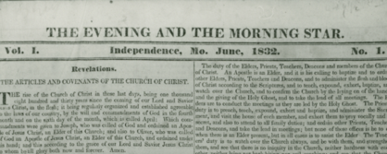
Background
During the summer of 1832 Joseph Smith was excited about receiving the publication of the Evening and Morning Star
“As soon as I could arrange my affairs, I recommenced the translation of the Scriptures, and thus I spent most of the summer. In July, we received the first number of The Evening and Morning Star, which was a joyous treat to the Saints. Delightful, indeed, was it to contemplate that the little band of brethren had become so large, and grown so strong, in so short a time as to be able to issue a paper of their own, which contained not only some of the revelations, but other information also,—which would gratify and enlighten the humble inquirer after truth. …”
Joseph Smith
September 1832 in Kirtland, Ohio
The Elders return from their missions from the Eastern state to Ohio
During this reunion, Joseph Smith received the revelation of Section 84

Slide 3
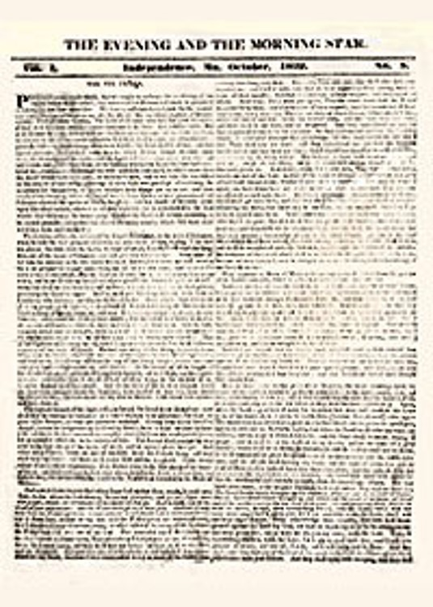
The Evening and the Morning Star
The Evening and the Morning Star was an early Latter-Day Saint newspaper published monthly in Independence, Missouri, from June 1832 to July 1833, and then in Kirtland, Ohio, from December 1833 to September 1834.
Reprints of edited versions of the original issues were also published in Kirtland under the title Evening and Morning Star.
It was initially published in the printing office of William Wines Phelps in Independence, Missouri.
The first issue was printed in June 1832 as volume 1 number 1. last issue published in Missouri.

Slide 4
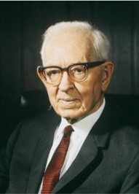
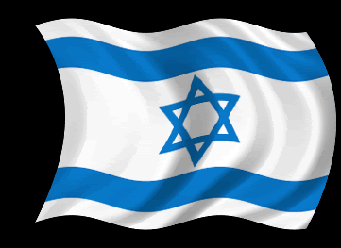
Jerusalem and New Jerusalem
“When Joseph Smith translated the Book of Mormon, he learned that America is the land of Zion which was given to Joseph and his children and that on this land the City Zion, or New Jerusalem, is to be built. He also learned that Jerusalem in Palestine is to be rebuilt and become a holy city. These two cities, one in the land of Zion and one in Palestine, are to become capitals for the kingdom of God during the millennium.
“In the meantime, while the work of preparation is going on and Israel is being gathered, many people are coming to the land of Zion saying: ‘Come ye, and let us go up to the mountain of the Lord, to the house of the God of Jacob.’ The Latter-day Saints are fulfilling this prediction, since they are being gathered from all parts of the earth and are coming to the house of the Lord in these valleys of the mountains. Here they are being taught in the ways of the Lord through the restoration of the gospel and by receiving blessings in the temples now erected. Moreover, before many years have passed away, the Lord will command the building of the City Zion, and Jerusalem in Palestine will in due time be cleansed and become a holy city and the habitation of the Jews after they are cleansed and are willing to accept Jesus Christ as their Redeemer.”
President Joseph Fielding Smith
D&C 84:2

Slide 5
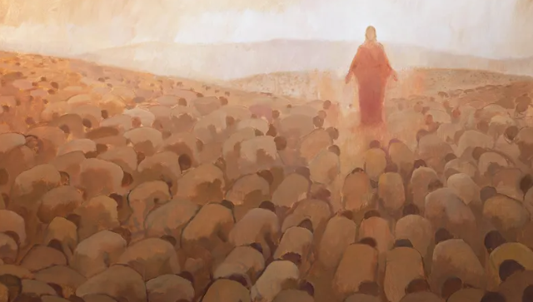
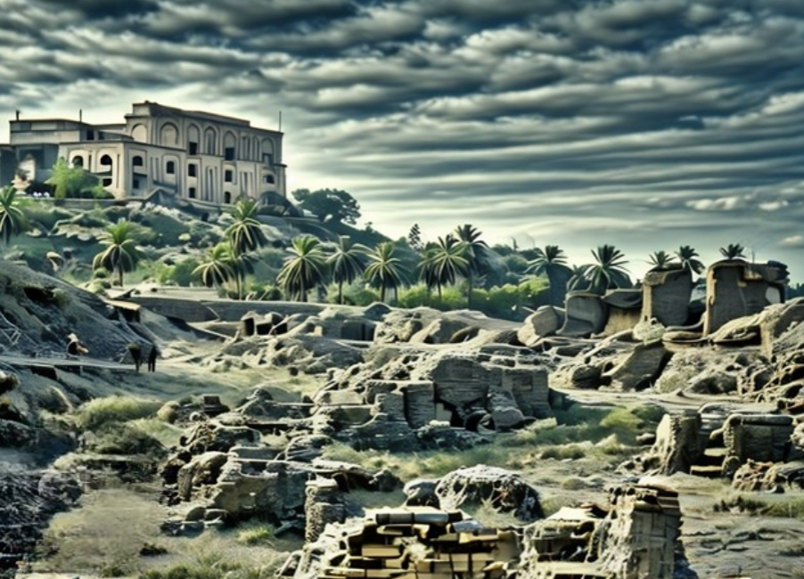
Gathering
Zion is the opposite of the world, or spiritual Babylon. In preparation for the Millennium, therefore, Babylon must be destroyed.
The cry to all people is, “Go ye out from among the nations, even from Babylon, from the midst of wickedness, which is spiritual Babylon. … and he that goeth, let him not look back lest sudden destruction shall come upon him.” When one flees Babylon, one gathers to Zion and her stakes.
Student Manual
“The gathering of Israel consists of receiving the truth, gaining again a true knowledge of the Redeemer, and coming back into the true fold of the Good Shepherd”
Elder Bruce R. McConkie
D&C 84:4
Ruins of Babylon

Slide 6
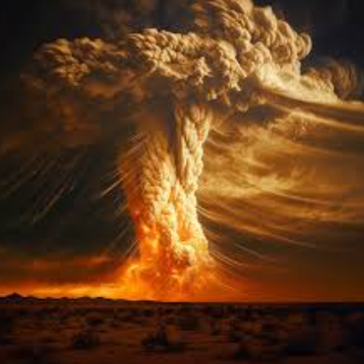
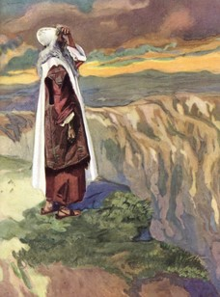
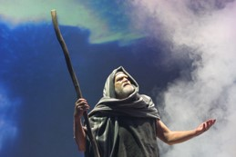
“A Cloud Shall Rest Upon It”
“The Lord manifested Himself in ancient Israel in a cloud, shaped as a pillar, which became luminous at night.
It guided the people on the journey to Canaan.
It stood at the entrance to the Sanctuary, and in it God spoke to Moses. It rested on the Sanctuary and filled it, when that sacred tent was set up.
It was the visible sign of God’s guiding and protecting care over His people.”
Smith and Sjodahl
D&C 84:5

Slide 7
A Priesthood Line of Authority
Priesthood line of authority shows how priesthood authority has been conferred from one priesthood holder to another, from Jesus Christ to a priesthood holder today.
D&C 84:

Slide 8
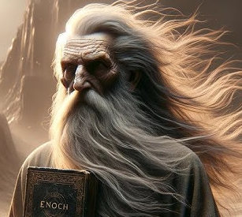

Slide 9
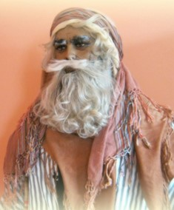
Who Was Jethro?
“The descent of this authority, or divine power, from Adam to Moses is here given in the Lord’s own words to Joseph Smith. Moses received it from Jethro, a priest of the house of Midian.
The Midianites were descendants of Abraham, through the children of Keturah, wife of Abraham, therefore the Midianites, who were neighbors to the Israelites in Palestine, were related to the Israelites, and were Hebrews.
As descendants of Abraham they were entitled through their faithfulness to his blessings (see Abraham 2:9–11), and in the days of Moses and preceding them, in Midian the Priesthood was found.” Joseph Smith

Slide 10
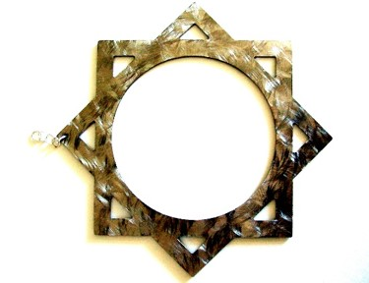
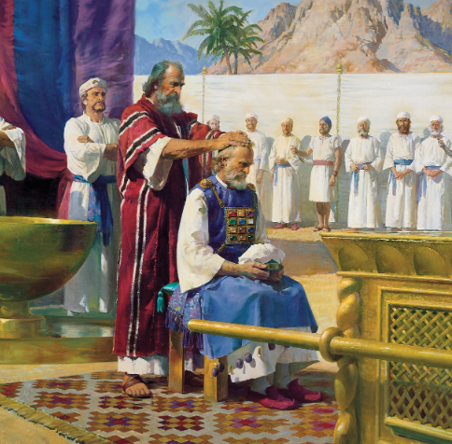
Higher Order to Lower Order
“When Israel, as a people and as a whole, failed to live in harmony with the law of Christ as contained in the fulness of his everlasting gospel… while in the wilderness…He took Moses out of their midst, and the Holy Priesthood also. That is, he took the Melchizedek Priesthood.
The keys of the priesthood were taken away with Moses so that any future priesthood ordinations required special divine authorization.
But in place of the higher priesthood the Lord gave a lesser order, and in place of the fulness of the gospel he gave a preparatory gospel—the law of carnal commandments, the law of Moses.
There is the fulness of the gospel, and there is the preparatory gospel. There is the full law of Christ, and there is a partial law of Christ.
The Mosaic system was the partial law, a portion of the mind and will of Jehovah, a strict and severe testing arrangement that would qualify those who obeyed its terms and conditions to receive the eternal fulness when the Messiah came to deliver and to restore it.”
Elder Bruce R. McConkie
D&C 84:19-28

Slide 11
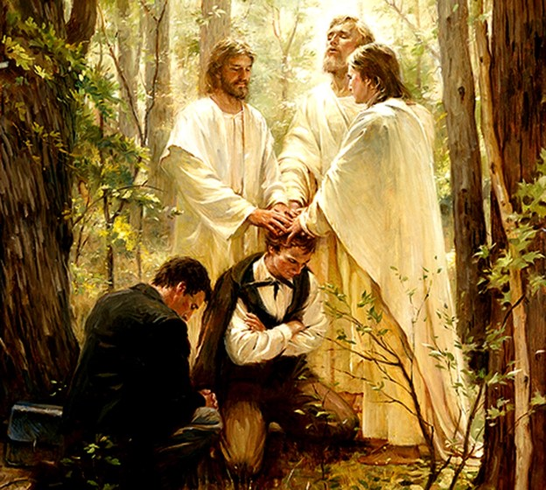
Conferring of the Melchizedek Priesthood
Soon thereafter, Peter, James, and John appeared on the banks of this river and conferred on Joseph and Oliver the Melchizedek Priesthood.
“The greater priesthood administereth the gospel” refers to the authority of the Melchizedek Priesthood to administer the ordinances necessary for our salvation and exaltation.
D&C 84:19

Slide 12
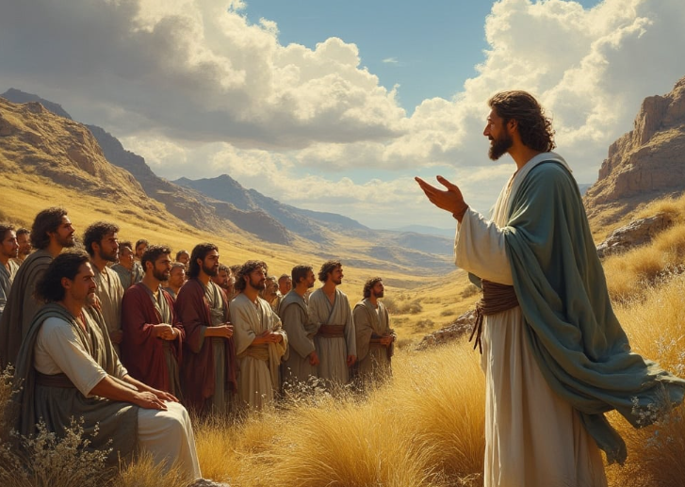
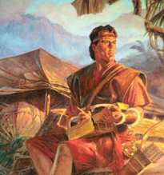
Mysteries of the Kingdom
“spiritual truths known only by revelation”
God reveals His mysteries to those who are obedient to the gospel. Some of God’s mysteries are yet to be revealed.
1 Nephi 1:1 records:
…having had a great knowledge of the goodness and the mysteries of God, therefore I make a record of my proceedings in my days.
Jesus answers questions to Apostles about parables:
Because it is given unto you to know the mysteries of the kingdom of heaven, but to them it is not given.
Matthew 13:11
D&C 84:19

Slide 13
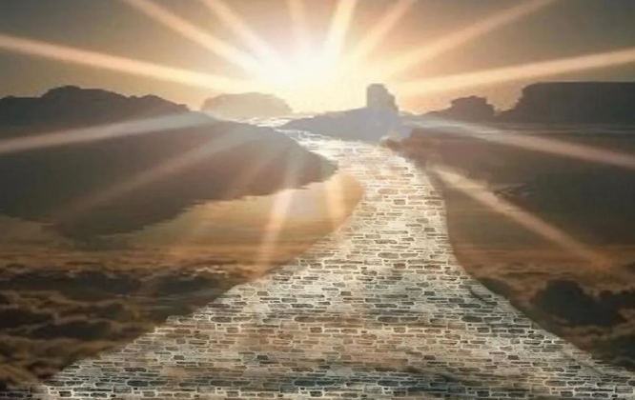
Power of Godliness
The power that comes from God to help us in this life and prepare us for eternal life.
Through the ordinances of the priesthood, we can receive the power of godliness in our lives
When have you felt God’s power through the priesthood ordinances you have received?
D&C 84:19

Slide 14
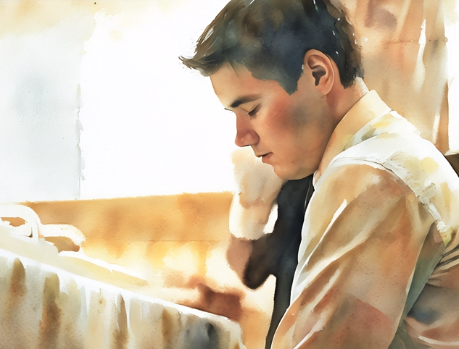
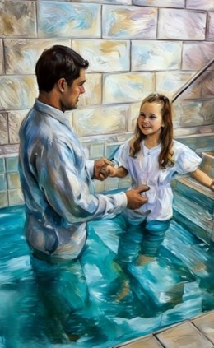
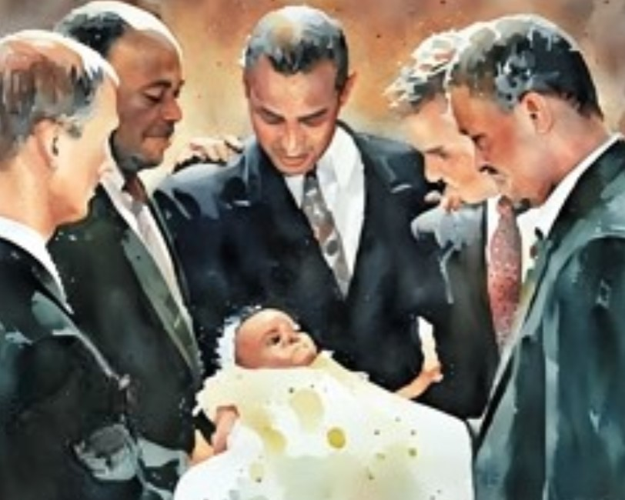
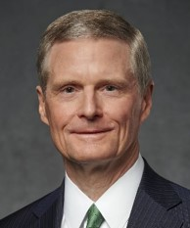
Read Moroni 10:30-33 and Alma 34:10-14
Priesthood ordinances are the pathway to the power of godliness. … Priesthood ordinances are essential to fully “come unto Christ, and be perfected in him”
Without the ordinances, an individual cannot receive all of the blessings made possible through the Lord’s infinite and eternal atoning sacrifice
--even the power of godliness.
David A. Bednar
D&C 84:20-21

Slide 15
Doctrinal Mastery
Therefore, in the ordinances thereof, the power of godliness is manifest.
And without the ordinances thereof, and the authority of the priesthood, the power of godliness is not manifest unto men in the flesh;
For without this no man can see the face of God, even the Father, and live.
D&C 84:20-22

Slide 16
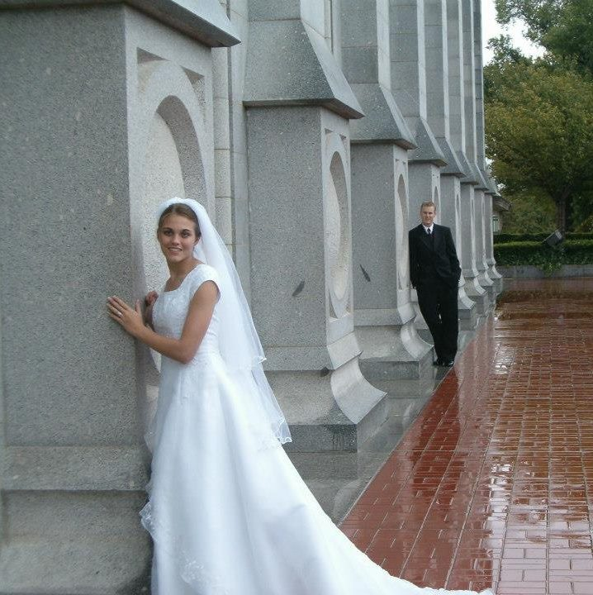
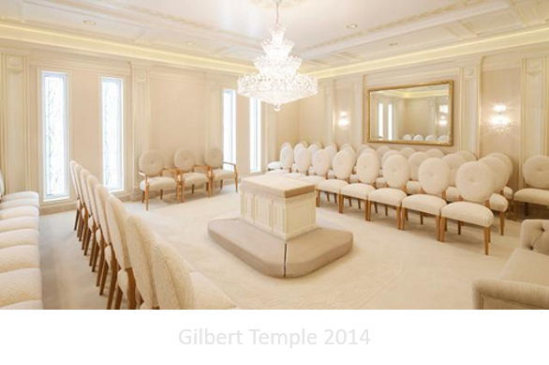
Melchizedek Priesthood
Which of the saving ordinances must be performed by the authority of the Melchizedek Priesthood?
Confirmation, conferral of the Melchizedek Priesthood, the temple endowment, and the temple sealing.
Why is it important that we receive the ordinances of the Melchizedek Priesthood?
The “power of godliness” manifest in these ordinances will allow us to see the face of God and live
D&C 84:22

Slide 17
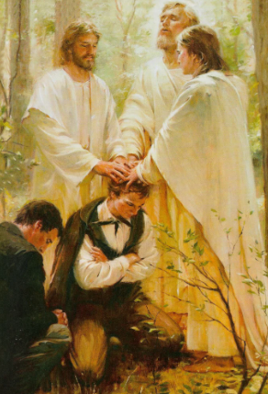
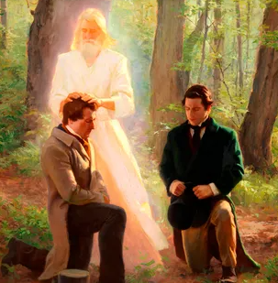
Jesus
Melchizedek
Peter
James
John the Baptist
John
Aaronic
Peter, James, and John are ordained by the Savior
Mark 3:14
Matthew 16:19
Joseph Smith

Slide 18
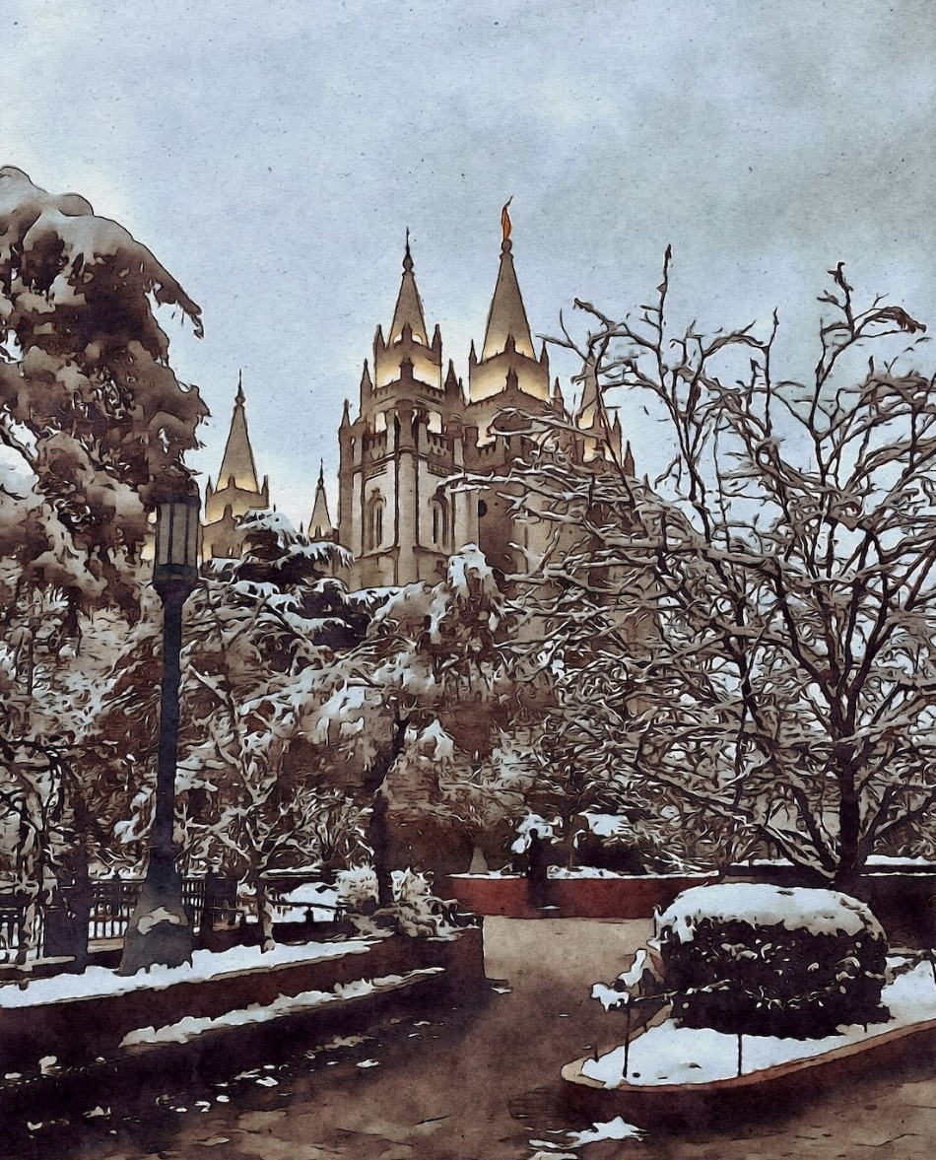
Temple—Melchizedek Ordinances
“The temple is the object of every activity, every lesson, every progressive step in the Church. … Ordinances of the temple are absolutely crucial. We cannot return to God’s glory without them”
Henry B. Erying
D&C 84:22

Slide 19
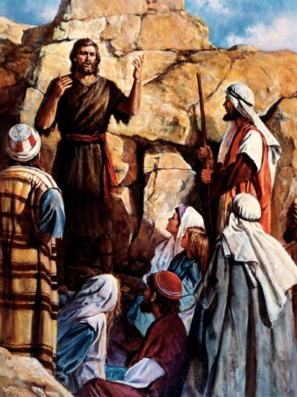
John The Baptist
John the Baptist was ordained by the angel of God when he was 8 days old to prepare for the coming of the Savior
Susquehanna River, Harmony Township, Pennsylvania
On 15 May 1829, John the Baptist appeared to Joseph Smith and Oliver Cowdery and conferred on them the Aaronic Priesthood.
They then went into this river and baptized each other for the remission of sins. Joseph and Oliver were then directed by John the Baptist to ordain one another to the Aaronic Priesthood.
Joseph Smith History
D&C 84:28

Slide 20
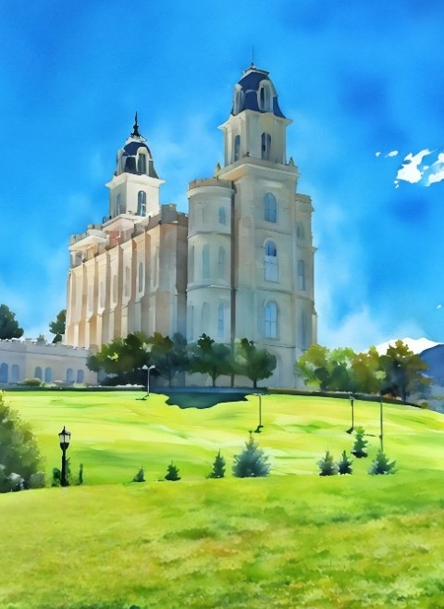
Baptismal and Temple Covenants
Each person who makes covenants in baptismal fonts and in temples—and keeps them—has increased access to the power of Jesus Christ.
Please ponder that stunning truth!
The reward for keeping covenants with God is heavenly power—power that strengthens us to withstand our trials, temptations, and heartaches better.
This power eases our way. Those who live the higher laws of Jesus Christ have access to His higher power.
Russell M. Nelson
Meridian, Idaho
Manti Temple
D&C 84:31-32

Slide 21
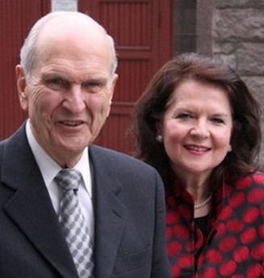
Sisters and the Priesthood
“One day Sister Nelson and I will dwell together in the presence of our family and the Lord forevermore. We will have been faithful to covenants made in the temple and to the oath and covenant of the priesthood, which have assured us, in the words of the Lord, that ‘all that my Father hath shall be given unto [you]’
“Faithful sisters share the blessings of the priesthood. Think of those words ‘all that my Father hath.’ … It means that no earthly reward—no other success—could compensate for the bounties the Lord will bestow upon those who love Him, keep His commandments and endure to the end.”
Elder Russell M. Nelson
D&C 84:38

Slide 22
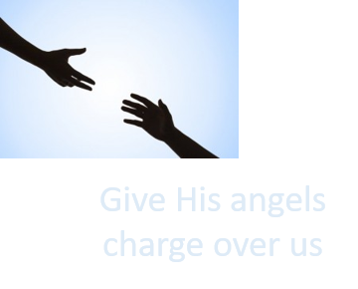
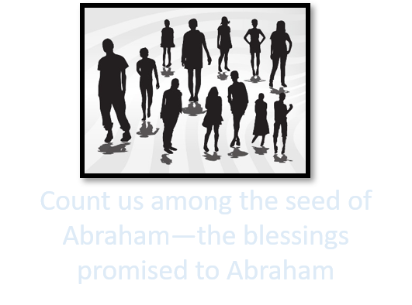
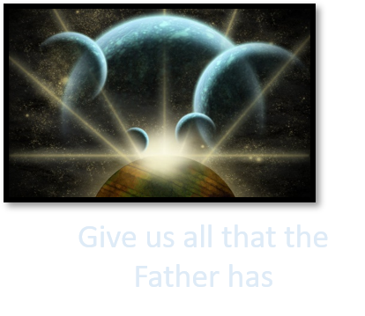
Promises of the Lord
Sanctify us by the Spirit
We can receive His truth, His love, His joy, and His peace. We can be blessed by a fulness of His power
D&C 84:31-32

Slide 23
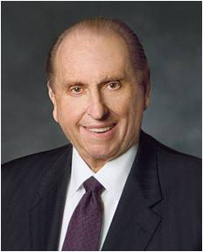
Oath and Covenants
“We magnify our priesthood and enlarge our calling when we serve with diligence and enthusiasm in those responsibilities to which we are called by proper authority. … We magnify our calling, we enlarge the potential of our priesthood when we reach out to those in distress and give strength to those who falter. … We magnify our calling when we walk with honesty and integrity”
President Gordon B. Hinckley
Those who are faithful and magnify their callings
“How does one magnify a calling? Simply by performing the service that pertains to it. … I hope with all my heart and soul that every young man who receives the priesthood will honor that priesthood and be true to the trust which is conveyed when it is conferred”
President Thomas S. Monson
D&C 84:31-32

Slide 24
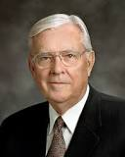
Magnify Your Callings
As we work to magnify our callings, we should seek the inspiration of the Spirit to solve problems in ways that will best help the people we serve.
We have handbooks of instruction, and their guidelines should be followed.
But within that framework are substantial opportunities to think, to be creative, and to make use of individual talents.
The instruction to magnify our callings is not a command to embellish and complicate them. To innovate does not necessarily mean to expand; very often it means to simplify. M. Russell Ballard
If we magnify our callings and responsibilities in the Church, God will sanctify us by His Spirit and renew our bodies.
If we faithfully obtain the Aaronic and Melchizedek Priesthoods and receive God’s chosen servants, Heavenly Father will bless us with all He has.
D&C 84:33

Slide 25
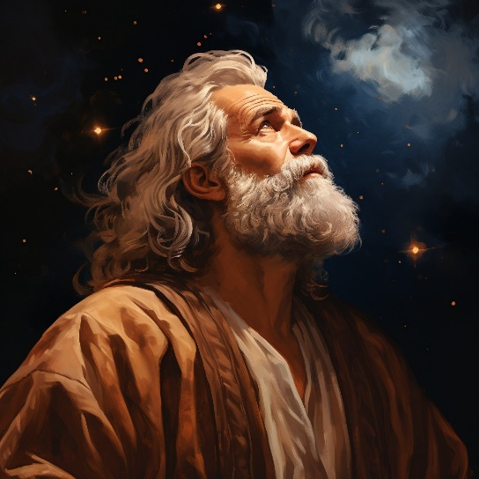
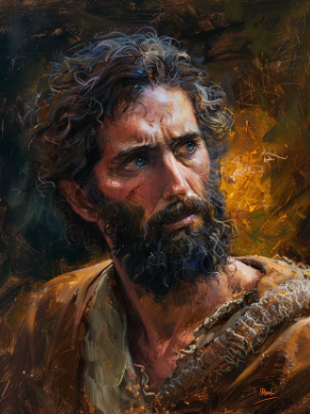
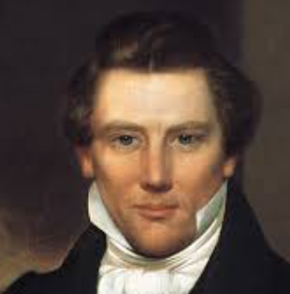
All That Heavenly Father Has
Abraham, Isaac, and Jacob, had the promise of eternal life confirmed to them by an oath of the Lord, but that promise or oath was no assurance to them of their salvation; but they could by walking in the footsteps and continuing in the faith of their fathers, obtain, for themselves an oath for confirmation that they were meet to be partakers of the inheritance, with the Saints in light. . . .
Must I not rather obtain for myself by my own faith and diligence in keeping the commandments of the Lord, an assurance of salvation for myself?
And have I not an equal privilege with the ancient Saints?
And will not the Lord hear my prayers and listen to my cries as soon as he ever did to theirs, if I come to him in the manner they did?
Or, is he a respecter of persons?
D&C 84:38 Joseph Smith writes a letter to his uncle Silas Smith in September 1833

Slide 26
Sources:
Videos:
The Power of Godliness in Ordinances (3:19)
Sanctify Yourselves (4:37)
“The Oath and Covenant of the Priesthood Is Relevant to Women”
(from time code 01:48 to 03:31).
Joseph Smith (History of the Church, 1:273, 286–87.)
President Joseph Fielding Smith (Doctrines of Salvation,3:71.)
Presentation by ©http://fashionsbylynda.com/blog/
Doctrine and Covenants Student Manual Religion 324-325 Section 84
Elder Bruce R. McConkie (in Conference Report, Lima Peru Area Conference 1977, p. 33; or Ensign, May 1977, p. 117).
(Mortal Messiah, pp. 59–60.)
Hyrum M. Smith and Janne M. Sjodahl Doctrine and Covenants Commentary p. 497
Joseph Smith, Church History and Modern Revelation, 1:338.)
Joseph Smith History 1:66-74, D&C 13).
Henry B. Erying (“Prepare for the Blessings of the Temple,” Ensign, Oct. 2010, 41).
David A. Bednar, “Missionary, Family History, and Temple Work,” Ensign or Liahona, Oct. 2014, 16
President Gordon B. Hinckley(“Magnify Your Calling,” Ensign, May 1989, 48–49).
President Thomas S. Monson (“Priesthood Power,” Ensign, Nov. 1999, 49, 51).
Elder Russell M. Nelson: (“Identity, Priority, and Blessings,” Ensign, Aug. 2001, 10); “Overcome the World and Find Rest,” Liahona, Nov. 2022, 96)
M. Russell Ballard, “O Be Wise,” Ensign or Liahona, Nov. 2006, 19
Presentation by ©http://fashionsbylynda.com/blog/

Slide 27
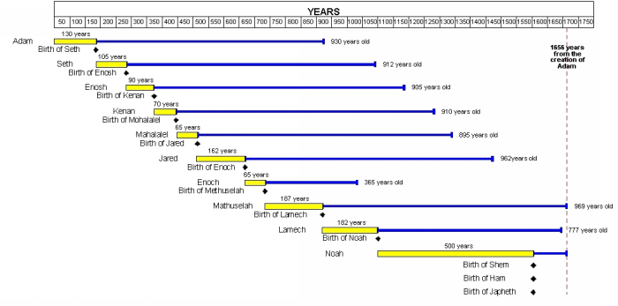

Slide 28
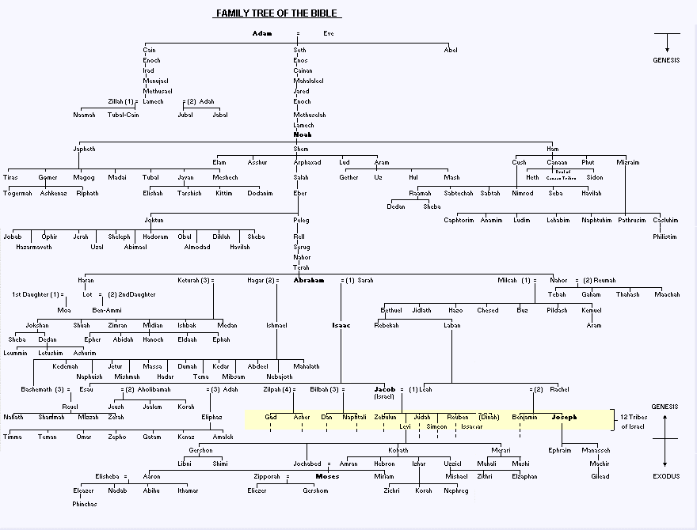

Slide 29
What Authority Did John the Baptist Receive from the Angel?
Elder Bruce R. McConkie explained:
“What concerns us above all else as to the coming of John, however, is that he came with power and authority. He first received his errand from the Lord. His was no ordinary message, and he was no unauthorized witness. He was called of God and sent by him, and he represented Deity in the words that he spoke and the baptisms he performed. He was a legal administrator whose words and acts were binding on earth and in heaven, and his hearers were bound, at the peril of their salvation, to believe his words and heed his counsels.
“Luke says: ‘The word of God came unto John the son of Zacharias in the wilderness.’ Later John is to say: ‘He that sent me to baptize with water, the same said unto me,’ such and such things. (John 1:33.) Who sent him we do not know. We do know that ‘he was baptized while he was yet in his childhood [meaning, when he was eight years of age], and was ordained by the angel of God at the time he was eight days old unto this power [note it well, not to the Aaronic Priesthood, but] to overthrow the kingdom of the Jews, and to make straight the way of the Lord before the face of his people, to prepare them for the coming of the Lord, in whose hand is given all power.’ (D&C 84:24.) We do not know when he received the Aaronic Priesthood, but obviously it came to him after his baptism, at whatever age was proper, and before he was sent by one whom he does not name to preach and baptize with water.” (Mortal Messiah, pp. 384–85.)
The Oath and Covenants:
President Joseph Fielding Smith taught:
“As all of us know, a covenant is a contract and an agreement between at least two parties. In the case of gospel covenants, the parties are the Lord in heaven and men on earth. Men agree to keep the commandments and the Lord promises to reward them accordingly. The gospel itself is the new and everlasting covenant and embraces all of the agreements, promises, and rewards which the Lord offers to his people.
“And so when we receive the Melchizedek Priesthood we do so by covenant. We solemnly promise to receive the priesthood, to magnify our callings in it, and to live by every word that proceedeth forth from the mouth of God. The Lord on his part promises us that if we keep the covenant, we shall receive all that the Father hath, which is life eternal. Can any of us conceive of a greater or more glorious agreement than this? …
“To swear with an oath is the most solemn and binding form of speech known to the human tongue; and it was this type of language which the Father chose to have used in the great Messianic prophecy about Christ and the priesthood. Of him it says: ‘The Lord hath sworn, and will not repent, Thou art a priest for ever after the order of Melchizedek.’ (Ps. 110:4.)
“In explaining this Messianic prophecy, Paul says that Jesus had ‘an unchangeable priesthood,’ and that through it came ‘the power of an endless life.’ (See Heb. 7:24, 16.) Joseph Smith said that ‘all those who are ordained unto this priesthood are made like unto the Son of God, abiding a priest continually,’ that is, if they are faithful and true.
“And so Christ is the great prototype where priesthood is concerned, as he is with reference to baptism and all other things. And so, even as the Father swears with an oath that his Son shall inherit all things through the priesthood, so he swears with an oath that all of us who magnify our callings in that same priesthood shall receive all that the Father hath.” (In Conference Report, Oct. 1970, pp. 91–92.)
“We learn through the Joseph Smith Translation that the Lord … instructed Moses: ‘I will take away the priesthood out of their midst; therefore my holy order, and the ordinances thereof.’ (JST Ex. 34:1; italics added.) “This higher priesthood, with its attendant ordinances, was taken from Israel till the time of Jesus Christ. …
“Between Moses and Christ only certain prophets possessed the right to the higher priesthood and the blessings that could bring men into the presence of God” (“What I Hope You Will Teach Your Children about the Temple,” Ensign, Aug. 1985, 9).
Ezra Taft Benson

Slide 30
Who has access to priesthood power?
President Camille N. Johnson, Relief Society General President, taught:
Women, men and children access and draw upon priesthood power, the Savior’s power, to help the people they love (see Dallin H. Oaks, “The Melchizedek Priesthood and the Keys,” Ensign or Liahona, May 2020, 69–72). The blessings of priesthood power available to all Church members who keep their covenants—women, men and children—include:
Guidance for their lives.
Inspiration to know how to serve family members and others.
Strength to endure and overcome challenges.
Gifts of the Spirit to magnify their abilities.
Revelation to know how to fulfill the work they are ordained, set apart or assigned to do.
Help and strength to become more like Jesus Christ and Heavenly Father (General Handbook, 3.5).
The Savior is the source of all these blessings. Guidance, inspiration, gifts of the Spirit and revelation all come through the Holy Ghost, sent by the Father in the name of the Savior. …
In my experience, priesthood power, particularly that with which I have been endowed in the house of the Lord, amplifies the companionship of the Holy Ghost and my understanding of the Atonement of Jesus Christ. (Camille N. Johnson, “President Camille N. Johnson: What Must Women and Men Do to Have Access to Priesthood Power?,” Church News, Oct. 30, 2022, thechurchnews.com)
The temple lies at the center of strengthening our faith and spiritual fortitude because the Savior and His doctrine are the very heart of the temple. Everything taught in the temple, through instruction and through the Spirit, increases our understanding of Jesus Christ. His essential ordinances bind us to Him through sacred priesthood covenants. Then, as we keep our covenants, He endows us with His healing, strengthening power [see Doctrine and Covenants 109:15, 22]. And oh, how we will need His power in the days ahead. (Russell M. Nelson, “The Temple and Your Spiritual Foundation,” Liahona, Nov. 2021, 93–94)
All That Heavenly Father Has D&C 84:38
To know that we have a Father in Heaven and that Jesus Christ is His Only Begotten Son means we are looking farther down the covenant path than just where we are standing today. It means we appreciate we are heirs to all that the Father has; kingdoms without number are His realm and can be ours. The Savior has promised, “If thou art faithful unto the end thou shalt have a crown of immortality, and eternal life in the mansions which I have prepared in the house of my Father.” (Ronald A. Rasband, “The Divine Destiny of His Daughters” [BYU Women’s Conference, Apr. 30, 2021], broadcasts.ChurchofJesusChrist.org)
Magnify Your Calling D&C 84:33
The Prophet Joseph Smith was once asked, “Brother Joseph, you frequently urge that we magnify our callings. What does this mean?” He is said to have replied, “To magnify a calling is to hold it up in dignity and importance, that the light of heaven may shine through one’s performance to the gaze of other men.” (Thomas S. Monson, “Our Sacred Priesthood Trust,” Ensign or Liahona, May 2006, 56)
Every woman and every man who makes covenants with God and keeps those covenants, and who participates worthily in priesthood ordinances, has direct access to the power of God. Those who are endowed in the house of the Lord receive a gift of God’s priesthood power by virtue of their covenant, along with a gift of knowledge to know how to draw upon that power. (Russell M. Nelson, “Spiritual Treasures,” Ensign or Liahona, Nov. 2019, 77)

