Slide 1

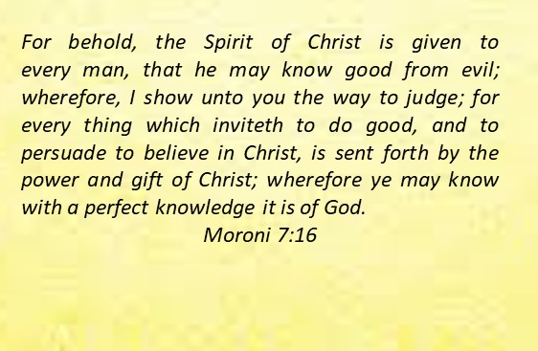
Doctrine and Covenants 84:43-61
The Spirit of Christ
Presentation by ©http://fashionsbylynda.com/blog/

Slide 2

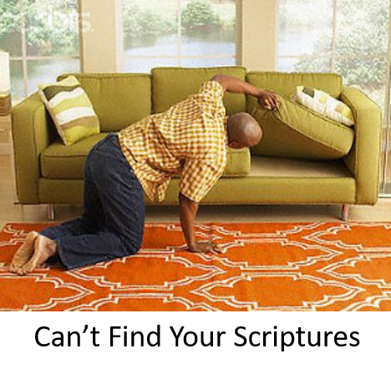




Challenges of Scripture Study
D&C 84:43-44

Slide 3
The Word of the Lord
Truth
Sanctify them through thy truth: thy word is truth. John 17:17
Light
That which is of God is light; and he that receiveth light, and continueth in God, receiveth more light; and that light groweth brighter and brighter until the perfect day. D&C 50:24
Spirit
But God hath revealed them unto us by his Spirit: for the Spirit searcheth all things, yea, the deep things of God. 1 Corinthians 2:10
Spirit of Jesus Christ
In the name of our Lord Jesus Christ, when ye are gathered together, and my spirit, with the power of our Lord Jesus Christ 1 Corinthians 5:4
Voice of the Spirit
And everyone that hearkeneth to the voice of the Spirit cometh unto God, even the Father
D&C 84:47
D&C 84:45-46

Slide 4
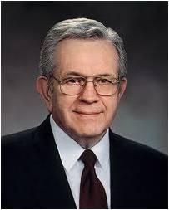
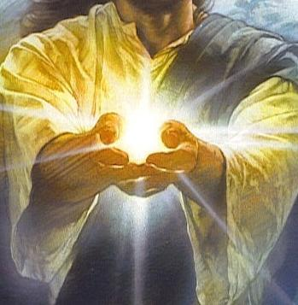

The Light of Christ
The Light of Christ is “an influence for good in the lives of all people. … [However,] the Light of Christ should not be confused with the Holy Ghost.
It is not a personage, as the Holy Ghost is” TF
The Light of Christ is within each person and provides a “knowledge of right and wrong, [or] moral sense, or conscience.” It “can direct us to moderate our actions—unless, that is, we subdue it or silence it.”
Boyd K. Packer
D&C 84:45-46

Slide 5
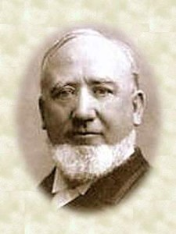


Our Conscience
“Satan has power in the earth, and in the exercise of his agency he tempts the children of men. … At the same time we have the sweet influence of the Spirit of God pleading with us to do that which is right, pleading with every human being that does not drive it from him; for every human being has a portion of the Spirit of God given unto him.
“We sometimes call it conscience; we call it by one name and we call it by another; but it is the Spirit of God that every man and woman possesses that is born on the earth. God has given unto all his children this Spirit. Of course, it is not the gift of the Holy Ghost in its fullness; for that is only received by obedience to the commandments of God.”
George Q. Cannon
D&C 84:45-46

Slide 6
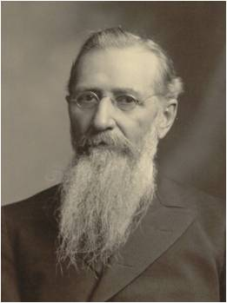
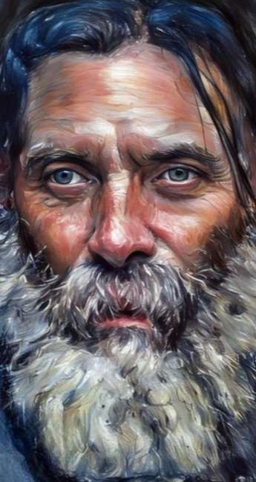
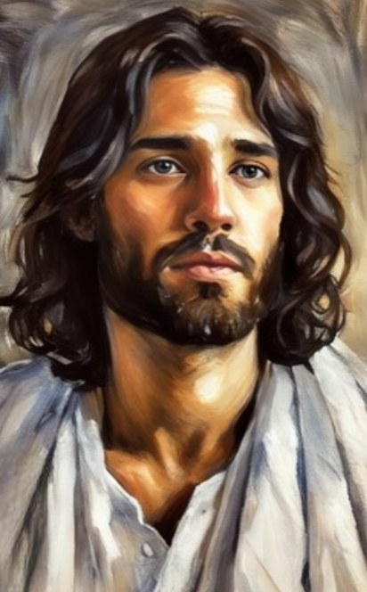
The Spirit of God
“We often say the Spirit of God when we mean the Holy Ghost; we, likewise, say the Holy Ghost when we mean the Spirit of God.
The Holy Ghost is a personage in the Godhead, and is not that which lighteth every man that comes into the world.
It is the Spirit of God which proceeds through Christ to the world, that enlightens every man that comes into the world, and that strives with the children of men, and will continue to strive with the, until it brings them in a knowledge of truth and the possession of the greater light and testimony of the Holy Ghost.”
Joseph F. Smith
Holy Ghost
D&C 84:46

Slide 7
“The Light of Christ is defined in the scriptures as ‘the Spirit [which] giveth light to every man that cometh into the world’; ‘the light which is in all things, which giveth life to all things, which is the law by which all things are governed’
And the Light of Christ is also described in the scriptures as ‘the Spirit of Jesus Christ’,
the Spirit of the Lord
the Spirit of truth
the light of truth
the Spirit of God
and ‘the Holy Spirit
Some of these terms are also used to refer to the Holy Ghost.
Boyd K. Packer
If we give diligent heed to the word of God, we will be enlightened through the Spirit of Christ
If we hearken to the Spirit of Jesus Christ, we will come unto the Father
D&C 84:45-47; 2 Corinthians; Mosiah 25:24; D&C 93:26: D&C 88:6; D&C 46:17: D&C 45:57

Slide 8

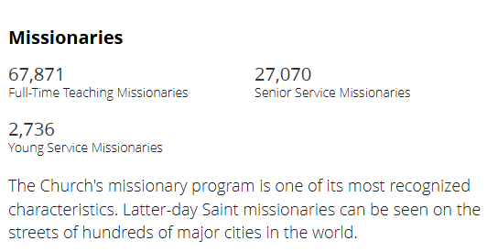
Around the World
Where are missionaries serving around the world?
Where are they not?
D&C 84:49

Slide 9

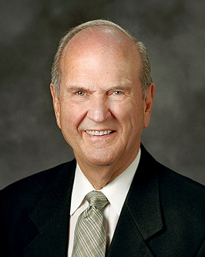
Everyone
And the peace of God, which passeth all understanding, shall keep your hearts and minds through Christ Jesus.
Philippians 4:7
Everyone deserves the chance to know about the restored gospel of Jesus Christ. Every person deserves to know where they can find the hope and peace that “[pass] all understanding”.
Russell M. Nelson
D&C 84:49

Slide 10

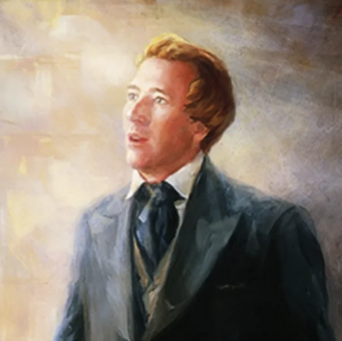

Background
September 1832 was a time of joy in Kirtland as missionaries returned from serving missions and reported on their experiences in the eastern states of America.
During this time, Joseph Smith received instructions from the Lord. Some of these instructions addressed the condition and needs of the world.
D&C 84:49-53

Slide 11

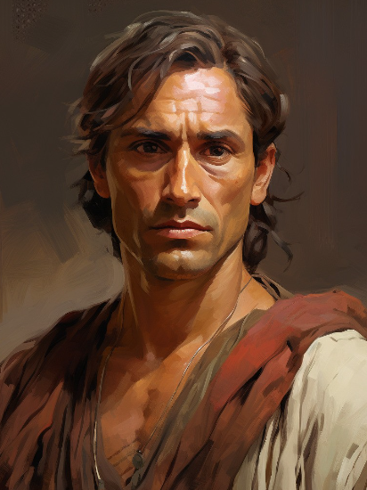
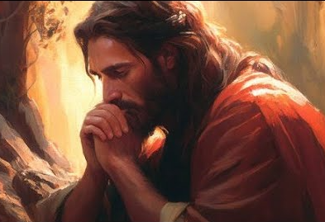
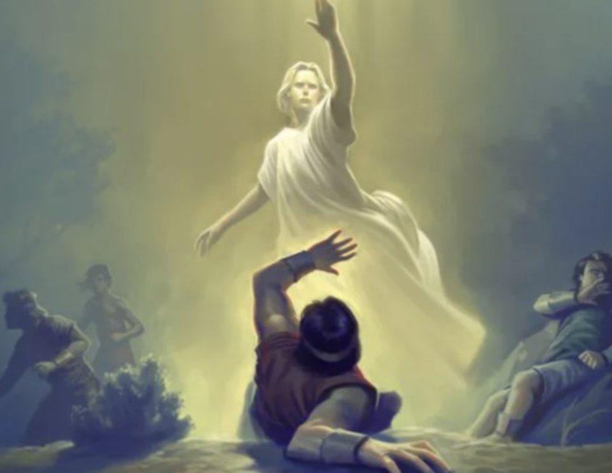
Feeling the Sin of Others
Moses 7:26, 28, 41
Alma 31:2
3 Nephi 17:14
Mosiah 28:3
D&C 84:49-54-57

Slide 12
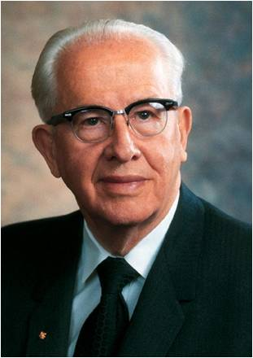
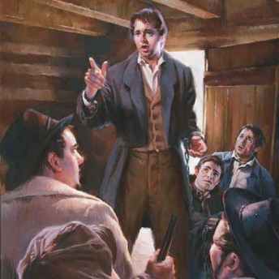
Being in the Dark
The Lord was rebuking the elders of “Treating things lightly”—taking your testimony for granted
They had received the Book of Mormon but were not sincere in their desires to embrace the gospel
“Some of the early missionaries, on returning home, were reproved by the Lord in section 84 of the Doctrine and Covenants because they had treated lightly the Book of Mormon. As a result, their minds had been darkened. The Lord said that this kind of treatment of the Book of Mormon brought the whole Church under condemnation, even all of the children of Zion. And then the Lord said, ‘And they shall remain under this condemnation until they repent and remember the new covenant, even the Book of Mormon.’
Are we still under that condemnation? …
President Ezra Taft Benson
D&C 84:54-57

Slide 13
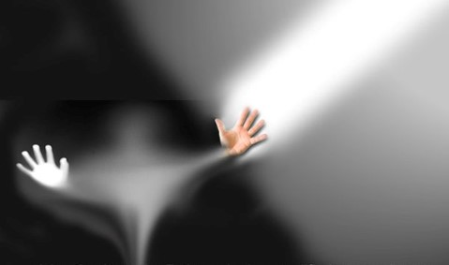

Getting Out of the Dark
“Every Latter-day Saint should make the study of this book a lifetime pursuit. Otherwise he is placing his soul in jeopardy and neglecting that which could give spiritual and intellectual unity to his whole life…
“Let us not remain under condemnation, with its scourge and judgment, by treating lightly this great and marvelous gift the Lord has given to us. Rather, let us win the promises associated with treasuring it up in our hearts”
President Ezra Taft Benson
D&C 84:54-59

Slide 14

If we treat the word of God lightly, our minds will be darkened and we will be brought under condemnation
We are to study the Book of Mormon faithfully and live according to its teachings
D&C 84:54-59

Slide 15
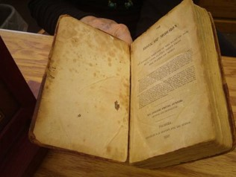
Principles of the Gospel
Study the principles of the gospel in the Book of Mormon
Teach the principles of the gospel to others
3. Live the principles of the gospel
Good Advice For All
“ The Lord informed these priesthood holders that they were to be obedient to the above counsel that they might bring forth fruit pleasing unto the Lord. They were promised forgiveness inasmuch as they were faithful.”
Otten and Caldwell
D&C 84:60-61

Slide 16
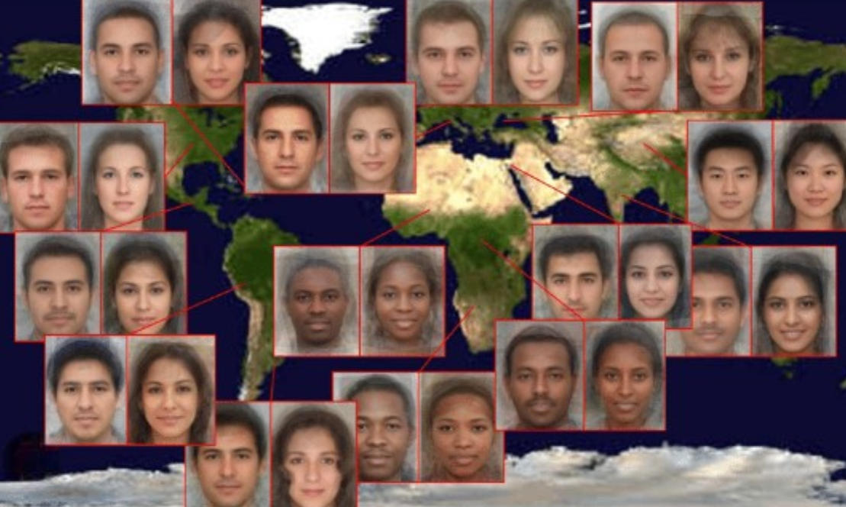
Next Time…Share
Jesus Christ wants us to share the Book of Mormon and our testimonies with all of God’s children around the world.
D&C 84:60-62

Slide 17
Sources:
Videos:
Patterns of Light: The Light of Christ (2:33)
A Lifetime Pursuit (0:48)
Book of Mormon: Messages from Heaven (2:33)
https://www.youtube.com/watch?v=INgHmUOsmrQ
(Bring the Book of Mormon to all the world)
Russell M. Nelson, “Preaching the Gospel of Peace,” Liahona, May 2022, 7
Doctrine Immunizes Us against Sin (0:52)
TF=True to the Faith [2004], 96
Boyd K. Packer, “The Light of Christ,” Ensign, Apr. 2005, 9
Presentation by ©http://fashionsbylynda.com/blog/
(George Q. Cannon, in Journal of Discourses, 26:191.)
Joseph F. Smith Gospel Doctrine pg. 82 (1st edition) pg. 67 (later edition)
President Ezra Taft Benson (“The Book of Mormon—Keystone of Our Religion,” Ensign, Nov. 1986, 7).
L. G. Otten and C. M. Caldwell Sacred Truths of the Doctrine and Covenants Vol. 2 pg. 76
Presentation by ©http://fashionsbylynda.com/blog/

