Slide 2
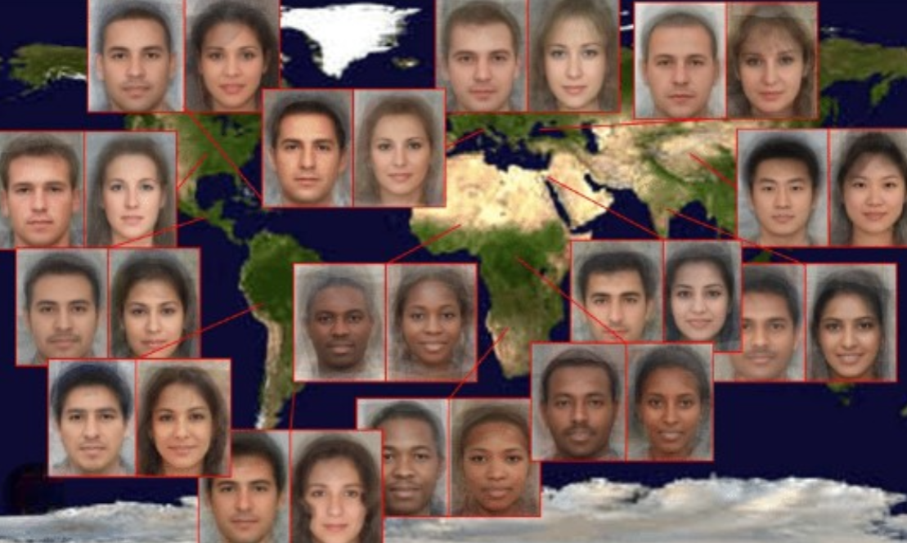
Previously…Share
Jesus Christ wants us to share the Book of Mormon and our testimonies with all of God’s children around the world.
D&C 84:60-62

Slide 3
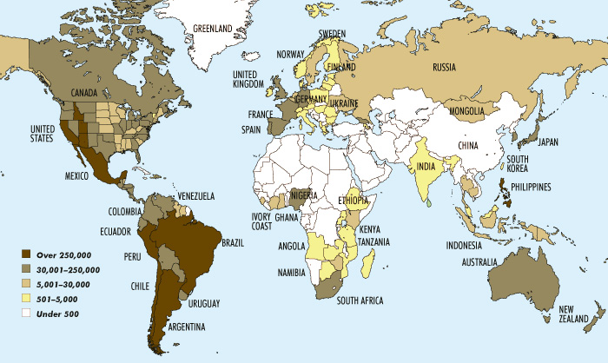
Where Have All the Missionaries Gone?
It would be impossible for the First Presidency, the Quorum of the Twelve Apostles, and the Seventy, all of whom have the charge to declare the gospel to all nations, to preach everywhere and teach everyone.
Everyone should have the opportunity to have the gospel preached to them
Church growth
2017

Slide 4
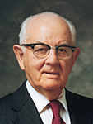
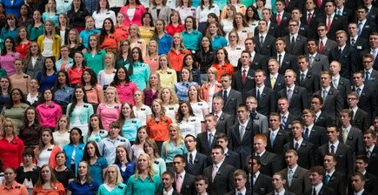
Every Member A Missionary
“The scriptures are abundantly clear in stating that all members of the Church are responsible to do missionary work. …
“The prophets of this dispensation also have clearly taught the concept that missionary service is the responsibility of all members.
President David O. McKay taught the principle with the challenging words, ‘Every member a missionary!’
Spencer W. Kimball
All Latter-day Saints have a responsibility to take the gospel to the whole world.

Slide 5
To Enter Into The Kingdom of God
Why is it important for people to accept the gospel, be baptized, and receive the Holy Ghost?
We must be baptized and receive the Holy Ghost to enter the kingdom of God.
D&C 84:64

Slide 6
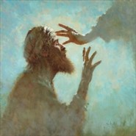
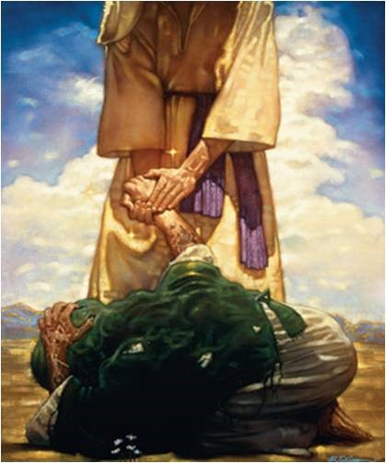
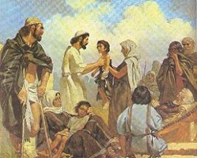
Signs Are Given To Those Who Believe
Do many wonderful works
Cast out devils (Newel Knight)
Heal the sick
Open the eyes of the blind and heal the deaf
The dumb shall speak
Poison shall not hurt them
The Lord gave His disciples these gifts as the Lord give us these same gifts
D&C 84:65-72

Slide 7
A Warning
But a commandment I give unto them, that they shall not boast themselves of these things, neither speak them before the world; for these things are given unto you for your profit and for salvation.
D&C 84:73

Slide 8
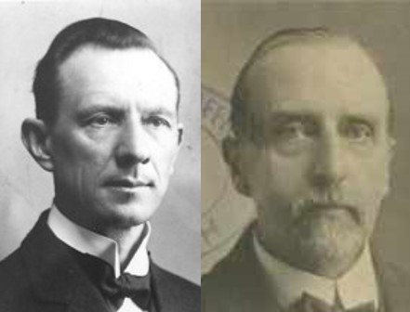
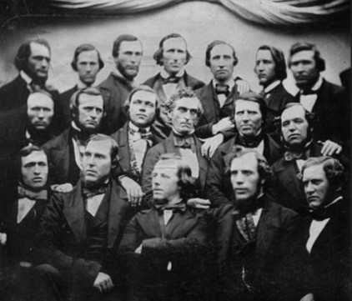
Missionary Baggage
The Lord did not want His servants to travel with much baggage…No purse nor scrip…or two coats
If they were faithful, the Lord would provide for them. As missionaries, they were not to take any thought “for tomorrow” concerning what to eat and drink, etc.
Nether were they to take any thought beforehand as to what to say. If they would but treasure up in their minds continually the words of life, they would, on each occasion, be given what to say.
Smith and Sjodahl
D&C 84:73-88

Slide 9
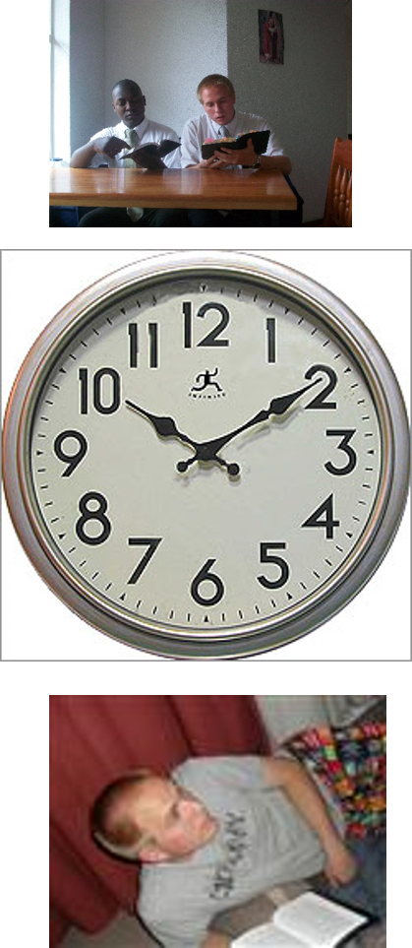
Missionary Commitments
A daily schedule for most missionaries includes the following:
6:30 a.m. | Arise
7:00 a.m. | Study time with companion
8:00 a.m. | Breakfast
8:30 a.m. | Personal study
9:30 a.m. | Proselyting
Noon | Lunch
1:00 p.m. | Proselyting
5:00 p.m. | Dinner
6:00 p.m. | Proselyting
9:30 p.m. | End proselyting; plan next day’s activities
10:30 p.m. | Retire
When missionaries begin their missions, they are given rules and schedules that help make their important work effective and productive.
Missionaries must commit to obey these in order to serve the Lord and have the Spirit to guide them.
D&C 84:73-88 Young Woman Manual

Slide 10
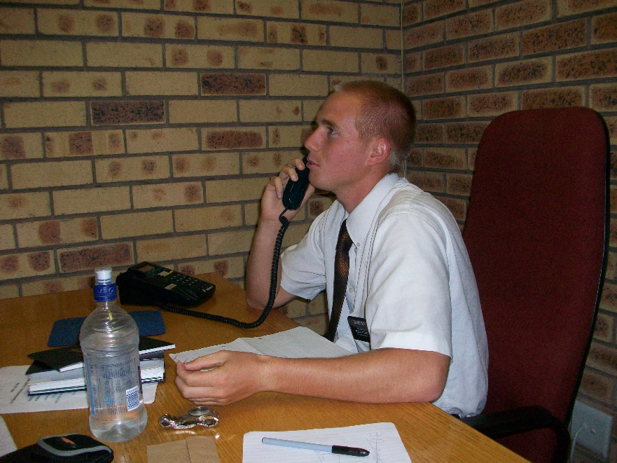
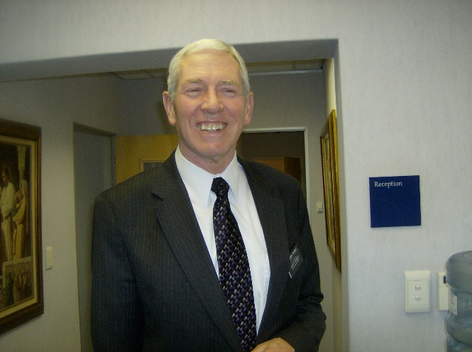
Missionary Rules
Depending upon the mission and culture of the people, a missionary is expected to follow these additional rules:
1. Missionaries are asked to write to their parents once a week.
2. Missionaries should not call their families or friends except when the mission president gives them permission.
3. Missionaries give their mission president a weekly report and letter.
D&C 84:73-88 Young Woman Manual

Slide 11
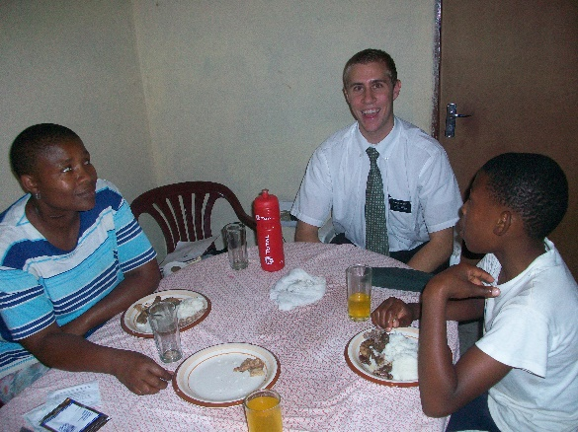
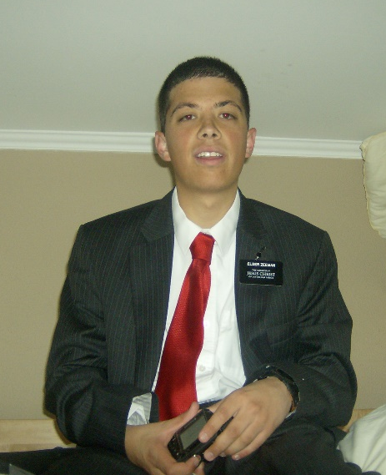
Missionary Rules
4. Missionaries should not get into debt. They should use their money wisely and for things relating to their mission.
5. Missionaries should not stay longer than an hour when they are invited to dinner, and they should use the time to motivate members in their missionary efforts.
6. Missionaries are never to be alone with anyone of the opposite sex or have inappropriate associations with those of the opposite sex. They should not teach single members of the opposite sex unless an adult chaperon is present.
D&C 84:73-88 Young Woman Manual

Slide 12
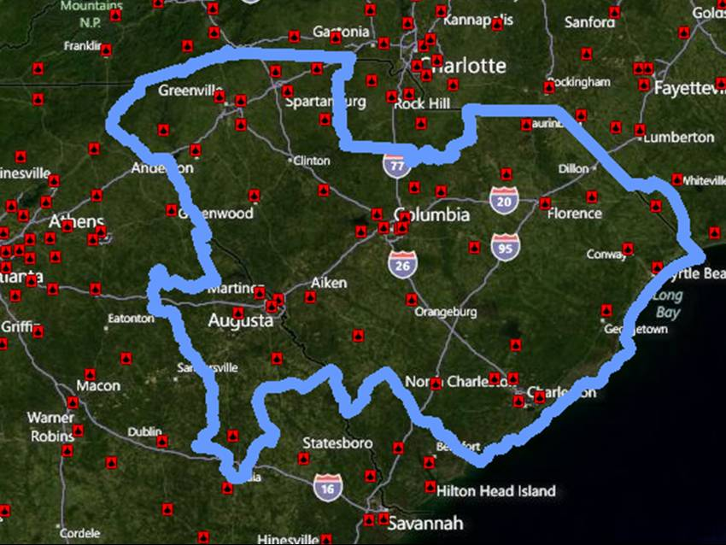
Missionary Rules
7. Missionaries should not write to people who live in the mission boundaries.
8. Missionaries are not to go outside their assigned areas without permission from the mission president.
9. Missionaries must behave with dignity and keep their conversations free of debate and argument. They should read only literature authorized by the mission president.
The Scriptures and Church study aids
The Preach My Gospel Manual
Official Church magazines (The Ensign, Liahona, etc.)
Other lesson manuals and official Church materials
The Church News
Jesus the Christ, by James E. Talmage
Our Heritage: A Brief History of the Church of Jesus Christ of Latter-day Saints
Our Search for Happiness, By M. Russell Ballard
True to the Faith
D&C 84:73-88 Young Woman Manual

Slide 13
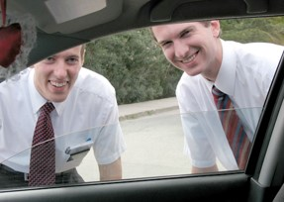
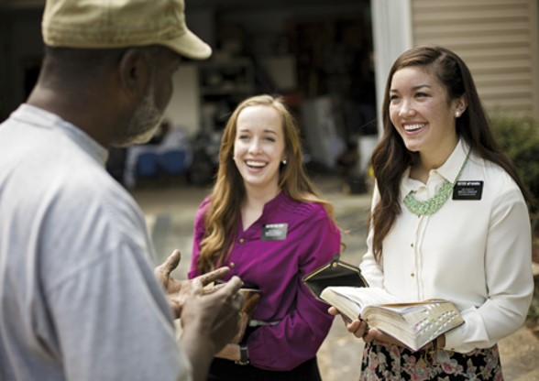
Reprove--Convict
“‘Reprove,’ as stated is to ‘convict.’
God’s messengers, as it were, are lawyers before the bar of God.
It is their duty to ‘convict’ the world of sin, and to warn all men of the ‘judgment which is to come.’
They are not sent out to entertain the world with philosophical lectures, or ethical discourses, or flowery oratory, or amusing anecdotes.
Their one duty is to secure conviction and, if possible, repentance and salvation.”
D&C 84:87 Smith and Sjodahl

Slide 14
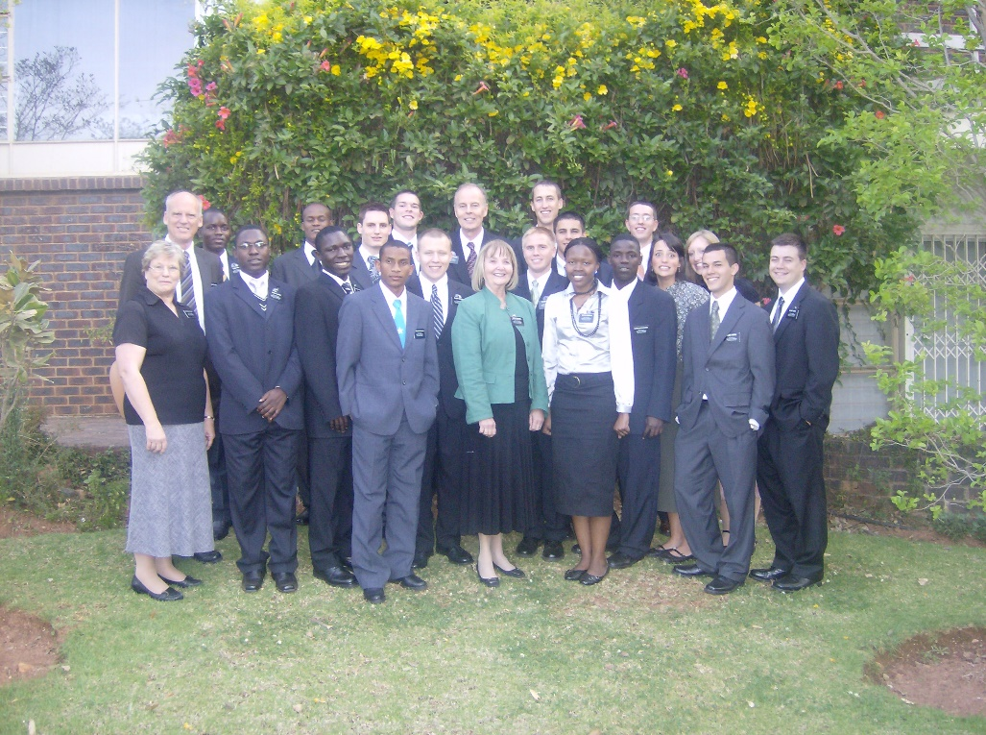
The Servant and the Receiver
“The Lord promises His servants that He will be their companion; that His spirit will be in their hearts; and His angel round about them.”
“Those who receive the servants of the Lord as teachers and guests, receive the Lord, whose embassadors and representatives they are, and their reward is sure. They will receive such reward as the Lord’s messenger have., and our Lord Himself will reward them hereafter.”
D&C 84:88-91 Smith and Sjodahl

Slide 15
Song of Joy and Praise
The song of the redemption of Zion will be sung after the Second Coming of Jesus Christ, when all people who remain on the earth will come to know Him.
The Lord hath brought again Zion; The Lord hath redeemed his people, Israel, According to the election of grace, Which was brought to pass by the faith And covenant of their fathers.
The Lord hath redeemed his people; And Satan is bound and time is no longer. The Lord hath gathered all things in one. The Lord hath brought down Zion from above. The Lord hath brought up Zion from beneath.
The earth hath travailed and brought forth her strength; And truth is established in her bowels; And the heavens have smiled upon her; And she is clothed with the glory of her God; For he stands in the midst of his people.
Glory, and honor, and power, and might, Be ascribed to our God; for he is full of mercy, Justice, grace and truth, and peace, Forever and ever, Amen.
D&C 84:98-102

Slide 16
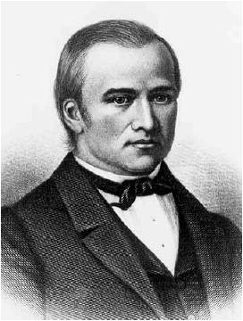
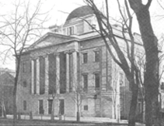
New York, Albany, and Boston
Bishop Newel K. Whitney was given a special mission to go to the cities mentioned and warn the inhabitants that the hour of judgment was near at hand, if they should reject the gospel message. The promise was added that he should go and return in safety, if he would trust in the Lord.
Shortly after this Revelation was given, the Prophet Joseph, accompanied by Bishop Whitney, took a hurried journey to Albany, New York, and Boston.
In the Millennial Star, Vol. X p. 286, there is an extract from an article from the Albany Express, in which a conflagration is described, by which building and property to the value of 2,000,000 was destroyed at Albany.
Several lives were lost and many business men were utterly ruined. (1880)
D&C 84:114

Slide 17
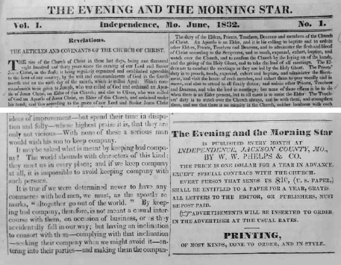
Rend the Kingdom
The Elders are charged with the duty of warning the world of judgments. But not unless directed to do so by the Holy Spirit.
The Evening and Morning Star
You are to walk in the valley of humility, and pray for the salvation of all; yea, you are to pray for your enemies and warn in compassion without threatening the wicked with judgments which are to be poured out upon the world hereafter. You have no right to take the judgments which fell upon the ungodly before the flood, and pour them upon the head of this generation; you have no authority to use the judgments which God sent upon Pharaoh in Egypt, to terrify the inhabitants of America, neither have you any direction by commandment, to collect the calamities of six thousand years and paint them upon the curtain of these last days to scare mankind to repentance; no, you are to preach the gospel, which is the power of God unto salvation , even glad tidings of great joy unto all people.” (History of the Church, Vol. L. p 280)
D&C 84:118-120

Slide 18
Sources:
Videos:
A Work of Love (0:56)
Angels Round about You (2:17)
A Mighty Change: Conversion(2:47)
Spencer W. Kimball (See Conference Report, April 1959, p. 12 2.)” (“It Becometh Every Man,” Ensign, Oct. 1977, 3).
Presentation by ©http://fashionsbylynda.com/blog/
Lesson 20: Understanding a Missionary’s Responsibilities
Young Women Manual 3, (1994), 72–74
Ezra Taft Benson Our Responsibility to Share the Gospel April 1985 Gen. Conf.
Hyrum M. Smith and Janne M. Sjodahl Doctrine and Covenants Commentary pg. 518-19
Presentation by ©http://fashionsbylynda.com/blog/

Slide 19
Evil Spirits Newel Knight
The case of Newel Knight whom the Prophet rescued from the power of an evil spirit, is known as the first miracle performed after the organization of the church, (History of the church Vol. 1 pp. 82-3
The opening of the British Mission was attended by combats with evil spirit. On July 30, 1837, at daybreak, Elder Isaac Russell, one of the first British missionaries, called Elder Heber C. Kimball out of bed and implored him to deliver him from the evil spirits that were tormenting him to such a degree that he felt that he must succumb. Elder Heber C. Kimball arose immediately, and so did Orson Hyde, who was sleeping in the same be. Both laid hands on him and prayed and rebuked the evil spirits. (Whitney’s Life of Heber C. Kimball pp. 144-5)
Poison:
Newel K. Whitney was suffering from a fractured leg in May 1832. The Prophet Joseph Smith frequently walked in the woods, and one day as he arose from his table he walked to the door and vomited blood profusely. Because of the violent nature of this his jaw was dislocated and knew that some poison had entered into his system. He walked over to Newel K. Whitney, and while Newel was on his bed laid his hands on the Prophet and Joseph was healed instantly. (History of the Church Vol. 1 pp. 271
Missionary Work:
In June 1830, Samuel Harrison Smith trudged down a country road in New York State on the first official missionary journey of the restored church. He had been set apart by his brother, the Prophet Joseph. This great missionary traveled 25 miles that first day without disposing of a single copy of the new and strange book which he carried on his back. Seeking lodging for the night, faint and hungry, he was turned away, after briefly explaining his mission, with the words: “You liar, get out of my house. You shan’t stay one minute with your books.” Continuing his journey, discouraged and with heavy heart, he slept that first night under an apple tree.
So began, in the most inauspicious way, the missionary work of this dispensation through the restored church, The Church of Jesus Christ of Latter-day Saints. Ezra Taft Benson Missionary Work: A Major Responsibility April 1974 Gen. Conf.
The Lord Supports His Servants
“Thousands of missionaries have put this promise to the test and the Lord has kept his promise to all those who have been faithful in their calling. Surely if the Father notices when a sparrow falls, he will not forsake any who in faithful obedience to his will seek his aid. That there have been those who have gone forth and have been weary in body and mind, and who have gone hungry, there is no doubt, for there are missionaries who have not given all their heart to the Lord and they have idled away valuable time when it was needful for them to proclaim the truth.” (Smith, Church History and Modern Revelation, 1:344.)
President Joseph Fielding Smith taught:
“Thousands of missionaries have put this promise to the test and the Lord has kept his promise to all those who have been faithful in their calling. Surely if the Father notices when a sparrow falls, he will not forsake any who in faithful obedience to his will seek his aid. That there have been those who have gone forth and have been weary in body and mind, and who have gone hungry, there is no doubt, for there are missionaries who have not given all their heart to the Lord and they have idled away valuable time when it was needful for them to proclaim the truth” (Church History and Modern Revelation, 2 vols. [1953], 1:344).
Without purse or scrip:
Elder Bruce R. McConkie of the Quorum of the Twelve Apostles explained what it means to preach the gospel without purse or scrip today:
“A special rule applies to those who are called to go into the world without purse or scrip and preach the gospel. For the time and season of their missionary service they are to have no concern about business enterprises or temporal pursuits. They are to be free of the encumbering obligations that always attend those who manage temporal affairs. Their whole attention and all of their strength and talents are to be centered on the work of the ministry, and they have the Father’s promise that he will look after their daily needs” (Doctrinal New Testament Commentary, Volume 1: The Gospels, 3 vols. [1966–73], 1:243).

Slide 20
New York, Albany, and Boston
These cities were the subject of another prophet’s testimony. Elder Wilford Woodruff addressed a conference in Logan, Utah, on 22 August 1863. Speaking directly to the youth in attendance, he declared: “‘Now, my young friends, I wish you to remember these scenes you are witnessing during the visit of President Young and his brethren. Yea, my young friends, treasure up the teachings and sayings of these prophets and apostles as precious treasure while they are living men, and do not wait until they are dead. A few days and President Young and his brethren, the prophets and apostles and Brothers Benson and Maughan, will be in the spirit world. You should never forget this visitation. You are to become men and women, fathers and mothers; yea, the day will come, after your fathers, and these prophets and apostles are dead, you will have the privilege of going into the towers of a glorious Temple built unto the name of the Most High (pointing in the direction of the bench), east of us upon the Logan bench; and while you stand in the towers of the Temple and your eyes survey this glorious valley filled with cities and villages, occupied by tens of thousands of Latter-day Saints, you will then call to mind this visitation of President Young and his company. You will say: That was in the days when Presidents Benson and Maughan presided over us; that was before New York was destroyed by an earthquake; it was before Boston was swept into the sea, by the sea heaving itself beyond its bounds; it was before Albany was destroyed by fire; yea, at that time you will remember the scenes of this day. Treasure them up and forget them not.’ President Young followed and said: ‘What Brother Woodruff has said is revelation and will be fulfilled.’” (In Lundwall, Temples of the Most High,pp. 97–98.)
Albany:
The city government eventually purchased the plot of land where the present city hall stands and had architect Philip Hooker build the new city hall in 1832.
In 1880, Hooker’s building was destroyed by a fire. Henry Richardson, one of the most prominent architects during that time, was commissioned to make a design. The current Albany City Hall features trademark designs of Richardson’s unique style called Romanesque. Generations of critics have cited Albany City Hall as one of Richardson’s finest works, despite the financial woes the building faced during construction. The building was eventually added to the National Register of Historic Places.
http://famouswonders.com/albany-city-hall/

