Slide 2
Background
Letter by Joseph Smith to William W. Phelps
November 27, 1832
‘My God, great and mighty art Thou, therefore show unto Thy servant what shall become of those who are essaying to come up unto Zion, in order to keep the commandments of God, and yet receive not their inheritance by consecrations, by order of deed from the Bishop, the man that God has appointed in a legal way, agreeably to the law given to organize and regulate the Church, and all the affairs of the same.’
I am well, and my family also; God grant that you may enjoy the same, and yours, and all the brethren and sisters who remember to inquire after the commandments of the Lord, and the welfare of Zion and such a being as myself; and while I dictate this letter, I fancy to myself that you are saying or thinking something similar to these words:—‘
“Brother William, in the love of God, having the most implicit confidence in you as a man of God, having obtained this confidence by a vision of heaven, therefore I will proceed to unfold to you some of the feelings of my heart, and to answer the question.”
“I say brother, because I feel so from the heart, and although it is not long since I wrote a letter unto you, yet I feel as though you would excuse me for writing this, as I have many things which I wish to communicate. Some things which I will mention in this letter, which are lying with great weight on my mind.
This letter is in Section 85 and the concerns that Joseph Smith had

Slide 3
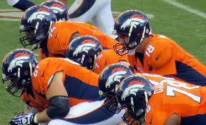
Team Player
You have just been awarded a starting position on a sports team.
After a few days of playing with this team you observe that one team member is a selfish player,
some team members won’t play their positions properly,
and others ignore the coach.
Why might it be difficult for this team to win?
What might need to change so this team can play better?

Slide 4
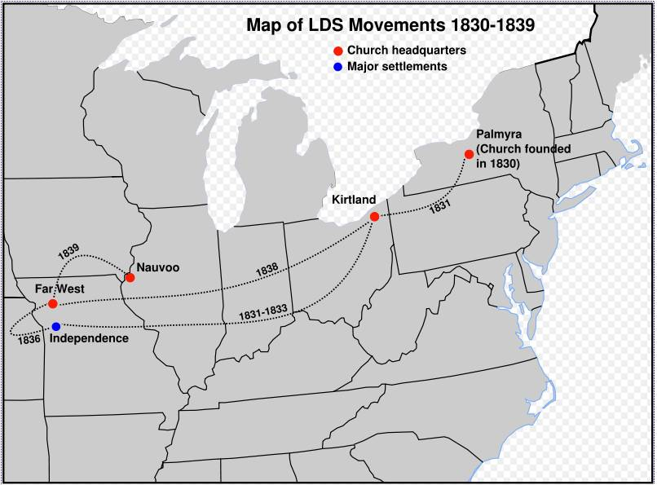
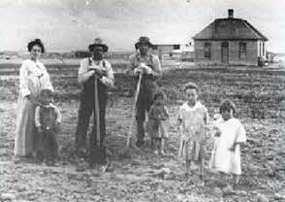
Situation Arises
A growing number of Saints arrived in Missouri.
Earlier revelations had stipulated that the city of Zion would be built in Jackson County, Missouri, according to the Lord’s laws and under the direction of the priesthood.
According to these laws, Church members were not to travel to Zion unless they received a certificate from the Church leaders.
1832
Once they arrived, they were to consecrate all their money and property to the Church and receive an inheritance from the bishop.
In addition, they were to keep all the commandments of God.

Slide 5
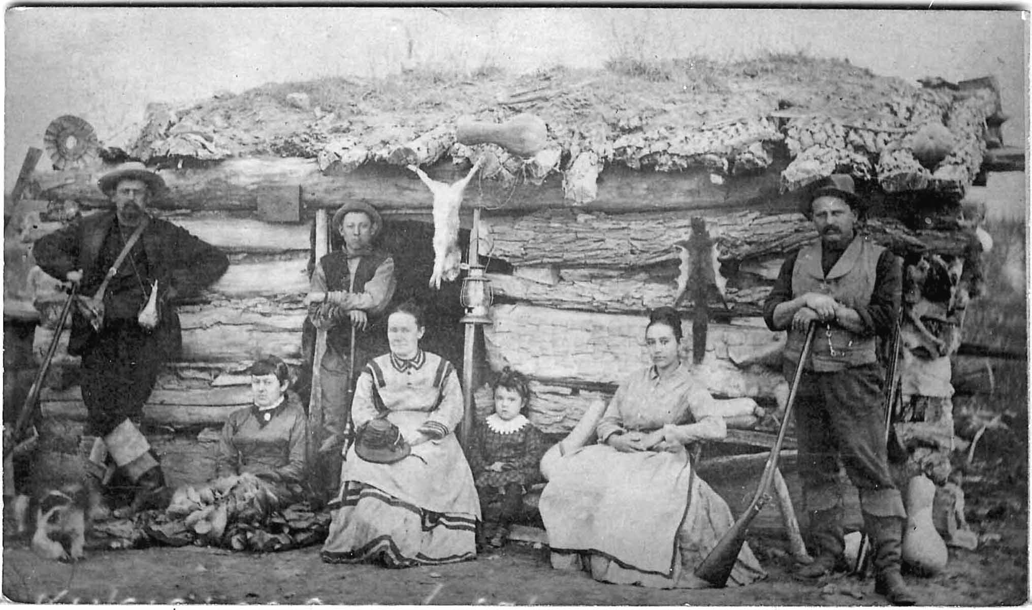
No Inheritances
Many of the Saints in Missouri lived in harmony with the laws the Lord had set forth for building Zion.
However, some Church members disobeyed the Lord’s command to consecrate their properties and traveled to Zion without obtaining a certificate from their leaders.
D&C 85:2
Because of this, they did not receive their inheritances.

Slide 6
The Clerk
D&C 85:1-5
Those who consecrated their properties
Those who were living faithfully
Those who apostatized
Those who left the Church would not have their names found in their records or the children’s
The duty of the Lord’s clerk is to keep a History and a general Church Record
Those who left the Church:
Their genealogy would not be kept by the Church
Church Record
Genealogy History

Slide 7
Judged Out of the Books
“We are informed that we are to be judged out of the books that are to be kept, therefore they should be accurate in every detail. …
“… To keep a record of the manner of life of these consecrated members was important because of the nature of the covenant which they were required to make when they entered into this order, or covenant.
… The names of all faithful members were to be recorded, with an account of their stewardship, their faith and their works. What a happy people they would have been if they had hearkened with singleness of heart to these commandments, for the Lord had promised to protect them in these inheritances if they would be faithful to him.
The Lord knew that there would be some among them who would falter; some who would come to Zion not willing to enroll themselves and their property to the welfare of Zion, and therefore could not be given stewardships in the covenant which the Lord had made with the saints. He, therefore, commanded that all those who came to Zion and who were not willing to receive an inheritance, and consecration agreeable to his law should not be numbered among the faithful.”
Joseph Smith
If we live the laws
of God, our names will be written upon the records of the Church as faithful members.

Slide 8
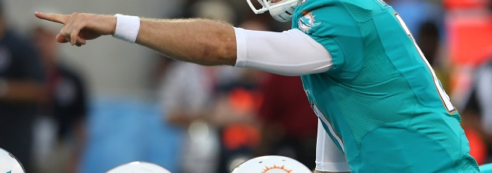
Mighty and Strong
The reference to the “one mighty and strong” who is to set in order the house of God and the reference to one who “putteth forth his hand to steady the ark” have been used by many apostates to justify their falling away from the Church. They claim that various Presidents of the Church have lost favor with God and are rejected, and that they, the apostates, are the “one mighty and strong” called
by God to set thing
s right. Such claims
contradict the
meaning of the
scriptures.
D&C 85:7-8

Slide 9
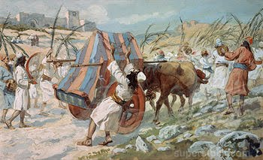
Steady The Ark
The phrase “steady the ark of God” refers to “an incident during the reign of King David in ancient Israel. The Philistines had captured the ark of the covenant in battle but returned it when they were struck by plagues (see 1 Samuel 4–6).
David and the people later brought the ark to Jerusalem in an ox cart, driven by Uzzah and Ahio. ‘And when they came to Nachon’s threshing floor, Uzzah put forth his hand to the ark of God, and took hold of it; for the oxen shook it. And the anger of the Lord was kindled against Uzzah; and God smote him there for his error, and there he died by the ark of God’ (2 Samuel 6:6–7; see vv. 1–11).
The ark was the symbol of God’s presence, His glory and majesty. When first given to Israel, the ark was placed in the Holy of Holies in the tabernacle, and not even the priest was allowed to approach it. Only the high priest, a type of Christ, could approach it, and then only after going through an elaborate ritual of personal cleansing and propitiation for his sins. …
1 Samuel 4-6
D&C 85:7-12

Slide 10
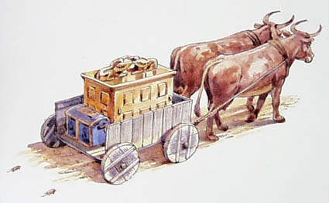
With Good Intentions
“However well-meaning Uzzah’s intentions, he approached casually what could only be approached under the strictest conditions. He had no faith in God’s power. He assumed that the ark was in danger, forgetting that it was the physical symbol of the God who has all power. We cannot presume to save God and His kingdom through our own efforts.
“‘Uzzah’s offence consisted in the fact that he had touched the ark with profane feelings, although with good intentions, namely to prevent its rolling over and falling from the cart. Touching the ark, the throne of the divine glory and visible pledge of the invisible presence of the Lord, was a violation of the majesty of the holy God.
“Uzzah was therefore a type of all who with good intentions, humanly speaking, yet with unsanctified minds, interfere in the affairs of the kingdom of God, from the notion that they are in danger, and with the hope of saving them”
Student Manual
1 Samuel 4-6
D&C 84:7-12

Slide 11
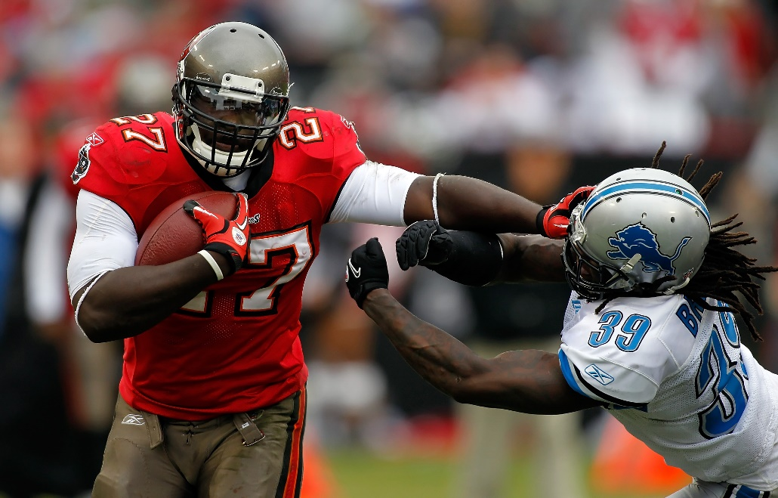
Being a Team Player
The Lord referred to this incident in modern revelation to teach the principle that we should not take upon ourselves the responsibility to give direction (“steady the ark”) to our priesthood leaders or others whom God has called and appointed.
Yet there are those who fear the ark is tottering and presume to steady it. Some members of the Church may see problems and be frustrated with the way they feel their leaders or others are addressing those problems.
They may feel that even though they do not have the authority to do so, they need to correct the course of their ward or even of the Church.
However, the best intentions do not justify such interference with the Lord’s Church.
D&C 85:8

Slide 12
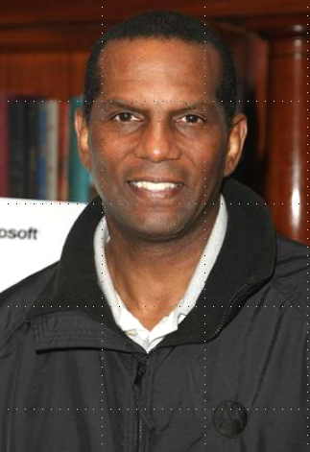
Burgess Owens
Dressed in a suit and tie, Burgess Owens stood at the pulpit in the Herriman LDS chapel and surveyed the scene before him on Sunday, Feb. 3, 2013.
The 61-year-old man could see his wife, Josie, surrounded by six children and six grandchildren, seated among the congregation. A short time earlier, male family members had participated in the blessing of their newest granddaughter. In the midst of that sweet moment, Owens wanted to share his testimony with fellow members of The Church of Jesus Christ of Latter-day Saints.
“The church has been everything to us,” Owens said.
More than 30 years earlier, Owens wore a different suit, one consisting of black and silver for the Oakland Raiders. As a hard-hitting safety, Owens earned a ring when the Raiders won Super Bowl XV.
But it was during the 1982 season that Owens and his wife were introduced to the LDS Church by a Mormon teammate, sparking a series of events that changed their lives.
Andrew H. Walker, Getty Images

Slide 13
A Team Player
Three decades later, the former pro football player is grateful for how following the gospel plan has blessed him and his family, not to mention those who’ve joined the church as a result of their missionary efforts.
“It (the church) has given us perspective of how important family is. It has helped us understand the parameters that the Lord wants us to live within,” Owens said in a telephone interview. “We don’t have to wonder or drift with society; the Lord has a very strong and clear pathway of what is right and where blessings come from. Understanding that, we continue to convert ourselves.”
Trent Toone, Deseret News
1982

Slide 14
Sources:
Video:
I’m a Mormon, Supportive Sister, and Grateful Daughter (3:14)
Letter to William Phelps https://www.churchofjesuschrist.org/study/church-historians-press/jsp-revelations/dc-085-1832_11_27_005?lang=eng
(History of the Church, 1:297–98.)
Joseph Smith (Church History and Modern Revelation,1:348–49.)
Student Manual (O. V. Gerlach).’ (Keil and Delitzsch, Commentary, bk. 2: Joshua, Judges, Ruth, 1 and 2 Samuel, ‘Second Book of Samuel,’ p. 333.)” (Doctrine and Covenants Student Manual, 2nd ed. [Church Educational System manual, 2001], 188).
Presentation by ©http://fashionsbylynda.com/blog/
Trent Toone, Deseret News Former Oakland Raider recounts LDS conversion
PS I am not a follower of football, except the High Schools, and I am sorry if I didn’t get your team colors in the presentation
Presentation by ©http://fashionsbylynda.com/blog/

Slide 15
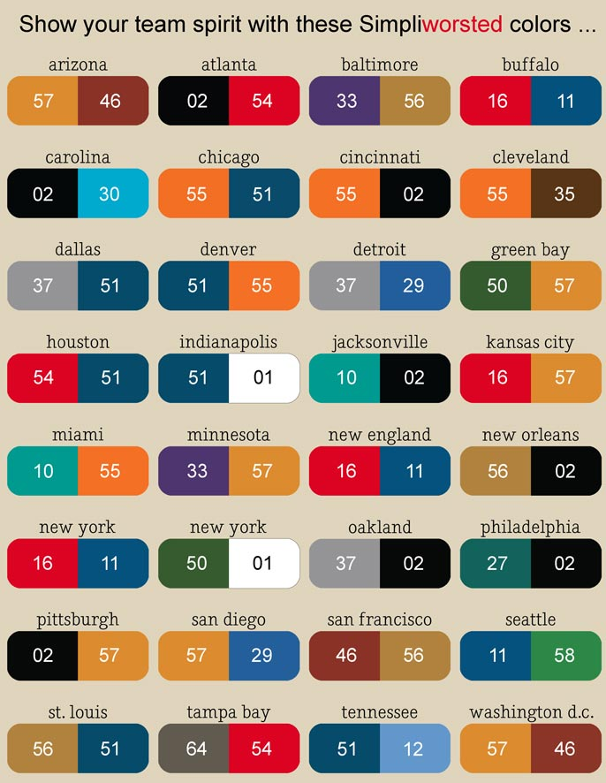
Mighty and Strong; In an official statement issued in 1905, the First Presidency (Joseph F. Smith, John R. Winder, and Anthon H. Lund) discussed the circumstances that brought forth the revelation in Doctrine and Covenants 85:7–8 and those to whom these two phrases referred:
“It is to be observed first of all that the subject of this whole letter [the Prophet’s letter to William W. Phelps], as also the part of it subsequently accepted as a revelation, relates to the affairs of the Church in Missouri, the gathering of the Saints to that land and obtaining their inheritances under the law of consecration and stewardship; and the Prophet deals especially with the matter of what is to become of those who fail to receive their inheritances by order or deed from the bishop. …
“Bishop Partridge was one of the brethren, who—though a most worthy man, one whom the Lord loved, and whom the Prophet described as ‘a pattern of piety,’ and ‘one of the Lord’s great men’—at times arrayed himself in opposition to the Prophet in those early days, and sought to correct him in his administrations of the affairs of the Church; in other words, ‘put forth his hand to steady the ark.’ …
“It was while these conditions of rebellion, jealousy, pride, unbelief and hardness of heart prevailed among the brethren in Zion—Jackson County, Missouri—in all of which Bishop Partridge participated, that the words of the revelation taken from the letter to William W. Phelps, of the 27th of November, 1832, were written. The ‘man who was called and appointed of God’ to ‘divide unto the Saints their inheritance’—Edward Partridge—was at that time out of order, neglecting his own duty, and putting ‘forth his hand to steady the ark’; hence, he was warned of the judgment of God impending, and the prediction was made that another, ‘one mighty and strong,’ would be sent of God to take his place, to have his bishopric—one having the spirit and power of that high office resting upon him, by which he would have power to ‘set in order the house of God, and arrange by lot the inheritance of the Saints’; in other words, one who would do the work that Bishop Edward Partridge had been appointed to do, but had failed to accomplish. …
“… And inasmuch as through his repentance and sacrifices and suffering, Bishop Edward Partridge undoubtedly obtained a mitigation of the threatened judgment against him of falling ‘by the shaft of death, like as a tree that is smitten by the vivid shaft of lightning,’ so the occasion for sending another to fill his station—‘one mighty and strong to set in order the house of God, and to arrange by lot the inheritances of the Saints’—may also be considered as having passed away and the whole incident of the prophecy closed” (in James R. Clark, comp., Messages of the First Presidency of The Church of Jesus Christ of Latter-day Saints, 6 vols. [1965–75], 4:112, 113, 115, 117; see also Doctrine and Covenants Student Manual, 2nd ed. [Church Educational System manual, 2001], 186–87).

Slide 16
More on Burgess Owens
First contact
Owens was raised in a Baptist home in Tallahassee, Fla., during the 1960s. He was one of four African-American players integrated onto a football team at a white high school. It was a rough year, Owens said.
“It was similar to what happened in the movie, ‘Remember the Titans,'" Owens said. “That was pretty much my experience.”
During the integration transition in 1967, Owens became involved in an interracial club aimed at building unity and finding commonalities. One activity was attending various churches of different faiths in the community. At one point, the group visited an LDS church and Owens recalled seeing two missionaries with black name tags.
“Someone in the club was a member. I remember being told by our instructor that Mormons didn’t like blacks, so we will go there but don’t be offended,” Owens said. “So, I kind of went in with a preconceived notion.”
As a young man, Owens was very religious. At one point, he told his father his goal was to become a minister and travel to Russia “because so many there needed to know about Christ,” he said.
“Why go to Russia?” his father replied. “There are plenty of people here in the United States that could use that message.”
Miami to Oakland
Once the Rickards High team members got past their racial issues, they started to win football games. Based on a couple of good seasons, especially his junior year, Owens was the third of four black athletes recruited to play at the University of Miami.
Owens played for the Hurricanes from 1970-72, recording 160 tackles, eight interceptions and three fumble recoveries and earning All-American honors.
Despite his individual success, his team did not enjoy a single winning season during Owens’ time with the Hurricanes. The university even considered dropping the football program at one point. That changed in time. Owens’ impact at Miami was such that in 1999, his name would be added to the famed “Ring of Honor” next to that of quarterback Vinny Testaverde.
Owens was named MVP of the Senior Bowl and was selected in the first round of the NFL draft (13th overall) by the New York Jets.
The football losing trend continued in New York over the next seven seasons. It wasn’t until he was traded to the Raiders in 1980, his 13th season dating back to his junior year of high school, that he was finally part of a winning team.
“Those were lean years,” Owens said. “I call them my character-building years … a continuation of my education as an eternal optimist. You learn after losing quite a bit, year after year, that you have to continue to work hard, stay tough and endure to the end before it’s going to work out.”
New friends
All the hard work paid off for Owens during the 1980 season when the Raiders not only had a winning season (11-5), they won Super Bowl XV. Oakland defeated the Philadelphia Eagles 27-10, becoming the first wild card team to triumph in the Super Bowl. Owens started the game at free safety and finished with six tackles. Winning the big game was the highlight of his career, Owens said.
“We didn’t want it to come to an end. We won it convincingly and we had a good time being the underdogs. There is nothing more rewarding than winning when you’re looked at as not being capable of doing so,” Owens said. “Our biggest regret was there was nobody else to play.”
In the midst of that exciting season, another significant thing happened. Owens developed a close friendship with teammate Todd Christensen. In fact, Owens now feels one of the main reasons he played pro football was so he and his wife could meet the Christensens.
It’s interesting to note how Christensen came to be with the Raiders. He was drafted by Dallas in the second round of the 1978 draft, but spent the season on the bench with a broken foot. The Cowboys cut him after the last exhibition game prior to the 1979 season. The New York Giants picked him up in time for its season opener against the Eagles, and he got into the game for exactly one play. The Giants cut him the next day. Christensen then had conversations with the New England Patriots, Philadelphia and Green Bay Packers before he was finally offered a tryout with the Raiders. Despite a less-than-stellar workout, he made the roster.
Owens knew Christensen and quarterback Marc Wilson both played at BYU and were Latter-day Saints, but he avoided the topic of religion because he still had a negative impression of the Mormons.
“We got to be very close friends. They didn’t hide the fact they were LDS … but I decided to not to ask him about his religion because I didn’t want to not like him. So we talked about everything else,” Owens said. “It was a good thing that we didn’t talk about religion for a few years because we had a chance to get close to them without any pressure. Win or lose, they (the Christensens) were consistent. We had good, wholesome fun when we got together.”

Slide 17
Burgess Owens cont.
Finding the Lord
In the summer of 1982, Owens and his wife decided it was time “to find the Lord.” Burgess had grown up Baptist and Josie was a Catholic, but they hadn’t attended either church in years. They wanted to investigate and learn about other faiths.
“We had won a Super Bowl, I was starting (on the defense) and having success, and we were doing pretty well financially,” Owens said. “But there was still a void that needed to be filled. … We knew something else was out there that had some answers for us. We did a lot of searching but we didn’t come up with anything we felt good about.”
In November 1982, the Owenses were invited to Thanksgiving with the Christensens. The Mormon missionaries also happened to be there and although they didn’t discuss the church, Owens came away impressed by these two young men.
“I couldn’t believe these guys, 19-20 years old, and they have all this insight on life,” Owens said. “I’m 10 years older and wouldn’t have thought about some of those things at that age.”
About two weeks later, as the Raiders played a road game, Todd’s wife, Kathy, invited Josie Owens to attend church with her. She accepted and came away impressed, especially with the Relief Society. She felt right at home and appreciated the information she received, her husband said.
Josie wanted her husband to attend church with her the following week, and with the team playing a rare home game on Monday night, he was able to go. He also had a positive experience.
“I left there with a feeling that I had learned something,” Owens said. “From that point, we were an elder’s dream because we said yes to almost everything.”
The Owenses began taking the missionary discussions and everything felt good, he said. A baptism date was set and then came a wall of doubt.
Proud of his black heritage, Owens’ main concern was that fact that blacks had not always held the priesthood. The LDS Church had only made the change a few years earlier in 1978.
“There were questions I didn’t have the answers to, and I was trying to figure it out,” Owens said. “I remember staying up until 4 a.m. reading the Bible and praying.”
As these concerns were shared with the Christensens, Todd tried to help by doing some deep research, but “after much discussion and study, Burgess simply looked at me and thanked me for my efforts,” Christensen said in an email. “It was clear that I had not reached him.”
An answer came the following day when the Owenses had dinner with the mission president. As they sat at a long table, the church leader said something that has always remained with Owens.
“He said it’s interesting how the Lord works,” Owens recalled. “He will give you enough to take the first step, then he’ll ask you to take the second step on faith. … That was something that resonated with me. I needed to hear that. I had enough at that time to know it felt right. Todd and Kathy were great examples. We went on faith and got baptized.”
The Owenses were baptized on Dec. 31, 1982, around 10 p.m., so they could bring in the new year as members of the LDS Church.
He retired from the NFL the following April.
Christensen remembers Owens asking him if he should pay tithing retroactively for 1982, even though he wasn’t a member yet. Christensen said it wasn’t necessary, but Owens did it anyway.
“Great faith. Great integrity. Great people,” Christensen said.
Faith rewarded
Owens said his real conversion came after leaving Oakland. They returned to New York and were surprised when a home teacher showed up at their home to welcome them to the ward.
“To actually have someone come to your doorstep with knowledge of our membership records, to welcome you, that was quite unique for us,” Owens said. “There’s no telling, we might have just let it drop at that point. Don’t know if we would have searched the church out.”
The bishop called Owens to teach the 14-year-olds and the former football player was sure it was a mistake. He was still trying to learn and understand the gospel. How could he teach the gospel? But it turned out to be just what Owens needed, he said.
“That was really where I gained my testimony,” Owens said. “I gained so much knowledge as I would prepare and teach these kids, I began to understand so much myself. It was a process.”
As the years rolled by, the Owenses remained active in the church, serving while raising a family.
Summur-Rayn Berrett, their oldest daughter, recalls the faithful dedication of her parents. They held family home evening and scripture study each week. They traveled long distances to attend church meetings and activities. The children each received a father’s priesthood blessing at the start of each school year. They attended early-morning seminary. Young Women camp was a high priority. One sibling was pulled off the soccer team because games were on Sunday. They spent general conference weekend at the stake center and had a picnic in between sessions because it was too far to return home. Owens consistently made the 2.5-hour drive to attend the Washington D.C. Temple.
“That was just how it was,” Berrett said. “We didn’t know any different.”
“We had a firm foundation at home, where our parents taught us to be leaders and examples,” said Randii Foster, another daughter.

Slide 18
Burgess Owens Continued:
“That was just how it was,” Berrett said. “We didn’t know any different.”
“We had a firm foundation at home, where our parents taught us to be leaders and examples,” said Randii Foster, another daughter.
Both women expressed gratitude for their special friendship with Todd and Kathy Christensen over they years. The Christensens were with the family in the Bountiful Temple when Berrett was sealed to her husband.
“It speaks volumes when you live a Christ-like life,” Berrett said, shedding a tear. “It’s scary to think what our lives would be like without the gospel. They (the Christensens) are an integral part of our lives and I’m grateful for their courage. It’s been a great blessing to us.”
Foster said her parents have been active missionaries, bringing upwards of 50 people into the church over the years.
“They (the Christensens) may not know the extent of the impact of their actions. Them sharing the gospel with my parents has impacted countless lives,” Foster said. “A thank you wouldn’t suffice.”
Final thoughts
Vai Sikahema, also a former NFL player, didn’t play against Owens in the NFL, but for a time they attended the same LDS ward and became friends. Sikahema has heard Owens’ conversion story several times and says it’s “an amazing example of how the Lord prepares his children to receive the truth.” Sikahema, a former BYU Cougar, also called Todd and Kathy Christensen “tremendous member missionaries.”
“An NFL locker room is not an easy place to share the gospel. Players are consumed with their money, fame and the trappings of professional success in the most visible arena of hero worship that exists,” Sikahema said in an email. “Through that clutter, Todd invited Burgess to take the missionary discussions. In that clutter, Burgess recognized the message. When I met the Owenses, they were dyed-in-the-wool Latter-day Saints, their testimonies firm and immovable.”
Sikahema continued: “It’s funny, I often see Burgess in NFL Films highlights as a Raider and … I marvel that in that atmosphere, he joined the church. Those teams were notorious partiers and rabble-rousers; even in the NFL their reputation is legendary. Yet, in their midst, was a black, athletic, knock-your-teeth-out safety who now holds the priesthood and is sealed to his wife and children for time and all eternity. Amazing, isn’t it?”
Reflecting on what he has learned over the past 30 years, Owens hopes others can learn something from his experience. He hopes others open their hearts and sincerely ask the right questions.
“We are all children of a Heavenly Father who loves us all. He sees us from the inside out, not the outside in, and his gospel treats us that way,” Owens said. “He wants us all to be successful. He has given parameters to guide us, and if we follow those rules and guidance, we’ll be blessed. And he will always be there — he will never give up on us.”
Former Oakland Raider recounts LDS conversion
By Trent Toone, Deseret News
http://www.deseretnews.com/article/865580835/Former-Oakland-Raider-recounts-LDS-conversion.html?pg=all

