Slide 2
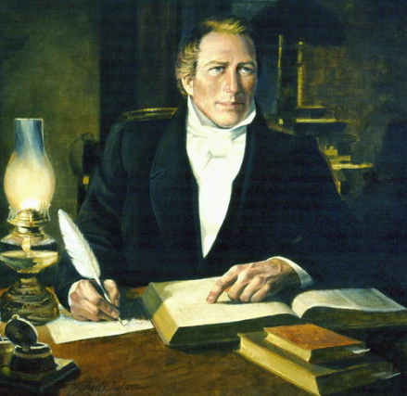
Background to Section 86
December 6, 1832 at Kirtland, Ohio
Joseph Smith was reviewing and editing the inspired revision of the Bible.
He received a more complete version of the Parable of the Wheat and Tares in Matthew 13:36-43
The Savior taught about His efforts to gather the righteous in preparation for His Second Coming.

Slide 3
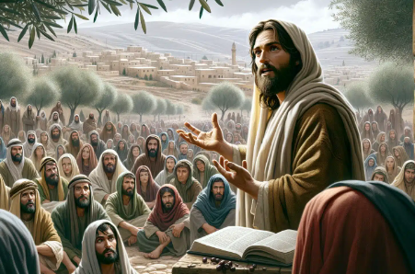
Parables
“Parables are short stories which point up and illustrate spiritual truths. Those spoken by Jesus deal with real events, or, if fictitious, are so consistent and probable that they may be viewed as the commonplace experiences of many people.
“When opposition to his message became bitter and intense, the master Teacher chose to present many of the truths of salvation in parables in order to hide his doctrine from those not prepared to receive it. It was not his purpose to cast pearls before swine.”
Elder Bruce R. McConkie
D&C 86:1

Slide 4
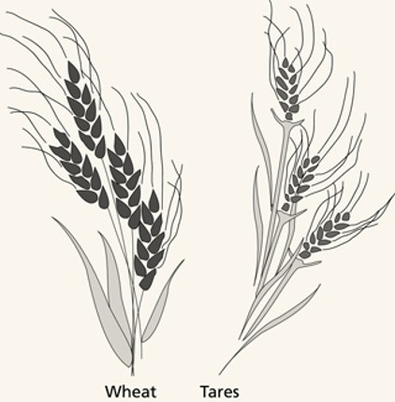
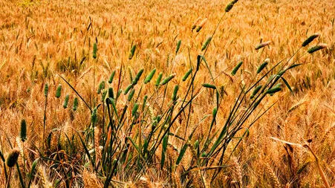
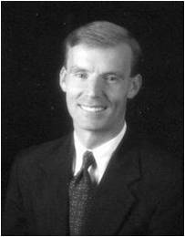
Tares
Tares are a type of poisonous weed. Wheat and tares are almost identical when they sprout, but they can be distinguished once they mature.
“The word tares occurs in the New Testament only in this parable. The Greek word zizanion, translated as “tares,” is said to come from a Semitic root and refers to weeds in grain. Most assume it is the somewhat poisonous bearded darnel, or weed grass.”
John Bytheway
D&C 86:1

Slide 5
Parable in Matthew
The man sowing seed is the Son of Man
The field is the world
Matthew 13:37
Matthew 13:38

Slide 6
The good seed are the children of the kingdom (followers of Jesus).
The tares are children of the wicked one (those who follow the enticements of Satan).
Matthew 13:38
Matthew 13:25-38-39

Slide 7
The harvest is the end of the world
The reapers are the angels sent to reap the field.
Matthew 13:39-40
Matthew 13:41

Slide 8
The tares bound and burned are the evil ones separated out and cast into fire (punishment) at the Judgment.
The wheat gathered into the barn represents the righteous who are separated out and made to “shine forth” in the kingdom of the Father
Matthew 13:42
Matthew 13:43

Slide 9
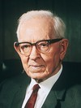
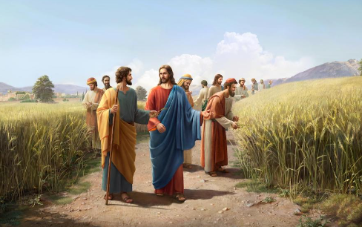
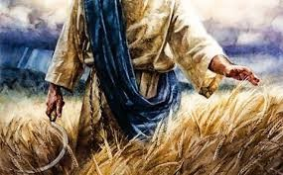
The Rest of the Story
The Apostles are the sowers of the seed
“In Matthew’s account the Lord declares that he is the sower of the good seed, and in the Doctrine and Covenants it is stated that the apostles were the sowers of the seed.
…Christ is the author of our salvation and he it was who instructed the apostles, and under him they were sent to preach the Gospel unto all the world, or to sow the seed, and as the seed is his and it is sown under his command, he states but the fact in this revelation and also in the parable.”
President Joseph Fielding Smith
D&C 86:2

Slide 10
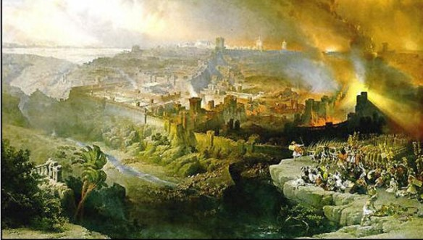
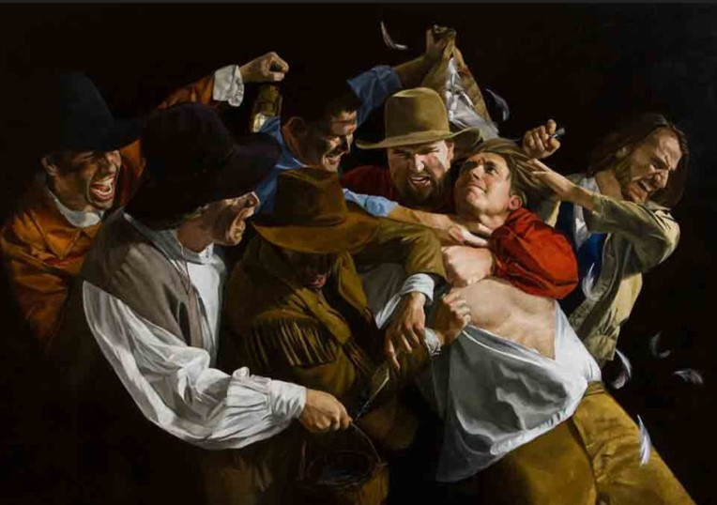
Apostasy
Falling asleep implies the death of the original Apostles
The enemy is Babylon the great whore, which is elsewhere called the great and abominable church (see 1 Nephi 13:4–8).
Babylon is a symbol of worldliness and evil, and therefore may be said to represent the devil’s power in this world.
Those who remain in Babylon are those who follow the practices of the world and who do not accept the word of the Lord.
Sometimes Satan’s persecution of the Church takes the form of aggressive persecution, such as killing the prophets or physically abusing the Saints. More often the persecution consists of social pressure against the humble followers of Christ.
Student Manual
D&C 86:3

Slide 11
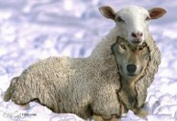
Tares of the World
The tares represent evil doctrines and those who spread them
“Even in the Church the tares are to be found. It is the tares which are to be gathered up and burned from all over the world, but those in the Church will also be gathered out and find their place in the fire.
President Joseph Fielding Smith
False doctrines or individuals who present themselves as faithful members of the Church but are in reality servants of Satan are a source of temptation to the faithful and tend to choke or corrupt the word of God, or the good seed that is sown.
Student Manual
D&C 86:3

Slide 12
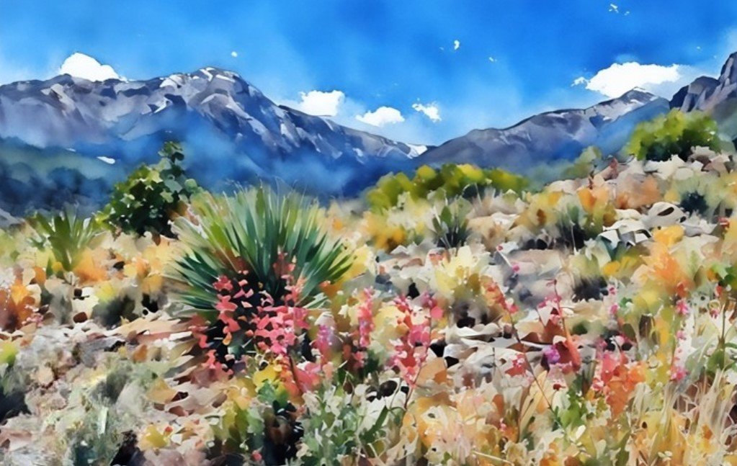
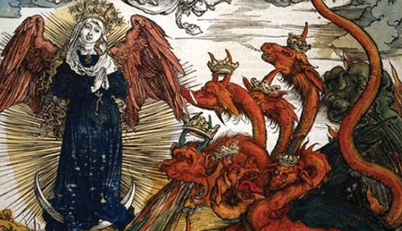
Wilderness
The Church being driven into the wilderness represents the time of the Apostasy
The wilderness represents the period of time when the Church and the priesthood were taken from the earth
And to the woman were given two wings of a great eagle, that she might fly into the wilderness, into her place, where she is nourished for a time, and times, and half a time, from the face of the serpent. Revelation 12:14
D&C 86:3

Slide 13
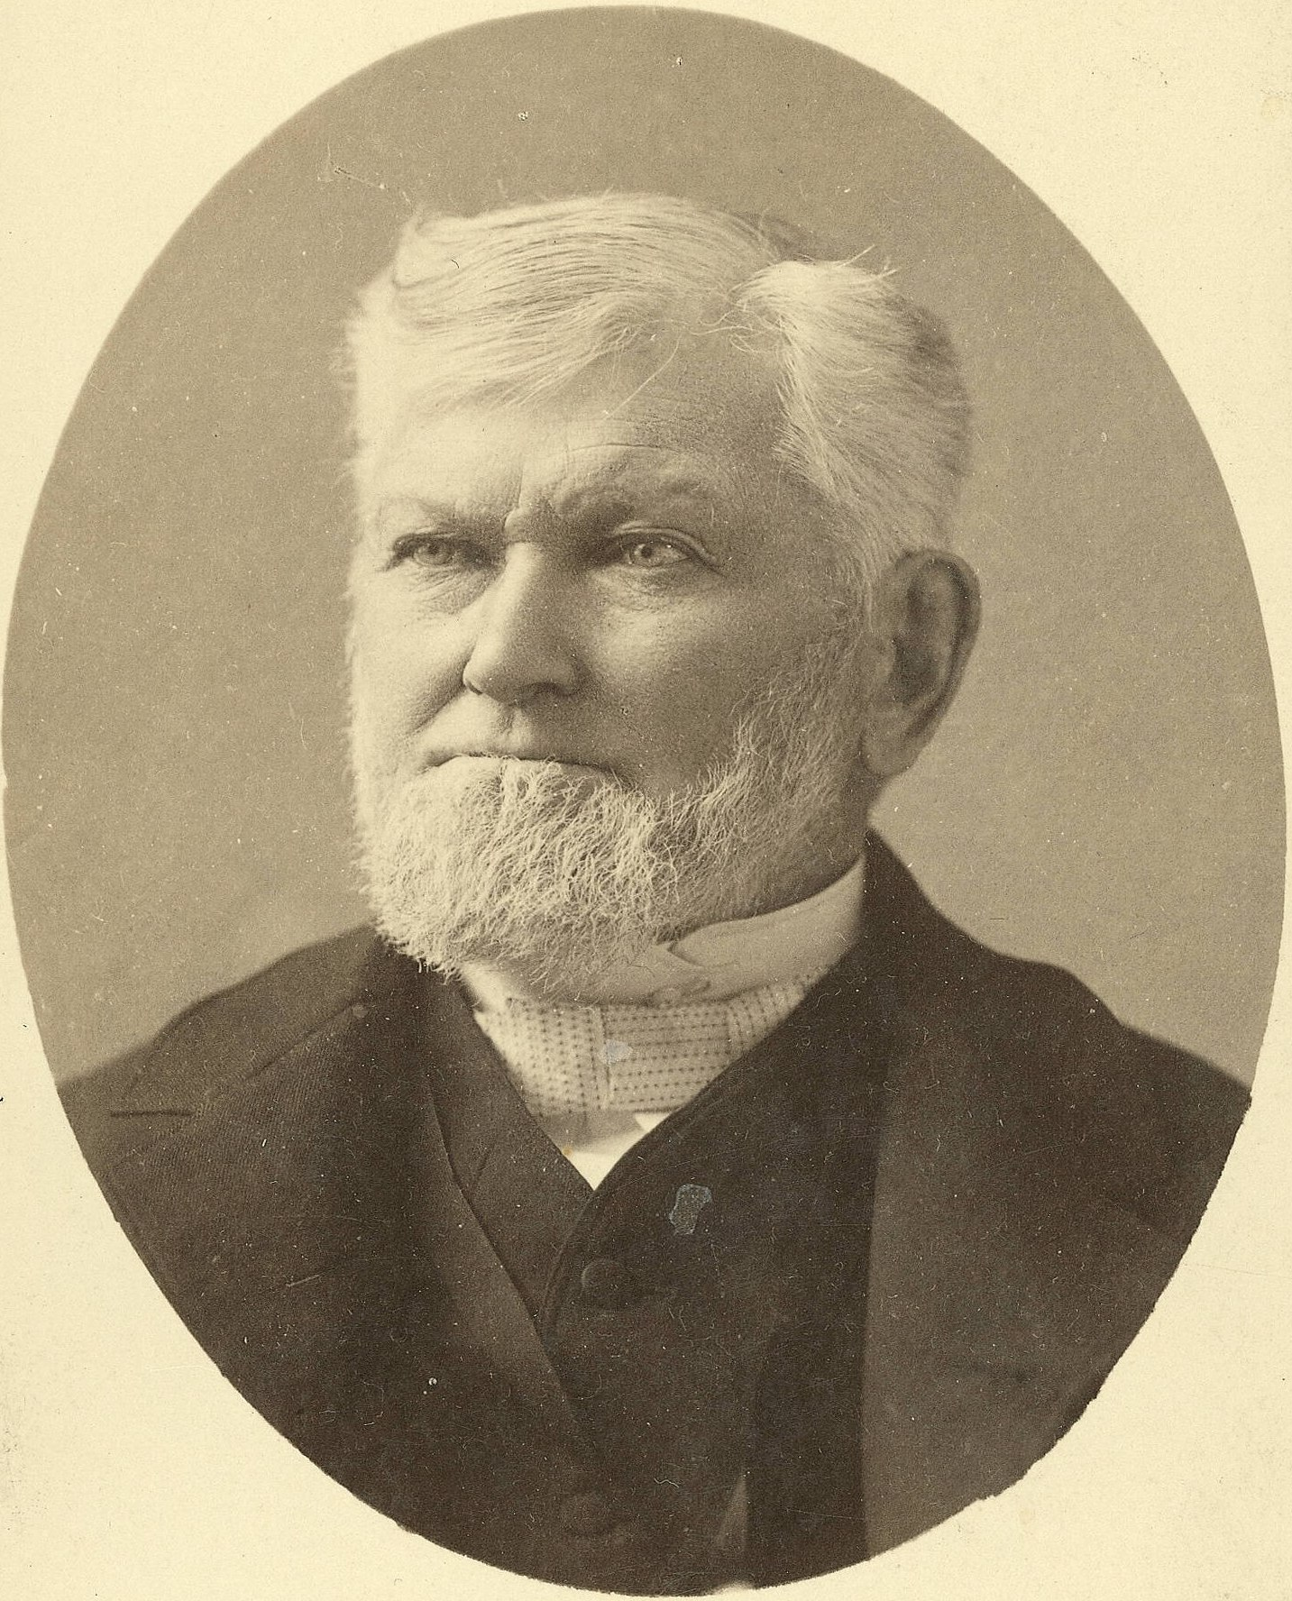
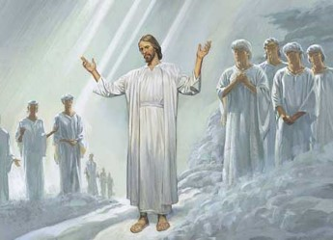
The Reapers
In Matthew—identified as the angels of God
But the Lord also indicates that at the time this revelation was given, the angels were anxiously awaiting permission to carry out their mission.
“God has held the angels of destruction for many years, lest they should reap down the wheat with the tares.
But I want to tell you now, that those angels have left the portals of heaven, and they stand over this people and this nation now, and are hovering over the earth waiting to pour out the judgments. And from this very day they shall be poured out.
Calamities and troubles are increasing in the earth, and there is a meaning to these things. Remember this, and reflect upon these matters. If you do your duty, and I do my duty, we’ll have protection, and shall pass through the afflictions in peace and in safety.”
President Wilford Woodruff
D&C 86:5

Slide 14
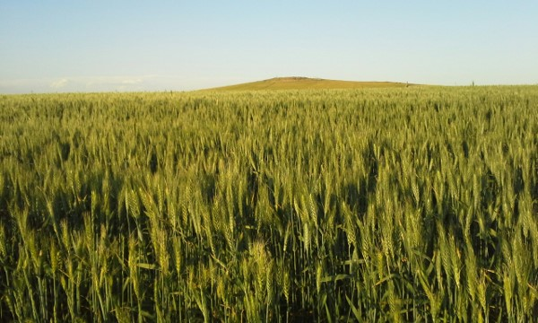
Tenderness of Wheat
The weakness, or newness, in the faith
When this revelation was given in December 1832, the Church was not yet three years old and was, therefore, still very “tender.”
At that time many of the tares were not yet identifiable, and attempts to systematically root out those who would eventually prove themselves to be tares would have been very destructive.
Student Manual
D&C 86:6

Slide 15
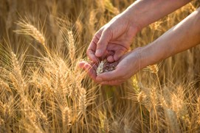
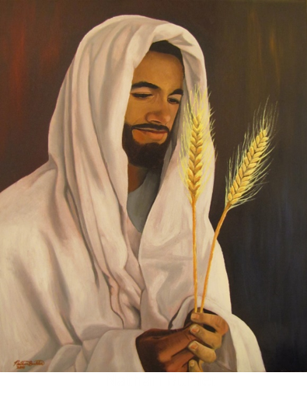
Allowed to Grow Together
The owner of the field advised the householders to “let both grow together” to prevent damaging the entire crop. At the time of the harvest, they would separate the two.
The Lord is gathering Israel prior to His Second Coming.
The Lord will gather the righteous during the last days and then destroy the wicked at His Second Coming
D&C 86:7

Slide 16
Prophets Foretell
Isaiah 11:11-12
The Lord is gathering those who will choose to let God be the most important influence in their lives.
For centuries, prophets have foretold this gathering and it is happening right now! As an essential prelude to the Second Coming of the Lord, it is the most important work in the world! …
When we speak of gathering Israel on both sides of the veil, we are referring, of course, to missionary, temple, and family history work.
We are also referring to building faith and testimony in the hearts of those with whom we live, work, and serve. Anytime we do anything that helps anyone—on either side of the veil—to make and keep their covenants with God, we are helping to gather Israel.
Russell M. Nelson
2 Nephi 21:11-12
Mosiah 15:11

Slide 17
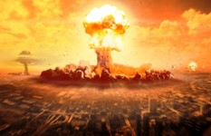
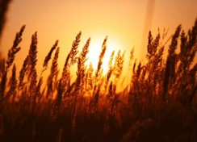
The Last Days
“The harvest and the end of the world have an allusion directly to the human family in the last days. …
As, therefore, the tares are gathered and burned in the fire, so shall it be in the end of the world; that is, as the servants of God go forth warning the nations, both priests and people, and as they harden their hearts and reject the light of truth—these first being delivered over to the buffetings of Satan, and the law and the testimony being closed up…
We understand that the work of gathering together of the wheat into barns, or garners, is to take place while the tares are being bound over, [in preparation] for the day of burning, that after the day of burnings, the righteous shall shine forth like the sun, in the Kingdom of their Father.”
Prophet Joseph Smith
D&C 86:7

Slide 18
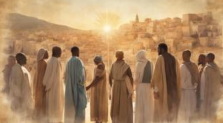
The Gentiles
Members and those who are not members of the Church of Jesus Christ of Latter-day Saints
As used in the scriptures, Gentiles has several meanings. Sometimes it designates people of non-Israelite lineage, sometimes people of non-Jewish lineage, and sometimes nations that are without the gospel, even though there may be some Israelite blood among the people.
Guide to the scriptures
The descendants of Israel who honor their heritage and those who join Israel’s descendants by adoption will be the instruments God uses to set up his kingdom in the last days. There is no distinction in the blessings God gives to a person who is a literal descendant of Israel or to a person who adopted into Israel’s linage through the sacred covenants of the gospel. Later revelations given to Joseph Smith explain how members of the Church in the latter-days mirror the work of the Savior of all mankind by becoming saviors of their ancestors as well.
Casey Paul Griffiths
D&C 86:11

Slide 19
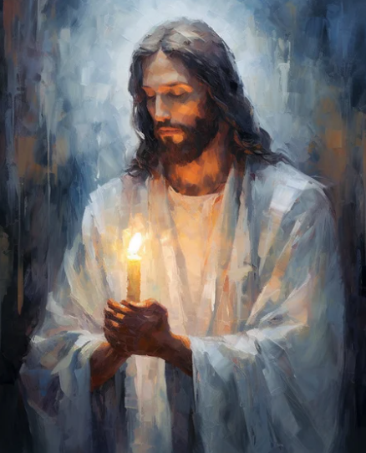
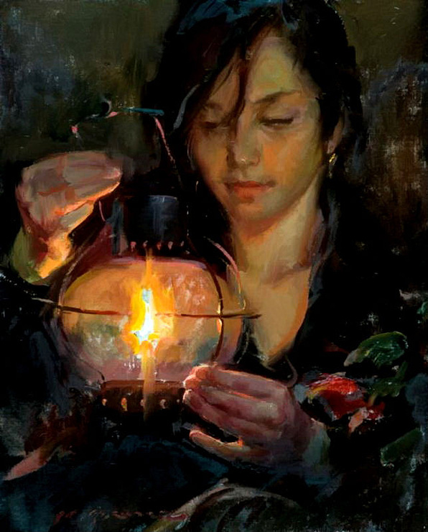
Light Unto the Gentiles
Ye are the light of the world. A city that is set on an hill cannot be hid.
Neither do men light a candle, and put it under a bushel, but on a candlestick; and it giveth light unto all that are in the house.
Let your light so shine before men, that they may see your good works, and glorify your Father which is in heaven.
Matthew 5:14-16
Therefore, hold up your light that it may shine unto the world. Behold I am the light which ye shall hold up—that which ye have seen me do. Behold ye see that I have prayed unto the Father, and ye all have witnessed.
3 Nephi 18:24
D&C 86:11

Slide 20
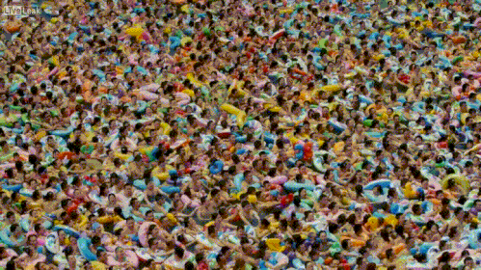
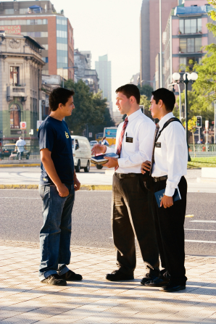
The Lord will gather the righteous during the last days and then destroy the wicked at His Second Coming

Slide 21
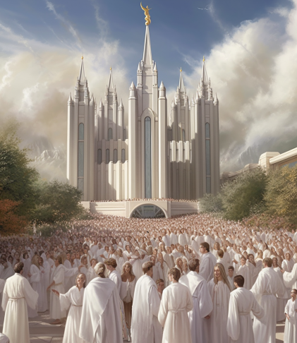
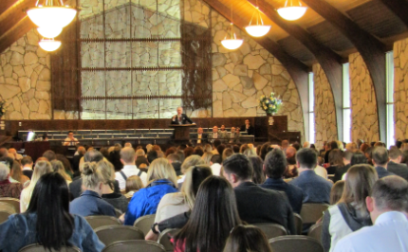
Why Does the Lord Gather
The Lord gathers His people when they accept Him and keep His commandments. …
… The Lord gathers His people to worship, to build up the Church, for a defense, and to receive counsel and instruction. …
The Prophet Joseph Smith declared that in all ages the divine purpose of gathering is to build temples so that the Lord’s children can receive the highest ordinances and thereby gain eternal life.
David A. Bednar
D&C 86:11

Slide 22
Invitation to Gather Israel
Stay on or return to the covenant path.
Make a weekly sacrifice of time to the Lord, giving up something you like to do and using that time to help gather Israel.
Give up social media for seven consecutive days.
Pray daily for all of Heavenly Father’s children to receive the blessings of Jesus Christ’s gospel.
Stand out; be different from the world.
Russell M. Nelson and Wendy W. Nelson

Slide 23
Sources:
Videos:
Jesus Declares the Parable of the Wheat and the Tares (1:17)
“LightTheWorld—Follow the Example of Jesus Christ. Share His Light—
Serve as He Served” (2:17) from time code 0:29 to 2:17
“Gatherers in the Kingdom” (1:51)
“Gathering and Growing: Eldon’s Story (2:10). Invite
Elder Bruce R. McConkie, Doctrinal New Testament Commentary, 1:283
John Bytheway Of Pigs, Pearls and Prodigals pg. 20
President Joseph Fielding Smith (Church History and Modern Revelation, 1:353-4.)
Russell M. Nelson, “Let God Prevail,” Ensign or Liahona, Nov. 2020, 92–93
President Wilford Woodruff in 1894 (Young Women’s Journal, Aug. 1894, pp. 512–13.)
Prophet Joseph Smith(Teachings, p. 101.)
Presentation by ©http://fashionsbylynda.com/blog/
Casey Paul Griffiths “Doctrine and Covenants Central” section 86
Doctrine and Covenants Student Manual Religion 324-325 Section 86
David A. Bednar, “The Spirit and Purposes of Gathering” [Brigham Young University–Idaho devotional, Oct. 31, 2006], byui.edu)
Russell M. Nelson and Wendy W. Nelson, “Hope of Israel” [worldwide youth devotional, June 3, 2018], ChurchofJesusChrist.org
Presentation by ©http://fashionsbylynda.com/blog/

Slide 24
Lawful Heir According to the Flesh—D&C 86:9
This phrase means that one’s right to the priesthood is held by virtue of being of the house of Israel. Elder Theodore M. Burton explained:
“One thing we often fail to realize is that our priesthood comes to us through the lineage of our fathers and mothers. The Lord explained it in these words: ‘Therefore, thus saith the Lord unto you, with whom the priesthood hath continued through the lineage of your fathers. …’ (D&C 86:8.)
“‘Oh,’ I can hear some of you say, ‘there must be something wrong with that statement, for I am the only member of my family who has joined the Church. How could I have received the priesthood from my parents?’
“In this scripture the Lord was not talking about your priesthood line of authority. He was talking about your inherited right to receive and use priesthood power. This readiness to listen and believe is an inherited gift which enabled you to recognize and accept the truth. Jesus explained this thought as he said: ‘My sheep hear my voice, and I know them, and they follow me.’ (John 10:27.)
“That spirit of acceptance is a manifestation of your inherited right to priesthood blessings. Such willingness to believe does not represent predestination, but it does represent foreordination. The Lord continues the revelation: ‘For ye are lawful heirs, according to the flesh, and have been hid from the world with Christ in God.’ (D&C 86:9.)
“This means we receive a right to priesthood blessings from our blood ancestry. I hope you can understand that priesthood with its accompanying blessings is dependent to a great degree on family relationship.” (In Conference Report, Apr. 1975, p. 103; or Ensign, May 1975, p. 71.)
“You live in a world where technological advances occur at an astounding pace. It is difficult for many of my generation to keep up with the possibilities. Depending on how technology is used, these advances can be a blessing or a deterrent. Technology, when understood and used for righteous purposes, need not be a threat but rather an enhancement to spiritual communication.”
Elder Richard G. Scott April 2103 Gen. Conf. For Peace at Home
Being Part of the Gathering D&C 86:11
The Lord explained that in this final time prior to His return, the “wheat,” whom He describes as “the children of the kingdom” [Matthew 13:38], would grow side by side with the “tares,” or those who do not love God and do not keep His commandments. They would “both grow together” [Matthew 13:30] side by side.
This will be our world until the Savior returns, with much that is good and much that is evil on every side.
You may at times not feel like a strong, mature strand of wheat. Be patient with yourself! The Lord said that the wheat would include tender blades springing up [Doctrine and Covenants 86:4, 6]. We are all His Latter-day Saints, and although not yet all we want to be, we are serious in our desire to be His true disciples. (Neil L. Andersen, “Drawing Closer to the Savior,” Liahona, Nov. 2022, 73)

