Slide 1

Doctrine and Covenants 87
Prophecy of War
O that ye had repented before this great destruction had come upon you. But behold, ye are gone, and the Father, yea, the Eternal Father of heaven, knoweth your state; and he doeth with you according to his justice and mercy.
Moroni 6:22
Presentation by http://fashionsbylynda.com/blog/

Slide 2
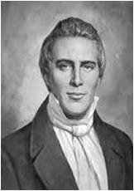
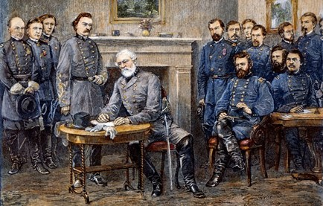
Background
Political Unrest in United States of America
Joseph Smith received the prophecy and revelation in
Section 87 on December 25, 1832
The revelation that followed contained prophecy on war with specific details only God could know at that time.
“Appearances of troubles among the nations became more visible this season than they had previously been since the Church began her journey out of the wilderness solemn crisis.”
Joseph Smith

Slide 3
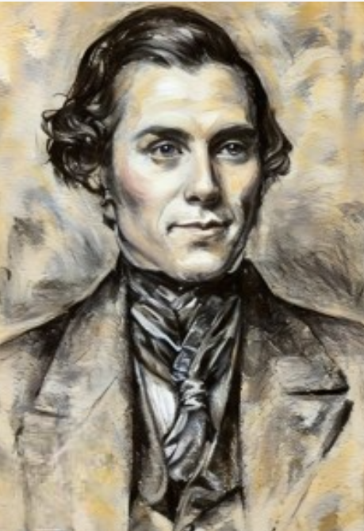
Revelation Not Fulfilled Yet
Orson Pratt was an early member of the Church who served as one of the original members of the Quorum of the Twelve Apostles.
He was called to serve many missions during his life to preach the restored gospel of Jesus Christ throughout the United States and Canada.
On his journeys, he carried with him a copy of a specific revelation that Joseph Smith received from the Lord in 1832. Although the prophecy contained in the revelation had not yet been fulfilled, Elder Pratt frequently shared it with others.
He was often mocked, recalling that people said the prophecy was “the height of nonsense” and that he was “the victim of an imposter”.
Orson Pratt

Slide 4
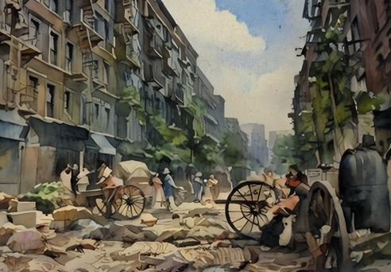
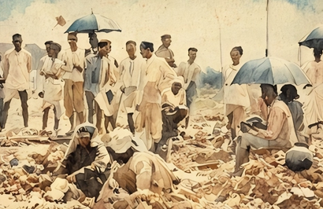
Sickness
The ravages of the cholera were frightful in almost all the large cities on the globe.
The plague broke out in India, while the United States, amid all her pomp and greatness, was threatened with immediate dissolution.
Joseph Smith

Slide 5
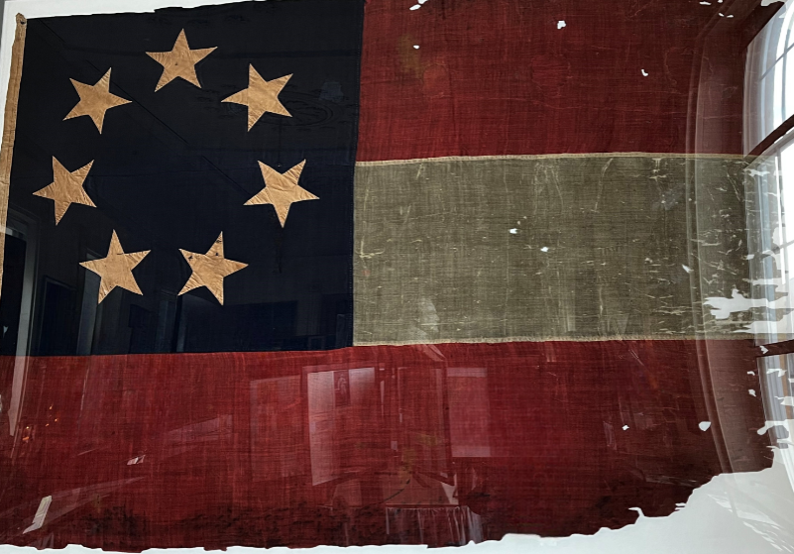
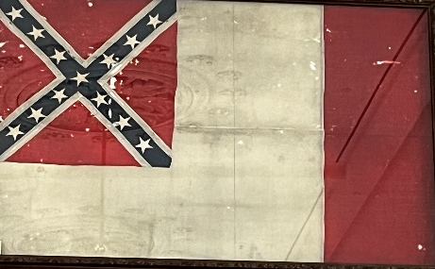
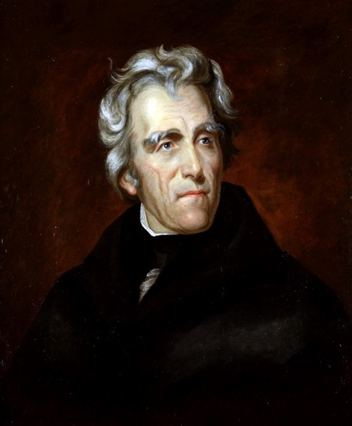
The South
“The people of South Carolina, in convention assembled (in November), passed ordinances, declaring their state a free and independent nation; and appointed Thursday, the 31st day of January 1833, as a day of humiliation and prayer, to implore Almighty God to vouchsafe His blessings, and restore liberty and happiness within their borders.”
It was the intent of South Carolina, following the day of prayer and humiliation, to sever ties with the United States on the first day of February; however,
“President Jackson issued his proclamation against this rebellion, called out a force sufficient to quell it, and implored the blessings of God to assist the nation to extricate itself from the horrors of the approaching and solemn crisis.”
D&C 87:1-4 Joseph Smith

Slide 6
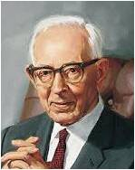
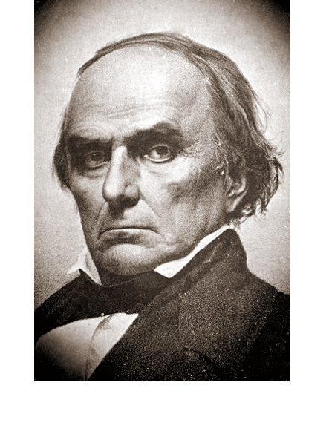
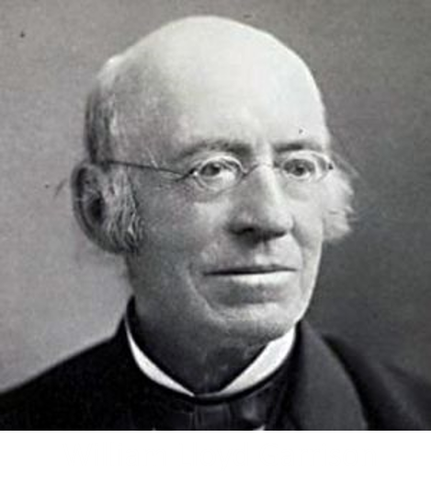
Clouds of War
“Scoffers have said it was nothing remarkable for Joseph Smith in 1832, to predict the outbreak of the Civil War and that others who did not claim to be inspired with prophetic vision had done the same.
It has been said that Daniel Webster and William Lloyd Garrison in 1831 had predicted the dissolution of the Union.
It is well known that senators and congressmen from the South had maintained that their section of the country had a right to withdraw from the Union, for it was a confederacy, and in 1832, war clouds were to be seen on the horizon.
Joseph Fielding Smith

Slide 7
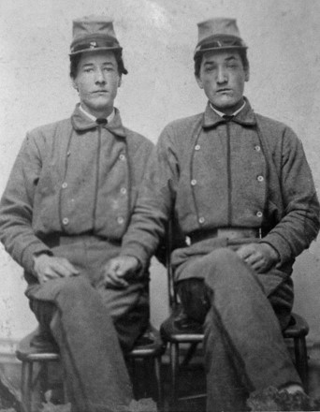
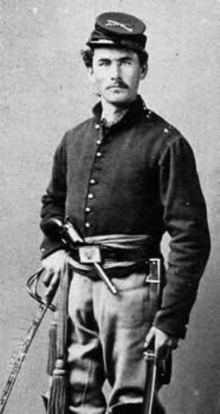
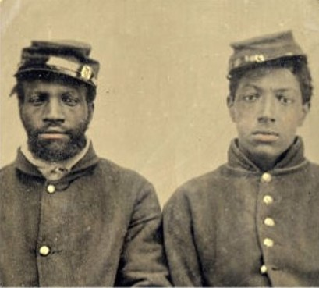
Predictions of War
“It was because of this fact that the Lord made known to Joseph Smith this revelation stating that wars would shortly come to pass, beginning with the rebellion of South Carolina, which would eventually terminate in war being poured out upon all nations and in the death and misery of many souls.
It may have been an easy thing in 1832, or even 1831, for someone to predict that there would come a division of the Northern States and the Southern States, for even then there were rumblings, and South Carolina had shown the spirit of rebellion.
It was not, however, within the power of man to predict in the detail which the Lord revealed to Joseph Smith, what was shortly to come to pass as an outgrowth of the Civil War and the pouring out of war upon all nations.”
Joseph Fielding Smith

Slide 8
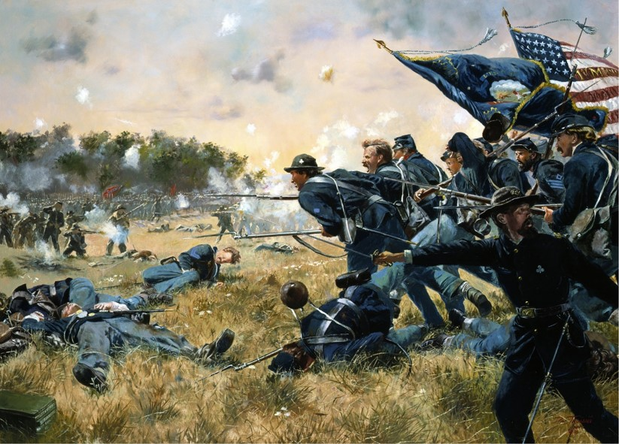
Prophesy of Bloodshed
In April 1843, when the threat of secession was not so immediate, the Prophet again stated:
“I prophesy, in the name of the Lord God, that the commencement of the difficulties which will cause much bloodshed previous to the coming of the Son of Man will be in South Carolina. It may probably arise through the slave question. This a voice declared to me while I was praying earnestly on the subject, December 25th, 1832.”
D&C 87:1-4 Joseph Smith

Slide 9
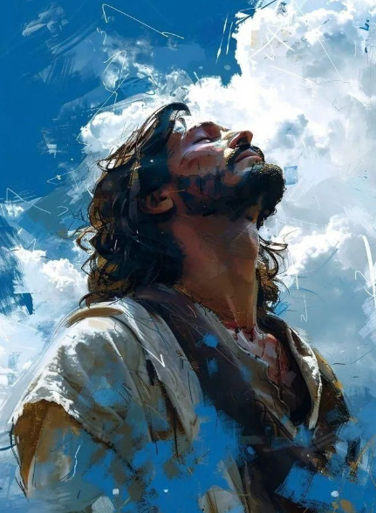
The Lord Knoweth
Abraham 2:8
1 Nephi 9:6
Doctrine and Covenants 38:1-2
My name is Jehovah, and I know the end from the beginning; therefore my hand shall be over thee.
But the Lord knoweth all things from the beginning; wherefore, he prepareth a way to accomplish all his works among the children of men; for behold, he hath all power unto the fulfilling of all his words. And thus it is. Amen.
Thus saith the Lord your God, even Jesus Christ, the Great I Am, Alpha and Omega, the beginning and the end, the same which looked upon the wide expanse of eternity, and all the seraphic hosts of heaven, before the world was made;
The same which knoweth all things, for all things are present before mine eyes;

Slide 10
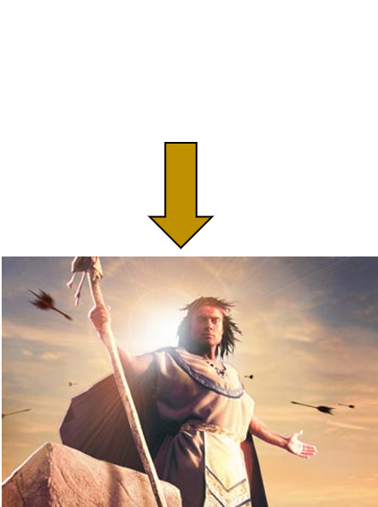
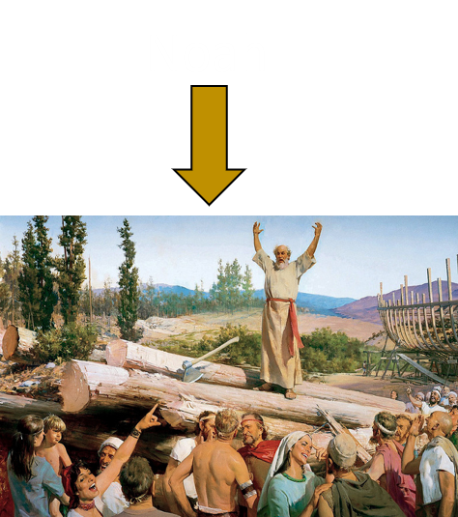
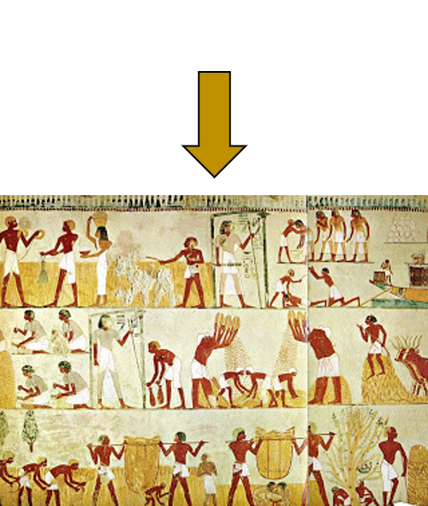
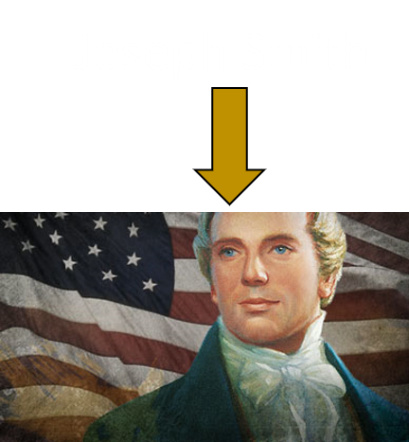
Prophecy VS Predictions
A prediction is an opinion about what might happen in the future. In contrast, a prophecy is a declaration of a future sign or event as revealed by the Holy Ghost

Slide 11
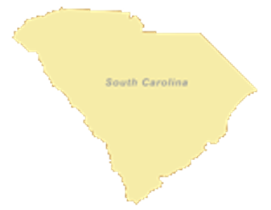
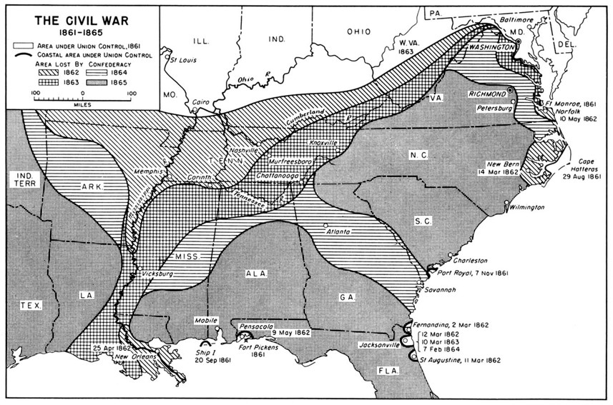
“Shortly Come To Pass”
Wars would shortly come to pass, beginning with the rebellion of South Carolina, which would bring death and misery to many souls.
The Lord can reveal the future to us through His prophets
D&C 87:1-4

Slide 12
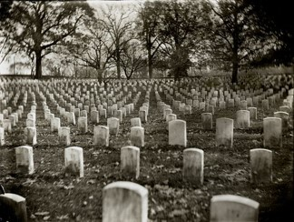
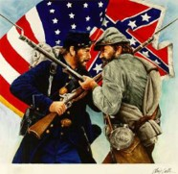
Cost of the American Civil War
Based on a 3 Year Standard Enlistment
1,556,000 soldiers served in the Federal army
634,703 Casualties
359,528 deaths
275,175 wounded
800,00 Serving in confederate forces
483,000 Casualties
258,000 deaths
225,000 wounded
“The cost in treasure was, of course, staggering for the embattled sections. Both governments, after strenuous attempts to finance the prosecution of the war by increasing taxes and floating loans, were obliged to resort to the printing press to make fiat money. While separate Confederate figures are lacking, the war finally cost the United States over $15,000,000,000.
In sum, although the Union was preserved and restored, the cost in physical and moral suffering was incalculable, and some spiritual wounds caused by [this] holocaust still have not yet been healed.”
New Encyclopedia Britannica

Slide 13
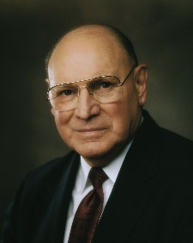
War in All Nations
1832
1861
1864
1865
1866
1877
1894/95
1898
1904/05
1914-1918
Revelation
Civil War
Italy and Austria
China and Japan
Japan and Russia
Denmark and Prussia
Austria and Prussia
Russia and Turkey
Spanish American War
World War I
1920-Ethiopia and Italy, when the people in that land of Ethiopia were taken over and controlled by Italy. I am grateful to the Lord that they now have their freedom.
Then, the World War just passed [World War II] and, of course, the Korean War. [Since 1958 there have been, among numerous other wars, the Vietnam War in Southeast Asia, the war in Angola, the Six-Day and Yom Kippur wars in the Holy Land, and the Persian Gulf War.]
Elder Joseph L. Wirthlin
Since 2001--America has fought wars on terrorism and helping to fight the war against the 2020 COVID.
D&C 87:2

Slide 14
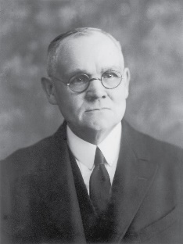
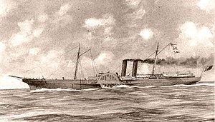
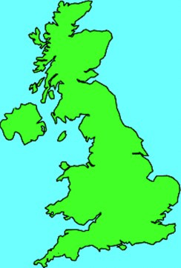
The British
“While no open alliance between the Southern States and the English government was effected, British influence gave indirect assistance and substantial encouragement to the South, and this in such a way as to produce serious international complications.
Vessels were built and equipped at British ports in the interests of the Confederacy; and the results of this violation of the laws of neutrality cost Great Britain fifteen and a half millions of dollars, which sum was awarded the United States at the Geneva arbitration in settlement of the Alabama claims.
The Confederacy appointed commissioners to Great Britain and France; these appointees were forcibly taken by United States officers from the British steamer on which they had embarked. This act, which the United States government had to admit as overt, threatened for a time to precipitate a war between this nation and Great Britain.”
Elder James E. Talmage
World War I and World War II occurred as nations called on other nations to help them defend themselves. In both of these wars, Great Britain called upon other nations for help.
D&C 87:3

Slide 15
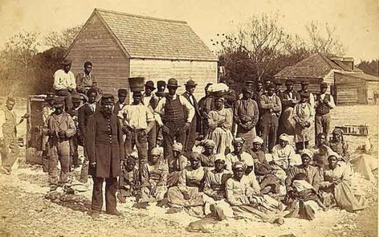
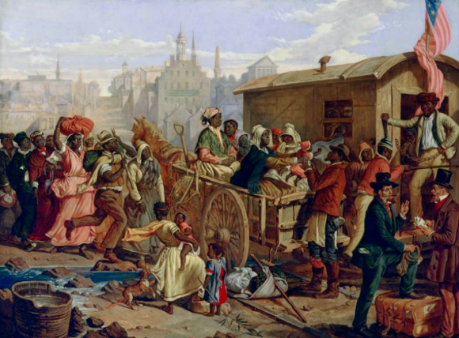
The Slave Issue
I prophesy, in the name of the Lord God, that the commencement of the difficulties which will cause much bloodshed previous to the coming of the Son of Man will be in South Carolina.
It may probably arise through the slave question. This a voice declared to me, while I was praying earnestly on the subject, December 25th, 1832.
D&C 130:12-13
When this revelation was given, slavery existed not only in the United States but also in other parts of the world. Slaves, or those in bondage, in the 19th and 20th centuries rose up against their masters and fought for their freedom.
D&C 87:4

Slide 16
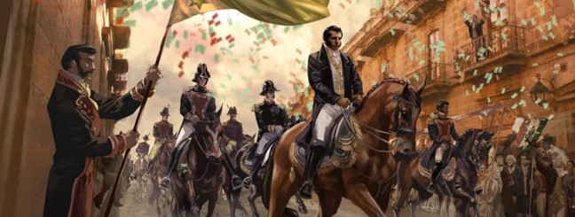
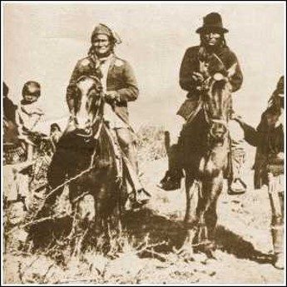
Remnants Left in Land
“The history of this American continent … gives evidence that the Lamanites have risen up in their anger and vexed the Gentiles.
This warfare may not be over. It has been the fault of people in the United States to think that this prophetic saying has reference to the Indians in the United States, but we must remember that there are millions of the ‘remnant’ in Mexico, Central and South America.
It was during our Civil War that the Indians in Mexico rose up and gained their freedom from the tyranny which Napoleon endeavored to inflict upon them contrary to the prediction of Jacob in the Book of Mormon, that there should be no kings among the Gentiles on this land.
The independence of Mexico and other nations to the south has been accomplished by the uprising of the ‘remnant’ upon the land.
However, let us not think that this prophecy has completely been fulfilled.”
D&C 87:5 President Joseph Fielding Smith

Slide 17
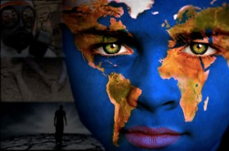
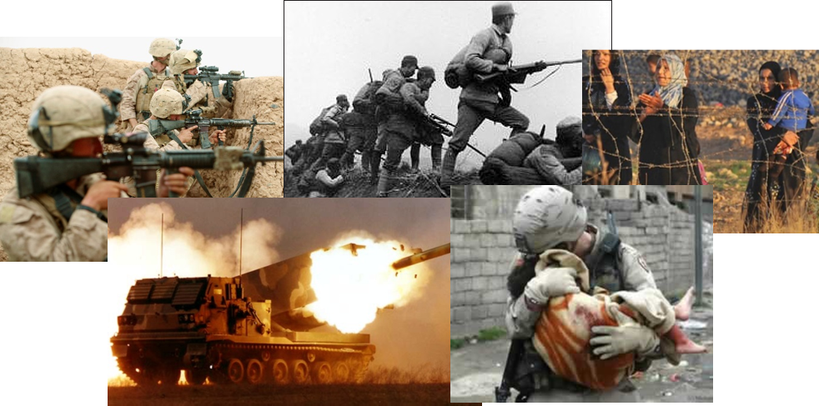
Spirit Has Departed
The Lord is dealing with the nations of the earth, and his Spirit has departed in large measure from nations that have defied him and his commandments, and as a result, they, being left largely to themselves, war with one another, and seek all means by which they can destroy one another most expeditiously.
The Lord is not the author of these evil things; the nations are bringing these inflictions upon themselves, and there shall be a consummation brought about as the Lord hath decreed, which shall mean an end of all nations as such, if they will not observe the law and the commandments of the Lord their God.”
D&C 87:6 James E. Talmage

Slide 18
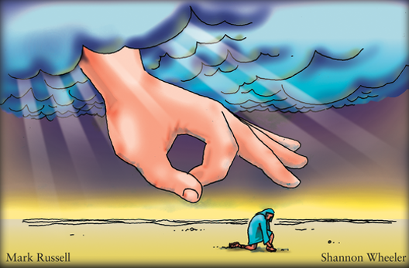
Chastening Hand—to Remember
“chastening hand” of God refers to the fact that the Lord uses His judgments to prompt His children to repent of their sins.
In addition, some of the judgments described in these verses will occur as the Lord punishes the wicked for their unjust treatment of the righteous.
And thus we see that except the Lord doth chasten his people with many afflictions, yea, except he doth visit them with death and with terror, and with famine and with all manner of pestilence, they will not remember him.
Helaman 12:3
D&C 87:6

Slide 19
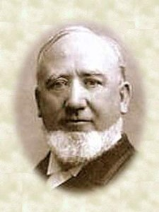
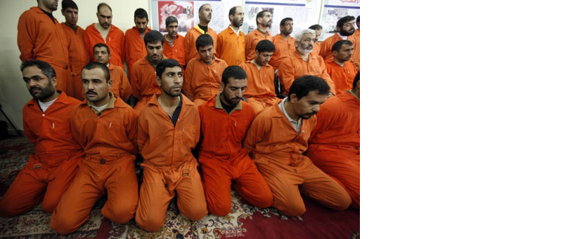
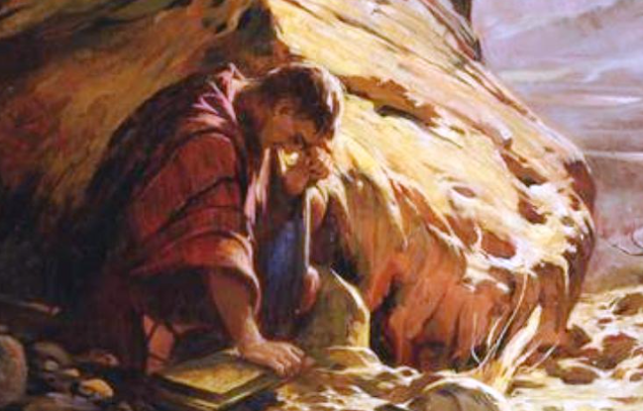
Blood of the Saints
“There is no sin that a nation can commit, which the Lord avenges so speedily and fearfully, as he does the shedding of innocent blood, or, in other words, the killing of his anointed and authorized servants.
No nation which has been guilty of this dreadful crime has ever escaped his vengeance.
The thunderbolts of his wrath have been always launched forth for the destruction of the perpetrators of such wickedness.
It is a rank offence against the majesty of Heaven and the authority of the Creator, which he never suffers to pass unrebuked; for such men act in his stead, and are his representatives on the earth.”
Elder George Q. Cannon
D&C 87:7
Moroni—the Nephite and the Lamanite People were destroyed

Slide 20
Peaceful Resolution
In early 1833, not long after Joseph Smith’s prophecy was given, the disagreements that had made it appear that war could break out soon in America were peacefully resolved.
HOWEVER:
“I knew the prophecy was true, for the Lord had spoken to me and had given me revelation. I knew also concerning the divinity of this work. Year after year passed away, while every little while some of the acquaintances I had formerly made would say, “Well, what is going to become of that prediction? It’s never going to be fulfilled.” Said I, “Wait, the Lord has his set time.”
Orson Pratt

Slide 21
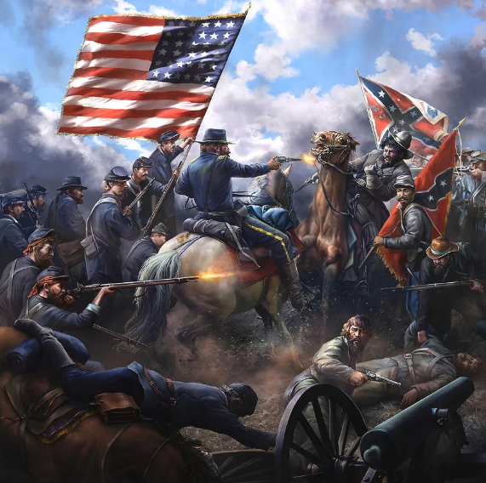
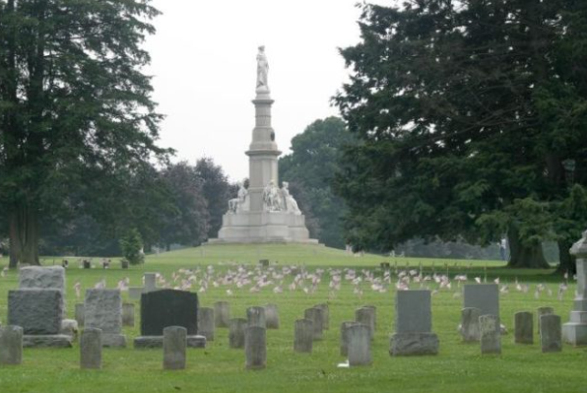
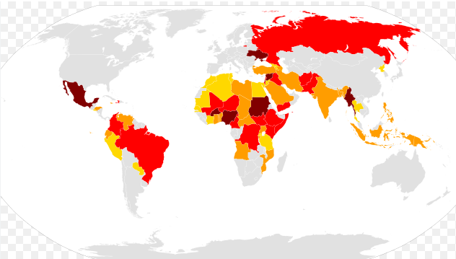
Prophecy Fulfilled
Although Joseph Smith was not alive to see the fulfillment of the prophecy, a portion of it was fulfilled nearly 30 years after it had been given.
The conflict did begin in South Carolina, and Southern and Northern states fought against each other from 1861 to 1865.
As prophesied, the South called on Great Britain for help and many who had been slaves fought against their former masters.
Many people died in this war.
As described in the prophecy, subsequent wars have been waged in nations around the world.

Slide 22
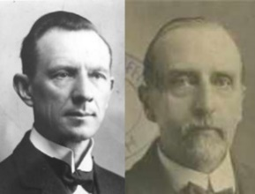
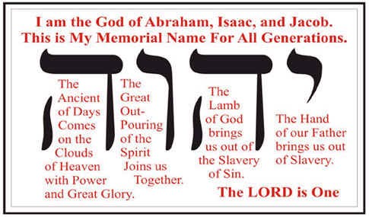
מארחים
Sabaoth
“‘Sabaoth’ is a Hebrew word meaning ‘hosts.’ It sometimes refers to the armies of Israel and other nations; sometimes to the priests officiating in the Sanctuary; sometimes to the people of God generally, and sometimes to the stars and planets in the sky. ‘Lord of Hosts’ is equivalent to the ‘all-sovereign,’ or ‘omnipotent’ Lord.
When we pray, we should remember that He, to whom we speak, has all power in heaven and on Earth—the Lord of Hosts.
The Lord has given His interpretation to this word to be: ‘The Creator of the first day, the beginning and the end.’”
Smith and Sjodahl
D&C 87:7

Slide 23
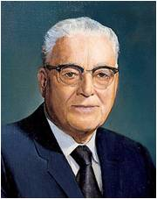


Stand in Holy Places
“The true servants of God, those who are doing their duty, will be protected and preserved if they will do as the Lord has counseled: ‘stand ye in holy places’”
“The Lord has told us where these ‘holy places’ are:
“‘And it shall come to pass among the wicked, that every man that will not take his sword against his neighbor must needs flee unto Zion for safety.’ (D&C 45:68.)
We are to stand in holy places and be not moved until the Lord comes
D&C 87:8 President Harold B. Lee

Slide 24
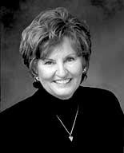


Where Are Our Holy Places--Zion
“Standing in holy places is all about being in good company, whether you are alone or with others. It’s being where the Holy Ghost is our companion—alone or in a crowd.
When we determine within ourselves that we will control our thoughts and our actions and be the best we can possibly be, the best of life will come to us. …
“… Regardless of what is going on around you, you can practice creating an environment of your own, filled with the Spirit of the Lord. …
“Holy places can be wherever you are—alone, in a crowd, with strangers, with friends. … There are things you can do to bring holiness to ordinary places.”
Sister Sharon G. Larsen
D&C 87:7 President Harold B. Lee

Slide 25

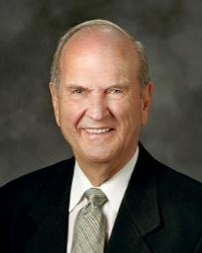


It seems that we are accosted daily by an onslaught of sobering news.
You may have had days when you wished you could don your pajamas, curl up in a ball, and ask someone to awaken you when the turmoil is over.
But, my dear brothers and sisters, so many wonderful things are ahead. In coming days, we will see the greatest manifestations of the Savior’s power that the world has ever seen.
Between now and the time He returns “with power and great glory”, He will bestow countless privileges, blessings, and miracles upon the faithful.
Russell M. Nelson
Joseph Smith—Matthew 1:36

Slide 26
Sources:
Video: Stand in Holy Places and Be Not Moved (2:10)
Joseph Smith (History of the Church, 1:301.)
(History of the Church, 5:324.)
Orson Pratt, Journal of Discourses, 18:224–25.
President Joseph Fielding Smith (Church History and Modern Revelation, 1:358–59, 1:363)
(Warren W. Hassler Jr., in New Encyclopedia Britannica [1978], s.v. “Civil War, U.S.”)
Elder Joseph L. Wirthlin (In Conference Report, Oct. 1958, p. 33.)
Elder James E. Talmage (Articles of Faith, pp. 25–26.) (Conference Report, Oct. 1923, p. 54.)
Elder George Q. Cannon (Millennial Star, 4 June 1864, pp. 361–62;
Hyrum M. Smith and Janne M. Sjodahl Doctrine and Covenants
Commentary pg. 540
Presentation by ©http://fashionsbylynda.com/blog/
President Harold B. Lee (Stand Ye in Holy Places, p. 87).
Sister Sharon G. Larsen (“Standing in Holy Places,” Ensign, May 2002, 91, 92).
Russell M. Nelson, “Overcome the World and Find Rest,” Liahona, Nov. 2022, 95)
Presentation by ©http://fashionsbylynda.com/blog/

Slide 27
The War:
“At that time [1832] there was considerable commotion in the United States. The tariff question was one of great issue. The State of New York, before its acceptance of the Federal Constitution, surrounded itself with protective tariffs, and this policy was gradually approved by other Northern States. The Southern States, on the other hand, regarded free trade as best serving their interests, as their products were limited to a few articles of raw material, which they exported, while they imported practically all the manufactured commodities they needed. In 1824, Congress enacted a protective-tariff bill. A few years later, a stricter measure was adopted against Great Britain, in retaliation for efforts to exclude American trade from the British West Indies. This met with vigorous opposition in the South, especially in South Carolina. In this State, in 1832, a convention of the citizens declared that the tariff acts of 1828 and 1832 were not binding within their territory, and fixed February 1st, 1833, as the date after which they would be considered abrogated, unless Congress should, before then, remove the difficulty. Many Northerners were in favor of carrying the laws of the Union into effect by means of arms, at that time, and a bill empowering the President to use force was introduced in Congress. It was during this political agitation that the Prophet Joseph made the condition of his Country the subject of prayer and received this Revelation (See Sec. 130:12, 13).
“While all of these differences existing between the North and the South had a tendency to drive the people apart, yet it was the question of slavery, and the contention over the expansion of new territory and the creation of new states and whether or not slavery should be permitted in such new territory, that became the crux which brought upon the people the great Civil War. …
“South Carolina took the initiative. From a mere human point of view this appeared improbable. The probability was that the Northern States, conscious of their numerical and financial strength, would throw down the gauntlet. A bill was before Congress authorizing President Andrew Jackson to use force in defense of the Union. But, notwithstanding this, the North did not begin the war. South Carolina took the first step, by recalling her representatives in the United States Senate, November 10, 1860. This was followed by an ordinance of secession, passed by the State Legislature on the 17th of November, the same year. And on the 12th of April, 1861, the first shot of the war was fired by General Beauregard against Fort Sumter, and thus the conflict was begun by South Carolina, as foretold by the Prophet, and not by any of the Northern States.” (Commentary, pp. 533–35.)
Joseph Smith had learned about a political conflict between the state of South Carolina and the federal government of the United States over tariffs. (A tariff is a tax on imports.) Because residents of South Carolina relied more on imported manufactured products than did people in the northern states, they felt that federal tariffs were unfair and that they had been purposely levied at the expense of the South. Government leaders in South Carolina adopted an ordinance invalidating, or nullifying, the federal laws, and many South Carolinians began to prepare for military action against the federal government. The president of the United States asserted that he would maintain the laws of the United States by force. In December 1832, newspapers throughout the United States were reporting on this conflict. It was at this time that Joseph Smith received the revelation in Doctrine and Covenants 87 prophesying that “wars … will shortly come to pass, beginning at the rebellion of South Carolina” (D&C 87:1). In early 1833, not long after this prophecy was given, the United States government peacefully settled the issue with the state of South Carolina. Some may have believed the crisis had passed, but it had been only temporarily halted and South Carolina would still rebel.
British and the Civil War:
The blockade runners of the American Civil War were seagoing steam ships that were used to make their way through the Union blockade that extended some 3,500 miles along the Atlantic and Gulf of Mexico coastlines and the lower Mississippi River. To get through the blockade these ships had to cruise by undetected, usually at night. If spotted the runners would then attempt to outmaneuver or simply outrun any Union ships on blockade patrol. The typical blockade runners were privately owned vessels often operating with a letter of marque issued by the Confederate States of America (Confederate States) or (Confederacy). These vessels would carry cargoes to and from neutral ports often located in Nassau and Cuba where neutral merchant ships in turn carried these cargoes, usually coming from or destined to England or other points abroad. Inbound ships usually brought badly needed supplies and mail to the Confederacy while outbound ships often exported cotton, tobacco and other goods for trade and revenue while also carrying important mail and correspondence to suppliers and other interested parties in Europe, most often in England. Most of the guns and other ordinance of the Confederacy was imported from England via blockade runners. Some blockade runners made many successful runs while many others were either captured or destroyed. There were an estimated 2500-2800 attempts to run the blockade with at least an 80% success rate. However, by the end of the Civil War the Union Navy had captured more than 1,100 blockade runners and had destroyed or run aground another 355 vessels. http://en.wikipedia.org/wiki/Blockade_runners_of_the_American_Civil_War

Slide 28
American Civil War
On Christmas Day 1832, Joseph Smith received a revelation about a coming conflict between the Northern and Southern United States over the question of slavery. The war would begin, the Lord declared, in South Carolina, and it would eventually lead to warfare among “all nations.” At that time, a crisis had arisen over South Carolina’s refusal to honor recent federal tariffs, and many Americans worried that the situation could intensify into a civil war. The government averted civil war at that time, but contention over slavery persisted, deepening the social, political, and economic divide between the Northern and Southern United States.
During the 1860 presidential election, many politicians and voters in the Southern states viewed Abraham Lincoln’s candidacy as a threat to the institution of slavery. When Lincoln won the election, some Southern states, beginning with South Carolina, declared their independence from the Union and formed a separate government called the Confederacy. After Lincoln’s inauguration in 1861, a standoff at Fort Sumter, South Carolina, erupted into armed conflict when a Confederate brigade fired on the fort. Lincoln called for volunteers to suppress the rebellion, and the remaining Southern states began to side with either the Confederacy or the United States. European nations observed the onset of this war with interest, and some opened diplomatic channels with the Confederacy, hoping to intervene in the war on the South’s behalf. Battles between the United States and the Confederacy multiplied while the conflict dragged on for years. The United States eventually looked for additional recruits that included 179,000 African American men, many of them former slaves, to fight against the Confederacy.
Latter-day Saints were continuing to heed the prophetic call to gather to Zion in the American West and thereby largely avoided the conflict. Some branches remained in areas caught in the war, bringing a few Saints into both sides of the conflict. In 1861, Brigham Young sent some Church members on a mission to raise a cotton supply near St. George, Utah. The mission became a modest producer of cotton after the Confederacy embargoed the commodity. As the war progressed, Lincoln’s War Department called upon Young to muster a volunteer army unit to protect postal deliveries, telegraph systems, and travelers on the overland trail. In response, Young’s counselor Daniel H. Wells, who also served as the commanding general of Utah’s militia, assigned Lot Smith to command a cavalry company that totaled just over 100 soldiers. Smith’s cavalry company served for four months in 1862.
The surrender of Confederate General Robert E. Lee in Virginia in April 1865 effectively ended the Civil War. The war ultimately cost the United States over 700,000 lives, the most in any conflict in American history. The major outcome of the war was the end of legalized slavery and the emancipation of African American slaves.
Church Resources
Jed Woodworth, “Peace and War: D&C 87,” in Matthew McBride and James Goldberg, eds., Revelations in Context: The Stories behind the Sections of the Doctrine and Covenants (Salt Lake City: The Church of Jesus Christ of Latter-day Saints, 2016), 158–64.

